Slide 1
Biochemical & Molecular
Collaborations
Proband / Family
Test Examples
Andy Faucett, MS, CGC
Emory University School of Medicine
Note: All information in this presentation is from GeneReviews.
Content was condensed for slide format.

Slide 2
Tay-Sachs Testing - Proband
Tay-Sachs = Hexosaminidase A Deficiency
Assay of HEX A enzymatic activity is the primary method of diagnosis for symptomatic individuals and of population screening … given its greater sensitivity.
Issue
  Borderline activity levels

Slide 3
Tay-Sachs Testing - Proband
Targeted mutation analysis of common HEXA mutations can be used for:
  Symptomatic individual to identify the disease-causing mutations;
  Confirmatory diagnosis in symptomatic individuals with borderline enzyme activity.
Sequence analysis or mutation scanning would be required in an individual who:
  Is affected but had only one or neither mutations identified using a panel of standard mutations.

Slide 4
Tay-Sachs Testing - Family
Assay of HEX A enzymatic activity using synthetic substrates provides a simple, inexpensive, and highly accurate method for carrier identification.
  Serum may be used to test all males and those women who are not pregnant and not using oral contraceptives;
  Leukocytes are used to test: (1) pregnant women; (2) women using oral contraceptives; and (3) any individual whose serum HEX A enzymatic activity is in an inconclusive range.
Issue – pseudodeficiency allele

Slide 5
Pseudodeficiency Allele
Need for Molecular Clarification
One pseudodeficiency allele reduces HEX A enzymatic activity toward synthetic substrates, but does not with the natural substrate
All enzymatic assays use the artificial substrate - the naturally occurring GM2 ganglioside is not stable and not available.
Molecular genetic testing can be used to clarify.
  About 35% of non-Jewish individuals identified as carriers by HEX A enzyme-based testing are carriers of a pseudodeficiency allele.
  About 2% of Jewish individuals identified as carriers by HEX A enzyme-based testing are actually heterozygous for a pseudodeficiency allele.

Slide 6
Tay-Sachs Testing - Family
Mutation analysis with a panel of common HEXA mutations:
  Screen Ashkenazi Jewish individuals for the three common mutations which account for 92% to 94% of carriers.
  Distinguish pseudodeficiency from disease-causing alleles.
  Identify the specific disease-causing alleles in an affected individual for carrier detection in at-risk family members.
  Prenatal diagnosis when both parental mutations are known.
Sequence analysis or mutation scanning would be required to identify HEXA mutations in an individual who:
  Has carrier-level enzymatic results but did not have a mutation identified using a panel of standard mutations.

Slide 7
TS Molecular Test Methods
Targeted mutation analysis. Panel of the six most common mutations:
  Three null alleles, (+TATC1278, +1IVC12, +1IVS9), which are associated with TSD in the homozygous state or as compound heterozygotes.
  G269S allele, which is associated with the adult-onset form of hexosaminidase A deficiency in the homozygous state or in compound heterozygosity with a null allele.
  Two pseudodeficiency alleles (R247W and R249W), which are not associated with neurologic disease but with reduced degradation of synthetic substrate.
  Extended panels or testing for selected mutations specific to certain populations. In Quebec, a 7.6-kb deletion is the most common.
  In the French-Canadian population or other populations with founder mutations, testing for the appropriate mutations is needed.
Sequence analysis/mutation scanning. 100+ HEXA mutations have been detected to date.

Slide 8
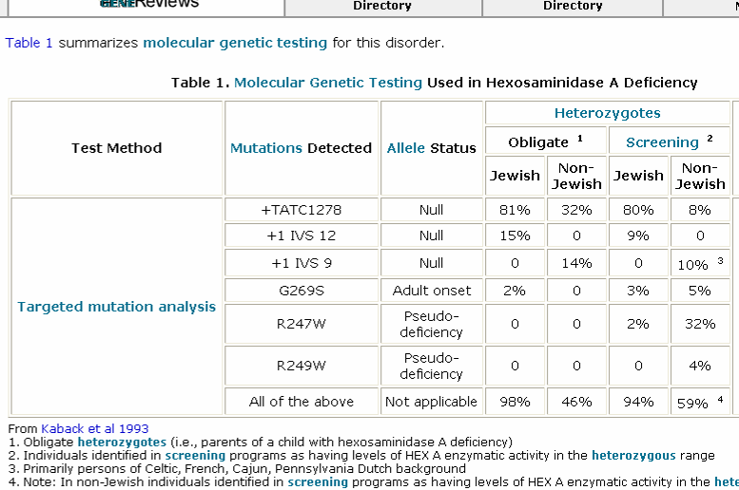
TS Mutation Detection

Slide 9
Mucopolysaccharidoses Type 1
Proband
Hurler, Hurler-Scheie, and Scheie Syndrome
Diagnosis/testing. The diagnosis of MPS I relies on the demonstration of deficient activity of the lysosomal enzyme -L-iduronidase in peripheral blood leukocytes or cultured fibroblasts.
Glycosaminoglycan (GAG) (heparan and dermatan sulphate) urinary excretion is a useful preliminary test.

Slide 10
MPS 1 – Diagnostic Testing
IDUA is the only gene currently known to be associated with MPS I. Using sequence analysis and/or mutation analysis, it is possible to identify both IDUA mutations in 95% of individuals with MPS I.

Slide 11
MPS 1 – Biochemical Testing
Proband
Glycosaminoglycan (GAG) urinary excretion.
  Measurement of urinary GAGs may be quantitative or qualitative.
  Neither method can diagnose a specific lysosomal enzyme deficiency but indicate the likely presence of MPS disorder.
  Both methods have reduced sensitivity (dilute urine). Qualitative testing can exclude / include certain disorders, but definitive diagnosis requires enzyme determination.
Diagnosis of MPS I relies on the demonstration of deficient activity of the enzyme - L-iduronidase.
L-iduronidase activity - measured in most tissues
  Usually peripheral blood leukocytes, cultured fibroblasts, or plasma.

Slide 12
MPS 1 – Family
Carrier testing for MPS I is COMPLEX.
Relatives of a proband.
  Carrier testing of immediate family members of affected individuals requires testing of obligate carriers first to determine if their levels of IDUA enzyme activity are clearly distinguishable from normal. The same analysis can then be applied to other family members at risk.
General population
  The interpretation of -L-iduronidase enzyme activity within the general population is difficult.
    Overlap exists between the lower end of the normal range of enzyme activity and the upper end of the heterozygous range.
  Pseudodeficiency alleles for L-iduronidase enzyme activity difficult.
    Pseudodeficiency relates to the finding of reduced or undetectable IDUA enzymatic activity - artificial substrates.
    No evidence of altered glycosaminoglycan metabolism with the use of radiolabelled (35S)-GAG.
    Molecular basis and frequency of pseudodeficiency are unknown.

Slide 13
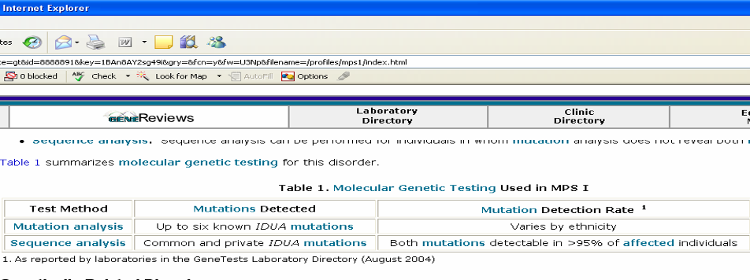
MPS 1 – Mutation Detection

Slide 14
Glycogen Storage Disease Type 1
Proband
Diagnosis is based on clinical presentation; abnormal blood/plasma concentrations of glucose, lactate, uric acid, triglycerides and lipid; AND molecular testing.

Slide 15
Glycogen Storgae Disease Type 1
Proband
Glucagon or epinephrine administration.
The lack of either glucose-6-phosphatase catalytic activity or glucose-6-phosphate translocase activity in the liver results in the following:
  Hypoglycemia: Fasting blood glucose concentration <60 mg/dL
  Lactic acidosis: Blood lactate >2.5 mmol/L
  Hyperuricemia: Blood uric acid >5.0 mg/dL
  Hyperlipidemia:
    Triglycerides: >250 mg/dL Hypertriglyceridemia- plasma appears "milky."
    Cholesterol: >200 mg/dL
Hepatic enzyme activity. Snap-frozen liver biopsy - dry ice - overnight delivery.
  Glucose-6-phosphatase (G6Pase) catalytic activity.
    In most individuals with GSD type Ia, the G6Pase enzyme activity is lower than 10% of normal.
    In rare individuals with higher residual enzyme activity, the G6Pase enzyme activity could be higher
Glucose-6-phosphate translocase (transporter) activity. G6P translocase activity in vitro is difficult to measure in frozen liver
  Fresh (unfrozen) liver is often needed and most laboratories refrain from offering this assay.

Slide 16
Glycogen Storage Disease Type 1
Proband
The two genes associated with GSDI are:
  G6PC (GSDIa), about 80% of GSDI.
  SLC37A4 (GSDIb), about 20% of GSDI.
Molecular testing of G6PC and SLC37A4 is available.

Slide 17
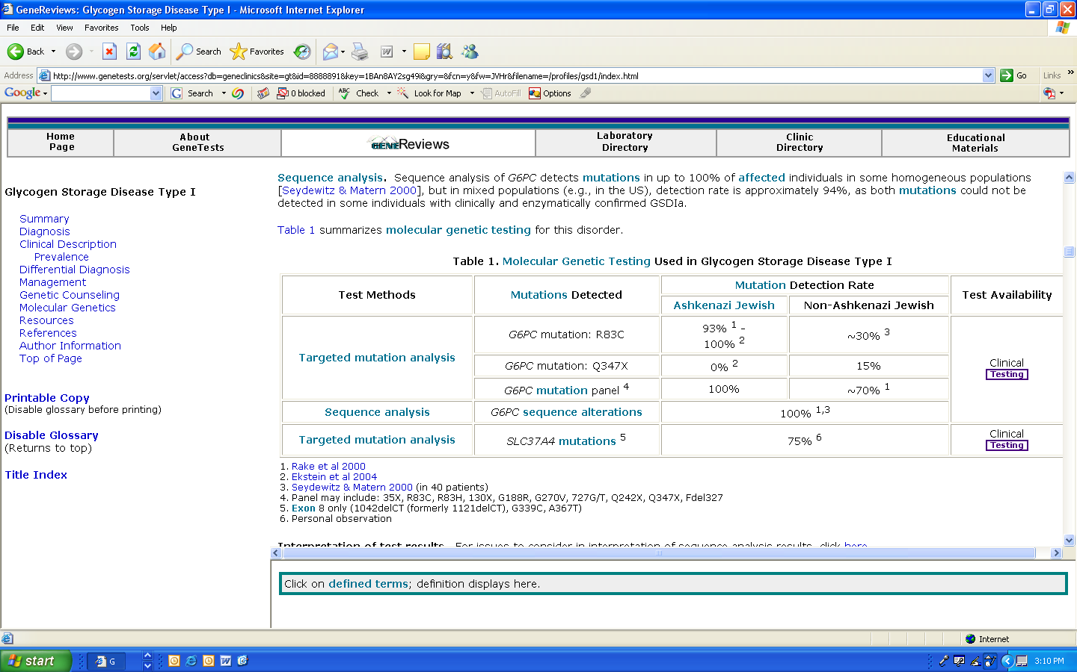
GSD 1 – Mutation Detection

Slide 18
Glycogen Storage Disease 1
Family
Carrier testing using molecular genetic diagnosis for at-risk family members is available once the mutations have been IDENTIFIED in the proband.
Biochemical testing. Enzymatic testing is UNRELIABLE for use in carrier detection.

Slide 19
Glycine Encephalopathy
Proband
Glycine encephalopathy is suspected with elevated glycine concentration in urine.
An increased CSF-to-plasma glycine ratio suggests the diagnosis.
Reliable enzymatic confirmation requires measurement of glycine cleavage enzyme (GCS) activity of liver obtained by BIOPSY or AUTOPSY.
Most affected individuals have no detectable activity; testing is available on a research basis only.

Slide 20
Glycine Encephalopathy
Proband
The GLDC gene accounts for disease in 80% of individuals with NKH.
The AMT gene accounts for disease in 10-15% of individuals with NKH.
The GCSH gene accounts for ?
Combined mutation detection rate is 60% to 90%.

Slide 21
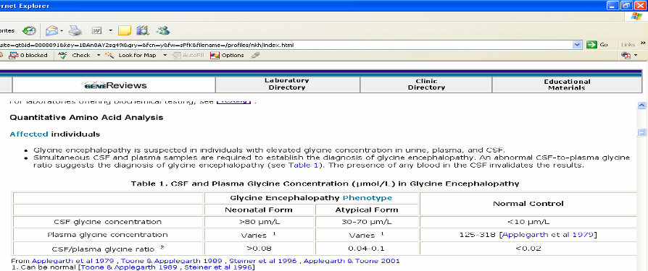
Glycine Encephalopathy
Proband

Slide 22
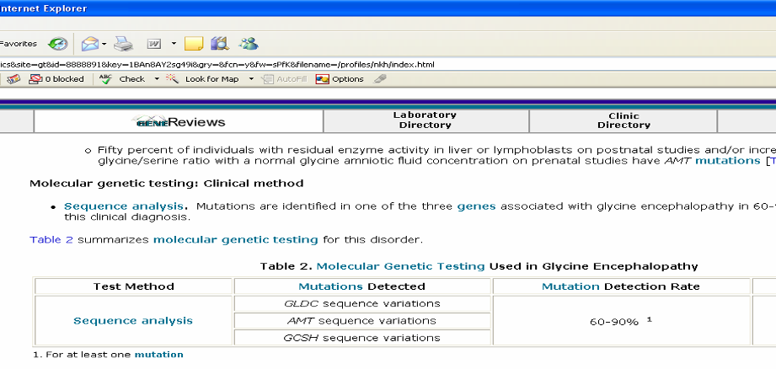
Glycine Encephalopathy
Proband

Slide 23
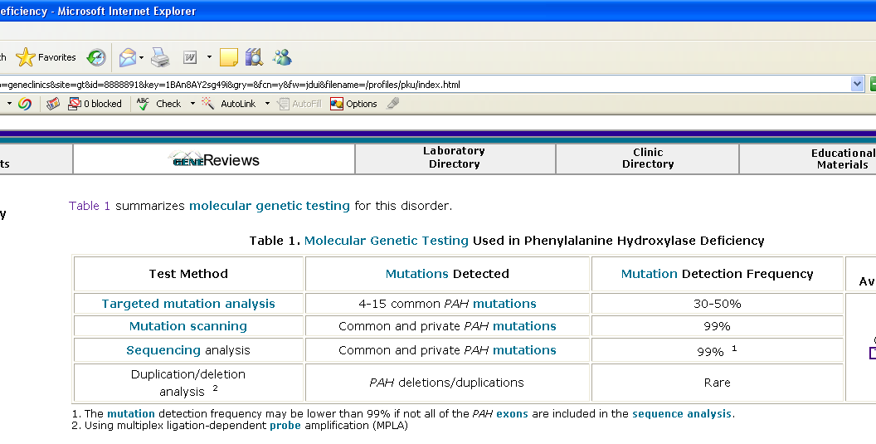
PKU
Proband / Family

Slide 24
PKU Family
At-risk family members have the option of being tested for carrier status.
Partners of carriers have limited access to testing.
Three methods can be used:
  Molecular genetic testing for at-risk family members; once the mutations have been identified in the proband.
  Linkage analysis, for the few families in which the mutation has not been identified, if the family is informative for markers within the PAH gene.
  Biochemical analysis for determination of carrier status ONLY IF MOLECULAR IS NOT POSSIBLE.

Slide 25
PKU Family
Biochemical analysis can be used to determine carrier status if molecular testing is not possible.
Testing relies on analysis of the plasma phe concentration and phe/tyr ratio.
  This test must take into account circadian variation (i.e., it must be performed before noon after a normal breakfast) and variations in a woman's menstrual cycle; it is not accurate during pregnancy.

Slide 26
PKU – Family
Prenatal diagnosis is possible by analysis of DNA extracted from fetal cells obtained by amniocentesis or chorionic villus sampling (CVS).
Both disease-causing alleles of an affected family member MUST BE IDENTIFIED or linkage established in the family.

