Slide 1
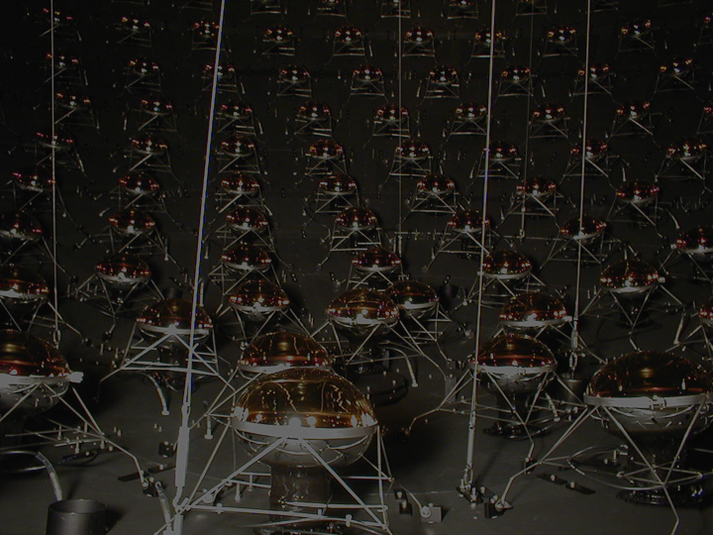
Neutral Current π⁰ Production in MiniBooNE
Jonathan Link
Virginia Polytechnic Institute & State University
Fifth International Workshop on Neutrino-Nucleus Interactions in the Few-GeV Region
June 1st 2007

Slide 2
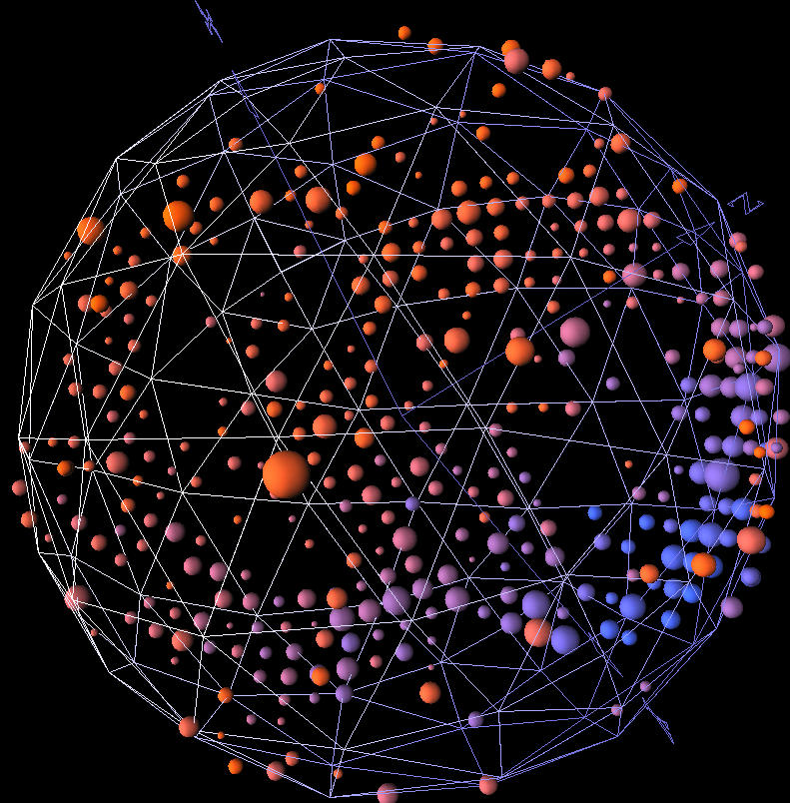
Neutral Current π⁰ Events in MiniBooNE
Neutral current π⁰ production is a major background to the ν_{e} appearance analysis. It is also a prime opportunity to study neutrino induced π⁰ production.
Today I’ll talk about:
The performance of the reconstruction algorithm.
Our method of measuring the π⁰ production rate.
Our extraction of the coherent production relative to resonant.
And I’ll show some comparisons of the various generator to MiniBooNE data.
π⁰ Candidate Event in MiniBoone

Slide 3
MiniBooNE Neutral Current π⁰ Analysis
The analysis builds on the thesis work of Jen Raaf (NuInt04).
The major difference is that there has been great progress in the reconstruction algorithm and in the optical model. As a result we now have much better data/MC agreement and a better signal to noise ratio.
The central improvement of the new reconstruction algorithm is that it uses several starting points to the π⁰ and therefore does not get trapped in the wrong local minimum as often.
Also we have since discovered and fixed some inadequacies in the Monte Carlo generator. These effects have had a non-trivial impact on the resulting numbers.

Slide 4
MiniBooNE Neutral Current π⁰ Analysis
The focus of the analysis has been pragmatic:
  Our main objective is to measure the rate of π⁰ production so that misidentification in the ν_{e} oscillation sample can be determine as a function reconstructed ν_{e} energy in the CCQE mode.
As a result the initial product of the NC π⁰ analysis effort is not an absolute cross section. Instead it is a measurement of the total π⁰ production in bins of true π⁰ momentum, and a measurement of the coherent contribution which effectively fixes the angular distribution.
Correcting the Monte Carlo to reflect the observed π⁰ production provides a much better estimate of π⁰ misidentification.

Slide 5
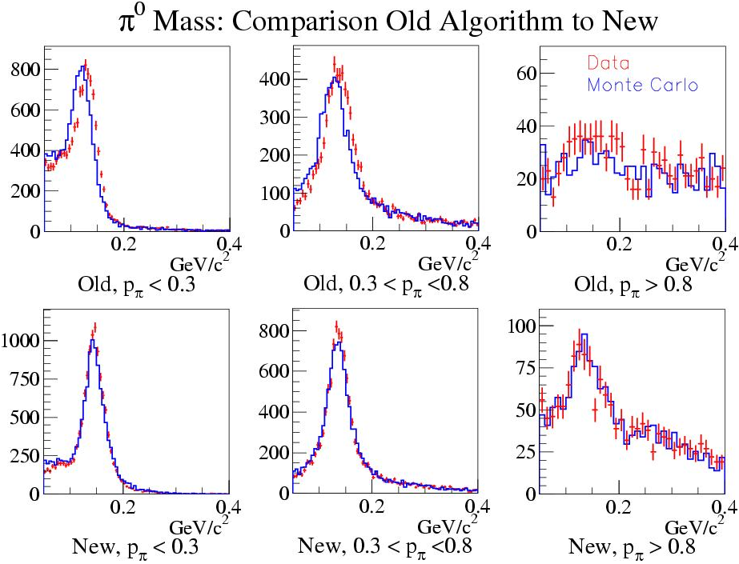
Reconstruction Performance
New π⁰ algorithm (by Ryan Patterson) improves efficiency and data to Monte Carlo agreement while admitting less background.
The improved algorithm allows us to use the Monte Carlo to efficiency correct, background subtract and unsmear the data.
Algorithm returns likelihoods for the electron, muon and π⁰ hypotheses whose absolute differences are powerful indicators of event type.

Slide 6
Analysis Cuts
Pre-cuts (Also applied in the oscillation analysis):
  1 sub-event (No evidence of a decaying muon)
  Tank hits > 200 (Above the muon decay endpoint)
  Veto hits < 6 (Eliminates cosmic rays)
Analysis cuts:
  Event radius < 500 cm (Reduces edge effects)
  eμ likelihood difference prefers electron hypothesis
  eπ likelihood difference prefers pion hypothesis
Mass window:
  80 MeV/c² < m_{γγ} < 200 MeV/c²

Slide 7
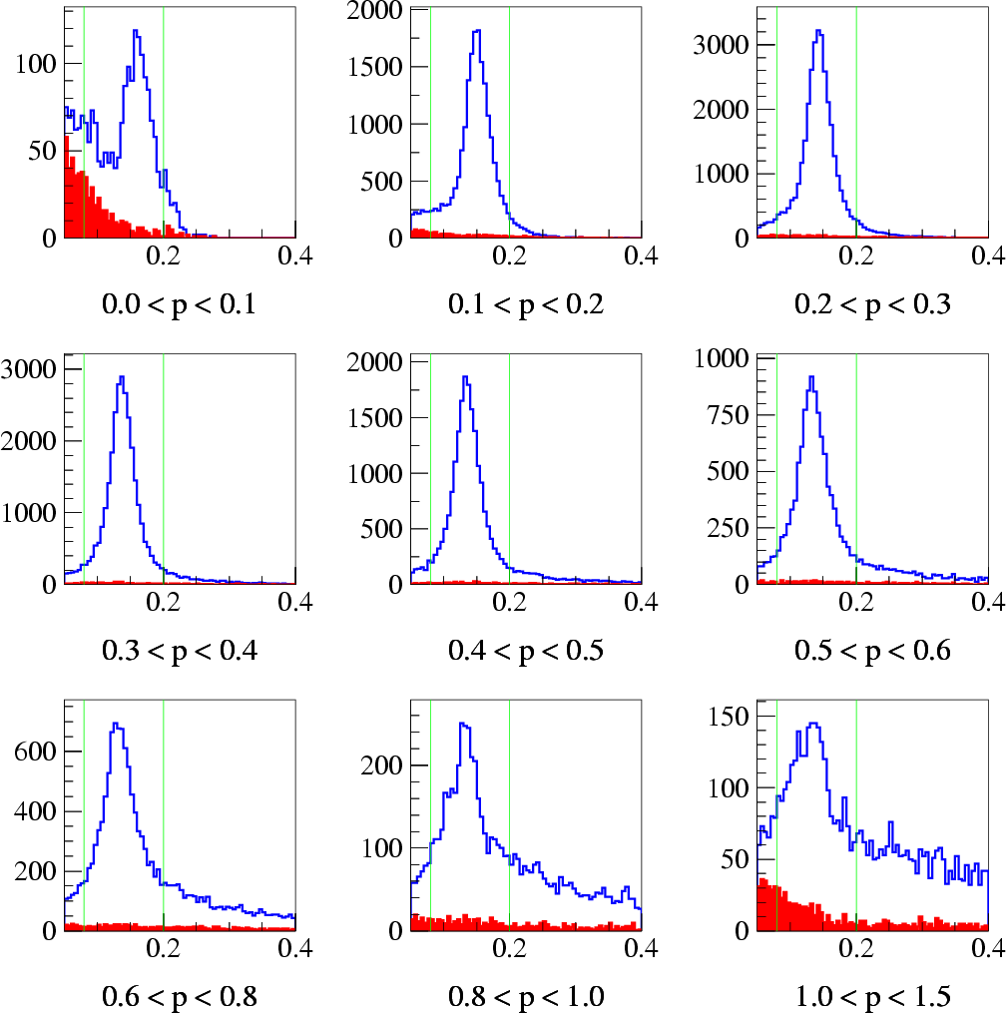
Data Unsmearing and Efficiency Correction
Monte Carlo Events Passing Analysis Cuts
The reconstructed γγ mass distribution is divided momentum bins.
MC is used to unsmear the data:
All events
Events with no π⁰
In bins of true momentum vs. reconstructed momentum, count MC events, over BG, in the signal window.
Divide by the total number of π⁰ events generated in that true momentum bin.
Invert the matrix.
Perform a BG subtraction on the data in each reconstructed momentum bins.
Multiply the data vector by the MC unsmearing Matrix

Slide 8
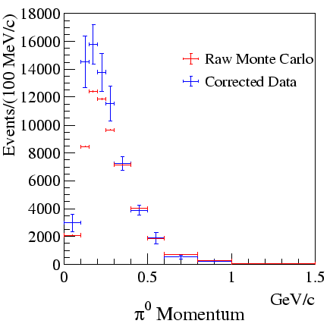
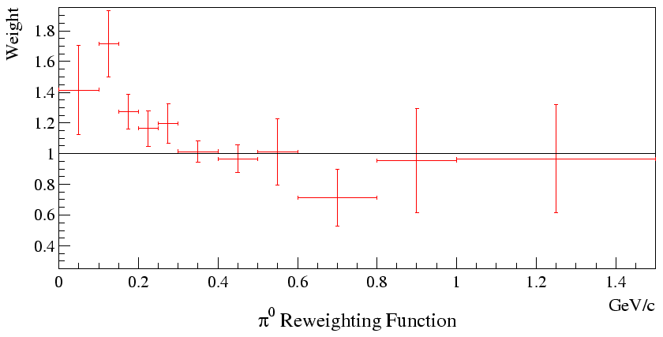
The Corrected Data Distribution
The corrected π⁰ momentum distribution is softer than the default Monte Carlo. The normalization discrepancy is across all interaction channels in MiniBooNE.
Preliminary
From this distribution we derive a reweighting function for Monte Carlo events.
MC: Generated distribution
Data: Corrected to true
momentum and
100% efficiency
Ratio of data and MC
Preliminary

Slide 9
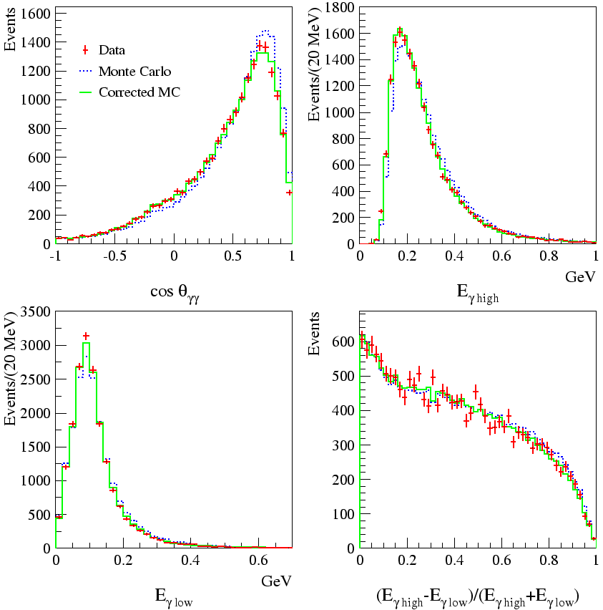
Reweighting Monte Carlo to Data
Reweighting in generated momentum improves data/MC agreement.
Here we see:
Decay opening angle
Energy of high energy γ
Energy of low energy γ
The energy asymmetry
In all cases the momentum reweighting significantly improves the Data/MC agreement.
Preliminary

Slide 10
Neutral Current Resonant and Coherent π⁰ Production
ν
ν
Resonant π⁰ production occurs through a resonance like the Δ(1232).
Z⁰
p (n)
¹²C
Δ⁺ (Δ⁰)
π⁰
ν
ν
Coherent π⁰ production is an interaction involving the entire nucleus. In these events one expects the π⁰s to scatter in a more forward direction.
Z⁰
π⁰
¹²C

Slide 11
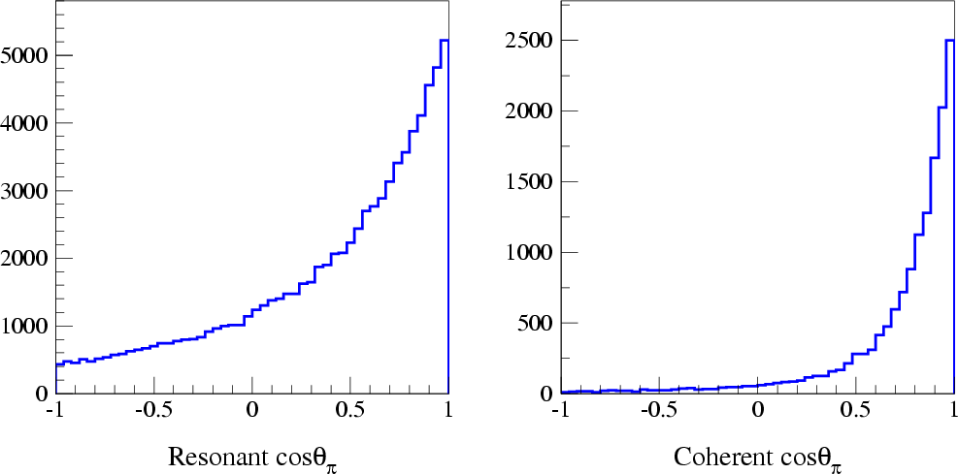
Cos θ and Coherent π⁰ Production
Coherent and resonant production are distinguishable by the π⁰ angle with respect to the beam direction (cos θ_{π}).
We can use this fact to extract a measure of the coherent fraction.

Slide 12
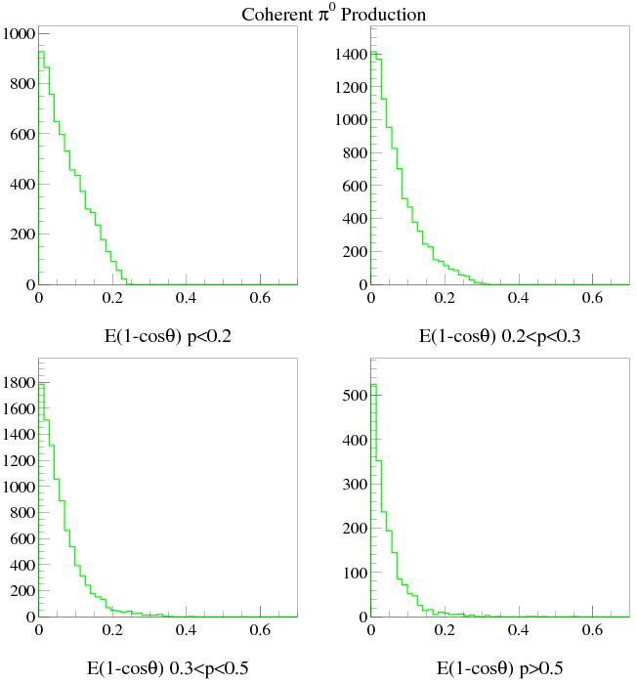
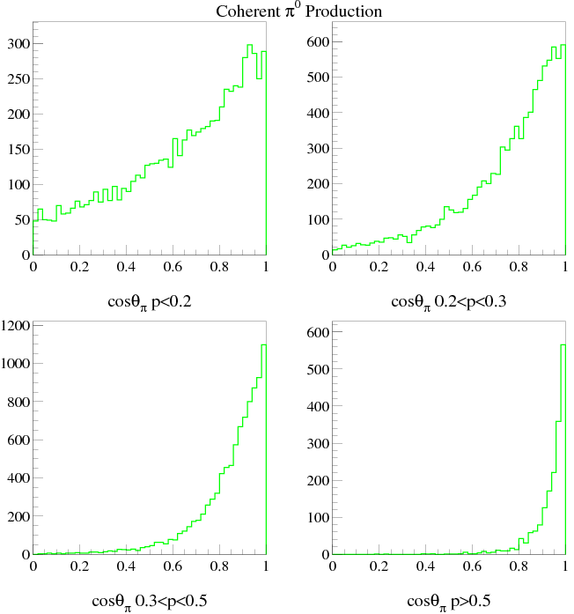
Study Coherent as a Function of E(1-cosθ)
In coherent events E(1-cosθ) has a more regular shape, as a function of momentum, than cosθ alone, so we fit for coherent content as a function of this composite.

Slide 13
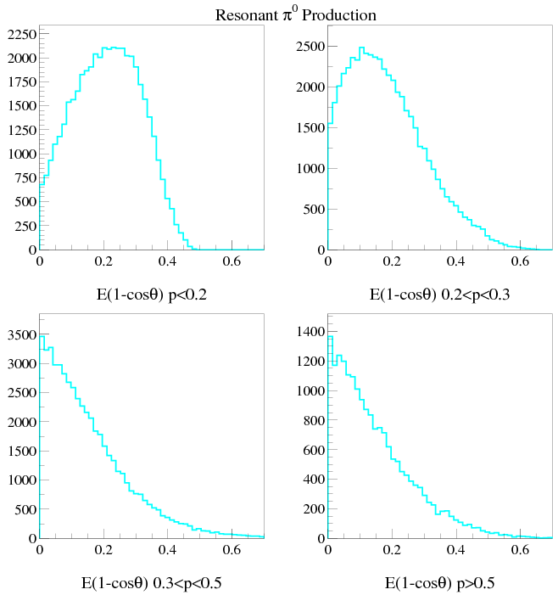
Study Coherent as a Function of E(1-cosθ)
Meanwhile E(1-cosθ) can have large variation in the resonant process in this energy range.
The Δ decay tends to scramble the π⁰ angular distribution, which is particularly true at low momentum.

Slide 14
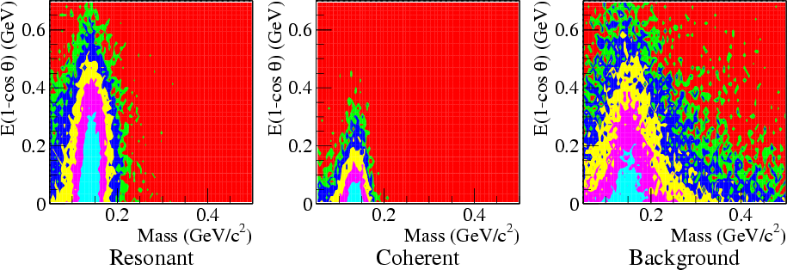
2D Fits for Coherent Fraction
The data are fit in γγ mass and E(1-cos θ) using three templates from the Monte Carlo: Resonant, Coherent and Background. The Nuance Generator* is the underlying model.
Variable binning is used to get approx. equal numbers of events in each bin. The number of bins in each projection is varied from 15 to 25 and the average fit parameters are used.
* Maintained by Dave Casper. The NC π⁰ model is based on Rein and Sehgal.

Slide 15
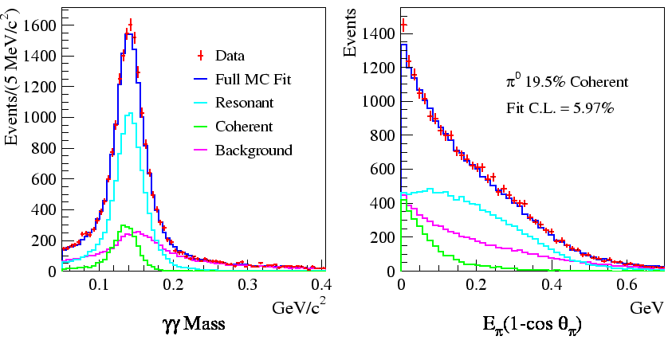
Fit Results
Here the resulting fit is plotted against the projections, and the fit components are shown.
Preliminary
Preliminary
For the MiniBooNE flux and with the Nuance model we find that (19.5±1.1)% of all exclusive neutral current π⁰ production is coherent.

Slide 16
Coherent Fraction Systematic Error
We studied systematic error due to a number of sources including:
  Choice of binning
  Make up of background
  Momentum reweighting
  Neutrino flux uncertainty
  Choice of analysis cuts
  Optical model (new since NuFact06)
All systematic sources are small compared to the statistical error/fit uncertainty except the optical model error which is now the dominate error in the analysis. The optical model largely measures an uncertainty in energy scale.
Source | Error
Binning | 0.21
Background Model | 0.64
Reweighting | 0.51
Flux | 0.06
Analysis Cuts | 0.51
Optical Model | 2.34
All Systematics | 2.54

Slide 17
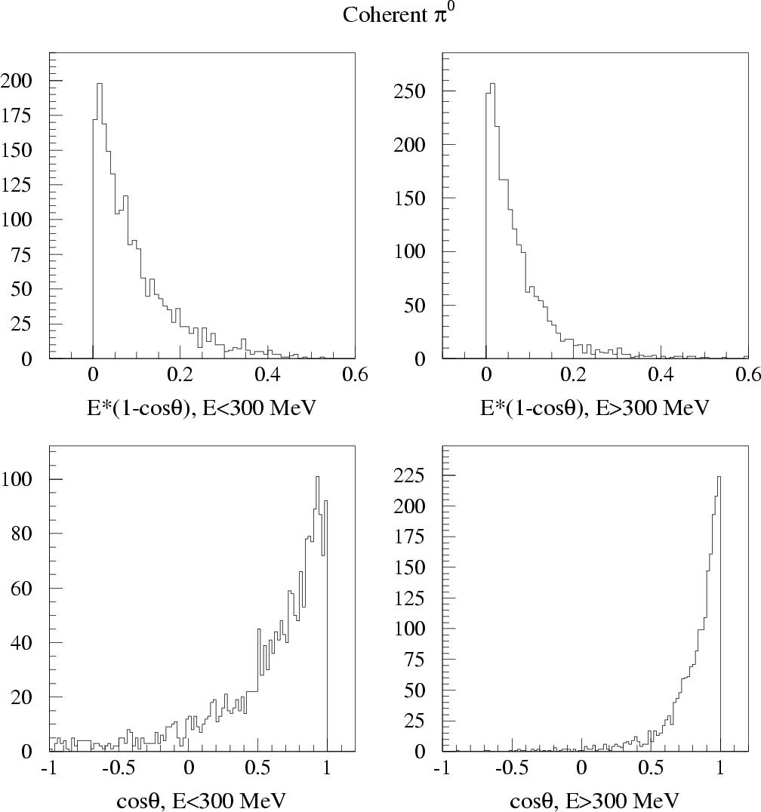
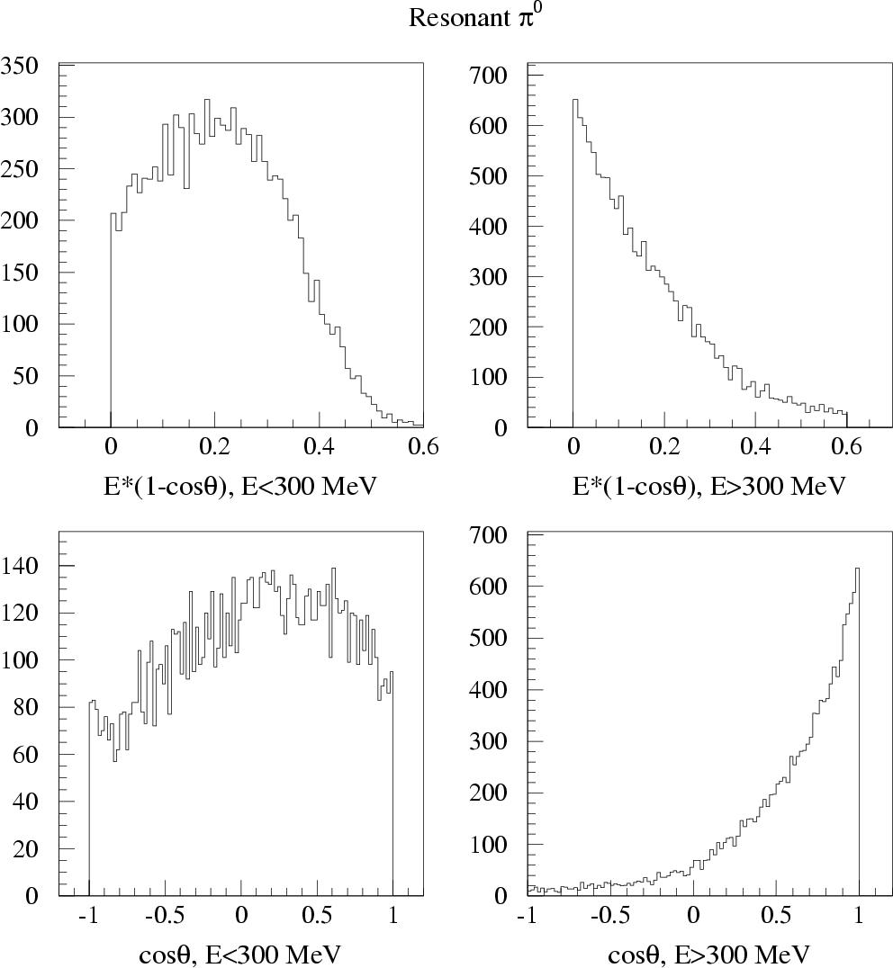
Energy Dependence of the Coherent Fit
Remember, although we expect a fairly uniform E(1-cos) as a function of momentum, we expect different behavior for the resonant events...
A slewing of the energy distribution with respect to Monte Carlo will effect the fit. This uncertainty is accounted for in the optical model error.

Slide 18
Model Dependence of the Coherent Extraction
As a test of the robustness of this coherent result, we looked at drastic variations to the cross section model parameters…
Variation | Coherent | Avg CL (%)
 | Fraction (%) | Coh | No Coh.
Default Model | 19.5±1.1 | 5.97 | 1.8×10⁻¹⁶
M_{A} Coherent | 19.6±1.1 | 5.73 | 3.8×10⁻¹⁷
No Diffractive | 17.9±1.0 | 11.63 | 5.7×10⁻¹⁷
M_{A} π± Hi | 17.9±1.1 | 3.27 | 1.5×10⁻¹⁴
M_{A} π± Lo | 21.1±1.1 | 5.00 | 7.2×10⁻²²
Binding Energy Hi | 19.4±1.1 | 5.85 | 6.4×10⁻¹⁶
Binding Energy Low | 19.6±1.1 | 6.29 | 2.2×10⁻¹⁷
Fermi Momentum Hi | 18.2±1.1 | 3.29 | 1.3×10⁻¹⁵
Fermi Momentum Lo | 21.0±1.1 | 4.24 | 4.6×10⁻²³
The fit value is stable against these large changes. In all cases, a coherent fraction of zero is highly disfavored.

Slide 19
Model Dependence of the Coherent Extraction
Just before NuFact06 we discovered that Nuance decays the Deltas isotropically. This disagrees with the Rein and Seghal model. We now reweight events, based on the Delta decay angle, to the Rein and Seghal angular distribution.
The effect of this change is not trivial:
Variation | Coherent | Avg CL (%)
 | Fraction (%) | Coh | No Coh.
Rein and Sehgal | 19.5±1.1 | 5.97 | 1.8×10⁻¹⁶
Isotropic (NuFact06) | 18.1±1.1 | 1.88 | 7.1×10⁻¹⁷
Pure spin projection 3/2 | 20.8±1.0 | 3.49 | 1.7×10⁻¹⁸
Pure spin projection 1/2 | 16.9±1.2 | 0.01 | 1.3×10⁻¹⁹
In addition we expect that the Delta decay angle could have an affect on π⁰ misidentification in the oscillation analysis.

Slide 20
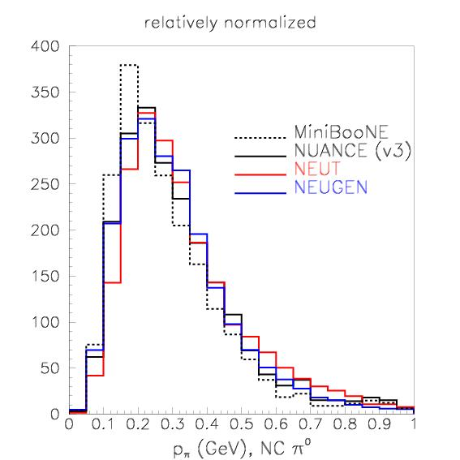
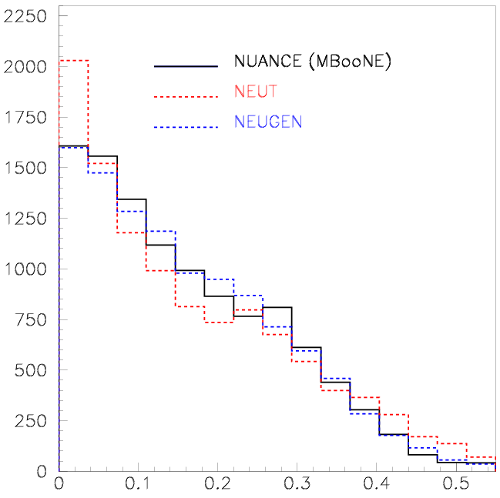
Generator Comparisons
Comparison of NEUGEN and NEUT to MiniBooNE data distribution.
E_{π}(1-cosθ)
Plots from Sam Zeller

Slide 21
Conclusions
Neutral current π⁰ production is both a major background to the MiniBooNE oscillation analysis, and an opportunity to make high impact measurements in neutrino cross sections (with world’s largest data set of GeV neutrino interactions).
In this talk:
I demonstrated the goal oriented approach we have adopted to dealing with π⁰ events in MiniBooNE.
This results in a measurement of the total π⁰s produced in bins of momentum
And a measurement of the coherent fraction: (19.5 ± 1.1 (stat) ± 2.5 (sys)) %
These π⁰ rates as a function of momentum and coherent fraction are used to reweight the Monte Carlo in the oscillation analysis.

Slide 22
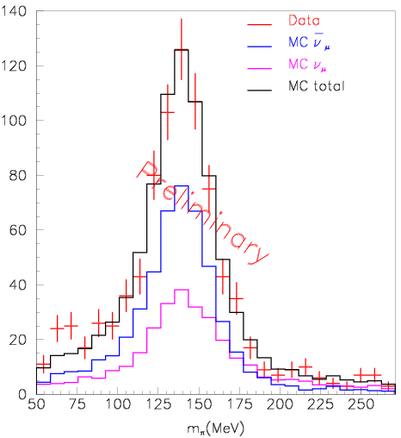
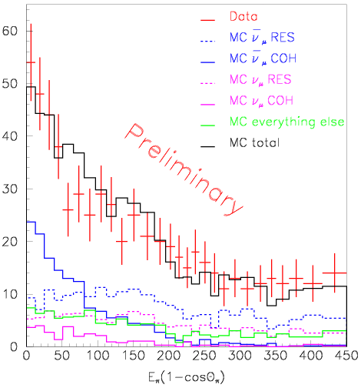
π⁰ Events in MiniBooNE Antineutrino Running
See poster by Van Nguyen for a discussion of π⁰ production in the MiniBooNE antineutrino data.

