Slide 1
Centrality measurement and the centrality dependence of dN_{charged}/dη at mid-rapidity
Judith Katzy (MIT)
for
the PHOBOS collaboration

Slide 2

The PHOBOS Collaboration
ARGONNE NATIONAL LABORATORY
Birger Back, Nigel George, Alan Wuosmaa
BROOKHAVEN NATIONAL LABORATORY
Mark Baker, Donald Barton, Alan Carroll, Stephen Gushue, George Heintzelman, Robert Pak, Louis Remsberg, Peter Steinberg, Andrei Sukhanov
INSTITUTE OF NUCLEAR PHYSICS, KRAKOW
Andrzej Budzanowski, Roman Holynski, Wojtek Kucewicz, Jerzy Michalowski, Andrzej Olszewski, Pawel Sawicki , Marek Stodulski, Adam Trzupek, Barbara Wosiek, Krzysztof Wozniak
MASSACHUSETTS INSTITUTE OF TECHNOLOGY
Wit Busza* , Patrick Decowski, Kristjan Gulbrandsen, Conor Henderson, Jay Kane , Judith Katzy, Piotr Kulinich, Johannes Muelmenstaedt, Heinz Pernegger, Corey Reed, Christof Roland, Gunther Roland, Leslie Rosenberg, Pradeep Sarin, Stephen Steadman, George Stephans, Gerrit van Nieuwenhuizen, Carla Vale, Robin Verdier, Bernard Wadsworth, Bolek Wyslouch
NATIONAL CENTRAL UNIVERSITY, TAIWAN
Willis Lin, JawLuen Tang
UNIVERSITY OF ROCHESTER
Erik Johnson, Josh Hamblen, Nazim Khan, Steven Manly, Robert Pak, Inkyu Park, Wojtech Skulski, R. Teng, Frank Wolfs
UNIVERSITY OF ILLINOIS AT CHICAGO
Russell Betts, Clive Halliwell, David Hofman, Burt Holzman, Don McLeod, Rachid Nouicer, Michael Reuter
UNIVERSITY OF MARYLAND
Richard Bindel, Edmundo Garcia-Solis, Alice Mignerey
* spokesperson

Slide 3
Global characterization of the Au-Au collision
Nuclear geometry
Determination of impact parameter
Determination of number of participants
measurement of produced particles and spectator matter
Energy density
Formation of entropy
Process of particle production
measurement of particle density as a function of centrality

Slide 4
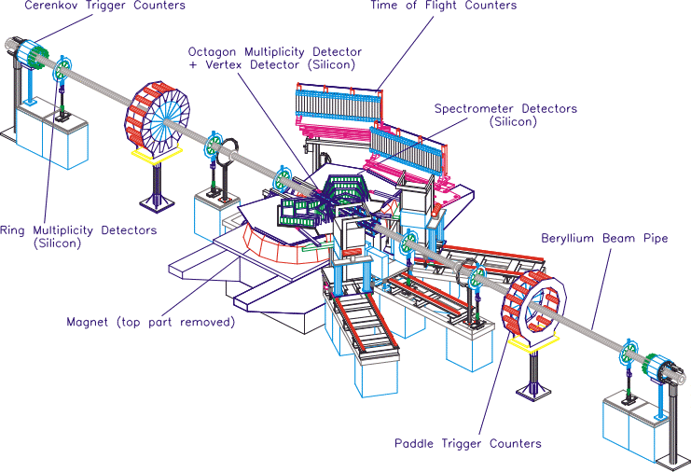
The PHOBOS Detector
Spectrometer
Vertex Detector
Paddle Trigger Counters

Slide 5
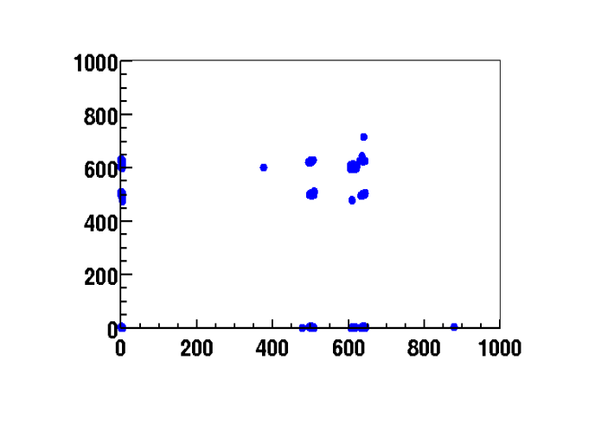
Trigger & Event Selection
−4.5<η<-3
4.5<η<3
ZDC N
ZDC P
Au
Au
θ<2.5mrad
η<-6
θ<π-2.5mrad
η>6
PN>0 Δt<10ns PP>0
Offline analysis cuts:
t_{zdcn}, t_{zdcp}
background suppression
Δt_{paddle} < 4ns
−60cm < z < 60cm
register 97% of cross section
ZDC time
t_{N}
collisions
single beam
background
t_{P}

Slide 6
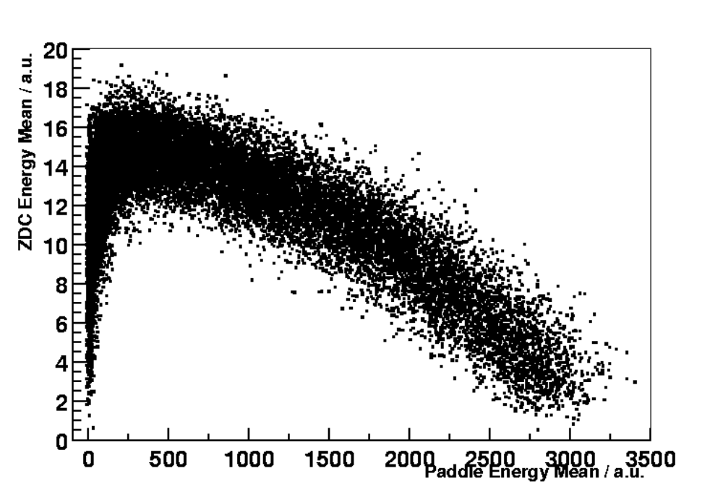
Collision Geometry
ZDC
Spectators
B
θ<2.5mrad
η<-6
b
Participants
ZDC
B
N_{part} = A - N_{n}* 1.67
2 independent methods
with different systematic
uncertainties

Slide 7
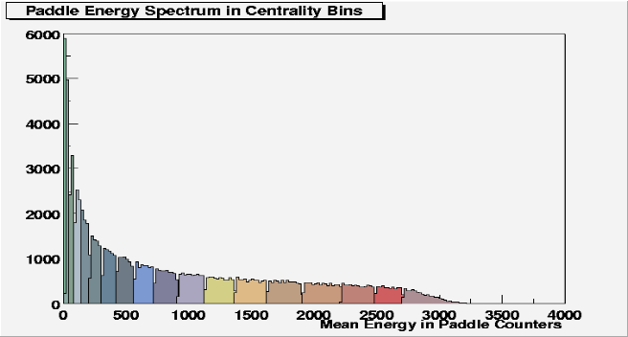
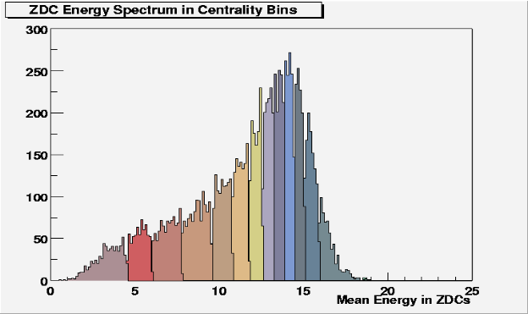
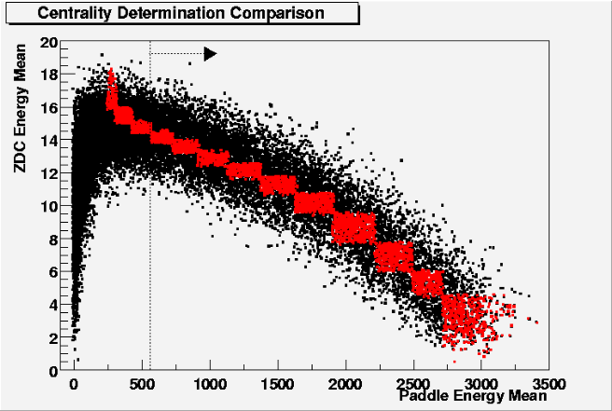
Determination of Centrality
In average both methods
yield the same centrality bin
No systematic variation between
methods

Slide 8
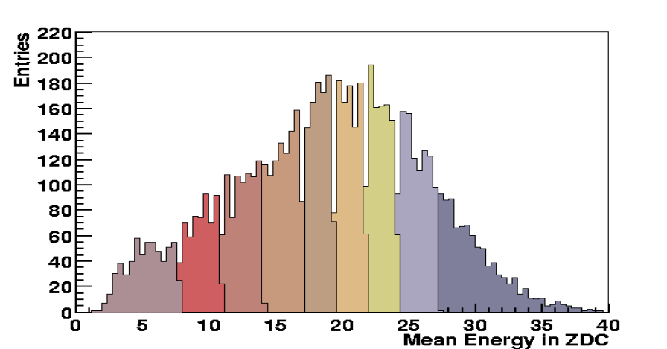
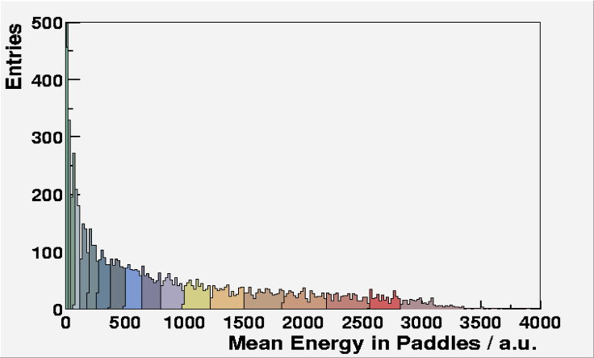
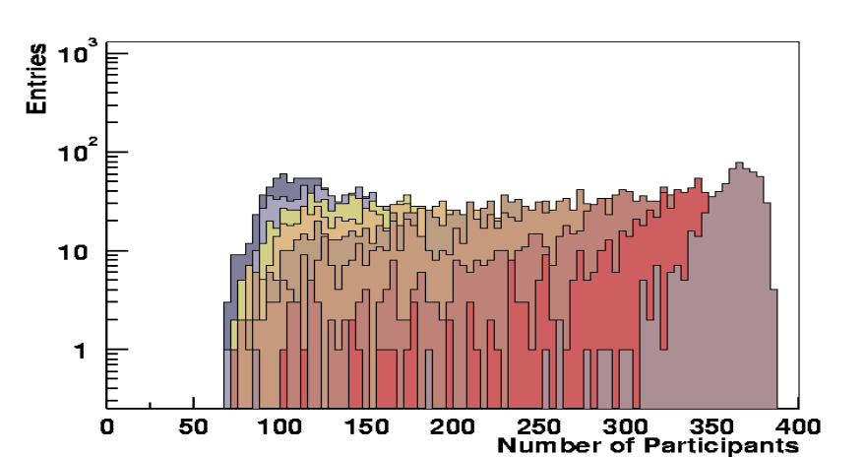
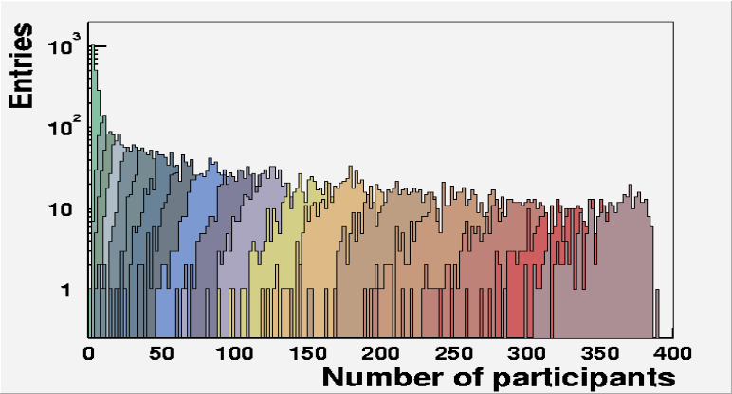
Determination of Npart
Fragmentation
pt broadening
detector resolution
Glauber implementation
Parametrization of nucl. density (Wood-Saxon)
Cross section measurement
Hadronic crosssection
variation of event shape
detector resolution
N_{part}

Slide 9
Result of Npart determination
determined the impact parameter and N_{part} with 2 independent
methods to exclude many systematic uncertainties
estimated the influence of the cross section measurement
estimated the influence of the Glauber implementation and
the parametrization of the nuclear density
Total systematic error on Npart
Δ(Npart)
Variation of Glauber implementation
Variation of cross section
Npart

Slide 10
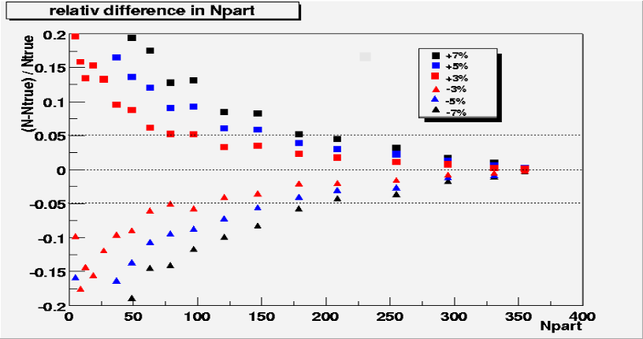
Measurement of the
“unbiased” spectrum
Simulation:
(2.6 % +/-3) % lost due to trigger acceptance
Confirmation with data:
Measurement of relative cross sections
loss >10% excluded by comparison of event topologies in ZDCs

Slide 11
Measurement of cross section ratios
σ_{tot} = σ_{hadron} + σ_{Coulomb}
theoretical predictions: 10.90 = 6.92 + 4.0 barn
measurement (trigger): all = paddles + ZDC
γ
σ_{hadron}/ σ_{tot} theory: 0.636 +/- 0.032 (Nucl.Instr.Meth.A 417(1998)1)
data: 0.615 +/- 0.061

Slide 12
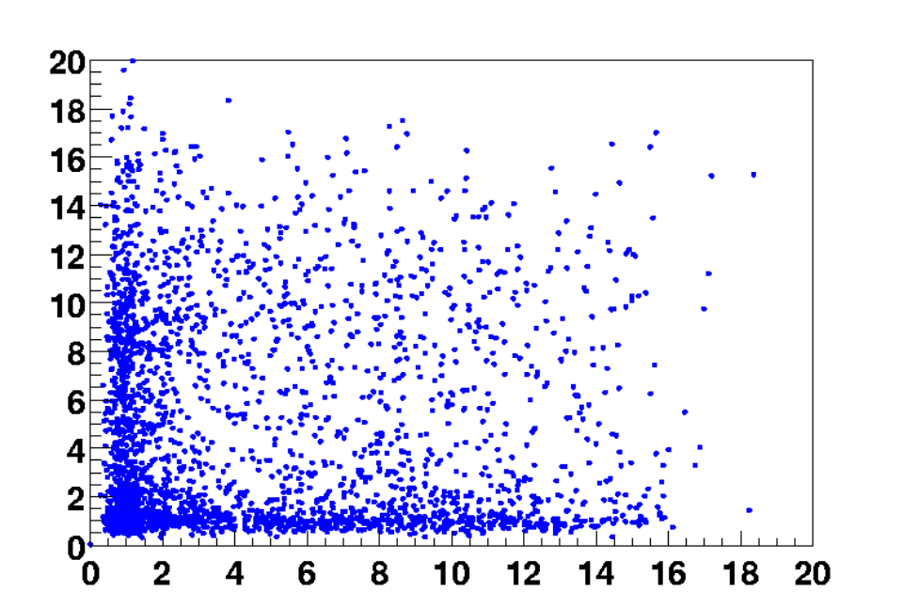
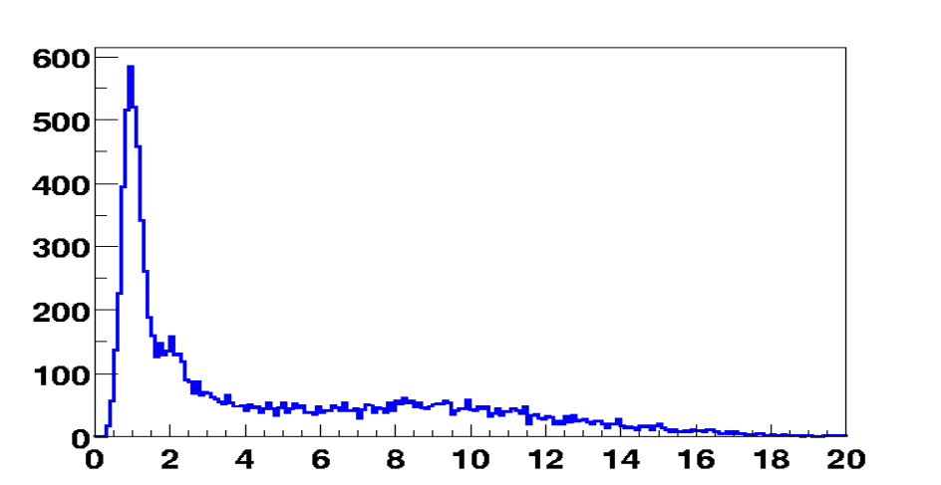
Mutual Coulomb dissociation measured in ZDC
E_{P}
a.u.
1.364
Background: 4%
ZDC inefficiency <1%
0.449
E_{N} a.u.
σ_{1n}/ σ_{1nX} = 0.33
data: 0..31 +/- 0.046
σ_{1nX}/ σ _{tot} = 0.12
data: 0.13 +/- 0.018
1 neutron (Dipole resonance)
E_{N} a.u.

Slide 13
ZDC Simulation

Slide 14
Measurement of charged particle density at mid-rapidity
Spectrometer
(P.Decowski Poster)
z
0 < η <1
x
(Δη² + Δφ ²) ^{1/2} < 0.015
N^{data}_{prim} = (N^{data}_{track} - N^{data}_{back}) x N^{MC}_{prim} / (N^{MC}_{track} - N^{MC}_{back})

Slide 15
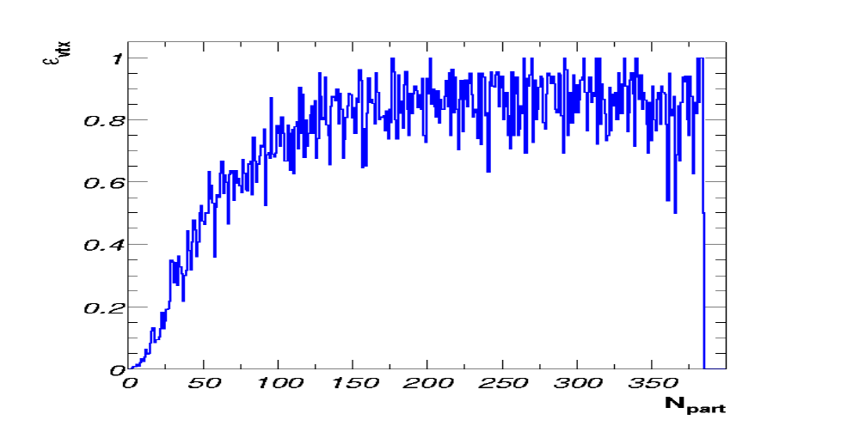
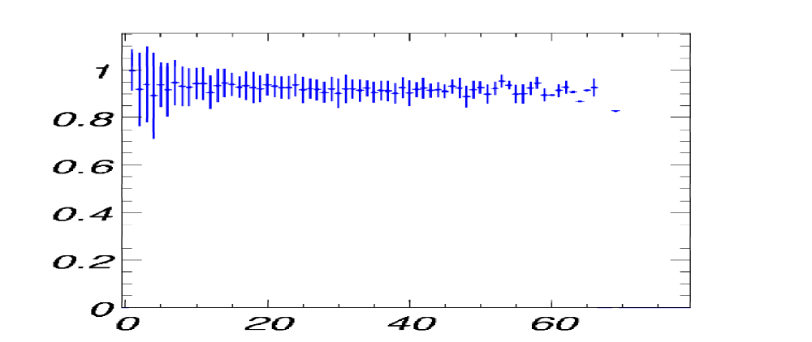
Vertex and Tracklet Reconstruction
Vertex reconstruction:
Resolution σ_{z} = 150 μm
σ_{x} = σ_{y} = 600 μm
selection for this analysis:
-4 cm < z < 12 cm
Tracklet reconstruction:

Slide 16
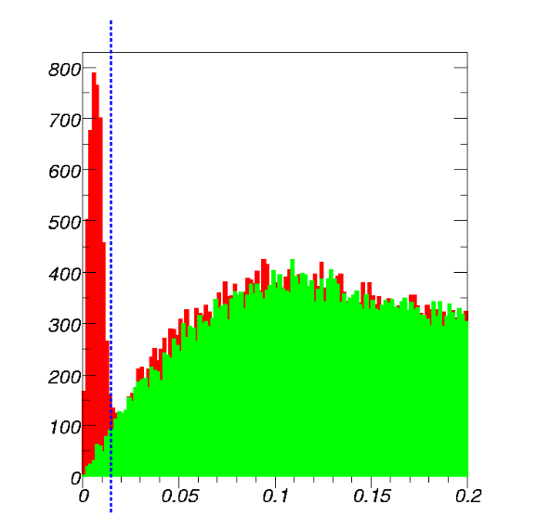
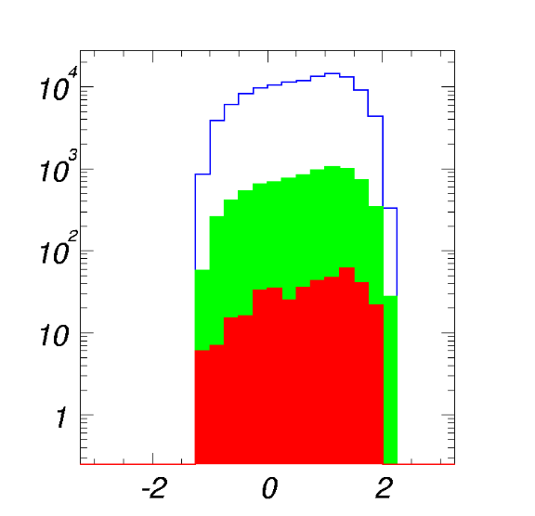
Background
tracklets
2 - 13% combinatorical background
0.5 % background from decaying
particles (Hijing)
6.5 % secondaries originating in
dead material (Hijing,Geant)
background
D
primaries
secondar.
feeddown
η

Slide 17
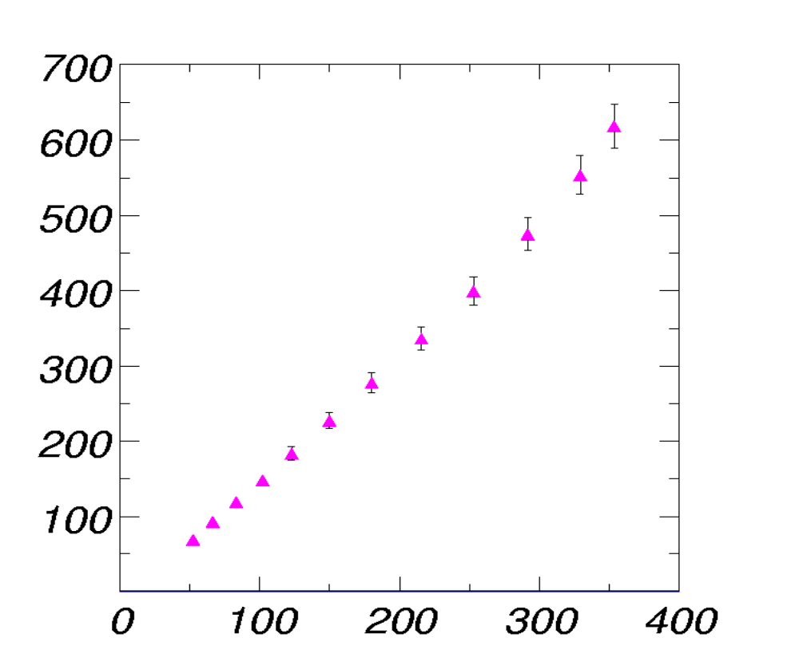
dN/dη
N_{part}

Slide 18
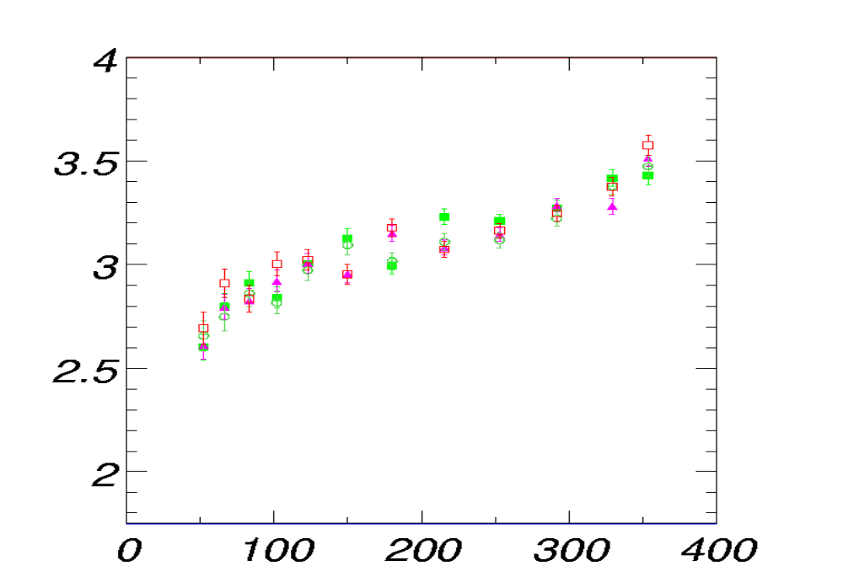
Result & error estimate
combinatorical background 1%
tracklet reconstruction and event selection 4%
dN/dη∗0.5Npart
N_{part}

Slide 19
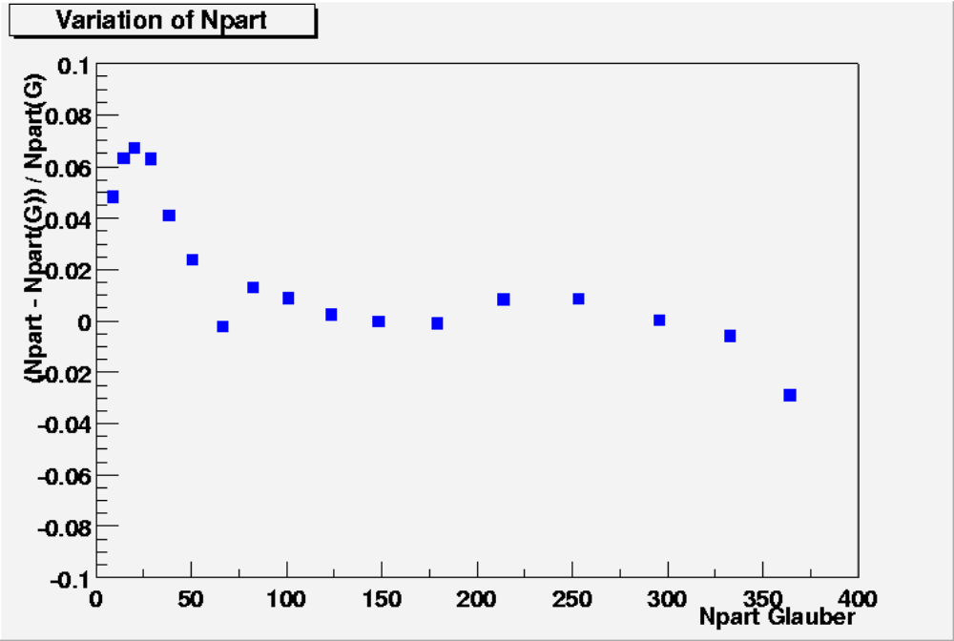

Slide 20
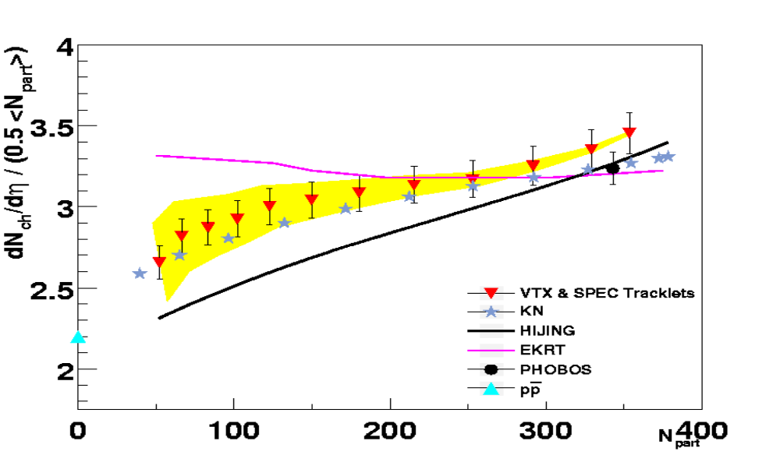
Comparison with theoretical models
Npart
N_{part}
Agrees with Glauber based model (KN)
Agrees with gluon saturation model (KN)
Disagrees with HIJING (Glauber, jet quenching, nuclear
shadowing)
Disagrees with EKRT (gluon saturation model)
Not distinguishable

Slide 21
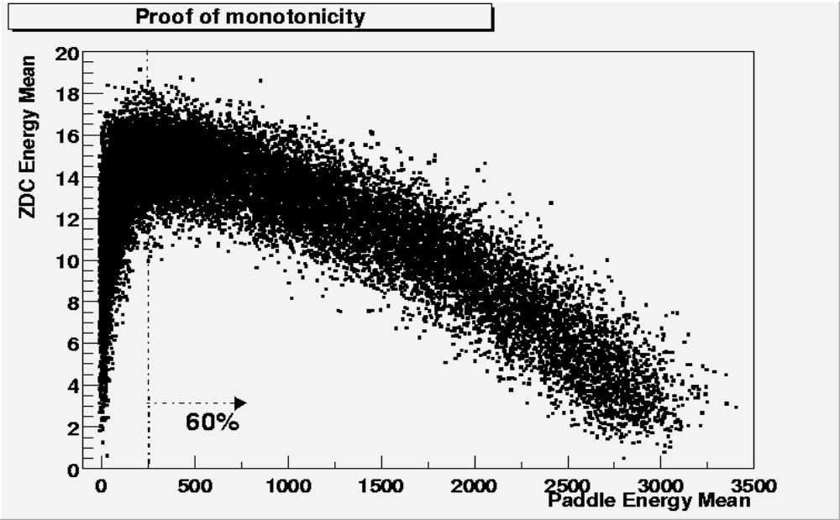
Monotonicity
Proof of monotonicity for signal in paddles and in ZDC
Anti-correlation confirms relation of signals to spectators
and participants

