Slide 1
Communications Technology Group
Status Report to the Commercial Mobile Service Alert Advisory Committee
July 18, 2007
Brian K. Daly, CTG Leader

Slide 2
Status - CTG Issues to Address
Recommendations for technologies and methods permitting the efficient transmission of messages to potentially the entire subscriber base of an operator – First reported in March:
  The CTG has defined Service Profiles which prescribe the underlying delivery attributes
    Text and future streaming audio, streaming video & multimedia
    Text is the minimum requirement for CMAS
  Goal has been to define service profiles and not specific delivery technologies
  If an Operator elects to transmit alerts they should have the option to use any available technology that supports a given profile
Permit the distribution of alerts with the appropriate priorities as indicated by the AIG.
  Messages will be delivered in the order received; prioritization and sequencing to be performed at the Alert Gateway

Slide 3
Status - CTG Issues to Address
Recommendations on methods permitting the targeting of alerts to specific geographic regions or locales, thereby enabling use of this important emergency service by other alerting authorities, including state and local governments.
  Geo-targeting will be on a county basis
    CMSP may target smaller areas subject to CMSP policy & delivery technology capabilities
Recommendations on handset and device technologies appropriate for alerting services – First reported in March.
  Several draft conclusions to be provided in this briefing
The needs of non-English subscribers as well as people with special needs, including people with disabilities and the elderly.
  Draft conclusion developed; further details provided in this briefing

Slide 4
Status - CTG Issues to Address
To ensure that this critical emergency service continues to evolve with technology supporting it, the CTG should also consider recommendations permitting the incorporation of planned service improvements, such as expected multimedia and broadband services, into their CMS alerting capability – First reported in March.
  Service profiles defined for future streaming audio, streaming video, and multimedia for future broadband multimedia networks
The CTG will develop recommendations to facilitate eventual alignment of the Advisory Committee’s recommendations with relevant standards organizations focused on the development of mobile communication standards to support its continued evolution and adaptation.
  Standards recommendations will be provided after all technology recommendations are known

Slide 5
CTG Status
Initiated a process for CTG drafting sessions to accelerate development of input into the CMAS Architecture & Recommendations document
Monthly multi-day face-to-face meetings with interim conference calls
  Since May report, held 2 multi-day face-to-face meetings and 7 multi-hour conference calls
Coordinating with the other working groups
  Held joint meetings with the AIG, AGG and the UNG
CTG provided significant input into the 1st and 2nd drafts of the CMAS Architecture & Recommendations document
Defined the process for project completion, including a CTG review of the final draft of the CMAS Architecture & Recommendations document

Slide 6
CTG Statistics (Totals)
 | As of May 16th | Current
Number of Assigned Doc Numbers | 145 | 258
Total Number of Docs including Revisions | 236 | 448
Number of Liaison Docs | 23 | 25
Number of Action Items | 20 | 34
Total Number of Face-to-Face Meetings & Days | 4 meetings over 9 days | 6 meetings over 15 days
Total Number of Conference Calls of CTG & Ad-Hocs | 18 | 25

Slide 7
Project Timelines & Milestones
July
  Finalize battery life conclusion
  Finalize text message length
  Standardize alert tone and vibration cadence
  Finalize mobile device client recommendations
  Complete “C” reference point; i.e. Alert Gateway to CMSP Gateway interface
    Joint w/AGG
  Finalize alert information sent to mobile device over the “E” reference point
    Finalize character length of displayable text for the Text Profile
  Develop CMSP transmission delay conclusions
  Develop policy for retransmission & rebroadcast of alerts
August
  All technical issues resolved
  Address alignment with standards
  Final delivery of CTG requirements to the PMG
  CTG review & comment to Draft 3 CMAS Architecture & Recommendations
September
  Address final comments from all working groups

Slide 8
CMA Scenarios
Narrative describing foreseeable interactions of types of users and the system or between two system/software components
  Include information about goals, expectations, actions and reactions
  Plain language without any technical descriptions
  Allows normal users to understand them and confirm if they describe a real situation

Slide 9
CMA Scenarios (continued)
CTG has developed scenarios for:
  Nominal CMAS alert for text based CMAS alert
  CMAS alert cancellation
  CMAS alert update for text based CMAS alert
  CMAS alert expiration
  Duplicate CMAS alerts:
    Duplicate CMAS alerts on the same broadcast technology
    Duplicate CMAS alerts from different broadcast technologies
  Multiple Different Active CMAS alerts

Slide 10
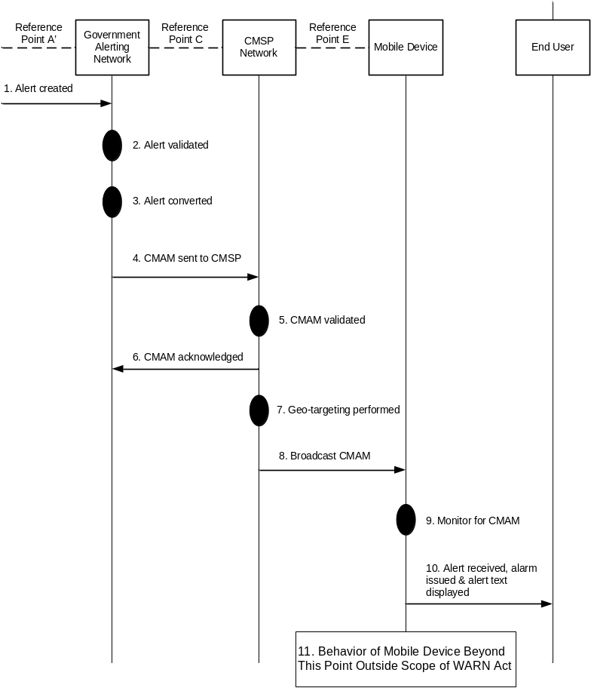
Example CMA Scenario
Normal Text-based CMA
Shows flow from alert initiator to presentation to the end user at the mobile device
Error cases described in the text associated with the flow

Slide 11
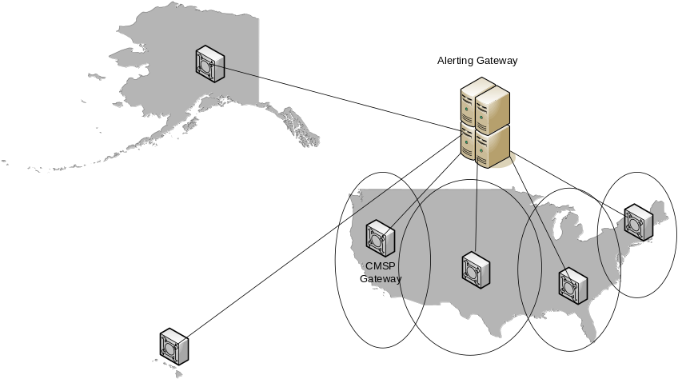
CMSP Gateway
Primary Function is the managed distribution of authenticated alerts across the service provider network
CMSP will have one or more CMSP Gateways in the CMSP network to handle anticipated CMA message traffic levels
Government
Domain

Slide 12
CMSP Gateway (continued)
CTG has identified key functions of the CMSP Gateway, including:
  Mapping the alert area of the CMAS alert message into the associated set of cell sites / pager transceivers
  Processing CMA messages in a first in – first out (FIFO) queuing method except for a Presidential-level alert
CMSP Gateway shall not be responsible for performing any formatting, re-formatting, or translation of the CMA message

Slide 13
Mobile Devices
CTG has been working with UNG to identify key requirements of the mobile device to support CMAs
  Presentation of CMAS alerts should be distinguishable from any other types of text messages received
    Using an alert tone and/or vibration cadence
    Color cannot be a required method for distinguishing CMAS alert messages
CMSP and mobile device vendors should have flexibility in the design and implementation of CMA in mobile devices to:
  take advantage of advances in mobile device technologies
  account for the evolution of mobile devices and the capabilities of the future

Slide 14
Battery Life Concerns
CTG is still investigating battery life concerns with commercial mobile broadcast technologies
  CTG is seeing conflicting reports
Issue will be further discussed in the July meeting of the CTG
  CTG will take into account mobile device vendor input, case studies, ETSI and 3GPP work, and a recent University study being circulated

Slide 15
Multi-Language Support
Provision has been made in the CMAS architecture to support multi-languages:
  Protocols at “C” and “E” reference points will be designed to support multiple languages.
  Service Profiles will support multiple languages.

Slide 16
Multi-Language Support (continued)
Alert initiation with existing alerting mechanism in languages other than English is very limited today
  A national plan for multiple languages needs to be developed by the government before a CMSP will be able to support CMA in multiple languages
CMA message must be delivered to the CMSP in the language that it is to be delivered
  CMSP network or the mobile device shall not perform language translation

Slide 17
Multi-Language Support (continued)
CTG recommends that participating CMSPs may choose to transmit alerts received in language(s) other than English based on:
  Capabilities of the technology the CMSP has deployed to support CMAS alerts
  Capabilities of the mobile device
  CMSP’s policy
  More complete understanding of alert rates and characteristics
  Definition of the national plan for the support of alerts in multiple languages

Slide 18
Future CMAS Capabilities
Streaming audio, streaming video and multimedia are optional future CMAS capabilities:
  CTG recommends that the CMAS Architecture & Recommendations document be treated as a living document, with periodic updates to account for:
    CMSP experiences with initial CMAS deployments
    CMSP experiences with new technologies and their applicability to CMAS
  CTG recommends an industry technology group consisting of government and industry stakeholders should be created after the CMSAAC’s activity is completed
    Review and update the CMAS Architecture & Recommendations document on a periodic basis focusing on new technology capabilities
    Recommended this review should occur no less frequently then biannually

Slide 19
Summary
CTG is on track for resolving all technical issues and provide recommendations to the PMG by August, 2007

