Slide 1
High p_{T} Hadron Correlation
and No Correlation
Rudolph C. Hwa
University of Oregon
Hard Probes 2006
Asilomar, CA, June 10, 2006

Slide 2
A. Conventional scenario
Hard scattering ⇒ high p_{T} jet
⇒ hadron correlation
(usual conductor has resistance)
B. Unconventional scenario
High p_{T} hadrons ⇒ high p_{T} jet
⇒ correlation
(superconductor has no resistance)

Slide 3
A. Jet Correlation
p_{T1}-p_{T2}
η₁-η₂
φ₁-φ₂
near side
1
away side
auto-correl
B. No Jet Correlation
φ and Ω production up to p_{T} ~ 6 GeV/c
Forward production at any p_{T}
Large p_{T} at LHC

Slide 4
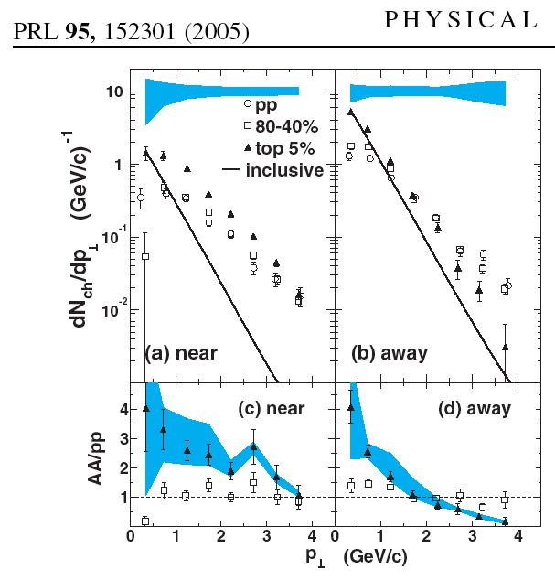
same side
STAR

Slide 5
Associated particle p_{T} distribution
p₁ -- trigger
p₂ -- associated
In the recombination model
k
q₁
q₂
q₃
q₄

Slide 6
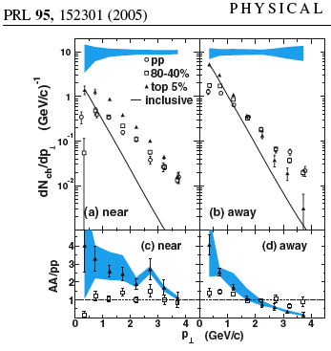
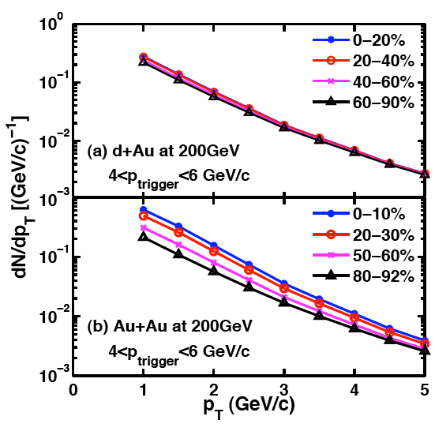
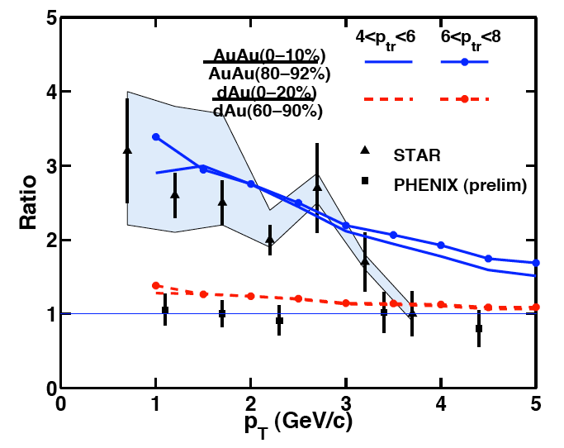
STAR
Associated particle distribution in the recombination model -- for ππ only
Hwa & Tan, PRC 72, 057902 (2005)

Slide 7
Medium modified dihadron fragmentation function -- more relevant at higher p_{T}.
Majumder, Wang, Wang nucl-th/0412061
Jet tomography CGC forward production
All use fragmentation for hadronization -- but not reliable at intermediate p_{T}
Remember p/π ratio
in white paper
All in recombination/ coalescence model
TTT TT
T S
If proton production cannot be described by fragmentation at intermediate p_{T}, how much trust can be placed on pion production by fragmentation?
S S -- fragmentation

Slide 8
A. Jet Correlation
p_{T1}-p_{T2}
η₁-η₂
φ₁-φ₂
near side
1
away side
2
auto-correl

Slide 9
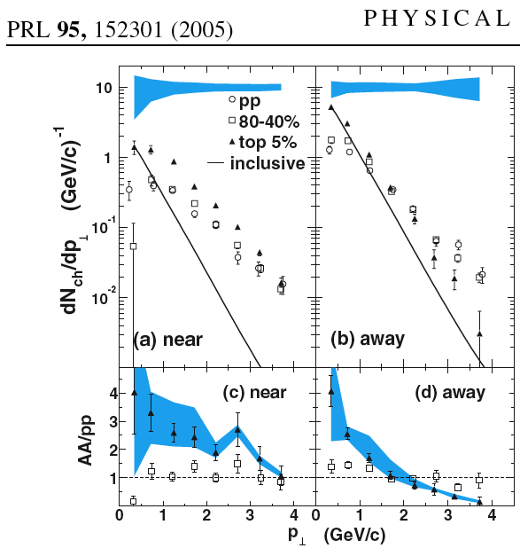
Away side
medium effect on away-side jet
Jet quenching
enhancement
suppression

Slide 10
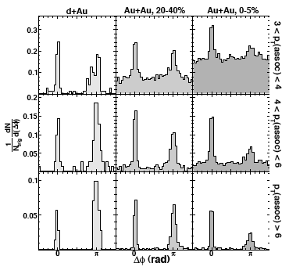
Dijet fragmentation STAR, nucl-ex/0604018
enhancement
suppression

Slide 11


π production in AuAu central collision at 200 GeV
recombination
fragmentation
Hwa & CB Yang, PRC70, 024905 (2004)

Slide 12
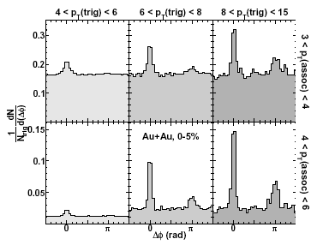
STAR dijet
12
0.2
8
p_{T}(assoc)
0.1
4
0
4
8
12
16
p_{T}(trig)

Slide 13
Trigger-normalized fragmentation function
Trigger-normalized momentum fraction
is measurable without direct knowledge of the parton energy.
X.-N. Wang, Phys. Lett. B 595, 165 (2004)
J. Adams et al., nucl-ex/0604018

Slide 14
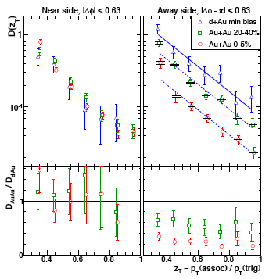
STAR, nucl-ex/0604018

Slide 15
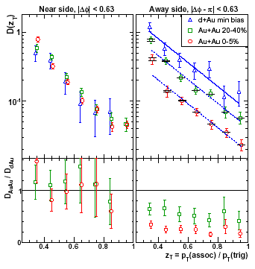
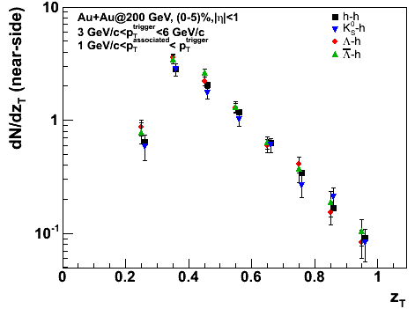
STAR dijet
z_{T}=0.8-0.9
12
Bielcikova PANIC 05
z_{T}=0.5-0.6
8
p_{T}(assoc)
4
0
4
8
12
16
p_{T}(trig)

Slide 16
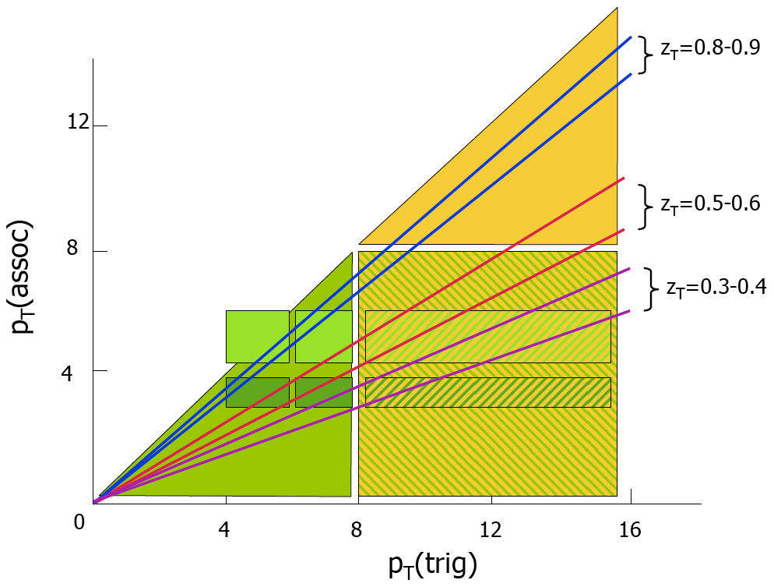
STAR claims universal behavior in D(z_{T})
fragmentation
violation of universal behavior due to medium effect ---- thermal-shower recombination
Suggestion: look for p/π ratio in this region. Large if dominated by recombination.

Slide 17
A. Jet Correlation
p_{T1}-p_{T2}
η₁-η₂
φ₁-φ₂
near side
1
3
away side
2
auto-correl

Slide 18
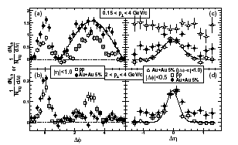
Correlation on the near side
Δφ and Δη distributions
STAR, PRL 95, 152301 (2005)
peaks

Slide 19
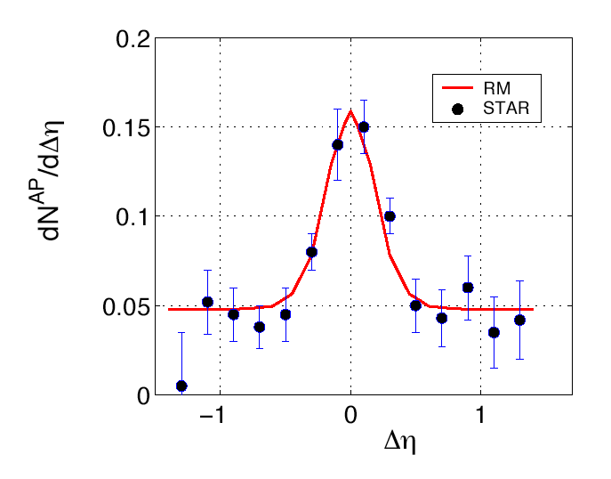
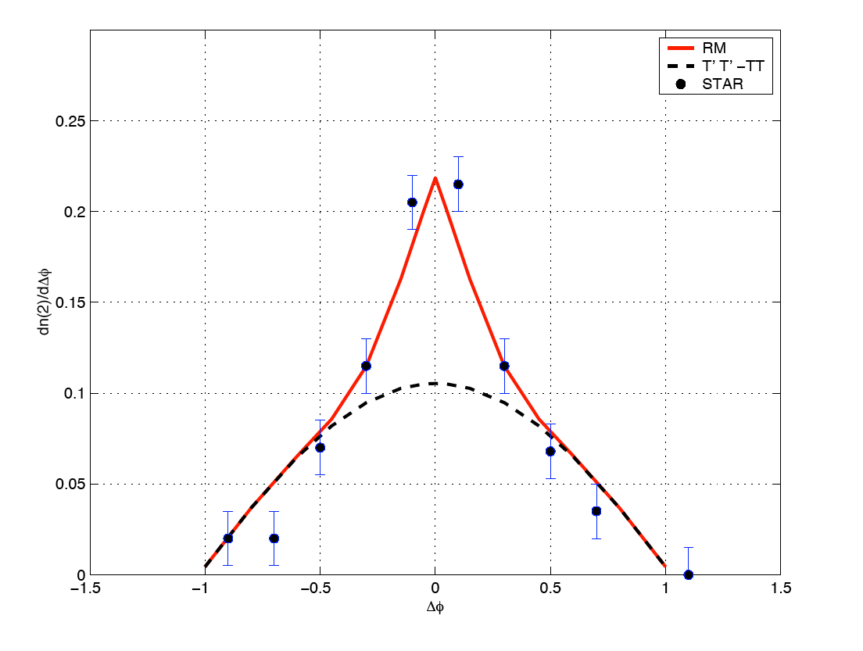
Chiu & Hwa, PRC 72, 034903 (2005)
pedestal ΔT=15 MeV
Δφ
energy loss converts to soft particles
hard parton
hard parton
shower parton, leads to the trigger particle
trigger hadron
At higher trigger momentum, the hard parton originate closer to the surface, so less energy is lost. Hence no pedestal.
Those soft particles form the pedestal.
At low trigger momentum, hard partons can originate farther in.

Slide 20
A. Jet Correlation
p_{T1}-p_{T2}
η₁-η₂
φ₁-φ₂
near side
1
3
away side
2
4
auto-correl

Slide 21
Away-side distribution
Casalderrey-Solana, Shuryak, Teaney Mach cone
Dremin Cherenkov gluons
Ruppert, Muller color wake
Koch, Majumder, Wang Cherenkov radiation
Vitev jet quenching+fragm
.
.
Chiu, Hwa parton multiple scattering

Slide 22
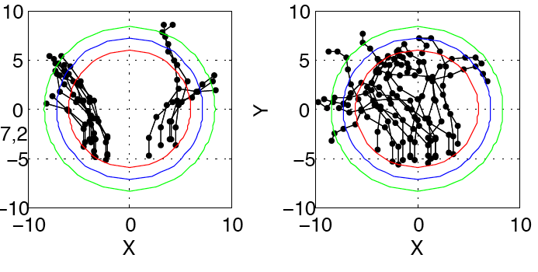
Parton multiple-scattering model
Sample trajectories for 2.5<p(trig)<4, 1<p(assoc)<2.5
absorbed (thermalized) tracks
exit tracks
high p_{T} parton

Slide 23
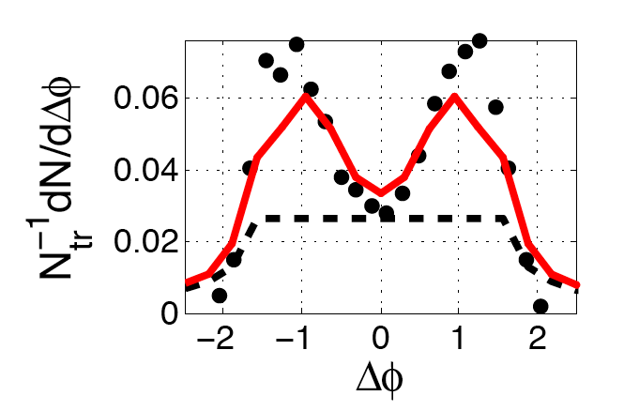
PHENIX 2.5<p(trig)<4
Away-side Δφ distribution
parton p=4.5
Event averaged, background subtracted.
energy loss thermalized
Cannot distinguish between 1-jet and 2-jet contributions (e.g., Mach cone)
- π
A new measure proposed that suppresses statistical background event-by-event
Chiu & Hwa, nucl-th/0605054
Chiu’s talk in parallel session on Monday

Slide 24
A. Jet Correlation
p_{T1}-p_{T2}
η₁-η₂
φ₁-φ₂
near side
1
3
away side
2
4
auto-correl
5

Slide 25
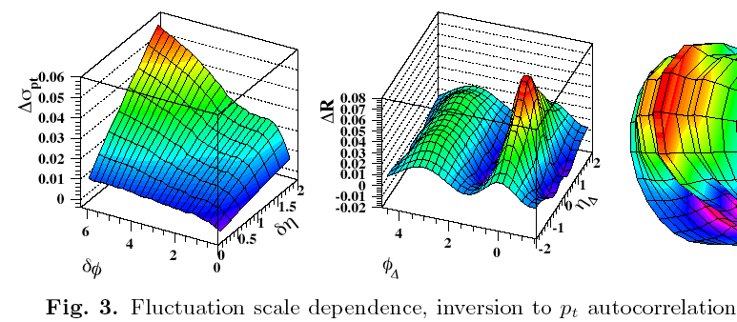
Autocorrelation
Consider an example in time series analysis
Trainor (STAR) Jamaica workshop (2004)

Slide 26
Correlation function
Treat 1,2 on equal footing --- no trigger
Define
Autocorrelation
Fix and , and integrate over all other variables in
The only non-trivial contribution to near , would come from jets
No ambiguous subtraction procedure; only do as defined.

Slide 27
x
k
hard parton momentum k
ψ₁
ψ₂
χ
q₁
q₂
Radiated gluon momentum q
thermal partons
y
z
x
jet axis
χ
p₁
p₂
two shower partons with angular difference χ
(a much larger set)
φ₋
θ₁
θ₂
χ
y
z
pion momenta (observable)

Slide 28
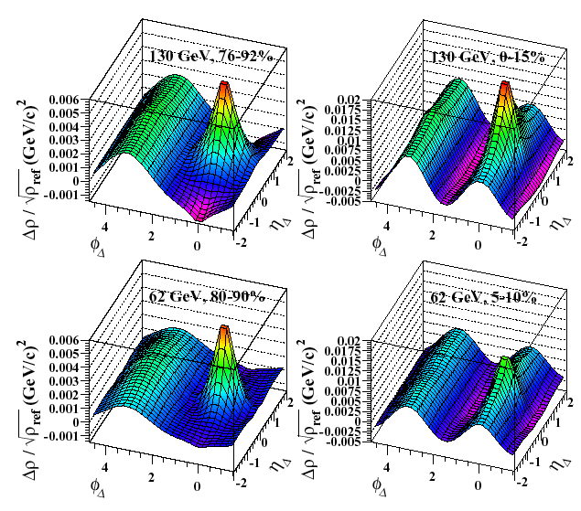
STAR data on Autocorrelation for central Au+Au at 130 GeV for |η|<1.3, 0.15<pT<2 GeV/c
dominated by soft partons
NO trigger, no subtraction
Chiu & Hwa, PRC 73, 014903 (2006)
TS recombination in a jet with pT>3 GeV/c
nucl-ex/0605021

Slide 29
A. Jet Correlation
p_{T1}-p_{T2}
η₁-η₂
φ₁-φ₂
near side
1
3
away side
2
4
auto-correl
5
B. No Jet Correlation
φ and Ω production up to p_{T} ~ 6 GeV/c
Forward production at any p_{T}
Large p_{T} at LHC

Slide 30
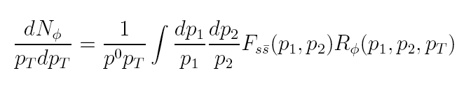


φ and Ω production at intermediate p_{T}
p_{T} distribution of φ by recombination
For Ω
strange-quark shower is very suppressed.

Slide 31
Hwa & CB Yang, nucl-th/0602024
recombination
hard parton scattering
recombination
s
s
s
s
s
s
fragmentation
If they are produced by hard scattering followed by fragmentation, one expects jets of particles.
There are other particles associated with
and

Slide 32
We claim that no shower partons are involved in φ, Ω production, so no jets are involved.
Select events with φ or Ω in the 3<p_{T}<6 region, and treat them as trigger particles.
Predict: no associated particles giving rise to peaks in Δφ, near-side or away-side.

Slide 33
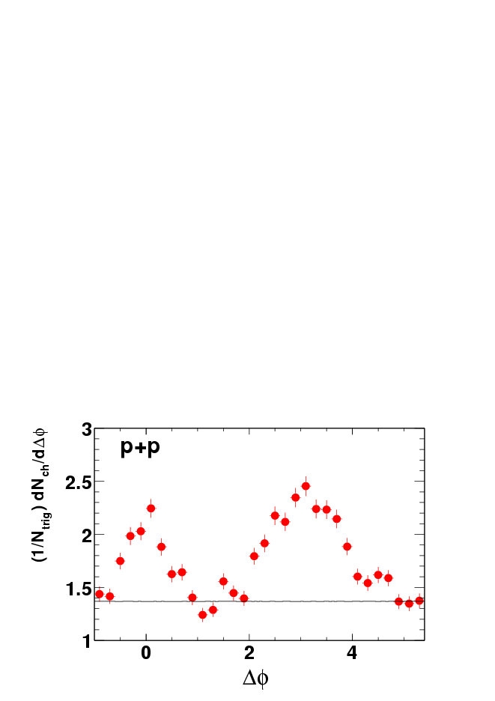
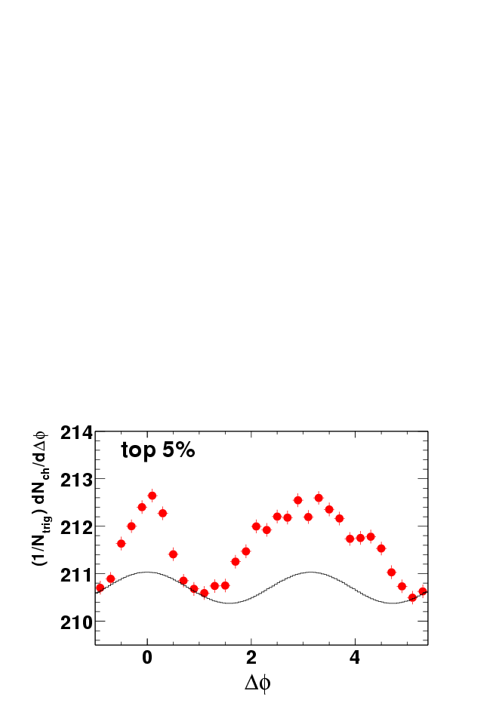
p+p
Jet-like structures
(1/N_{trig}) dN/d(Δφ)
Au+Au top 5%
Signal
charged hadrons
background
Δφ
Ω trigger (pT>3 GeV/c) in Au+Au
?

Slide 34
A. Jet Correlation
p_{T1}-p_{T2}
η₁-η₂
φ₁-φ₂
near side
1
3
away side
2
4
auto-correl
5
B. No Jet Correlation
φ and Ω production up to p_{T} ~ 6 GeV/c
Forward production at any p_{T}
Large p_{T} at LHC

Slide 35
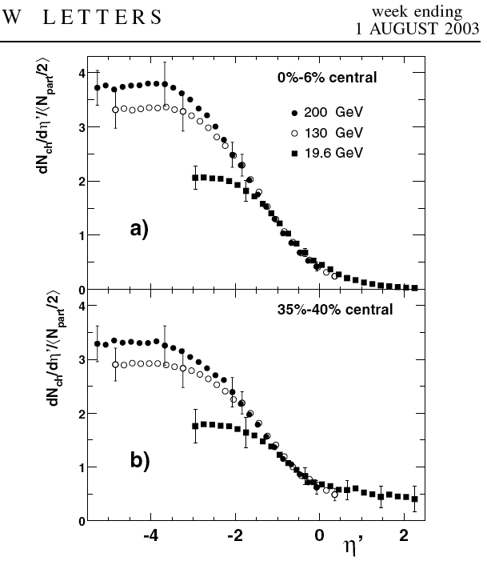
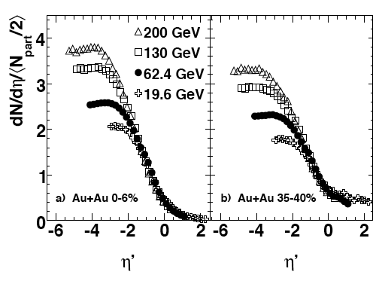
Forward production of hadrons
PHOBOS, nucl-ex/0509034
Without knowing p_{T}, it is not possible to determine x_{F}
Back et al, PRL 91, 052303 (2003)

Slide 36
Theoretically, can hadrons be produced at x_{F} > 1?
(TFR)
It seems to violate momentum conservation, p_{L} > √s/2.
In pB collision the partons that recombine must satisfy
p
B
A
B
But in AB collision the partons can come from different nucleons
In the recombination model the produced p and π can have smooth distributions across the x_{F} = 1 boundary.

Slide 37
proton
: momentum degradation factor
pion
Hwa & Yang, PRC 73,044913 (2006)
proton-to-pion ratio is very large.

Slide 38
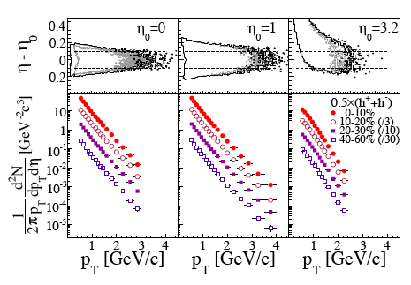
BRAHMS, nucl-ex/0602018

Slide 39
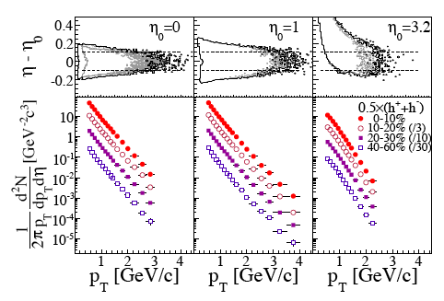
x_{F} = 0.9
x_{F} = 1.0
x_{F} = 0.8
TFR
TS
TTT
TT

Slide 40
Hwa & Yang (2006)
p_{T} distribution fitted well by recombination of thermal partons
⇒ no shower partons involved ⇒ no jets involved ⇒ no jet structure ⇒ no associated particles

Slide 41
A. Jet Correlation
p_{T1}-p_{T2}
η₁-η₂
φ₁-φ₂
near side
1
3
away side
2
4
auto-correl
5
B. No Jet Correlation
φ and Ω production up to p_{T} ~ 6 GeV/c
Forward production at any p_{T}
Large p_{T} at LHC

Slide 42
π and p production at high p_{T} at LHC
New feature at LHC: density of hard partons is high.
High p_{T} jets may be so dense that neighboring jet cones may overlap.
If so, then the shower partons in two nearby jets may recombine.
2 hard partons
π
p
1 shower parton from each

Slide 43
GeV/c
The particle detected has some associated partners.
But they are part of the background of an ocean of hadrons from other jets.
There should be no observable jet structure distinguishable from the background.
That is very different from a super-high p_{T} jet.
A jet at 30-40 GeV/c would have lots of observable associated particles.

Slide 44
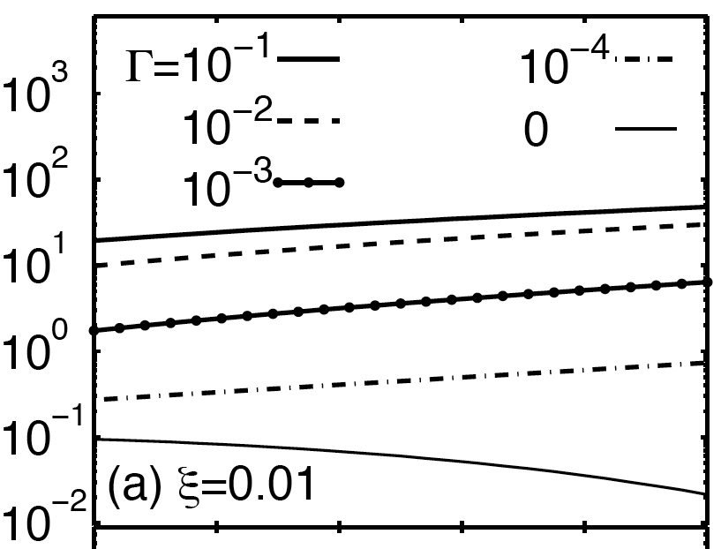
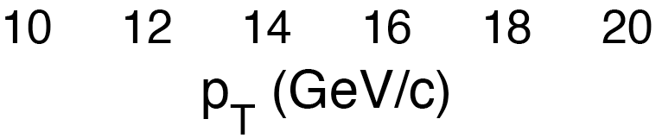
Proton-to-pion ratio at LHC
Γ -- probability of overlap of 2 jet cones
single jet
Hwa & Yang nucl-th/0603053

Slide 45
We predict for 10<p_{T}<20 Gev/c at LHC
Large p/π ratio
NO associated particles above the background

Slide 46
Summary
A. Jet Correlation
There’s jet quenching, but not necessarily fragmentation
p_{T1}-p_{T2}
η₁-η₂
φ₁-φ₂
near side
Jet fragmentation at high and
away side
Recombination at
auto-correl
No trigger bias, need more data at high p_{T}
B. No Jet Correlation
φ and Ω production up to p_{T} ~ 6 GeV/c
Forward production at any p_{T}
Large p_{T} at LHC
?
When recombination dominates over fragmentation, B/M ratio can be very large, and there would be no jets, no jet structure and no correlation above background.
?
?

