Slide 1



Transverse Single-Spin asymmetries for π+ ανδ π− προδυχτιον φρομ ππ χολλισιονσ ατ _√Σ_{ΝΝ= 200 Γες}
Introduction
Measurements, Kinematic variables
Corrections and checks
Preliminary Physics results
Conclusion and Prospects
F.Videbaek
Notes:
Not a physics talk Polarization
Bunch dependent luminosities
Systematic errors
Experimental Checks

Slide 2
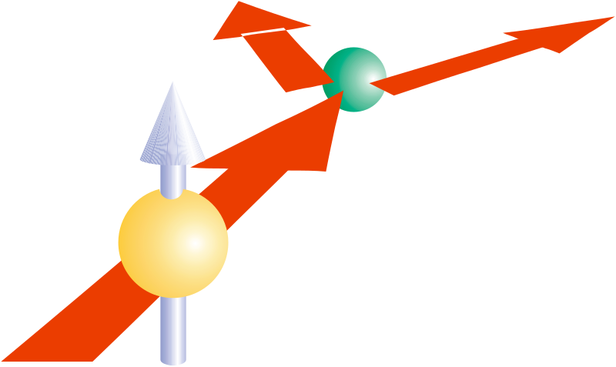
Introduction
Left
Right
A_{n} = (σ⁺ - σ⁻) / (σ⁺ + σ⁻)
  Where the spin cross section is determined with the spin direction defined by k_{b} x k_{pi}
Early (naive) QCD predicted this effect to be small.
Non-zero Single Transverse Spin Asymmetry (SSA/ A_{n}) requires
  Spin Flip Amplitude and phase difference in intrinsic states.
Such studies may clarify properties of transverse quark structure of the nucleon.

Slide 3
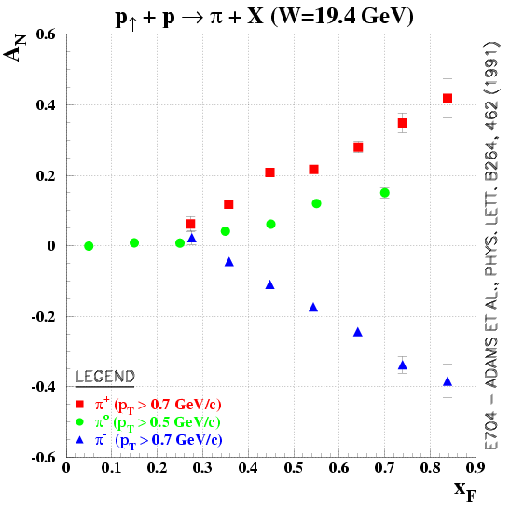
Background
Low energy data (FNAL E704 ) show clear differences between π⁺⁻ and π⁰.
π+
π⁰
D.L.Adams (E704) Phys.Lett B264,462(1991); Phys.Rev. D53, 4747 (1996).
Recent STAR results on π⁰ also shows a significant SSA/ A_{n} at RHIC energies.
π-

Slide 4
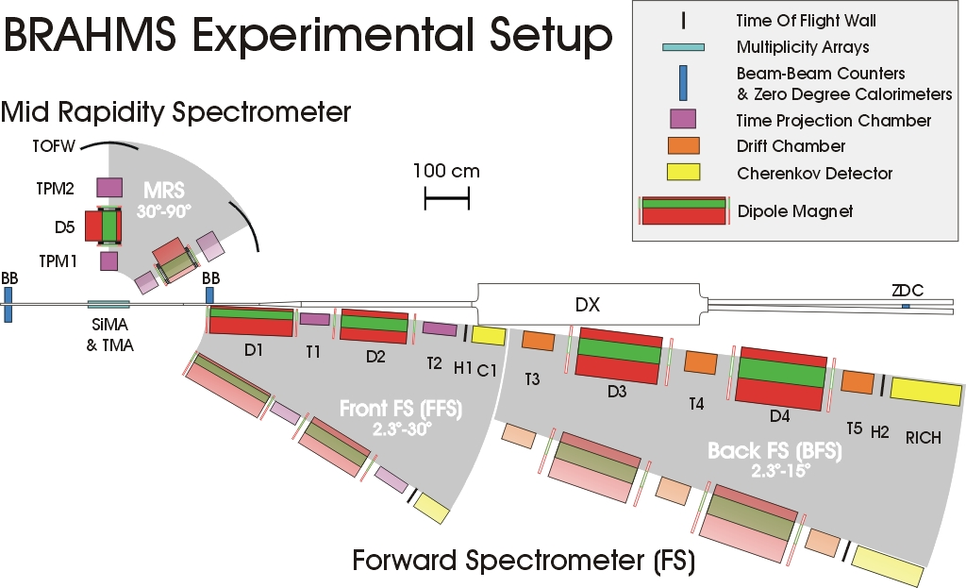
The BRAHMS Spectrometer

Slide 5
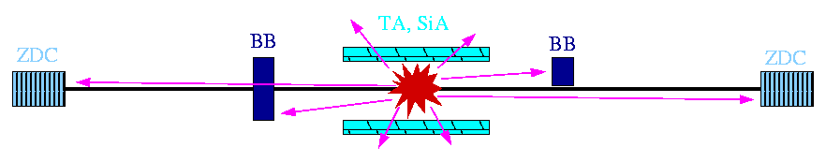
Event characterization
Global Detectors in use for luminosity measures, and inelastic pp cross section
Triggers are defined with the CC,Inel ZDC and BB; p+p collisions were triggered with the INEL/CC detectors.
TMA
BB
BB
CC/INEL

Slide 6
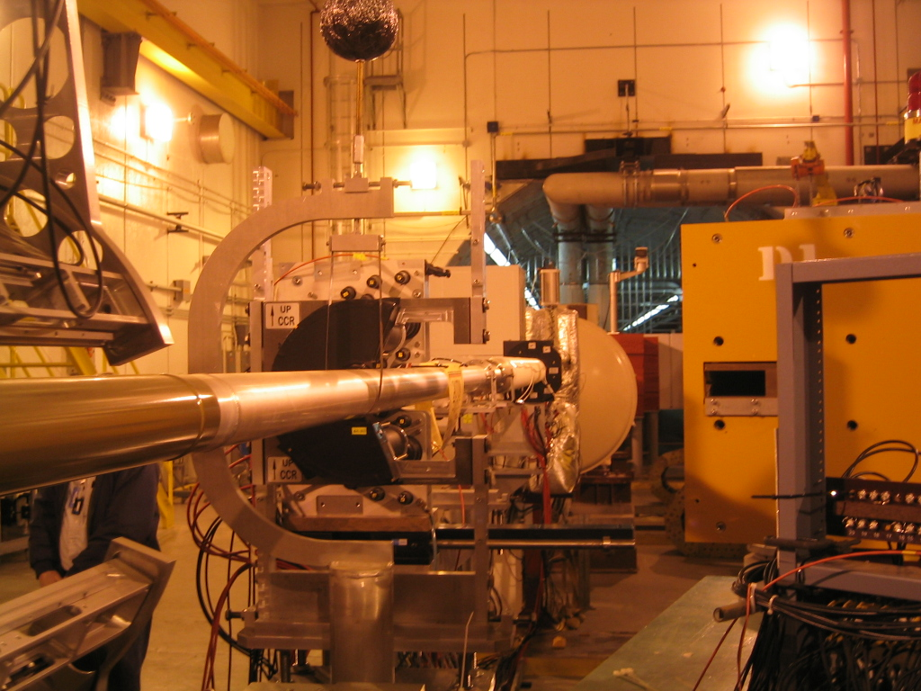
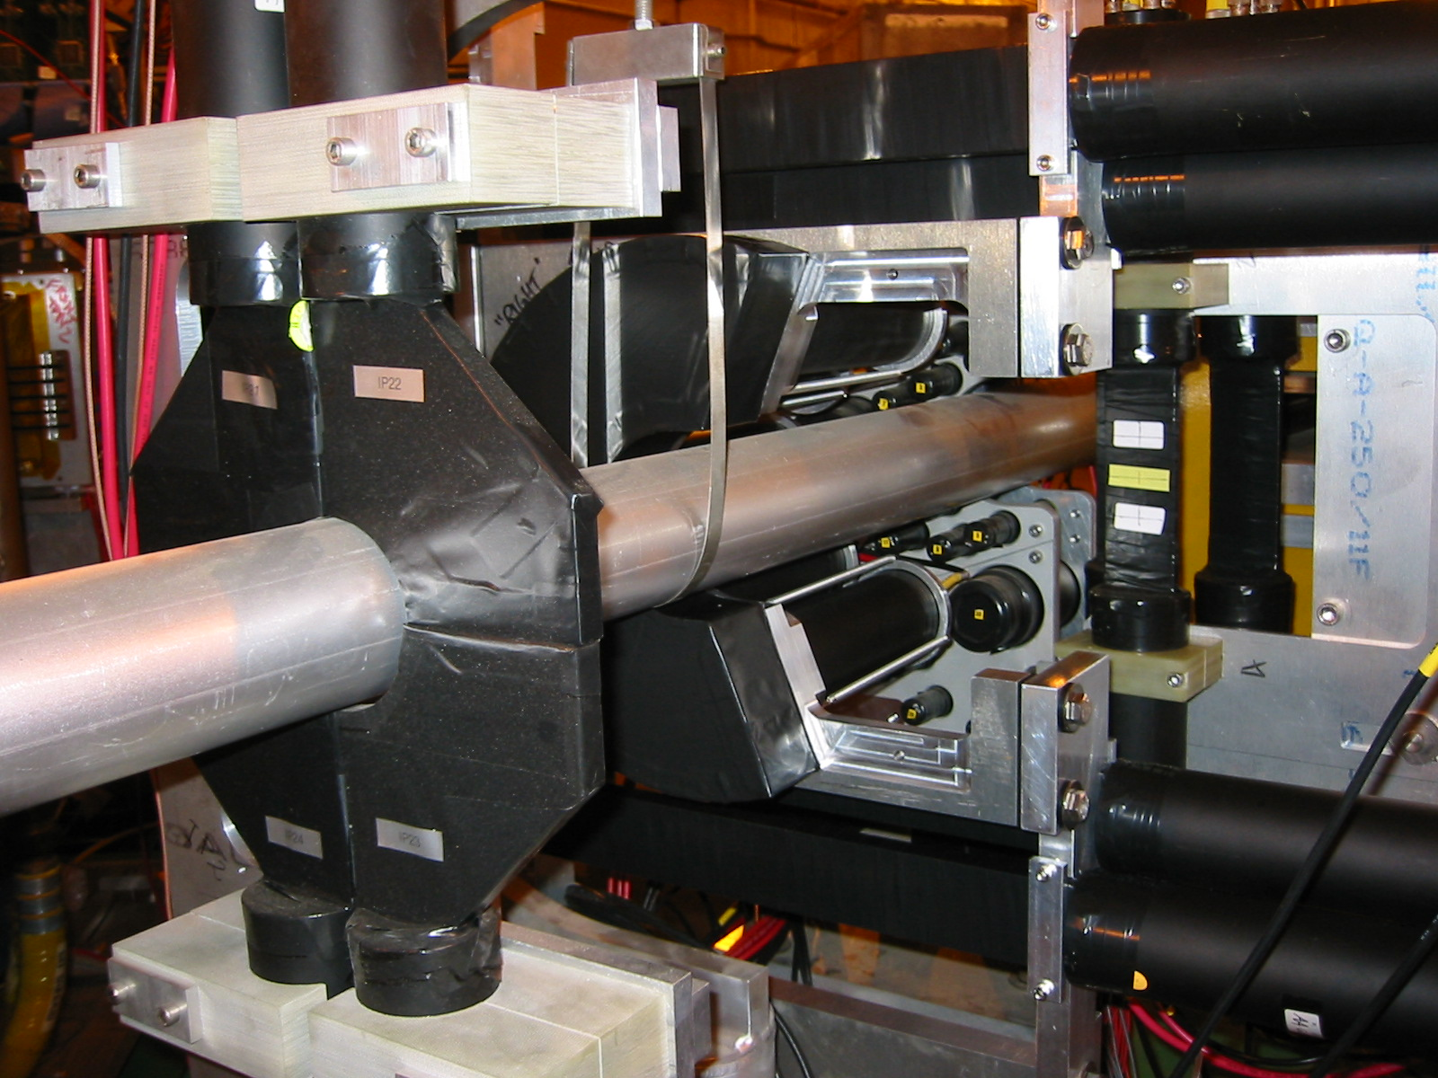
New Min-Bias Counter for pp
“CC” Counter –
Cherenkov Counter
Installed for pp05
Covers ~70% of pp inelastic cross-section
Vertex resolution
σ ~ 2cm

Slide 7
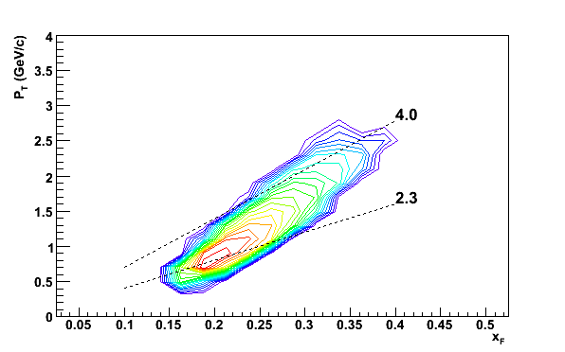
Kinematic Variables
The kinematic variables of interest are Feynman x (x_{F}) and p_{T}.
Shown is the BRAHMS acceptance for the data taken at θ = 2.3 deg and the maximum field setting (7.2 Tm).
Note the correlation between x_{F} and p_{T} as characteristic for a fixed angle spectrometer.
The momentum resolution is δp/p~1% at 22 GeV/c.

Slide 8
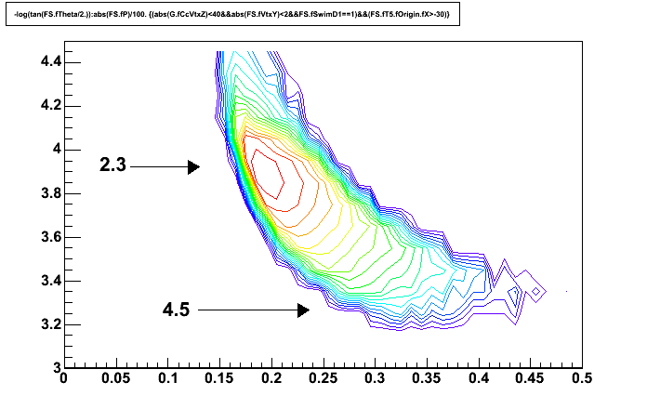
BRAHMS acceptance
The acceptance is not straight in angle or η. Illustrated in this plot. Thus care should be taken when comparing to both other experiments (STAR) and to theory.
η

Slide 9
Determination of raw asymmetries.
  Asymmetries are determined from A_{n} = ε /P
  The polarization P of the beam was ~42% in the RHIC Run-4 (Blue beam)
  With ε = (N⁺ - N⁻) / (N⁺ + N⁺ ) where the yield of pions in a given kinematic bin with the beam spin direction is N⁺ (up) and N⁻ (down).
  For non-uniform bunch intensities
= (N⁺ /L⁺ - N⁻/L⁻) / (N⁺ /L⁺ + N⁻/L⁻)
= (N⁺ - L*N⁻) / (N⁺ + L*N⁻) where L = L⁺ / L⁻
Since the up and down spin patterns alternate most time-dependent systematic errors are small. The main issue is determination of the L⁺ and L^{-.}

Slide 10
Event Selection Criteria
Clean track through spectrometer and in time with the RHIC 108 nsec clock.
Momentum determined from 3 measurements.
-40< Z_Vertex <30 (Vertex from collision) determined from global detectors (INL, BB, ZDC)
Track points to collision vertex (in Z and Y)
Good Bunches Only (selected per store)
Select pions using RICH for particle identification.
Notes:
Low luminosity,

Slide 11
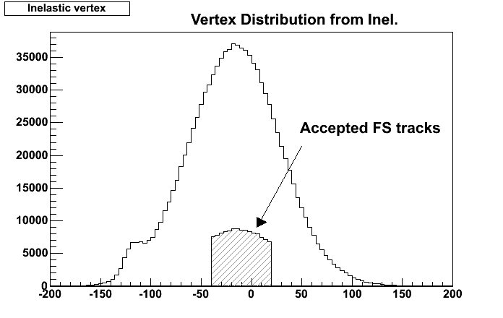
Vertex determination
Vertex Calculated from timing measurements in sets of counters INEL position on each side of IP covering roughly 2 < |η| < 5.2.
Z-resolution is ~ 10 cm in Run-4
The spectrometer accepts track weighted towards negative Z

Slide 12
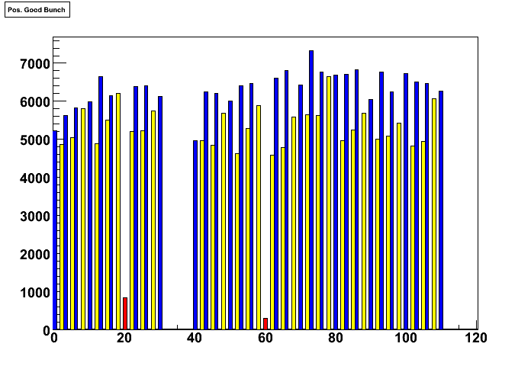
Bunch Pattern Selection
Bad bunches with different intensity outside norm is rejected.
L+/L- ~ 1.05-1.15 typical factors
Current run-5 have more systematic check with varying patterns.

Slide 13
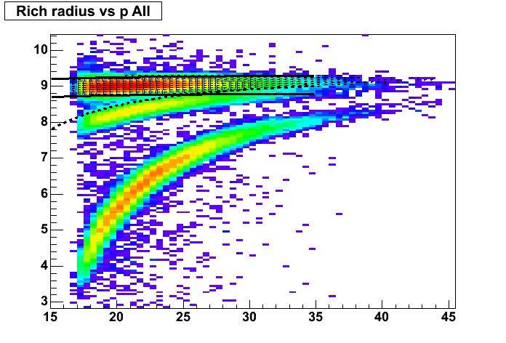
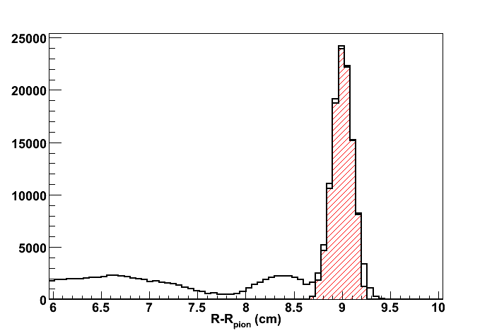
PID using RICH
Mass determined from momentum and Radius measured in a Ring Imaging Cherenkov Counter.
The pion identification is clean up to 35 GeV.
Measured radius vs. calculated showing the selected pions

Slide 14
Yields that can be used for analysis
 | positive | negative
pion | 219K | 216K
kaon | 46K | 26K
proton | 165K | 17K
Integrated yields of π,K and proton in x_{F} range 0.15-0.35

Slide 15
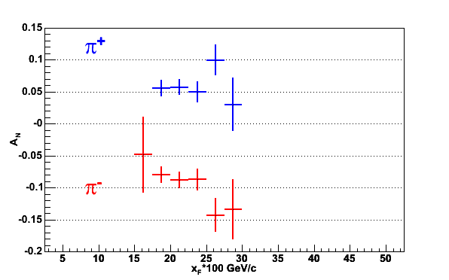
Data of A_{N} for π⁺ and π⁻
Polarization was ~42% for π⁺ measurements and ~38% for π⁻.
Systematic scale error on P ~ 20-30%. Will improve final final analysis of CNI and Gas Jet data.
Α_{N} = +0.05 +- 0.005 +- [0.015] in 0.17 < x_{F} < 0.32
Α_{N} = -0.08 +- 0.005 +- [0.02] in 0.17 < x_{F} < 0.32

Slide 16
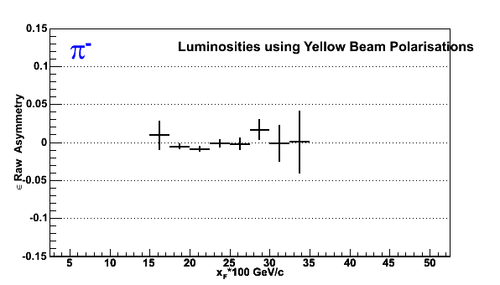
π⁻ and π⁺ with yellow Polarization pattern.
BRAHMS preliminary
This corresponds to negative x_{F}, and is consistent with 0
as expected.
Notes:
This plot is final in reagrd to sign

Slide 17
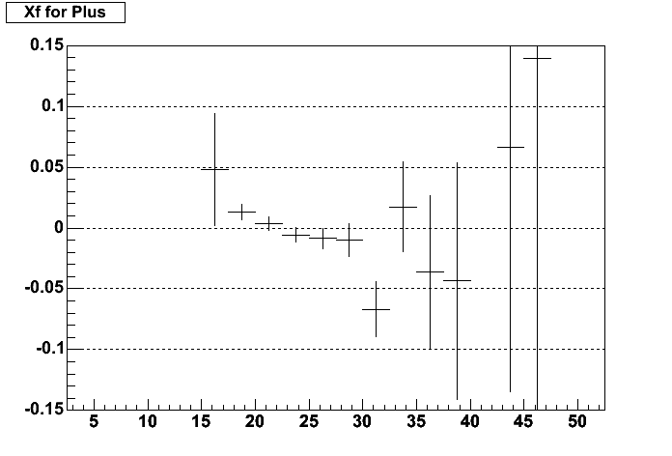
BRAHMS preliminary
e
ε
Pl (GeV)
The proton An is also consistent with 0.

Slide 18
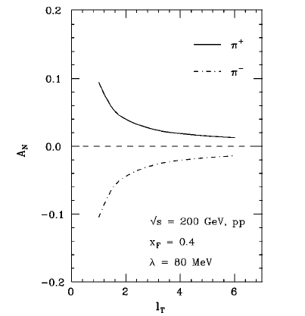
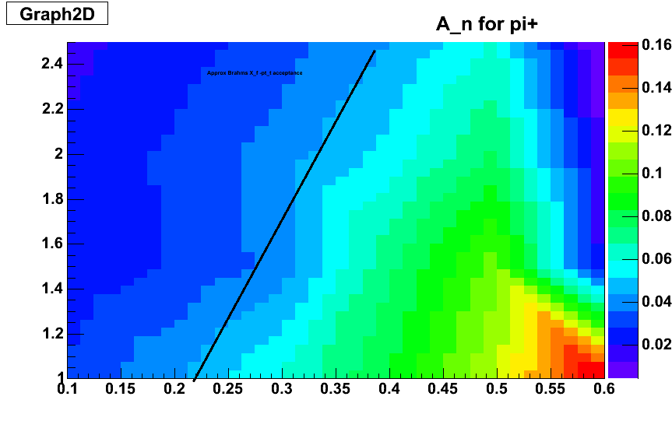
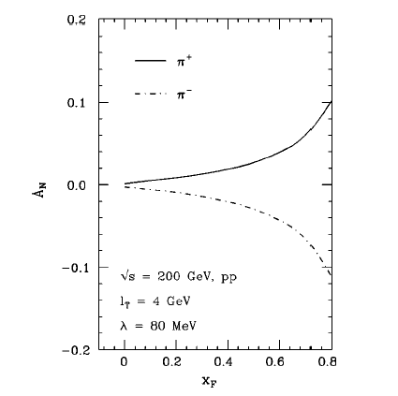
Twist 3 (initial state) calculations by J.Qiu and G.Sterman, Phys.ReV.D59,014004(98)
Extrapolated to lower p_{T}
2.3 deg

Slide 19
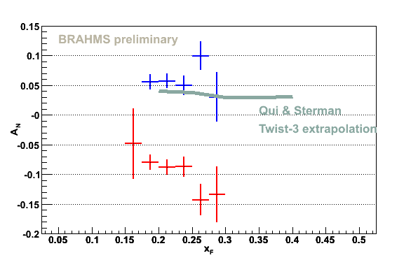
Comparison to data within acceptance.

Slide 20
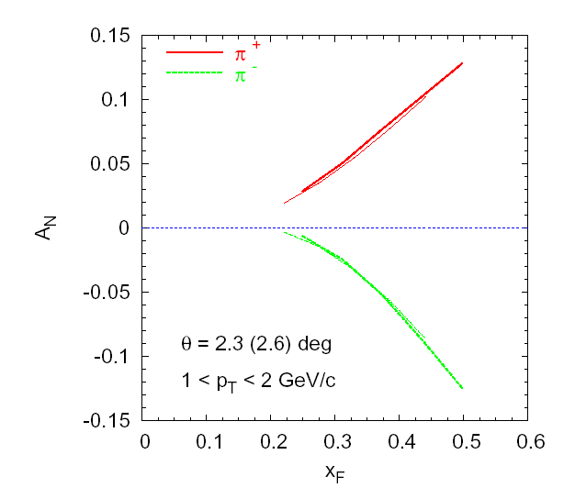
SSA calculations by U.Alesio & F.Murgia PRD70,074009(04); hep-ph/0412317 & private comm.
pQCD approach, including Sivers functions determined from the E704 data.
Asymmetry for pi+,pi-.
Data indicates the opposite trend.

Slide 21
Current RHIC Run
RHIC Run-5 is just underway.
  Increased luminosity
  Polarization ~45-55%
  New vertex detector with σ_{Z} ~ 2 cm.
  Additional bunch luminosity measures.

Slide 22
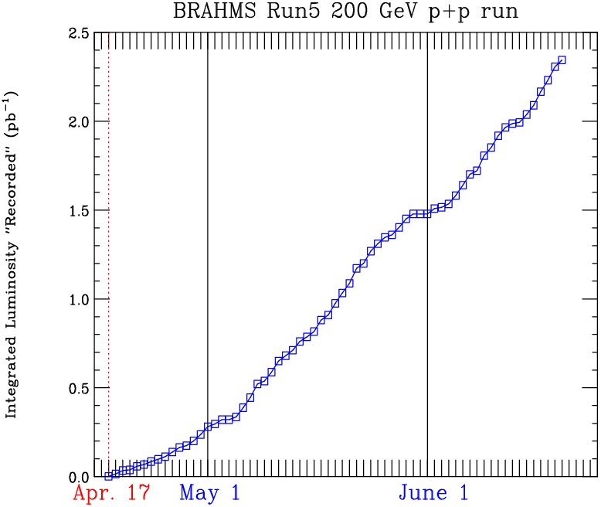
Calculated by min-bias trigger (“CC trigger”)
covering ~70% of pp inelastic cross-section
Goal Assumed:
-Recorded/Delivered ~0.5
-Blue Polarization = 45%
Goal
2.3 deg K+/K-
3/2.3 – high xF/Pt
Ref spectra revisited
2.3 deg pi+
2.3 deg pi-
2.3 deg
4 deg
Reference spectra
3/2.3

Slide 23
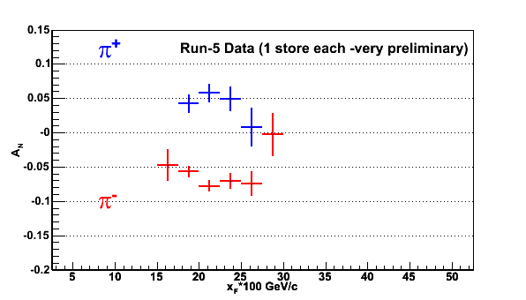
Preliminary Run-5 Data
Very preliminary data from Run-5 confirms the run-4 measurements.
Data from just 1(2) stores. Total statistics ~10-20 times this.

Slide 24
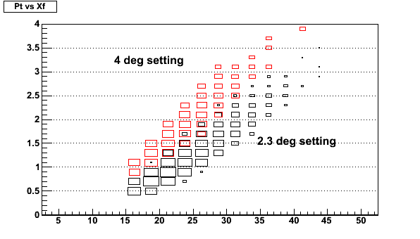
P_{T}-x_{F} acceptance
The measurements at 4 deg in addition to 2.3 deg will allow for some p_{t} coverage.

Slide 25
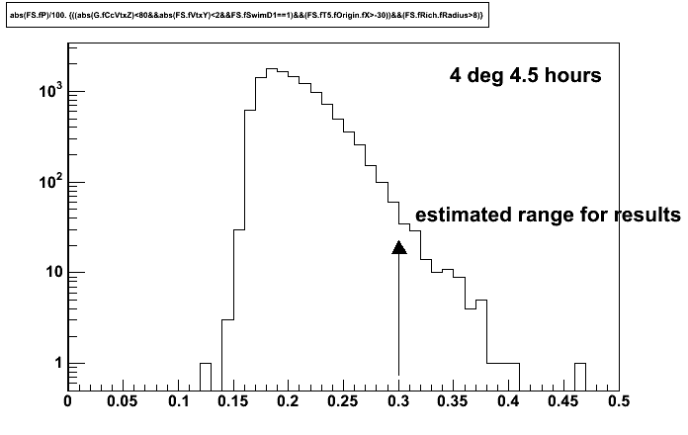
Expectations for 4 deg
Statistics obtained for one run

Slide 26
Conclusions
BRAHMS has obtained the first preliminary result for single spin asymmetries for π⁺ and π⁻ in 200 GeV pp collisions at RHIC in the x_{F} range of 0.17 to 0.32.
The A_{N} value for π⁺ and π⁻ are significantly different with opposite sign, and the π⁻ < 0 at ~ 3 sigma level and π⁺ >0 at ~ 1.5 sigma level
The sign of A_{n} is consistent with behavior from lower energy.
A_{n} at negative x_{F} for π⁺ and π⁻ are consistent with 0 (as also found by STAR for π⁰)
The protons are found to have A_{N} ~0

Slide 27
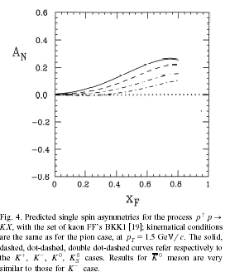
Summary
The ongoing Run-5 should enable BRAHMS to extend the measurements to x_{F} ~ 0.45 and to get some information on p_{Τ}-dependence at x_{F}~0.25
RICH operating mode was be changed to get K+/K- out to about 35 GeV/c (x_{F} ~ 0.4)

Slide 28
The BRAHMS Collaboration
- 12 institutions-
I.Arsene¹⁰,I.G. Bearden⁷, D. Beavis¹, S.Bekele, C. Besliu¹⁰,,
B. Budick⁶,H. Bøggild⁷ ,C. Chasman¹, C. H. Christensen⁷, P. Christiansen⁷,
J.Cibor⁴,R.Debbe¹, E.Enger,J. J. Gaardhøje⁷, M. Germinario⁷, K. Hagel⁸,
H. Ito¹, A. Jipa¹⁰, E.B.Johnson, J. I. Jordre¹⁰, F. Jundt^{2,} C.E.Jørgensen⁷, R.Karabowisz,
E. J. Kim⁵, T. Kozik³, T.M.Larsen¹², J. H. Lee¹, Y. K.Lee⁵,S.Lindahl, R.Lystad,
G. Løvhøjden², Z. Majka³, M. Murray⁸,
J. Natowitz⁸,B.S.Nielsen⁷, D. Ouerdane⁷, R.Planeta⁴, F. Rami²,
D. Roehrich⁹, C.Ristea, O.Ristea, B. H. Samset¹², S. J. Sanders¹¹, R.A.Sheetz^{1,}
P. Staszel⁷, T.S. Tveter¹², F.Videbæk¹, R. Wada⁸ ,H.Yang, Z. Yin^{9,} I. S. Zgura¹⁰
¹Brookhaven National Laboratory, USA, ²IReS and Université Louis Pasteur, Strasbourg, France
³Jagiellonian University, Cracow, Poland, ⁴Institute of Nuclear Physics, Cracow, Poland
⁷Niels Bohr Institute, Blegdamsvej 17, University of Copenhagen, Denmark
⁸Texas A&M University, College Station. USA, ⁹University of Bergen, Norway
¹⁰University of Bucharest, Romania, ¹¹University of Kansas, Lawrence,USA
¹² University of Oslo Norway

Slide 29
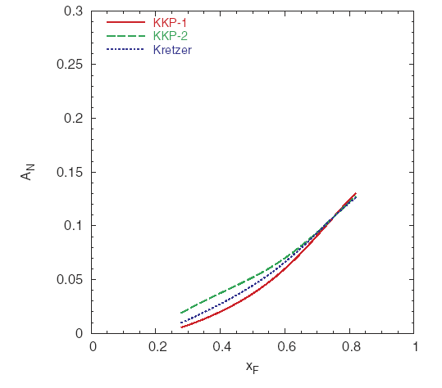
What is sensitivity to fragmentation.
From same paper:
SSA calculations by U.D’Alesio & F.Murgia PRD70,074009(04);
Small differences- possibly not distinguishable within our data stat and systematic.
For STAR kinematic acceptance.

Slide 30
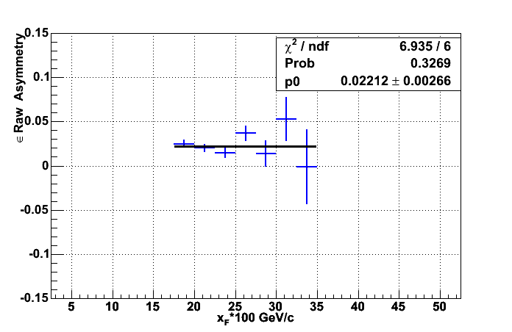
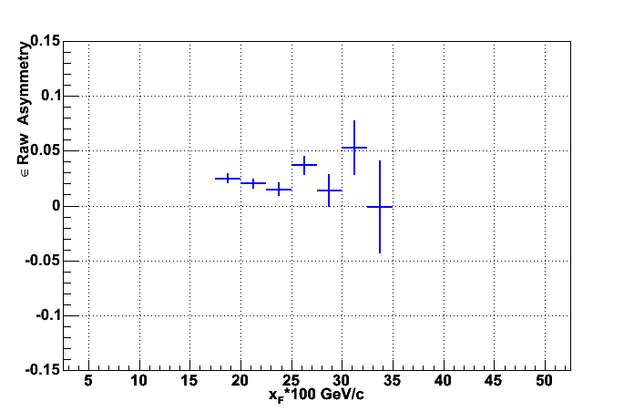
π+ ε vs. x_{F} * 100
BRAHMS preliminary
<ε>∼ +0.022 => Α_{N} = +0.05 +- 0.005 +- [0.015] in 0.17 < x_{F} < 0.32

Slide 31
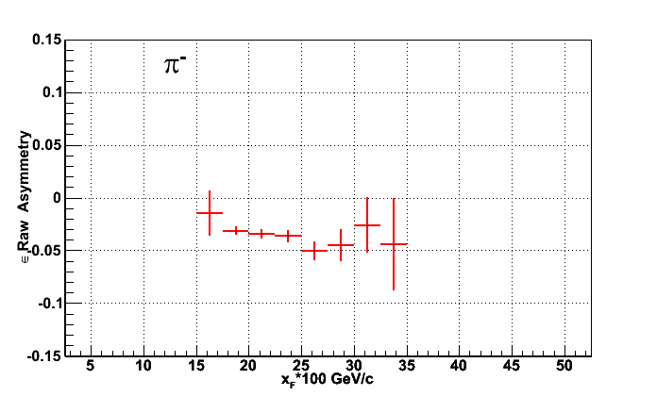
π⁻ ε vs. x_{F} * 100
BRAHMS preliminary
<ε>∼ −0.035 => Α_{N} = -0.08 +- 0.005 +- [0.02] in 0.17 < x_{F} < 0.32

