Slide 1
Introduction to DUC-2002: an Intrinsic Evaluation of Generic News Text Summarization Systems
Paul Over
Retrieval Group
Information Access Division
Walter Liggett
Measurement Process Evaluation Group
Statistical Engineering Division
National Institute of Standards and Technology

Slide 2
Document Understanding Conferences (DUC)…
Summarization has always been a TIDES component
An evaluation roadmap created in 2000 after spring TIDES PI meeting
Specifies a series of annual cycles, with
  progressively more demanding text data
  both direct (intrinsic) and indirect (extrinsic, task-based) evaluations
  increasing challenge in tasks
Year 1 (DUC-2001 at SIGIR in September 2001)
  Intrinsic evaluation of generic summaries,
    of newswire/paper stories
    for single and multiple documents;
    with fixed target lengths of 50, 100, 200, and 400 words
  60 sets of 10 documents used
    30 for training
    30 for test

Slide 3
… Document Understanding Conferences (DUC)
Year 2 – short cycle – (DUC-2002 at ACL ’02 in July 2002)
  Intrinsic evaluation of generic summaries,
    of newswire/paper stories
    for single and multiple documents
  Abstracts of single documents and document sets
    fixed lengths of 10, 50, 100, and 200 words
    manual evaluation using SEE software at NIST
  Extracts of document sets
    fixed target lengths of 200 and 400 words
    automatic evaluation at NIST and by participants
  60 sets of ~10 documents each
    All for test
    No new training data
    Two abstracts/extracts per document (set)

Slide 4
DUC-2002 schedule
26 Nov Call for participation
28 Feb Guidelines complete
29 Mar Test documents distributed
12 Apr Extended abstracts due for speakers
15 Apr Results submitted for evaluation
7 Jun Evaluated results returned to participants
23 Jun Notebook papers due
11-12 Jul Workshop at ACL’02 in Philadelphia

Slide 5
Goals of the talk
Provide an overview of the:
  Data
  Tasks
  Evaluation
    Experience with implementing the evaluation procedure
    Feedback from NIST assessors
Introduce the results:
  Basics of system performance on 12 + 1 + 1 measures
  Sanity checking the results and measures
  Exploration of various factors on performance
    Systems
    Document sets, Assessors, Target lengths, Document set types
    Multi- vs Single document

Slide 6
Data: Formation of test document sets
Each of 10 NIST information analysts chose one set of newswire/paper articles of each of the following types:
  A single natural disaster event with documents created within at most a 7-day window
  A single event of any type with documents created within at most a 7-day window
  Multiple distinct events of the same type (no time limit)
  Biographical (discuss a single person)
Each assessor chose 2 more sets of articles so that we ended up with a total of 15 document sets of each type.
Each set contains about 10 documents
All documents in a set to be mainly about a specific “concept”

Slide 7
Example document set subjects
Hurricane Gilbert (1)
Outcome of longest criminal trial in US history (2)
Grievances & strikes of miners around the world (3)
Andrei Sakharov (4)
The eruption of Mt. Pinatubo in the Philippines (1)
The Clarence Thomas confirmation hearings (2)
Heart attacks (3)
Margaret Thatcher (4)

Slide 8
Manual abstract creation
Single-document
abstracts
A
B
Documents in a document set
C
A: Read hardcopy of documents.
B: Create a 100-word softcopy abstract for each
document using the document author’s perspective.
C: Create a 200-word softcopy multi-document abstract of all 10 documents together written as a report for
a contemporary adult newspaper reader.
D,E,F: Cut, paste, and reformulate to reduce the size
of the abstract by half.
Multi-document
abstracts
200
D
100
E
50
F
10
Notes:
There were 9 groups who contributed to the design and actually ran the experiments.
I also want to thank friends of the track who did not run experiments for their contributions to the design discussions.
This talk is laid out as follows >>>

Slide 9
Manual extract creation
A
Documents in a document set
B
A: Automatically tag sentences
B: Create a 400-word softcopy multi-document extract of all 10 documents together
C: Cut and paste to produce a 200-word extract
Multi-document
extracts
400
C
200
Notes:
There were 9 groups who contributed to the design and actually ran the experiments.
I also want to thank friends of the track who did not run experiments for their contributions to the design discussions.
This talk is laid out as follows >>>

Slide 10
Duplicate and withdrawn abstracts/extracts
NIST created two sets of abstracts and extracts for each of the 60 document sets
NIST withdrew – due to differences in documents used by systems and NIST summarizers – the following:
  D076: one set of abstracts and extracts
  D088: both sets of abstracts and extracts
  D098: one set of abstracts and extracts

Slide 11
Automatic baseline abstracts
NIST (Nega Alemayehu) created 3 baselines automatically based roughly on algorithms suggested by Daniel Marcu from earlier work
No truncation of sentences, so some baseline abstracts went over the limit (+ <=15 words) and some were shorter than required
Algorithms:
  Single-document summaries:
    take the first 100 words in the document
  Multi-document summaries:
    take the first 50, 100, or 200 words in the most recent document.
  Multi-document summaries:
    take the first sentence in the 1st, 2nd, 3rd,… document in chronological sequence until you have the target summary size.

Slide 12
Submitted summaries by system code
Abstracts Extracts
---------------------- --------
Single --- Multi ----
100 10 50 100 200 200 400 System ID Code Group
--- -- -- --- --- --- --- ------------ -- -----------------------
567 0 0 0 0 0 0 uottawa 15 Univ. of Ottawa
567 59 59 59 59 59 59 MICHIGAN 16 Univ. of Michigan
565 0 0 0 0 0 0 SumUMFAR 17 Univ. of Montreal
567 0 0 0 0 0 0 imp_col 18 Imperial College
566 59 59 59 59 59 59 lcc.duc02 19 LCC
0 59 59 59 59 59 59 tno-duc02 20 TNO
567 0 0 0 0 59 59 wpdv-xtr.v1 21 Catholic Univ. Nijmegen
0 0 0 0 0 59 59 unicorp.v36 22 Pennsylvania State Univ.
559 0 0 0 0 0 0 MSRC 23 Microsoft
0 0 59 59 59 59 59 lion_sum 24 Columbia Univ.
566 59 59 59 59 59 59 gleans.v1 25 ISI/Gleans
0 59 59 59 59 0 0 webcl2002 26 ISI/Webclopedia
567 0 0 0 0 0 0 ntt.duc02 27 NTT
567 0 59 59 59 59 59 ccsnsa.v2 28 CCS-NSA
567 59 59 59 59 59 59 kul.2002 29 Catholic Univ. Leuven
567 0 0 0 0 0 0 bbn.headln 30 BBN
567 0 0 0 0 59 59 ULeth131m 31 Univ. of Lethbridge
---- --- --- --- --- --- ---
7359 354 472 472 472 590 590
---------------------- --------
9129 1180

Slide 13
Evaluation basics
Intrinsic evaluation by humans using special version of SEE (thanks to Chin-Yew Lin, ISI)
Compare:
  a model summary - authored by a human
  a peer summary - system-created, baseline, or additional manual
Produce judgments of:
  Peer quality (12 questions)
  Coverage of each model unit by the peer (recall)
  Relevance of peer-only material

Slide 14
Models
Source:
  Authored by a human
  Phase 1: assessor is model author, but not the document selector
  Phase 2: assessor is neither document selector nor model author
Formatting:
  Divided into model units (MUs)
    (MUs == EDUs - thanks to Alexander Fraser at ISI)
  Lightly edited by authors to integrate uninterpretable fragments
    George Bush’s selection of Dan Quale
    as his running mate surprised many
    many political observers thought him a lightweight with baggage
    to carry
  Flowed together with HTML tags for SEE

Slide 15
Peers
Formatting:
  Divided into peer units (PUs) –
    simple automatically determined sentences
    tuned slightly to documents and submissions
      Abbreviations list
    Flowed together with HTML tags for SEE
3 Sources:
  Automatically generated by research systems
    For single-document summaries: 5 “randomly” selected from those abstracted by all systems
  Automatically generated by baseline algorithms
  Authored by a human other than the assessor

Slide 16
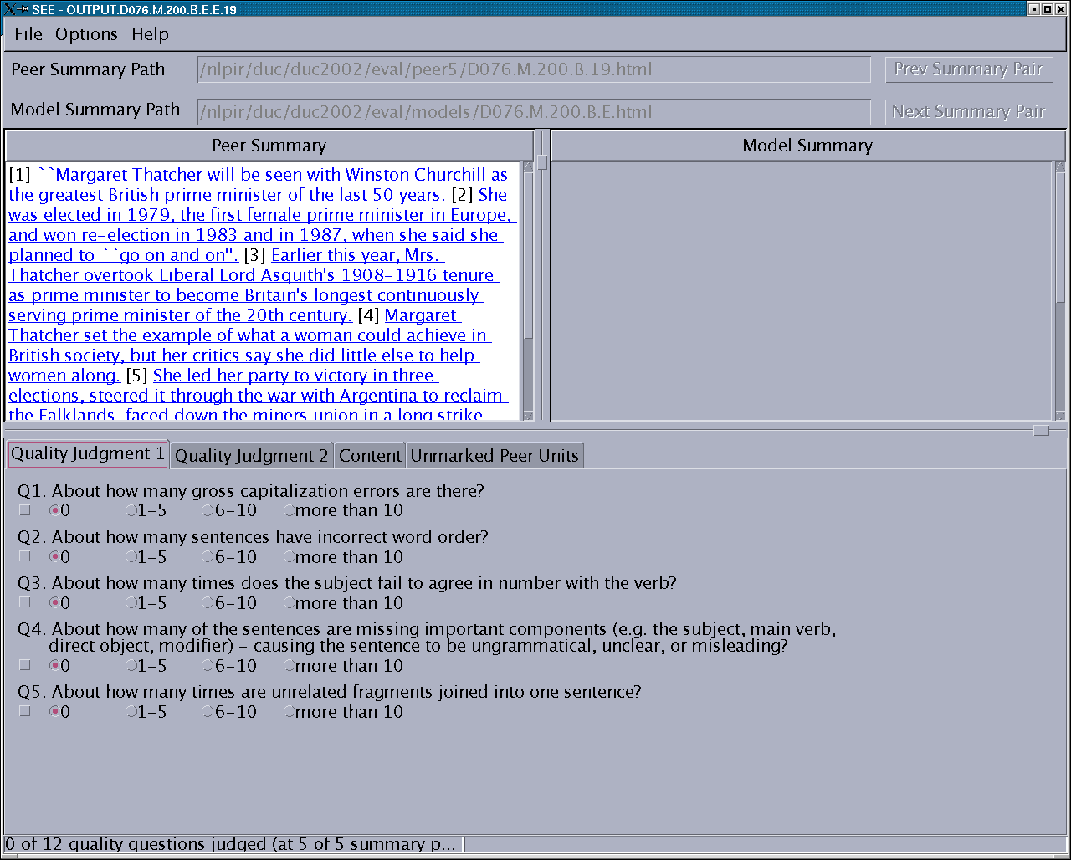
SEE: overall peer quality

Slide 17
Overall peer quality
12 Questions developed with participants
Answer categories: 0 1-5 6-10 >10
About how many gross capitalization errors are there?
About how many sentences have incorrect word order?
About how many times does the subject fail to agree in number with the verb?
About how many of the sentences are missing important components (e.g. the subject, main verb, direct object, modifier) – causing the sentence to be ungrammatical, unclear, or misleading?
About many times are unrelated fragments joined into one sentence?

Slide 18
Overall peer quality
About how many times are articles (a, an, the) missing or used incorrectly?
About how many pronouns are there whose antecedents are incorrect, unclear, missing, or come only later?
For about how many nouns is it impossible to determine clearly who or what they refer to?
About how times should a noun or noun phrase have been replaced with a pronoun?
About how many dangling conjunctions are there ("and", "however"...)?
About many instances of unnecessarily repeated information are there?
About how many sentences strike you as being in the wrong place because they indicate a strange time sequence, suggest a wrong cause-effect relationship, or just don't fit in topically with neighboring sentences?

Slide 19
Overall peer quality
Systems ≠ Baselines ≠ Manual
Mean number of quality questions indicating one or more errors
 | n | Mean | ~95% Conf Int | Max
Multi-doc:
Systems | 1770 | 1.821 | 1.741 – 1.901 | 9
Baselines | 354 | 1.234 | 1.094 – 1.374 | 7
Manuals | 228 | 0.539 | 0.419 – 0.659 | 5
Single-doc:
Systems | 3827 | 1.276 | 1.236 – 1.316 | 10
Baseline | 294 | 0.718 | 0.598 – 0.838 | 8
Manuals | 285 | 0.505 | 0.405 – 0.605 | 5

Slide 20
Overall peer quality
Uneven distribution of scores by question
 | None | 1-5 | 6-10 | > 10
Q1 | 4847 | 904 | 236 | 360
Q2 | 5955 | 391 | 1
Q3 | 6188 | 159
Q4 | 4932 | 1408 | 6 | 1
Q5 | 5665 | 669 | 8 | 5
Q6 | 6084 | 260 | 3
Q7 | 5796 | 545 | 6
Q8 | 5092 | 1245 | 7 | 3
Q9 | 6219 | 128
Q10 | 6164 | 183
Q11 | 5778 | 557 | 11 | 1
Q12 | 4423 | 1857 | 66 | 1
⬅ Capitalization
⬅ Main component missing
⬅ Unrelated fragments joined
⬅ Noun referent unclear
⬅ Unnecessary repetition
⬅ Misplaced sentences

Slide 21
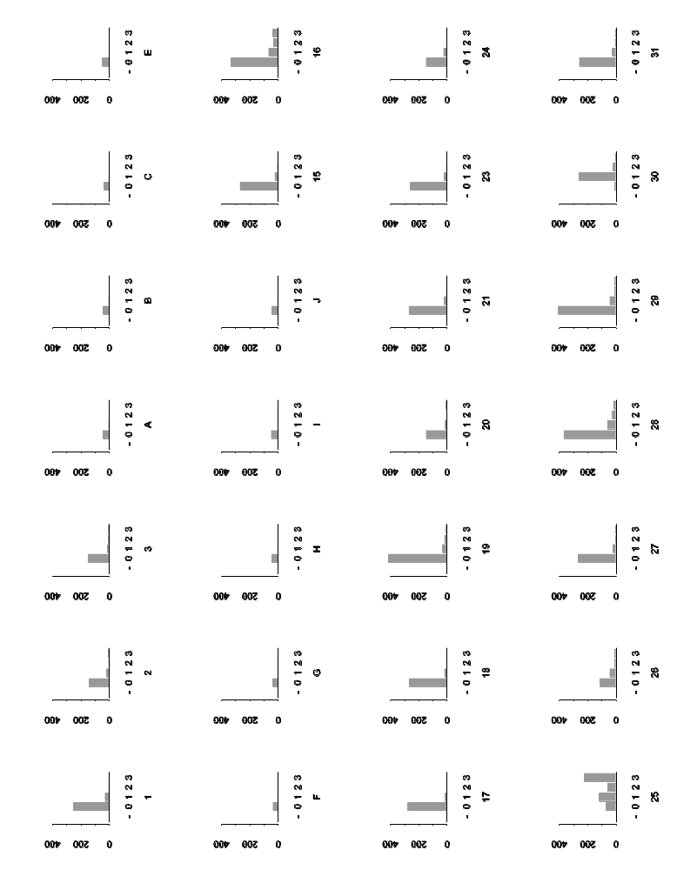
Overall peer quality
Q1: Capitalization by peer source
25

Slide 22
System 25 (GLEANS) added headlines
[1] RIFLES IN LODI, SACRAMENTO, AND OHIO [2] A series of rifles happened in Lodi, Sacramento, Ohio, and other places between Jan. 17, 1989 and Jan. 21, 1989. [3] "Several dozen shots were heard from an automatic rifle," said Monk.

Slide 23
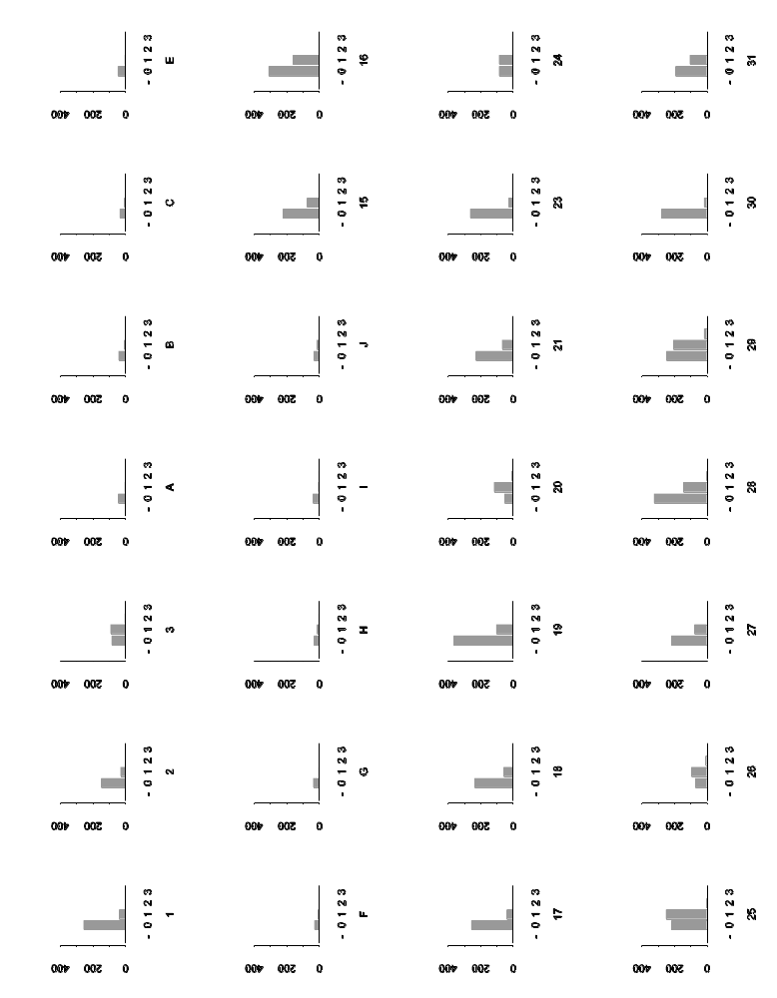
Overall peer quality
Q12: Misplaced sentences
3
25
26
29

Slide 24
Overall peer quality
Assessor feedback
Not sure how to count capitalization errors in “all caps” headline
Some accepted extra material (place, news service, …); others called it a fragment.
British versus American English, e.g., “in hospital”
Sometimes domain knowledge (e.g., place names) made a difference in judging coverage
Sometimes fragments were related but joined awkwardly – no question to catch this
Tended to step through text and then look for relevant question rather than step through questions and look for relevant text
Peer unit boundaries were distracting

Slide 25
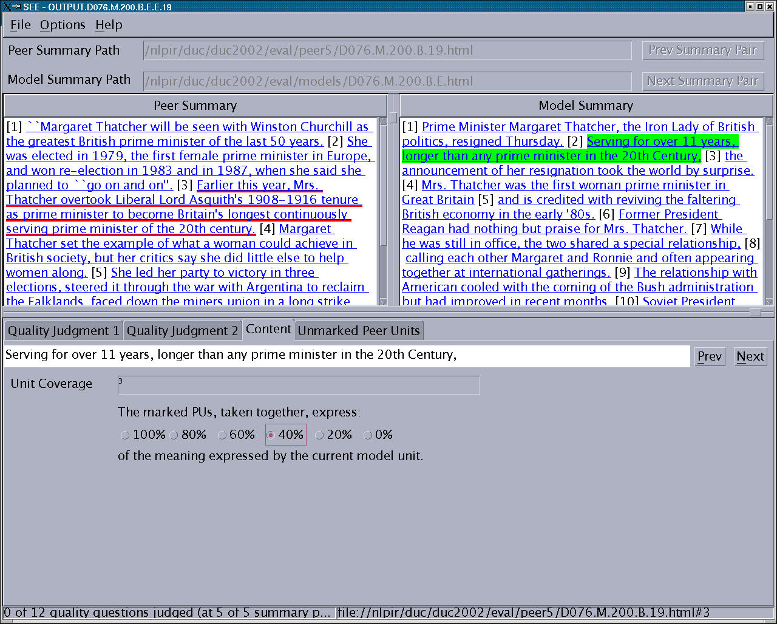
SEE: per-unit content

Slide 26
Per-unit content: evaluation details
“First, find all the peer units which tell you at least some of what the current model unit tells you, i.e., peer units which express at least some of the same facts as the current model unit. When you find such a PU, click on it to mark it.
“When you have marked all such PUs for the current MU, then think about the whole set of marked PUs and answer the question:”
“The marked PUs, taken together, express about
[ 0% 20% 40% 60% 80% 100% ]
of the meaning expressed by the current model unit”
Lots of judgments:
  6 742 abstracts judged
  63 320 MUs
  276 697 MU-PU comparisons

Slide 27
Per-unit content: assessor feedback
Missed “50%” choice among the possible answers
Some confusion about criteria for marking peer units:
  Share expression of some assertions?
  Share references to same people, places, things,..?
Some model units not large enough to express an assertion and so could not overlap with any peer unit.

Slide 28
Per-unit content: measures
Recall
  What fraction of the model content is also expressed by peer?
  Mean coverage –
    average of the per-MU completeness judgments [0, 20, 40, 60, 80,100]% for a peer summary
  Mean length-adjusted coverage –
    average of the per-MU length-adjusted coverage judgments for a peer
    length-adjusted coverage = 2/3 * coverage + 1/3 * brevity where brevity =
      0 if actual summary length >= target length; else
      (target size – actual size) / target size

Slide 29
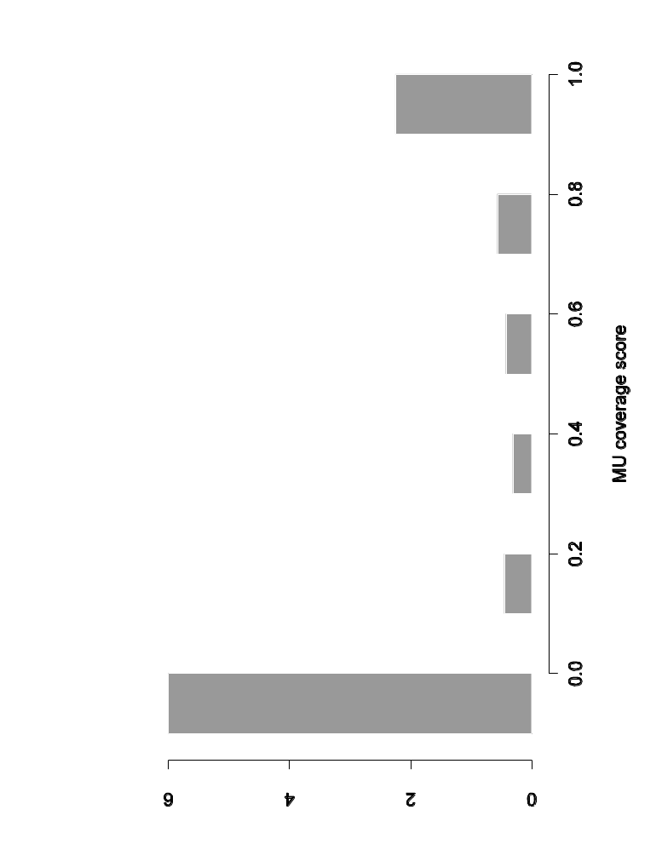
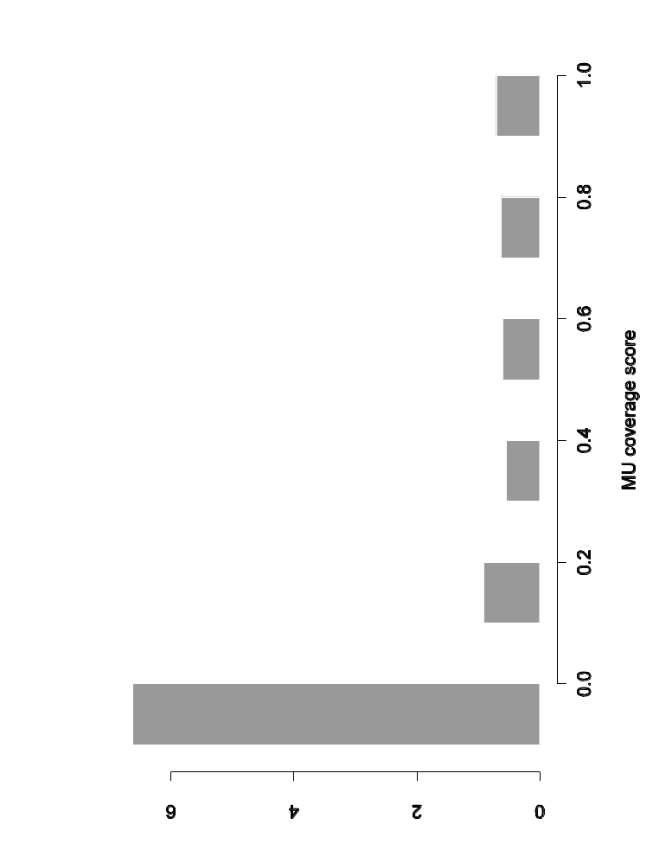
Per-unit content: Distribution of individual MU coverage scores
Single-document abstracts
Multi-document abstracts
Most MUs (62%) have 0% coverage (~42% for manually created peers)
63% of MUs had no coverage in DUC-2001
Appears to be due to real differences in content

Slide 30
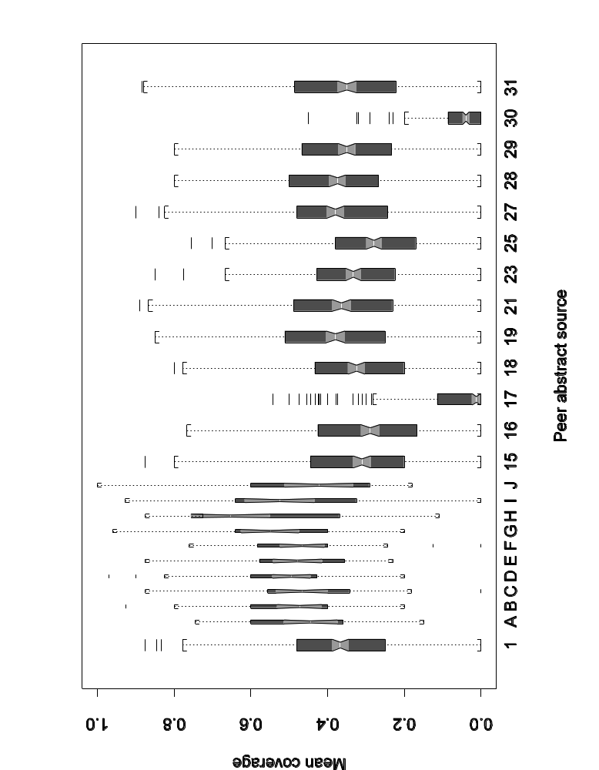
Mean coverage by peer source
Single-document abstracts

Slide 31
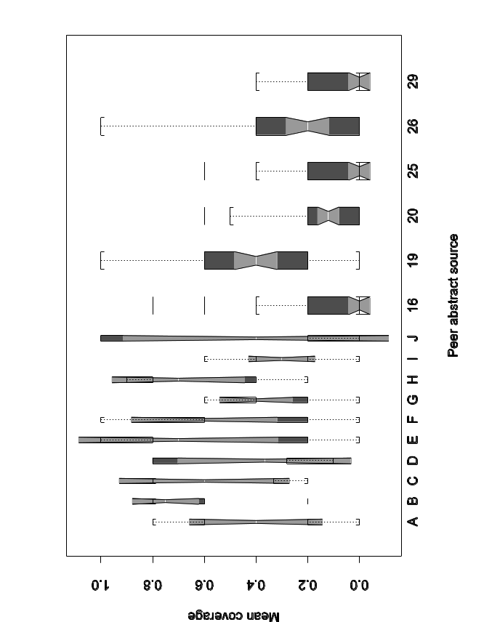
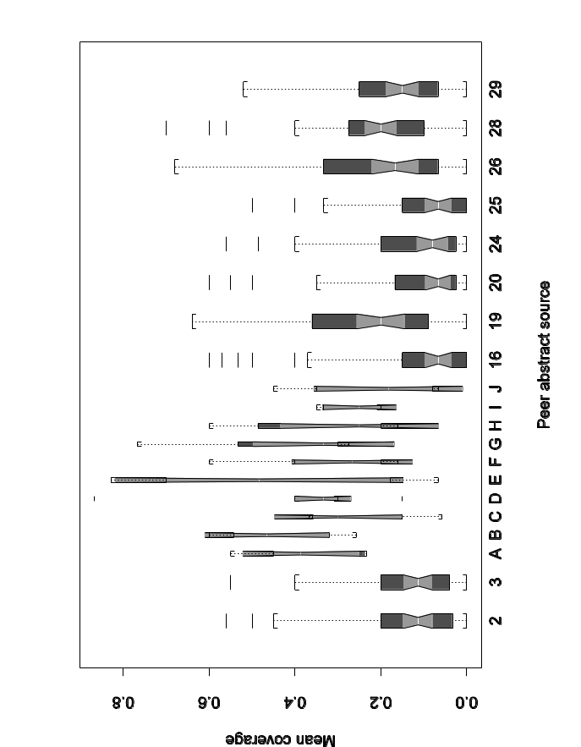
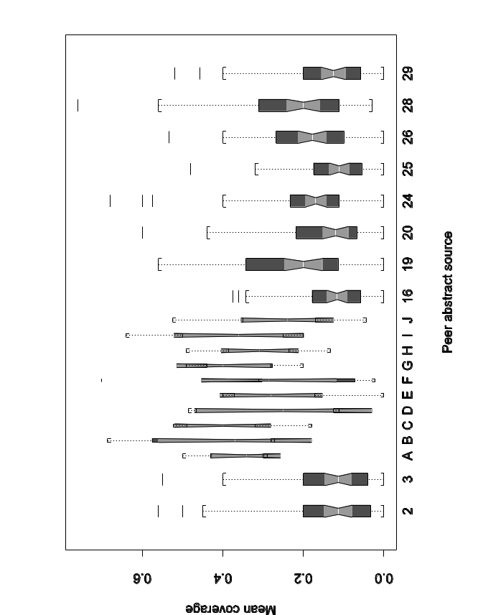
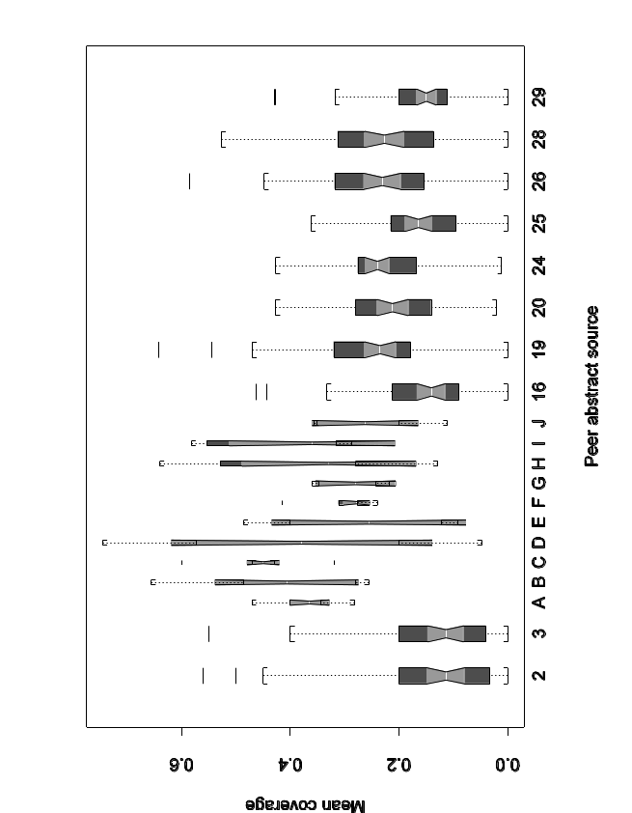
Mean coverage by peer source
Multi-document abstracts by size
10 50
100 200

Slide 32
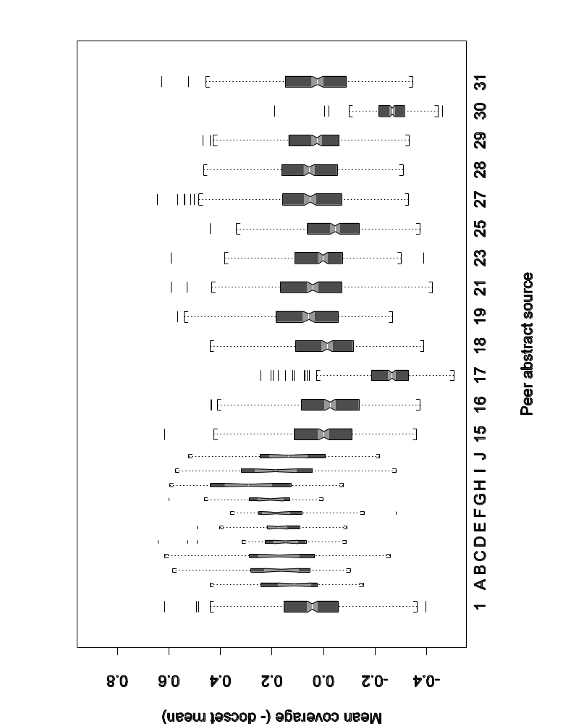
Comparing systems
(mean coverage - docset mean for all peers)
Single-document abstracts
Systems slightly below humans, but about the same or just under the baseline.
Two exceptionally low systems…

Slide 33
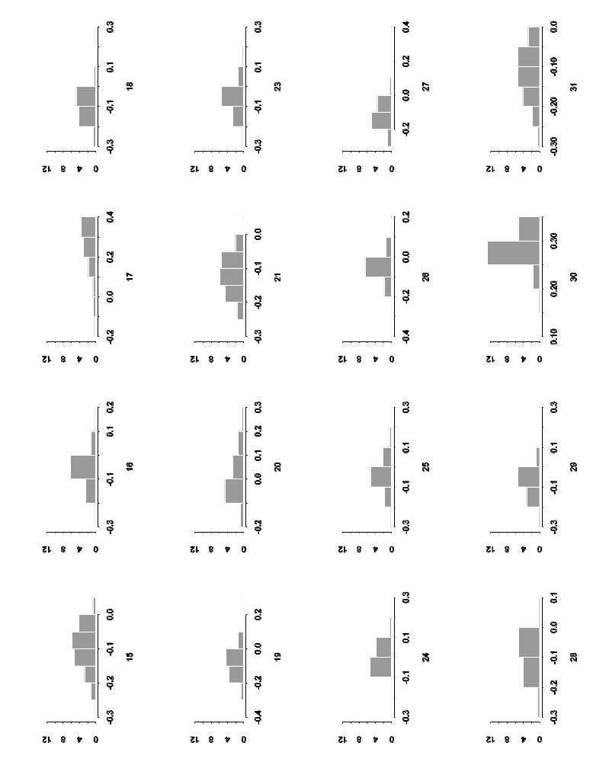
What systems benefited from length-adjustment?
Distribution of (adjusted coverage – coverage)
17: SumUMFAR
30: bbn.headline

Slide 34
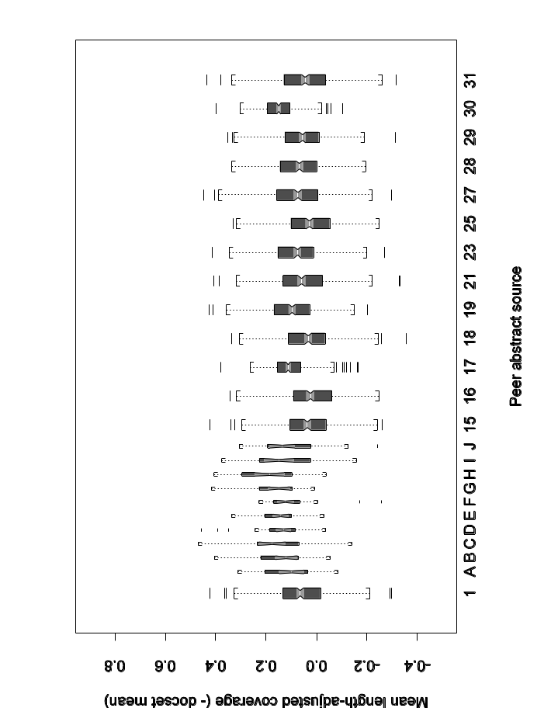
Effect of length-adjustment by system
Single-document abstracts
Using the a length adjustment seems to work: rewards shorter summaries with respect to longer
Appropriate amount of boost is application-dependent
Length-adjusted
Not length-adjusted

Slide 35
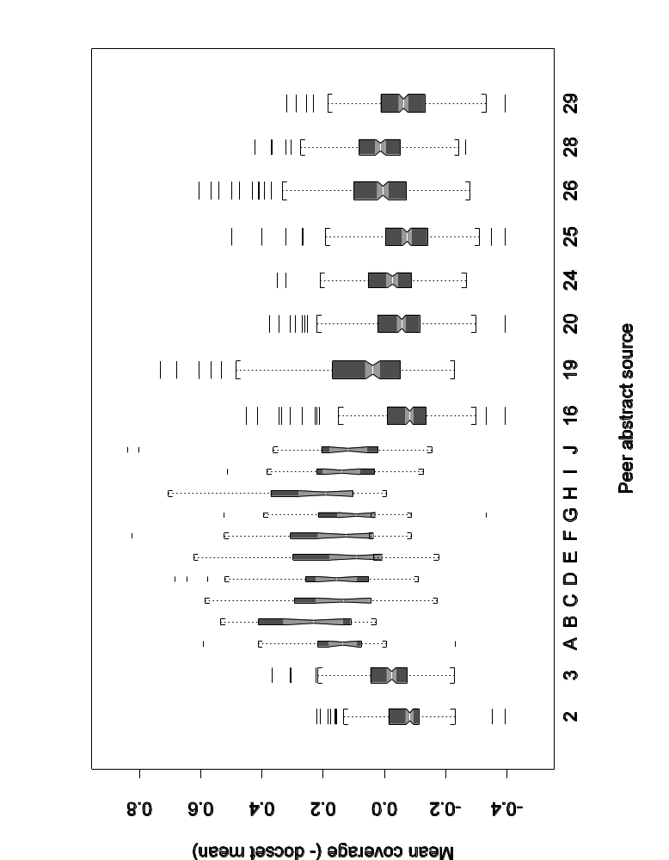
Comparing systems (mean coverage - docset mean) Multi-documents, all sizes
Baseline 3 better than 2
Systems still worse than manual but not by much
Systems mostly the same as baselines

Slide 36
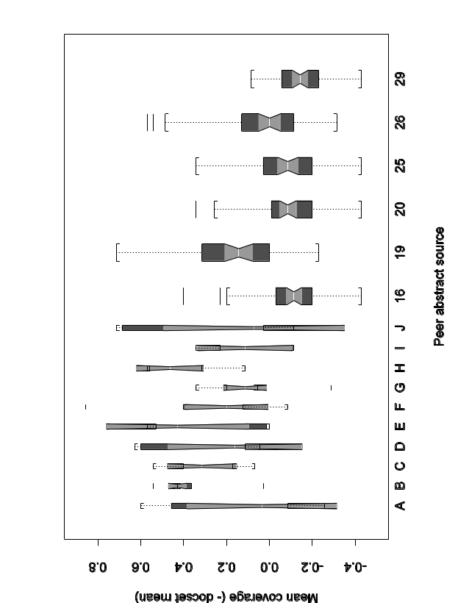
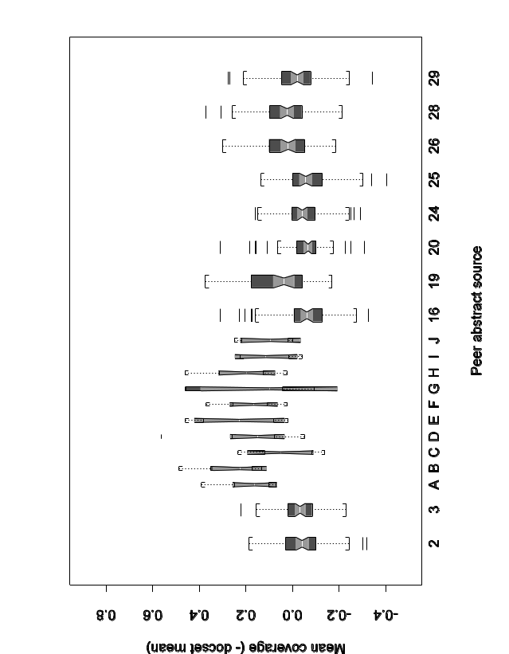
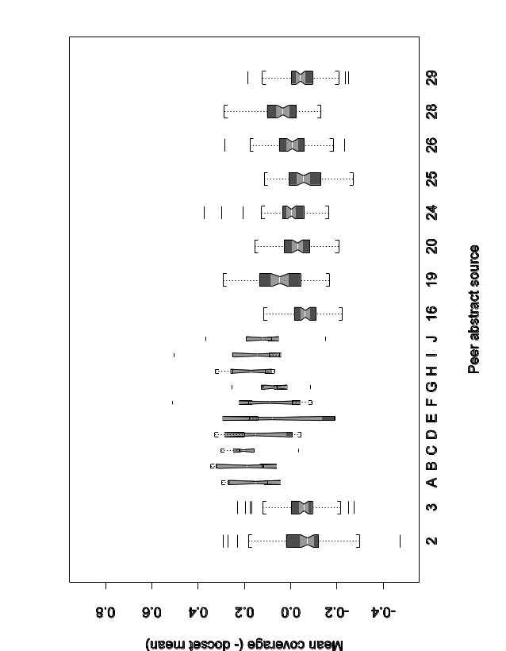
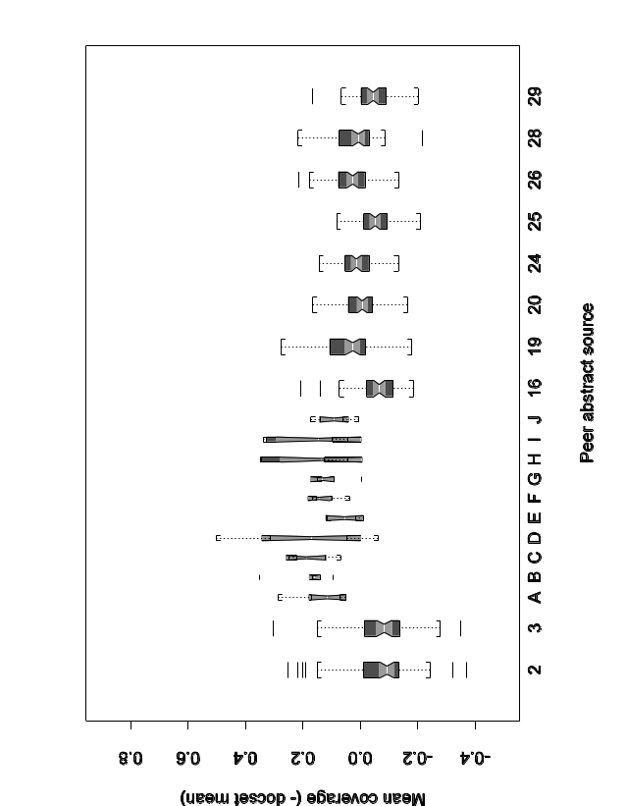
Comparing systems (mean coverage - docset mean) Multi-document abstracts by size
10 50
Gradual increase in most scores with abstract size
Relations among systems relatively stable
100 200

Slide 37
Factors affecting coverage
Analysis of Variance (ANOVA)
Try ANOVA using simple model equation to see which factors matter: Mean coverage =
  Grand mean +
  System effect +
  Document set (assessor) effect +
  Noise
Useful if
  Other main effects are small
  Interactions are small
  ANOVA assumptions mostly met
Note: for system rankings,
  Main effects of document set, assessor, etc are balanced
  Only interactions can cause problems

Slide 38
ANOVA results for multi-doc summaries by length
(Manual summaries combined)
200-word
Df Sum of Sq Mean Sq F Value Pr(F)
system 10 2.262390 0.2262390 37.67023 0
doc.set 56 3.300333 0.0589345 9.81297 0
Residuals 560 3.363235 0.0060058
System and docset/assessor are significant
100-word
Df Sum of Sq Mean Sq F Value Pr(F)
system 10 2.275274 0.2275274 21.53187 0
doc.set 56 4.010818 0.0716217 6.77786 0
Residuals 560 5.917524 0.0105670
50-word
Df Sum of Sq Mean Sq F Value Pr(F)
system 10 2.960068 0.2960068 19.73176 0
doc.set 56 5.827342 0.1040597 6.93660 0
Residuals 560 8.400861 0.0150015
Account for most of the variability.
10-word
Df Sum of Sq Mean Sq F Value Pr(F)
system 6 8.12534 1.354223 32.92919 0.0000
doc.set 56 3.96627 0.070826 1.72220 0.0019
Residuals 336 13.81811 0.041125

Slide 39
Other main factors and interactions…
Main effect of document set type, document selector, summary author, etc. are not distinguishable from the noise
Interactions are expected, but the experimental design lacks replicates – the main basis for directly estimated interactions
Multi-judgment (Phase 2) data provide basis for assessing interactions
  Designed to gauge effect of different assessors
  Restricted to 6 document sets
  3 assessors,
    none of which selected the documents or summarized them
    used the same models to evaluate the same peers

Slide 40
Multiple judgment (Phase 2) study…
Interactions are present as expected, but not large
coverage = grand mean + assessor + system + doc.set +
assessor:system + assessor:doc.set + system:doc.set
Df Sum of Sq Mean Sq F Value Pr(F)
assessor 7 0.4790834 0.06844049 38.91456 0.00000000
system 10 0.7434290 0.07434290 42.27061 0.00000000
doc.set 5 0.1695724 0.03391449 19.28343 0.00000001
assessor:system 70 0.3729502 0.00532786 3.02937 0.00061792
assessor:doc.set 3 0.0183594 0.00611979 3.47965 0.02797229
system:doc.set 50 0.3669116 0.00733823 4.17244 0.00003924
Residuals 30 0.0527621 0.00175874

Slide 41
…Multiple judgment (Phase 2) study
Table of interaction sizes for system:docset can provide starting points for study:
E.g., System 19 seems to have largish interactions with D081, 94, and 99.
Why?
D070 D071 D081 D094 D099 D102
16 0.0375 -0.1255 0.0005 0.0366 0.0476 0.0193
19 0.0845 0.0589 -0.1333 -0.1200 0.1243 -0.0173
2 -0.0174 -0.1077 -0.0579 0.0524 0.0253 0.0944
20 -0.0491 0.0646 0.0521 0.0233 -0.0718 -0.0256
24 0.0390 0.0004 0.0222 0.0418 -0.0757 -0.0455
25 -0.0694 0.0916 0.0313 -0.0180 -0.0781 0.0270
26 -0.0026 0.0007 -0.0066 -0.0119 0.0785 -0.0342
28 -0.0496 0.0677 0.0501 -0.0042 -0.0248 -0.0308
29 -0.0051 -0.0084 -0.0502 0.0440 0.0059 -0.0010
3 0.0378 -0.0368 0.1287 -0.0277 -0.0857 -0.0020
MANUAL -0.0055 -0.0055 -0.0368 -0.0164 0.0543 0.0157

Slide 42
System differences using multiple comparisons.. (Tukey’s)
Use multiple comparisons test to answers questions about real versus chance differences in baseline, system, and manual abstracts in terms of mean coverage
For 200-word multi-doc abstracts: 3 main groups with some members of second group on the borderline with first
As target size decreases,
  noise increases
  results blur
  harder to tell if things are really different
2 16 25 29
20 24 3 28 26 19
Manual

Slide 43
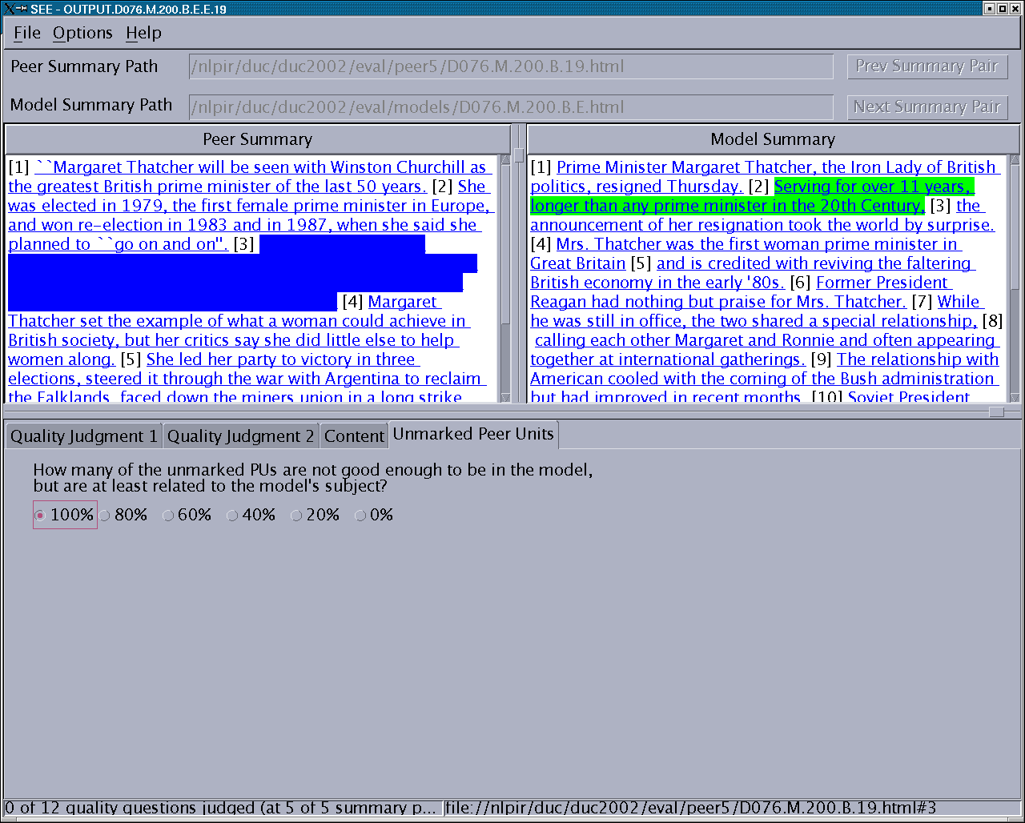
SEE: unmarked peer units

Slide 44
Unmarked peer units: evaluation details
How many of the unmarked peer units are not good enough to be in the model, but at least relevant to the model’s subject?
  0% 20% 40% 60% 80% 100% ?
If the number of unmarked PUs is
  2, choose 0, or 100%
  3, choose 0, 60, or 100%
  4, choose 0, 20, 60, 80, or 100%
If half the unmarked PUs are relevant
  Choose 60%
Assessor feedback
  Served to sanity check coverage
  Some uncertainty about criteria for relatedness

Slide 45
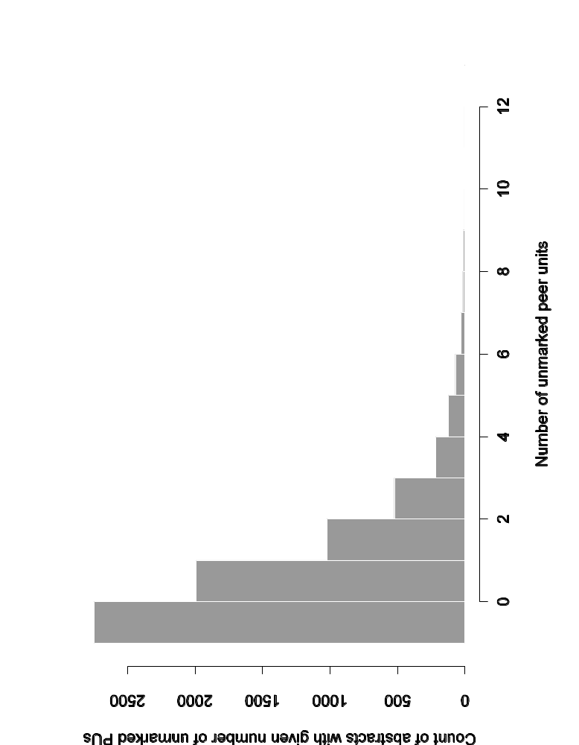
How many unmarked peer units?

Slide 46
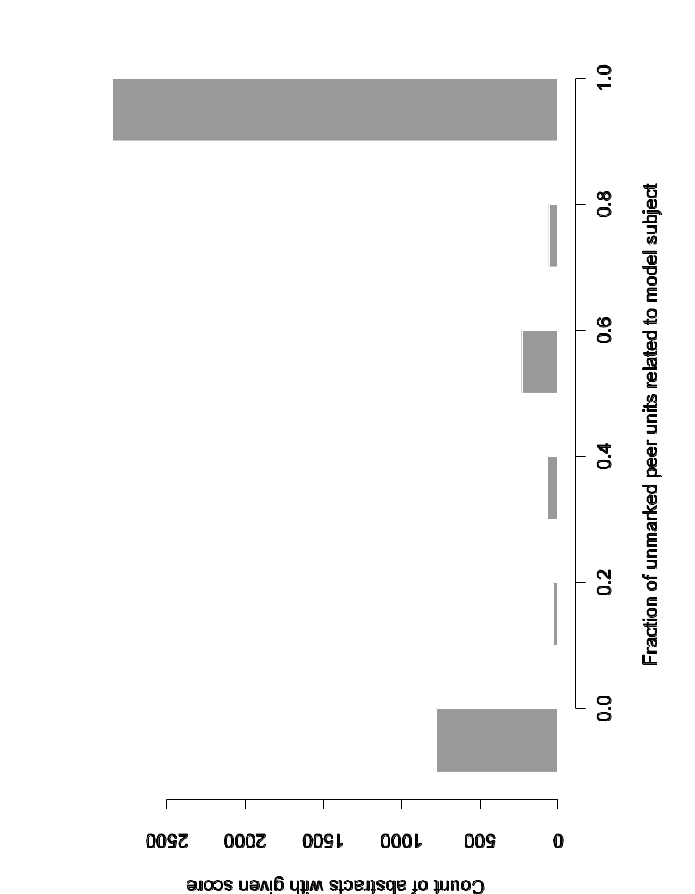
How many unmarked peer units related to model subject?

Slide 47
Summing up …
Overall peer quality:
  Appears assessors could handle the 12 peer quality questions
  Results pass several sanity checks
  Systems, baselines, and manual are distinguishable
  But unintended “error” conditions were rare
Per-unit content (coverage):
  Surprising stability in system rankings across target sizes
  Some systems stand out – why?
  Room for improvement despite disagreement among humans
  Too many systems are no better than baselines
  Large number of MUs with no coverage needs further analysis
Unmarked peers:
  Cases of unmarked PUs being UNRELATED are rare
  Should be examined

Slide 48
Incremental improvements…?
Overall peer quality
  Did any of the quality questions provide useful feedback?
  If so, which ones?
  Should others be substituted?
Per-unit content (coverage)
  Number of target lengths could be reduced
  Still problems with EDU – sentence matching
    Replace sentence separator with state-of-the-art
    Better control EDU post-editing
  All model units are not equal?
    Investigate ways of categorizing/ranking MUs
    Considering comparing MUs across target lengths to get simple 4-level ranking
Unmarked peer units
  Doesn’t appear to be very informative

