Slide 1
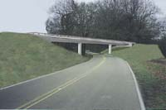
Evolution of the
Feasible and Prudent Standard
Diane Mobley
Attorney-Advisor, FHWA

Slide 2
Section 4(f)
“The Secretary shall not approve any program or project which requires the use of any publicly owned land from a public park, recreation area, or wildlife or waterfowl refuge…..unless (1) there is no feasible and prudent alternative to the use of such land and (2) such program includes all possible planning to minimize harm to such park, recreation area, wildlife or waterfowl refuge, or historic site resulting from such use.”

Slide 3
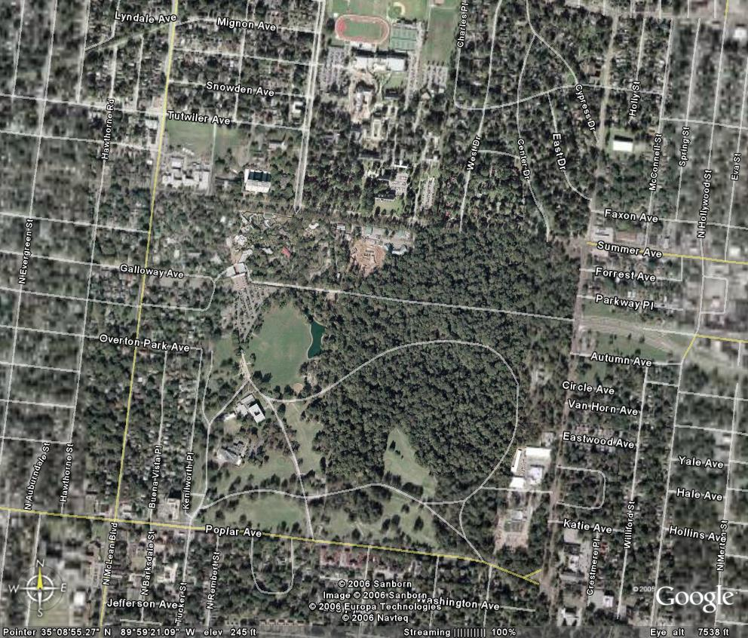

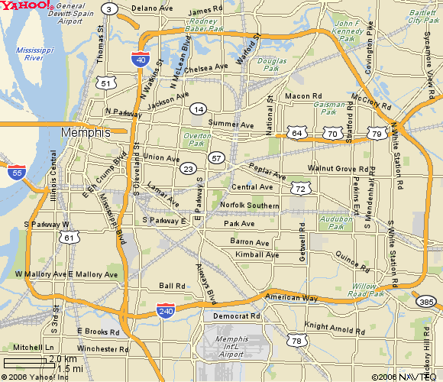
Overton Park v. Volpe (1971)
Congress intended “the few green havens that are public parks were not to be lost unless there were truly unusual factors present in a particular case or the cost or community disruption resulting from alternative routes reached extraordinary magnitudes.”
“The Secretary cannot approve the destruction of parkland unless he finds that alternative routes present unique problems.”
The facts are important because they are distinguishable from most present-day proposals.

Slide 4
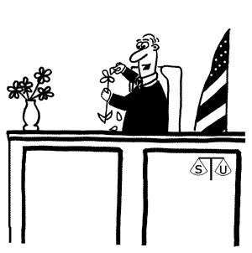
“prudent. . . not prudent. . . prudent. . . not prudent. . .”

Slide 5
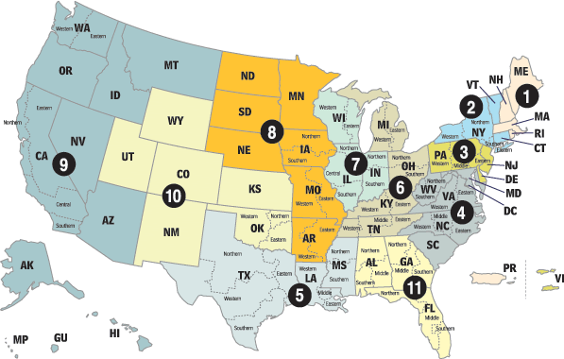
The Circuits have different interpretations of Overton Park

Slide 6
Three General Approaches:
● 5th, 9th & 11th - A black box
● 1st, 3rd, 6th, 8th & D.C. - A flexible black box
● 4th, 7th & 10th – Balance the harms, perhaps with a thumb on the 4(f) side of the scale.
2nd – Has also used a balancing test, although parameters were not described.

Slide 7
The “Black Box” approach
Louisiana Environmental Society v. Coleman Proposed bridge across 9,000 acre recreational lake would use 18 acres of air space and less than 1 acre of lake bottom, causing relocation of a boat racing course and impairing the view for lakeside hikers and picnickers. FHWA determined that an avoidance alternative was not prudent. The avoidance alternative would displace 1,500 people, 21 businesses and 2 churches, and caused a 10 year delay.
Stop H-3 Association v. Brinegar Proposed highway ran along the border of a park designed with a buffer zone next to the planned highway’s location, passing 100 feet from the closest campsite and 75 feet from an equestrian trail. FHWA determined that an avoidance alternative was not prudent. The avoidance alternative would displace 31 residences, three businesses and a church; cause increased noise, air quality, and visual impacts to residences; increase the cost by $42 million; and had safety considerations due to sub-standard curves.
● In each case, the court ruled against FHWA, finding that the impacts of the avoidance alternatives did not reach extraordinary magnitude.
● Courts following these principles also refuse to consider the degree of harm to the 4(f) property, and the relative opportunities to mitigate harm….leading to the view that highway planners should simply draw an impenetrable black box around all 4(f) properties on their maps, ignoring all other factors.

Slide 8
The Flexible Black Box approach
These courts interpret Overton Park with more flexibility when there is no total avoidance alternative.
Examples:
Coalition on Sensible Transportation v. Dole – proposed Interstate widening would use strips of land from several parks. FHWA rejected a high retaining wall avoidance option for two parks because it was aesthetically unappealing, and also rejected a 24 foot alignment shift that would have avoided a park on one side of the highway but slightly increased the use of another park. Court upheld the aesthetic determination because there was no evidence of impropriety or bad faith; and the alignment shift because the harm to parkland (.5 acre difference) was substantially equal with either alternative.
Ringsred v. Dole – proposed Interstate extension would tunnel under an urban park, permanently using .2 of 11.6 acres. FHWA determined that an alternative avoiding the use of land but still having traffic, noise, visual and air pollution impacts on the park was not prudent. Court agreed, holding that an alternative still impacting parkland was not an alternative to using the parkland.
Concerned Citizens Alliance v. Slater – Proposed bridge replacement re-routed traffic through a historic district. While all build alternatives used portions of the historic district, a two bridge replacement/bypass alternative would minimize harm. In upholding FHWA’s determination that the two bridge alternative was not prudent, court stated “the Secretary has slightly greater leeway—compared to a 4(f)(1) inquiry—in using its expertise as a federal agency to decide what the world of feasible and prudent alternatives should be under 4(f)(2).”

Slide 9
The “Balancing” approach
Allows FHWA to take the totality of circumstances into account, weighing the cumulative drawbacks of the avoidance alternative against the net harm to the 4(f) property.
Described as “a common sense balancing of practical concerns.”
A determination of “unique” problems is not necessary.
Examples:
Eagle Foundation v. Dole – A proposed highway would use 31 acres of an 862 acre refuge and 12.5 acres of a 190 acre historic farmstead. FHWA studied 10 avoidance alternatives, but determined none were prudent due to safety concerns, increased costs of at least $8 million, and impacts to eagle roosting trees. Court agreed, explaining that a “prudent judgment is one that takes into account everything important that matters,” and holding “it would be prudent to build around the park if the Secretary were convinced that the aggregate injuries caused by doing so exceeded those caused by reducing the size of the park.”
Hickory Neighborhood Defense League v. Skinner - A proposed highway widening in a historic district. Court upheld FHWA’s determination that an avoidance alternative was not prudent since it would impede access to two hospitals, increased traffic in a quiet, residential neighborhood, and resulted in operational difficulties due to sharp turns and inadequate crosswalks.

Slide 10
Is there anything that all of the courts agree upon?
“Feasible” alternatives – An alternative is feasible if it is technically possible to design and build the alternative.
The role of the project’s ”purpose and need” - An alternative that completely fails to meet the purpose and need identified for the project is not a prudent alternative.

Slide 11
FHWA’s revised 4(f) Policy Paper
Identifies 7 factors that may render an alternative not prudent (listed on page 5 of the Policy Paper).
Provides guidance for complex situations where there is no total avoidance alternative. For these projects, FHWA should determine which alternative would result in the least net harm to Section 4(f) property:
1. Identify the net harm to 4(f) properties (after all mitigation opportunities are implemented) for each alternative.
2. Make a qualitative comparison of the net harm to 4(f) properties with each alternative.
3. Take into account any difference in the importance of the various 4(f) properties used.
4. Consider if other important environmental resources would be impacted by each alternative. In that instance, it may be more prudent to select the alternative with the least overall harm to the environment rather than the least harm to 4(f) property.

Slide 12
SAFETEA-LU § 6009(b)
Directs DOT to promulgate a new regulation by August 10, 2006.
The regulation must “clarify the factors to be considered and the standards to be applied in determining the prudence and feasibility of alternatives” to using 4(f) property.
The regulation must maintain the fundamental legal standard of the Overton Park case.

