Slide 1
Gamma Rays from Accreting Black Holes
Roger Blandford
KIPAC, Stanford

Slide 2
Accretors
Protostars
Planets
Cataclysmic Variables
X-ray Binaries
Disk Galaxies!
Active Galactic Nuclei
Inactive Galactic Nuclei
Gamma Ray Bursts?
…

Slide 3
Traditional Disks are:
Conservative
Stationary
Radiative
Thin
Fluid dynamical

Slide 4
Traditional Disk Power
Torque
Keplerian Disk
Angular Momentum
Energy
Dissipation
Binding
Energy
r_{in}
r_{out}

Slide 5
Non-conservative disks
Outflows,winds, jets remove, mass, angular momentum, energy
Thick (H~r/M)
  Ion pressure
    Dissipated energy heats ions
    Poor ion-electron coupling
    Cold electrons don’t radiate
    Radio galaxies
  Radiation pressure
    Thomson scattering optical depth
    Photons trapped within
    Advected inwards
    BALQs

Slide 6
Torque Transports Energy
Angular Momentum Transport
Energy Transport
G
Energy transport from small r
by torque unbinds gas at large r.
Bernoulli Function

Slide 7
ADAF vs ADIOS
Advection-Dominated Accretion Flow
  Liberated binding energy advected across horizon
ADiabatic Inflow-Outflow Solution
  Liberated binding energy carried off in a wind
  Removes mass, angular momentum and energy
  Mass accretion<<mass supply
  Hydromagnetic for low mass supply rate
  Radiatively driven for high mass supply rate?
  Accretion efficiency always high ~ 0.1c²
Quataert
RB & Begelman
1999, 2004
These are radically different and distinguishable

Slide 8
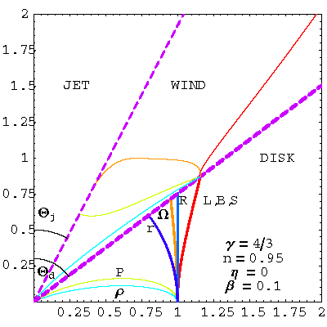
Self-Similar, Fluid, Disk-Wind Model
RB & Begelman
Disk
  Bound
  Gyrentropic
  Circulation
  Inflow
Wind
  Thermal Front
  Unbound
Jet
  Evacuated cone

Slide 9
Sketch Disk Model
Radio spectrum S ~ ν^{1/3}, ν<1THz
T~10¹¹(λ/1cm)^{5/3}(r/6m)⁻²K
Optically thin at all radii for λ<1cm
Superpose radiation from a range of radii
Polarization (Broderick+B)
X-ray emission from synchrotron radiation from high energy tail (cf Liu)
Jet emission model also possible (Falcke)
1/3
S
2
ν

Slide 10
Sketch Disk Model
(dM/dt)_{sup}~10²¹⁻²² g/s
(dM/dt)_{acc}~10¹⁸⁻¹⁹ g/s
Power release ~10³⁸⁻³⁹ erg/s
Luminosity ~ 10³⁶ erg/s => wind
  eg 10²¹ g/s at 5000km/s
  Shocks at ~ (V/c_{s})^{1/2} r_{B} ~ 1 lt yr (cf Atoyan)
  Could be competitive with colliding stellar winds
  Particle acceleration site for H.E.S.S., GLAST photons?
    10TeV photons must originate outside10m

Slide 11
Real Disks are Magentized
Magnetorotational Instability
Hawley et al
dΩ / dr
X

Slide 12
Jet/Outflow Formation
Gas dynamics flows
Hadronic jets
Hydromagnetic wind launched from disk
  Toroidal flux loops
  Poloidal channels
  Centrifugally-driven
Electromagnetic-power from spinning hole
  Collimated by disk wind
Hybrid Models

Slide 13
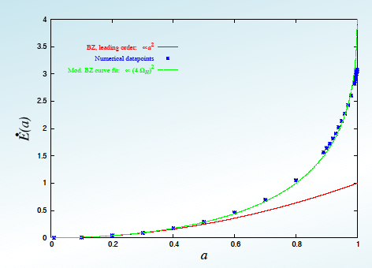
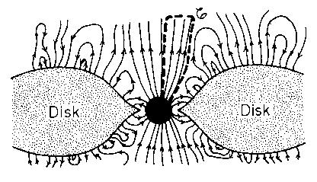
Energy Extraction from Spinning Hole
Electromagnetic extraction of energy from hole
Causal?
Efficient?
Krasnopolsky
Also Gammie, Komissarov, Hawley, Koide et al

Slide 14
Unipolar Induction
Rules of thumb:
Φ ∼ B R² ; V ~ Ω Φ
I~ V / Z₀; P ~ V I
PWN AGN GRB
B 100 MT 1 T 1 TT
ν 10 Hz 10 μHz 1 kHz
R 10 km 10 Tm 10 km
V 3 PV 300 EV 30 ZV
I 300 TA 3 EA 300 EA
P 100 XW 1 TXW 10 PXW
UHECR!

Slide 15
Simulations are transforming our understanding of disks
MHD
3D
GR
Plot of magnetic energy density
Villiers et al

Slide 16
More Variations
Energy transport
  AC transmission (eg Spruit, Thompson)
    eg chaotic electromagnetic fields with length scale ~ 100-1000 km, characteristic of the source variation
      E~B as relativistic
    Dynamically like radiation-dominated outflow
      Scalar pressure
      No active collimation
    Natural particle acceleration mechanisms

Slide 17
More Variations
Energy Transport
  Local DC transmission
    Episodic ejection of magnetically-confined jet segments
    No large scale current circuits
    Relativistic motion
    Changing polarity of parallel field reflects changing polarity of disk field
    Disk may eject loops of toroidal field or be launched and collimated by vertical field

Slide 18
More Variations
Energy transport
  Global DC transmission
    Large scale order in magnetic field
    Large scale current circuits
    Toroidal magnetic field dominates parallel field far from the source
      If flux is conserved, parallel field ~ (Area)⁻¹
      If current conserved toroidal field ~ (Area)^{-1/2}
    E~B still and energy carried by Poynting flux ~ B²c
      Center of momentum frame moves relativistically
    Need equipartition particle pressure along axis to oppose hoop stress of toroidal field in comoving frame.

Slide 19
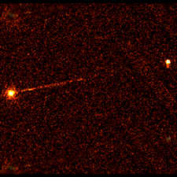
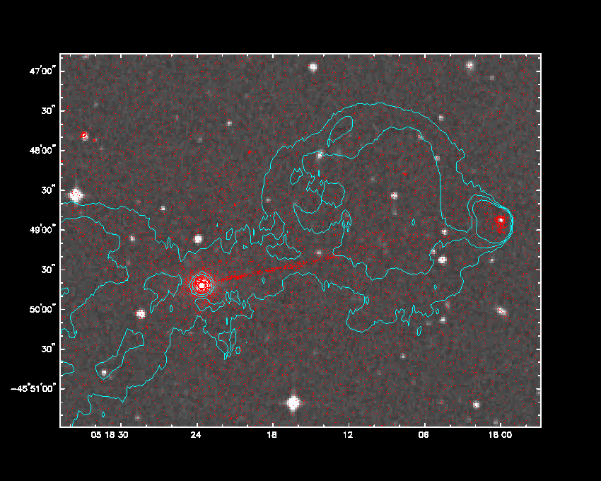
Pictor A
Magnetic Pinch?

Slide 20
Pictor A
Wilson et al
Electromagnetic Transport
10¹⁸ not 10¹⁷ A
DC not AC
No internal shocks
New particle acceleration mechanisms
Current Flow
Nonthermal emission
is ohmic dissipation
of current flow?
Pinch stabilized by
velocity gradient
Equipartition in core

Slide 21
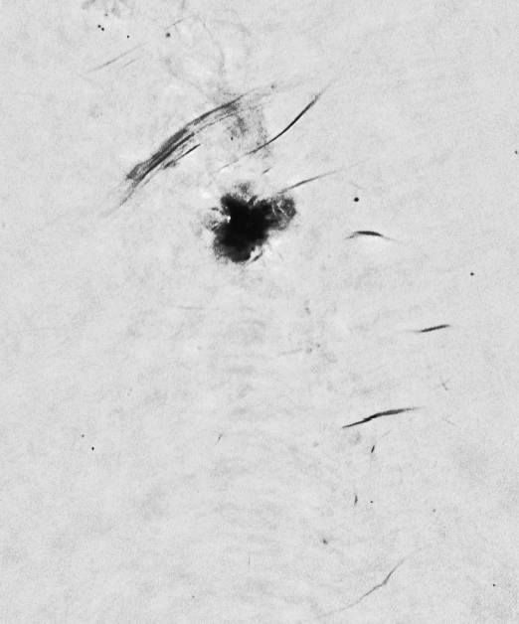
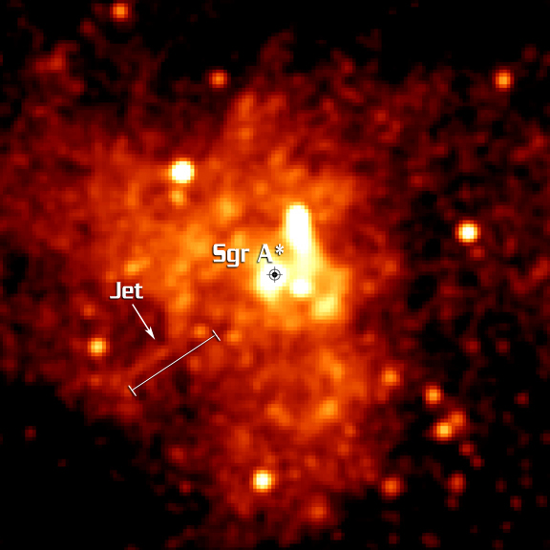
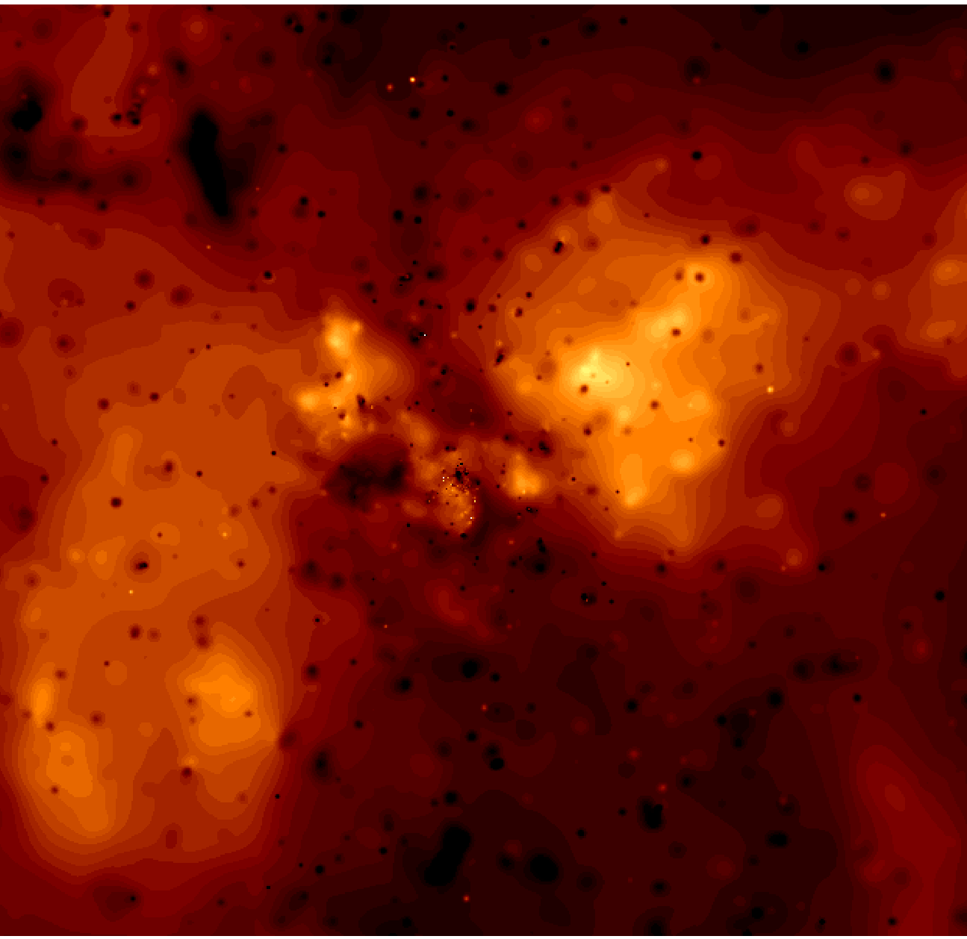
IGN
Baganoff, Morris etal
Sgr A* Jet?
Φ~3PV
I~300TA
L_{EM}~10³⁰W
L_{wind} 10³²W
Magnetically-pinched current?
L_{lobe} ~ 10³² W?
6’ = 15 pc

Slide 22
Archimedean Disks
r_{out} ~ (c/v_{out})²r_{in} ~10⁶r_{in}.
RB, Wang et al

Slide 23
Archimedean Disks
r_{out} ~ (c/v_{out})²r_{in} ~10⁶r_{in}.

Slide 24
Archimedean Disks
r_{out} ~ (c/v_{out})²r_{in} ~10⁶r_{in}.
Net radial field
Conservative disk
Ignore irradiation,
self-gravitation etc
Magnetic pressure dominates and field lines escape

Slide 25
Twister
Outflow
Mean field configuration is MRI unstable.
Growth time ~ Period
λ < H
Conjecture
  Mean field is responsible for the torque
  Random component is responsible for effective
resistivity and viscosity
Test with numerical simulations

Slide 26
Inner Disk - Black Holes
<B>
Ω
X
J
X
X
.

Slide 27
Asymmetric Outflows/Jets
X
Even Parity
Odd Parity
Mixed Parity
Can you measure the toroidal field pattern?

Slide 28
Quasars for the Impatient
Fender
source gets
very bright
and ‘softens’
~1.0
~0.1
Outburst
~0.01
source remains
soft for some
time then fades
away, returning
to hard X-ray
spectrum
Intensity / Eddington
after, typically,
10+ years of
relative peace,
accretion rate
increases
soft
spectrum
hard
spectrum
<10⁻⁶
Quiescence

Slide 29
Jet Fuel
Thick Radiation Disk
Spin Up/Down
Unsteady
Relativistic Jets Powered by Black Hole Spin
Thick disks spin down hole electromagnetically
Thin disks spin up hole through accretion
10
Thin Radiative Disk
Spin Up
Radio Quiet
1
Jet properties depend
upon mass supply rate
and history.
0.1
Thick Ion Disk
Spin Down, Steady,
Radio Loud

Slide 30
Jet Fuel
Relativistic Jets Powered by Black Hole Spin
Thick disks spin down hole electromagnetically
Thin disks spin up hole through accretion
10
1
Jet properties depend
upon mass supply rate
and history.
Width ~ΩM
0.1

Slide 31
Summary
Sgr A* disk may drive large outflow contributing to bipolar lobes and X-ray jet
Reasonable interpretations of disk spectrum
TeV emission does not come from Sgr A* hole
GLAST observations may help us understand IGN like Sgr A*
Blazar GeV emission comes from relativistic jets
GLAST observations should diagnose the jet composition and dynamics

