Slide 1
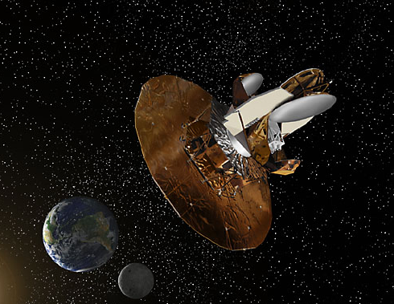

Slide 2
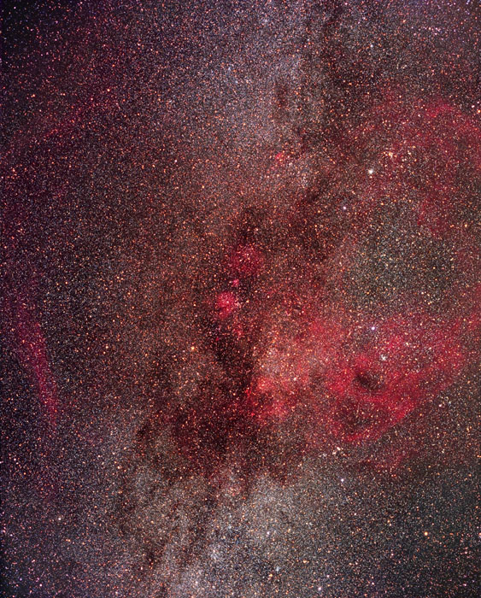
The
Endless Universe
w/Neil Turok (Cambridge)
feynman.princeton.edu/~steinh
Notes:
According to the standard model of cosmology, our universe began in a big bang about 15 billion years ago filled
gas of infinite temperature and density. A few instants later, it underwent a tremendous burst of exponential expansion, known as
inflation, which made the distribution of energy nearly uniform, which flattened the curvature of the universe; and
created small inhomogeneties that eventually led to the formation of galaxies.
Over the past decade, this model has been carefully put to the test through a host of new observations. And the model
has passed all the tests, agreeing with each observation with exquisite detail. No wonder so many cosmologists believe that
the correct cosmological has been idenitified??
But maybe, just maybe, we have been fooled. Maybe the truth is a radically different model, but one which happens to give
very similar predictions. This is the issue we are considering today.
In particular, we will be talking about a model which claims that the big bang is not the beginning. Rather, the bang is
really a period of transition to an earlier, pre-existing phase of expansion and cooling in the universe. Furthermore, the key events that
fixed the large scale structure of the universe did not occur after bang, but rather, before the bang, or BEFORE THE BEGINNING…
Yet, despite these radical differences, this new model seems capable of reproducing all the successful predictions of the standard
model to date with the same exquisite detail.
This new theory, developed with Neil Turok of Cambridge University, is a cyclic model of the universe,
reminiscent of cyclic of the models discussed in the 1920’s, 30’s and 40’s. Those earlier models had some intriguing and appealing
aspects, but also had some major flaws that make them untenable today. The new cyclic model is a 21st century version,
using many novel ideas that enable it to circumvent the old flaws, especially recent advances drawn from so-called superstring theory.
Thus, after decades of disappearing from the scene, we have the return of the cyclic in a new and exciting version.
Today I will try to give you a brief introduction to the model. This will be a descriptive introduction, but I want to emphasize
that it is a fully developed, quantitative picture – a detailed, predictive scientific model in the same sense as the standard
picture. Not just a conceptual idea. If you want to read more about it, here is a website.

Slide 3
Today’s Standard Model
(big bang + inflation)
big bang
inflation

Slide 4
Today’s Standard Model
(big bang + inflation)
big bang
inflation
New ingredient: Scalar field ( Y)
V
Y

Slide 5
Today’s Standard Model
(big bang + inflation)
big bang
inflation
New ingredient: Scalar field ( Y)
V
Y

Slide 6
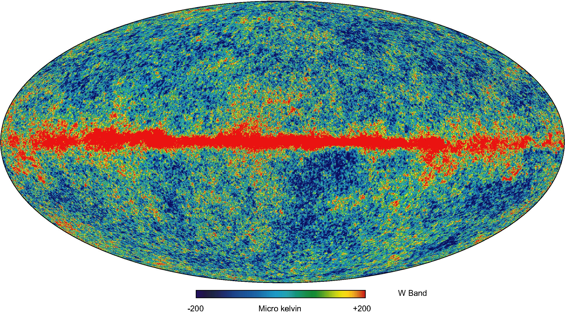
Wilkinson Microwave Anisotropy Probe

Slide 7
Today’s Standard Model
(big bang + inflation)
big bang
inflation
radiation
matter
dark energy ??

Slide 8
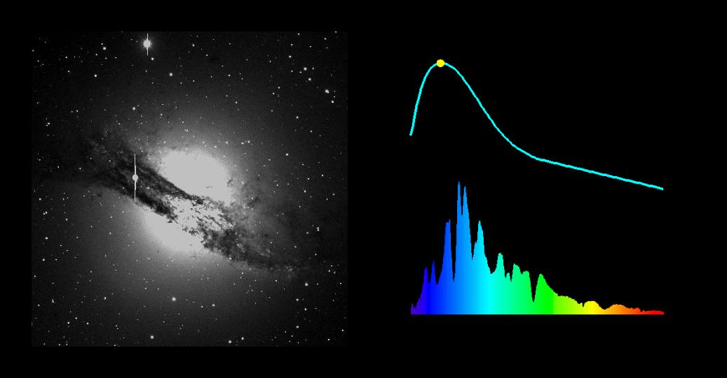

Slide 9
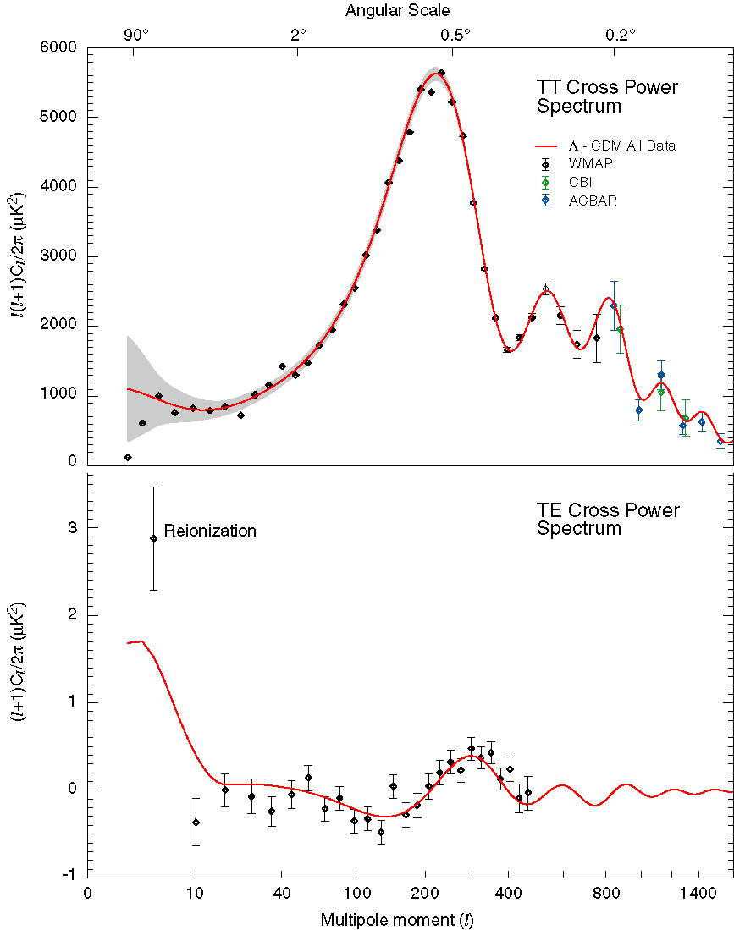

Slide 10
Today’s Standard Model
(big bang + inflation)
big bang
inflation
radiation
matter
dark energy ??
???

Slide 11
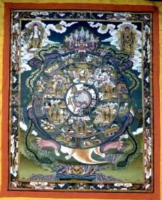
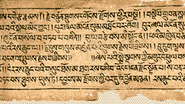
A Cyclic Universe

Slide 12
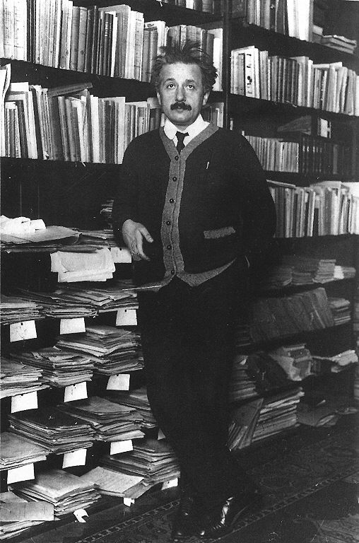
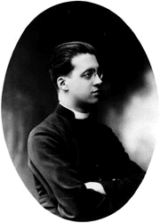
Albert Einstein
George Lemaitre

Slide 13
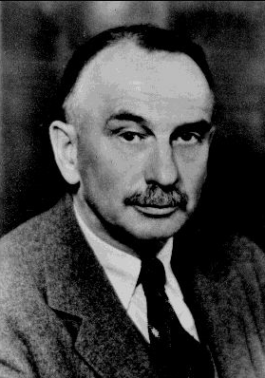
A Cyclic Universe
Richard Tolman
a(t)
t

Slide 14
A Cyclic Universe
Richard Tolman
a(t)
t

Slide 15

The New Cyclic Universe
“branes”
Superstring theory

Slide 16
The New Cyclic Universe
“branes”
V
Y
Y
Field theory
Superstring theory

Slide 17
Consensus
(big bang + inflation)
Cyclic
PJS & Neil Turok
big bang
“bang”
inflation
radiation
radiation
matter
matter
dark energy
the “bounce”
dark energy ??
“contraction”
???
“crunch”
Notes:
The model is actually much more subtle than advertized so far. The early phases are all rather standard, but the contraction, crunch and bounce are anything but what we you may have been accustomed to before. That is because the model is based on novel ideas inspired by string theory.

Slide 18
Consensus
(big bang + inflation)
Cyclic
PJS & Neil Turok
big bang
“bang”
inflation
radiation
radiation
matter
matter
dark energy
the “bounce”
dark energy ??
“contraction”
???
“crunch”
Reproduces successful predictions
Notes:
The model is actually much more subtle than advertized so far. The early phases are all rather standard, but the contraction, crunch and bounce are anything but what we you may have been accustomed to before. That is because the model is based on novel ideas inspired by string theory.

Slide 19
Consensus
(big bang + inflation)
Cyclic
PJS & Neil Turok
big bang
“bang”
inflation
radiation
radiation
matter
matter
dark energy
the “bounce”
dark energy ??
“contraction”
???
“crunch”
Fewer ingredients: no need for inflation
Notes:
The model is actually much more subtle than advertized so far. The early phases are all rather standard, but the contraction, crunch and bounce are anything but what we you may have been accustomed to before. That is because the model is based on novel ideas inspired by string theory.

Slide 20
Consensus
(big bang + inflation)
Cyclic
PJS & Neil Turok
big bang
“bang”
inflation
radiation
radiation
matter
matter
dark energy
the “bounce”
dark energy ??
“contraction”
???
“crunch”
Dark energy given a purpose
Notes:
The model is actually much more subtle than advertized so far. The early phases are all rather standard, but the contraction, crunch and bounce are anything but what we you may have been accustomed to before. That is because the model is based on novel ideas inspired by string theory.

Slide 21
Consensus
(big bang + inflation)
Cyclic
PJS & Neil Turok
big bang
“bang”
inflation
radiation
radiation
matter
matter
dark energy
the “bounce”
dark energy ??
“contraction”
???
“crunch”
Avoids infinities (?)
Notes:
The model is actually much more subtle than advertized so far. The early phases are all rather standard, but the contraction, crunch and bounce are anything but what we you may have been accustomed to before. That is because the model is based on novel ideas inspired by string theory.

Slide 22
Consensus
(big bang + inflation)
Cyclic
PJS & Neil Turok
big bang
“bang”
inflation
radiation
radiation
matter
matter
dark energy
the “bounce”
dark energy ??
“contraction”
???
“crunch”
More complete theory of cosmic history
Notes:
The model is actually much more subtle than advertized so far. The early phases are all rather standard, but the contraction, crunch and bounce are anything but what we you may have been accustomed to before. That is because the model is based on novel ideas inspired by string theory.

Slide 23
Consensus
(big bang + inflation)
Cyclic
PJS & Neil Turok
big bang
“bang”
inflation
radiation
radiation
matter
matter
dark energy
the “bounce”
dark energy ??
“contraction”
???
“crunch”
Empirically distinguishable: e.g., gravitational waves
Notes:
The model is actually much more subtle than advertized so far. The early phases are all rather standard, but the contraction, crunch and bounce are anything but what we you may have been accustomed to before. That is because the model is based on novel ideas inspired by string theory.

Slide 24
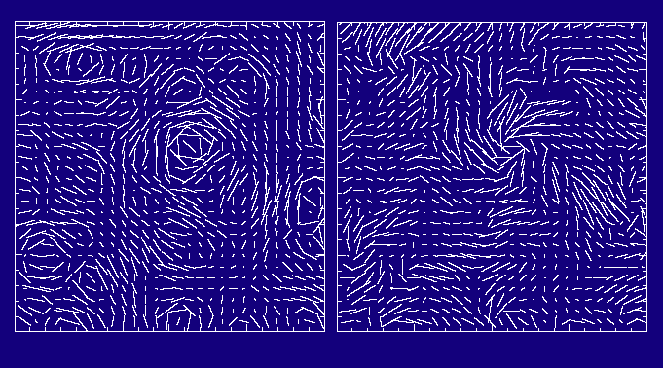
E-modes
(energy fluctuations)
B-modes
(gravitational waves)

Slide 25

CAPMAP
the Cosmic Anisotropy
Polarization
MAPper
DASI, WMAP, Boomerang
…. Planck, …. CMBPOL

Slide 26

FAQs: feynman.princeton.edu/~steinh/
Violates conservation of energy?
What happens at the bounce?
Tolman problems?
Notes:
Perpetual motion?
Is it stable?
What about Tolman:
potential energy rather than mass density
no infinities
no entropy problem
Could there be remnants left over from previous cycles?
Combination model

