Slide 1
Measuring Beam Intensity With Toroids
The operation of toroids and their calibration
Aisha Ibrahim
July 28, 2004

Slide 2
Introduction
Toroids are intensity devices used to measure a pulsed beam current.
The Toroid Intensity Monitor Integrator Module is designed to integrate the total area under a beam-induced toroid signal to determine the beam intensity.
These provide a way to monitor transfer efficiencies between two accelerators and/or to ensure intensity are within safety or operational envelopes.

Slide 3
Basic Installation
Basically, it consists of a vacuum tube with a ceramic piece and transformer cores.
Pearson Models 3100 (3.5” ID) and 2864 (4.875” ID)
  Tap-wound cores
  10Hz to 26MHz Bandwidth
  0.5 Volts/Amp into 50 Ohms Load
  0.033 Amp-Sec max / 41 Volts-Sec max at output
  Electrically isolated from beam pipe and tunnel ground
200-1300ft Cabling between toroid and integrator module
  78 Ohms balanced twin-ax for induced signals
  3/8” Heliax for calibration test pulses

Slide 4
Ceramic Break
Since the magnetic field of the beam is attenuated outside a continuous, conducting vacuum chamber, a beam current monitor needs a “window to the beam”.
Often a ceramic piece is inserted in series with an otherwise continuous beam section. This interruption along the beam tube forces wall currents to find a path outside the vacuum chamber.
Z_{shunt} can be added to limit the gap impedance and damp potential resonances

Slide 5
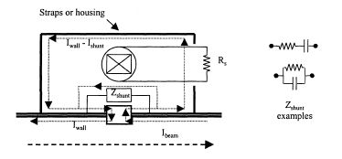
Gap /Wall Currents Model
This is an example modeling a current monitor enclosed in a housing over a gap with shunting elements.

Slide 6
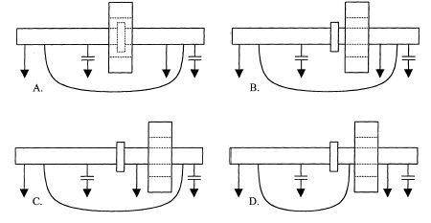
Gap Positioning Relative to Transformer
All paths by which the wall currents bypass the gap MUST enclose the transformer.
The transformer should be as close to gap as possible for best high frequency performance, but doesn’t have to straddle the gap physically.
  In each case, wall currents can pass around gap via a path connecting to the beam tube at either side of the break.
  A & B are acceptable positions because current bypass path enclose transformer.
  C&D are NOT acceptable because ground or other connections short-circuit the gap via paths not enclosed by the monitor. Wall currents interfere with beam current measurements.

Slide 7
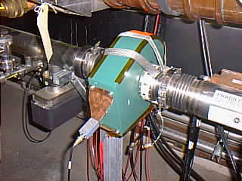
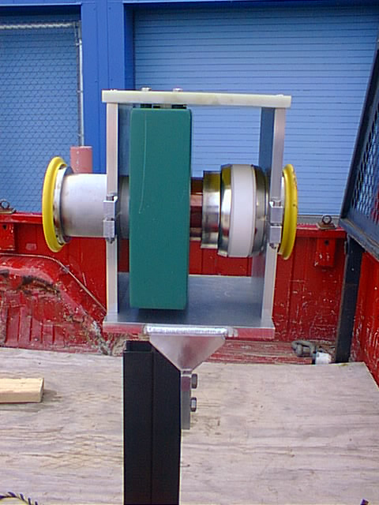
Basic Installation
10MHz 3rd order low-pass filter used at Pearson output
A RC network shunt the ceramic gap to further provide noise immunity.
Straps or full-housing controls the side effects of gap impedance and guides wall/image currents from one side of the ceramic break to the other.
  Previously, toroids were electrically isolated with Kapton tape, while beam image currents were handled with braided conductors clamped to the beam pipe.
  New mounting hardware mechanically supports, electrically isolates, provides a robust connection for the calibrate winding and output signals, and protects the toroid.

Slide 8
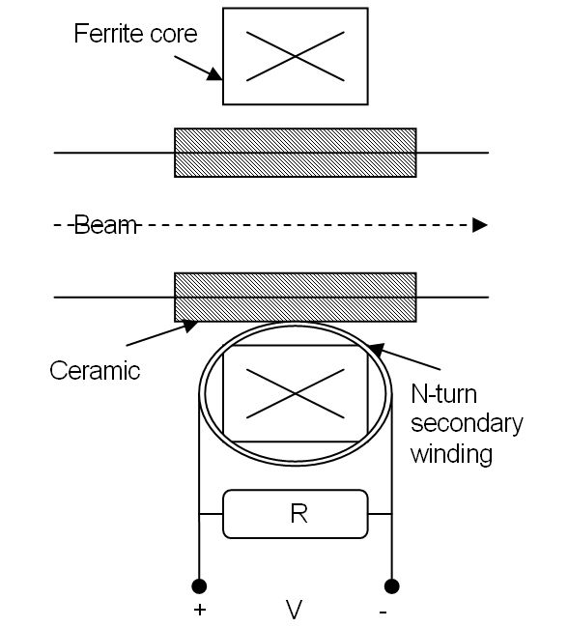
Theoretical Overview
Passing through the center of the ferrite ring, the beam forms a single-turn primary coil of the transformer.
An N-turn secondary coil is wound around the core (either a ferrite ring or tape-wound cores).
Using both Ohm’s law and transformer relationships N = (# of secondary turns) (# of primary turns) N* I _{Secondary} = I _{Primary} = I _{Beam}
V = I _{Secondary} * R = I _{Beam} * R / N
For a constant N, the output voltage is linear with respect to the beam current.
The electronics is designed to integrate the total area under this beam-induced signal to determine the beam intensity.
  It is AC coupled to beam current and have no DC response.

Slide 9
Toroid Intensity Monitor Integrator Module (TIMI)
<Schematic on Slide 12 >
The first stage receives a signal transmitted over twin-ax cable.
  This signal passes through a common-mode choke to filter any additive noise induced over the transmission lines, an impedance matching network to handle cable termination and reflections, and then a differential receiver amplifier.
  This differential-to-single-ended amplifier is characterized to have a high common-mode rejection ratio (70dB @10MHz).
    This minimizes the corruption by external noise sources or crosstalk.
    The amplifier also has tuneable gains to adjust for losses in the transmission lines or for different full-scale intensity ranges.

Slide 10
Toroid Intensity Monitor Integrator Module (TIMI)
<Schematic on Slide 12 >
The second stage addresses the baseline of the AC-coupled signal. It is composed of a sample-and-hold (S/H) amplifier and a differential amplifier.
  A 300nsec minimum acquisition time must be allotted for acquiring and sampling the baseline between integrations.
  Further, the S/H amplifier is characterized with a slow 0.02µV/µs droop rate, allowing the sampled baseline to be held relatively steadily.
  Also, due to the noise contribution of the S/H amplifier, this sampled signal is filtered at 10KHz. Assuming that the baseline drifts very slowly or not at all, this effectively samples the baseline much slower than the actual beam signal.
Once sampled, the baseline is subtracted from the original signal using a differential amplifier.
  The differential input range of the differential amplifier must accommodate differences between peaks in the beam bunches and the baseline.

Slide 11
Toroid Intensity Monitor Integrator Module (TIMI)
<Schematic on Slide 12 >
Next, this baseline-corrected signal is feed into the integrator in a switched-capacitor configuration.
  The time constant determined by the feedback resistor and capacitor needs to be much greater than the typical gate width.
    This minimizes the intrinsic exponential droop error of non-ideal integrators during the hold state.
    In addition, errors due to noise also vary proportionally to the square root of the gate width.
    Serving as an input buffer to the A/D converter, this amplifier has a fast settling time (90nsec to 0.1%) as well as a high slew rate (230V/msec uncompensated).

Slide 12
Toroid Intensity Monitor Integrator Module (TIMI)
<Schematic on Slide 12 >
From this integrated signal, there 2 distinguishable intensity outputs.
  One is a full 16-bit digital intensity reading. The integrated signal is then passed to the next stage, where is it converted to a digital 16-bit equivalent (A/D) and then back to analog (D/A). With a 250 kHz sampling rate, the A/D acquisition and conversion time is at most 4µsec. The 16-bit D/A has a bipolar output rate of +10V and has a typical settling time for 1 LSB step is 2.5µsec.
  The other is an analog intensity reading. This analog output is put through a non-inverting unity operational amplifier. This low noise op-amp has a maximum offset voltage drift of 0.1µ/ºC and a maximum offset voltage of 25µV at 25ºC. This eliminates the need of external offset voltage adjustments and increases system accuracy over temperature.

Slide 13
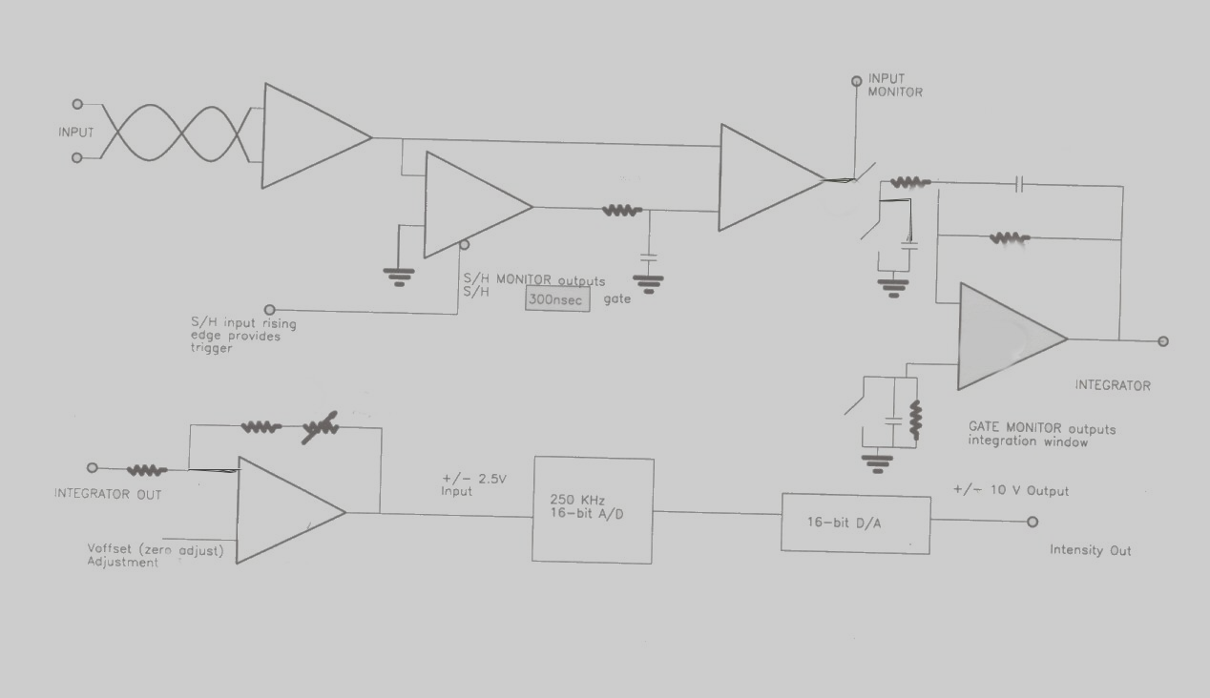
TIMI Schematic Summary

Slide 14
Triggering & Gating
Each toroid integrator has at least one trigger.
  Each trigger is determined from a list of Reflected TCLK Events as well as delay in μsec.
  The corresponding toroid is set to start its integration window “some delay” after an event occurs.
  Also, each trigger can be enabled or disabled by toggling the asterisk at the end of the line.
When integration window is active, the integrator module starts integrating the beam signal received from the toroid.
  “Local Gating Mode”: 0.1-99.9 μsec
  “Remote Gating Mode”: Follows width of triggering pulse with about 180nsec delay and 500nsec minimum size
  Typically, transfer line toroids use “local mode”, set to 11.1usec.
  The RMS noise output behaving proportionally to the √gate
Baseline Subtraction is available
  Requires a separate TTL timing signal and 300 nsec min acquisition time

Slide 15
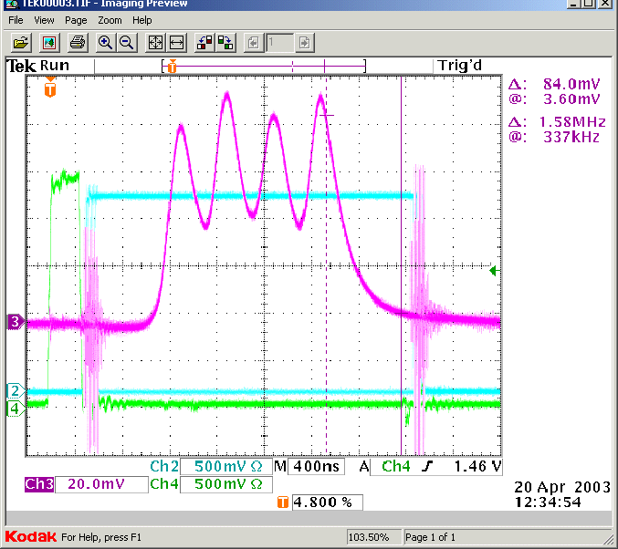
Example of Gating/Timing
Channel 2 : ~2.8μsec Integration Window produced using “Remote Mode”
  For transfer line toroids, this window would typically be a 11.1μsec wide.
Channel 4 : 300nsec Gate for Baseline sample and hold
Channel 3 : Beam signal from Wall Current Monitor (WCM) consisting of 4 bunches in RR
  For transfer line toroids, the signal would be a 1.6μsec pulse.

Slide 16
Calibration Procedure
Dedicated Equipment : HP 33120A
  15MHz Function/Arbitrary Waveform Generator.
  Its internal resistance was verified to be 50.540Ω.
  Verified accuracy from equipment manual: There a 0.5% change in gain for 1% change in output termination accuracy.
It is used to send a known pulsed waveform to a single turn winding around the toroid in tunnel.
  CALPULSE was created and consists of 11000 points and models a 1.6usec pulse at 91KHz.
  Although the calibration winding is terminated with 50Ohms, this resistance is measured and verified using a DVM.
  $0F triggers are used to time in the integration gate and the pulsed test signal.

Slide 17
Calibration Procedure
The voltage is typically stepped from 0-5Volts in 1 volt increments.
Primarily for calibration/testing scenarios, a time-averaged ACNET reading is available.
  This is the last 100 data points of the MADC reading sampled at 15Hz.
  It will take approx 7-10 seconds for the reading to level out; a fast-time-plot can be used to verify this.
A “least squares fit” is done between the ACNET measured value and the calculated, expected value.
  Error Deviation of the measurements and %change is analyzed
  Gain/Offset adjustments are DABBELED into ACNET database

Slide 18
TYPICAL Transfer Line Toroids
Full-scale Intensity * | 1.03e13 (9.7V/1e13)
Integrating Time Constant* | 330nsec
Integrator Low Corner Frequency* | 48.2Hz (τ ~21msec)
Integrator Droop Rate ≈ 1 – e ( - gate / τ ) | 0.05%
* Can be modified for a given application
Magnetic Field Sensitivity | 6E9/Gauss (f>100Hz)
Temperature Sensitivity | -0.01/ºF error from Integrator +0.02%/ºF error from Pearson
Short-term or Pulse-pulse “RMS” variation/error | ±1E9
Observed long-term systematic drift | ±1E11 over several months

Slide 19
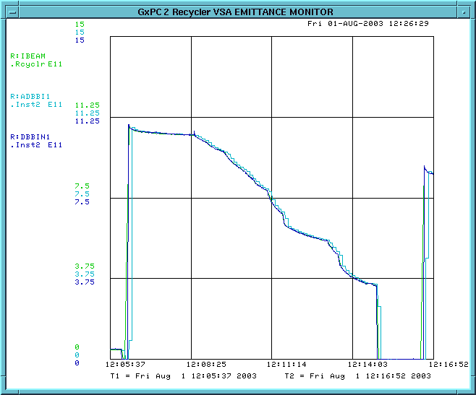
08/01/03 Calibration Studies using TIMI in RR
As part of a partial calibration effort, high intensity beam is injected in to a 1.6μsec wide RR barrier bucket and scrapped down from 120e10 to about 0.5e10.
Calibration curves calculated R:DBBIN1 to vary with R:IBEAM by about 4%

Slide 20
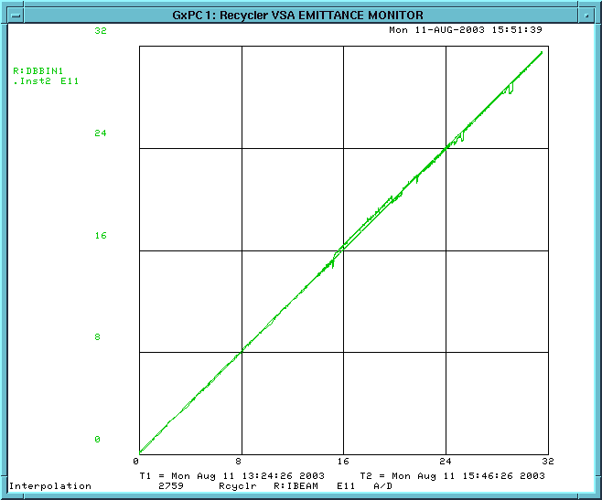
08/11/03 Response Studies using TIMI in RR
Stacked about 30e11protons in RR.
Debunched them in a barrier bucket and set the gating properly to look at its response.
Found that the R:DBBIN1 and R:IBEAM follow very closely within 1%

Slide 21
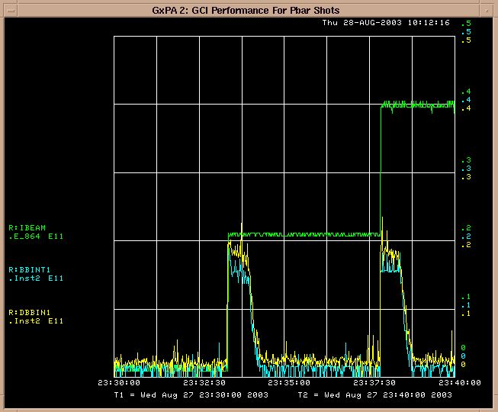
08/27/03 Response Studies using TIMI in RR
As pbar shots were injected into the RR barrier bucket, the integrator module showed intensity. As the beam was moved and fell out of the buckets, the intensity dropped.
Notice that injected beam was not on target on previous transfers. Hence we expected some dc beam in RR which affected the S/H signals and caused the module to underestimate the beam intensity. For cleaner beam transfers this problem should go away.

Slide 22
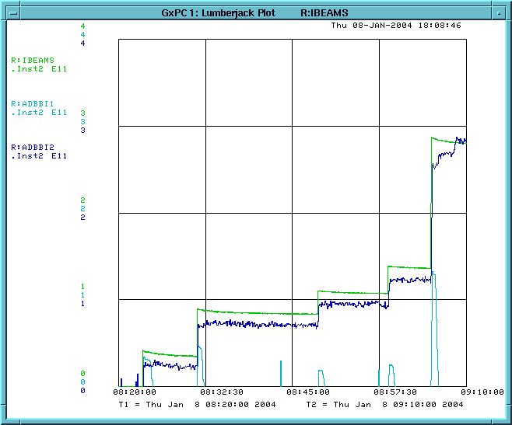
01/08/04 Response Studies using TIMI in RR
Pbar beam in RR before spreading the beam around the machine.
  R:ADBBI1 provides only the intensity at the barrier bucket for injection
  R:ADBBI2 is positioned to read the intensity for the entire RR

Slide 23
Future Developments
Planned for August Shutdown
  Install improved mounting hardware for MI/RR transfer line toroids
  Pull in Trumpeter twin-ax signal cables to replace RG108
  Modify electronics to improve temperature sensitivity and long-term stability
Track toroid efficiencies (Lumberjack vs. SDA)
Cross-calibrate toroids along a single transfer line
Devise an automatic calibration process
  Looking into how Columbia module is used for EBERM

