Slide 1
LWG Assessment of DOE’s Energy Portfolio
George Crabtree
Argonne National Laboratory
Don McConnell
Battelle
Laboratory Working Group Co-Chairs
Basic Energy Sciences Advisory Committee
February 16-17, 2006

Slide 2

Motivation
“We have not done as good a job as we should in coordinating the activities of the ESE offices. We have not done as good a job as we should in performing the crosscutting analysis we need to justify our budgets to the Congress.”
David Garman
Under Secretary for Energy, Science and Environment
Senate Confirmation Hearing
April 6, 2005

Slide 3
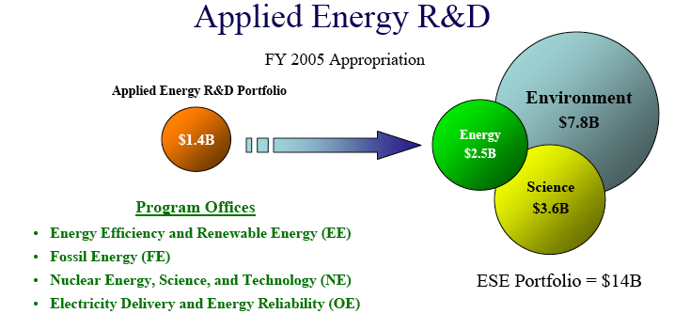
Program Scope

Slide 4
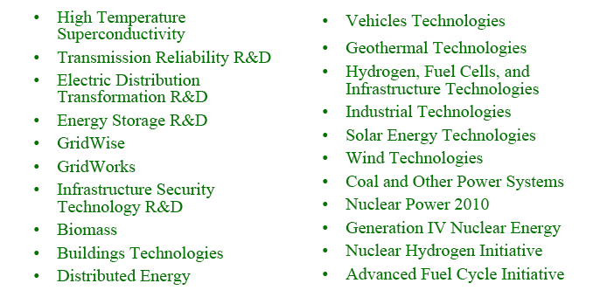
Applied Energy Programs Units

Slide 5
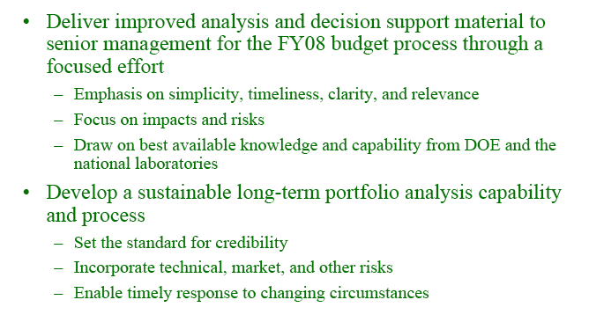
Charge to Laboratory Working Group (LWG)

Slide 6




The Context: Advancing Four, Broad National Energy Policy Goals
Diversify our energy mix and reduce dependence on foreign petroleum, thereby reducing vulnerability to disruption and increasing the flexibility of the market
to meet U.S. needs
Reduce greenhouse gas emissions
and other environmental impacts
(water use, land use, criteria pollutants) from our energy production and use
Create a more flexible, more reliable
and higher capacity U.S. energy infrastructure, thereby improving energy services throughout the economy, enabling use of diverse sources, and improving robustness against disruption
Improve the energy productivity
(or energy efficiency) of the U.S. economy
Planning
Guidance
FY07–FY11

Slide 7
LWG Organization
Under Secretaries for S&T
Energy
Science
David Garman
Ray Orbach (if confirmed)
John Sullivan
Associate Under Secretary for Energy
James Decker
Deputy Director, Office of Science
Co-Chairs
R&D Council
EERE, FE, NE, OE, Science (Pat Dehmer)
Don McConnell
George Crabtree
Co-Chairs
~ 30 participants
from Nat’l Labs
S&T Integration
Working Group
S&T Laboratory
Working Group
S&T Analysts
Ad-Hoc S&T
Analysis Teams

Slide 8
Multi-year Process
FY05 (for FY07 programs) applied energy programs, qualitative impact
FY06: (for FY08 programs) + quantitative impact, relation to science, risk
FY07 (for FY09 cycle) + model analysis
FY08 (for FY10 cycle)

Slide 9
Analysis Tasks
√ Task 1: Energy R&D Innovation Strand definition, assessment & characterization
√ Task 2: Innovation Strand impact analysis
Task 3: Integrated portfolio assessment
Task 4: Recommendations for an enduring S&T assessment process

Slide 10
Innovation Strands
Supply
Distribution
Use
Advanced Nuclear
Electric Grid
of the Future
Industrial Technologies
Alternative Liquid
Fuels
Zero Emission Fossil
Electric Generation
Advanced Building Systems
Fuel Grid
of the Future
Renewable Energy
Fusion Energy
Hydrogen
Infrastructure
Vehicle Technologies
Bioenergy/Chemicals
Fusion Energy
Future Electricity Systems
Future Liquid Fuels & Transportation
Future Hydrogen & Gas Systems
Cross-cutting / Enabling Science and Technology Opportunities & Challenges

Slide 11
General Observations on the Portfolio
FY05 (for FY07 cycle)

Slide 12
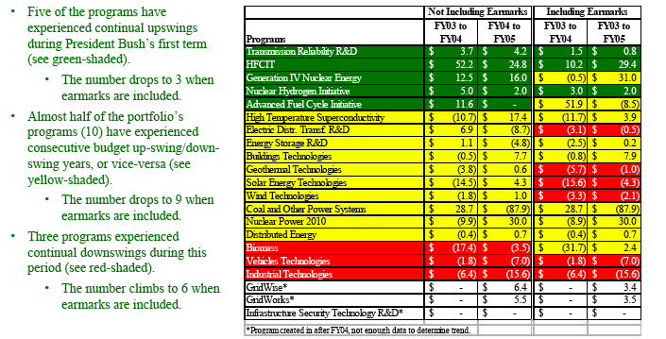
Earmarks and Budget Swings

Slide 13
There are several crosscutting technical challenges that warrant focused attention
Energy storage at every scale is a critical issue in multiple technology strands
  Applies to electric grid, buildings, vehicles, renewables
  Need is for both high power density and low weight
Electrochemical conversion (at high and low temperature) is a key issue
  Applies to hydrogen, fuel cells, energy storage
New materials for extreme environments are required in multiple technology areas
  Nuclear power, fusion, hydrogen production
Real-time adaptive control of large scale or complex systems is required at multiple scales
  Engines, buildings, electric grid

Slide 14
Several areas of science have particularly high enabling potential
Nanostructured materials will have transforming impact in the near, mid and long term
  Energy storage and conversion, solar power, hydrogen storage
  Engineered materials (e.g. active building components)
  Materials for extreme environments (especially VHT nuclear)
Catalysis advances will enable
  Energy conversion, zero emission hydrocarbons, biomass
Advances in systems biology can “change the game”
for biofuels and bioproducts
  Engineered feed stocks, bioprocessing technologies
Advances in high temperature superconductivity are important
for both the grid and for fusion
High end computational modeling and simulation has very high potential for enabling technological advance in many areas
  Engines, fuel cells, process technologies, efficient power plants, etc.

Slide 15
The role of science
Basic Science Vision
Incremental advances in the state of the art of existing energy technologies will not meet the nation's future energy and environmental security challenges.
Revolutionary innovations are needed, both in the energy technologies themselves and in our understanding of the fundamental science that enables their operation.
Vibrant fundamental science programs generate revolutionary innovations in two ways: (i) by discovery-driven advances in the frontier of knowledge, enabling new paradigms and unexpected opportunities for disruptive energy technologies, and (ii) by use-inspired research targeting specific areas where incomplete understanding blocks technological progress. DOE should maintain strong programs in both areas that sustain US leadership in science.
Basic-applied interactions are a fertile source of innovation. DOE should develop new ways to stimulate translational research and creative connections across the basic-applied interface.

Slide 16
Basic Science Frontiers
High Performance Materials
Science at the nanoscale, especially low-dimensional systems
Dynamics of physical, chemical and biological phenomena
Emergent behavior in complex systems, from high Tc superconductors to pattern formation in chemical solutions to self-assembly and self-repair
Catalysis and control of chemical transformation
Molecular to systems level understanding of living systems
Biomimetics and photobiological energy conversion
Molecular scale understanding of interfacial science, separations, and permeability in physical systems and membranes
New Tools for:
In situ molecular characterization
Theory/Computation/Numerical Applications
Biomolecule production and characterization

Slide 17
Basic Science Frontiers
High Performance Materials
Research Directions:
  Stability in extreme environments: temperature, corrosion, radiation
  Greater functionality: fast, small, strong, smart, efficient, multifunctional
Scientific Challenges:
  Understand structure-function relationship at all scales
  Simulate/model behavior from first principles
  Create properties through nanoscale design
Potential Impact:
  Next generation materials for nuclear reactors, high temperature thermochemistry, superconductivity, catalysis, biomimetics, energy conversion among photons, electrons, chemical compounds and heat
Timescale:
  Continuous. Advances are interdependent- discovery in one class of materials triggers breakthroughs in another

Slide 18
Basic-Applied Research
Samuel Bodman
Clay Sell
Orbach
Garman
Basic
Applied
Research
Office of Science
Applied Energy Offices

Slide 19
Basic-Applied Research
What are the goals?
Translation of applications from basic to applied
50% efficient quantum dot solar cell
Cost competitive superconducting wire
Develop disruptive approach to grand energy challenges
Make an electronic switch ⇒ information revolution
Store 24 GWh of electrical energy for 24 hours
Personal transportation at 1/10th cost of cars
What are the attributes?
Integrated basic-applied PI teams
Integrated basic-applied management teams
Tap the best scientists/engineers: innovative thinkers, receptive to new ideas and people
Objectives are innovation driven, not time-scale driven
Stable program: 10+ year life
International network of workshops and visitors to create community and stimulate fresh perspective
Periodic review by top scientists/engineers outside DOE
Examine other innovation machines for organizational inspiration: DARPA, Bell Labs, Google, Microsoft, Apple, Xerox Parc

