Slide 1
Forging New Relationships to Promote Employment for People Who Are Homeless
Strategies for Change That
Cross System Cultures
David M. Wertheimer, M.S.W., M.Div.
Kelly Point Partners

Slide 2
Listening to What
Our Customers Tell Us
“I am not incompetent; I just need help moving the obstacles out of the way.”
– Joseph, a homeless man with co-occurring mental illness and substance use disorders living in a shelter in Seattle

Slide 3
We Are Actually Some of the “Obstacles”
We have designed systems that make sense to bureaucrats, funders, and agency administrators
We have not created systems that make sense from the perspective of people with multiple problems who need or are seeking our help

Slide 4
This Includes Treatment, Housing, and Employment Programs
Treatment agencies too often assume that a person with significant disabilities and a history of homelessness is incapable of employment
Housing providers chasing reliable subsidies fail to make the connection between meaningful work and sustained tenancy
Employment programs consider work for people who are homeless a “specialty” service outside the mainstream of employment services

Slide 5
Further Complications: Systems-level Cultural Barriers
Treatment, housing, and employment systems are separate and distinct cultures
Creating a single, homogenous “melting pot” environment will not succeed
Promoting understanding and competency reaching across cultures is a critical task
Systems integration is a critical goal

Slide 6
How We Get There from Here
Acknowledging the current levels of systems fragmentation
Recognizing that most of our clients are struggling with multiple problems that make providing treatment, housing, and employment ALL significant challenges
Changing the basic ways we do business
Promoting systems integration as an alternative to fragmentation

Slide 7
Systems Integration:
Why Bother?
The issues that we are here to address are beyond the capacity of any single system to solve on its own
No one system has the resources
No one system has the expertise
No one system has the person power
No one system has the complete solution

Slide 8
So What Is Systems Integration?
Housing, health, and human services systems are integrated when there is sharing of:
Information
Planning
Clients
Resources
Responsibility

Slide 9
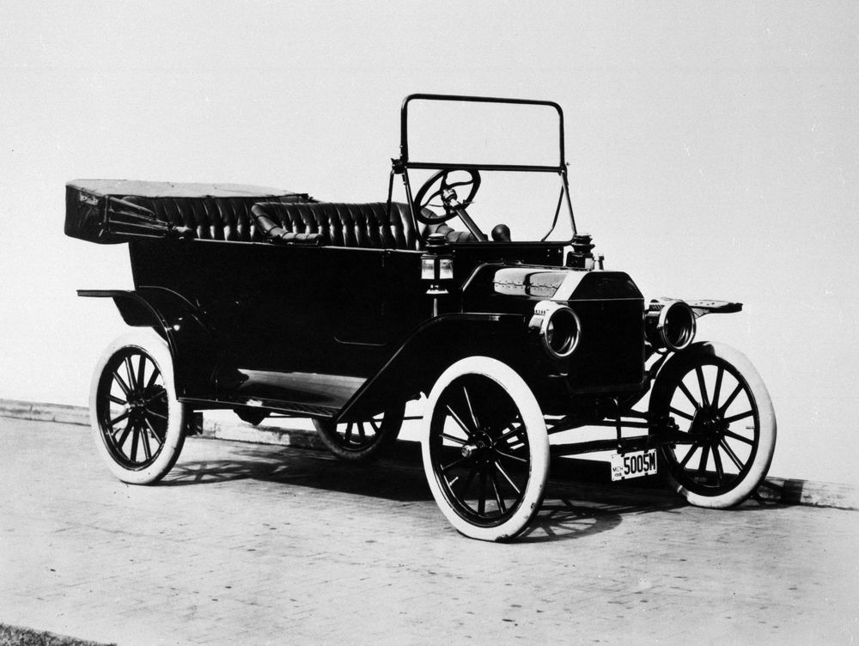
Wrapping Our Heads Around Systems Integration

Slide 10
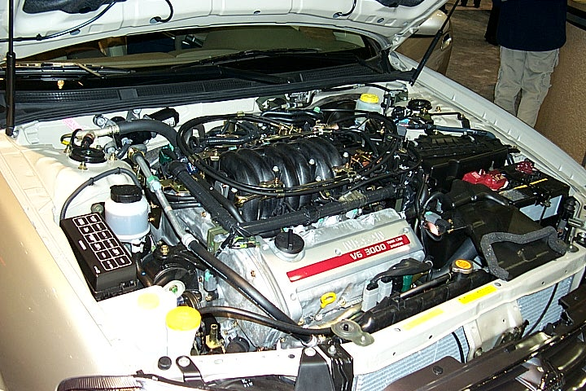
Systems Integration: The Mechanic’s Perspective

Slide 11
The Mechanic’s View
The engine is a complex piece of machinery
The mechanic needs to know how it works, how the pieces fit together, how to diagnose a problem, and how to repair what broken
To the rest of us, looking under the hood is a daunting and confusing task
If we’re going to use a car, the nonmechanics among us need it to be easy

Slide 12
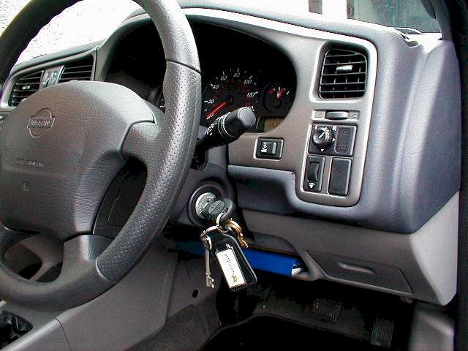
Systems Transformation:
Making Integration Invisible to the “End User”

Slide 13
In the World of Homelessness, Housing, and Employment,
YOU Are the Mechanics!
So how do we promote systems change to empower systems integration?

Slide 14
A Perspective on Systems Change
The Corporation for Supportive Housing Perspective

Slide 15
What a System Is
A system is the ways that…
Power
Money
Ideas and values
Technology or knowhow (methods and skills)
Day-to-day routine (habits)
… are linked to achieve a mission or goal
Notes:
The “system” is the set of relationships that link these 5 elements with each other and with the goals that they are meant to serve.

Slide 16
Changes in Power
Changes in power require that:
Duties and authority are rearranged
Designated positions are given responsibility for new activities
Stakeholders who have not been heard or present may assume new and different roles
Housing, treatment, and employment systems promote cross-system alignment

Slide 17
Changes in Money
Changes in money require:
Identification of funds “in play” from all systems: housing, supportive services, treatment, and employment
Analysis of how funds are currently or traditionally identified, allocated, spent, and monitored
Development of new resource procedures
Testing of new procedures for reliability, manageability, and effectiveness

Slide 18
Changes in Ideas and Values
Changes in ideas and values require:
Reexamination of traditional definitions of “success”
New definitions of “success” rooted in different data, standards, and values that are widely shared
Discussion of and education about “success” occurs across multiple systems

Slide 19
Changes in Methods
Changes in methods require:
Identification of new promising practice approaches for employment linked to housing and supportive services
Development of skill bases among housing, treatment, and employment services that providers require to implement promising practices
Implementation, monitoring, and evaluation of changes/new models

Slide 20
Changes in Habits
Changes in habits require:
Understanding the demands of an integrated, “multicultural” environment
Providing training and rationale for changing habits and practices
Developing capacity among participants to interact with each other differently as part of their core work activity to support employment goals

Slide 21
How Systems
Change Occurs
New goals are identified
A better way of doing things is recognized
A new vision guides the change process
Resources in all relevant systems are made to work together
Administrative and program structures are linked
Notes:
These are “the five signs” or key elements / indicators of systems change.
Achieving real and lasting systems change is different from (more than) making the system do something innovative – it’s about new patterns of doing things in a new way on a consistent basis so they become habit –an accepted part of the way people and organizations do their jobs
People and systems regularly do the new thing – not just in response to a special initiative, or because particularly skilled or committed individuals happen to care about it – and others can rely on the system to operate in a changed way

Slide 22
Effective Systems Change
Requires persistent pressure on most or all of the key elements over a sustained period of time (years, not months)
To get there, begin with:
  Persuasive short-term accomplishments
  Production of a new product or service by extraordinary means, just to show that it can be done and is worth replicating

Slide 23
Building Blocks of
Systems Change
Collaborative planning
Building consensus and setting goals
Investment and leveraging resources
Coordination and streamlining of funding
Building provider capacity
Developing industry standards, quality assurance, and monitoring
Cultivating leaders and champions
Data and communications to make the case

Slide 24
Expect Resistance!
Systems transformation unsettles old systems as it builds new ones. This is to be expected!
Old systems exist because they have survived pressures and onslaughts before. You are the next concept of the day and hopefully will disappear!

Slide 25
Be Creative About Money
New money is powerful but scarce and hard to sustain over time
Most transformation comes from old money used in new ways
Work to assemble packages of existing funding that reach across systems: housing, treatment, and employment
One effective pilot or demo can start the process

Slide 26
Use Old Money in New Ways
Change eligibility rules, e.g.:
  Target populations: Are people who are homeless screened in or out of programs?
  Providers: Are employment goals prioritized in treatment plans?
  Services: Are employment services accessible and accepting of people who have been or are homeless?
Establish priorities, set-aside funds, etc.
Address policy or technical problems that create or sustain gaps and barriers

Slide 27
Use Multiple Funding Strategies
New money (often discretionary or one-time funds) gets things started and leverages commitments from existing funding streams
Private fundraising from philanthropy and businesses also may “jolt” the system
Target mainstream funds (e.g., Medicaid, Section 8, Shelter Plus Care, TANF, WIA/WDC, block grants)
Utilize dedicated funding streams not subject to annual appropriations
Use new financing models – stretch!

Slide 28
Create Systems That
Make Sense to Clients
Even when using money for the same purposes as before, make applications and the administration of funding consistent with the experiences and needs of individuals experiencing chronic homelessness
Put the client first in terms of how we define, conceptualize, and move towards integrated systems solutions that promote true change
Braid funding as far “upstream” as possible

Slide 29
The Systems Change Mechanic: “Boundary Spanning”
Individuals and organizations that can span the gaps and penetrate the barriers that exist across systems: housing, treatment, employment, etc.
Boundary spanners operate at both the service and systems levels
Boundary spanners are open to input from all systems and able to articulate a clear point of view that offers a way out of the woods
Boundary spanning across systems requires balancing trust in the “change agent” with suspicion about the change process

Slide 30
Boundary Spanners as the Essential Glue
Boundary spanning can occur at both the service and system levels
Systems-level Boundary Spanners: Reach across multiple systems to promote collaborative approaches to problem solving and removal of barriers
Service-level Boundary Spanners: Reach across multiple direct service disciplines to promote holistic treatment of persons with co-occurring disorders

Slide 31
Systems-level
Boundary Spanners
Identify statutory, regulatory, and policy-level gaps and barriers to employment linkages for people who are or have been homeless in all relevant systems
Stimulate cross-system dialogue and activities at senior levels of relevant systems
Develop formal cross-system working agreements that articulate a clear employment vision and measurable goals

Slide 32
Service-level
Boundary Spanners
Function with ease in multiple agency and system environments
Demonstrate multisystem competencies: housing, services, and employment
Ensure continuity of care from system to system and from location to location
Can provide both direct services and a liaison/brokering role on behalf of clients

Slide 33
Service and Systems Change:
Four Key Levels
Functional Supportive Housing, Treatment, and Employment Linkages
Consumers & Line Staff
Service Integration
Supervisors & Program Mgrs.
Agency CEOs
Vision, Policy, and Funding Alignment Across Systems
Systems Integration
Funders & Policymakers

Slide 34
Case Study: Taking Health Care Home’s King County Program
Taking Health Care Home: Addressing systems alignment for populations experiencing long-term homelessness
Began with mobilizing a permanent supportive housing pipeline
Turned next to employment: The region was far behind where it needed to be in this area

Slide 35
The THCH Employment Initiative
2005: Launched THCH Employment Initiative
Convened cross-systems “Leadership Team”
Convened cross-systems “Research Group”
Conducted research
Authorized next steps

Slide 36
The THCH Employment Initiative: Surprising Results
A massive report detailing the current environment, the challenges to be addressed, and the opportunities ahead
Report included “early quick victories” where the systems could begin…
Extensive material about this work will be presented in the topical sessions on “Strategies for Linking Systems”

Slide 37
Consider the Implications
What would bringing the homelessness, housing, treatment, and employment systems together in your community look like?
What would it take to get these systems to the same table?
What would it take to keep them there and working on the core issues?

Slide 38

And Don’t Forget About Joseph:
“I am not incompetent; I just need help moving the obstacles out of the way.”

Slide 39
Questions and Discussion

