Slide 1
Adult Immunization 2006
Satellite Broadcast
December 7, 2006
Tdap Vaccine Segment
Graphics subject to change
This material in the public domain

Slide 2
NOTE:
Participants are strongly encourage to have a copy of the current adult immunization schedule available during this program.
The current schedule can be downloaded from the National Immunization Program website at www.cdc.gov/nip/recs/adult-schedule.htm

Slide 3
Tetanus and Diphtheria Immunity
More than 50% of adults 20 years of age and older in the U.S. do not have a protective level of antibody against tetanus and diphtheria
Many adults 60 years of age and older have not received a primary series of tetanus- and diphtheria-containing vaccine
Many adults of all ages do not receive routine Td booster doses every 10 years

Slide 4
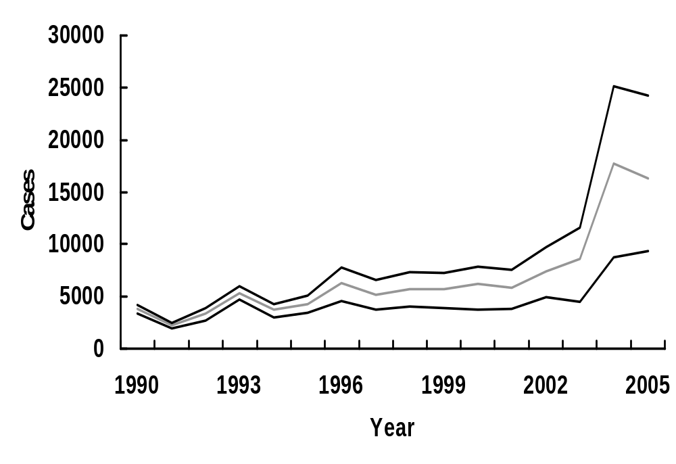
Reported Pertussis by Age Group, 1990-2005
>18 yrs
11-18 yrs
<11 yrs

Slide 5
Tetanus and Diphtheria
Vaccines for Adults
Tetanus and Diphtheria Toxoid (Td)
  formalin-inactivated toxins
  3 doses induces protective antibody in nearly everyone
  protection for at least 10 years

Slide 6
Tetanus and Diphtheria
Vaccines for Adults
Tdap (Adacel®)
  only Tdap brand approved for adults
  single dose
  approved for persons 11 through 64 years of age

Slide 7
Use of Tdap Among Adults
Single dose of Adacel to replace a single dose of Td
May be given at an interval less than 10 years since receipt of last tetanus toxoid-containing vaccine
Special emphasis on adults with close contact with infants (e.g., childcare and healthcare personnel, and parents)

Slide 8
Tdap for Persons Without a History of DTaP
All adults should have documentation of having received a series of DTaP, DTP, DT, or Td
Adults without documentation should receive or complete a series of 3 doses
Preferred schedule*:
  single dose of Adacel
  Td at least 4 weeks after the Tdap dose
  second dose of Td at least 6 months after the Td dose
*off-label recommendation. See MMWR 2006;55(RR-3)

Slide 9
Tdap and Pregnancy*
Td is generally preferred during pregnancy
All women should receive a dose of Tdap in the immediate postpartum period
Any woman who might become pregnant is encouraged to receive a single dose of Tdap
A clinician may choose to administer Tdap to a pregnant woman in certain circumstances, such as during an outbreak of pertussis in the community
Pregnancy is not a contraindication to vaccination with Tdap
*provisional ACIP recommendation, June 2006

Slide 10
Tdap/Td Adverse Reactions
Local reactions
(pain, redness)
Temp >100º F
Systemic events
70%-75%
3%-5%
30%-40%

Slide 11
Tdap Contraindications
Severe allergic reaction to a vaccine component or following a prior dose
Encephalopathy within 7 days of administration of a pertussis vaccine that is not attributable to another identifiable cause

Slide 12
Tdap Precautions
History of an Arthus-type reaction following a previous dose of tetanus or diphtheria toxoid-containing vaccine
Progressive neurologic disorder, uncontrolled epilepsy, or progressive encephalopathy
History of Guillain-Barré syndrome (GBS) within 6 weeks after a previous dose of tetanus toxoid-containing vaccine
Moderate or severe acute illness

Slide 13
Adult Immunization 2006
Satellite Broadcast
December 7, 2006
Zoster Vaccine Segment
Graphics subject to change
This material in the public domain

Slide 14
Herpes Zoster (shingles)
Caused by reactivation of the varicella zoster virus
Can occur years or decades after illness with chickenpox
Generally associated with normal aging and with anything that causes reduced immunocompetence
Lifetime risk of 20% in the United States
Estimated 500,000 to 1 million cases zoster diagnosed annually in the U.S.

Slide 15
Herpes Zoster Vaccine
(Zostavax®)
Contains the same live attenuated varicella virus but at a much higher titer than regular varicella vaccine
Must be stored at freezer temperature at all times
Use within 30 minutes of reconstitution
Administered by the subcutaneous (subQ) route

Slide 16
Zostavax Clinical Trial
Compared to the placebo group the vaccine group had:
  51% fewer episodes of zoster
  Less severe disease
  66% less postherpetic neuralgia
No significant safety issues were identified
NEJM 2005;352(22):2271-84.

Slide 17
ACIP Recommendations* for Zoster Vaccine
Single dose of zoster vaccine for adults 60 years of age and older whether or not they report a prior episode of shingles
Persons with a chronic medical condition may be vaccinated unless a contraindication or precaution exists for their condition
*provisional (as of December 2007)

Slide 18
Adult Immunization 2006
Satellite Broadcast
December 7, 2006
Influenza Vaccine Segment
Graphics subject to change
This material in the public domain

Slide 19
Impact of Influenza and Pneumococcal Disease
Approximately 36,000 influenza-associated deaths during each influenza season
Persons 65 years of age and older accounted for more than 90% of deaths
>2,000 deaths from invasive pneumococcal disease among persons 65 years and older
Source: MMWR 2006;55 (RR-10); ABCs

Slide 20
Influenza Virus Strains
Type A
  moderate to severe illness
  affects all age groups
  affects humans and other animals (particularly migratory waterfowl)
Type B
  milder disease
  primarily affects children
  humans only

Slide 21
Influenza Virus
Type of nuclear
material
Neuraminidase
Hemagglutinin
A/Fujian/411/2002 (H3N2)
Virus
type
Geographic
origin
Strain
number
Year of
isolation
Virus
subtype

Slide 22
Antigenic Drift and Shift
Antigenic Drift
  minor change, same subtype
  associated with epidemics
Antigenic Shift
  major change, new subtype
  associated with pandemics

Slide 23
Influenza Vaccines
Inactivated subunit (TIV)
  intramuscular
  trivalent
  viruses grown in chicken eggs
Live attenuated vaccine (LAIV)
  intranasal
  trivalent
  viruses grown in chicken eggs

Slide 24
Inactivated Influenza
Vaccine (TIV) Efficacy
70%-90% effective among healthy persons <65 years of age
30%-40% effective among persons 65 years and older with underlying medical conditions
Prevents complications and death from influenza among those who get the disease

Slide 25
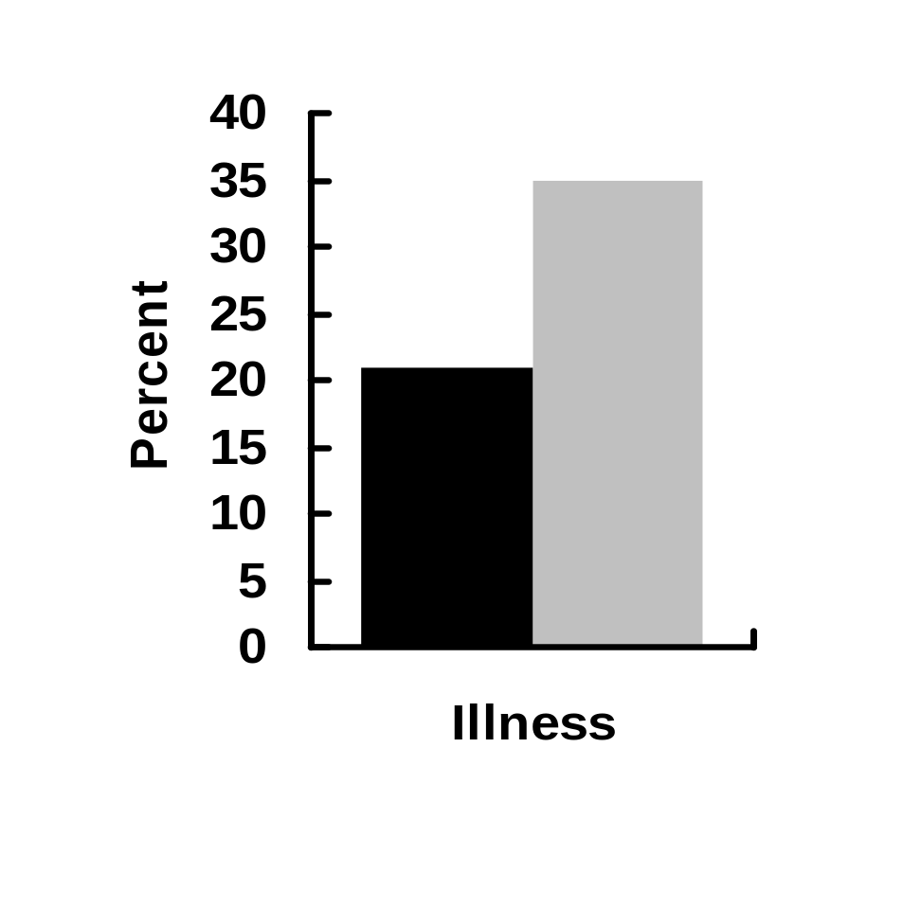
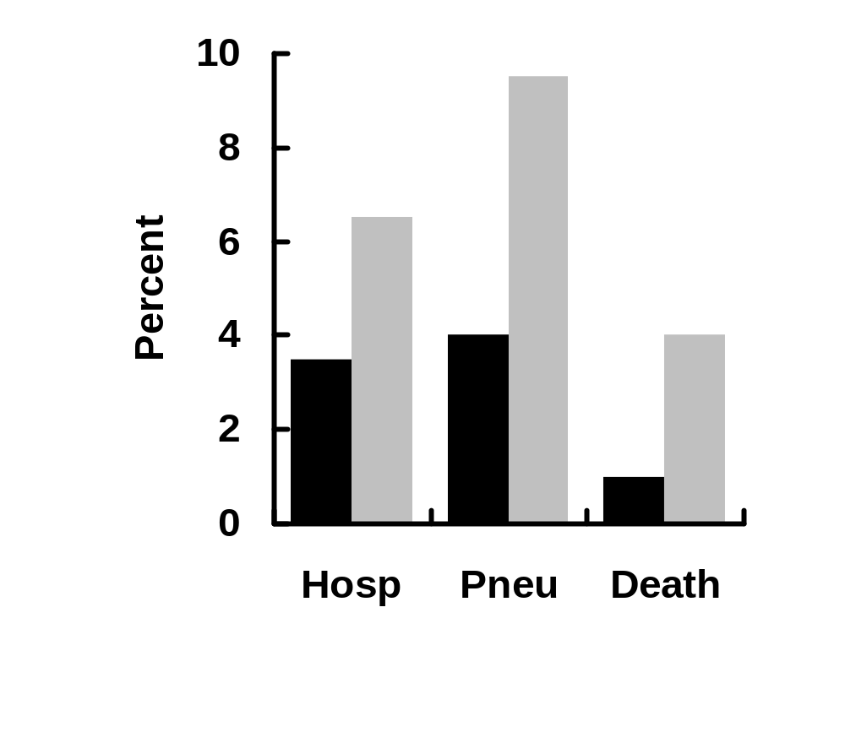
Influenza and Complications Among Nursing Home Residents
Vaccinated*
Unvaccinated
RR=1.9
RR=2.0
RR=2.5
RR=4.2
*Inactivated influenza vaccine. Genesee County, MI, 1982-1983

Slide 26
Live Attenuated Influenza
Vaccine (LAIV)
Approved only for healthy persons 5 - 49 years of age
Do not administer to persons younger than 5 years or older than 49 years
Dose is 0.5 mL

Slide 27
Inactivated Influenza Vaccine
Recommendations
All persons 50 years of age or older
Persons >6 months of age with chronic illness
Healthy children 6 - 59 months of age

Slide 28
Inactivated Influenza Vaccine
Recommendations
Persons with the following chronic illnesses should be considered for inactivated influenza vaccine:
  Pulmonary
  Cardiovascular
  Metabolic
  Renal dysfunction
  Hemoglobinopathy
  Immunosuppression
  Any condition that can compromise respiratory function or the handling of respiratory secretions or that can increase the risk of aspiration

Slide 29
Inactivated Influenza Vaccine
Recommendations
Residents of long-term care facilities
Persons 6 months - 18 years receiving chronic aspirin therapy
Pregnant women

Slide 30
Pregnancy and Influenza Vaccine
Risk of hospitalization >4 times higher than nonpregnant women
Risk of complications comparable to nonpregnant women with high risk medical conditions
ACIP recommends vaccination with inactivated influenza vaccine for ALL women who will be pregnant during influenza season (December through March)
Source: MMWR 2006;55 (RR-10)

Slide 31
Inactivated Influenza Vaccine
Recommendations
Household members of high-risk persons
Healthcare providers, including home care personnel
Employees of long-term care facilities
Providers of essential community services
International travelers
Persons in institutional settings
Anyone who wants to reduce the likelihood of influenza

Slide 32
Live Attenuated Influenza
Vaccine (LAIV)
Approved only for healthy persons 5 - 49 years of age
  Healthcare providers
  Persons in close contact with high-risk groups
  Persons who want to reduce their risk of influenza

Slide 33
Use of LAIV Among Close
Contacts of High-Risk Persons
Inactivated influenza vaccine is preferred for close contacts of severely immunosuppressed persons who require care in a protective environment
Persons who receive LAIV should refrain from contact with severely immunosuppressed persons for 7 days after vaccination

Slide 34
TIV Adverse Reactions
Local reactions
(pain, redness)
Systemic reactions
(fever, malaise)
Severe allergic
reactions
Neurological reactions
15%-20%
<1%
Rare
Very rare

Slide 35
LAIV Adverse Reactions
Significantly increased rate of cough, coryza, nasal congestion, sore throat, chills
No increase in fever
No serious adverse reactions have been identified

Slide 36
Inactivated Influenza Vaccine
Contraindications and Precautions
Severe allergic reaction to a vaccine component or following a prior dose
Moderate or severe acute illness

Slide 37
Live Attenuated Influenza Vaccine
Contraindications and Precautions
Persons 50 years of age and older
Chronic illness
Immunosuppression
Pregnancy
History of Guillain-Barre´ Syndrome
Moderate or severe acute illness

Slide 38
Adult Immunization 2006
Satellite Broadcast
December 7, 2006
Pneumococcal Polysaccharide Segment
Graphics subject to change
This material in the public domain

Slide 39
Pneumococcal Polysaccharide Vaccine
Purified capsular polysaccharide antigen from 23 types of pneumococcus
Account for 88% of bacteremic pneumococcal disease
Cross-react with types causing additional 8% of disease

Slide 40
Pneumococcal Polysaccharide
Vaccine
60% to 70% efficacy against invasive disease
Duration of immunity at least 5 years
Schedule 1 dose, selective revaccination (at least 5 years after the first dose)

Slide 41
Pneumococcal Polysaccharide
Vaccine Recommendations
Adults >65 years of age
Adults of any age with a normal immune system who have chronic illness
  cardiovascular or pulmonary disease
  diabetes
  alcoholism, cirrhosis
  cerebrospinal fluid leak
  cochlear implant

Slide 42
Pneumococcal Polysaccharide
Vaccine Recommendations
Immunocompromised adults
Persons with HIV infection
Persons living in special environments or social settings with an identified increased risk of invasive pneumococcal disease

Slide 43
Candidates for Pneumococcal Revaccination
Functional or anatomic asplenia
Immunosuppression
Chronic renal failure
Nephrotic syndrome
First dose before 65 years of age and >5 years since first dose
First dose at >65 years of age AND later develop a condition for which revaccination is recommended AND at least 5 years since the first dose

Slide 44
Pneumococcal Polysaccharide Vaccine Adverse Reactions
Local reactions
(pain, redness)
Systemic reactions
(fever, malaise)
Severe adverse
reactions
30%-50%
<1%
Rare

Slide 45
Pneumococcal Polysaccharide Vaccine
Contraindications and Precautions
Severe allergic reaction to a vaccine component or following a prior dose
Moderate or severe acute illness

Slide 46
Adult Immunization 2006
Satellite Broadcast
December 7, 2006
Human Papillomavirus Vaccine Segment
Graphics subject to change
This material in the public domain

Slide 47
Human Papillomavirus
More than 100 types
  More than 60 cutaneous types
    Can lead to skin warts
  40 mucosal types
    High risk types (particularly 16 and 18)
      cervical cell abnormalities
      certain anogenital cancers
    Low risk types (particularly 6 and 11)
      cervical cell abnormalities- usually resolve spontaneously and do not lead to cancer
      genital warts
      respiratory papillomatosis

Slide 48
Natural History of HPV Infection
Up to Decades
Within 1 Year
1-5 Years
Initial
HPV Infection
Persistent
Infection
CIN 2/3
Cervical Cancer
CIN 1
Cleared HPV Infection

Slide 49
Cancer Attributable to HPV - 2002
Estimated
Cases
12,000
3,700
4,480
1,000
10,000
Attributable
Fraction
100%
90%
40%
40%
12%
Cancer
Cervical
Anal
Vulvar/vaginal
Penile
Oral/pharynx

Slide 50
HPV-associated Conditions
HPV 16, 18
Cervical cancer
High/low grade cervical
abnormalities
Anal, Vulvar, Vaginal, Penile
Head and neck cancers
HPV 6, 11
Low grade cervical
abnormalities
Genital warts
RRP
Estimated %
70%
30%-50%
10%
10%
90%
90%

Slide 51
Human Papillomavirus
Vaccine Recommendations*
Women 19-26 years of age are recommended to receive the HPV series if they have not already received it
*provisional (as of December 2007)

Slide 52
Human Papillomavirus
Vaccine
3 dose series
Administered intramuscularly
Schedule: 0, 2 months, and 6 months
Minimum intervals:
  dose 1-2: 4 weeks
  dose 2-3: 12 weeks

Slide 53
Human Papillomavirus
Vaccine
Effective only in preventing infection, not in curing disease, or treating a current infection
Recommended for all women in the approved age range (through 26 years) regardless of sexual history, prior HPV infection, or prior disease

Slide 54
Human Papillomavirus Vaccine
Contraindications and Precautions
Severe allergic reaction to a vaccine component or following a prior dose
Moderate or severe acute illness
Defer HPV vaccine until after pregnancy

Slide 55
Adult Immunization 2006
Satellite Broadcast
December 7, 2006
Hepatitis B Vaccine Segment
Graphics subject to change
This material in the public domain

Slide 56
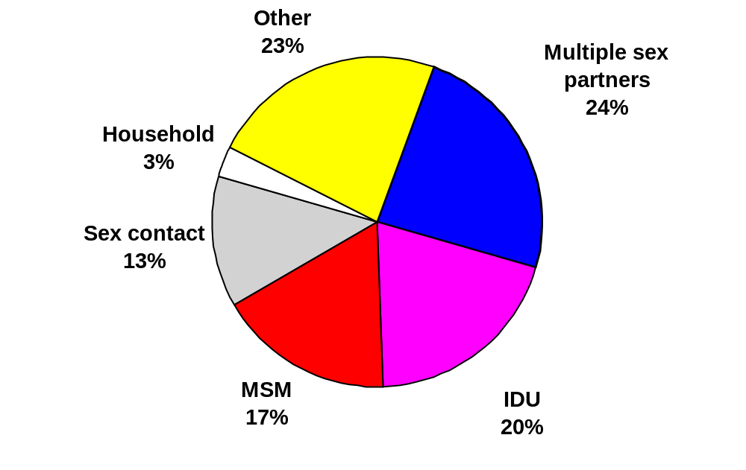
Risk Factors for Hepatitis B
CDC Sentinel Sites. 2001 data.

Slide 57
Hepatitis B Vaccine
Long-Term Efficacy
Immunologic memory develops following vaccination
Antibody level declines following successful vaccination
Anamnestic response upon exposure (antibody level increases quickly)

Slide 58
Hepatitis B Vaccine
Adult Schedule
Usual
Interval
---
1 month
4-6 months
Minimum
Interval
---
4 weeks
8 weeks*
Dose
Primary 1
Primary 2
Primary 3
*third dose must be separated from
first dose by at least 16 weeks

Slide 59
Hepatitis B Vaccine
Booster doses are NOT recommended routinely for any group

Slide 60
Hepatitis B Vaccine
Adult Candidates
Men who have sex with men
Heterosexual with multiple partners
Persons with a recently acquired sexually transmitted disease
Commercial sex workers
Injection drug users
Male prison inmates
Persons receiving hemodialysis

Slide 61
Hepatitis B Vaccine
Adult Candidates
Staff and clients in institutions for the developmentally disabled
Alaska Natives, Pacific Islanders
Household members of adoptees from hepatitis B endemic areas
Household members and sex partners of HBV carriers
Persons who travel to HBV-endemic areas
Recipients of certain blood products

Slide 62
Hepatitis B Vaccine
Adverse Reactions
Pain at injection site
Mild systemic complaints
(fatigue, headache)
Temperature >100ºF
Severe systemic reactions
13%-29%
11%-17%
1%
rare

Slide 63
Adult Immunization 2006
Satellite Broadcast
December 7, 2006
Hepatitis A Vaccine Segment
Graphics subject to change
This material in the public domain

Slide 64
Hepatitis A
Fecal-oral transmission
Indistinguishable from other types of hepatitis
Does not lead to chronic infection
Complications related to the acute disease

Slide 65
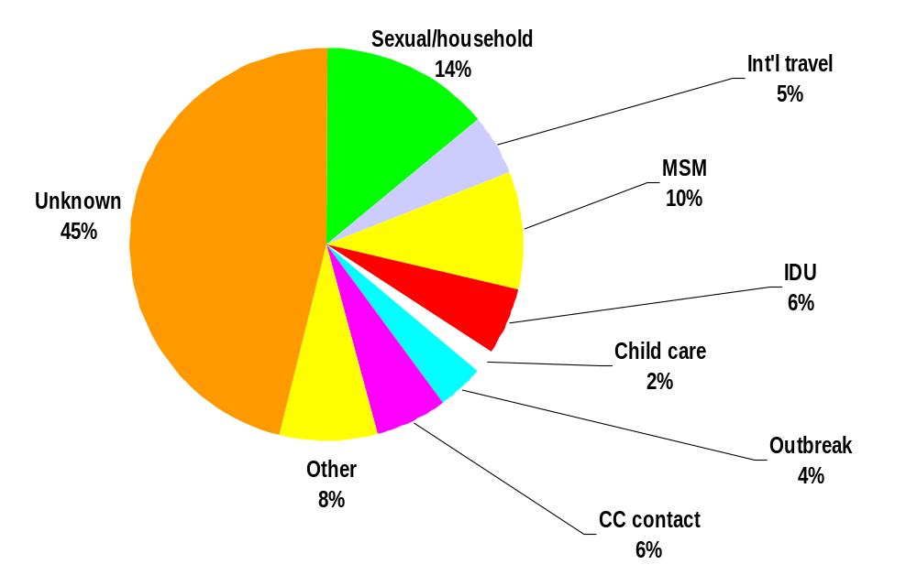
Source of Hepatitis Infection, 1990-2000
Source: NNDSS/VHSP

Slide 66
Hepatitis A Vaccines
Inactivated whole virus
Pediatric and adult formulations
Adult formulations for persons 19 years and older
2 dose series (0, 6-18 months)
Minimum interval between doses is 6 calendar months
Not necessary to repeat the first dose if the interval is longer than the recommended 6 to 18 months

Slide 67
Twinrix®
Hepatitis B (adult dose) and hepatitis A (pediatric dose)
3-dose series at 0, 1, 6 to 12 months
Approved only for adults 18 years of age and older

Slide 68
Hepatitis A Vaccine
Recommendations
International travelers
Men who have sex with men
Persons who use illegal drugs
Persons with occupational risk (limited to certain laboratory personnel and animal handlers)
Persons with chronic liver disease, including hepatitis C

Slide 69
Hepatitis A Vaccine
Adverse Reactions
Local reactions
Systemic reactions
(fever, malaise)
No serious adverse reactions reported
20%-50%
<10%

Slide 70
Hepatitis A Vaccine
Contraindications and Precautions
Severe allergic reaction to a vaccine component or following a prior dose
Moderate or severe acute illness

Slide 71
Adult Immunization 2006
Satellite Broadcast
December 7, 2006
MMR Vaccine Segment
Graphics subject to change
This material in the public domain

Slide 72
Measles-Mumps-Rubella
Vaccine (MMR)
Contains live attenuated viruses
Effective in preventing disease caused by these viruses in up to 95% of recipients of one dose
Variation in the efficacy of the components (mumps efficacy lower than for measles and rubella)
All adults born after 1956 should have documentation of at least 1 dose (or other evidence of immunity)

Slide 73
Adults at High Risk for
Measles
College students
International travelers
Healthcare personnel

Slide 74
MMR Adverse Reactions
Fever 5%-15%
Rash 5%
Joint symptoms 25%
Thrombocytopenia <1/30,000 doses
Parotitis rare
Deafness rare
Encephalopathy <1/1,000,000 doses

Slide 75
MMR Vaccine
Contraindications and Precautions
Severe allergic reaction to vaccine component or following prior dose
Pregnancy
Immunosuppression
Moderate or severe acute illness
Recent receipt of a blood product

Slide 76
Measles Vaccine and HIV Infection
MMR recommended for persons with asymptomatic and mildly symptomatic HIV infection
NOT recommended for persons with evidence of severe immuno-suppression
Prevaccination HIV testing not recommended

Slide 77
MMR Vaccination of Women of Childbearing Age
Ask if pregnant or likely to become so in next 4 weeks
Exclude those who say "yes“
For others
  explain theoretical risks
  vaccinate

Slide 78
Adult Immunization 2006
Satellite Broadcast
December 7, 2006
Varicella Vaccine Segment
Graphics subject to change
This material in the public domain

Slide 79
Varicella Vaccine
Composition Live virus
(Oka/Merck strain)
Efficacy 70%-90%
(any disease)
95%-100%
(severe disease)

Slide 80
Varicella Vaccine
Adverse Reactions
Local reactions
(redness, pain)
Rash
Fever >100ºF
20% to 30%
6% (first dose)
1% (second dose)
10%

Slide 81
Varicella Vaccine
Contraindications and Precautions
Severe allergic reaction to vaccine component or following prior dose
Pregnancy
Immunosuppression
Moderate or severe acute illness
Recent receipt of a blood product

Slide 82
Varicella Vaccine
Use in Immunocompromised Adults
Most immunocompromised persons should not be vaccinated
Vaccine is effective and safe in persons with isolated humoral immunodeficiency
  passive antibody used to treat the condition may interfere with vaccine

Slide 83
Adult Immunization 2006
Satellite Broadcast
December 7, 2006
Meningococcal Vaccine Segment
Graphics subject to change
This material in the public domain

Slide 84
Meningococcal Disease
Caused by Neisseria meningiditis
Infants <1 years of age highest risk
College freshmen who live in a dormitory at increased risk
Two meningococcal vaccines available in the United States
  Polysaccharide vaccine approved in 1978 (Menomune®)
  Conjugate vaccine approved in 2005 (Menactra®)

Slide 85
Meningococcal Polysaccharide
Vaccine (MPSV) - Menomune®
Quadrivalent (serogroups A, C, Y, W-135)
Approved for persons 2 years of age and older
Administered by subcutaneous injection

Slide 86
Meningococcal Conjugate
Vaccine (MCV) - Menactra®
Quadrivalent (serogroups A, C, Y, W-135) conjugated to diphtheria toxoid
Approved for persons 11-55 years of age
Administered by intramuscular injection
MCV is preferred for persons 11- 55 years of age
MPSV is acceptable if MCV is not available

Slide 87
Meningococcal Vaccine
Recommendations
Recommended for certain high-risk persons:
  military recruits
  certain research and laboratory personnel
  travelers to and U.S. citizens residing in countries in which N. meningitidis is hyperendemic or epidemic
  college freshmen living in a dormitory

Slide 88
Meningococcal Vaccine
Recommendations
Recommended for certain high-risk persons:
  terminal complement
  component deficiency
  HIV infection
  functional or anatomic asplenia

Slide 89
Meningococcal Vaccine
Revaccination
Most persons with an indication for meningococcal vaccine need only one dose
Some very high risk persons (e.g., asplenic persons) may need a second dose if the first dose was meningococcal polysaccharide vaccine*
A booster dose following meningococcal conjugate vaccine is currently not recommended
*see MMWR 2005;54(RR-7) for details

Slide 90
Adult Immunization 2006
Satellite Broadcast
December 7, 2006
Adult Immunization Strategies Segment
Graphics subject to change
This material in the public domain

Slide 91
Influenza Vaccination
Coverage for Adults, 2005
18- 49 years of age
with high risk
conditions
50-64 years of age
HP 2010 goal
18%
34%
60%

Slide 92
Pneumococcal Vaccination
Coverage for Adults, 2005
18- 49 years of age
with high risk
conditions
50-64 years of age
HP 2010 goal
15%
31%
60%

Slide 93
Vaccination Coverage for
Adults 65 Years and Older
Influenza vaccine
Pneumococcal vaccine
HP 2010 goal
60%
56%
90%

Slide 94
One of the most important reasons adults identify for not receiving a vaccine is the lack of a provider recommendation for the vaccine.

Slide 95
Interventions to Improve
Adult Vaccination Coverage
Client reminder and recall systems
Provider reminder and recall systems
  computer notification
  flow sheet or checklist
  flagging medical record with sticker or stamp
Assessment and feedback for providers

Slide 96
Interventions to Improve
Adult Vaccination Coverage
Standing orders
  allow nonphysician personnel to prescribe or deliver vaccines using a protocol
Reducing out-of-pocket costs for patients
Expanding access
  increasing or changing hours when immunization services are offered
  “express lane” for immunizations

Slide 97
Adult Immunization 2006
Satellite Broadcast
December 7, 2006
Vaccination of Healthcare Personnel Segment
Graphics subject to change
This material in the public domain

Slide 98
Sources of Healthcare Personnel Vaccination Recommendations
Immunization of Health-care Workers: Recommendations of the Advisory Committee on Immunization Practices (ACIP) and the Hospital Infection Control Practices Advisory Committee (HICPAC). MMWR 1997;46(No. RR-18):1-42.
Annual adult immunization schedule, available at
www.cdc.gov/nip/recs/adult-schedule.htm
Vaccine-specific ACIP statements

Slide 99
Diseases with Occupational Risk for Healthcare Personnel
Hepatitis B
Influenza
Measles
Mumps
Rubella
Varicella
Meningococcal disease (certain laboratory personnel only)

Slide 100
Influenza Vaccination of
Healthcare Personnel
Only 42% of U.S. healthcare personnel were vaccinated in 2004
Resource for improving influenza vaccination of healthcare personnel available:
MMWR 2006; 55 (No. RR-2):1-15 (February 9, 2006)

Slide 101
Measles Vaccination of
Healthcare Personnel
Born in 1957 or later
  documentation of 2 doses of measles-containing or other evidence of immunity (e.g., serology)
Born before 1957
  1 dose of measles-containing vaccine should be considered

Slide 102
Mumps Vaccination of
Healthcare Personnel
Routine vaccination
  same criteria for immunity as for measles
During a mumps outbreak
  facilities should strongly consider recommending 2 doses of mumps vaccine to unvaccinated personnel born before 1957 who do not have evidence of mumps immunity

Slide 103
Varicella Immunity Among
Healthcare Personnel
Laboratory evidence of immunity
Clinician diagnosed or verified history of varicella or zoster
Age-appropriate vaccination
Birth before 1980 should NOT be considered as evidence of immunity for healthcare personnel

Slide 104
Healthcare Personnel Without a Written Vaccination Record
If a written vaccination record cannot be located, healthcare personnel should be considered susceptible and should be vaccinated as age-appropriate
Serologic testing can be considered for diseases with an established serologic correlate of immunity (e.g., measles, rubella)

Slide 105
Hepatitis B Postvaccination Serologic Testing
ACIP recommends testing for hepatitis B surface antibody 1- 2 months after the third dose
Anti-HBs of >10 mIU/mL indicates immunity
If negative, repeat series of 3 doses followed by repeat serologic testing
“Catch-up” serologic testing of persons vaccinated (and not tested) in the past is not recommended (test if exposed)

Slide 106
National Immunization Program
Telephone (800) CDC-INFO
Email nipinfo@cdc.gov
Website www.cdc.gov/nip
Broadcast Updates and Resources
Web Page
www.cdc.gov/nip/ed/UpdatesandResources.htm

