Slide 1

2004 Assistance to Firefighters
Grant Program
Workshop for
New Applicants
Office for Domestic Preparedness
U.S. Department of Homeland Security
Notes:
Instructor’s Notes
There are two versions of the Applicant Workshop presentations: one for New Applicants and one for Previous Applicants. This is the New Applicants PowerPoint presentation, which covers all aspects of the program and gives detailed guidance on preparing and completing the online application. The presentation for Previous Applicants focuses on what is new in the program in FY 2004 and lessons learned in FY 2003.
If a separate training session is conducted for New Applicants, the instructor has the option of scheduling and presenting the presentations at different times. It is suggested that the New Applicant presentation be given first because it provides the most detail.

Slide 2

About This Presentation
Designed for New Applicants Who Are Not Familiar with the Assistance to Firefighters Grant Program, and
Have Not Previously Filed an Online Application.
View/Download Presentation from ODP Web Site: www.ojp.usdoj.gov/odp
Notes:
Instructor’s Notes
Download of PowerPoint Presentations: The instructor should explain that it is possible for individuals to download the PowerPoint presentation(s) (New Applicants and Previous Applicants) from the ODP Web site (www.ojp.usdoj.gov/odp/) for viewing when it is convenient.
Online Tutorial: An online tutorial will be available on the ODP Web site to help applicants use the online Grant Application.
At any point in the online tutorial, applicants will be able to move from one section to another by clicking on the menu located on the left side of the screen they are viewing.
The tutorial can be customized according to the user’s needs and interests.
FAQs will be updated regularly in the tutorial

Slide 3
Contents
Purpose
Grant Program Areas
Eligibility
Online Grant Tutorial
Grantee Requirements
Program Area 1: Operations and Firefighter Safety
Program Area 2: Fire Prevention
Program Area 3: Firefighting Vehicle
Notes:
Instructor’s Notes
Do not get into detail when reviewing the Contents items. Specific information will be provided later in the presentation.

Slide 4
Contents continued
Online Application
Lessons Learned in 2003
Top 10 Reasons Why Applicants Fail
Key Points
Next Steps
Questions
Notes:
Instructor’s Notes
NEW this year―We have added a “Lessons Learned” topic that discusses helpful hints derived during the FY 2003 program from applicants, Points of Contact, GPO staff, and GMS personnel.

Slide 5
Purpose of the
Assistance to Firefighters
Grant Program
The purpose of the Assistance to Firefighters Grant Program is to protect the health and safety of the public and firefighting personnel against fire and fire-related hazards, and to provide assistance for fire prevention programs.
Notes:
Instructor’s Notes
Make the point that this grant program is designed to fund the essential basic needs of local fire departments, and those applicants that focus on essential basic needs stand the best chance for success.
Local fire departments are those that protect urban, suburban, and rural communities.
They may be all career, all volunteer, paid/on-call, or have a combination of volunteer and career members.
Local fire departments may submit grant requests by completing an online application during the application period (spring 2004). Details on the online application appear later in this presentation.

Slide 6
Grant Program Areas
Each Fire Department May Submit Only One Application in One of Three Grant Program Areas:
  Operations and Firefighter Safety
  Fire Prevention
  Firefighting Vehicle
  Notes:
  EMS items are included in Operations and Firefighter Safety.
  Preparedness for CBRNE incidents has been always been eligible, but emphasized in the 2004 Grant Program.
Notes:
Instructor’s Notes
Each fire department may submit only one application in any one of three program areas:
Operations and Firefighter Safety
Fire Prevention
Firefighting Vehicle
Operations and Firefighter Safety includes five activities. Advise the participants that each of these activities will be discussed in detail later in this presentation.
The Instructor should emphasize that the focus of the program is to meet the essential basic needs of fire departments within each of the eligible activities. Also emphasize that the application is designed to provide all applicants with an equal opportunity to receive a grant because the priorities of the program reflect the unique needs of urban, suburban, and rural communities.
Urge the applicants to read the Program Guidance and to match their requests to the stated priorities as outlined in this document.
NEW this year: WMD preparedness support can be requested under PPE, Equipment, and Training activities in the Operations and Firefighter Safety Program. “Firefighting Equipment” (FFE) in FY 2003 has been modified to “Equipment” in 2004. Citizen awareness programs are also eligible in the Fire Prevention Program.

Slide 7
Eligibility
Who May Apply for the $750 Million Competitive Program?
Local Fire Departments of a State, Tribal Community, or Territory
Fire Departments: All Career, All Volunteer, or Combination
Previous Grant Awardees
Notes:
Instructor’s Notes
The program is funded at $750 million in FY 2004.
This competitive grant program is available to local fire departments of a State, tribal community, or territory. Those fire departments that provide emergency medical and rescue services are also eligible.
A fire department is defined as an agency or organization that has a formally recognized arrangement with a State, local or tribal authority (city, county, parish, fire district, township, town, or other governing body) to provide fire suppression to a population within a fixed geographical area.
Previous grant award winners may apply for another grant.
Funds are distributed on the basis of percentage of population protected by each type of FD. According to the NFPA Profile, 55% of the U.S. population protected by volunteer and combination fire departments; 45% by career fire departments.

Slide 8
Who is Not Eligible?
Private, For-Profit Fire Departments
Federally Funded Fire Departments
State Agencies, Independent Training Academies
Organizations Not Providing Fire Suppression, e.g., Rescue Squads
Airports, Port Authorities (Unless Formal Agreement Exists for First-Due Response to Adjacent Areas)
Questions? Call program help desk at 1-866-274-0960
Notes:
Instructor’s Notes
Airport and port authorities may be eligible if they have a formal agreement to provide first-due response to areas adjacent to their facilities.
Ineligible applicants include
Private for-profit fire departments
State agencies
Federally funded fire departments
Organizations that exclusively provide emergency medical and
rescue services
Organizations that provide only Search-and-Rescue services
Independent training academies
Questions concerning eligibility should be referred to the Help Desk at 1-866-274-0960 or usfagrants@dhs.gov. A response will be provided within 1 business day.

Slide 9
What is Not Eligible for Funding?
Operating Budgets
  May Not Replace Part of Annual Operating Budget
  Must Maintain Expenditure Level
Indirect Costs
  Unless Applicant Has Preexisting Federally Approved Indirect Cost Rate Agreement
Construction
  Building or Expanding Buildings Beyond Original Footprint
Notes:
Instructor’s Notes
A grant award is intended to supplement a department’s budget, not replace a portion of it. Therefore, grant recipients are required to maintain expenditures at a level at least equal to an average of the department’s expenditures for the previous 2 years for the activity for which the grant was awarded.
Construction where building permits are required are not eligible. Even when modifications are undertaken, they may be subject to an environmental and/or historical review. Renovations are allowed if the renovation is limited to the interior of the structure and does not disturb the site.

Slide 10
Online Grant Tutorial www.ojp.usdoj.gov/odp
Explanation of Grant Program
Guidance for Navigating Application Screens
Success Stories and Illustrations
Lessons Learned in FY 2003
New in the 2004 Grant Program
Notes:
Instructor’s Notes
Online Grant Tutorial: An online tutorial will be available on the Internet in early February to help applicants use the online grant application. This tutorial explains the application screens, provides tips for navigating the application screens, and summarizes the changes in the grant program that are new in FY 2004. The tutorial also provides a review of the lessons learned in the FY 2003 grant program.
Advise the applicants that they can access the online tutorial by clicking on the Assistance to Firefighters Grant Program link on the ODP Web page menu (www.ojp.usdoj.gov/odp). They will be able to download the tutorial and use it for guidance throughout the application process.
At any point in the online tutorial, applicants will be able to move from one topic to another by clicking on a button on the menu screen, which will be visible at all times during the tutorial. For example, an applicant can obtain more specific information about the topic of Firefighting Vehicles by clicking on that item on the tutorial’s menu.

Slide 11
Grantee Requirements:
Raise Matching Funds
Maximum Federal Share: $750,000
Match Not Required at Time of Application or Award
Required by End of Period of Performance
Must Be New Money
In-Kind Services Not Counted Toward Match
Notes:
Instructor’s Notes
The maximum Federal share available for any one applicant is $750,000.
The matching funds can be applied at any time during the period of performance; matching funds do not have to be in hand when the application is submitted or when the grant is awarded. However, a commitment to apply the match must be made at the time of award.
The local match must be in cash (new money). In-kind services are not allowed as part of the match.

Slide 12
Matching Funds: Population-Based
Departments Serving Pops. of 50,000 or Less Expected to Provide Min. 10% Cash Match of Amount Requested
Departments Serving Pops. of More Than 50,000 Expected to Provide Match of at Least 30%
Notes:
Instructor’s Notes
Fire departments that serve a population of 50,000 or less are required to provide at least a 10% match of the amount of the project. For example, if a department is awarded a grant for a program of $100,000, it would be required to fund $10,000 of the grant, and the federal share would be $90,000.
Fire departments that serve populations of more than 50,000 must provide a match of 30%.

Slide 13
Other Grantee Requirements
Start Reporting to National Fire Incident Reporting System for Period of Performance (NFIRS National Help Desk: 1-888-382-3827
File Progress Reports
Maintain Documentation; Submit to Audit or Program Review
Follow Established Procurement Procedures
Notes:
Instructor’s Notes
Although the requirement for NFIRS reporting is only for period of performance, the instructor should encourage their continued participation in this System.
Progress reports include at a minimum two interim reports, a closeout report, and an end-of–period of performance report. The purpose of the reports is to gather information that can be used to explain to Congress the beneficial impact that the program has on local fire departments and communities.
Grantees will be required to maintain ongoing documentation of their grant, e.g., purchase orders, training records, invoices, etc. Records must be kept current so that at any time a Federal government representative can review the status of their grant. Records must be maintained for a minimum of 3 years from the date of award.
All departments that receive awards will be audited. Some audits may be conducted on paper while others may involve site visits. An audit will be done by Inspector General’s Office or the General Accounting Office. Program Reviews are conducted by the POCs as a part of the monitoring program.
Ensure that all procurement actions are conducted in a manner that provides, to the maximum extent possible, open and free competition. In doing so, you must follow your local or established procurement processes when purchasing vehicles, equipment, and/or services with the grant funds. If the fire department has no established procedures, you should obtain at least two quotes/bids for the items you are procuring and document in your grant files the process used.

Slide 14
Program Area 1:
Operations and Firefighter Safety
Requests May Be for One or All Five Activities
  Training*
  Equipment*
  Personal Protective Equipment*
Note: Includes Items for Fire, Rescue, EMS, and CBRNE
Notes:
Instructor’s Notes
There are five eligible activities within this program area. Each one will be discussed in detail later in the presentation.
NEW for this year: WMD preparedness support may be requested under the “Training,” “Equipment,” and “PPE” activities. WMD equipment includes monitoring equipment, special pharmaceuticals, etc., that are used in WMD incidents.
EMS Program Incorporation: In 2003, only 1% of the applications received were in the EMS Program area, although it is well documented that a significant amount of service demand comes from EMS in departments that provide such services. The FY 2003 EMS Program has been incorporated into Program Area 1’s Training, Equipment, and Wellness/Fitness activities for the FY 2004 Program. EMS Training and Equipment: Accordingly, requests for assistance in EMS training and equipment will be added to the new “Training” and “Equipment” activities.
E-Application: EMS items such as defibrillators, splints, and other supplies have been added to the pull-down screens for “Equipment” in the online application.

Slide 15
Additional Activities
Wellness and Fitness Programs
Modification of Facilities
Notes:
Instructor’s Notes
Wellness and Fitness: Focused on Health and Safety of Firefighters
Modification of Facilities: Designed to improve firefighter health and safety.

Slide 16
Training Priorities
Operations and Firefighter Safety
  Basic Firefighting
  Emergency Medical Services Certification
  Required Special Operations Skills
  CBRNE Preparedness
Notes:
Instructor’s Notes
Training Activities: Examples of training activities include, but are not limited to firefighting I and II, driver/operator, fire officer, hazardous materials response, incident command, supervision and safety, or training firefighting personnel to provide training in any of these areas.
Special Operations Skills: Includes NFPA HazMat operations-level certification; rapid intervention team (RIT) training, etc.
EMS: The FY 2003 EMS Program has been incorporated into the training, equipment, and wellness/fitness activities for the FY 2004 Program. EMS Training and Equipment: In 2003, only 1% of the applications received were in the EMS Program area, although it is well documented that a significant amount of service demand comes from EMS in departments that provide such services. Accordingly, requests for EMS training and equipment will be added to the new “Training” and “Equipment” activities.
WMD Note: Details on WMD preparedness activities are provided on the next screen/Instructor’s notes.

Slide 17
CBRNE Training Examples
Operations and Firefighter Safety
CBRNE Training Levels:
  Awareness
  Performance
  Planning and Management
Note: ODP offers a variety of CBRNE training courses free of charge; visit the ODP Web site for details (www.ojp.usdoj.gov/odp/docs/coursecatalog.pdf) or call the ODP Helpline at 1-800-368-6498.
Notes:
Instructor’s Notes
NEW this year in WMD: WMD preparedness support may be requested under Training, Equipment, and PPE activities. WMD equipment includes monitoring equipment, special pharmaceuticals, etc., used in WMD incidents.
WMD Training: ODP provides WMD training at the Awareness, Performance, and Planning and Management levels FREE OF CHARGE for eligible applicants. This training is listed in the ODP Course Catalog (www.ojp.usdoj.gov/odp/docs/coursecatalog.pdf) or may be obtained by calling the ODP Helpline at 1-800-368-6498.
Examples of WMD training include the following:
Operations-level Training
Technician-level Training
Other Specialized WMD Training:
Specialist
EMS for Incidents Involving WMD
ICS for Terrorism
Mass Decontamination
Live Agent
Explosives and Secondary Device Awareness
Seaport
Environmental
Exercises/Preparedness
UASI Partners: Priority is given to departments that fall in jurisdictions that are mutual aid partners of Urban Areas Security Initiative (UASI) cities, who have critical infrastructure specifically mentioned in their State’s homeland security strategy, or that are UASI cities.

Slide 18
Training Priorities
  Priorities tailored to community type:
    Urban
    Suburban
    Rural
  Space Renovation for Training (up to $10,000)
Notes:
Instructor’s Notes
Community training priorities are tailored to type of community (urban, suburban, or rural).
Priority will be given to types of training unique to specific community or department needs. Applicants will need to justify the types of training requested. See the following for some examples:
For all communities, high priorities are WMD awareness and NFPA safety officer certifications.
For all communities, secondary priorities are
NFPA 1003: Airport FF Professional Qualifications
NFPA 1006: Rescue Technician Professional Qualifications
NFPA 1670: Operations & Training–Technical Rescue Incidents
EMT-P
For rural communities, basic courses are high priorities (NFPA 1001, 472, 1002, 1021 RIT and EMT-B, and EMT-I.
For urban/suburban fire departments, HazMat tech, fire inspector, fire investigator, etc, are high priorities.
Renovations: Renovations that are necessary to accomplish the training function are eligible, however, the footprint of the building may not change, i.e., the building may not be enlarged, nor can the height increase. Maximum of $10,000.

Slide 19
Training Delivery Priorities
  (In Order of Priority)
  Tested Training (Instructor-Led, Leading to State or National Certification)
  Instructor-Led or Guided But Not Including a Testing Component or Certification
  Other Training and Training-Related Equipment
Notes:
NEW this year:
First Priority: Tested training that is direct, instructor-led, guided, or hands-on (in person) and leads to State or national certification is the highest priority and may include the following:
Classroom setting with instructor
In-house or offsite training
Interactive or real-time training
Distributive/distance learning
State or nationally approved and/or accredited courses
EMS certification: Basic-level training (first responder, EMT-B, and EMT-I) are given higher priority than advanced-level training.
Second Priority: Training that is direct, “hands-on” (in person), instructor-led or guided but does not include a testing component or lead to certification. This may include the following:
In-station training (drills, simulations, etc.)
Self-guided classes using workbooks, CDs, etc.
Attending professional conferences
Third Priority: Other Training and/or Training-Related Equipment includes videos, multimedia materials, training props, and equipment, such as LED projectors and computer training software.

Slide 20
Equipment Priorities
  Basic Tools
  Forcible Entry Tools
  Extrication Tools
  Ladders and Hoses
  CBRNE Response Equipment
  EMS Equipment
Note: First purchases or replacing obsolete/ substandard equipment are priorities.
Notes:
Instructor’s Notes
The Equipment Activity includes equipment needed directly for fire suppression or to enhance the safety or effectiveness of firefighting, EMS, or rescue activities. Equipment includes basic firefighter tools and appliances such as forcible entry tools, ladders, and hoses. The stated purpose of this grant program is to protect the health and safety of firefighters from fire and fire-related hazards, therefore basic equipment is the priority. Equipment should not be confused with items such as SCBA, helmets, boots, etc., that are worn by firefighters to protect them from dangers in the atmosphere.
Other eligible Equipment items include washer/extractors, compressors, generators, and small watercraft. We recommend that the applicant refer to the Program Guidance for details.
NEW this year—WMD Equipment: Tools and equipment used exclusively for WMD incidents may include items such as monitoring devices and WMD-related pharmaceuticals. Other examples include the following:
Detection and Monitoring
Real-time X-ray
Biological Detection
Mini-cams
Amino Assay - Thermocycler Biological Agent Detector
EMS: Auto-injectors
EMS: Basic EMS and rescue tools such as defibrillators and extrication tools are also eligible in this activity this year.
E-Application More examples of eligible items are included in the pull-down menu on the Equipment screen.

Slide 21
More Equipment Priorities
  Radios and Pagers
  CAD and MDT Systems
  Thermal Imaging Cameras
  Breathing Air Compressors
  Industrial Washers/Extractors
  ATVs, Small Boats (13 ft. and under)
Notes:
Instructor’s Notes
Communications: Communications equipment such pagers and portable and mobile radios are eligible. Devices that promote interoperability with neighboring jurisdictions are a priority. Cellular telephones, however, are not eligible.
Thermal Imaging Cameras: Thermal imaging cameras are eligible but are limited in quantity to one camera for communities with fewer than 20,000 people, two cameras for communities with between 20,000 and 50,000 people, and three cameras for communities with more than 50,000 people.
Breathing Air Compressors: Breathing air compressors (both stationary and portable) are eligible along with the associated cost for installation. Other associated equipment such as cascade systems and fragmentation protection systems are also eligible.

Slide 22
Personal Protective Equipment (PPE)
Structural, Wildland, HazMat, EMS, and CBRNE Ensembles
Self-Contained Breathing Apparatus (SCBA)—Guideline is 1 Spare Cylinder
Personal Alert Safety Systems (PASS)
Fire Shelters
Note: Condition rather than age of PPE items will be a priority consideration. All PPE should meet or exceed national and/or Federal regulations.
Notes:
Instructor’s Notes
Priorities in FY 2004 will focus on the condition of PPE items to be replaced rather than age.
PPE Activity: Personal protective equipment includes equipment required for active firefighting personnel by the Occupational Safety and Health Administration (OSHA), and other PPE for firefighting personnel. [The OSHA Standard (29 CFR) Fire brigades. -1910.156, applies to fire department responsibilities for firefighter safety, including protective clothing. Additionally, NFPA 1971 through 1975 are referenced in this OSHA standard.] PPE includes those items worn by firefighters and EMS personnel to protect them from exposure to bodily fluids, hazardous materials, and dangers in the atmosphere.
NEW this year: Nationally certified WMD PPE is preferred over noncertified PPE, e.g., NIOSH, NFPA certifications. WMD-specific PPE includes protective equipment (CBRN-certified SCBA, chemical/biological suits conforming to NFPA 1994, 2001 edition) that meets national standards for operations in incidents involving CBRN.
Note: One spare bottle per SCBA will be used as a guideline for consideration in 2004.
Station-wear is not eligible.
E-Application: Recommend that the applicant refer to the Program Guidance for details. The PPE screen has a pull-down menu that lists examples of eligible items. Washer/extractors, compressors, cascade systems, and testing equipment should be requested in the Equipment activity only rather than in PPE.

Slide 23
Wellness and Fitness Programs
Emphasis on Programs Featuring
  Periodic Physical Exams Combined With
    Initial Physical Exams
    Job-Related Immunization Programs
Notes:
Instructor’s Notes
This activity is designed to provide assistance to fire departments in implementing
Initial physical examinations,
Job-related immunization programs, and
Periodic physical examinations and health screenings.
All three programs must be in place before applicants are allowed to request any other type of wellness/fitness activity/service, such as
Physical fitness equipment
Employee assistance
Injury and illness rehab
Injury prevention, etc.

Slide 24
Other Wellness and Fitness Programs
Injury Prevention
Critical Incident Stress Management
Employee Assistance
Injury and Illness Rehab
Renovation of Space (Up to $10,000)
Physical Fitness Equipment
Notes:
Instructor’s Notes
Other eligible programs are those for formal injury prevention, critical incident stress management, employee assistance, injury and illness rehabilitation, and physical fitness equipment.
An applicant may request up to $10,000 to renovate an existing space to accommodate a wellness and fitness program provided that the footprint of the building is not changed. Refer to the Program Guidance for details.
Injury and Illness rehab: Includes physical therapy.
Employee Assistance: Treatment for chemical dependency, post-traumatic stress disorder, etc.

Slide 25
Modification of Facilities*
Vehicle Exhaust Systems
Fire Alarm and/or Detection Systems
Automatic Fire Sprinkler Systems
Fixed Emergency Generators
Priority Given to Facilities Staffed 24–7
*Note: Environmental review may be required.
Notes:
Instructor’s Notes
Grant funds may be used to help fire departments protect the health and improve the safety of their members by modifying an existing facility in one of the following ways:
Installation of vehicle exhaust systems,
Installation of fire alarm and/or detection systems, and
Installation of automatic fire sprinkler systems.
Vehicle exhaust extraction systems should be extensive enough to extract all toxic vapors and particulates emitted from internal combustion engines, and meet all applicable Federal, State, and local standards.
Stationary or fixed emergency generators, formerly eligible under FFE, should be requested under this activity. Portable generators should be requested under “Equipment.” Environmental review may be necessary before accomplishing this portion of an award.
Renovations necessary to support requests for training, fire prevention, and/or wellness/fitness should be requested in those activities and are not eligible in this activity.
Limitations for modifications are $100,000 per fire station.
The highest priority is given to facilities that are staffed around the clock. Refer applicants to the Program Guidance for details.

Slide 26
Program Area 2: Fire Prevention
Public Education
Fire Prevention Literature
Code Enforcement
Arson Awareness and Abatement
Public CBRNE Awareness
Smoke Alarm and/or Sprinkler Systems*
*Sprinkler systems are not eligible unless installed specifically as a critical element in a demonstration or awareness project.
Note: Priority given to programs based on a risk assessment.
Notes:
Instructor’s Notes
Eligible activities for the Fire Prevention Program include
Public Education
Smoke Alarm and Sprinkler Systems
Fire Prevention Literature
Code Enforcement
Arson Awareness and Abatement
Public WMD Awareness
Eligible contracted services: personnel, presentation aids, education on wildland fire mitigation plans, etc.
WMD Awareness programs are eligible to support fire departments in providing courses to prepare citizens for incidents involving WMD (Citizen Corps, etc.)
An additional opportunity to apply for fire prevention funding will be available in the fall under the auspices of the Special Fire Prevention and Safety Grant Program. For details, visit the Web site at [www.usfa.fema.gov]. Refer to the Program Guidance for the details.

Slide 27
Fire Prevention Priorities
Highest Priority Given to Prevention Programs Targeting
  Children Ages 14 and Younger
  Adults 65 and Older
  Firefighters
Space Renovation Supporting Fire Prevention (Up to $10,000)
Notes:
Instructor’s Notes
By statute, a minimum of 5% of the total grant funds must be expended on programs designed to prevent fires. The highest priority will be given to those programs that target these populations:
Children age 14 and younger
Adults 65 and older
Firefighters
Highly rated applications are those that commit to long-term support (beyond the period of performance) and are focused on the priorities.
Renovations: Renovations that are necessary to accomplish the training function are eligible, however, the footprint of the building may not change, i.e., the building may not be enlarged, nor can the height increase. Maximum award of $10,000. Renovations must be in support of the proposed project.
Also eligible are renovation of public education areas, computer equipment, etc.

Slide 28
Program Area 3: Firefighting Vehicle
Vehicle Grantees in 2001, 2002, or 2003 Not Eligible for Another Vehicle in 2004
Vehicle Must Comply with NFPA Standards
Type of Community Served and Type of Apparatus Requested Determine Priority
Notes:
Instructor’s Notes
By statute, not more than 25% of the AFG Program’s grant funds may be used to acquire firefighting vehicles.
Departments are limited to one vehicle per awardee. Those who received vehicle grants in 2001, 2002, or 2003 are not eligible for another vehicle in 2004.
All vehicles purchased must comply with the appropriate NFPA standards.
Grants can be used to rehabilitate existing apparatus.
The type of community served (urban, suburban, and/or rural) determines the priority assigned to the various types of apparatus. Refer to the Program Guidance for details.

Slide 29
Priority | Urban Communities | Suburban Communities | Rural Communities
1 | Pumper Aerial Quint(Aerial <76’) Quint(Aerial 76’ or >) Fire Boat Rescue | Pumper Aerial Quint (Aerial <76’) Quint (Aerial 76’ or >) Fire Boat Brush/Attack | Pumper Brush/Attack Tanker/Tender Quint (Aerial <76’)
2 | Command HazMat Light/Air Rehab | Command HazMat Rescue Tanker/Tender | HazMat Rescue Light/Air Aerial Fire Boat Quint(Aerial 76’ or >)
3 | Foam Truck ARFFV Brush/Attack Tanker/Tender Ambulance | Foam Truck ARFFV Rehab Light/Air Ambulance | Foam Truck ARFFV Rehab Command Ambulance
Apparatus Priority Matrix
Notes:
Instructor’s Notes
The Apparatus Priority Matrix shows the priority for grant consideration by communities served for FY 2004.
In FY 2004, all types of pumping apparatus have been consolidated into the pumper category, and apparatus with water tanks that have a capacity greater than 1,000 gallons will be considered a tanker. Quints with aerial devices less than 76 feet will be considered pumpers (that happens to have a ladder), those 76 feet or greater will be considered aerial vehicles.
Applicants that own few or no vehicles of the type requested will receive priority. Next priority will be applicants that have an aged fleet of firefighting vehicles with old high mileage vehicles.

Slide 30
Online Application
Automated Grant Application to be Completed Online
Built-In Help Screens, Glossary of Terms
Will Not Allow Submission of Incomplete Application
Sends Electronic Confirmation of Submittal (Print and Save)
Paper Applications Discouraged
Notes:
Instructor’s Notes
It is anticipated that most applicants will choose to complete the online application. However, the information in this presentation also applies to those who choose to complete a paper application.
Two sample screens will be shown later in the presentation.
Instructors will be given electronic copies of the some of the major application screens to share with applicants as they consider appropriate.

Slide 31
What You Need to Get Started
Username, Password, E-Mail Address
    Do Not Create New Username or Password If Previous Ones Exist
    Use Most Current
Primary and Secondary Contacts
Employer ID No.
Applicant Type
Routing No. and Bank Account No.
DUNS No. (Call 1-866-705-5711 to Obtain; Dun & Bradstreet Web Site Takes Longer)
Notes:
Instructor’s Notes
E-Application:
You need to capture all of this information before you begin your application. After completing each page, you will be encouraged to click the “Save and continue” button to save your application data. The application has a timer, and you may be inadvertently logged off and lose your work unless you have saved it.
Username and Password: Urge applicants to write down their username and password and inform them that both are case sensitive.The user name must be at least seven (7) digits, and it is case sensitive.
** Change of Command: If you change command and need to request a change of the username and password, you must put it in writing, on department letterhead, and explain why you are requesting the change. Send or fax the request to Tom Harrington.
Primary and Secondary Contacts: Try to ensure that the people listed as contacts are those who will remain in positions of authority for the entire period of performance.
EIN: The employer ID number (EIN) is a nine-digit tax number used to identify organizations in the same manner that a person’s social number identifies individual tax payers. Applicants may use the EIN number of their local governing body.
Applicant Type: City, Town, Parish, etc.
Routing Number and Bank Account Number: Applicants must have a bank account in order to receive an award and a routing number is necessary because all funds will be transferred electronically.
DUNS Number: In FY 2004, OMB is requiring all applicants to obtain a nine-digit DUNS number. Emphasize the importance of obtaining a DUNS number as early in the process as possible to avoid last minute delays and possible loss of an opportunity to obtain a grant. Applicants should use the toll-free number, not the Web-based request process. It may take as much as 30 days to receive one via the Dun & Bradstreet Web site.
** If using same tax ID number as city, may use city’s DUNS no. also.

Slide 32
More of What You Need to Get Started
  Population Size (Census Bureau link)
  First-Due Area of Response (Sq. Miles)
  No. of Active Members
  Call Volume
  Budget Information
  FDIN or FDID No.
  Match Awareness (10% or 30%)
Notes:
Instructor’s Notes
Population Size: Population is the number of permanent residents of the applicant’s first due area. If uncertain of population, applicants may estimate, or use the 2000 Census population.
The department information is used to determine the type of community served (Urban, Suburban, or Rural).
Number of Active Members: An active member is defined as a member in good standing who plays an active role in firefighting activities, e.g., firefighter, EMS technician, etc.
Call Volume: Call volume is focused on the number of emergency incidents a fire department responds to in an average year (not number of vehicles responding to an incident). Estimates are OK.
FDIN or FDID: For those departments currently reporting to NFIRS. May also be referred to as the FDID in some States.
Match Awareness: Must be able to select match commitment before completing application.

Slide 33
Application Screens
Status
Overview
Contact Information
Applicant Information
Fire Department Characteristics (I)(II)
Department Call Volume
Request Information
Request Details
Budget
Narrative Statement
Assurances and Certifications
Review
Submit
Notes:
Instructor’s Notes
It is recommended that attendees review the online tutorial; those without Internet access may request a CD.
Status: This is the first screen to appear after you log in. Provides access options for previous awardees.
Overview: Fill this out only if you are not a member of the department making the application.
Contact Information: Identify primary and secondary contacts. Information should be correct, at least until final award determinations are made. Ensure and maintain the accuracy of the information.
Applicant Information: Include type of applicant, business address, phone no., EIN and DUNS nos., and banking info.
Fire Department Characteristics (I): This is where the determination is made for urban, suburban, or rural community classification; types of services, numbers of firefighters, etc.
Fire Department Characteristics (II): Include community fire problem and service demands, budget information including funding sources, and apparatus fleet inventory.
Department Call Volume: Refers to the distribution of fire calls by nature of incident.
Request Information: Identify for which of the three Program Areas you wish to submit an application; choose the appropriate Program Area, and select Save and Continue.
Request Details: Here the applicant identifies activities and begins to request specific items for the project; click on View Details to initiate a request; here applicants are to answer questions that determine their initial score. Additional screens may be displayed that request that you add Programs, Budget items, and Additional Funding.
Budget: Tabulation of the items requested on the Request Details Screen; amounts are automatically totaled, and the applicant only needs to identify how the local match will be met.
Narrative Statement: Write offline using a word processing program; cut and paste; 5-page limit; no photos or figures accepted.
Assurances and Certifications: Sign and insert address of place of performance; non-lobbying disclosure.
Review: Check your work.
Submit: Print a copy of your application and record your Application Number. You will receive an electronic confirmation. The existence of your Application Number further confirms that you have successfully submitted your application.

Slide 34
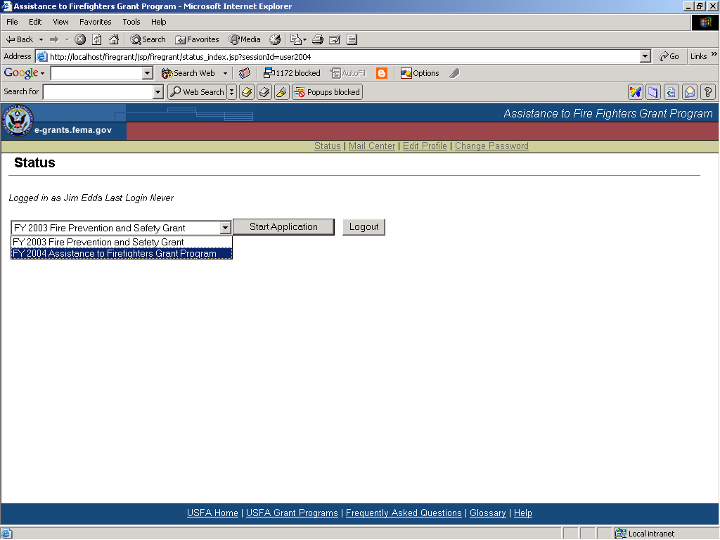
Notes:
Instructor’s Notes
“Status” is the first screen to appear after you log in. If you have an active AFG Program award, you will be given the choice of managing the previous grant award or applying for the 2004 program.

Slide 35
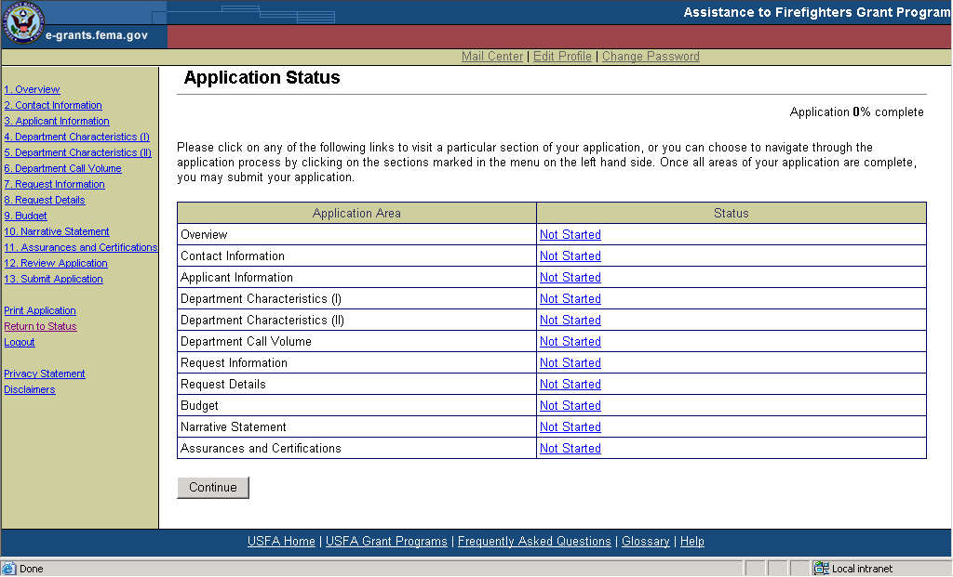
Notes:
Instructor’s Notes
This slide lists the status of all of the application screens. Note the names of each screen, the screen status (in this case none of the screens have been started), and note the order in the menu to the left and the “Application __% complete” note in the upper right-hand corner.

Slide 36
Narrative Statement: What To Include
Online Application
Detailed Description of Project
Explanation of Benefit to Community (AKA Cost-Benefit Statement)
Demonstration of Financial Need
Justification for Additional Funding
Notes:
Instructor’s Notes
The Narrative Statement should provide a detailed description of the proposed project, demonstrate financial need for the grant, and explain the benefit to be derived if the project is funded. The description of the department’s financial need should indicate why it has been unable to fund the project so far. Discuss the steps taken to seek alternate funding.
The Narrative Statement can be no more than 5 pages long and may not include photos, graphs, or other illustrations. Be concise—it should be no longer or shorter than necessary to tell the story.
It is recommend that the Narrative be prepared offline in a word processing program. Applicants should then log back on and insert their Narrative into their application by copying and pasting the text into the appropriate screen.
For the convenience of the grant reviewers, do not use all capital letters; use single line spacing.
Applicants may wish to include an overview of their department’s local risk assessment and explain how their proposed project mitigates that risk.
NOTE: Any WMD requests must explain their relationship with the State plan.
Additional Funding Justification. Should be fully explained and justified in the Narrative Statement as well as in the text box on the Additional Funding page of the application.

Slide 37
Project Description
What is Condition or Problem?
What is Purpose of Project?
What Will Change Because of the Project?
What Will You Do to Improve the Condition or Solve the Problem?
How Will Your Department Support This Project in the Future?
Notes:
Instructor’s Notes
Emphasize that the Project Description must clearly describe the problem for which they need assistance. The project must be closely aligned to Grant Program priorities.
Provide statistics or quantify the problem where possible (e.g., number of firefighters affected, size of population affected, etc.)
How does this condition or problem negatively affect your ability to provide mission-critical services?
Applicant must provide details of what the project involves, e.g., type of equipment, unit costs, individuals to be trained, costs per training session, cost of vehicle, and discussion of any additional equipment needed.
Emphasize the need for a commitment to continue the project and/or benefits of the project beyond the grant year.

Slide 38
Cost-Benefit
Requests Must Be Frugal But Sufficient to Achieve Goals
Projects Receiving Priority Will Request Least Amount of Federal Funds for Greatest Benefit (Cost-Benefit)
Benefit Must Directly Correlate to the Grant Program Priorities
Note: Community partnerships and sharing of resources encouraged
Notes:
Instructor’s Notes
Highest-rated applications are those that request the least amount of money sufficient to achieve their goals; should achieve the greatest benefit to the community.
Applicants that demonstrate opportunities for partnerships and sources of matching funds receive priority consideration.
Plans to share the resources obtained through the grant with other fire departments or neighboring jurisdictions will receive additional consideration because it enhances the cost-benefit of the project.

Slide 39
Financial Need
Projects Demonstrating Significant Financial Need Receive Additional Consideration
Proper Justification Mandatory
Show Fiscal Trends, Fund-Raising Strategies Used to Date
Note: Details can be explained in the Narrative Statement.
Notes:
Instructor’s Notes
Emphasize that applicants must clearly demonstrate and justify a financial need for what they are requesting. Grant requests must show their relationship to the Grant Program priorities.
Many unsuccessful applications suffered from inadequate financial need justification. Emphasize the importance of Financial Need in the Narrative section. Why the applicant requires Federal assistance in providing services is central to justifying an award. Making a case for Financial Need includes providing a brief picture of the economy in their community. Examples include job market and tax base situations. The applicant must also make a case for their willingness to obtain funding through local avenues. Examples should include fund raising and seeking assistance from other grant programs.

Slide 40
Lessons Learned in 2003

Slide 41
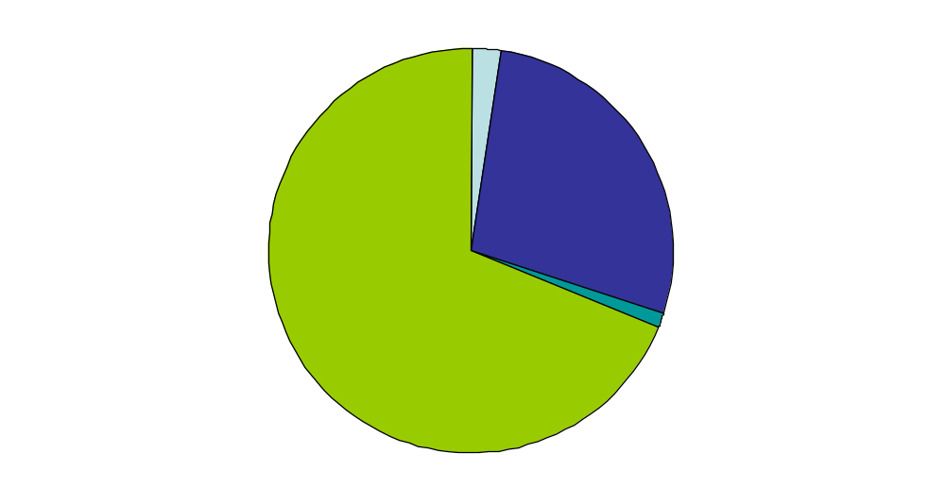
Applications by Program
Lessons Learned in 2003
Fire Prevention 2% (422)
Firefighting Vehicle
28% (5,554)
Fire Ops & Firefighter Safety
69% (13,759)
EMS 1% (213)
Notes:
Instructor’s Notes
The 2% request in Fire Prevention was in the competitive portion of the process. The 5% legislative requirement was met through the special Fire Prevention and Safety Grant Program held in fall 2003.

Slide 42
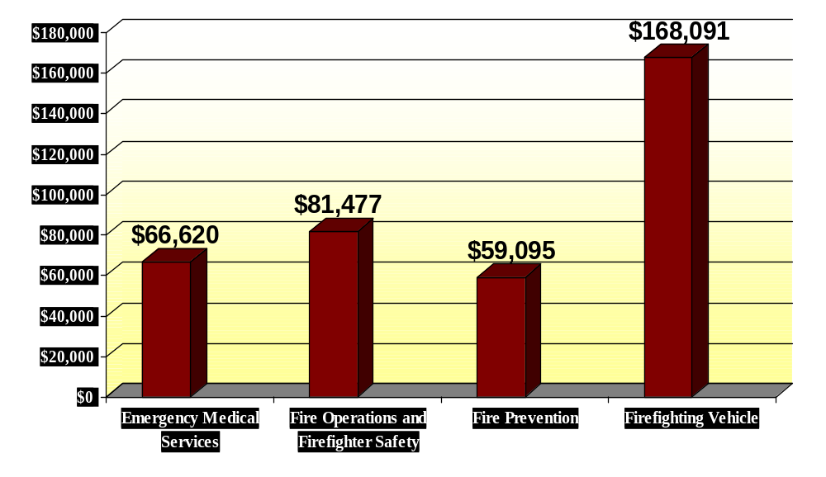
Average Federal Share of Grant Requests
Lessons Learned in 2003
Notes:
Instructor’s Notes
The $168,000 average Federal share of grant requests for Firefighting Vehicles represents the average costs of a variety of vehicles, including aerial ladder devices, pumpers, tankers, brush units, etc.

Slide 43
Grant Writers
Lessons Learned in 2003
Fees Must Be Reasonable
Fees Eligible But Cannot Be Contingent on Receipt of Award
Fees Must Be Paid Before Receiving Award
Read and Approve Grant Writer’s Work Before Submission
Notes:
Instructor’s Notes
Some departments use professional grant writers to complete their applications. Grant writers are a worthy resource to many departments, and we don’t want to discourage their use. But departments should make sure the grant writer is providing a fair service.
The grant writers fees are eligible, but they may not be contingent upon receipt of an award and must be paid prior to the department’s receiving an award. The fee must be reasonable, and there must be a direct correlation between the fee and the complexities of the proposed project. Grant writer fees should not be based on a percentage of the amount requested. It may be just as difficult to write an application requesting $30,000 as it is to write one requesting $300,000.
A member of the department should review the completed application for accuracy and completeness before it is formally submitted. Misrepresentations or exaggerations of fact may result in an application being rejected at a minimum, or charged with fraud if egregious.

Slide 44
Community Served
Lessons Learned in 2003
Check Community Classification:
  Urban, Suburban, or Rural
Priorities Vary According to Community Type
Verify Community Classification
Notes:
Instructor’s Notes
E-Application: After answering the questions on the Fire Department Characteristics Part I screen, your community will be automatically classified as Urban, Suburban, or Rural. That classification will appear in the upper right-hand corner of the screen and immediately below the “Application __% complete” information.
Your community classification is very important because program priorities vary for different types of communities. Based upon applicant concerns about the FY 2003 classification formula, changes have been made in the FY 2004 formula that should better reflect the characteristics of your community.
If you do not agree with your community classification, contact the Help Desk. No changes can be made in the designation, but the information will help to further refine the program in 2005.

Slide 45
Additional Funding and EMS
Additional Funding Guidelines
  Fully Explain and Justify
  Avoid Excessive Requests
Few EMS Requests
Only 1% of 2003 Requests
Notes:
Instructor’s Notes
E-Application: In the application, there is an opportunity for applicants to request Additional Funding in the Request Details screen.
Additional Funding: There was some confusion regarding Additional Funding in 2003. Many applications were scored lower due to excessive requests in this budget item. Applicants should ensure that their requests are for essential basic needs. This is an allowable expense in the Vehicle Program and in the Equipment and PPE activities within the Operations and Firefighter Safety Program. For example, the cost to equip a pumper may be eligible for Additional Funding, but only those costs required to comply with NFPA 1901 or ISO standards would be eligible.
Breathing air compressors may be purchased as Equipment, and Additional Funding may be awarded to install the compressors.
Additional Funding may be awarded for fit testing of SCBA face pieces that are purchased through the PPE activity.
Additional Funding must be fully explained and justified in the Narrative and the text box provided in the application.
Applicants should be aware of impending changes to national standards that might have an impact on the cost of a requested item.
EMS Program: In 2003, only 1% of applications received were for the EMS Program Area, although it is well documented that a significant amount of service demand comes from EMS in departments providing EMS. Accordingly, in 2004 requests for assistance in EMS training and equipment have been added to the “Equipment Activity” and “Training Activity” under the Operations and Firefighter Safety Program.

Slide 46
Financial Need Justification
Lessons Learned in 2003
Make the Case for Financial Need
Give Brief Picture of Local Economy, e.g., Job Market
Describe Other Fund-Raising Efforts and/or Funding Sources
Notes:
Instructor’s Notes
Inadequate Justification of Financial Need: Many unsuccessful applications suffered from inadequate financial need justification. Emphasize the importance of Financial Need information in the Narrative. Why the applicant requires Federal assistance in providing services is of central importance in justifying an award. Making a case for financial need includes providing a brief picture of the economy in the applicant’s community. Examples include job market and tax base situations. The applicant also must make a case for its willingness to obtain funding through local avenues, such as fund raising and seeking other grants.
Additionally, the applicant should provide a detailed description of any and all funding sources (example: fund-raising activities such as bingo, fund drives, retail sales, etc.)

Slide 47
Top 10 Reasons
Why Grant Applicants Fail
10. Request is for low priority items
9. Lack collaboration, partnerships
8. Don’t check their work
7. Don’t make a case for financial need
6. Don’t shop around for lowest costs

Slide 48
Top 10 Reasons
Why Grant Applicants Fail
Don’t provide a problem statement
4. Fail to make a case for cost-benefit
3. Do not itemize costs
2. Request too many items (“shopping cart” proposal)
1. Don’t follow directions

Slide 49
Key Points
Start Application Early
Get DUNS No. NOW (Call 1-866-705-5711 to obtain)
Write Down and Save Login Username and Password
Ensure Application Is Complete and All Information Correct
Notes:
Instructor’s Notes
A DUNS number is necessary to complete your application. No extensions will be granted to allow applicants to obtain a DUNS number. Get it now.
If you have applied in the past, whether competitive or noncompetitive, use the same username and password. Do not create a new one. If you have forgotten it, call 866-274-0960.

Slide 50
Key Points continued
Ask Someone to Proofread the Application Before Submission
SAVE Frequently While Completing the Online Application
Print and Save a Copy of Your Online Application—Get Application Number
Application Deadline Is Firm—No Exceptions!
Notes:
Instructor’s Notes
Advise the audience to monitor the ODP Web site for the grant program deadline. The application deadline has not yet been set.
E-Application: The online application has a timer function. If no activity is detected after a period of time, the application will be logged off automatically. Typing text into a text box is not a detectable activity! So save your work often. Better yet, type responses offline in a word processing document and copy and paste it into the online application’s text boxes.

Slide 51
Next Steps
Initial Computer Scoring of Applications
Highest-Rated Applications Undergo Peer Review
Technical Review and Report Are Completed for Final Award Decisions
Awards Announced until All Available Funds Are Expended
Keep E-Mail Address Current by Editing Profile on Application Web Site
Notes:
Instructor’s Notes
Applications are scored and evaluated in terms of how well they correspond to the Grant Program’s priorities.
During Phase I, a computer scores each application that was submitted online. These scores are then rank-ordered according to how closely the application matches the established program priorities.
In Phase II, the highest-rated applications are sent to evaluators for peer review and evaluation. During this phase, panels of peer evaluators meet to review and evaluate the highest-rated applications. They consider the narrative statements, program descriptions, cost-benefit information, and financial need information.
A technical review is undertaken by subject matter specialists and contractor staff to capture panel recommendations, ensure eligibility, and complete final quality control.
The highest-scoring applications are referred to the Program Office for award processing.

Slide 52
Timeframe
February Draft and Publish Fed. Rule, NOFA, Program Guidance
February/March Workshops
Late February Online Tutorial, CDs Available
March 1–April 2, 2004 Application Period (tentative)

Slide 53
Timeframe
May/June Peer Panels Conducted
May/June State Review of WMD Requests
June/July Technical Review
July Award Announcements Begin

Slide 54
Questions?

Slide 55


