Slide 1
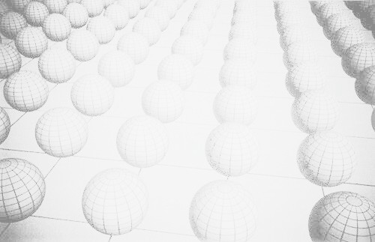
A repository for BSM Tools and other news from Les Houches ‘05
ILC Workshop, Snowmass CO, Aug 2005
P. Skands (FNAL)
Thanks to LH’05 BSM people, esp. P. Richardson

Slide 2
A (lack of) overview
A call to arms (stolen from A. de Roeck, LH’05, including exp. wishlist.)
1st concrete result (since ~ 1 week ago): A repository for BSM tools
http://www.ippp.dur.ac.uk/montecarlo/BSM/

Slide 3
A (lack of) Overview: X-dim Tools
From Les Houches…
Disclaimer: I am not fully up-to-date!
  CHARYBDIS, Truenoir, “BlackHole”: Black Holes
  PYTHIA, HERWIG: Randall-Sundrum graviton excitations.
  SHERPA: ADD graviton excitations.
  …, UED in CompHEP,...
I do not have a good overview of available codes. Does anyone? Should this be a task?

Slide 4
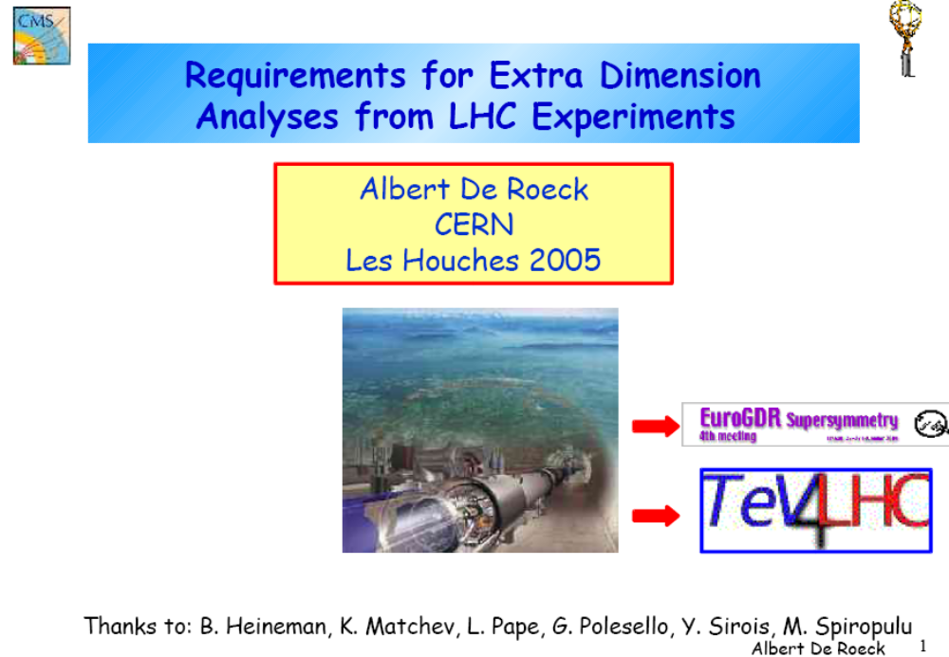
A Call to Arms (A. de Roeck, LH’05)

Slide 5
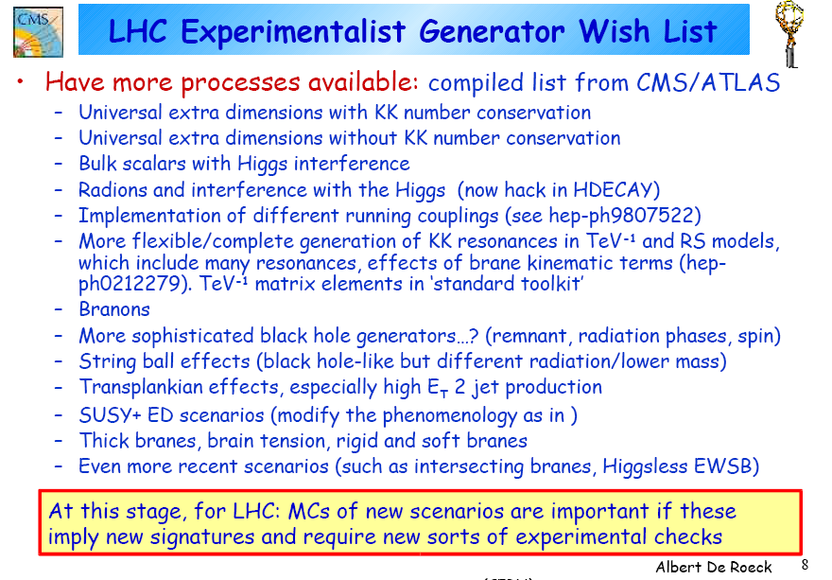

Slide 6
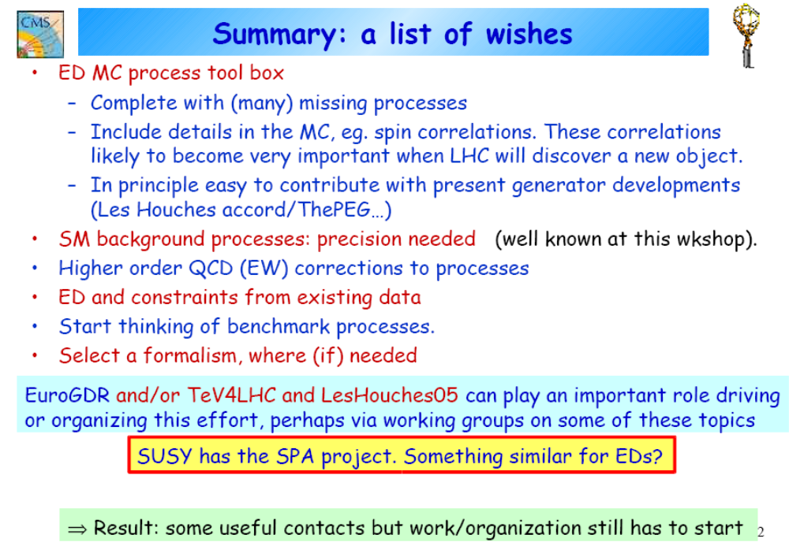

Slide 7
A (lack of) Overview: X-dim Tools
From Les Houches BSM Tools intro talk:
Disclaimer: I am not fully up-to-date!
  CHARYBDIS, Truenoir, “BlackHole”: Black Holes
  PYTHIA, HERWIG: Randall-Sundrum graviton excitations.
  SHERPA: ADD graviton excitations.
  …, UED in CompHEP,...
I do not have a good overview of available codes. Does anyone? Should this be a task?
YES!

Slide 8

Progress at Les Houches
Introduce, review, and collect a repository of available tools. (Top of wishlist presented by de Roeck)
R-S graviton excitations:
  HERWIG
  PYTHIA (incl RS+jet)
  MicrOMEGAs (Servant, Belanger, Pukhov)
  CompHEP/MadGraph (Frisch, Karagoz)
A.D.D. graviton excitations:
  SHERPA... (Gleisberg, Krauss, Matchev)
  PYTHIA? (Lykken+Matchev, Besancon)
  CompHEP? (Balazs, ...?)
Black Holes:
  CHARYBDIS (Richardson et al)
  TRUENOIR (Lansberg)
  “BlackHole” (Tanaka et al)
Universal Extra Dimensions:
  CompHEP (Przysiezniak-Frey+Goujdami, Servant+Matchev+student: implementation ready in autumn?)
  Decays (CMS: Pape, Alemany)
  SDecay... (Matchev, Muhlleitner)
+ … (your code here)
http://cmslip-ued.web.cern.ch/cmslip-ued/
[Ferrag, Muanza, Kraml, de Roeck, Przysiezniak-Frey, Azuelos, Skands, Grojean, Miakov?, Benakli, Belanger, Pukhov, Semenov, Servant, Giacomo, Pape, Balazs, Dominici, Kazana, Lykken, Matchev?, Alemany, Besancon, Dobrescu, Gustavo, Eduardo, …]

Slide 9
Progress since Les Houches
Not much yet…
  (e.g. we have a (proof-of-concept) generator for NMSSM: CompHEP + NMHDecay → Pythia. Contact A. Pukhov or me.)
Last week! Started process of collecting BSM tools → Web Repository in Durham (P.Richardson)
  Easy to use. Click “Add Tool”, write a brief description + link to local web page + responsible person → done.
  (No “quality control” as yet. When list → more complete, a validation process may or may not begin. Automatic?)
http://www.ippp.dur.ac.uk/montecarlo/BSM/
YOU ARE INVITED TO CONTRIBUTE

