Slide 1

HERWIG and PYTHIA
Durham University
Peter Richardson
IPPP, Durham University

Slide 2
Summary
Introduction
Basics of Monte Carlo Simulations
Processes inside the Generators
The Les Houches Accord
Future

Slide 3
Introduction
Monte Carlo event generators are programs which starting with some fundamental process predict the stable particles which will interact with a detector.
There are a number of Monte Carlo event generators in common use
  PYTHIA
  HERWIG
  SHERPA
They all split the event generation up into the same pieces.
The models and approximations they use for the different pieces are of course different.

Slide 4
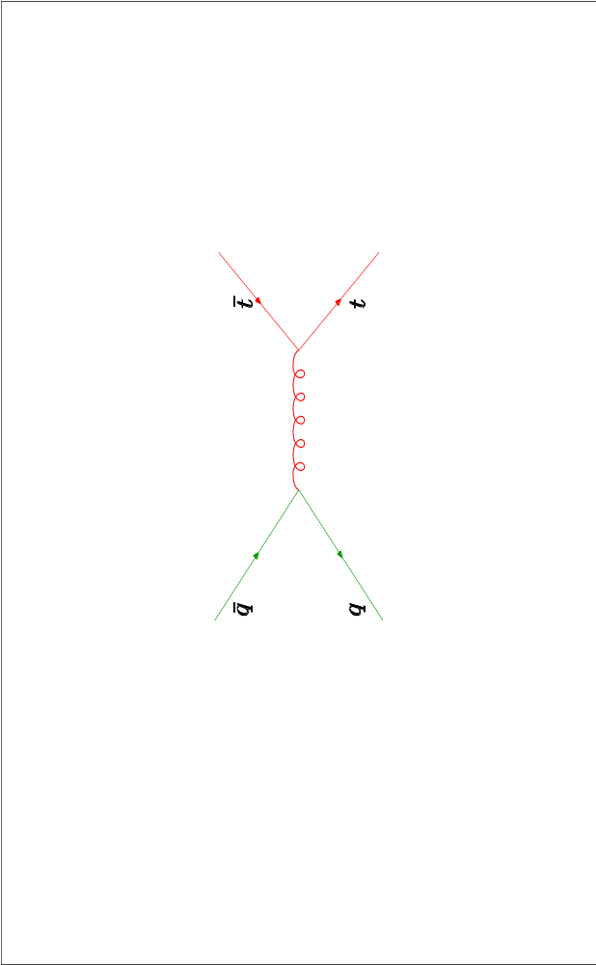
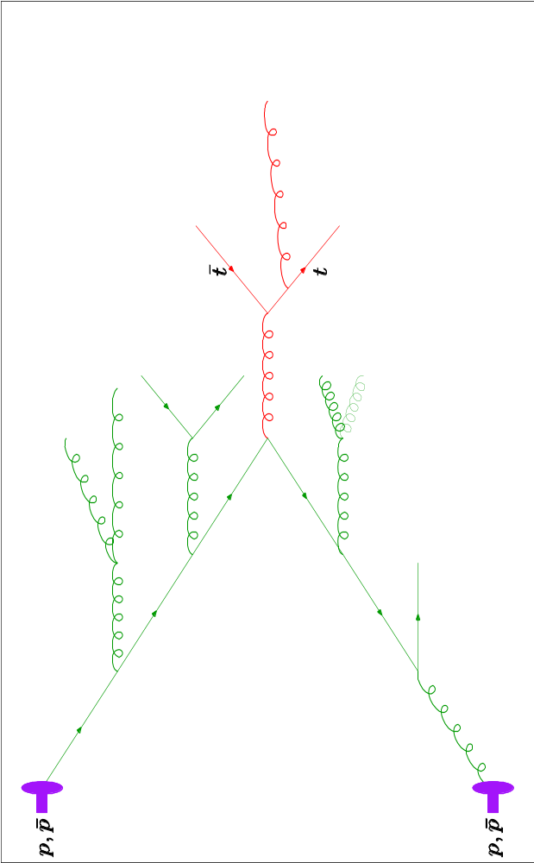
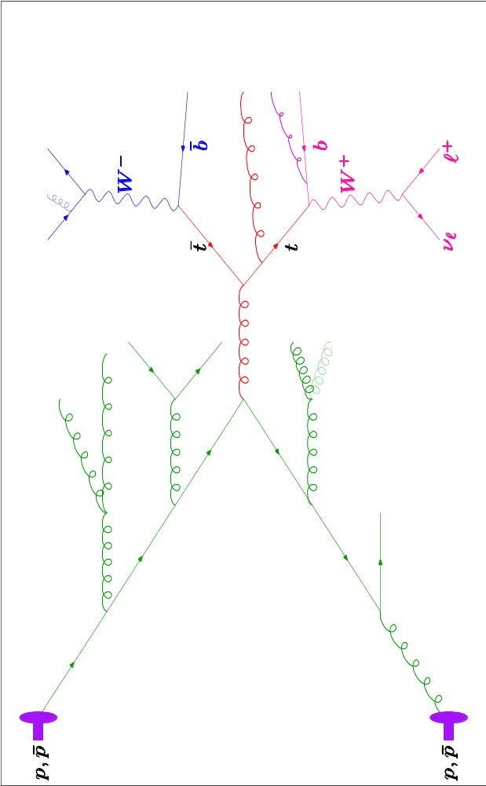
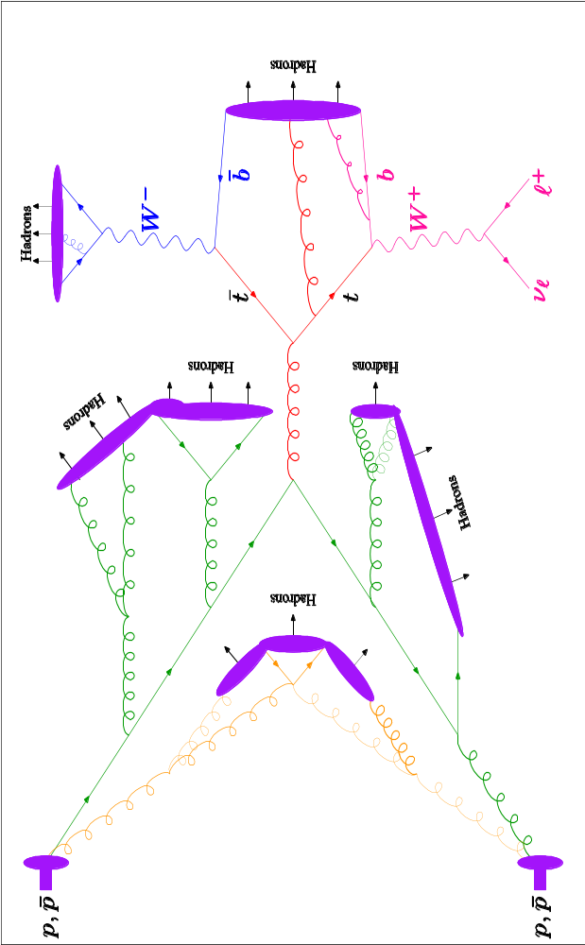
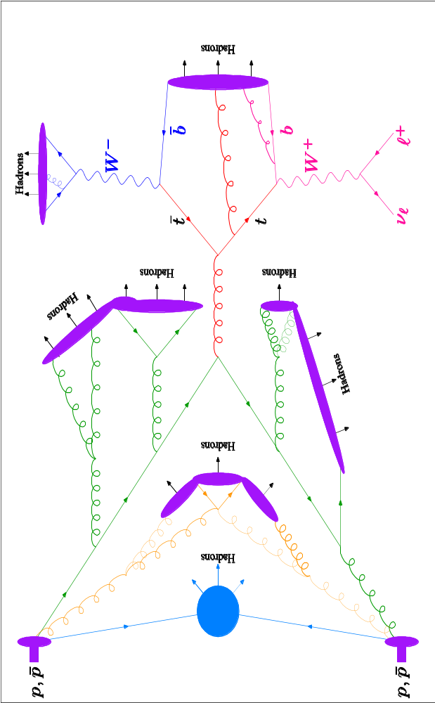
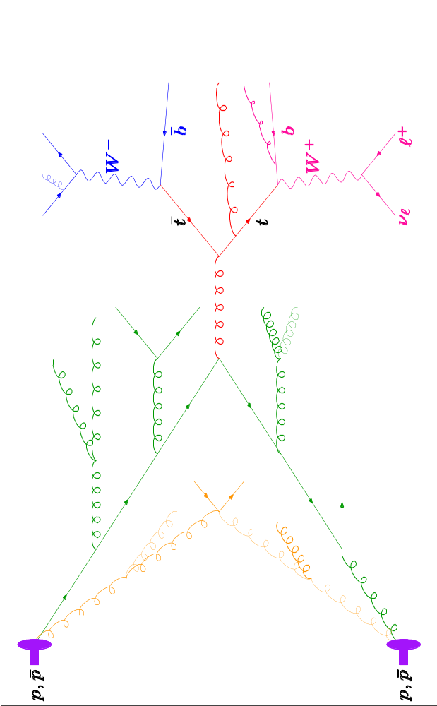
A Monte Carlo Event
Hard Perturbative scattering:
Usually calculated at leading order in QCD, electroweak theory or some BSM model.
Modelling of the soft underlying event
Multiple perturbative scattering.
Perturbative Decays calculated in QCD, EW or some BSM theory.
Initial and Final State parton showers resum the large QCD logs.
Finally the unstable hadrons are decayed.
Non-perturbative modelling of the hadronization process.

Slide 5
Monte Carlo Event Generators
For BSM physics the main pieces of the event generators are
Hard Process
    New intermediate particles
    New particles produced
    Changes to SM distributions
Decays
    Decays of new particles produced in the hard process or previous decays.

Slide 6
Built In Models
Traditionally models of new physics are built into the event generator.
This will often include hard processes and decays.
Relatively few models have been implemented and the sophistication of the simulation varies.

Slide 7

Built In Models
 | HERWIG | PYTHIA
SUSY
SUSY+RPV
RS Gravitons
Z’/W’
Technicolor
Left-Right Models
Compositeness
Excited fermions
Leptoquarks
Fourth generation

Slide 8
Built In Models
In general a lot more effort has gone into the simulation of SUSY than everything else put together.
In general the simulation of SUSY is very sophisticated including simulation of the hard process, matrix elements for the decays and (in HERWIG) spin correlations between the production and decay.

Slide 9
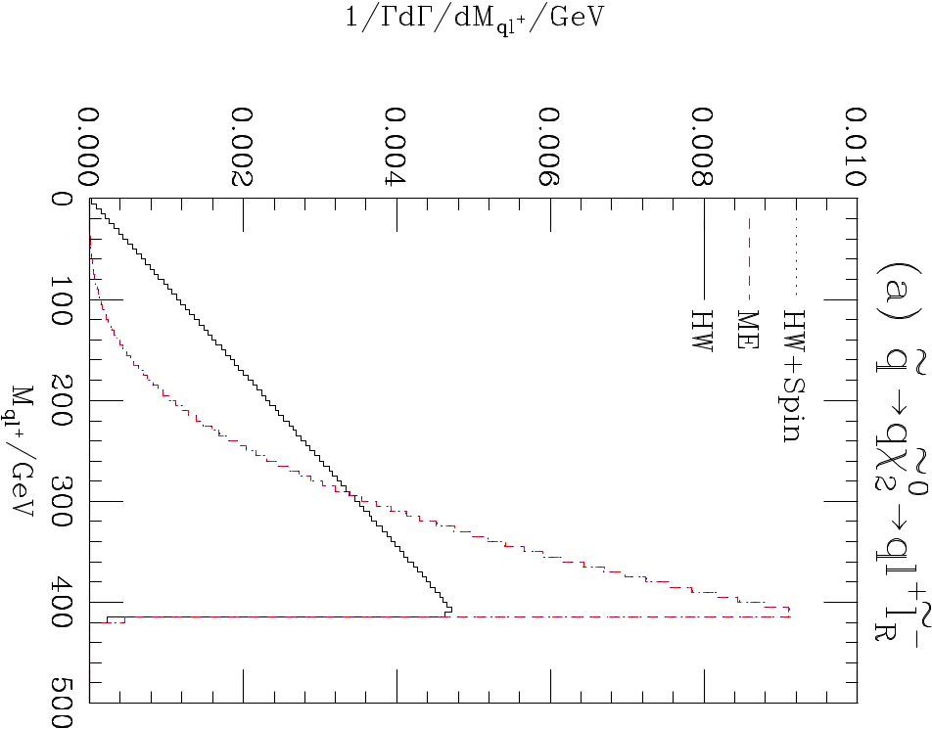
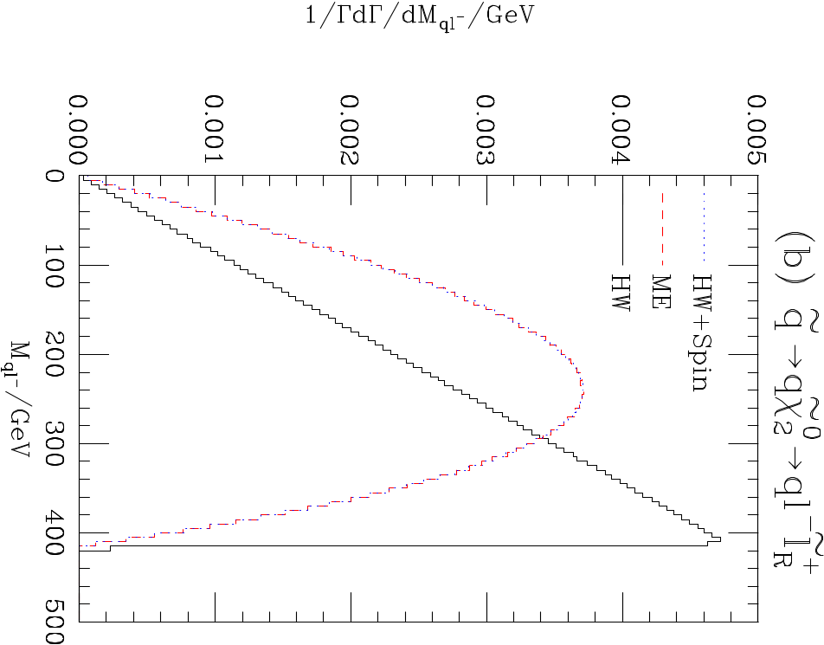
Spin Correlations

Slide 10
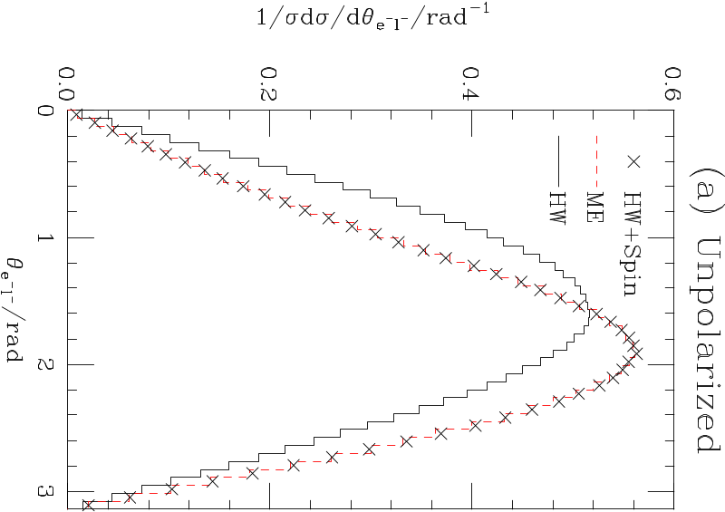
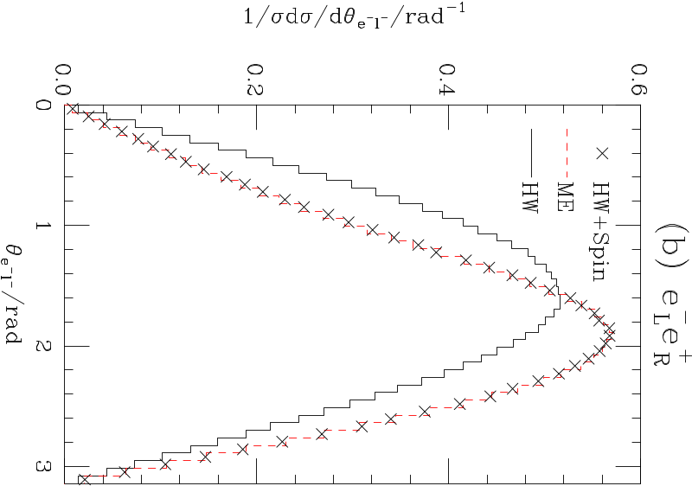
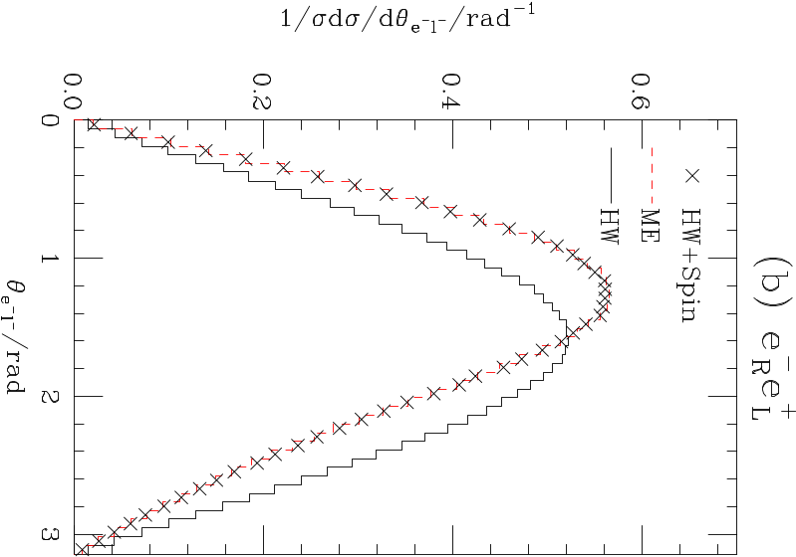
Spin Correlations

Slide 11
Les Houches Accord
In 2001 there was a paradigm change in the way new processes were implemented in event generators.
The old procedure
  Email author of program to ask for a new process to be included
  Author thinks about it
  Maybe gets implemented.

Slide 12
Les Houches Accord
Had many problems
  Only authors of the programs could add new processes.
  Large demand on a small number of people.
  Often processes people wanted (needed?) did not get implemented.

Slide 13
Les Houches Accord
At the 2001 Les Houches meeting an agreement was reached on a method of passing information between programs generating partonic processes and general purpose event generators.
Based on a common block.

Slide 14
Les Houches Accord
Basic idea was that the Matrix Element Generator (MEG) provides
  Momenta and types of the particles.
  A option for the cross section calculation.
  The colour flow for the process.
  Optionally information on intermediate particles which need special treatment.

Slide 15
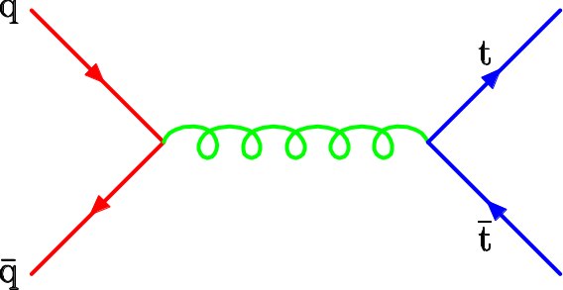
Les Houches Accord
Most of the rest is fairly self explanatory but colour flow isn’t.
If we take the large number of colours limit we can assign a colour flow.
Needed by the event generator to get the simulation of QCD radiation and hadronization right.

Slide 16
Les Houches Accord
New paradigm
  If asked to implement a new process a generator author will say do it yourself using the Les Houches accord.
  We have provided a simple tutorial to help with this
  http://www.ippp.dur.ac.uk/montecarlo/leshouches/tutorial/

Slide 17
Les Houches Accord
Implemented in both HERWIG and PYTHIA
Some problems
  Particles involved need to be known to the generator.
  HERWIG not good at handling coloured non-SM particles.
But has proven very successful.

Slide 18
Les Houches Accord
Many of the matrix element generators use it
  MADGRAPH
  ALPGEN
  CALCHEP
Together with some BSM packages (e.g. CHARYBDIS)
Also used by many private programs to pass information into the general purpose event generators.

Slide 19
Future
It may be a good idea to have a simple way of tell generators about new particles and their decays, perhaps based on what already exists for SUSY.
In general this will be good enough for most cases.
However there are some situations where sophisticated simulation is needed.

Slide 20
Future
It order to decide whether the spin of SUSY particles can be measured need spin correlations.
In this case the event generator has to perform all the simulation (otherwise it’s almost impossible to get it right.)
This was done for the MSSM in HERWIG.
However it was a lot of work and even simple extensions (NMSSM etc.) can’t be handled.

Slide 21
Herwig++
In designing the new Herwig++ generator we decide to go with a different approach.
A C++ helicity library based on the HELAS formalism is used for all matrix element and decay calculations.
This makes coding new matrix elements for both production and decay much easier.
Also easy to do the spin correlations as we have access to the spin unaveraged matrix elements.

Slide 22



Herwig++
In principle we could write a matrix element generator using this as the basis.
However a lot of work and there are all ready many good programs available.
Settle for a more limited aim.
Code the hard matrix elements based on the spin structures (there’s less possibilities than you might think).
Code the and decays in the same way.

Slide 23
Herwig++
For most models then only need to supply the Vertices , i.e. the Feynman rules for a new model.
C++ inheritance should help even there with say the NMSSM inheriting from the MSSM and only having to implement the new features.
May be supplemented with special treatment for some models.

Slide 24
Conclusions
The existing HERWIG and PYTHIA programs will remain the workhorses of event simulation in the near future.
Unlikely to be any new models implemented in them directly.
New processes should use the Les Houches.
The simulation in the new C++ generators will be different and hopefully allow more models to be studied.

