Slide 1
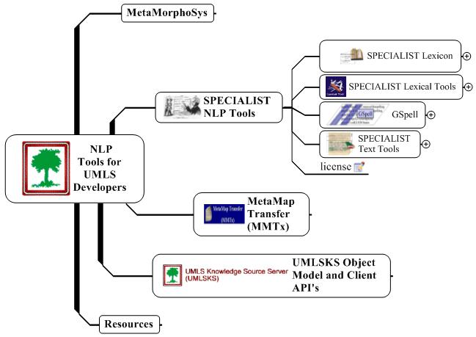

Slide 2
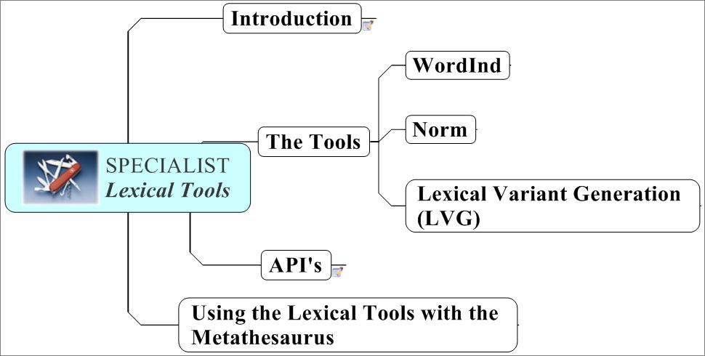

Slide 3
Lexical Tools: Introduction
Command line tools
  norm
  Lvg
  wordInd
Web GUI
Pure Java Application
Embeddable Java API’s
Notes:
What ARE these tools, AND what are they good for?
These tools are primarily command line tools. Built from java code.
There are GUI’s that run these tools.
The source code is distributed.
These tools are intended to be embedded into your applications.
As such, there are an untold number of public JAVA API’s that
were developed to be called within your app.
Chris*

Slide 4
Lexical Tools: Introduction
These tools are good for
  aggressive text pattern matching
  making word, term, phrase indexes
  matching queries with indexed entries
  increasing recall and/or precision
Notes:
What are these tools good for?
These tools are good for text matching that is more powerful than exact match.
The tools are used to normalize terms, as well as generate expanded terms.
These tools are used to create word, term, and phrase indexes. They are embedded between queries and target indexes.
If your purpose is to increase recall over exact matches, the lexical tools can be configured to do that.
If your purpose is to increase precision over some loose matching algorithm, the lexical tools can be configured to do that.

Slide 5
Lexical Tools: Introduction
Characteristics of all the command line tools
  take input from the screen or a file
  put their results to the screen or a file
  Interpret fielded text
    Can be told which fields contain what type of information
Notes:
Some general characteristics of all of the command line tools:
They all take input from standard in, and put results on standard out.
They all are configured via command line arguments.
They all interpret fielded text, using by default, the UNIX’sh Pipe character
as a field separator, and a newline (natively defined) as the end of record,
or end of term indicator.
That is, all the tools can be told
what field to do the text transformation on,
what fields to pass through to the output, and
what fields contain other relevant information.
Chris

Slide 6



Lexical Tools: WordInd
wordind
is
a
tool
to
break
terms
into
words
it
is
used
to
Wordind is a tool to break terms into words.
It is used to take a row from a Metathesaurus table that contains a term, sentence, paragraph, story,
and break the text part of that row into it’s constituent words.
Notes:
Wordind is a tool to break terms into words.
It is used to take a row from a Metathesaurus table that contains a term, sentence, paragraph, story,
and break the text part of that row into it’s constituent words,
while passing along, duplicating the other fields in that row.
From the very beginning we needed a way to standardize what we meant what a word is. This turns out to be critically important for fitting programs together.
We consider a word what wordInd says it is, for better or worse. WordInd, considers as a word a sequence of alpha-numeric tokens broken by white space or punctuation. Whitespace and puncutation is subsequently thrown out.

Slide 7
Lexical Tools: WordInd
Breaks words into tokens
Passes other fields to output, untouched
Lowercases
Removes white space and punctuation
Notes:
WordInd is primarily used to create word indexes. As such, it does a bit more than tokenizing words. It also lowercases the tokenized words as well.
So, it tokenizes, ,
it strips punctuation, ,
it lowercases, ,
and it passes other fields through to the output, untouched.

Slide 8
Lexical Tools: WordInd
Useful command line options for wordInd
-t[:Num] | Defines what field to tokenize
-f[:Num[:Num]] | Defines what fields get passed through
Notes:
Here are two well used command line options that wordInd uses. The –t option tells wordInd what field to tokenize, and the –f option tells word in what fields to pass through to the output untouched.

Slide 9
Lexical Tools: WordInd
> wordInd –t:7 –F:1:6
C0185495|S0298948|denis
C0185495|S0298948|browne
C0185495|S0298948|splint
C0185495|S0298948|strapping
C0185495|ENG|P|L0223844|PF|S0298948|Denis-Browne splint strapping|3|
Notes:
Here’s an example of what wordind does to a row from the Metathesaurus’ MRCON.
The command line arguments to WORDIND include telling wordind to use the seventh field to find the term, and to pass through fields one and six to the output.

Slide 10

Lexical Tools: Norm
Metathesaurus
English
Strings
Normalized string index
norm
MRXNS.ENG
WordInd
Normalized word index
MRXNW.ENG
Notes:
Here’s where the lexical tools fit in with the UMLS Metathesaurus.
The norm program normalizes the Metathesaurus strings to produce the normalized string index.
In general, normalization involves transforming something that’s not uniform to something that is uniform.
The wordInd program tokenizes the normalized strings to create the normalized word index.

Slide 11

Lexical Tools: Norm
Normalized string index
Query
norm
Normed
term
Normalized word index
SUIS
Metathesaurus
Concepts
Metathesaurus
Concepts that match
The normalized query
Notes:
These indexes provide great recall enhansed access to the content of the Metathesaurus.
To take advantage of these indexes, queries need to use the same program to transform the query to mediate between the query and entries in the normalized indexes.

Slide 12
Lexical Tools: Norm
Norm abstracts away from:
  case
  punctuation
  word order
  possessive forms
  inflectional variation
Notes:
Our form of normalization involves the following:
It abstracts away from case, punctuation, and word order.
It abstracts away from inflectional variations.
It abstracts away from possessive forms.

Slide 13
Lexical Tools: Norm
Hodgkin's
Diseases,
NOS
remove genitives
replace punctuation with spaces
remove stop words
lowercase
uninflect each word
word order sort
Notes:
Norm in some more detail.
Let’s take the example Hodgkin’s Diseases, NOS. Here’s a term that could be found in text an awful lot of ways.
This program will transform a fair number of those variant ways into a uniform representation that will enable applications to recognize all those variants belonging to the same term.

Slide 14
Lexical Tools: Norm
Hodgkin's
Diseases,
NOS
Hodgkin'sDiseases,
NOS
remove genitives
Hodgkin Diseases,
NOS
replace punctuation with spaces
remove stop words
lowercase
uninflect each word
word order sort
Notes:
Genitives, those apostrophe ses, or the possessive forms are removed.
Medical terminology is replete with terms that include possessive forms,
Such as Parkinson’s Disease.
There are a lot of variation caused by forms that differ by possessive forms.
In a lot of cases, as Allen had mentioned, terms evolve from possessive forms to plural forms.
It turns out to be a good idea to abstract away from possessive forms for retrieval purposes.
In our example, Hodgkin’s gets transformed to Hodgkin.

Slide 15
Lexical Tools: Norm
Hodgkin's
Diseases,
NOS
Hodgkin'sDiseases,
NOS
remove genitives
Hodgkin Diseases,
NOS
replace punctuation with spaces
Hodgkin Diseases
NOS
remove stop words
lowercase
uninflect each word
word order sort
Notes:
Punctuation is replaced by spaces.
It is important to identify the apostrophe s’s
before punctuation is replaced.
The comma is removed in this example.

Slide 16
Lexical Tools: Norm
Hodgkin's
Diseases,
NOS
Hodgkin'sDiseases,
NOS
remove genitives
Hodgkin Diseases,
NOS
replace punctuation with spaces
Hodgkin Diseases
NOS
remove stop words
Hodgkin Diseases
lowercase
uninflect each word
word order sort
Notes:
Stop words are stripped.
Stop words are those words that you really don’t want to query on,
such as determiners and frequently used prepositions.
For example, words like “THE”, and ”OF”.
We consider NOS as one of our stop words. It gets stripped.

Slide 17
Lexical Tools: Norm
Hodgkin's
Diseases,
NOS
Hodgkin'sDiseases,
NOS
remove genitives
Hodgkin Diseases,
NOS
replace punctuation with spaces
Hodgkin Diseases
NOS
remove stop words
Hodgkin Diseases
lowercase
hodgkin diseases
uninflect each word
word order sort
Notes:
For obvious reasons, it’s a big win to either lower case your input or uppercase it.
We’ve settled on lowercasing the input to abstract away from case variation in terms. In this example, everything is lowercased.
.

Slide 18
Lexical Tools: Norm
Hodgkin's
Diseases,
NOS
Hodgkin'sDiseases,
NOS
remove genitives
Hodgkin Diseases,
NOS
replace punctuation with spaces
Hodgkin Diseases
NOS
remove stop words
Hodgkin Diseases
lowercase
hodgkin diseases
uninflect each word
hodgkin disease
word order sort
Notes:
Each word of the term is uninflected.
Uninflection is the what we would consider an entry form in our Lexicon. These are, for the most part,
the singular forms of nouns,
the infinitive forms for verbs, and
the positive forms for adjectives and adverbs.
Uninflected forms are similar to, but are not the same as Stemmed forms. Stemming involves suffix stripping, not bothering to heed the distinction between derivational suffixes and inflectional suffixes. Stemmers often refer to the “stems” as the root of the word, regardless whether the meaning had changed when the suffix was removed or added.
Stemmers often only involve suffix replacement and may or may not filter to a word list after the suffix transformations.

Slide 19
Lexical Tools: Norm
Hodgkin's
Diseases,
NOS
Hodgkin'sDiseases,
NOS
remove genitives
Hodgkin Diseases,
NOS
replace punctuation with spaces
Hodgkin Diseases
NOS
remove stop words
Hodgkin Diseases
lowercase
hodgkin diseases
uninflect each word
hodgkin disease
word order sort
disease hodgkin
disease
hodgkin
Notes:
As a last step, all the resulting words are sorted in ASCII order.
Why?
There are terms in the Metathesaurus in inverted form. That is, where the important part of the term is at the front of the term. “Cancer, Breast”. Inversion is a useful cataloguing technique.
There are terms in the Metathesaurus in uninverted form. And, there are terms in the Metathesaurus that are in inverted form, but, where the inversion points, typically commas, are missing.
We found that stripping punctuation and sorting in word order, in general helps rather than hurts recall. There rare exceptions to this, such as the distinction between school nursing and nursing school.

Slide 20
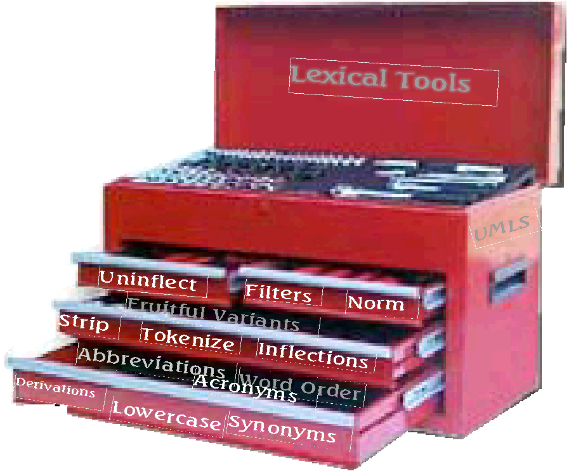
Lexical Tools
Notes:
The lexical tools include a word and string normalization tool,
a word tokenization tool,
and a suite of text utilities, otherwise known as lexical variant generation , or LVG.
We often refer to the lexical tools as the Swiss army knife of text utilities. It’s got 54 different tools, some sharp, some blunt.
This presentation contains material that is suitable for end-users and developers. This presentation contains excruciating detail on the tools wtih some gratuitous code examples thrown in.
Chris

Slide 21
Lexical Tools: Flow Components
Mnemonic | Tool
A | Return known acronyms
a | Return known acronym expansions
b | Uninflect a term
c | Tokenize a term into "words"
Ct | Retrieve the citation term
d | Generate derivational variants
g | Remove genitive
i | Generate inflectional variants
L | Retrieve category and inflection for a term
Notes:
I’m going to switch terminology at this point from talking about text utilities or tool and introduce and refer to each utility as this funny thing called a
“FLOW COMPONENT” I’ll explain later.
There are 54 tools, or FLOW COMPONENTS with more on the way.
I’m going to flip through an alphabetical list of some of these tools. (Not all are listed here. They are fully specified in the documentation).
The mnemonic on the left is what you would specify on the command line.
These include tools to grab acronyms and their expansions.
Uninflection tools, tokenxization tools.

Slide 22
Lexical Tools: Flows
leave
leaves
leave
inflect
leaving
left
Notes:
Some characteristics about the lexical tools:
Each of the utilities can be used separately.
Here is an example of the inflect tool.
This tool generates all known inflections of a word.
There is a notion of a flow is a serial combination of these tools put together.
Thus the name for each tool: a flow component.

Slide 23
Lexical Tools: Flows
> lvg –f:i
leave
leave|leave|128|1|i|1|
leave|leave|128|512|i|1|
leave|leaves|128|8|i|1|
leave|left|1024|64|i|1|
leave|left|1024|32|i|1|
leave|leave|1024|1|i|1|
leave|leave|1024|262144|i|1|
leave|leave|1024|1024|i|1|
leave|leaves|1024|128|i|1|
leave|leaving|1024|16|i|1|
Notes:
The example shows just how such a tool is invoked from the command line.
Don’t pay any attention to those pesky fields with numbers in them right now.
Pay attention to the fact that we put leave into this tool and leave, leaves, left, and leaving were returned.
[That same information should be shown in the GUI tool].

Slide 24
Lexical Tools: Fielded Output
> lvg –f:L
leaves
Flow Number
Flow history
leaves
|
leaves
|
1152
|
136
|
L
|
1
Input Term
Output Term
Categories
Inflections
Notes:
On each output line, five additional fields are added to the input fields.
The output or transformed term,
what categories and inflections the output term can be,
what transformations or flow components produced it. This is also known as the flow history,
And,
the flow number that produced it.

Slide 25
Lexical Tools: Fielded Output
Output
term
Categories
Inflections
noun
plural
leaves
verb
pres3ps
Notes:
Imagine, if you will, that some flow produced the output term “leaves”.
Leaves can be either the plural form of a noun or the present third person singular of a verb.
That’s what conceptually will be part of the output for this term.

Slide 26
Lexical Tools: Categories
Categories
1152
Category bit vector
modal
compl
verb
pron
prep
noun
det
conj
aux
adv
adj
1
0
0
1
0
0
0
0
0
0
0
Notes:
But, that’s not easy to stuff into a concise, machine parsable, single line representation that can be used by other tools. A somewhat less readable bit vector representation of category and inflection was adopted to be the concise, parsable form that could be used by other tools.
Let’s concentrate on category for a minute. The bit vector for category consists of 11 bits in this order. To represent the categories that leaves take on, the bits for noun and verb are set to one.
What appears on the command line output is the decimal representation of this bit vector.

Slide 27
Lexical Tools: Categories
Adjective | 1
Adverb | 2
Auxiliary | 4
Complement | 8
Conjunction | 16
Determiner | 32
Modal | 64
Noun | 128
Preposition | 256
Pronoun | 512
Verb | 1024
modal
compl
verb
pron
prep
noun
det
conj
aux
adv
adj
Bit Vector
positions
10
9
8
7
6
5
4
3
2
1
0
Notes:
Here is the decimal representation of these categories.

Slide 28
Lexical Tools: Inflections
Inflections
136
Present participle
Present 3ps
comparative
Present 3ps
superlative
plural
base
0
0
0
0
0
0
0
0
0
0
0
0
0
0
1
0
1
0
0
0
Notes:
Likewise, inflections are stored in a bit vector representing inflections. Here, the base form is a simplified form for singular if the term is a noun, infinitive if the term is a verb, and positive if the term is an adjective or adverb.
Leaves in the example can be either the plural form of a noun or the present third person singular of a verb.
Those bits are set, which, when represented as a decimal, add up to be 136.

Slide 29
Lexical Tools: Inflections
Base | 1
Comparative | 2
Superlative | 4
Plural | 8
Present Participle | 16
Past | 32
Past Participle | 64
Present 3rd Person Singular | 128
Notes:
Here are the basic inflections viewed in their decimal representation.

Slide 30
Lexical Tools: Fielded Input
Input
term
Categories
Inflections
leaves
noun
Notes:
If the output knows about category and infection, it would reason that we should be able to tell each tool any category and inflection information about an input term.
We can.
We can put on the input, via fielded input, category and inflection information.
Suppose we have leaves as an input term, and we know we are talking about the leaves, the noun, as in “the leaves of a tree”.

Slide 31
Lexical Tools: Fielded Input
Input term field
Input category field
> lvg –f:L –t:1 –cf:2
leaves|128
leaves|leaves|128|8|L|1
Notes:
On the command line, we tell the tool which field to look for the term, and which field to look for the category information.
On the input, we then can put the categories in the field, using the bit vector form.

Slide 32
Lexical Tools: Post Flow Options
Input
term
Output
terms
SC | Show category names
SI | Show inflection names
ccgi | Mark the end of the set of variants returned
F:Int[:Int] | Specify fields for outputs
ti | Display the only input term in the output when using fielded input
R:Int | Restrict the number of variants returned
Notes:
The lexical tools have some useful post processing options that are of note.
For the most part these options are filters. Though some of these options add information to the end of the processing.
Here are some miscellaneous but useful options.
Show the categories and inflections in string form, not in bit vector form.
-ccgi, an end of processing marker.
-F followed by the fields you want to have in your output.
-ti Forget about passing through all the input fields, only pass through the field you are picking up the term from.
-R followed by a number to restrict the number of output rows. This is useful, say when you are generating lots of forms, but you only need the top 10.

Slide 33
Lexical Tools: Post Flow Options
Show category names
Show inflection names
Show the category and inflection names
> lvg -f:L -SC -SI
phosphoprotein
phosphoprotein|phosphoprotein|<noun>|<base+singular>|L|1|
sclerosing
sclerosing|sclerosing|<adj+verb>|<base+presPart+positive>|L|1|
Notes:
These options are necessary for those of us who cannot do the math.
It displays the categories and inflections as strings rather than bit vectors.
I generally use these for debugging purposes.
The fields can get quite long for terms that can be many categories and inflections.

Slide 34
Lexical Tools: A Serial Flow
lowercase
Strip diacritics
Input
term
Output
term
Remove possessive
Remove stop words
Strip punctuation
Word order sort
Flow components can be arranged so that the output of one is the input to another.
Notes:
Here’s an example of such a serial combination. That is,
where the output of one tool serves as
the input to the next tool.
In this example, we are first lowercasing the input, then stripping diacritics, removing possessives, removing stop words, stripping punctuation, and finally sorting the resulting words in ASCII sort order.
The example shows just how this flow is invoked on the command line.

Slide 35
Lexical Tools:
Embedding These Tools into Your Application
Classpath
NormApi()
LvgCmdApi()
Your application
Input
term
Output
terms
Notes:
Here’s the section for developers and those that want to embed the lexical tools into their apps.
I’m going to cover the prerequisites, and the basic classes to use, from the simplest to the more featured interfaces.
The full code to the next examples can be found in the appendix to this tutorial, and are distributed as examples within the source code distribution.

Slide 36
Lexical Tools:
Embedding These Tools into Your Application
CLASSPATH = ${CLASSPATH}:
${LVG_DIR}:
${LVG_DIR}/lib/lvg2003dist.jar:
Notes:
But first, some prerequisates: Classpath, classpath, classpath. Here’s what you need to add to your classpath to use our tools.
The LVG_DIR, the lvg2002.jar file, and one of the following depending on if you are using the IDB database or MySQL database.

Slide 37
Lexical Tools:
Embedding Norm into Your Application
import gov.nih.nlm.nls.lvg.Api.*;
NormApi normalize = new NormApi();
String input2Norm = null;
Vector outputFromNorm = null;
Notes:
Here are the important pieces of code that are needed to imbed this into your app.
You need to import the Lvg.Api.* packages.
You need to instantiate the NormApi class.
Better have handy a string and a vector variable …

Slide 38
Lexical Tools:
Embedding Norm into Your Application
while ( (input2Norm = stdIn.readLine() ) != null ) {
outputFromNorm= normalize.Mutate(input2Norm);
for ( int i = 0; i < outputFromNorm.size(); i++ ) {
System.out.println((String) outputFromNorm.get(i));
}
}
normalize.CleanUp();
Notes:
I’m going to assume that you know how to read terms in from some stream, or method.
This bit of code shows that you can call the normalize.Mutate method over and over again
In a loop. This Mutate method (yes it’s an uppercase M, by design) takes a string as input,
And returns a vector of strings.
This example shows looping through the resulting output vector, printing out the resulting
Normalized terms.
When your done, be nice, clean up. This method closes open files, open database connections.

Slide 39
Lexical Tools:
Embedding Lvg into Your Application
Your application
Input
term
Output
terms
LvgCmd
Api
Notes:
Now, for a simple way to embed other lexical tools into your application.
For simple tasks, there is the LvgCmdApi() that takes a term from the input
And returns a vector of strings. It’s similar in structure to the NormApi()

Slide 40
Lexical Tools:
Embedding Lvg into Your Application
import gov.nih.nlm.nls.lvg.Api.*;
LvgCmdApi lvgApi = new LvgCmdApi(“-f:b –CR:o –SC –SI”);
String input2Lvg = null;
Vector outputFromLvg = null;
Notes:
Again, you need to import the LvgApi packages.
You will need to instantiate the LvgCmdApi with an argument. The argument is a string.
That string should contain what you would have put on the command line if you were
Running the process from the command line.

Slide 41
Lexical Tools:
Embedding Lvg into Your Application
while ( (input2Lvg = stdIn.readLine() ) != null ) {
outputFromLvg= lvgApi.MutateToString(input2Lvg);
for ( int i = 0; i < outputFromLvg.size(); i++ ) {
System.out.println((String) outputFromLvg.get(i));
}
}
lvgApi.CleanUp();
Notes:
This bit of code shows that you can call the normalize.Mutate method over and over again
In a loop. This Mutate method (yes it’s an uppercase M, by design) takes a string as input,
And returns a vector of strings.
This example shows looping through the resulting output vector, printing out the resulting
mutated terms. The output is the same as what would have gone out to standard out
From the command line.
When your done, be nice, clean up. This method closes open files, open database connections.

Slide 42
Using The Lexical Tools with The Metathesaurus
Metathesaurus
English
Strings
Normalized string index
norm
MRXNS.ENG
WordInd
Normalized word index
MRXNW.ENG
Notes:
Here’s where the lexical tools fit in with the UMLS Metathesaurus.
The norm program normalizes the Metathesaurus strings to produce the normalized string index. Each normalized string is also associated with three types of identifiers, a concept identifier, a lexical term identifier, and a string identifier. These ids are keys into all the other tables. The normalized string index is then broken into a normalized word index via wordind, carrying along the identifiers.

Slide 43
Using The Lexical Tools with The Metathesaurus
Normalized string index
Query
norm
Normed
term
Normalized word index
SUIS
Metathesaurus
Concepts
Metathesaurus
Concepts that match
The normalized query
Notes:
Application developers put the norm program between queries and the Metathesaurus.
Normalized queries are then used get entries from either the normalized string or word index to get the ids to retrieve Metathesaurus concept information.
Metathesaurus concept information is then returned to satisfy the request.

Slide 44
Using The Lexical Tools with The Metathesaurus
Dry Eyes Syndrome
Query
Normed
term
dry eye syndrome
norm
Notes:
Here’s a simple minded example. Suppose the query is Dry eyes syndrome.
The query gets normalized.

Slide 45
Using The Lexical Tools with The Metathesaurus
ENG|dry eye syndrome|C0013238|L0013238|S0004019|
ENG|dry eye syndrome|C0013238|L0013238|S0035652|
ENG|dry eye syndrome|C0013238|L0013238|S0090228|
ENG|dry eye syndrome|C0013238|L0013238|S0090454|
ENG|dry eye syndrome|C0013238|L0013238|S0220550|
ENG|dry eye syndrome|C0013238|L0013238|S0368350|
ENG|dry eye syndrome|C0013238|L0013238|S1459074|
Normed
term
SUIS
Notes:
All entries that share the normalized form are retreived from the normalized string index. The string unique identifiers to these rows are used ...

Slide 46
Using The Lexical Tools with The Metathesaurus
C0013238|ENG|P|L0013238|VS |S0004019|Dry eye syndrome
C0013238|ENG|P|L0013238|VS |S0368350|Dry Eye Syndrome
C0013238|ENG|P|L0013238|VS |S1459074|dry eye syndrome
C0013238|ENG|P|L0013238|VWS|S0090228|Syndrome, Dry Eye
C0013238|ENG|P|L0013238|VWS|S0220550|Dry, eye syndrome
C0013238|ENG|P|L0013238|VW |S0090454|Syndromes, Dry Eye
MRCON
SUIS
C0013238|ENG|P|L0013238|PF |S0035652| Dry Eye Syndromes
Notes:
To retrieve Metathesurus concept information.
If one of the things you want to return are the the concept names, not the string names for the query, you can review all the returned strings to see which ones are the concept names. I’ve got one of these rows highlighted that indicates that it’s the preferred term for that group of strings, and that group of strings is considered the preferred group for that concept. All told, this is what we consider the concept name.

Slide 47
Building an Index Using The Lexical Tools
Can we build a tool that increases precision?
  Case
  Constrain by part of speech
  Filter to the lexicon
Can we a tool that increases recall?
  synonyms
  derivations
  acronyms and their expansions
  spelling variants
Notes:
We may want to have case be significant.
Or we may only want to handle words that we know about.

Slide 48
Building an Index Using The Lexical Tools
Metathesaurus
Strings
String index
Wordind
Word index
Notes:
Just as norm was used to create the normalized word and string index, we can come up with our own.
I’ve got a really small set of rows from the Metatheaurus, that we can use to create an index on, load into mysql, then retrieve via a web page that uses our norm.
We can create our norm by putting our flavor in script that is called by the indexing script as well as the web page behind the query.

Slide 49

Building an Index Using The Lexical Tools
Transformed
query
String index
Query
SUIS
Metathesaurus
Concepts that match
the transformed query
Metathesaurus
Concepts
Notes:
On the retrieval side, I’ve created simple java program that calls our norm script to transform the query, retrieves entries from our norm’d index, gets the suis, and uses the suis to get strings from the Metathesaurus.
I’ve got it set up as word index.
Now to demonstrate that ….

Slide 50
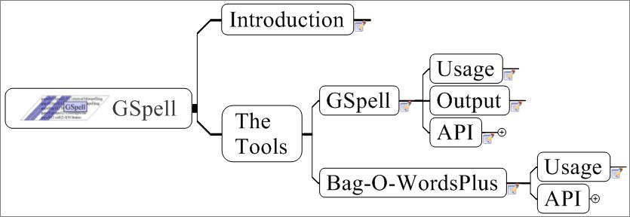

Slide 51
Gspell: Introduction
The GSpell program is a spelling suggestion tool that uses a mix of algorithms to retrieve close neighbors. This application is best suited to applications that index at the word or term level of tokenization.
BagOWordsPlus is a phrase retrieval tool. This tool is useful to retrieve closest matching phrases to data such as strings from the Metathesaurus.

Slide 52
GSpell: Usage
  Usage
  GSpellFind.[sh|bat]
  --dictionary=NameOfDictionary
  [--inputFile=Source] [--outputFile=target]
  [--truncate=N] [--considerNCandidates=N]
  [--maxEditDistance=N]

Slide 53
GSpell: Indexing
Usage
  GSpellIndex.[sh|bat]
  --dictionary=NameOfDictionary
  --inputFile=SourceFile
  [--reportTime] [--version][--help]
Format for the input file
  One word per line

Slide 54
GSpell: Output
Input Term | Suggestion | Edit Distance | Rank | Method | Message
anonomous|anonymous|1.0|0.87|NGrams|
anonomous|allonomous|2.0|0.58|NGrams|
anonomous|autonomous|2.0|0.58|NGrams|
anonomous|anadromous|3.0|0.29|NGrams|
anonomous|analogous|3.0|0.29|NGrams|
anonomous|anomalous|3.0|0.29|NGrams|
anonomous|anonymously|3.0|0.29|NGrams|
anonomous|anonymes|3.0|0.29|Metaphone|
anonomous|anonyms|3.0|0.29|Metaphone|
anonomous|acoprous|4.0|0.11|NGrams|

Slide 55
GSpell: API
import gov.nih.nlm.nls.gspell.GSpell; // <-------These come from the gspell.jar
import gov.nih.nlm.nls.gspell.Candidate;
GSpell gspell = new GSpell( _dictionaryName, GSpell.READ_ONLY );
Vector candidates = gspell.find( aTerm );
if ( candidates != null )
for ( int i = 0; i < candidates.length; i++ )
System.out.println(candidates[i].toString());
else
System.out.println("No Suggestions");
gspell.cleanup();

Slide 56
BagOWordsPlus: Usage
  Usage
  BagOWordsPlusFind.[sh|bat]
  --dictionary=NameOfDictionary
  [--inputFile=Source] [--outputFile=target]
  [--truncate=N] [--considerNCandidates=N]
  [--maxEditDistance=N]

Slide 57
BagOWordsPlus: Indexing
Usage
  BagOWordsPlusIndex.[sh|bat]
  --dictionary=NameOfDictionary
  --inputFile=SourceFile
  [--reportTime] [--version][--help]
Format for the input file
  One phrase per line

Slide 58
BagOWordsPlus: Output
Input Term | Suggestion | Edit Distance
sleep|sleep|0.0
sleep|S-sleep|2.0
sleep|S sleep|2.0
sleep|REM sleep|4.0
sleep|deep sleep|5.0

Slide 59
BagOWordsPlus: API
import gov.nih.nlm.nls.gspell.BagOWordsPlus; // <-------These come from the gspell.jar
import gov.nih.nlm.nls.gspell.Candidate;
BagOWordsPlus ir = new BagOWordsPlus( args );
Vector candidates = ir.get( aTerm );
if ( candidates != null )
for ( int i = 0; i < candidates.length; i++ )
System.out.println(candidates[i].toString());
else
System.out.println("No Suggestions");
ir.cleanup();

Slide 60

SPECIALIST NLP Tools:
Table of Contents
  Logical/physical views of the functionalities
  The tools as stand-alone applications
    Command line options
    Example output
  API functionalities
    The model of a document
      Parts list
      Structure
      Details: Lexical Element
      Details: Token

Slide 61
Table of Contents
  Example applications using the API's
    Sentence Tokenizer
    Noun Phrase Tokenizer

Slide 62
Introduction: Logical View
  Word Tokenizer
  Term Tokenizer
  Phrase Tokenizer
  Sentence Tokenizer
  Section Tokenizer

Slide 63
Introduction: Physical View
  Section/Sentence/Word Tokenizer
  Term Tokenizer
    a.k.a lexical lookup, term recognizer
  Phrase Tokenizer
    a.k.a phrase chunker, noun phrase extractor, parser

Slide 64

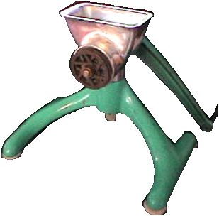
Section/Sentence/Word Tokenizer
SPME determination of volatile aldehydes for evaluation of in-vitro antioxidant activity
Elena E. Stashenko, Miguel A. Puertas, Jairo R. Martínez
^{A1} Chromatography Laboratory, Research Center for Biomolecules, School of Sciences, Industrial University of Santander. A.A. 678, Bucaramanga, Colombia
Abstract:
Abstract. The in-vitro antioxidant activity of natural (essential oils, vitamin E) or synthetic substances (tert-butyl hydroxy anisole (BHA), Trolox) has been evaluated by monitoring volatile carbonyl compounds released in model lipid systems subjected to peroxidation. The procedure employed methodology previously developed for the determination of carbonyl compounds as their pentafluorophenylhydrazine derivatives which were quantified, with high sensitivity, by means of capillary gas chromatography with electron-capture detection. Linoleic acid and sunflower oil were used as model lipid systems. Lipid peroxidation was induced in linoleic acid by the Fe²⁺ ion (1 mmol L⁻¹, 37 °C, 12 h) and in sunflower oil by heating in the presence of O₂ (220 °C, 2 h).
Tokenizes text into
  Sections (paragraphs)
  Sentences
  Tokens
Tokenizer
Document
Section
Sentence
Token

Slide 65
SPECIALIST NLP Tools: Tokenizer
Usage
tokenize.[bat|sh] [Options]
--fileName=fileName
--outputFileName=fileName
--inputType=[freeText|medlineCitations]
--sections
--sentences
--tokens
--pipedOutput
--indicate_citation_end

Slide 66
SPECIALIST NLP Tools: Tokenizer
tokenize.bat --inputFile=5.txt --inputType=freeText --sentences --tokens
--pipedOutput
Sentence|1|97|182|But those follow-up tests have been inconclusive, state and federal officials said.
Token|16|97|99|0|0|But|||
Token|17|101|105|1|0|those|||
Token|18|108|113|2|0|follow|||
Token|19|114|114|2|0|-|||
Token|20|115|116|3|0|up|||
Token|21|118|122|4|0|tests|||
Token|22|124|127|5|0|have|||
Token|23|129|132|6|0|been|||
Token|24|134|145|7|0|inconclusive|||

Slide 67
SPECIALIST NLP Tools: Tokenizer
// =============+ Create a TokenizeAPI object +==
TokenizeAPI tokenizer = new TokenizeAPI( argv );
// =======================+ Tokenize the file +==
Document aDocument =
tokenizer.processDocument( aFile);
Vector tokens = aDocument.getTokens() ;
int numberOfTokens = tokens.size();
Token aToken = null;
// ====================+ Print the tokens out +==
for ( int i = 0; i < numberOfTokens; i++ ) {
aToken = (Token) tokens.get(i);
System.out.println( aToken.toPipedString() );
}

Slide 68
SPECIALIST NLP Tools:
Term Tokenizer
SPME determination of volatile aldehydes for evaluation of in-vitro antioxidant activity
Elena E. Stashenko, Miguel A. Puertas, Jairo R. Martínez
^{A1} Chromatography Laboratory, Research Center for Biomolecules, School of Sciences, Industrial University of Santander. A.A. 678, Bucaramanga, Colombia
Abstract:
Abstract. The in-vitro antioxidant activity of natural (essential oils, vitamin E) or synthetic substances (tert-butyl hydroxy anisole (BHA), Trolox) has been evaluated by monitoring volatile carbonyl compounds released in model lipid systems subjected to peroxidation. The procedure employed methodology previously developed for the determination of carbonyl compounds as their pentafluorophenylhydrazine derivatives which were quantified, with high sensitivity, by means of capillary gas chromatography with electron-capture detection. Linoleic acid and sunflower oil were used as model lipid systems. Lipid peroxidation was induced in linoleic acid by the Fe²⁺ ion (1 mmol L⁻¹, 37 °C, 12 h) and in sunflower oil by heating in the presence of O₂ (220 °C, 2 h).
Chunks tokens into
terms
  From SPECIALIST
  Lexicon
  From regular
  expressions
Term
Tokenizer
Document
Section
Sentence
Lexical Element

Slide 69
SPECIALIST NLP Tools:
Term Tokenizer
Usage
LexicalLookup.[bat|sh] [Options]
--fileName=fileName
--outputFileName=fileName
--inputType=[freeText|HTML|medlineCitations]
--sections
--sentences
--lexicalElements
--lexicalEntries
--tokens
--pipedOutput

Slide 70
SPECIALIST NLP Tools:
Term Tokenizer
LexicalLookup.bat --inputFile=5.txt --inputType=freeText --lexicalElements --lexicalEntries --pipedOutput
Lexical Element|12|SHAPE:Unlabeled|unknown|Richmond|67|74
Lexical Element|13|LEXICON|prep|for|76|78
Lexical Element|14|LEXICON|adj|further|80|86
Lexical Element|15|LEXICON|verb|testing|88|94
Lexical Element |16|PUNCTUATION|punctuation|.|95|95
Lexical Element |17|LEXICON|prep|But|97|99
Lexical Element |18|LEXICON|det|those|101|105
Lexical Element |20|LEXICON|adj|follow-up|108|116
Lexical Element |23|LEXICON|noun|tests|118|122
Lexical Element |24|LEXICON|aux|have|124|127

Slide 71
SPECIALIST NLP Tools:
Term Tokenizer
LexicalLookup.bat --inputFile=5.txt --inputType=freeText --lexicalElements --lexicalEntries --pipedOutput
Lexical Element|17|LEXICON|prep|But|97|99
LexicalEntry|but|conj|base|E0014465
LexicalEntry|but|prep|base|E0014464
Lexical Element|18|LEXICON|det|those|101|105
LexicalEntry|those|det|plural|E0060728
LexicalEntry|those|pron|base|E0060729
Lexical Element|20|LEXICON|adj|follow-up|108|116
LexicalEntry|follow-up|adj|base|E0028422
Lexical Element|23|LEXICON|noun|tests|118|122
LexicalEntry|tests|verb|pres3s|E0060349
LexicalEntry|tests|noun|plural|E0060348

Slide 72
SPECIALIST NLP Tools:
Term Tokenizer
// ==========+ Create a LexicalLookupAPI object +==
LexicalLookupAPI look = new LexicalLookupAPI(argv);
// ============================+ Chunk the file +==
Document aDocument = look.processDocument( aFile );
Vector les = aDocument.getLexicalElements();
int numberOfLexElements = les.size();
LexicalElement aLexElement = null;
// =============+ Print the LexicalElements out +==
for (int i = 0; i< numberOfLexElements; i++ ) {
aLexElement = (LexicalElement) les.get(i);
System.out.println(aLexElement.toPipedString());
}

Slide 73
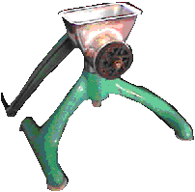
SPECIALIST NLP Tools:
Phrase Tokenizer
Document
Chunks sentences
into simple phrases
Sections
Section 1
Sentences
Sentence 1
Phrase
Tokenizer
Phrases
LexicalElements
Lexical Element 1
Tokens

Slide 74
SPECIALIST NLP Tools:
Phrase Tokenizer
Usage
npParser.[bat|sh] [Options]
--fileName=fileName
--outputFileName=fileName
--inputType=[freeText|HTML|medlineCitations]
--sections
--sentences
--phrases|--nps|--mincoMan
--lexicalElements
--lexicalEntries
--tokens
--pipedOutput

Slide 75
SPECIALIST NLP Tools:
Phrase Tokenizer
npParser.bat --inputFile=5.txt --inputType=freeText --phrases --pipedOutput
Phrase|0|0|10|The company|company
Phrase|1|12|14|has|
Phrase|2|16|24|forwarded|
Phrase|3|26|39|some materials|materials
Phrase|4|41|62|to a state laboratory|state laboratory
Phrase|5|64|74|in Richmond|Richmond
Phrase|6|76|86|for further|further
Phrase|7|88|94|testing|

Slide 76
SPECIALIST NLP Tools:
Phrase Tokenizer
// ====================+ Create a Parser object +==
Parser parser = new Parser( argv );
// ============================+ Parse the file +==
Document aDocument = parser.processDocument(aFile);
Vector phrases = aDocument.getPhrase() ;
Int numberOfPhrases = phrases.size();
Phrase aPhrase = null;
// =====================+ Print the Phrases out +==
for ( int i = 0; i < numberOfPhrases; i++ ) {
aPhrase = (Phrase) phrases.get(i);
System.out.println( aPhrase.toPipedString() );
}

Slide 77
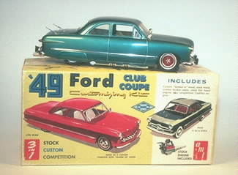
Document: A Model
How it’s put together
Image from: www.themodelcarmuseum.org/ 49box0.jpg

Slide 78
Document Model: Parts List
SPME determination of volatile aldehydes for evaluation of in-vitro antioxidant activity
Elena E. Stashenko, Miguel A. Puertas, Jairo R. Martínez
^{A1} Chromatography Laboratory, Research Center for Biomolecules, School of Sciences, Industrial University of Santander. A.A. 678, Bucaramanga, Colombia
Abstract:
Abstract. The in-vitro antioxidant activity of natural (essential oils, vitamin E) or synthetic substances (tert-butyl hydroxy anisole (BHA), Trolox) has been evaluated by monitoring volatile carbonyl compounds released in model lipid systems subjected to peroxidation. The procedure employed methodology previously developed for the determination of carbonyl compounds as their pentafluorophenylhydrazine derivatives which were quantified, with high sensitivity, by means of capillary gas chromatography with electron-capture detection. Linoleic acid and sunflower oil were used as model lipid systems. Lipid peroxidation was induced in linoleic acid by the Fe²⁺ ion (1 mmol L⁻¹, 37 °C, 12 h) and in sunflower oil by heating in the presence of O₂ (220 °C, 2 h).
  Sections
  Sentences
  Phrases
  Terms
  Words
  Lexicon Entries

Slide 79
Document Model: Parts List
SPME determination of volatile aldehydes for evaluation of in-vitro antioxidant activity
Elena E. Stashenko, Miguel A. Puertas, Jairo R. Martínez
^{A1} Chromatography Laboratory, Research Center for Biomolecules, School of Sciences, Industrial University of Santander. A.A. 678, Bucaramanga, Colombia
Abstract:
The in-vitro antioxidant activity of natural (essential oils, vitamin E) or synthetic substances (tert-butyl hydroxy anisole (BHA), Trolox) has been evaluated by monitoring volatile carbonyl compounds released in model lipid systems subjected to peroxidation. The procedure employed methodology previously developed for the determination of carbonyl compounds as their pentafluorophenylhydrazine derivatives which were quantified, with high sensitivity, by means of capillary gas chromatography with electron-capture detection. Linoleic acid and sunflower oil were used as model lipid systems. Lipid peroxidation was induced in linoleic acid by the Fe²⁺ ion (1 mmol L⁻¹, 37 °C, 12 h) and in sunflower oil by heating in the presence of O₂ (220 °C, 2 h).
  Sections
  Sentences
  Phrases
  Terms
  Words
  Lexicon Entries
Title
Abstract

Slide 80
Document Model: Parts List
SPME determination of volatile aldehydes for evaluation of in-vitro antioxidant activity
Elena E. Stashenko, Miguel A. Puertas, Jairo R. Martínez
^{A1} Chromatography Laboratory, Research Center for Biomolecules, School of Sciences, Industrial University of Santander. A.A. 678, Bucaramanga, Colombia
Abstract:
The in-vitro antioxidant activity of natural (essential oils, vitamin E) or synthetic substances (tert-butyl hydroxy anisole (BHA), Trolox) has been evaluated by monitoring volatile carbonyl compounds released in model lipid systems subjected to peroxidation. The procedure employed methodology previously developed for the determination of carbonyl compounds as their pentafluorophenylhydrazine derivatives which were quantified, with high sensitivity, by means of capillary gas chromatography with electron-capture detection. Linoleic acid and sunflower oil were used as model lipid systems. Lipid peroxidation was induced in linoleic acid by the Fe²⁺ ion (1 mmol L⁻¹, 37 °C, 12 h) and in sunflower oil by heating in the presence of O₂ (220 °C, 2 h).
  Sections
  Sentences
  Phrases
  Terms
  Words
  Lexicon Entries

Slide 81
Document Model: Parts List
SPME determination of volatile aldehydes for evaluation of in-vitro antioxidant activity
Elena E. Stashenko, Miguel A. Puertas, Jairo R. Martínez
^{A1} Chromatography Laboratory, Research Center for Biomolecules, School of Sciences, Industrial University of Santander. A.A. 678, Bucaramanga, Colombia
Abstract:
The in-vitro antioxidant activity of natural (essential oils, vitamin E) or synthetic substances (tert-butyl hydroxy anisole (BHA), Trolox) has been evaluated by monitoring volatile carbonyl compounds released in model lipid systems subjected to peroxidation. The procedure employed methodology previously developed for the determination of carbonyl compounds as their pentafluorophenylhydrazine derivatives which were quantified, with high sensitivity, by means of capillary gas chromatography with electron-capture detection. Linoleic acid and sunflower oil were used as model lipid systems. Lipid peroxidation was induced in linoleic acid by the Fe²⁺ ion (1 mmol L⁻¹, 37 °C, 12 h) and in sunflower oil by heating in the presence of O₂ (220 °C, 2 h).
  Sections
  Sentences
  Phrases
  Terms
  Words
  Lexicon Entries

Slide 82
Document Model: Parts List
SPME determination of volatile aldehydes for evaluation of in-vitro antioxidant activity
Elena E. Stashenko, Miguel A. Puertas, Jairo R. Martínez
^{A1} Chromatography Laboratory, Research Center for Biomolecules, School of Sciences, Industrial University of Santander. A.A. 678, Bucaramanga, Colombia
Abstract:
The in-vitro antioxidant activity of natural (essential oils, vitamin E) or synthetic substances (tert-butyl hydroxy anisole (BHA), Trolox) has been evaluated by monitoring volatile carbonyl compounds released in model lipid systems subjected to peroxidation. The procedure employed methodology previously developed for the determination of carbonyl compounds as their pentafluorophenylhydrazine derivatives which were quantified, with high sensitivity, by means of capillary gas chromatography with electron-capture detection. Linoleic acid and sunflower oil were used as model lipid systems. Lipid peroxidation was induced in linoleic acid by the Fe²⁺ ion (1 mmol L⁻¹, 37 °C, 12 h) and in sunflower oil by heating in the presence of O₂ (220 °C, 2 h).
  Sections
  Sentences
  Phrases
  Terms
  Words
  Lexicon Entries
single-word term
Multi-word term

Slide 83
Document Model: Parts List
SPME determination of volatile aldehydes for evaluation of in-vitro antioxidant activity
Elena E. Stashenko, Miguel A. Puertas, Jairo R. Martínez
^{A1} Chromatography Laboratory, Research Center for Biomolecules, School of Sciences, Industrial University of Santander. A.A. 678, Bucaramanga, Colombia
Abstract:
The in-vitro antioxidant activity of natural (essential oils, vitamin E) or synthetic substances (tert-butyl hydroxy anisole (BHA), Trolox) has been evaluated by monitoring volatile carbonyl compounds released in model lipid systems subjected to peroxidation. The procedure employed methodology previously developed for the determination of carbonyl compounds as their pentafluorophenylhydrazine derivatives which were quantified, with high sensitivity, by means of capillary gas chromatography with electron-capture detection. Linoleic acid and sunflower oil were used as model lipid systems. Lipid peroxidation was induced in linoleic acid by the Fe²⁺ ion (1 mmol L⁻¹, 37 °C, 12 h) and in sunflower oil by heating in the presence of O₂ (220 °C, 2 h).
  Sections
  Sentences
  Phrases
  Terms
  Words
  Lexicon Entries

Slide 84
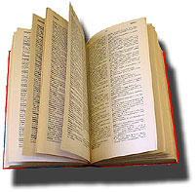
Document Model: Parts List
  Sections
  Sentences
  Phrases
  Terms
  Words
  Lexicon Entries
Specialist Lexicon

Slide 85
Document Model: Parts List
  Sections
  Sentences
  Phrases
  Terms
  Words
  Lexicon Entries
SPECIALIST Lexical Records
{base=capillary
entry=E0015013
cat=adj
}
{base=capillary
entry=E0015014
cat=noun
}
Specialist Lexicon

Slide 86
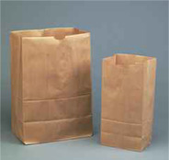
Document Model: Structure
Document
Section
Section

Slide 87
Document Model: Structure
Document
Sentence
Lexical Element
Section
Phrase
Token
One to Many
Relationship

Slide 88
Document Model: Structure
Document
Sentence
Lexical Element
Section
Phrase
Token
One to Many
Relationship

Slide 89
Document Model: Structure
Document
Sentence
Lexical Element
Section
Phrase
Token
One to Many
Relationship

Slide 90
Document Model: Structure
Document
Sentence
Lexical Element
Section
Phrase
Token
One to Many
Relationship

Slide 91
Document Model: Structure
Lexical Element
Lexical Entry
Token
One to Many
Relationship

Slide 92
Document Model:
Lexical Element
SPME determination of volatile aldehydes for evaluation of in-vitro antioxidant activity
Elena E. Stashenko, Miguel A. Puertas, Jairo R. Martínez
^{A1} Chromatography Laboratory, Research Center for Biomolecules, School of Sciences, Industrial University of Santander. A.A. 678, Bucaramanga, Colombia
Abstract:
The in-vitro antioxidant activity of natural (essential oils, vitamin E) or synthetic substances (tert-butyl hydroxy anisole (BHA), Trolox) has been evaluated by monitoring volatile carbonyl compounds released in model lipid systems subjected to peroxidation. The procedure employed methodology previously developed for the determination of carbonyl compounds as their pentafluorophenylhydrazine derivatives which were quantified, with high sensitivity, by means of capillary gas chromatography with electron-capture detection. Linoleic acid and sunflower oil were used as model lipid systems. Lipid peroxidation was induced in linoleic acid by the Fe²⁺ ion (1 mmol L⁻¹, 37 °C, 12 h) and in sunflower oil by heating in the presence of O₂ (220 °C, 2 h).
vitamin E
single-word term
Multi-word term

Slide 93
Document Model:
Lexical Element
Lexical Element:
Vitamin E
Token:
vitamin
Token: vitamin
Token: E
Lexical Entry:
{base=vitamin E
entry=E0064781
cat=noun
Token:
E
Tagger
Part of
speech
tag
Token:
vitamin
Token:
E

Slide 94
Document Model:
Token
Token
Span
Part of Speech Tag
Span
Char begin offset
Char end offset

Slide 95
Document Model:
Phrase
Phrase
Phrase (cont.)
String displayTags()
String displayVariants()
List getAllVariants()
UMLS_ConceptPointer getConceptPointer()
UMLS_ConceptPointer[] getConcepts()
List getDerivedPhrases()
ArrayList getFinalMappings()
List getLexicalElements()
List getNp()
String getNpString()
List getNpTokens()
String getOriginalString()
int getPhrasePosition()
int getSizeOfPhrase()
String getTrimmedString()
boolean isOfPhrase()
boolean isPrepPhrase()
String toMincoManString()
String toMoString()
String toPipedString()
String toString()
String toSyntaxString()

Slide 96
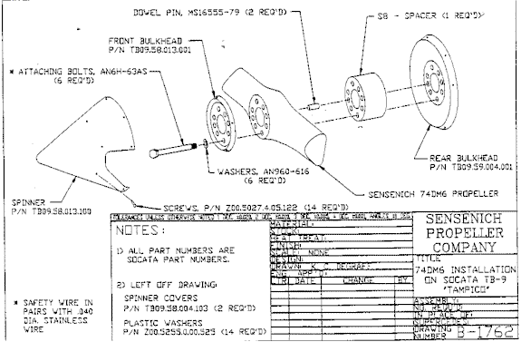
Assembly Instructions

Slide 98
Term Tokenizer
SPME determination of volatile aldehydes for evaluation of in-vitro antioxidant activity
Elena E. Stashenko, Miguel A. Puertas, Jairo R. Martínez
^{A1} Chromatography Laboratory, Research Center for Biomolecules, School of Sciences, Industrial University of Santander. A.A. 678, Bucaramanga, Colombia
Abstract:
Abstract. The in-vitro antioxidant activity of natural (essential oils, vitamin E) or synthetic substances (tert-butyl hydroxy anisole (BHA), Trolox) has been evaluated by monitoring volatile carbonyl compounds released in model lipid systems subjected to peroxidation. The procedure employed methodology previously developed for the determination of carbonyl compounds as their pentafluorophenylhydrazine derivatives which were quantified, with high sensitivity, by means of capillary gas chromatography with electron-capture detection. Linoleic acid and sunflower oil were used as model lipid systems. Lipid peroxidation was induced in linoleic acid by the Fe²⁺ ion (1 mmol L⁻¹, 37 °C, 12 h) and in sunflower oil by heating in the presence of O₂ (220 °C, 2 h).
Tokenizer
Sentence
Lexical Element
Token
Lexical
Entry

Slide 99
Phrase Tokenizer
SPME determination of volatile aldehydes for evaluation of in-vitro antioxidant activity
Elena E. Stashenko, Miguel A. Puertas, Jairo R. Martínez
^{A1} Chromatography Laboratory, Research Center for Biomolecules, School of Sciences, Industrial University of Santander. A.A. 678, Bucaramanga, Colombia
Abstract:
Abstract. The in-vitro antioxidant activity of natural (essential oils, vitamin E) or synthetic substances (tert-butyl hydroxy anisole (BHA), Trolox) has been evaluated by monitoring volatile carbonyl compounds released in model lipid systems subjected to peroxidation. The procedure employed methodology previously developed for the determination of carbonyl compounds as their pentafluorophenylhydrazine derivatives which were quantified, with high sensitivity, by means of capillary gas chromatography with electron-capture detection. Linoleic acid and sunflower oil were used as model lipid systems. Lipid peroxidation was induced in linoleic acid by the Fe²⁺ ion (1 mmol L⁻¹, 37 °C, 12 h) and in sunflower oil by heating in the presence of O₂ (220 °C, 2 h).
Tokenizer
Sentence
Lexical Element
Token
Lexical
Entry

