Slide 1

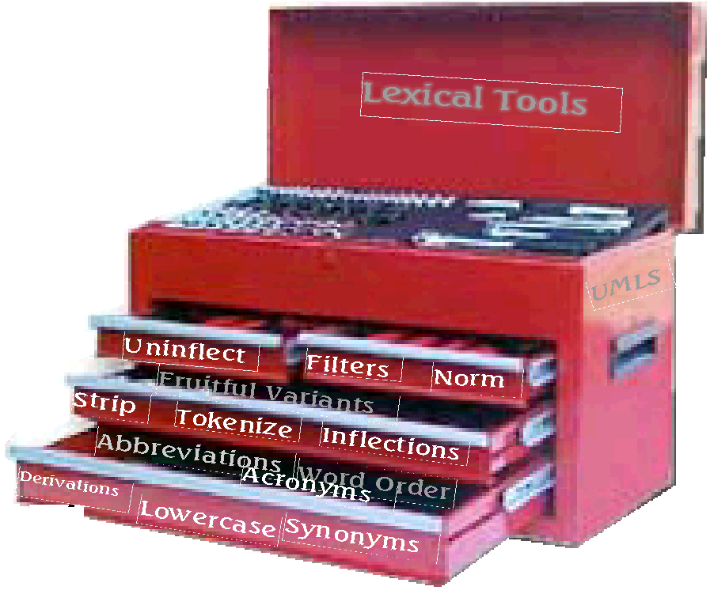
Lexical Tools for UMLS Developers
November 4, 2001
Allen C. Browne, Guy Divita,
Chris Lu
Lister Hill National Center for Biomedical Communications
National Library of Medicine

Slide 2
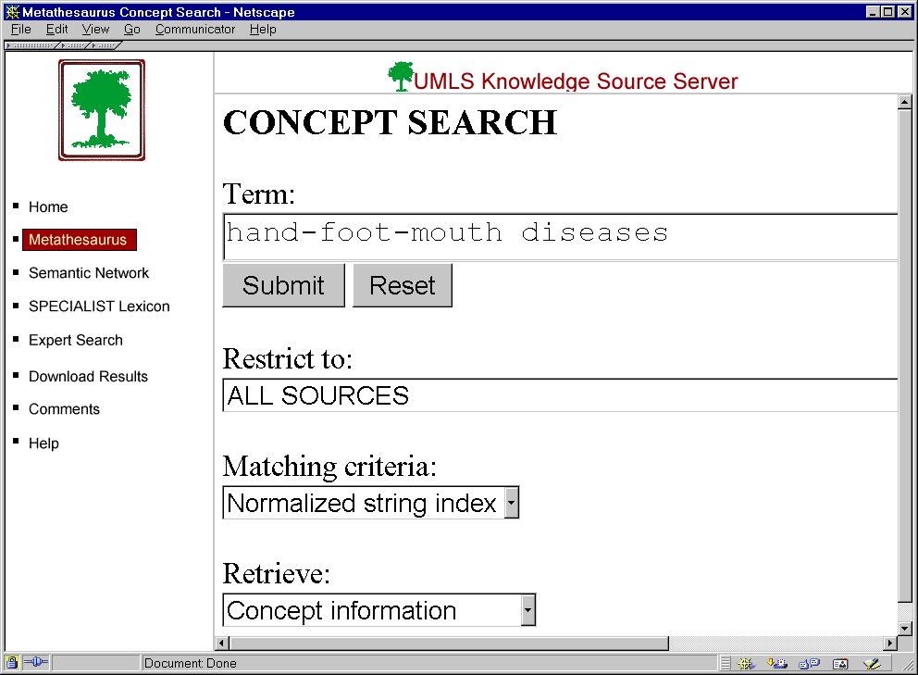
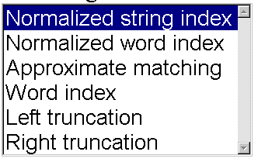

Slide 3
Lexical Tools for UMLS Developers
The SPECIALIST lexicon – Browne
The lexical tools – Divita/Lu
Coffee Break– 10:00 - 10:30
Lexical tools cont. – Divita/Lu

Slide 4
Text
processing
Lexical tools
SPECIALIST
LEXICON

Slide 5
The SPECIALIST Lexicon
A syntactic lexicon
Biomedical and general English
Over 160,000 records

Slide 6
The SPECIALIST Lexicon
General English:
10,000 most frequent words from the American Heritage word frequency list
2,000 words used by Longman’s Dictionary of Contemporary English
Verbs and adjectives identified by heuristics

Slide 7
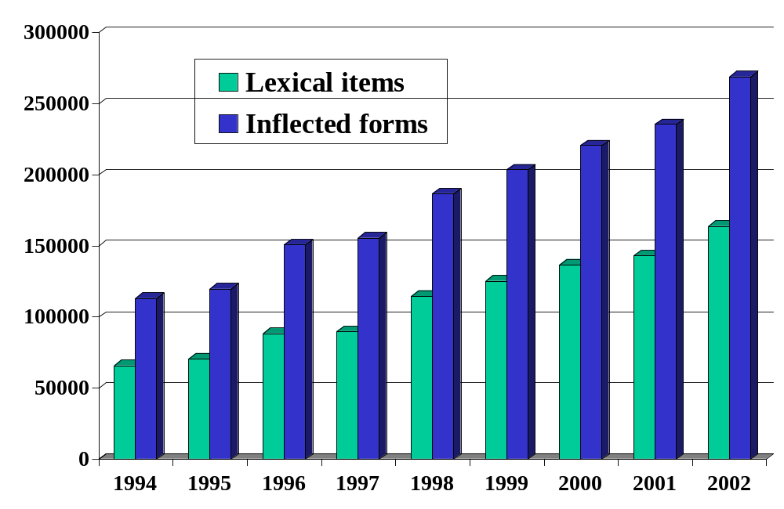
Lexicon Growth

Slide 8
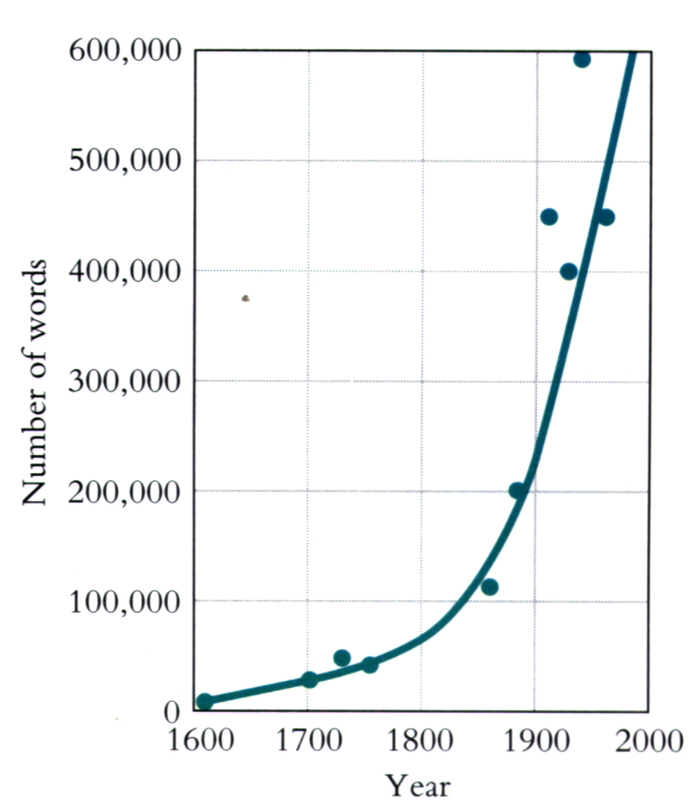
George A. Miller
The Science of Words
1991

Slide 9
The SPECIALIST Lexicon
Morphology
  Inflection
  Derivation
Orthography
  Spelling variants
Syntax
  Complementation for verbs, nouns, and adjectives

Slide 10
Morphology
Inflectional
  nucleus -- nuclei
  cauterize, cauterizes, cauterized, cauterizing
  red, redder reddest
Derivational
  laryngeal -- larynx
  transport -- transportation

Slide 11
Orthography
Spelling Variation
align -- aline
Grave’s disease -- Graves’s disease -- Graves’ disease
anesthetize -- anesthetise
esophagus -- oesophagus

Slide 12
British and American Spelling
Criticise -- criticize
naturalise --naturalize
centre -- center
foetus -- fetus

Slide 13
Try This Test
Which of the variant spellings below do you, accept
as standard American English? After making your
choices, consult the pages of this book to see what the dictionaries say. You are due for some astonishments.
A Comparative Study of Spellings in four major collegiate dictionaries,
by Lee C Deighton,
Hardscrabble Press 1972.

Slide 14
Syntax -- Verb Complements
Intran
  I’ll treat.
tran=np
  He treated the patient.
ditran=np,pphr(with,np)
  She treated the patient with the drug.

Slide 15
Syntax -- Verb Complements
{base=treat
entry=E0061964
cat=verb
variants=reg
intran
tran=np
tran=pphr(with,np)
tran=pphr(of,np)
ditran=np,pphr(to,np)
ditran=np,pphr(with,np)
ditran=np,pphr(for,np)
cplxtran=np,advbl
nominalization=treatment|noun|E0061968
}

Slide 16
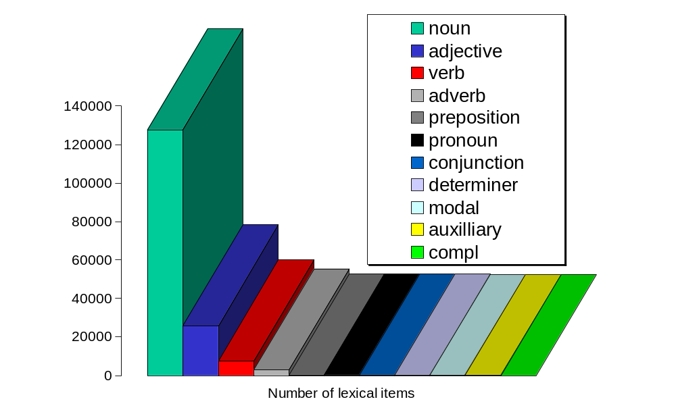
The 2002 SPECIALIST Lexicon

Slide 17
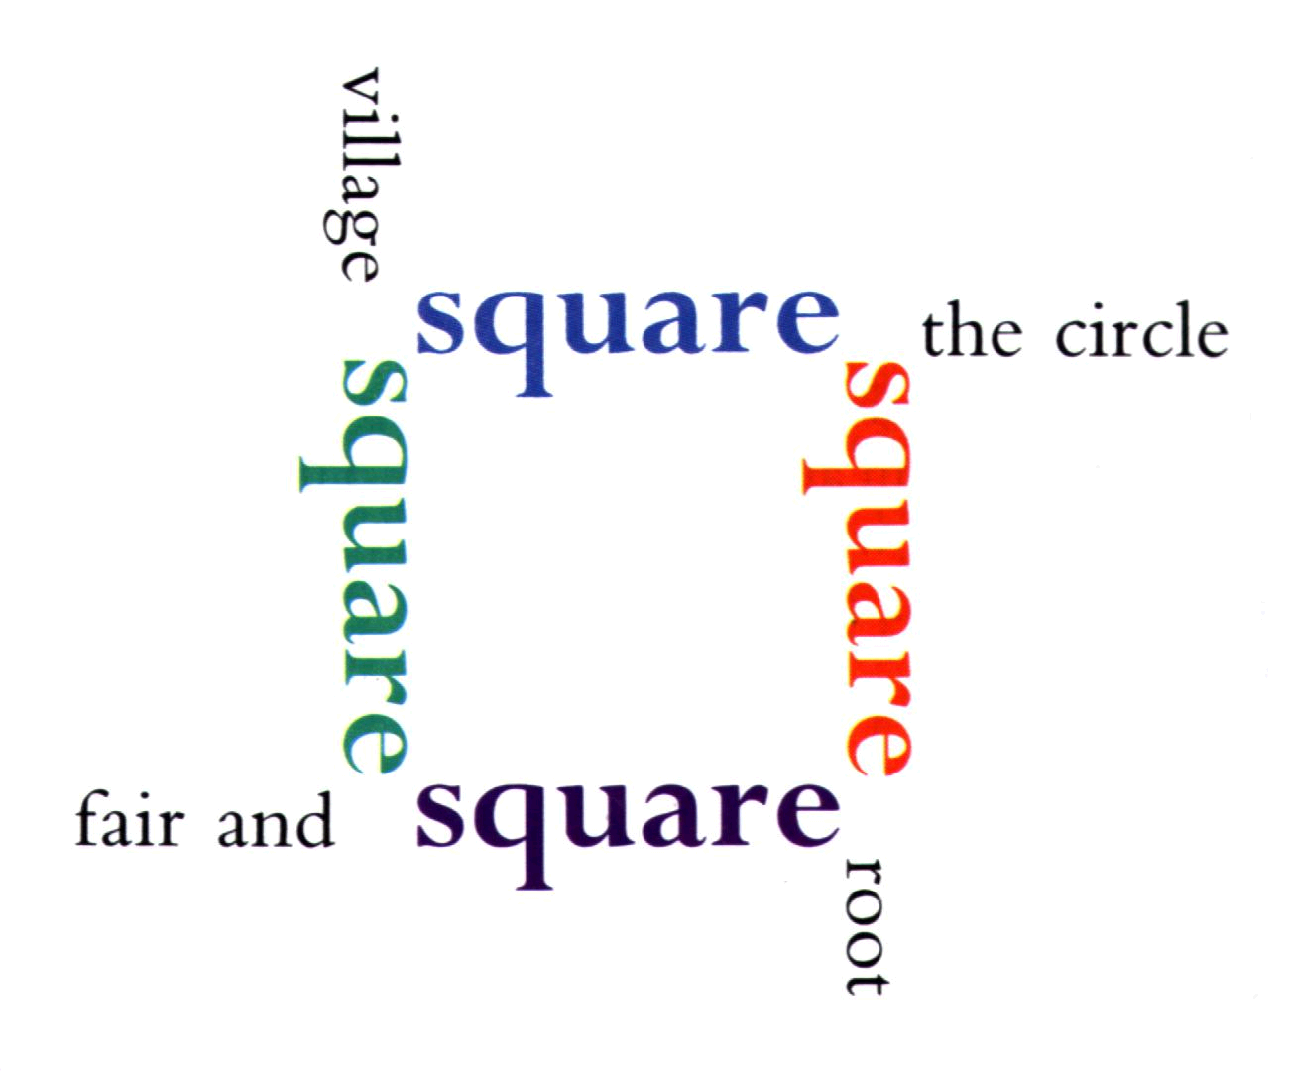

Slide 18
Lexicon Unit Records
{base=Kaposi's sarcoma
spelling_variant=Kaposi sarcoma
entry=E0003576
cat=noun
variants=uncount
variants=reg
variants=glreg
}
{base=chronic
entry=E0016869
cat=adj
variants=inv
position=attrib(1)
position=pred
stative
}
{base=aspirate
entry=E0010803
cat=verb
variants=reg
tran=np
nominalization=aspiration|noun|E0010804
}
{base=in
entry=E0033870
cat=prep
}

Slide 19
Noun Variants
Kaposi’s sarcoma
Kaposi’s sarcomas
Kaposi’s sarcomata
Kaposi sarcoma
Kaposi sarcomas
Kaposi sarcomata
{base=Kaposi's sarcoma
spelling_variant=Kaposi sarcoma
entry=E0003576
cat=noun
variants=uncount
variants=reg
variants=glreg
}

Slide 20
Regular Nouns
The plural suffix is s.
y becomes ie following a consonant before s.
e is inserted before s if the base ends in s, z, x, ch, or s

Slide 21
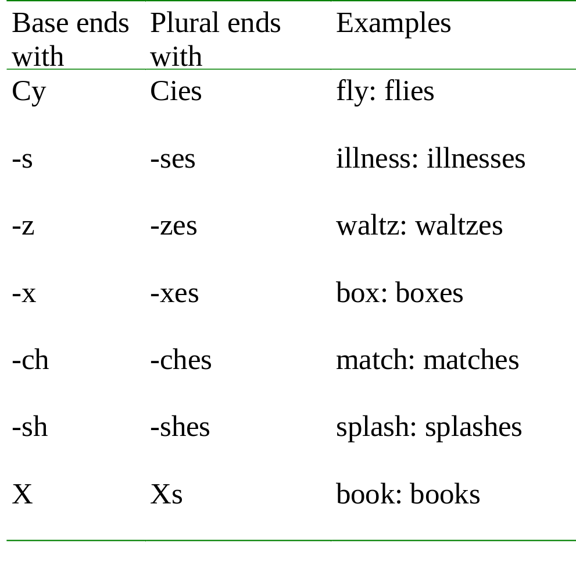
Regular Nouns

Slide 22
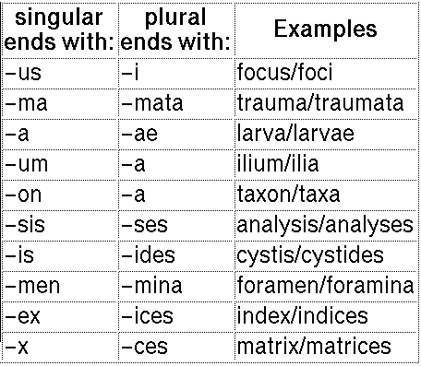
Greco-latin Regular nouns

Slide 23
Uncount Nouns
(abstract or mass)
{base=smallpox
entry=E0056359
cat=noun
variants=uncount
}
{base=potassium
entry=E0049387
cat=noun
variants=uncount
}
* a smallpox
* two smallpoxes
much smallpox
* a potassium
* two potassiums
much potassium

Slide 24
Fixed Plural Nouns
{base=police
entry=E0048616
cat=noun
variants=plur
}
{base=scissors
entry=E0054633
cat=noun
variants=plur
}

Slide 25
Irregular Nouns
{base=corpus
entry=E0019113
cat=noun
variants=irreg|corpora|
variants=reg
}
{base=larynx
entry=E0036919
cat=noun
variants=irreg|larynges|
variants=reg
}

Slide 26
Regular Verbs
The third person present tense suffix is s.
  y becomes ie following a consonant before s.
  e is inserted between z, x, ch, or sh and s.
The past tense suffix is ed.
  y becomes ie following a consonant before ed.
  Final e is deleted before ed.

Slide 27
Regular Verbs
dismiss:dismisses, dismissed, dismissing
agree: agrees; agreed; agreeing
dry: dries, dried, drying

Slide 28
Regular Doubling Verbs
End in a CVC pattern
Double the final consonant before ed and ing.
Are otherwise regular
variants=regd
e.g. control: controls, controlled, controlling

Slide 29
Irregular Verbs
{base=dive
cat=verb
variants=reg
variants=irreg|dives|dove|dove|diving|
intran
intran;part(in)
...
}

Slide 30
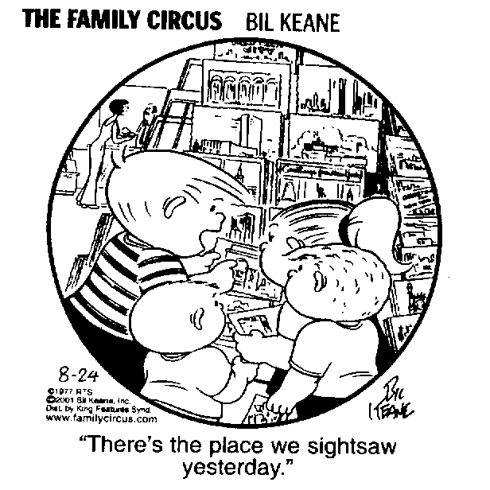
Defective Verb
sightsee
*sightsees
*sightsaw
*sightseen
sightseeing

Slide 31
Regular Adjectives and Adverbs
The comparative suffix is er.
The superlative suffix is est.
  y become ie after a consonant before er or est.
  Final e is deleted before er or est.
e.g. green: greener, greenest

Slide 32
Regular Doubling Adjectives and Adverbs
CVC final pattern
Final consonant is doubled before ed or est.
Otherwise regular
e.g. red: redder, reddest

Slide 33
Ancillary Data Bases
Synonymy
  sm.db
Derivation
  dm.db, dm.rules
Inflection
  im.rules
Neoclassical compounds
  nc.db

Slide 34
Derivational Facts and Rules
dm.facts
treatment|noun|treat|verb
prohibition|noun|prohibitive|adj
cell lineage|noun|cell line|noun
photochemotherapeutic|adj|photochemotherapy|noun
pharmacotherapeutic|adj|pharmacotherapy|noun

Slide 35
Derivational Facts and Rules
dm.rules
# e.g. alienation|alienate
ation$|noun|ate|verb
ration|rate; station|state;

Slide 36
Inflectional Facts and Rules
im.rules
# Noun rules (glreg)
us$|noun|singular|i$|noun|plural
antus|anti;
ma$|noun|singular|mata$|noun|plural
a$|noun|singular|ae$|noun|plural
um$|noun|singular|a$|noun|plural
on$|noun|singular|a$|noun|plural
sis$|noun|singular|ses$|noun|plural
is$|noun|singular|ides$|noun|plural
men$|noun|singular|mina$|noun|plural
ex$|noun|singular|ices$|noun|plural
x$|noun|singular|ces$|noun|plural

Slide 37
Neoclassical compounds
nc.db
abdomin(o)|abdomen|root
ab|away from|prefix
acanth(o)|prickle|root
acar(o)|mite|root
acetabul(o)|acetabulum|root
ad|towards|prefix
agogue|inducing|terminal
albumin(o)|albumin|root
sis|condition|terminal
stomy|surgical opening|terminal

Slide 38
Synonyms
sm.db
alar|adj|wing|noun
amygdaline|adj|tonsil|noun
articular|adj|joint|noun
bulbar|adj|medulla oblongata|noun
fununcular|adj|boil|noun
genicular|adj|knee|noun
hepatocellular|adj|liver cells|noun
lazar|adj|leprosy|noun
lenticular|adj|crystalline lens|noun
ypsiliform|adj|upsiloid|adj
wolfram|noun|tungsten|noun
double vision|noun|diplopia|noun

Slide 39
Relational Tables
One line records
Pipe separated Fields -- “|”
Keyed to EUI
LRAGR matches forms to EUIs
Word index: LRWD

Slide 40
Relational Tables
LRAGR - Agreement
LRCMP - Complements
LRFIL - Files
LRFLD - Fields
LRMOD - Modification
LRNOM - Nominalization
LRPRN - Pronouns
LRPRP - Properties
LRSPL - Spelling
LRTRM - Trademarks
LRWD - Word index

Slide 41
LRAGR
Agreement and Inflection
EUI - Entry ID
STR - Inflected form
SCA - Syntactic category
AGR - agreement information
BAS - Base form (morphological)
CIT - Citation form (base=)

Slide 42
LRAGR
E0003576|Kaposi sarcomas|noun|count(thr_plur)|Kaposi sarcoma|Kaposi's sarcoma|
E0003576|Kaposi sarcomata|noun|count(thr_plur)|Kaposi sarcoma|Kaposi's sarcoma|
E0003576|Kaposi sarcoma|noun|count(thr_sing)|Kaposi sarcoma|Kaposi's sarcoma|
E0003576|Kaposi sarcoma|noun|uncount(thr_sing)|Kaposi sarcoma|Kaposi's sarcoma|
E0003576|Kaposi's sarcomas|noun|count(thr_plur)|Kaposi's sarcoma|Kaposi's sarcoma|
E0003576|Kaposi's sarcomata|noun|count(thr_plur)|Kaposi's sarcoma|Kaposi's sarcoma|
E0003576|Kaposi's sarcoma|noun|count(thr_sing)|Kaposi's sarcoma|Kaposi's sarcoma|
E0003576|Kaposi's sarcoma|noun|uncount(thr_sing)|Kaposi's sarcoma|Kaposi's sarcoma|

Slide 43
Text
processing
Lexical tools
SPECIALIST
LEXICON

Slide 44
Lexical Tools
Wordind -- breaks strings into words
  Produces the Metathesaurus word indexes (MRXW)
LVG -- performs various lexical transformations
NORM -- a selection of LVG transformations,
  Used for Metathesaurus indexing
  Produces the Metathesaurus Normalized word and string indexes (MRXNW & MRXNS)
  Used to access those indexes

Slide 45
Normalization
Hodgkin Disease
HODGKINS DISEASE
Hodgkin's Disease
Disease, Hodgkin's
HODGKIN'S DISEASE
Hodgkin's disease
Hodgkins Disease
Hodgkin's disease NOS
Hodgkin's disease, NOS
Disease, Hodgkins
Diseases, Hodgkins
Hodgkins Diseases
Hodgkins disease
hodgkin's disease
Disease;Hodgkins
Disease, Hodgkin
Disease hodgkin

Slide 46
Lexical Tools
Notes:
The lexical tools include a word and string normalization tool,
a word tokenization tool,
and a suite of text utilities, otherwise known as lexical variant generation , or LVG.
We often refer to the lexical tools as the Swiss army knife of text utilities. It’s got 54 different tools, some sharp, some blunt.
Warning. This presentation contains material that is suitable for grad students and medical informatics trained professionals. There are some unseemly details with gratuitous code inserted just for developers.
Chris

Slide 47
The Lexical Tools
Introduction
Norm/WordInd/Lvg
Details, Details and More Details …
Installation
Embedding This into Your Application
Using The Lexical Tools with The Metathesaurus
Building an Index Using The Lexical Tools
Plans for 2003 and Beyond
Notes:
I’d like to cover the details of the command line tools. These include Norm, Wordind, and lvg.
Next covered, uncovered? is installalation. If things go right, we might even install the tools while we cover that section.
We’ll get into some details of how to embed these tools into your application.
At which point, those non-developers heads will explode with details they will never need to know.
But wait, the next section we’ll cover involves how these tools fit in with the Metathesaurus.
I’m going to end my presentation, if there is time, by talking about building customized indexes into the Metathesaurus.
And, oh, there are always plans for things we just haven’t snuck in the package yet.
Chris

Slide 48
Lexical Tools: Introduction
These tools:
  Includes Norm,WordInd, and Lvg
  Pure Java based
  Command line tools
  Java APIs
Notes:
What ARE these tools, AND what are they good for?
These tools are command line tools. Built from java code.
I used to say that these are built from C code and that binaries are distributed for Solaris and NT.
Thank the good lord I no longer need to say that.
The source code is also distributed.
These tools are intended to be embedded into your applications. We ARE assuming that REAL developers use JAVA.
As such, there are an untold number of public JAVA API’s that were developed to be called within your app.
I still have to give the warning for those Windows only people that the command line tool runs from
dos console windows. They do not have separate windows to set parameters! Don’t just click on the executable icons. No command arguments get set, and consequently, nothing happens. All the tools require setting some parameters to tell the tool what to do. You’ll see …
Chris

Slide 49
Lexical Tools: Introduction
These tools are good for
  aggressive text pattern matching
  making word, term, phrase indexes
  matching queries with indexed entries
  increasing recall and/or precision
Notes:
What are these tools good for?
These tools are good for text matching that is more powerful than exact match.
The tools are used to normalize terms, as well as generate expanded terms.
These tools are used to create word, term, and phrase indexes. They are embedded between queries and target indexes.
If your purpose is to increase recall over exact matches, the lexical tools can be configured to do that.
If your purpose is to increase precision over some loose matching algorithm, the lexical tools can be configured to do that.

Slide 50
Lexical Tools: Introduction
Characteristics of all the command line tools
  take input from the screen or a file
  put their results to the screen or a file
  Interpret fielded text
    Can be told which fields contain what type of information
Notes:
Some general characteristics of all of these tools:
They all take input from standard in, and put results on standard out.
They all are configured via command line arguments.
They all interpret fielded text, using by default, the UNIX’sh Pipe character as a field separator, and a newline (natively defined) as the end of record, or end of term indicator.
That is, all the tools can be told
what field to do the text transformation on,
what fields to pass through to the output, and
what fields contain other relevant information.
Chris

Slide 51
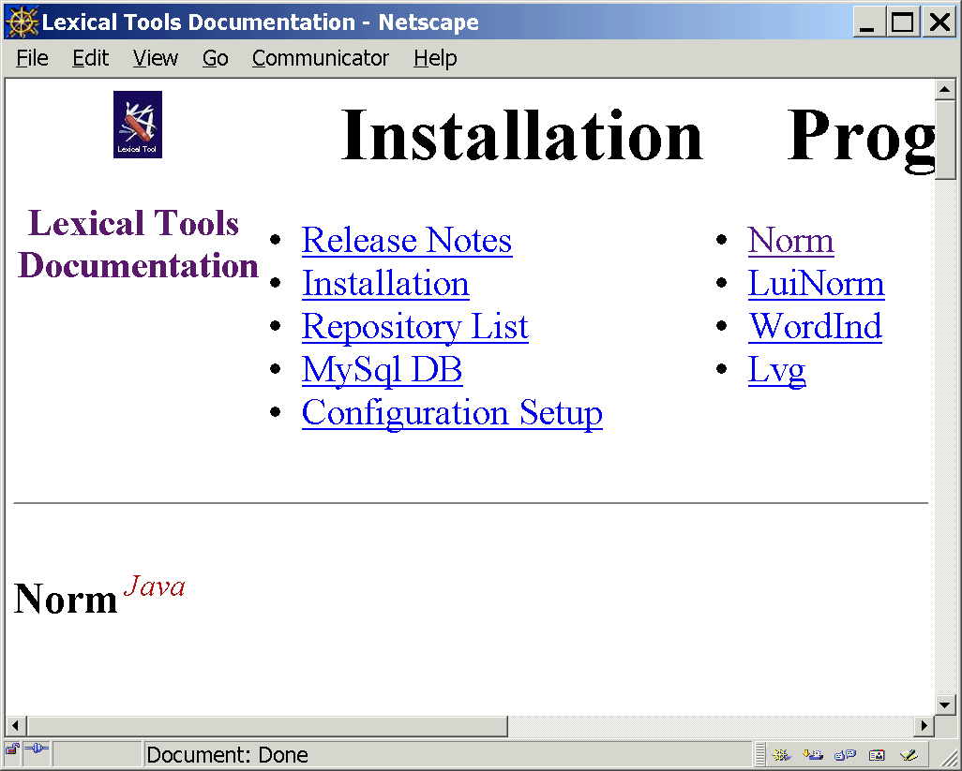
Lexical Tools: Norm
Notes:
Let’s begin with the most popular of the tools, NORM.
The norm program normalizes terms.
In general, normalization involves transforming something that’s not uniform to something that is uniform.
Norm is used to create the UMLS Metathesaurus normalized word and string indexes.
Applications that use these indexes,
also use norm to mediate between their queries and
entries in these indexes.

Slide 52
Lexical Tools: Norm
Norm abstracts away from:
  case
  Punctuation
  word order
  possessive forms
  inflectional variation
Notes:
Our form of normalization involves the following:
It abstracts away from case, punctuation, and wordorder.
It abstracts away from inflectional variations.
It abstracts away from possessive forms.

Slide 53
Lexical Tools: Norm
Hodgkin's
Diseases,
NOS
remove genitives
replace punctuation with spaces
remove stop words
lowercase
uninflect each word
word order sort
Notes:
Norm in some more detail.
Let’s take the example Hodgkin’s Diseases, NOS. Here’s a term that could be found in text an awful lot of ways.
This program will transform a fair number of those variant ways into a uniform representation that will enable applications to recognize all those variants belonging to the same term.

Slide 54
Lexical Tools: Norm
Hodgkin's
Diseases,
NOS
Hodgkin'sDiseases,
NOS
remove genitives
Hodgkin Diseases,
NOS
replace punctuation with spaces
remove stop words
lowercase
uninflect each word
word order sort
Notes:
Genitives, those apostrophe ses, or the possessive forms are removed.
Medical terminology is replete with terms that include possessive forms,
Such as Parkinson’s Disease.
There are a lot of variation caused by forms that differ by possessive forms.
In a lot of cases, as Allen had mentioned, terms evolve from possessive forms to plural forms.
It turns out to be a good idea to abstract away from possessive forms for retrieval purposes.
In our example, Hodgkin’s gets transformed to Hodgkin.

Slide 55
Lexical Tools: Norm
Hodgkin's
Diseases,
NOS
Hodgkin'sDiseases,
NOS
remove genitives
Hodgkin Diseases,
NOS
replace punctuation with spaces
Hodgkin Diseases
NOS
remove stop words
lowercase
uninflect each word
word order sort
Notes:
Punctuation is replaced by spaces.
It is important to identify the apostrophe s’s
before punctuation is replaced.
The comma is removed in this example.

Slide 56
Lexical Tools: Norm
Hodgkin's
Diseases,
NOS
Hodgkin'sDiseases,
NOS
remove genitives
Hodgkin Diseases,
NOS
replace punctuation with spaces
Hodgkin Diseases
NOS
remove stop words
Hodgkin Diseases
lowercase
uninflect each word
word order sort
Notes:
Stop words are stripped.
Stop words are those words that you really don’t want to query on,
such as determiners and frequently used prepositions.
For example, words like “THE”, and ”OF”.
We consider NOS as one of our stop words. It gets stripped.

Slide 57
Lexical Tools: Norm
Hodgkin's
Diseases,
NOS
Hodgkin'sDiseases,
NOS
remove genitives
Hodgkin Diseases,
NOS
replace punctuation with spaces
Hodgkin Diseases
NOS
remove stop words
Hodgkin Diseases
lowercase
hodgkin diseases
uninflect each word
word order sort
Notes:
For obvious reasons, it’s a big win to either lower case your input or uppercase it.
We’ve settled on lowercasing the input to abstract away from case variation in terms. and everything is lowercased
.

Slide 58
Lexical Tools: Norm
Hodgkin's
Diseases,
NOS
Hodgkin'sDiseases,
NOS
remove genitives
Hodgkin Diseases,
NOS
replace punctuation with spaces
Hodgkin Diseases
NOS
remove stop words
Hodgkin Diseases
lowercase
hodgkin diseases
uninflect each word
hodgkin disease
word order sort
Notes:
Each word of the term is uninflected.
Uninflection is the what we would consider an entry form in our Lexicon. These are, for the most part,
the singular forms of nouns,
the infinitive forms for verbs, and
the positive forms for adjectives and adverbs.
Uninflected forms are similar to, but are not the same as Stemmed forms. We don’t use the “S” word.
Stemming involves suffix stripping, not bothering to heed the distinction between derivational suffixes and inflectional suffixes. Stemmers often refer to the “stems” as the root of the word, regardless whether the meaning had changed when the suffix was removed or added.
Stemmers often only involve suffix replacement and may or may not filter to a word list after the suffix transformations.

Slide 59
Lexical Tools: Norm
Hodgkin's
Diseases,
NOS
Hodgkin'sDiseases,
NOS
remove genitives
Hodgkin Diseases,
NOS
replace punctuation with spaces
Hodgkin Diseases
NOS
remove stop words
Hodgkin Diseases
lowercase
hodgkin diseases
uninflect each word
hodgkin disease
word order sort
disease hodgkin
disease
hodgkin
Notes:
As a last step, all the resulting words are sorted in ASCII order.
Why?
There are terms in the Metathesaurus in inverted form. That is, where the important part of the term is at the front of the term. “Cancer, Breast”. Inversion is a useful cataloguing technique.
There are terms in the Metathesaurus in uninverted form. And, there are terms in the Metathesaurus that are in inverted form, but, where the inversion points, typically commas, are missing.
We found that stripping punctuation and sorting in word order, in general helps rather than hurts recall. There rare exceptions to this, such as the distinction between school nursing and nursing school.

Slide 60
Lexical Tools: Norm
Down’s Syndrome Down Syndrome | down syndrome
Acetolyses acetolysis | acetolysis
Lung cancer Cancer, lung | cancer lung
Norm to
Notes:
Here are some examples of normalized forms.
Possessive forms are removed in Down’s syndrome. It is common to see Down’s Syndrome with and without the S and with and without the apostrophe.
Acetolyses and acetolysis normalize to their uninflected form, and
lung cancer, and
cancer, lung
have it’s punctuation stripped, lowercased, and words sorted to come up with
its normalized form.

Slide 61
Lexical Tools: Norm
> norm
Paget’s disease-scapula
Paget's disease-scapula|disease paget scapula
Scapula, Paget Disease
Scapula, Paget Disease|disease paget scapula
Notes:
Here’s how it looks from the command line.

Slide 62
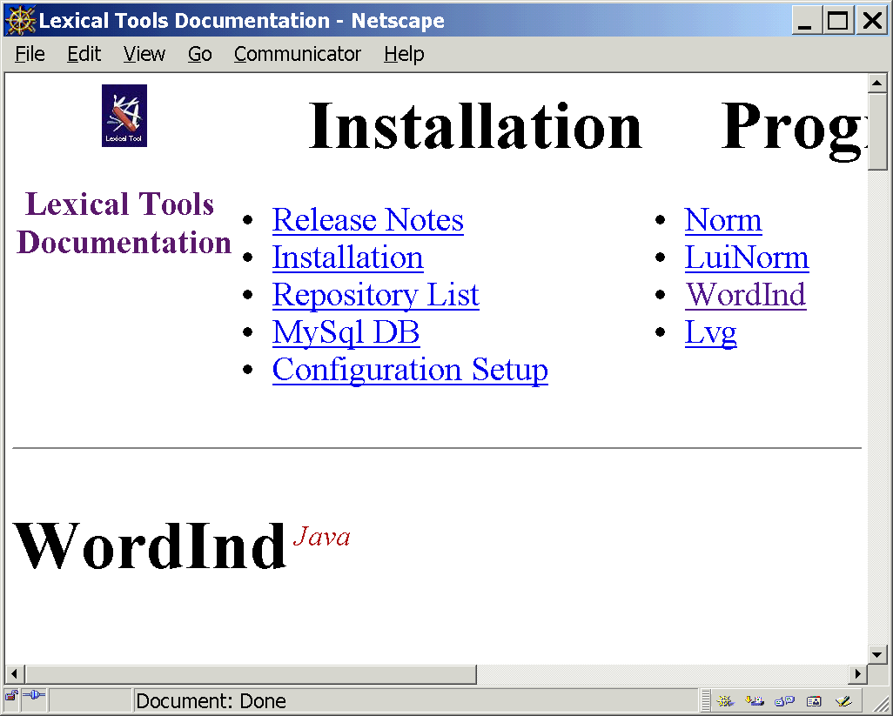
Lexical Tools: WordInd
Notes:
Wordind is a tool to break terms into words.
It is used to take a row from a Metathesaurus table that contains a term, sentence, paragraph, story,
and break the text part of that row into it’s constituent words,
while passing along, duplicating the other fields in that row.
From the very beginning we needed a way to standardize what we meant what a word is. This turns out to be critically important for fitting programs together. It’s like the centermeters/inches problem we heard about not too long ago.
We consider a word what wordInd says it is, for better or worse. WordInd, considers as a word a sequence of alpha-numeric tokens broken by white space or punctuation. Whitespace and puncutation is subsequently thrown out.
WordInd is primarily used to create word indexes. As such, it does a bit more than tokenizing words. It also lowercases the tokenized words as well.
So, it tokenizes, ,
it strips punctuation, ,
it lowercases, ,
and it passes other fields through to the output, untouched.

Slide 63
Lexical Tools: WordInd
Breaks words into tokens
Passes other fields to output, untouched
Lowercases
Removes white space and punctuation
Notes:
Wordind is a tool to break terms into words.
It is used to take a row from a Metathesaurus table that contains a term, sentence, paragraph, story,
and break the text part of that row into it’s constituent words,
while passing along, duplicating the other fields in that row.
From the very beginning we needed a way to standardize what we meant what a word is. This turns out to be critically important for fitting programs together. It’s like the centermeters/inches problem we heard about not too long ago.
We consider a word what wordInd says it is, for better or worse. WordInd, considers as a word a sequence of alpha-numeric tokens broken by white space or punctuation. Whitespace and puncutation is subsequently thrown out.
WordInd is primarily used to create word indexes. As such, it does a bit more than tokenizing words. It also lowercases the tokenized words as well.
So, it tokenizes, ,
it strips punctuation, ,
it lowercases, ,
and it passes other fields through to the output, untouched.

Slide 64
Lexical Tools: WordInd
Useful command line options for wordInd
-t[:Num] | Defines what field to tokenize
-f[:Num[:Num]] | Defines what fields get passed through
Notes:
Wordind is a tool to break terms into words.
It is used to take a row from a Metathesaurus table that contains a term, sentence, paragraph, story,
and break the text part of that row into it’s constituent words,
while passing along, duplicating the other fields in that row.
From the very beginning we needed a way to standardize what we meant what a word is. This turns out to be critically important for fitting programs together. It’s like the centermeters/inches problem we heard about not too long ago.
We consider a word what wordInd says it is, for better or worse. WordInd, considers as a word a sequence of alpha-numeric tokens broken by white space or punctuation. Whitespace and puncutation is subsequently thrown out.
WordInd is primarily used to create word indexes. As such, it does a bit more than tokenizing words. It also lowercases the tokenized words as well.
So, it tokenizes, ,
it strips punctuation, ,
it lowercases, ,
and it passes other fields through to the output, untouched.

Slide 65
Lexical Tools: WordInd
> wordInd –t:7 –F:1:6
C0185495|S0298948|denis
C0185495|S0298948|browne
C0185495|S0298948|splint
C0185495|S0298948|strapping
C0185495|ENG|P|L0223844|PF|S0298948|Denis-Browne splint strapping|3|
Notes:
Here’s an example of what wordind does to a row from the Metathesaurus’ MRCON.
The command line arguments to WORDIND include telling wordind to use the seventh field to find the term, and to pass through fields one and six to the output.

Slide 66
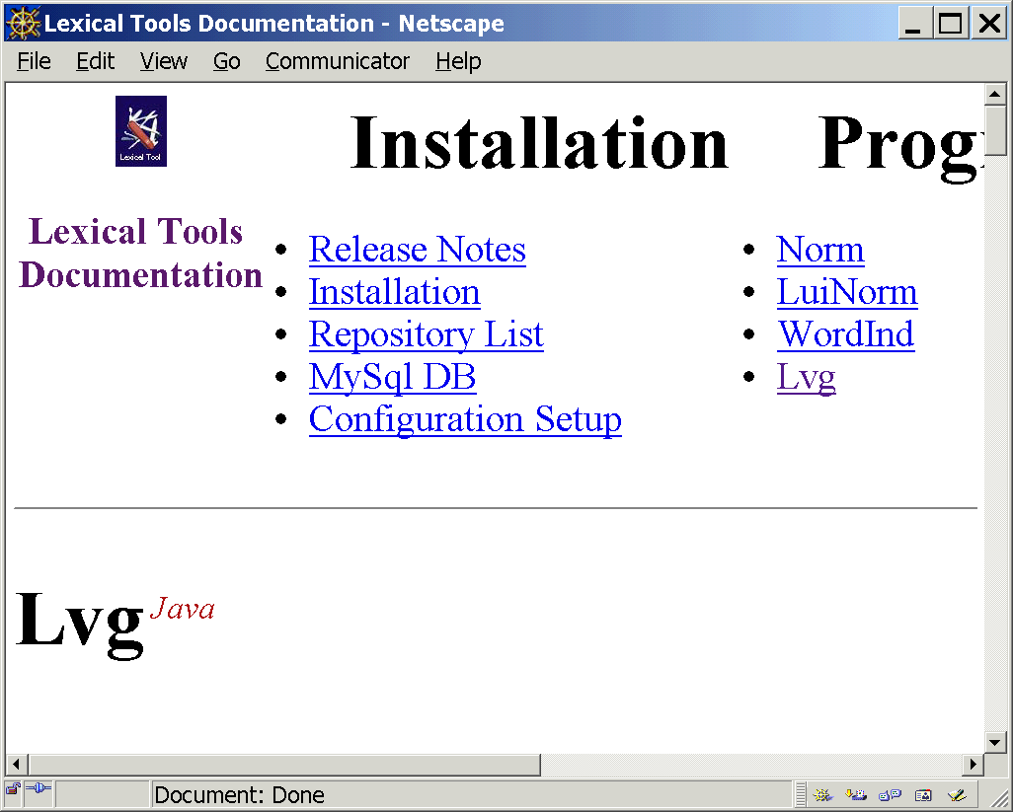
Lexical Tools: Lvg
Notes:
Lvg is a command line tool that does a lot, and
as a consequence
has lots of options and filters.

Slide 67
Lexical Tools: Flow Components
Mnemonic | Tool
A | Return known acronyms
a | Return known acronym expansions
B | Uninflect words in a term
b | Uninflect a term
C | Canonicalize
Ct | Retrieve the citation term
Notes:
I’m going to switch terminology at this point from talking about text utilities or tool and introduce and refer to each utility as this funny thing called a
“FLOW COMPONENT” I’ll explain later.
There are 54 tools, or FLOW COMPONENTS with more on the way.
I’m going to flip through an alphabetical list of some of these tools. (Not all are listed here. They are fully specified in the documentation).
The mnemonic on the left is what you would specify on the command line.
These include tools to grab acronyms and their expansions.
Uninflection tools.

Slide 68
Lexical Tools: Flow Components
Mnemonic | Tool
c | Tokenize a term into "words"
ca | Tokenize, keep everything
ch | Tokenize without breaking hyphens
d | Generate derivational variants
dc~N | Generate derivational variants with specifying output categories
Notes:
Several tokenization tools.
Derivation tools.

Slide 69
Lexical Tools: Flow Components
Mnemonic | Tool
E | Retrieve the unique EUI for a term
f | Filter output to contain only forms from lexicon
Gn | Generate known fruitful variants
g | Remove genitive
i | Generate inflectional variants
ici~Cats+Infls | Generate inflectional variants, by Categories and inflections
Notes:
Tools that filter output to words from the lexicon,
A useful variants generation tool
A genitive stripping tool
Inflect tools.

Slide 70
Lexical Tools: Flow Components
Mnemonic | Tool
L | Retrieve category and inflection for a term
l | Lowercase
N | Normalize the input text in a non-canonical way (Norm)
o | Replace punctuations with spaces
p | Strip Punctuation
q | Strip diacritics
R | Generate derivational variants, recursively
r | Generate synonyms, recursively
Notes:
Tools to retrieve part of speech and inflection from the lexicon.
Tools that Normalize.
Several punctuation removal tools.
Tools that recursively generate derivations and synonyms.

Slide 71
Lexical Tools: Flow Components
Mnemonic | Tool
s | Generate known spelling variants
t | Strip stop words
u | Uninvert the input phrase around commas
w | Sort words by order
y | Generate synonyms
Notes:
Tools that look up known spelling variants.
Tools that remove stop words.
Tools that un-invert.
Tools that word order sort the output
And a tool that generates synonyms.
Again, this is just over half of the available tools.

Slide 72

Lexical Tools: Flows
leave
leaves
leave
inflect
leaving
left
Notes:
Some characteristics about the lexical tools:
Each of the utilities can be used separately.
Here is an example of the inflect tool.
This tool generates all known inflections of a word.
The notion of a flow is a serial combination of these tools put together.
Thus the name for each tool: a flow component.

Slide 73
Lexical Tools: Flows
> lvg –f:i
leave
leave|leave|128|1|i|1|
leave|leave|128|512|i|1|
leave|leaves|128|8|i|1|
leave|left|1024|64|i|1|
leave|left|1024|32|i|1|
leave|leave|1024|1|i|1|
leave|leave|1024|262144|i|1|
leave|leave|1024|1024|i|1|
leave|leaves|1024|128|i|1|
leave|leaving|1024|16|i|1|
Notes:
The example shows just how such a tool is invoked from the command line.
Don’t pay any attention to those pesky fields with numbers in them right now.
Pay attention to the fact that we put leave into this tool and leave, leaves, left, and leaving were returned.
[That same information should be shown in the GUI tool].

Slide 74
Lexical Tools: A Serial Flow
lowercase
Strip diacritics
Input
term
Output
term
Remove possessive
Remove stop words
Strip punctuation
Word order sort
Flow components can be arranged so that the output of one is the input to another.
Notes:
Here’s an example of such a serial combination. That is,
where the output of one tool serves as
the input to the next tool.
In this example, we are first lowercasing the input, then stripping diacritics, removing possessives, removing stop words, stripping punctuation, and finally sorting the resulting words in ASCII sort order.
The example shows just how this flow is invoked on the command line.

Slide 75
Lexical Tools: A Serial Flow
> lvg –f:l:q:g:t:p:w
The Gougerot-Sjögren's Syndrome
The Gougerot-Sjögren's Syndrome|
gougerotsjogren syndrome|2047|16777215|
l+q+g+t+p+w|1|
Notes:
Here’s how that sequence would be put together.
The “-f” on the command line is an indication that what follows is to be taken as a sequence of flow components to execute in a serial order.
In this example, that sequence boils down to the sequence of the single character mnemonic forms: “L” for lowercase, q for strip diacritics, g for strip possessives, t for strip stop words, p for strip punctuation, and finally w for word order sort the input.
In this example, The Gougerot-Sjögren's Syndrome, “the” is stripped off, the o umlaut is normalized to “o”, the hyphen is removed, and the resulting form is sorted.

Slide 76
Lexical Tools: Parallel Flows
Output
term
noOperation
Input
term
Output
terms
Uninflect
synonyms
Multiple flows can be defined
Notes:
The flow components can be put together into separate flows that produce transformations that are only dependant on that flow.
In the example, we want both the original term and the synonyms of the term.

Slide 77
Lexical Tools: Parallel Flows
> lvg –f:n –f:B:y
ear
ear|ear|2047|1048575|n|1|
ear|aural|1|1|B+y|2|
ear|auricularis|1|1|B+y|2|
ear|otic|1|1|B+y|2|
ear|otor|1|1|B+y|2|
First Flow
Second Flow
Notes:
This is an example of how one would invoke such a parallel set of flows.
The output consists of the combined results from the output of each flow.
Note the last field of each output line,
the number in red.
That number indicates which flow it came from.

Slide 78
Lexical Tools: Fielded Output
> lvg –f:L
leaves
Flow Number
Flow history
leaves
|
leaves
|
1152
|
136
|
L
|
1
Input Term
Output Term
Categories
Inflections
Notes:
Just what are you getting on the output? Much more than you bargained for!
On each output line, five additional fields are added to the input fields.
The output or transformed term,
what categories and inflections the output term can be,
what transformations or flow components produced it. This is also known as the flow history,
And,
the flow number that produced it.

Slide 79
Lexical Tools: Fielded Output
Output
term
Categories
Inflections
noun
plural
leaves
verb
pres3ps
Notes:
Imagine, if you will, that some flow produced the output term “leaves”.
Leaves can be either the plural form of a noun or the present third person singular of a verb.
That’s what conceptually will be part of the output for this term.

Slide 80
Lexical Tools: Categories
Categories
1152
Category bit vector
modal
compl
verb
pron
prep
noun
det
conj
aux
adv
adj
1
0
0
1
0
0
0
0
0
0
0
Notes:
But, that’s not easy to stuff into a concise, machine parsable, single line representation that can be used by other tools. A somewhat less readable bit vector representation of category and inflection was adopted to be the concise, parsable form that could be used by other tools.
Let’s concentrate on category for a minute. The bit vector for category consists of 11 bits in this order. To represent the categories that leaves take on, the bits for noun and verb are set to one.
What appears on the command line output is the decimal representation of this bit vector.

Slide 81
Lexical Tools: Categories
Adjective | 1
Adverb | 2
Auxiliary | 4
Complement | 8
Conjunction | 16
Determiner | 32
Modal | 64
Noun | 128
Preposition | 256
Pronoun | 512
Verb | 1024
modal
compl
verb
pron
prep
noun
det
conj
aux
adv
adj
Bit Vector
positions
10
9
8
7
6
5
4
3
2
1
0
Notes:
Here is the decimal representation of these categories.

Slide 82
Lexical Tools: Inflections
Inflections
136
Present participle
Present 3ps
comparative
Present 3ps
superlative
plural
base
0
0
0
0
0
0
0
0
0
0
0
0
0
0
1
0
1
0
0
0
Notes:
Likewise, inflections are stored in a bit vector representing inflections. Here, the base form is a simplified form for singular if the term is a noun, infinitive if the term is a verb, and positive if the term is an adjective or adverb.
Leaves in the example can be either the plural form of a noun or the present third person singular of a verb.
Those bits are set, which, when represented as a decimal, add up to be 136.

Slide 83
Lexical Tools: Inflections
Base | 1
Comparative | 2
Superlative | 4
Plural | 8
Present Participle | 16
Past | 32
Past Participle | 64
Present 3rd Person Singular | 128
Positive | 256
Singular | 512
Infinitive | 1024
Pres 123p | 2048
Past Neg | 4096
pres123pNeg | 8192
Pres1s | 16384
past1p23pNeg | 32768
past1s3sNeg | 65536
pres1p23p | 131072
pres1p23p | 262144
pres1p23pNeg | 524288
past1s3s | 1048576
pres | 2097152
pres3sNeg | 4194304
presNeg | 8388608
all | 16777215
Notes:
Here are the inflections viewed in their decimal representation.

Slide 84
Lexical Tools: Fielded Output
Input
term
Output
term
Categories
Inflections
Flow
history
Flow
number
leaves
leaves
1152
136
L
1
Notes:
Finally, this is what you get on the output.
Note that the flow that produced this is the “L” flow component, which looks up the part of speech and inflection information from the LEXICON.

Slide 85
Lexical Tools: Fielded Input
Input
term
Categories
Inflections
leaves
noun
Notes:
If the output knows about category and infection, it would reason that we should be able to tell each tool any category and inflection information about an input term.
We can.
We can put on the input, via fielded input, category and inflection information.
Suppose we have leaves as an input term, and we know we are talking about the leaves, the noun, as in “the leaves of a tree”.

Slide 86
Lexical Tools: Fielded Input
Input term field
Input category field
> lvg –f:L –t:1 –cf:2
leaves|128
leaves|leaves|128|8|L|1
Notes:
On the command line, we tell the tool which field to look for the term, and which field to look for the category information.
On the input, we then can put the categories in the field, using the bit vector form.

Slide 87
Lexical Tools: Command Line Syntax
Hierarchical structure
-Option
:Option Attribute
:Option Attribute
:Option Attribute
~1’st
Attribute
Parameter
+2’nd
Attribute
Parameter
…
+N’th
Attribute
Parameter
Notes:
We are about to delve into more details about the tool then you ever wanted to know. To get the tool to do what we want, we needed to come up with a more expressive syntax than the POSIX standard. (That word was inserted just for developers)
The command line syntax for all these tools involves having options start with hyphens.
Options may have attributes associated with them. Those attributes are separated by colons.
Attributes may have parameters.
Attributes that have one parameter have the parameter separated by a tilda.
Additional parameters are separated by a plus sign.
Make sure there are not spaces between attributes and their parameters. There should be spaces between options.

Slide 88
Lexical Tools: Command Line Syntax
-f:L:ici~128+ALL:w
-f
:L
:ici
:w
~128
+ALL
Notes:
Here’s an example of the parse of the command line for Looking up lexical information, then inflecting only the nouns of those, then word order sorting them.
A flow is an command line option. A flow option is represented by an –f.
Flows are made up of flow components (The tools). Each flow component of a flow is separated by a colon.
flow components can have parameters associated with them. The :ici flow component has two attributes associated with it.

Slide 89
Lexical Tools: Post Flow Options
Input
term
Output
terms
SC | Show category names
SI | Show inflection names
ccgi | Mark the end of the set of variants returned
F:Int[:Int] | Specify fields for outputs
ti | Display the only input term in the output when using fielded input
R:Int | Restrict the number of variants returned
Notes:
The lexical tools have some useful post processing options that are of note.
For the most part these options are filters. Though some of these options add information to the end of the processing.
Here are some miscillanious but useful options.
Oh, my favorites: Show the categories and inflections in string form, not in bit vector form.
-ccgi, an end of processing marker.
-F followed by the fields you want to have in your output.
-ti Forget about passing through all the input fields, only pass through the field you are picking up the term from.
-R followed by a number to restrict the number of output rows. This is useful, say when you are generating lots of forms, but you only need the top 10.

Slide 90
Lexical Tools: Post Flow Options
Show category names
Show inflection names
Show the category and inflection names
> lvg -f:L -SC -SI
phosphoprotein
phosphoprotein|phosphoprotein|<noun>|<base+singular>|L|1|
sclerosing
sclerosing|sclerosing|<adj+verb>|<base+presPart+positive>|L|1|
Notes:
These options are necessary for those of us who cannot do the math.
It displays the categories and inflections as strings rather than bit vectors.
I generally use these for debugging purposes.
The fields can get quite long for terms that can be many categories and inflections.

Slide 91
Lexical Tools: Post Flow Options
Mark the end of the set of variants returned
Mark the end of processing
> lvg -f:L -ccgi
behavior
behavior|behavior|128|513|L|1|
__THE_END__
Notes:
Here’s the –ccgi option.
This option is useful when embedding this into applications where you need the tool to tell you that it’s done processing an input. This tells the calling app. To stop waiting for more output.

Slide 92
Lexical Tools: Post Flow Options
Specify fields for outputs
Display only the 8th and 6th field from the output
> lvg -f:u -t:7 -F:8:6
C0035440|ENG|S|L0035434|VW|S0003894|Rheumatic carditis, acute
acute Rheumatic carditis|S0003894
Notes:
Oh, yea, the –F option.
I use this option frequently,
to cull down the output to only those fields I need.
In this example, I only want the output field and
the field that has the SUI in it.

Slide 93
Lexical Tools: Post Flow Options
Display only the input term field when using fielded input
Display only the input term from the fielded input to
the output
> lvg -f:u -t:7 –ti
C0035440|S0003894|Rheumatic carditis, acute
Rheumatic carditis, acute|acute Rheumatic carditis|2047|16777215|u|1|
Notes:
The –ti option is always used in conjunction with the option that indicates the input field that contains the term.
An equivalent way of doing this would also be using the –F option with the input term field.

Slide 94
Lexical Tools: Post Flow Options
Restrict the number of variants returned
Limit the number of output terms to 2
> lvg -f:i -R:2
foo
foo|foo|128|1|i|1|
foo|foos|128|8|i|1|
Note: Dangerous!
Do not try this at home!
Note: The unrestricted output would
have produced 12 rows otherwise
Notes:
Here’s an example using the truncation filter. Here I’m passing an unknown word to be inflected. If I did not have this filter on, the tools would generate 12 forms.

Slide 95
Lexical Tools: Post Flow Options
Input
term
Output
terms
EC:Long | Display variants: exclude categories specified
EI:Long | Display variants: exclude inflections specified
DC:Long | Display variants that only contain the categories specified
DI:Long | Display variants that only contain the inflections specified
Notes:
The lexical tools have some useful post processing options that are of note.
For the most part these options are filters. Though some of these options add information to the end of the processing.
Worth mentioning are the filters that exclude categories or only include categories.

Slide 96
Lexical Tools: Post Flow Options
Display variants: exclude categories specified
Display variants, but exclude all terms other than nouns
> lvg –f:i –EC:1919
sleep
sleep|sleep|128|1|i|1
sleep|sleep|128|512|i|1
Notes:
For example, suppose because of some twisted reason, you want only to get noun variants.
Given this option with the bit vector set to everything set on but nouns will do it.

Slide 97
Lexical Tools: Post Flow Options
Display variants exclude inflection specified
Display variants, but exclude base forms
> lvg –f:i –EC:1919 –EI:1
sleep
sleep|sleep|128|512|i|1
Notes:
In addition to nouns, we only want to see non base form nouns.

Slide 98
Lexical Tools: Post Flow Options
Display variants contain category specified
Display variants, but only include nouns in the output
> lvg –f:i –DC:128
sleep
sleep|sleep|128|1|i|1
sleep|sleep|128|512|i|1
Notes:
An easier way to only get nouns from a flow would be to use the “display categories”
Filter with nouns (128)

Slide 99
Lexical Tools: Post Flow Options
Display variants contain inflection specified
> lvg –f:i –DI:255
sleep
sleep|sleep|128|1|i|1|
sleep|sleep|1024|1|i|1|
sleep|slept|1024|64|i|1|
sleep|slept|1024|32|i|1|
sleep|sleeps|1024|128|i|1|
sleep|sleeping|1024|16|i|1|
Display variants, but only include “simplified” inflections
Notes:
Here is a favorite filter of mine. There are many instances where I want the set of inflections where the base form is listed, but not its nearly redundant form. I call these the simplified inflections.
For example, I want the base form for a noun, but not the nearly redundant row that contains the singular row.
It turns out that all those forms are inflectional forms with bit vector representations lower than 256 decimal.
Creating a filter that allows all inflections below 256 does that.

Slide 100
Lexical Tools: Post Flow Options
Input
term
Output
terms
CR:o | Combine record by output term
CR:oc | Combine record by output term and category
CR:oi | Combine record by output term and inflection
St:o | Sort outputs by terms in an alphabetical order
St:oc | Sort outputs by term and category
St:oci | Sort outputs by term, category, and inflection
Notes:
There are grouping and sorting post flow options that we have found useful. These involve combining and sorting the output rows by the criteria of similar term forms, categories and/or inflections.

Slide 101
Lexical Tools: Post Flow Options
Combine record by output term
Combine records by term
> lvg -f:i -CR:o
sleep
sleep|sleep|1152|263681|i|1|
sleep|slept|1024|96|i|1|
sleep|sleeps|1024|128|i|1|
sleep|sleeping|1024|16|i|1|
Note: this is a noun+verb
Notes:
Here’s an example of combining records by term. Notice that the category and inflection bit vectors contain multiple categories and inflections.

Slide 102
Lexical Tools: Post Flow Options
Combine record by output term and category
Combine records by term and category.
> lvg -f:i -CR:oc
sleep
sleep|sleep|128|513|i|1|
sleep|sleep|1024|263169|i|1|
sleep|slept|1024|96|i|1|
sleep|sleeps|1024|128|i|1|
sleep|sleeping|1024|16|i|1|
Note: this is both the
base+singular inflections
combined
Notes:
Here’s an example that combines by term and category. Note that the inflection field indicates multiple inflections for the form “sleep”

Slide 103
Lexical Tools: Post Flow Options
Combine record by output term and inflection
Combine records by term and inflection
lvg -f:b -CR:oi
left
left|left|131|1|b|1|
left|leave|1024|1|b|1|
Note: This is an adj+adv+noun
Notes:
An example of combining by inflection.

Slide 104
Lexical Tools: Post Flow Options
Sort outputs by terms in an alphabetical order
>lvg -f:i -St:o
see
see|saw|1024|32|i|1|
see|see|1024|1|i|1|
see|see|1024|262144|i|1|
see|see|1024|1024|i|1|
see|seeing|1024|16|i|1|
see|seen|1024|64|i|1|
see|sees|1024|128|i|1|
Sort by the output term
Notes:
It’s sometimes necessary to sort the output by various criteria.
In this example, the output is sorted by term.

Slide 105
Lexical Tools: Post Flow Options
Sort outputs by term and category
> lvg -f:i -St:oc
left
…
left|left|1|1|i|1|
left|left|1|256|i|1|
left|left|2|1|i|1|
left|left|2|256|i|1|
left|left|128|1|i|1|
left|left|128|512|i|1|
left|left|128|8|i|1|
left|left|1024|64|i|1|
left|left|1024|32|i|1|
left|lefts|128|8|i|1|
Sort by the output term and category
Notes:
Here’s an example of sorting by term and category.

Slide 106
Lexical Tools: Post Flow Options
Sort outputs by term, category, and inflection
Sort by the output term, category and inflection
> lvg -f:i -St:oci
see
see|saw|1024|32|i|1|
see|see|1024|1|i|1|
see|see|1024|1024|i|1|
see|see|1024|262144|i|1|
see|seeing|1024|16|i|1|
see|seen|1024|64|i|1|
see|sees|1024|128|i|1|
Notes:
Here’s an example of sorting by term, category and inflection.

Slide 107
Lexical Tools:
Why Base+Singular
Base form for Nouns:
  Singular form
    There are exceptions:
      Police
      lvg -f:i -SC -SI -DC:128
      police
      police|police|<noun>|<base>|i|1|
      police|police|<noun>|<plural>|i|1|
Notes:
Here’s a public service message. It’s inserted here for lack of a better place to mention it.
Allen noted that we we generally consider the singular forms of nouns as the base form, and infinitive form for verbs as the base or uninflected forms. For years we’ve had inflection bit vectors that have combined the base form with the singular form because it’s redundant.
When we re-implemented the tools in java, they kept on breaking occasionally because of a class of words that breaks these rules.
Here’s an example of a noun that is plural, and has NO singular form. We had to account for such instances, so the tool will print out a row for the uninflected form AND a row for it’s singular form even though they are next to always the same. In the general case, separating the base from the singular or infinitive form means that in cases where it matters, you don’t have to do the inferencing to compute that base means singular or infinitive or positive.
If you don’t like this, then you can use the –Di:255 filter to filter back to the “simplified” inflectional forms.

Slide 108
Lexical Tools: Global Behaviors
Output
terms
Input
term
Output
terms
i:filename | Define input file name
o:filename | Define output file name
x:filename | Loading an alternative configuration file
p | Interactive prompt
m | Print extra information of flow mutations
s:Str | Defines a field separator.
Notes:
Here are some options that are worth mentioning.
The tools can take a file as input and can put the output to a file.
The tools can be configured in strange and divient ways by altering the config file.
You can tell the tools at startup time to use an alternative config file rather than the default one.
When using the tool interactively on the command line, it’s sometimes useful to have a prompt.

Slide 109
Lexical Tools: Global Behaviors
Interactive prompt
Set the prompt on
> lvg -f:s -CR:oc -p
- Please input a term (type "Ctl-d" to Quit) >
color
color|color|128|513|s|1|
color|color|1024|263169|s|1|
color|colour|128|513|s|1|
color|colour|1024|263169|s|1|
- Please input a term (type "Ctl-d" to Quit) >
Notes:
Here’s what the prompt looks like.

Slide 110
Lexical Tools: Global Behaviors
Output
terms
Input
term
Output
terms
K:dInt | Configure the derivation morphology behavior
K:iInt | Configure the inflection morphology behavior
Notes:
Finally, there are two options that control the generation of morphological forms. These options affect the general behavior of the inflection and derivation and related flow components.

Slide 111
Lexical Tools: Global Behaviors
Configure the derivation morphology behavior
1 | Restrict the output to those variants which are known to the lexicon (default).
2 | Restrict the output to those variants which are known to the lexicon, unless none of the variants are found in the lexicon, in which case the entire (rule-generated) list is returned.
3 | No restriction on the output of the morphology. Both facts and rules generated variants are displayed.
Notes:
You can alter the derivational variant generation behavior to restrict those forms produced to words that we know about via the lexicon. In general this is restriction is a good thing to do, because the tool blindly adds suffixes to the ends of words to make new words. In a lot of cases those new strings are not words at all. Having this filter on is the default.
At the other end of the spectrum, you can have the tool report all the forms generated whether or not they are words. You might want to do this in an environment where there is not a lot of overlap between the words in our lexicon and the words that you are working with.

Slide 112
Lexical Tools: Global Behaviors
Configure the derivation morphology behavior
Restrict the derivations to terms that are known to the Lexicon
> lvg -f:d -kd:1 -m
breath
breath|breather|128|1|d|1|RULE|$|verb|base|er$|noun|base|
breath|breathy|1|1|d|1|RULE|$|noun|base|y$|adj|base|
breath|breathless|1|1|d|1|FACT|breath|128|breathless|1|
Notes:
Here’s an example of turning on the filter.

Slide 113
Lexical Tools: Global Behaviors
Configure the inflection morphology behavior
1 | Restrict the output to those variants which are known to the lexicon.
2 | Restrict the output to those variants which are known to the lexicon, unless none of the variants are found in the lexicon, in which case the entire (rule-generated) list is returned (Default).
3 | No restriction on the output of the morphology. Both facts and rules generated variants are displayed
Notes:
Inflectional morphology can be altered in similar ways to constrain the output to only include forms known to the lexicon, or at the other end of the spectrum to return all forms, known and rule generated.
The inflectional rules are less aggressive than the derivational rules. If an input form is not in the lexicon, it has been found to be useful to go ahead and use the rule generated forms. This is the default behavior for inflections.

Slide 114
Lexical Tools: Global Behaviors
Configure the inflection morphology behavior
Return all inflected variants, both fact and rule generated
> lvg -f:i -m -ki:3 -R:5 -F:1:2:7:3:4 -SC -SI
Amish
Amish|Amish|FACT|<noun>|<base>
Amish|Amish|FACT|<noun>|<plural>
Amish|Amishs|RULE|<noun>|<plural>
Amish|Amishes|RULE|<noun>|<plural>
Amish|Amishs|RULE|<verb>|<pres>
Notes:
You may, I don’t know why, but you may, want to create an index that has all inflectional forms, fact AND rule generated. Here’s an example of doing that with the term Amish. (Oh, there’s another of those non-singular noun words)

Slide 115
Lexical Tools: No Operation
-f:n
Copies the input term to the output with no transformation
> lvg -f:n -f:d -f:y -SC -SI
force
force|force|<all>|<all>|n|1|
force|forcefully|<adv>|<base>|d|2|
force|forceful|<adj>|<base>|d|2|
force|forcible|<adj>|<base>|d|2|
force|dynamic|<adj>|<base>|y|3|
Notes:
Now, some specific flow components.
I’m going to cover only a few of them. Refer to the documentation for the rest of them.
The most trivial, but really useful flow component is just a pass through. The –f:n flow component just repeats the input term as an output term. This turns out to be useful, for instance, when you want to have the original term as one of the outputs.
In this example, force, the input term, is on the output of the “make me an index of terms, their derivations and their synonyms” flows only because of that pass through flow component, “-f:n”.

Slide 116
Lexical Tools: Inflect
-f:i
Generate inflectional variants
> lvg -f:i -SC -SI
West Nile Virus
West Nile Virus|West Nile virus|<noun>|<base>|i|1|
West Nile Virus|West Nile virus|<noun>|<singular>|i|1|
West Nile Virus|West Nile viruses|<noun>|<plural>|i|1|
Notes:
The inflect flow component. This flow component uses the LEXICON to find all the known inflectional forms of a term.
Here’s a pretty simple example. West Nile Virus, a term popular these days in Maryland.
In fact, for a given term, this utility will uninflect the term, then retrieve all the inflected forms for that term, including the form that came in.
If the term is not in the LEXICON, inflectional suffix adding and replacement rules based on the regular rules of inflection are applied to the input form to generate potential inflectional forms, in the hopes that at least some of resulting forms are useful. The rules come with exceptions to prune out forms that we’ve noticed go wrong.
The inflection flow component is just one configuration of the morphology module that produces both inflections, uninflections and derivations.

Slide 117
Lexical Tools: Inflect
-f:ici~cats+infls
Generate inflections, filter by cat and/or inflection
> lvg -f:ici~128+ALL -SC -SI
bioassay
bioassay|bioassay|<noun>|<base>|ici|1|
bioassay|bioassay|<noun>|<singular>|ici|1|
bioassay|bioassays|<noun>|<plural>|ici|1|
Notes:
But wait! There’s more to inflection. Inflections can be filtered to include or exclude certain categories and inflections.
For example, you may only want to build an index of noun forms, or build an index of all nouns being in their plural form.
The options to the –f:i flow component include the decimal representation of the categories and inflections to include.

Slide 118
Lexical Tools: Uninflect by Term
-f:b
Uninflect by term
> lvg -f:b -SC -SI
left atria
left atria|left atrium|<noun>|<base>|b|1|
Notes:
The uninflect by term flow component.
You can pass in terms from the input that contain multiple words, but where you want to treat as a single entity.
Here’s an example where uninflecting the term would be different than uninflecting each word. Why?
If we consider left atriums as a term, and uninflect it as a term, we get “left atrium” as the resulting form. If we were to uninflect by each word, left would uninflect to both left atrium and leave atrium as well. Not what we had intended.
This flow component is useful when you know you are working with terms.
There is a flow component that uninflects by word, when you don’t have that luxury.

Slide 119
Lexical Tools: Derivations
-f:d
Generate derivations
> lvg -f:d -SC -SI
diagnostic
diagnostic|diagnosis|<noun>|<base>|d|1|
diagnostic|diagnostics|<noun>|<base>|d|1|
diagnostic|diagnose|<verb>|<base>|d|1|
diagnostic|diagnostical|<adj>|<base>|d|1|
Notes:
Generate derivational forms.
Derivational forms are terms that are somewhat related to the original term, but change meaning in some way. They almost always involve shifting category as well.
By facts, such as nominalizations of verbs, adjectives and nouns from the LEXICON.
By suffix replacement rules that also have exceptions. These rules are by-directional, and include things like add or remove the suffix “tion”, or “ly” from the input term. Here are some of the derivational forms of diagnostic.

Slide 120
Lexical Tools: Derivations
-f:dc~cats
Generate derivations, filter by category
> lvg -f:dc~129 -SC -SI
reduce
reduce|reduction|<noun>|<base>|d|1|
reduce|reducible|<adj>|<base>|d|1|
Notes:
Like inflection, derivational forms can be filtered by category.
Derivational forms can be used when creating related variants when doing query expansion. Derivational variants, by their nature, involve some change in meaning and category. This can be over aggressive. One way to constrain some of this over generation, is to filter to reasonable categories.
For instance, you know you are working with nouns, you may want to constrain the derivations to nouns and adjectives.

Slide 121
Lexical Tools: Synonyms
-f:y
Generate synonyms
> lvg -f:y -SC -SI
kidney
kidney|nephric|<adj>|<base>|y|1|
kidney|nephritic|<adj>|<base>|y|1|
kidney|renal|<adj>|<base>|y|1|
Notes:
Generate synonyms.
This is a table lookup operation that retrieve synonyms from the table of synonyms that come from one of the LEXICON’s supplemental data sources.
These synonyms are intended to complement, not duplicate, the Metathesaurus’s set of synonymy. The synonyms that are on this list are more on the word rather than the “Metathesaurus term” level. Metathesaurus terms can be whole sentences.
The set of synonyms is small, and were created on a somewhat ad-hoc basis to cover word level synonymy that the Metathesaurus does not, or had not had at the time. One example is chest for breast.

Slide 122
Lexical Tools: Normalize (norm)
-f:N
Remove stop words, then remove genitives, then replace punctuation with spaces, then lowercase, then uninflect each word, then take each of the uninflected words, then word order sort.
> lvg -f:N
Syndrome, Dry Eyes
Syndrome, Dry Eyes|dry eye syndrome|2047|1|g+o+t+l+B+w|1|
Notes:
Generate normalized forms. This is the Norm transformation. We know this tool also as the “Norm” tool.
I think that I’ve talked enough about norm for you to get the idea.
The only other thing I’ll add is to repeat that norm, luiNorm, and wordind are all just utilities that are flow components from LVG.

Slide 123
Lexical Tools: Installation
Requirements
    1.6 gigabytes of space
    Solaris/NT/Linux
    Tar, gzip or WinZip
    Minimum of 36 MB Memory
Java JREs included
Notes:
The lexical tools do a lot, and they take some heafty resourses. 160 megabytes of space is needed
Before installation. A somewhat smaller amount is used after installation.
We are distributing Java programs.
For non developers, this means that the tool will work without having to do strange and dark deeds that developers are prone to do like compile code.
GONE are the days where I say that you will need an ANCI C compiler. Wee!
For the most popular platforms, we even provide the program that runs the java programs.
For those that don’t know, the program that runs java programs is called the Java Runtime Environment (JRE)
Experience has taught us that there are less phone calls when we distribute the JRE’s and automatically have them installed, rather than leave it up to the end user to acquire and install a JRE.
The Four JRE distributions actually account for over half the space required. Once the program is installed, the non-necessary JRE distributions are removed.
Here’s a developer’s note:
The tool comes with a pure java database. It’s a good database, but it’s not going to win any performance awards.
We developed the tool so that other databases could be swapped in if performance is a concern.
Note: you have to be a trained professional to do this. Do not attempt this at home. Go over to someone else’s house.
At NLM, we use the public domain MySQL database for a variety of projects. We’ve included all the necessary steps in our installation to use MySQL as the back end db, if you are already using MySQL.
Don’t count on this to be a permanent feature though, we are likely to change this feature.

Slide 124
Lexical Tools: Installation
  > ./install/bin/install_solaris_sparc.sh
  > .\install\bin\install_win
Notes:
Installation is relatively easy.
Just acquire the distribution archive. You can get it either from the CD, or download the UMLS, or get it from the UMLS Knowledge source Server’s Lexicon and Lexical Resources page.
Once gotten, un-archive it. On Unix machines this involves using tar and gzip. On the PC, winzip or pkarchive can be used.
Un-archive this to the location where you want to have this installed to. The un-archived folders and files will be contained in the folder named “lvg200X”.
We’ll call this the LVG_DIR directory.
Installation starts from the LVG_DIR directory. On the pc, you will have to open a command (or dos) window. (eeeuu).
Change directories (cd) to this LVG_DIR directory.
From here, type in the command bin install_ and your platform. That kicks off the install process.
Someday we’ll make a truly PC look and feel install. But not this year.

Slide 125
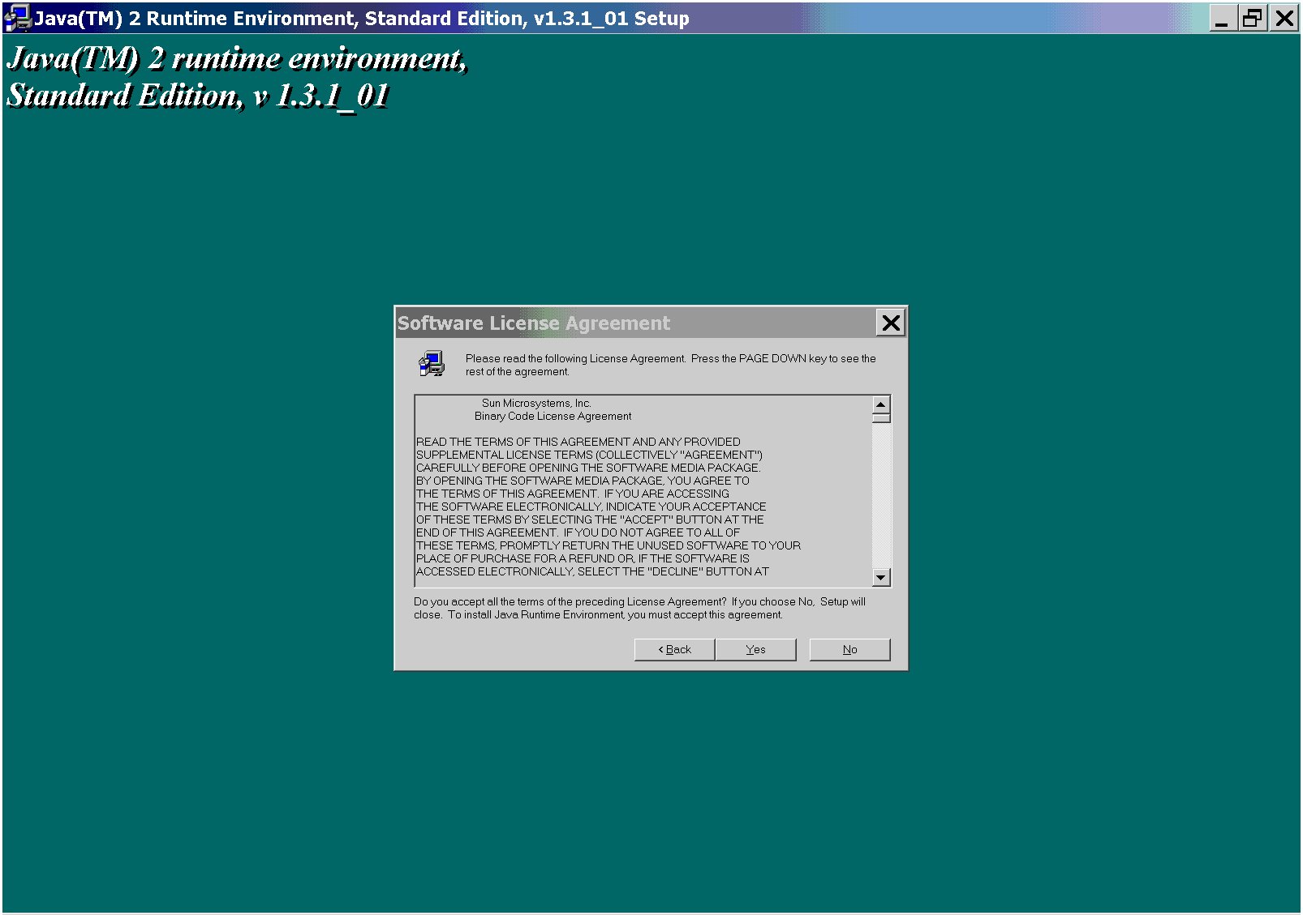
Lexical Tools: Installation
Notes:
The first thing that happens is the JRE gets installed.
On the PC, the JRE gets put into a standard place. If you already have the same JRE, it’s going to be overwritten. The registry does get updated with this version of the JRE. Sorry.
For you developers, that cannot deal with this, comment this out in the install script. You have to be a trained professional to do this. Oh, and you need to belong to the union.
Anyway, the JRE installation is going to ask that you aggree to some things. Agree to them if you will.
Once that is done …

Slide 126
Lexical Tools: Installation
Welcome to the Java Lexical Tools Installation!
-----------------------------------------------
Please read the installationNotes.html
prior to invoking this script.
This script will configure the
_LVG_DIR_/data/config/lvg.properties
file.
This script will create configured
lvg, norm, luiNorm, and wordind
scripts in the _LVG_DIR_ directory.
This script, as an option, will configure
and load the lexical tools into a pre-existing
MySql database. This option is only available
if you already have a MySql database running.
~~~~~~~~~~~~~~~~~~~~~~~~~~~~~~~~~~~~
~~~~~~~~~~~~~~~~~~~~~~~~~~~~~~~~~~~~~~~~~~~
The Java Lexical tools use or (may use) the
following third party software packages:
- Instant DB from Enhydra.org
(see http://instantdb.enhydra.org)
This package is covered under an Enhydra
Public License, which allows for redistribution
and use with a "use notice".
- The installation script uses some GNU CYGWIN
programs that have been distributed along with
this script. These commands are only used when
this installation is on a Windows platform.
The commands that have been distributed
include tar, gunzip, rm, find, hosthame,
tee, and cmp.
The CYGWIN package is licensed under the
GNU Public License. The entire CYGWIN package,
along with the sources to these commands can be
found at http://sources.redhat.com/cygwin/
Enhydra is a trademark of Lutris Technologies, Inc.
Notes:
The installation continues. I’ve got to put up the required stuff about what wonderful products we’ve used within our program. We use the IDB database, and for installation only, Unix tools written for the PC called CYGWIN.

Slide 127
Lexical Tools: Installation
+----------------------Note---------------------------+
|Although we do not support this feature, and it |
|is very likely that we will change the underlying |
|implementation, we have found it useful for our |
|applications to use an existing database system |
|other than IDB. We often use Mysql as the underlying |
|database for our applications. Since we needed a |
|way to get the lexical tools data into MySql, we |
|figured that we would incorporate the MYSQL loader |
|into this install. |
| |
|This option requires that an existing mysql database |
|(version 3.23 or higher) have already been installed,|
|that you have database root access privileges, |
|that the database has enough room to load this |
|data, and that the database is running now. |
+-----------------------------------------------------+
+--------------- Question -------------------+
| Do you want to have the lexical tools use |
| your mysql database [y/n] [n]? n
Notes:
The program is going to ask if you would like to use an already existing MySQL database. You must be a trained professional to say yes to that question. If you say yes to that question, you must have ready, a running MySQL database running, and a root or administrators account with root privileges along with its password. You will also need to make sure you have enough space to house the tables that will be loaded into this database. These will be asked of you.
One other note, it takes about 40 minutes or so to load all the tables into MySQL via this install.
But we are not going to get into that. We will say no for this demonstration.

Slide 128
Lexical Tools: Installation
+-----------------------------------------------+
| Verifying the installation ... |
+-----------------------------------------------+
Enhydra InstantDB - Version 3.26
The Initial Developer of the Original Code is Lutris Technologies
Inc. Portions created by Lutris are Copyright (C) 1997-2001
Lutris Technologies, Inc. All Rights Reserved.
Database sample is shutting down...
Database sample shutdown complete.
~~~~~~~~~~~~~~~~~~~~~~~~~~~~~~~~~~~~~~~~~~~~~~~~~~
~~~~~~~~~~~~~~~~~~~~~~~~~~~~~~~~~~~~~~~~~~~~~~~~~~
Notes:
At the tail end of the installation, we check to see that everything is installed and working properly …

Slide 129
Lexical Tools: Installation
~~~~~~~~~~~~~~~~~~~~~~~~~~~~~~~~~~~~~~~~~~~~~~~~~~
Congratulations!
~~~~~~~~~~~~~~~~~~~~~~~~~~~~~~~~~~~~~~~~~~~~~~~~~~
This script has completed configuring the java
lexical tools. You may invoke these tools from a
command line. These tools are found in the
__LVG_DIR__/bin directory.
You can add this __LVG_DIR__/bin path to your
$PATH environment variable. This would enable
you to find and run these tools from any location.
In UNIX, this would be done by adding this
path to your ~/.cshrc or ~/.profile startup script.
In Windows, this would be done by appending
this path to the PATH variable from the
control panel/System/Environment variables menus.
~~~~~~~~~~~~~~~~~~~~~~~~~~~~~~~~~~~~~~~~~~~~~~~~~~
The lexical tools are ready to be used!
~~~~~~~~~~~~~~~~~~~~~~~~~~~~~~~~~~~~~~~~~~~~~~~~~~
Notes:
If things go as they are expected to go, you should see a failure note. (Just kidding)
You should see a Congratulations note.
Upon a successful installation, it will be up to you to alter your environment to be able to run
This from anywhere on the machine. On unix machines, this involves adding the path to LVG’s
Bin directory into your cshrc, or .profile or .login file’s PATH environment variable.
On the pc, this involved adding this path to the control panel’s system, environment variable
Settings to the PATH environment variable.

Slide 130
Lexical Tools:
Embedding These Tools into Your Application
Your application
Classpath
NormApi()
LvgCmdApi()
LexItem
LvgLexItemApi()
Input
term
Output
terms
Notes:
Here’s the section for developers and those that want to embed the lexical tools into their apps.
I’m going to cover the prerequisites, and the basic classes to use, from the simplest to the more featured interfaces.
The full code to the next examples can be found in the appendix to this tutorial, and are distributed as examples within the source code distribution.

Slide 131
Lexical Tools:
Embedding Norm into Your Application
Your application
Input
term
Norm
Api
Output
terms
Notes:
Most applications are looking to embed norm into their application. We’ve got an interface for you.
The NormApi. This is an instantiated class that you can send terms through and get back
Normalized strings. It takes as input a string, and returns a vector of Strings.

Slide 132
Lexical Tools:
Embedding These Tools into Your Application
CLASSPATH = ${CLASSPATH}:
${LVG_DIR}:
${LVG_DIR}/classes/lvg2002.jar:
${LVG_DIR}/classes/IDB/jta-spec1_0_1.jar:
${LVG_DIR}/classes/IDB/idb.jar:
${LVG_DIR}/classes/jdbcDrivers/mm.mysql-2.0.6
If you are
using IDB
If you
are using
MySQL
Notes:
But first, some prerequisates: Classpath, classpath, classpath. Here’s what you need to add to your classpath to use our tools.
The LVG_DIR, the lvg2002.jar file, and one of the following depending on if you are using the IDB database or MySQL database.

Slide 133
Lexical Tools:
Embedding Norm into Your Application
import Lvg.Api.*;
NormApi normalize = new NormApi();
String input2Norm = null;
Vector outputFromNorm = null;
Notes:
Here are the important pieces of code that are needed to imbed this into your app.
You need to import the Lvg.Api.* packages.
You need to instantiate the NormApi class.
Better have handy a string and a vector variable …

Slide 134
Lexical Tools:
Embedding Norm into Your Application
while ( (input2Norm = stdIn.readLine() ) != null ) {
outputFromNorm= normalize.Mutate(input2Norm);
for ( int i = 0; i < outputFromNorm.size(); i++ ) {
System.out.println((String) outputFromNorm.get(i));
}
}
normalize.CleanUp();
Notes:
I’m going to assume that you know how to read terms in from some stream, or method.
This bit of code shows that you can call the normalize.Mutate method over and over again
In a loop. This Mutate method (yes it’s an uppercase M, by design) takes a string as input,
And returns a vector of strings.
This example shows looping through the resulting output vector, printing out the resulting
Normalized terms.
When your done, be nice, clean up. This method closes open files, open database connections.

Slide 135
Lexical Tools:
Embedding Lvg into Your Application
Your application
Input
term
Output
terms
LvgCmd
Api
Notes:
Now, for a simple way to embed other lexical tools into your application.
For simple tasks, there is the LvgCmdApi() that takes a term from the input
And returns a vector of strings. It’s similar in structure to the NormApi()

Slide 136
Lexical Tools:
Embedding Lvg into Your Application
import Lvg.Api.*;
LvgCmdApi lvgApi = new LvgCmdApi(“-f:b –CR:o –SC –SI”);
String input2Lvg = null;
Vector outputFromLvg = null;
Notes:
Again, you need to import the LvgApi packages.
You will need to instantiate the LvgCmdApi with an argument. The argument is a string.
That string should contain what you would have put on the command line if you were
Running the process from the command line.

Slide 137
Lexical Tools:
Embedding Lvg into Your Application
while ( (input2Lvg = stdIn.readLine() ) != null ) {
outputFromLvg= lvgApi.Mutate(input2Lvg);
for ( int i = 0; i < outputFromLvg.size(); i++ ) {
System.out.println((String) outputFromLvg.get(i));
}
}
lvgApi.CleanUp();
Notes:
This bit of code shows that you can call the normalize.Mutate method over and over again
In a loop. This Mutate method (yes it’s an uppercase M, by design) takes a string as input,
And returns a vector of strings.
This example shows looping through the resulting output vector, printing out the resulting
mutated terms. The output is the same as what would have gone out to standard out
From the command line.
When your done, be nice, clean up. This method closes open files, open database connections.

Slide 138
Lexical Tools:
Embedding Lvg into Your Application
Your application
LvgLexItem
Api
-f:g:o:t:l:i
Notes:
Now, for the real Api. This LvgLexItemApi is a bit more featured than the other two.

Slide 139
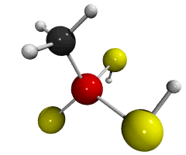
Lexical Tools:
Embedding Lvg into Your Application
Your application
LexItems
Input
term
LvgLexItem
Api
f:g:o:t:l:i
Notes:
It can take as input a term. Its output is not a vector of strings however, it is a vector of an object or structure we call lexItem. Internally we use these lexItems to carry around each term’s information.

Slide 140
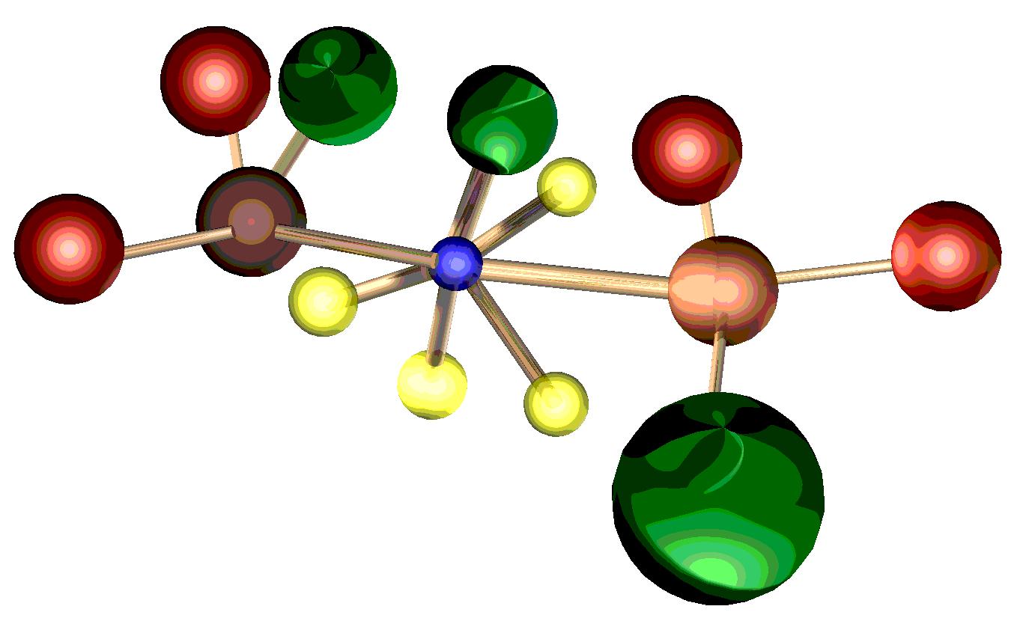
Lexical Tools:
The LexItem Class
Categories
Term
Original
Term
Categories
Detail
Info
Source
Inflections
Inflections
Flow
History
Target
Mutate
Info
Flow
Num
Term
Notes:
Here’s how I like to think of LexItems. LexItems contain information about an incoming or source term, including it’s category, inflection, and the actual string. LexItems contain information about the term once it’s been mutated. We call this information the target information. This includes the target term and its categories and inflections. LexItems also carry around some residual information including the mutations this term has gone through so far, the very first original term before any mutations were applied to it, and asorted extra information.
You should note that there is a strong correspondence between this structure and what information gets returned on every output row.
Suffice to say that there are getter and setter methods that come with this object.

Slide 141
Lexical Tools:
Embedding Lvg into Your Application
import Lvg.Api.*;
import Lvg.Lib.*;
LvgCmdApi lvgApi = new LvgLexItemApi(“-f:g:o:t:l:i”);
String input2Lvg = null;
Vector outputFromLvg = null;
LexItem aLexItem = null;
Notes:
Note that an additional set of packages are needed to use this method. The Lvg.Lib packages contain the lexItem.
Again, you need to instantiate the LvgLexItemApi with an argument that is the command line settings.
Please keep handy a vector of LexItems for the output.
A temparary LexItem will come in handy as well.

Slide 142
Lexical Tools:
Embedding Lvg into Your Application
while ( (input2Lvg = stdIn.readLine() ) != null ) {
outputFromLvg=lvgApi.MutateLexItem(input2Lvg);
for ( int i = 0; i < outputFromLvg.size(); i++ ) {
aLexItem = (LexItem) outputFromLvg.get(i);
System.out.println(aLexItem.GetSourceTerm() + "|" +
aLexItem.GetTargetTerm() + "|" +
aLexItem.GetTargetCategory().GetName()+ "|" +
aLexItem.GetTargetInflection().GetName() + "|" +
aLexItem.GetTargetInflection().GetValue() );
}
}
lvgApi.CleanUp();
Notes:
This example shows that you can call the Mutator over and over again. The MutateLexItem() method takes a string as input, and returns a vector of LexItem. Here are some examples of the get methods that can be called from the lexItem.
You’re going to have to assume that there exists a Category class and an Inflection class that
Become instantiated objects, AND that these objects have methods GetName() and GetValue()
To get both the string representation and their integer (ops, long) representation for category and inflection.
Once again, be kind and clean up after your finished processing.

Slide 143
Lexical Tools:
Java API Documentation
Packages
Lvg.Api | This package provides APIs
Lvg.CmdLineSyntax | Provides Java classes necessary to create a command line system.
Lvg.Db | Provides a higher level interface to LVG database.
Lvg.Flows | This package provides API of all Lvg flow components.
Lvg.Lib | Contains LVG general library classes of BitMaskBase, Category, Gender, Inflection, Configuration, CombineRecords, OutputFilter, Flow, GlobalBehavior, LexItem, LexItemComparator
Lvg.Trie | Provides the classes necessary to generate inflections, uninflections, and derivations using LVG rules tries
Lvg.Util | Contains LVG general utility classes of comparators, Bit operations, Case, In, Out, Strip operations, token operation, Char, Str, and Word.
Notes:
These are but a few of the many api’s available to be used. Refer to the JavaDoc for details.

Slide 144
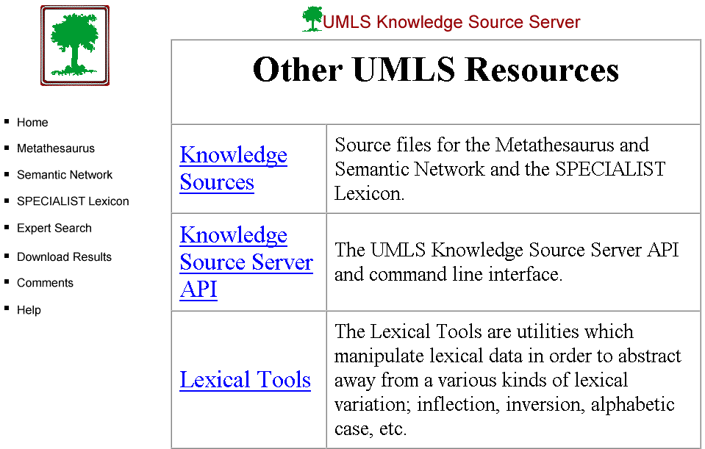
Lexical Resources
Notes:
Where to get the tools, the lexicon, the documentation, the updates.
Where else? the Resources page from the knowledge source server.

Slide 145
References
McCray AT, Loane RF, Browne AC, Bangalore AK. Terminology Issues in User Access to Web-based Medical Information. Proc AMIA Symp. 1998;:107-111
Divita G, Browne AC, Rindflesch T. Evaluating Lexical Variant Generation to Improve Information Retrieval, Proc AMIA Symp. 1998;:775-9
McCray AT, Browne AC. Discovering the modifiers in a terminology data set. Proc AMIA Symp. 1998;:780-4
McCray AT. The nature of lexical knowledge. Methods Inf Med. 1998 Nov;37(4-5):353-60.
McCray AT, Cheh ML, Bangalore AK, Rafei K, Razi AM, Divita G, Stavri PZ. Conducting the NLM/AHCPR Large Scale Vocabulary Test: a distributed Internet-based experiment. Proc AMIA Annu Fall Symp. 1997;:560-4.
McCray AT, Razi, AM, Bangalore AK, Browne AC, Stavri PZ. The UMLS Knowledge Source Server: A versatile Internet-based research tool. Proc AMIA Symp. 1996;164-8.
McCray AT, Srinivasan S, Browne AC. Lexical methods for managing variation in biomedical terminologies. Proc Annu Symp Comput Appl Med Care. 1994;:235-9.

Slide 146

Using The Lexical Tools with The Metathesaurus
Metathesaurus
English
Strings
Normalized string index
norm
MRXNS.ENG
WordInd
Normalized word index
MRXNW.ENG
Notes:
Here’s where the lexical tools fit in with the UMLS Metathesaurus.
The norm program normalizes the Metathesaurus strings to produce the normalized string index. Each normalized string is also associated with three types of identifiers, a concept identifier, a lexical term identifier, and a string identifier. These ids are keys into all the other tables. The normalized string index is then broken into a normalized word index via wordind, carrying along the identifiers.

Slide 147

Using The Lexical Tools with The Metathesaurus
Normalized string index
Query
norm
Normed
term
Normalized word index
SUIS
Metathesaurus
Concepts
Metathesaurus
Concepts that match
The normalized query
Notes:
Application developers put the norm program between queries and the Metathesaurus.
Normalized queries are then used get entries from either the normalized string or word index to get the ids to retrieve Metathesaurus concept information.
Metathesaurus concept information is then returned to satisfy the request.

Slide 148
Using The Lexical Tools with The Metathesaurus
Dry Eyes Syndrome
Query
Normed
term
dry eye syndrome
norm
Notes:
Here’s a simple minded example. Suppose the query is Dry eyes syndrome.
The query gets normalized.

Slide 149
Using The Lexical Tools with The Metathesaurus
ENG|dry eye syndrome|C0013238|L0013238|S0004019|
ENG|dry eye syndrome|C0013238|L0013238|S0035652|
ENG|dry eye syndrome|C0013238|L0013238|S0090228|
ENG|dry eye syndrome|C0013238|L0013238|S0090454|
ENG|dry eye syndrome|C0013238|L0013238|S0220550|
ENG|dry eye syndrome|C0013238|L0013238|S0368350|
ENG|dry eye syndrome|C0013238|L0013238|S1459074|
Normed
term
SUIS
Notes:
All entries that share the normalized form are retreived from the normalized string index. The string unique identifiers to these rows are used ...

Slide 150
Using The Lexical Tools with The Metathesaurus
C0013238|ENG|P|L0013238|VS |S0004019|Dry eye syndrome
C0013238|ENG|P|L0013238|VS |S0368350|Dry Eye Syndrome
C0013238|ENG|P|L0013238|VS |S1459074|dry eye syndrome
C0013238|ENG|P|L0013238|VWS|S0090228|Syndrome, Dry Eye
C0013238|ENG|P|L0013238|VWS|S0220550|Dry, eye syndrome
C0013238|ENG|P|L0013238|VW |S0090454|Syndromes, Dry Eye
MRCON
SUIS
C0013238|ENG|P|L0013238|PF |S0035652| Dry Eye Syndromes
Notes:
To retrieve Metathesurus concept information.
If one of the things you want to return are the the concept names, not the string names for the query, you can review all the returned strings to see which ones are the concept names. I’ve got one of these rows highlighted that indicates that it’s the preferred term for that group of strings, and that group of strings is considered the preferred group for that concept. All told, this is what we consider the concept name.

Slide 151
Building an Index Using The Lexical Tools
Can we build a tool that increases recall?
Can we build a tool that increases precision?
Notes:
Can we build a tool that increases recall?
Can we build a tool that increases precision?

Slide 152
Building an Index Using The Lexical Tools
Can we build a tool that increases precision?
  Case
  Constrain by part of speech
  Filter to the lexicon
Notes:
We may want to have case be significant.
Or we may only want to handle words that we know about.

Slide 153
Building an Index Using The Lexical Tools
Can we a tool that increases recall?
  - Include
  synonyms
  derivations
  acronyms and their expansions
  spelling variants
Notes:
We may want to include additional word level synonymy,
or derivations,
or acronyms and abbreviations,
or spelling variants to increase recall.

Slide 154
Building an Index Using The Lexical Tools
Metathesaurus
Strings
index
Wordind
word index
Notes:
Just as norm was used to create the normalized word and string index, we can come up with our own.
I’ve got a really small set of rows from the Metatheaurus, that we can use to create an index on, load into mysql, then retrieve via a web page that uses our norm.
We can create our norm by putting our flavor in script that is called by the indexing script as well as the web page behind the query.

Slide 155

Building an Index Using The Lexical Tools
Transformed
query
word index
Query
SUIS
Metathesaurus
Concepts that match
The transformed query
Metathesaurus
Concepts
Notes:
On the retrieval side, I’ve created simple java program that calls our norm script to transform the query, retrieves entries from our norm’d index, gets the suis, and uses the suis to get strings from the Metathesaurus.
I’ve got it set up as word index.
Now to demonstrate that ….

Slide 156
Lexical Tools:
2003 and Beyond
Performance issues addressed
Graphic User Interface
  Lexical GUI tool
  On-line Web based tool
Enhance flow components
  Norm improved
New flow components
  Nominalize, Complementation
Additional functionalities
  XML output option

Slide 157
Lexical Tools for UMLS Developers
November 4, 2001
Allen C. Browne, Guy Divita,
Chris Lu
Lister Hill National Center for Biomedical Communications
National Library of Medicine
Email: umlslex.nlm.nih.gov
Knowledge Source Server: http://umlsks.nlm.nih.gov
UMLS Information: http://umlsInfo.nlm.nih.gov

Slide 158
Appendix
NormExample.java
LvgExampleEasy.java
LvgExampleHarder.java
LvgExampleEvenHarder.java

