Slide 1
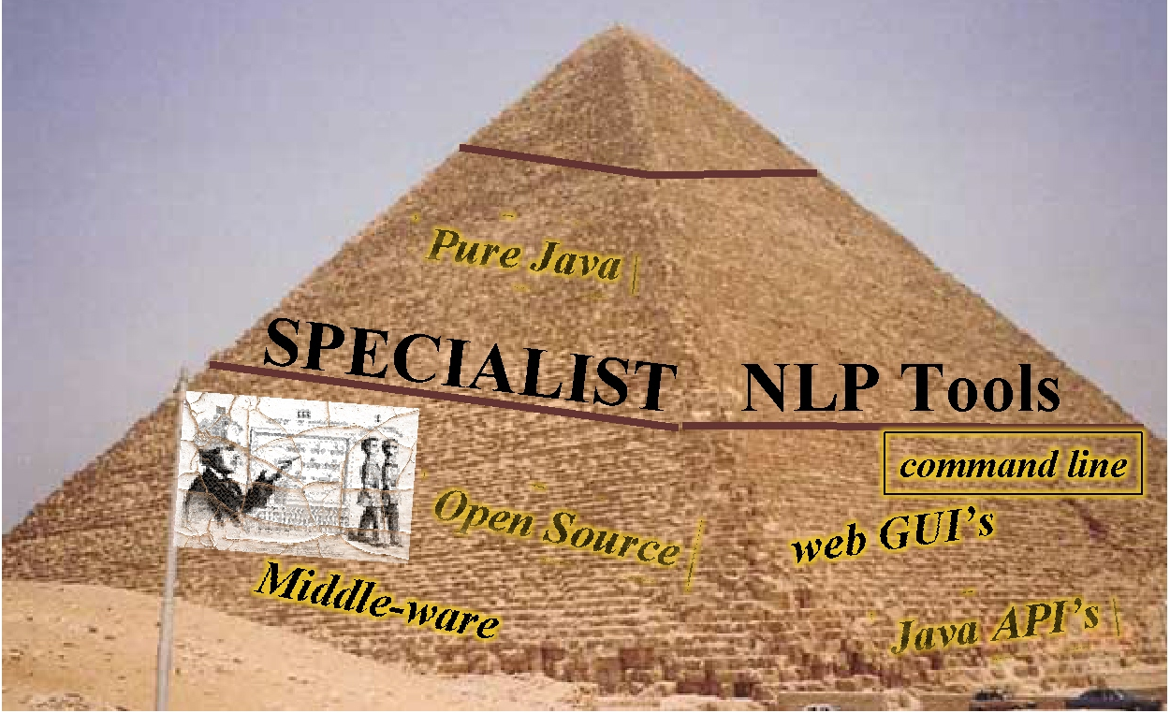

Guy Divita
Chris Lu

Slide 2

Sentence/Phrase/ Term/Word Tokenizers
Text-to-Concept Mapping Tools
Corpus
and Document Based Tools
Indexing Tools
POS Tagging
Text Categorization
Term Based Tools
Spelling Suggestion
Lexical Tools
Term Lookup
SPECIALIST
Lexicon

Slide 3
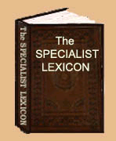
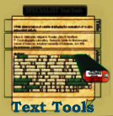





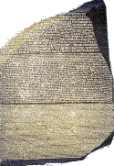
SPECIALIST.nlm.nih.gov
About
The Lexicon
Document Tokenization Tools
Projects
Lexicon
Term Lookup
Text Categorization Tool
Documents
Term Manipulation Tools
POS Tagger
Spelling Suggestion
MetaMap Transfer (MMTx)
mmtx.nlm.nih.gov

Slide 4
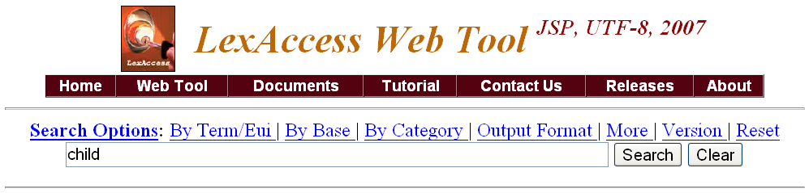
{base=child
entry=E0016427
cat=noun
variants=irreg|child|children|
}
{base=Child
entry=E0355216
cat=noun
variants=reg
variants=uncount
proper
}
Warning: This record’s content has been modified to fit this screen.
Lexicon

Slide 5

SPECIALIST Lexical Tools
Word Indexing
SPECIALIST Lexical Tools
Variant Generation
Term Normalization
Term Based
Tools

Slide 6
Uses
Term Transformation
Query Expansion
Term normalization
Building indexes
Component of controlled vocabulary building tools
Syntactic parsing
Component of search engines
Component of text-to-concept mapping tools
Component of automated document indexing tools
Component of text summarization tools
Component of data-mining tools

Slide 7
Lexical Variant Generation
treats
treating
inflections
treated
nominalizations
treat
treatment
treatments
combinations
derivations
treatable
treatability
treater
Term Based
Tools
treaty

Slide 8
Lexical Variant Generation
colour
coloring
colored
Spelling variants
colors
inflections
color
nominalizations
combinations
synonyms
chromatic
chromaticities
colorlessness
derivations
colorant
Chromaticness
colorful
Term Based
Tools
colorless

Slide 9
Lexical Variant Generation
seconds
seconded
inflections
serous
combinations
Ser
second
nominalizations
SOR
synonyms
secant
derivations
secondly
secondarily
acronyms
secondary
s
Acronym
expansions
s’s
Term Based
Tools
sec

Slide 10

Lexical Variant Generation
lowercase
Strip diacritics
Input
term
Output
term
Remove possessive
Remove stop words
Strip punctuation
Word order sort
Term Based
Tools
The tools can be arranged so that the output of one is the input to another.
Notes:
Here’s an example of such a serial combination. That is,
where the output of one tool serves as
the input to the next tool.
In this example, we are first lowercasing the input, then stripping diacritics, removing possessives, removing stop words, stripping punctuation, and finally sorting the resulting words in ASCII sort order.
The example shows just how this flow is invoked on the command line.

Slide 11
Term Normalization
Norm abstracts away from:
  case
  punctuation
  word order
  stop words
  possessive forms
  inflectional variation
  spelling variation
  normalizes diacritics/ligatures/symbols
Term Based
Tools
Notes:
Our form of normalization involves the following:
It abstracts away from case, punctuation, and word order.
It abstracts away from inflectional variations.
It abstracts away from possessive forms.

Slide 12
Term Normalization Examples
Word order
  Upper left lobe of lung
  Left upper lobe of lung
Possessive Forms
  Grave’s Disease
  Graves Disease
  Graves’ Disease
Diacritic/Ligature/Symbol Normalization
  entrée, anæsthesia, β-blockers, Medline®
Term Based
Tools

Slide 13
Term Normalization Example
Hodgkin Disease
HODGKINS DISEASE
Hodgkin's Disease
Disease, Hodgkin's
HODGKIN'S DISEASE
Hodgkin's disease
Hodgkins Disease
Hodgkin's disease NOS
Hodgkin's disease, NOS
Disease, Hodgkins
Diseases, Hodgkins
Hodgkins Diseases
Hodgkins disease
hodgkin's disease
Disease;Hodgkins
Disease, Hodgkin
disease hodgkin
Note: A normalized form is not necessarily itself a readable term. It is a hash.
Normalization web tool

Slide 14
Lgt, a GUI Example

Slide 15
Command Line Example
> lvg –f:i –SC -SI
leave
leave|leave|<noun>|<base>|i|1|
leave|leave|<noun>|<singular>|i|
leave|leaves|<noun>|<plural>|i|1|
leave|left|<verb>|<past>|i|1|
leave|left|<verb>|<pastPart>|i|1|
leave|leave|<verb>|<base>|i|1|
leave|leave|<verb>|<pres1p23p>|
leave|leave|<verb>|<infinitive>|i|
leave|leaves|<verb>|<pres3s>|i|1
leave|leaving|<verb>|<presPart>|
> lvg –f:i
leave
leave|leave|128|1|i|1|
leave|leave|128|512|i|1|
leave|leaves|128|8|i|1|
leave|left|1024|64|i|1|
leave|left|1024|32|i|1|
leave|leave|1024|1|i|1|
leave|leave|1024|262144|
leave|leave|1024|1024|i|1
leave|leaves|1024|128|i|1
leave|leaving|1024|16|i|1|

Slide 16
Command Line Example:
Output Fields Explained
> lvg –f:i
leave
leave
|
leave
|
128
|
1
|
i
|
1
Input Term
Inflections
Output Term
Flow history
Categories
Flow Number

Slide 17
SPECIALIST Lexical Tools: API’s
Outline of the needed pieces:
  import gov.nih.nlm.nls.lvg.Api.*;
  NormApi api = new NormApi();
  Vector<String> out = api.Mutate(inStr);
  api.CleanUp();

Slide 18
Norm API Example
import java.util.*;
import gov.nih.nlm.nls.lvg.Api.*;
public class simplestApi
{
public static void main(String[ ] args)
{
NormApi api = new NormApi( ); // instantiate a NormApi object
try // Process
{
Vector<String> out = api.Mutate(“inputs”);
for(int i = 0; i < out.size( ); i++) // print out result
{
System.out.println(out.elementAt(i));
}
}
catch (Exception e) { }
api.CleanUp(); // make sure to clean up
}
}

Slide 19
Norm API Example (2)
To compile and run:
CLASSPATH = ${CLASSPATH}:
${LVG_DIR}:
${LVG_DIR}/lib/lvg2007dist.jar:

Slide 20

Application
Metathesaurus
English
Strings
Normalized string index
norm
MRXNS.ENG
WordInd
Normalized word index
MRXNW.ENG
Notes:
Here’s where the lexical tools fit in with the UMLS Metathesaurus.
The norm program normalizes the Metathesaurus strings to produce the normalized string index.
Each normalized string is also associated with three types of identifiers, a concept identifier (CUI), a lexical term identifier (LUI), and a string identifier (SUI). These ids are keys into all the other tables.
The normalized string index is then broken into a normalized word index via wordInd, carrying along the identifiers.

Slide 21

Application
Normalized string index
Query
norm
Normed
term
Normalized word index
SUIS
Metathesaurus
Concepts
Metathesaurus
concepts that match
the normalized query
Notes:
Here is a example of the application.
Application developers put the norm program between queries and the Metathesaurus.
First of all, user input a term to search for Metathesaurus concept.
Term are normalized and form the query.
Normalized queries are then used get entries from either the normalized string or word index to get the ids to retrieve Metathesaurus concept information.
Metathesaurus concept information is then returned to satisfy the request.

Slide 22
Example
Dry Eyes Syndrome
Normed
term
Query
norm
dry eye syndrome
Notes:
Here’s a simple minded example. Suppose the query is Dry eyes syndrome.
The query gets normalized.

Slide 23
Example (Cont.)
ENG|dry eye syndrome|C0013238|L0013238|S0004019|
ENG|dry eye syndrome|C0013238|L0013238|S0035652|
ENG|dry eye syndrome|C0013238|L0013238|S0090228|
ENG|dry eye syndrome|C0013238|L0013238|S0090454|
ENG|dry eye syndrome|C0013238|L0013238|S0220550|
ENG|dry eye syndrome|C0013238|L0013238|S0368350|
ENG|dry eye syndrome|C0013238|L0013238|S1459074|
Normed
term
SUIS
Notes:
All entries that share the normalized form are retrieved from the normalized string index.
The string unique identifiers to these rows are used as key to retrieve the String name

Slide 24
Example (Cont.)
C0013238|ENG|P|L0013238|VS |S0004019|Dry eye syndrome
C0013238|ENG|P|L0013238|VS |S0368350|Dry Eye Syndrome
C0013238|ENG|P|L0013238|VS |S1459074|dry eye syndrome
C0013238|ENG|P|L0013238|VWS|S0090228|Syndrome, Dry Eye
C0013238|ENG|P|L0013238|VWS|S0220550|Dry, eye syndrome
C0013238|ENG|P|L0013238|VW |S0090454|Syndromes, Dry Eye
MRCON
SUIS
C0013238|ENG|P|L0013238|PF |S0035652| Dry Eye Syndromes
Notes:
To retrieve Metathesurus concept information.
If one of the things you want to return are the concept names, not the string names for the query, you can review all the returned strings to see which ones are the concept names.
I’ve got one of these rows highlighted that indicates that it’s the preferred term for that group of strings, and that group of strings is considered the preferred group for that concept.
All told, this is what we consider the concept name.

Slide 25
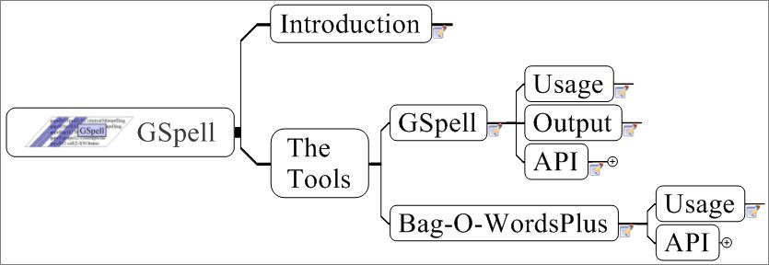
Notes:
GSpell. This is a set of spelling suggestion resources. Two tools are included in this set: GSpell which is a word and term based spelling suggestion tool, and Bag-O-WordsPlus, which is a phrase retrieval tool that uses GSpell when it needs to, but, as the name implies, uses a bag of words approach to retrieve phrases from a target, and only relies on gspell, when none of the words of the query are found in the target as spelled.
Both tool’s usage and api will be reviewed and the output of GSpell will be elaborated upon to show what kind of information is returned.

Slide 26
Spelling Retrieval Tools
GSpell
  A term retrieval tool
  N-gram nearest neighbor algorithm
  MetaPhone phonetic spelling normalization
  Homophones
  Common misspellings
  Candidates sorted by an edit distance and frequency of occurrence from a corpus
BagOWordsPlus
  a phrase retrieval tool
  uses correctly spelled words within the phrase to limit possible candidates
  uses GSpell only when it has to.
Term Based
Tools

Slide 27
GSpell: Usage
  Usage
  GSpellFind.[sh|bat]
  --dictionary=NameOfDictionary
  [--inputFile=Source] [--outputFile=target]
  [--truncate=N] [--considerNCandidates=N]
  [--maxEditDistance=N]
  GSpellIndex.[sh|bat]
  --dictionary=NameOfDictionary
  --inputFile=SourceFile
  [--reportTime] [--version][--help]
Notes:
Here’s GSpell’s Usage. This emplies a dictionary has been previously indexed, and you know the name of that index. GSpell is distributed with the current year’s lexicon as an index.
GSpell has options to fiddle with to tune at will.

Slide 28
GSpell: Output
Input Term | Suggestion | Edit Distance | Rank | Method | Message
anonomous|anonymous|1.0|0.87|NGrams|
anonomous|allonomous|2.0|0.58|NGrams|
anonomous|autonomous|2.0|0.58|NGrams|
anonomous|anadromous|3.0|0.29|NGrams|
anonomous|analogous|3.0|0.29|NGrams|
anonomous|anomalous|3.0|0.29|NGrams|
anonomous|anonymously|3.0|0.29|NGrams|
anonomous|anonymes|3.0|0.29|Metaphone|
anonomous|anonyms|3.0|0.29|Metaphone|
anonomous|acoprous|4.0|0.11|NGrams|
Notes:
Here is a sample output from GSpell. The output consists of the input term, the suggestion, the edit distance, a rank, the method that retrieved the suggestion and a message.
Edit distance is the minimum number of edits or transfermations that transforms the query term into the target term. These transformations include character removal, character substitution, and the swapping of two characters. Each transformation has a cost of 1. The Edit distance is the sum of the transformations necessary.
A rank is returned as well. This rank is the result of an equation employing the edit distance, with the properties that it has the range from 0 to 1, and the rank gets quickly smaller after two edit distances quickly approaching 0 by 4 edit distances.
A message, such as “correct” is given when a correctly spelled term is put in.

Slide 29
GSpell: API
import gov.nih.nlm.nls.gspell.GSpell; // <-------These come from the gspell.jar
import gov.nih.nlm.nls.gspell.Candidate;
GSpell gspell = new GSpell( _dictionaryName, GSpell.READ_ONLY );
Vector candidates = gspell.find( aTerm );
if ( candidates != null )
for ( int i = 0; i < candidates.length; i++ )
System.out.println(candidates[i].toString());
else
System.out.println("No Suggestions");
gspell.cleanup();
Notes:
Here’s how you might embed GSpell into your app. Like the other samples we’ve shone, a new instance is needed.
The GSpell constructor needs to have the name of the dictionary passed in, and a read-only flag passed in.
The find method takes a string as input, and returns a vector of candidates. A Candidate object contains all those things that we just saw on the output of the prior slide, with methods to get at each. See the java doc for the details.

Slide 30
SPECIALIST Text Tools
LexicalLookup
NpParser
SPECIALIST Text Tools
VariantLookup
POS tagger
Document
Indexing
Doc
Tools

Slide 31

SPECIALIST TextTools
Segments text into:
  Sections
  Sentences
  Phrases
  Terms
  Words
  Term variants
SPME determination of volatile aldehydes for evaluation of in-vitro antioxidant activity
Elena E. Stashenko, Miguel A. Puertas, Jairo R. Martínez
^{A1} Chromatography Laboratory, Research Center for Biomolecules, School of Sciences, Industrial University of Santander. A.A. 678, Bucaramanga, Colombia
Abstract:
The in-vitro antioxidant activity of natural (essential oils, vitamin E) or synthetic substances (tert-butyl hydroxy anisole (BHA), Trolox) has been evaluated by monitoring volatile carbonyl compounds released in model lipid systems subjected to peroxidation. The procedure employed methodology previously developed for the determination of carbonyl compounds as their pentafluorophenylhydrazine derivatives which were quantified, with high sensitivity, by means of capillary gas chromatography with electron-capture detection. Linoleic acid and sunflower oil were used as model lipid systems. Lipid peroxidation was induced in linoleic acid by the Fe²⁺ ion (1 mmol L⁻¹, 37 °C, 12 h) and in sunflower oil by heating in the presence of O₂ (220 °C, 2 h).
Title
Abstract
Java Objects
Document
Section
Sentence
Phrase

Slide 32
Specialist TextTools
Container Classes: Entity Diagram gov.nih.nlm.nls.nlp.textfeatures
These are terms
Document
Sentence
Lexical Element
Vector getSections()
Vector getSentences()
Vector getPhrases()
Vector getLexicalElem
Vector getTokens()
Vector getPhrases()
Vector getLexicalElem
Vector getTokens()
getTokens()
Section
Vector getSentences()
Vector getPhrases()
Vector getLexicalElem
Vector getTokens()
Phrase
Token
Vector getLexicalElemements()
Vector getTokens()
These are words
Contains many relationship

Slide 33
Specialist TextTools
Container Classes: Entity Diagram, more details gov.nih.nlm.nls.nlp.textfeatures
Collection
Variant
Collection()
Collection(GlobalBehavior pSettings)
Collection(StringBuffer pText)
Collection(String pFileName,
GlobalBehavior pSettings)
String getTerm()
Vector getTokens()
int getCategories()
int getDistance()
int getHistory()
String getNormalizedTerm()
int getOrigCat()
String getOrigTerm()
LexicalElement getParent()
Vector getDocuments()
Document (continued)
Doccument()
Document( File pFile)
Document(GlobalBehavior pSettings)
Document(String pFileName)

Slide 34
SPECIALIST TextTools
LexicalLookup
LexicalLookup
segments text into
Sections
Sentences
Terms
Lexical Entries
Words
Title
Abstract
Java Objects
Document
Section
Sentence
Terms

Slide 35
SPECIALIST TextTools
NPParser
Segments text into
Sections
Sentences
Noun Phrases
Terms
Words
Lexical Entries
Title
Abstract
Java Objects
Document
Section
Sentence
Phrase

Slide 36
SPECIALIST TextTools
NPParser Example
NpParser --fileName=PMID14700470.txt
…
Section: 8|Title Words|
Sentence|0|0|212|The knowledge and expectations of parents about the role of antibiotic treatment in upper respiratory tract infection - a survey among parents attending the primary physician with their sick child.
Phrase|0|0|12|The knowledge|knowledge|2|true|NOUN PHRASE
Lexical Element|0|LEXICON|det|The|0|2|false
Lexical Element|1|LEXICON|noun|knowledge|4|12|true
Phrase|1|14|16|and|and|1|false|CONJUNCTION_PHRASE
Lexical Element|2|LEXICON|conj|and|14|16|false
Phrase|2|18|29|expectations|expectation

Slide 37
SPECIALIST TextTools
Classes
gov.nih.nlm.nlp.lexicallookup.LexicalLookupAPI
Constructor Summary
LexicalLookupAPI( gov.nih.nlm.nls.utils.GlobalBehavior pSettings )
LexicalLookupAPI( String[] args)
gov.nih.nlm.nlp.parser.Parse.Parse
Constructor Summary
Parse( gov.nih.nlm.nls.utils.GlobalBehavior pSettings )
Parse( String[] args)

Slide 38
SPECIALIST TextTools
Common Methods
Method Summary
void
processCollection(Collection pCollection )
void
processDocument(Document pDocument )
void
processSentence(Sentence pSentence )
Sentence
processSentence(String pString )

Slide 39
SPECIALIST TextTools
Special Sauce
gov.nih.nlm.nls.utils
Class GlobalBehavior: Constructor Summary
GlobalBehavior( String pName, String registryFile )
GlobalBehavior( String pName, String registryFile, String[] args )
Just the Name
Properties File Location:
/somepath/textTools_v0.X.X/nls/nlp/config/ NLPRegistry.cfg
Java Classpath requirement:
/somepath/textTools_v0.X.X/nls/nlp/config/
NLPRegistry.cfg: Example Contents:
-015|--annotationFormat1|boolean|false|Simple Annotation format
Command line arguments: Example Contents:
--annotationFormat1

Slide 40
SPECIALIST TextTools
Extract Terms from Documents
// =============+ Create a LexicalLookupAPI object +==
LexicalLookupAPI look = new LexicalLookupAPI(args);
// =============================+ Chunk the file +==
Document aDocument = look.processDocument( aFile );
List terms = aDocument.getLexicalElements();
LexicalElement aTerm = null;
// ================+ Print the LexicalElements out +==
for (Iterator i = terms.iterator(); i.hasNext(); ) {
aTerm = (LexicalElement) i.next();
System.out.println(aTerm.toPipedString());
}

Slide 41
SPECIALIST TextTools
VariantLookup
This is LVG’s fruitful variants index available as an API within the textTools
Is used to generate variants from noun phrases extracted from documents
gov.nih.nlm.nlp.lexicon.VariantLookup
Constructor Summary
VariantLookup( gov.nih.nlm.nls.utils.GlobalBehavior pSettings )
Method Summary
Variant[] find( String pTerm)
Variant[] find( String pTerm, int pCats, int pVarTableType)

Slide 42
SPECIALIST TextTools taggerClient
Assigns Parts of Speech (POS) to words in text
NP parsers need terms with Parts of Speech assigned to determine phrase breaks and head assignment
Includes LexicalLookup
SPME determination of volatile aldehydes for evaluation of in-vitro antioxidant activity
Elena E. Stashenko, Miguel A. Puertas, Jairo R. Martínez
^{A1} Chromatography Laboratory, Research Center for Biomolecules, School of Sciences, Industrial University of Santander. A.A. 678, Bucaramanga, Colombia
Abstract:
The in-vitro antioxidant activity of natural (essential oils, vitamin E) or synthetic substances (tert-butyl hydroxy anisole (BHA), Trolox) has been evaluated by monitoring volatile carbonyl compounds released in model lipid systems subjected to peroxidation. The procedure employed methodology previously developed for the determination of carbonyl compounds as their pentafluorophenylhydrazine derivatives which were quantified, with high sensitivity, by means of capillary gas chromatography with electron-capture detection. Linoleic acid and sunflower oil were used as model lipid systems. Lipid peroxidation was induced in linoleic acid by the Fe²⁺ ion (1 mmol L⁻¹, 37 °C, 12 h) and in sunflower oil by heating in the presence of O₂ (220 °C, 2 h).
Legend:
noun
adj
adv
verb
conj
pron
det
prep
shape

Slide 43
SPECIALIST TextTools
TaggerClient
gov.nih.nlm.nlp.taggerservices.TaggerClientMain
Constructor Summary
TaggerClientMain( gov.nih.nlm.nls.utils.GlobalBehavior pSettings )
TaggerClientMain( String[] args)

Slide 44
SPECIALIST TextTools taggerservices
gov.nih.nlm.nlp.taggerservices
Interface TaggerInterface
Method Summary
tag( Sentence pSentence )
Class gov.nih.nlm.nlp.taggerservices.TaggerFactory
static TaggerInterface
build(GlobalBehavior pSettings )
NLPRegistry.cfg: Example Contents:
-043|--tagger|String|medpostskr|Name of tagger hooked in

Slide 45
MetaMap Transfer (MMTx)
Extracts UMLS concepts from text
Java Implementation of MetaMap
Retinoblastoma
What is retinoblastoma?
Retinoblastoma is a rare type of eye cancer that develops in the retina, which is the part of the eye that detects light and color. Although this disorder can occur at any age, it usually develops in young children.
Meta Mapping (1000):
C0496836
(Malignant neoplasm of eye, unspecified)
[Neoplastic Process]
Doc
Tools
Notes:
MetaMap, a tool developed by the National Library of Medicine, extracts concepts from free-text documents, such as MEDLINE abstracts, and maps them to candidate concepts in NLM’s UMLS Metathesaurus. MetaMap is a rese
MetaMap Transfer (or MMTx) is a Java implementation of MetaMap. MMTx is the version of MetaMap that is distributed.
As illustrated here, the term “eye cancer” has been mapped to the UMLS concept represented by the term “Malignant neoplasm of eye, unspecified.”
Because these tools map extracted terms to the UMLS Metathesaurus, the most comprehensive repository of medical knowledge available, I’ll now briefly describe the structure of the Metathesaurus.

Slide 46
Specialist TextTools
Container Classes: Entity Diagram gov.nih.nlm.nls.nlp.textfeatures
Phrase (cont.)
Candidate
Vector getLexicalElements()
Vector getTokens()
Vector getAllVariants()
ArrayList getBestMappings()
Vector getCandidateList()
String getCUI()
String getUMLSConceptName()
String getCandidateScore()
UMLS_SemanticTypePointer[]
getSemanticTypes()
String getSuis()
UMLSSourceInfo[] getSources()
FinalMapping
List getCandidates()
int getScore()

Slide 47
MetaMap Transfer (MMTx)
SPME determination of volatile aldehydes for evaluation of in-vitro antioxidant activity
Elena E. Stashenko, Miguel A. Puertas, Jairo R. Martínez
^{A1} Chromatography Laboratory, Research Center for Biomolecules, School of Sciences, Industrial University of Santander. A.A. 678, Bucaramanga, Colombia
Abstract:
Abstract. The in-vitro antioxidant activity of natural (essential oils, vitamin E) or synthetic substances (tert-butyl hydroxy anisole (BHA), Trolox) has been evaluated by monitoring volatile carbonyl compounds released in model lipid systems subjected to peroxidation. The procedure employed methodology previously developed for the determination of carbonyl compounds as their pentafluorophenylhydrazine derivatives which were quantified, with high sensitivity, by means of capillary gas chromatography with electron-capture detection. Linoleic acid and sunflower oil were used as model lipid systems. Lipid peroxidation was induced in linoleic acid by the Fe²⁺ ion (1 mmol L⁻¹, 37 °C, 12 h) and in sunflower oil by heating in the presence of O₂ (220 °C, 2 h).
Tokenization
Section, Sentence, Phrase, Term, Word
Variant Generation
UMLS Concept Retrieval
UMLS Concept to Phrase Evaluation
Final Mapping of Good Candidates to best cover the phrase

Slide 48
MetaMap Transfer (MMTx)
Display Mappings
// ======================+ Display Phrase and Concepts +==
String displayPhrase( Phrase aPhrase ) throws Exception {
// =================================+ Get the Mappings +==
List finalMappings = aPhrase.getFinalMappings();
if ( finalMappings != null ) {
Iterator mappingIterator = finalMappings.iterator();
// ===================+ Iterate through the Mappings +==
while (mappingIterator.hasNext()) {
FinalMapping aMapping=(FinalMapping) mappingIterator.next();
System.out.println( aMapping );
}
}
}

Slide 49
MetaMap Transfer (MMTx)
MMTxAPI
// ==========================+ Create a MMTxAPI object +==
MMTxAPI mmtx = new MMTxAPI( );
// =============================+ Analyze the Sentence +==
Sentence aSentence = mmtx.processSentence("Insomnia is a symptom of a sleep disorder" );
Iterator phraseIterator=aSentence.getPhrases().iterator();
// ======================+ Iterate through the Phrases +==
while ( phraseIterator.hasNext() ) {
Phrase aPhrase = (Phrase) phraseIterator.next();
System.out.println( displayPhrase( aPhrase) );
}

Slide 50
MetaMap Transfer (MMTx)
MMTxAPI
Phrase: "non-hodgkin's lymphoma"
Meta Candidates (5)
1000 Lymphoma, Non Hodgkin's [Neoplastic Process]
861 hodgkin's lymphoma (HODGKINS DISEASE)
[Neoplastic Process]
812 Lymphoma (Germinoblastoma) [Neoplastic Process]
812 Lymphoma [Neoplastic Process]
805 NON (NON Mouse) [Mammal]
Meta Mapping (1000)
1000 Lymphoma, Non Hodgkin's [Neoplastic Process]

Slide 51

Introduction
The SPECIALIST
dTagger
(A POS Tagger)
Features
Lexical Lookup
Handling Unknowns
specialist.nlm.nih.gov
Training
Tagging
Updating
Error Analysis
Work Still to Do

Slide 52
Motivation
Why another POS tagger?
SPECIALIST Lexicon
Arbitrary tag set
Supervised and unsupervised training and updating
True multi-word (term based) tagger
Generalizable to other languages
Term based
tools
Word based
taggers

Slide 53
Features
Tag set specified as a configurable file
    Just make sure Lexicon/tagset/corpus use the
    same tags.
Lexical Information (from .lex files)
    SPECIAST lexicon
    Pseudo lexicon (number words, roman numerals)
    Verbs as adjectives
    Local lexicon

Slide 54
Features (2)
Lexical lookup, pattern recognition to tokeninize into terms
Unknown words handled with several strategies
Hidden Markov Model, Viterbi Model used for training and tagging
Probability of correct tag assignment reported back

Slide 55
Lexical Lookup
Longest spanning matches from Lexicon
.. on diabetes gravidarum diagnosis and treatment
on
diabetes mellitus
diabetes Atherosclerosis Intervention Study
diabetes gravidarum
diabetes insipidus
on
diabetes gravidarum
diagnosis
and
treatment

Slide 56
Handling Unknowns
Overall probability of the next word being an unknown word gathered for (open class) words with low frequency
Suffix statistics gathered from annotated corpus or from Lexicon (for unsupervised training) for open class terms.
Frequency
Of Use
Words in Corpus

Slide 57
Handling Unknowns:
Shape Identification
Fifty two|trials|were|identified|which|fulfilled|
wordnum |noun |aux |verb |pron |verb |
In |17 |trials|with|placebo|groups|
prep|num|noun |prep|noun |noun |
... cure|rate|of |placebo|preparations|was|30% |
... verb|noun|prep|noun |noun |aux|percent|
... of |10 weeks |( |range|4 |to |24 weeks |) |
... prep|unitOfMeasure|lp|noun |num|prep|unitOfMeasure|rp|
... myocardial|scintigraphy|(P=0.02)
... adj |noun |levelOfSignificance

Slide 58
Handling Unknowns:
Shape Identification (2)
Units of Measure
Range
Equation
Level of Significance
EmailAddress
Address
Experiment Size
Date
Chemical
Number
URL
Gene Name
Real Number
Fraction
Proper Name
Word Number
Percent
Name
Telephone Number
Glob
Delimiter
*Next or future release

Slide 59
Unsupervised
Updating and Training
Unsupervised Updating
  With a prior model and lexicon and an un-annotated corpus
  Even 10 hand annotated sentences as the
  initial model gives a big boost
Unsupervised Training
  With only the lexicon and no prior model
  Suffix statistics gleaned from lexicon

Slide 60
dTagger
Available Programs
TrainWithTaggedText
Tag
UpdateWithUntaggedText
TrainWithUntaggedText
MorphologyDiscovery
AnalizeTaggedCorpus (next release)

Slide 61
Unsupervised
Updating and Training
Option | Description | Default Value
--dirName= | Where the input files will be found | the current directory
--fileName= | The input file or input file pattern | standard input
--modelName= | Saved Hidden Markov model name | “default”
--Rev= | Revision number useful for tracking multiple updates to a model | “0”

Slide 62
Unsupervised
Updating and Training
Option | Description | Default Value
--corpusName= | This is echoed out in output stats | “MedPost”
--sentenceIDMarker | Sentence ID in the training corpus. | “P”
--overwrite | Overwrite the current rev’s probs when updating | false

Slide 63
Error Analysis
Verbs tagged as nouns
Adj/noun and noun/adj’s
Odd usages
Human tagging inconsistencies
Conflicts with what the lexicon says

Slide 64
The dTagger Tag Class
gov.nih.nlm.nls.dtagger.Tag Constructor Summary
Tag(GlobalBehavior pSettings )
Method Summary
void
processCollection(Collection pCollection )
void
processDocument(Document pDocument )
void
processSentence(Sentence pSentence )
double
tag(LexicalElement[] pTerms )
double
tag(Sentence pSentence )
LexicalElement[]
tag(String pSentence )

Slide 65
Work In Progress
Put the latest and greatest on the website (includes textTools w/ dTagger now)
More evaluation
  Single vs. multi-word comparison
  Using different tag sets
Applied to Spanish to help build Spanish lexical resources
“fix it, Make it better, make it faster” tasks

Slide 66
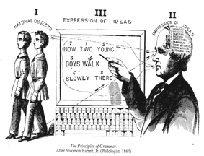
Lexical Systems Group
Websites | http://specialist.nlm.nih.gov http://mmtx.nlm.nih.gov
Contacts | Allen Browne browne@nlm.nih.gov Guy Divita divita@nlm.nih.gov Chris Lu lu@nlm.nih.gov Susanne M. Humphrey humphrey@nlm.nih.gov Lexical Systems Group umlslex@nlm.nih.gov

Slide 67
This Space to be filled in in Brisbane

Slide 68
Hidden Markov Model for
POS Tagging
The
run
Det
Adj
Noun
Verb
heal
a
process
acute
quick
process
run
heart
Transition
Probabilities
Emission
Probabilities
States
Observables
Notes:
A Markov Model (MM) consists of a set of states with probabilities of transitions between them.
In a Hidden Markov Model (HMM), the states have probabilities of emitting observations. When the same observation can be emitted by multiple states, it becomes ambiguous which state produced the observation. This problem never goes away, but the ambiguity can be quantified. The HMM makes it is possible to calculate the probability that a given state emitted a given observation.
For POS tagging, the states represent POS tags and the observations are words. Any given sentence is considered a sequence of observations. For each sentence, there are many possible sequences of POS tags (also called paths through state space). The HMM formalism allows us to calculate the probabilities that a given sequence is correct. We can also find the most likely, or best, POS sequence.
The figure is a simplified example of a HMM model for POS tagging. Circles are POS states. Rectangles are observed words. Arcs and arrows have a probability that they will be traversed. Note that the words "run" and "process" are emitted by two states.

Slide 69
Training (1)
Hidden Markov Model
  Emission counts gathered from annotated corpus
 | Noun | Adj | Adv | Verb | Det | Conj | …
the | 0 | 0 | 0 | 0 | 7406 | 0
cause | 7 | 0 | 0 | 13 | 0 | 0
...

Slide 70
Training (2)
  Transition counts gathered from annotated corpus
 | Noun | Adj | Adv | Verb | Det | Conj | …
Noun | 14242 | 1235 | 713 | 3231 | 3100 | 424
Adj | 11421 | 1703 | 113 | 11 | 4 | 1
Adv | 140 | 631 | 285 | 2014 | 359 | 9
Verb | 1273 | 758 | 794 | 97 | 19 | 3
...

Slide 71
Tagging
Viterbi Algorithm:
State Probabilities
 | Do | viruses | cause | cancer
Noun |  | 97 % | 45 % | 97 %
Adj
Adv
Verb | 77 % |  | 52 %
Aux | 23 %
Unknown |  | .07 % | .07 % | .07%
…
|Do |viruses|cause|cancer|
34.92|verb|noun |verb |noun |

