Slide 1
THE DEVELOPMENT OF GUIDANCE FOR THE USE OF NEW AGENTS IN HANDHELD EXTINGUISHERS FOR AIRCRAFT CABINS
Louise C. Speitel
Fire Safety Branch AAR-440
FAA W.J. Hughes Technical Center
Atlantic City International Airport, NJ 08405 USA
Aircraft Systems Fire Protection Working Group Meeting Ottawa, Canada
February 15-16, 2005

Slide 2
OUTLINE OF TALK
FAR requirements for hand-held extinguishers
Minimum performance standard (MPS) for transport category aircraft
Purpose of handheld advisory circular (AC)
Approach
Extinguisher ratings
Throw range
Fixed nozzle/ hose/ adjustable wand
Toxicity: decomposition products, agent, low oxygen hypoxia
Ventilation nomograms
A/C language for halocarbon fire extinguishers
Caveats

Slide 3
FEDERAL AVIATION REGULATION (FAR) REQUIREMENTS FOR HAND FIRE EXTINGUISHERS
Specifies the minimum number of Halon 1211 or equivalent extinguishers for various size aircraft.
Specifies the location and distribution of extinguishers on an aircraft.
Each extinguisher must be approved.
Each extinguisher intended for use in a personnel compartment must be designed to minimize the hazard of toxic gas concentration.
The type and quantity of extinguishing agent, if other than Halon 1211, must be appropriate for the kinds of fires likely to occur.
The FAR does not give extinguisher ratings. This is done in the AC.

Slide 4
THE MINIMUM PERFORMANCE STANDARD (MPS)
Provides requirements for equivalency to Halon 1211 5 B:C extinguishers to satisfy Federal Aviation Regulations citing “Halon 1211 or equivalent”:
UL rated 5 B:C Halocarbon extinguishers that will be used in transport category aircraft must pass 2 tests identified in DOT/FAA/AR-01/37 Development of a Minimum Performance Standard (MPS) for Hand-Held Fire Extinguishers as a replacement for Halon 1211 on Civilian Transport Category Aircraft.
  Hidden Fire Test
  Seat Fire/Toxicity Test
The MPS guarantees extinguishers to replace halon 1211 will have equal fire performance and an acceptable level of toxicity (for decomposition products of the agent). Guidance for agent toxicity can be found in the advisory circular.
The MPS requires that a permanent label be affixed to the extinguisher identifying FAA approval for use on board commercial aircraft.

Slide 5
PURPOSE OF ADVISORY CIRCULAR: Safety
“Provide methods for showing compliance with the hand fire extinguisher provisions in parts 21. 25, 29, 91,121, 125, 127 and 135 of the Federal Aviation Regulations (FAR 14)”. (Other avenues exist for showing compliance.)
21 Certification procedures for products and parts
25 Airworthiness standards - Transport category airplanes
29 Airworthiness standards - Transport category rotorcraft
91 General operating and flight rules
121 Operating requirements - Domestic, flag and supplemental operations
125 Certification & operations- Airplanes having a seating capacity of 20 or more passengers or a maximum payload capacity of 6000 pounds or more
127 Certification and Operations of Scheduled Air Carriers with Helicopters ?
135 Air Taxi Operators and commercial operators

Slide 6
PURPOSE OF ADVISORY CIRCULAR (cont.)
While this AC is not mandatory, it offers a method of demonstrating compliance with the applicable airworthiness requirements. ....
This AC does not constitute a regulation and is not intended to require anything beyond that specifically required by the regulations.

Slide 7
PURPOSE OF ADVISORY CIRCULAR (cont.)
Provides guidance for approval of each hand fire extinguisher.
  Provide safety guidance for halon replacement agents.
    Effectiveness in fighting onboard fires.
    Toxicity to passengers and crew
  Provides updated general information.
Applies to aircraft and rotorcraft.
Requires adherence to outside documents:
  ASTM specifications
  MPS for hand fire extinguisher for transport category aircraft
  CFR Title 40: Protection of the Environment, Part 82- Protection of Stratospheric Ozone, Subpart G, Significant New Alternatives Program and Subpart H- Halon Emissions Program.

Slide 8
RELATED SECTIONS
FEDERAL AVIATION REGULATIONS (FARS)
21.305 Certification procedures for products and parts
23.561 Normal, utility, acrobatic, and commuter category airplanes
25.561; 25.851 Transport category airplanes
27.561 Normal category rotorcraft
29.561; 29.851; 29.853 (e) and (f)
91.193 (c) ?
121.309 (c)
125.119 (b) and (c)
127.107 (c) ?
135.155

Slide 9
RELATED TITLES: CODE OF FEDERAL REGULATIONS (CFRs)
Title 40: Protection of the Environment
Title 46 Shipping
Title 49 Transportation
OTHER RELATED INFORMATION (ACs and ADs)
AC-120-80 In-Flight Fires
AC 20-42C Hand Fire Extinguishers for Use in Aircraft
AD 93-07-15 (2)(i) Airworthiness Directives:
    Boeing Models 707, 727, 737, 747, and 757
    McDonnell Douglas Models DC-8, DC-9, and DC-10

Slide 10
APPROACH
The FAA Fire Safety Section is providing guidance material to the FAA Aircraft Certification Office. The guidance material includes a draft AC for halocarbon hand-held extinguishers.
The Aircraft Certification Office will be tasked to write the advisory circular.
Recommend a separate AC for Halon Replacement Extinguishers.
This AC will be revised as new agents are introduced.
Use science-based approach published in peer-reviewed literature and adapted in NFPA 2001 Standard for Clean Agent Extinguishing Systems.
  Conservative
  More accurate than approach used for halons
The safe-use guidance is based on an assessment of the relationship between halocarbons in the blood and any adverse toxicological or cardiac sensitization event.

Slide 11
APPROACH (cont.)
Safe human exposure limits, up to 5 minutes are derived using a Physiologically-based Pharmacokinetic (PBPK) modeling of measured agent levels in blood .
Assume 8,000 ft or 14,000 ft P altitude, 70F (21.1C) cabin temperature & perfect mixing.
Non-ventilated aircraft: The allowed concentration would be based on the 5-minute PBPK safe human concentration if available. Otherwise, the “No Observable Adverse Effect Level” (NOAEL) may be used.
Ventilated aircraft: Tables /graphs will be included if PBPK data is available for that agent.
Agent manufacturers may provide PBPK data and tables for ventilated aircraft at their expense.
Operators of non-transport category aircraft should become familiar with the information in this AC
The proposed AC is subject to toxicological review & change/ rewrite by the FAA Aircraft Certification Office.

Slide 12
COMBINED OR SEPARATE A/C?
ONE A/C FOR ALL HANDHELD EXTINGUISHERS:
  The safe-use guidance for Halons would be changed to match the safe-use guidance for halon replacements.
    New guidance for the halons would restrict Halon 1211 from being used in small aircraft.
    Adoption would take years, or may never happen due to resistance from industry to lower the allowed weights of halon.
SEPARATE A/C FOR HALON REPLACEMENTS:
  A separate A/C for halon replacements may be adapted relatively quickly. Halon replacements are available meeting UL and MPS requirements: Halotron I, HFC236fa, and HFC227ea.
  The Montreal Protocol and U.S. Clean Air Act require phase out of ozone depleting halons and transition to available alternatives.
  Current A/C 20-42C for halons will be revised later.

Slide 13
EXTINGUISHER RATINGS FOR HALONS
AC 20-42C:
  A minimum UL rated 5 B:C sized extinguisher was recommended for Halon 1211 for all sized aircraft.
  A minimum UL rated 2 B:C extinguisher was recommended for Halon 1301 for aircraft with a maximum certificated occupant capacity (MCOC) of 4 including the pilot.
  Recommends a minimum 2A, 40B:C rating for accessible cargo compartments of combination passenger/cargo and cargo aircraft.
NFPA 408 allows 2 B:C UL rated bottle of Halon 1211 in aircraft with a MCOC of 4.

Slide 14
EXTINGUISHER RATINGS FOR HALOCARBONS
Proposed Halocarbon Extinguisher Advisory Circular:
  Recommends a minimum 5B:C UL rating.
  For transport category aircraft, extinguishers with a minimum UL 5 B:C rating must meet the Minimum Performance Standard. A permanent label is required, indicating FAA approval for use on-board commercial aircraft.
  Recommends a minimum 2A, 40B:C rating for accessible cargo compartments of combination passenger/cargo and cargo aircraft.

Slide 15
THROW RANGE
The MPS requires a minimum throw range of 6-8 feet
A throw range of 10 feet or greater is recommended for 5 B:C halocarbon extinguishers with a maximum certificated occupant capacity (MCOC) of 19 or more persons including the pilot.
  A longer throw range is needed to fight seat fires in large aircraft cabins and narrow body fuselages where the heat radiating from the ceiling may make it more difficult to get close to the fire.
A throw range of 3 feet or greater is recommended for halocarbon extinguishers with a MCOC of less than 19 passengers.
  A lower velocity discharge is less likely to cause splashing &/ or splattering of the burning material. Consider a shorter throw range for very small aircraft
  Select a range that would allow the firefighter to effectively fight fires likely to occur.

Slide 16
FIXED NOZZLE/HOSE/ ADJUSTABLE WAND
For access to underseat, overhead and difficult to reach locations, it is recommended that extinguishers be equipped with a discharge hose or adjustable wand.
An extinguisher with a discharge hose or adjustable wand is more likely to result in the extinguisher being properly held during use.
Provides a means of directing a stream of agent to more inaccessible areas.
An extinguisher with an adjustable wand allows one-handed use.

Slide 17
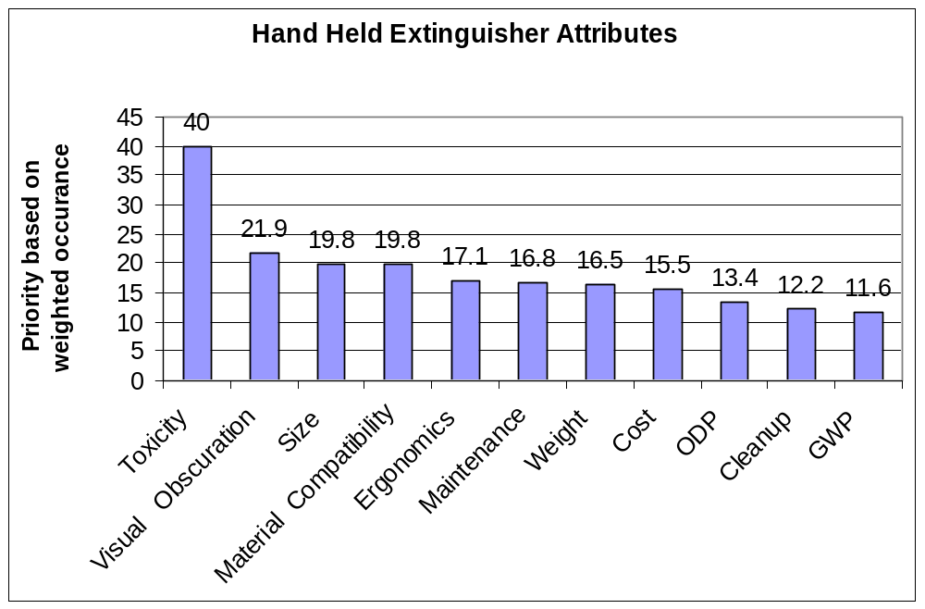
USER PREFERENCE SURVEY
The toxicity issues for extinguishing agents in portable fire extinguishers is the most important concern of the airline industry as indicated in over 111 responses to the User Preference Survey conducted by the FAA sponsored IASFPWG.

Slide 18
TOXICITY CONSIDERATIONS
Toxicity of the halocarbon itself
  Cardiotoxicity
  Anesthetic Effects
  Guidelines in the proposed AC are stricter than UL 2129 “Halocarbon Clean Agent Fire Extinguishers”. Immediate egress assumed for UL 2129 standard.
Low oxygen hypoxia: Very small aircraft
  Aircraft pressurized to 8,000 ft Altitude
  Nonpressurized Aircraft: Much greater concern up to 14,000 ft.
Toxicity of halocarbon decomposition products
  Guidelines set in the Minimum Performance Standard for Handheld Extinguishers

Slide 19
AGENT TOXICITY :
SAFE CLEAN AGENT CONCENTRATION
Total agent available from all required extinguishers should not be capable (assuming perfect mixing) of producing concentrations in the compartment by volume, at 70ºF (21.1ºC) when discharged at altitude (8,000 ft. P, pressurized Aircraft and 14,000 ft P, nonpressurized aircraft), that exceeds the agent’s safe exposure guidelines. (Note: Designing for altitude provides a large safety factor for ground use. No need for 120ºF correction)
Nonventilated passenger or crew compartments:
  PBPK derived 5 minute safe human exposure concentration, if known.
  If PBPK data is not available, the agent No Observable Adverse Effect Level (NOAEL) is to be used. (Note: UL 2129 allows use of a (sometimes higher) LOAEL Concentration)
Ventilated Compartments:
  Use graphs or tables to obtain maximum weight per cubic foot. Tables are based on PBPK modeling of theoretical concentration decay curves & perfect mixing. If tables are not available, follow concentration guidelines for nonventilated compartments.

Slide 20
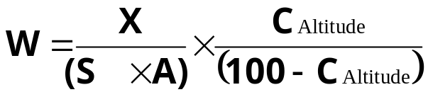
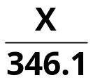
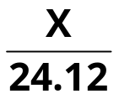
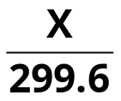
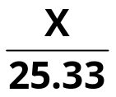
SAFE EXTINGUISHER WEIGHTS FOR AVIATION (NO VENTILATION, 8000 FT. ALTITUDE , 70ºF)
Where A= Altitude correction factor for S
At 8000 ft: A= 760mmHg/564.59mmHg = 1.346
(At 14,000 ft: A= 760mmHg/446.63mmHg = 1.702)
X = X_{1bottle} x No. Bottles
C_{Altitude} is the maximum FAA allowed clean agent concentration (%) discharged at altitude
W is the maximum FAA allowed weight of clean agent (lb) (all extinguishers) for volume X
X is the minimum FAA allowed volume of a compartment (ft³) (all extinguishers)
S is the specific volume of the agent at sea level at 70ºF (21.1º C) (ft³/lb)
Agent | C_{Alt} (%) | S (ft³/lb) | W (lb) | One 5BC Ext. (lb) | X_{1bottle} (ft³) | Max. No. 5BC Ext for 1000 ft³ = V/X = 1000/X
Halotron 1 | 1.0 | 2.597 |  | 5.0 | 1730.3 | 0.6
HFC 236fa | 12.5 | 2.4574 |  | 4.75 | 114.6 | 8.7
Halon 1211 | 1.0 | 2.248 |  | 2.5 | 748.9 | 1.3
HFC 227ea | 10.5 | 2.2075 |  | 5.75 | 145.6 | 6.7
0.5x
7x
5 x

Slide 21
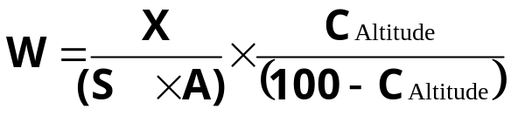
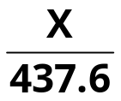
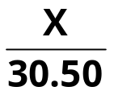
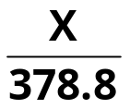
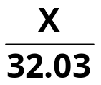
SAFE EXTINGUISHER WEIGHTS FOR AVIATION
(NO VENTILATION, 14,000 FT. ALTITUDE , 70ºF)
Where A= Altitude correction factor for S
(At 8000 ft: A= 760mmHg/564.59mmHg = 1.346)
At 14,000 ft: A= 760mmHg/446.63mmHg) = 1.702
X = X_{1bottle} x No. Bottles
C_{Altitude} is the maximum FAA allowed clean agent concentration (%) discharged at altitude
W is the maximum FAA allowed weight of clean agent (lb) (all extinguishers) for volume X
X is the minimum FAA allowed volume of a compartment (ft³) (all extinguishers)
S is the specific volume of the agent at sea level at 70ºF (21.1º C) (ft³/lb)
Agent | C_{Alt} (%) | S (ft³/lb) | W (lb) | One 5BC Ext. (lb) | X_{1bottle} (ft³/lb) | Max. No. 5BC Ext. for 1000 ft³ = V/X= 1000/X
Halotron 1 | 1.0 | 2.597 |  | 5.0 | 2188.0 | 0.5
HFC 236fa | 12.5 | 2.4574 |  | 4.75 | 144.9 | 6.9
Halon 1211 | 1.0 | 2.248 |  | 2.5 | 947.0 | 1.1
HFC 227ea | 10.5 | 2.2075 |  | 5.75 | 184.1 | 5.4
0.4x
6x
5 x

Slide 22
AGENT TOXICITY: MINIMUM SAFE COMPARTMENT VOLUME (NO VENTILATION, 70ºF)
The toxicity guidelines in the proposed halocarbon advisory circular allow the following minimum compartment volumes for the following 5 B:C extinguishers, released at 70ºF: (21.1ºC)
Agent | Notes | Agent Weight (lbs) | Minimum Volume of Compartment (ft³) 1
 |  |  | For Sea Level (For info only) | For 8,000 ft P Altitude (Pressurized A/C) | For 14,000 ft P Altitude (NonPressurized A/C)
HFC236fa |  | 4.75 | 85 | 115 | 145
Halotron I | 2 | 5.0 | 1286 | 1730 | 2188
HFC227ea |  | 5.75 | 108 | 146 | 184
Halon 1211 | 2, 3 | 2.5 | 556 | 749 | 947
Halon 1301 | 2, 3 | 5.0 | 243 | 327 | 414
Multiply this number by the number of extinguishers in the aircraft
Do not use in small spaces
(If the proposed halocarbon extinguisher AC was applied to the Halons)

Slide 23
AGENT TOXICITY: NO. OF 5BC BOTTLES ALLOWED
(NO VENTILATION, 8000 FT ALTITUDE, 70ºF)
Aircraft/ Helicopter | Vol (ft³) | Max No. Seats | Halon 1211 |  |  | HFC-236fa | Halotron 1 | HFC-227ea
 |  |  | AC20-42C & UL1093 | AC20-42C 1 air-change /min | New AC | New AC | New AC | New AC
Cessna 152- | 77 | 2 | 0.3 | 0.4 | 0.1 | 0.6 | 0.04 | 0.5
Cessna 210C | 140 | 6 | 0.5 | 0.7 | 0.2 | 1.2 | 0.08 | 1.0
Cessna C421B | 217 | 10 | 0.7 | 1.1 | 0.3 | 1.9 | 0.1 | 1.5
Sikorsky S76 | 204 | 14 | 0.7 | ___ | 0.2 | 1.8 | 0.1 | 1.4
B727-100 | 5,333 | 131 | 17 | ___ | 6.4 | 47 | 3.1 | 37
B767-200 | 11,265 | 255 | 36 | ___ | 14 | 98 | 6.5 | 77
B 747 | 27,899 | 500 | 90 | ___ | 34 | 243 | 16 | 192
 | Less than one 5 B:C extinguisher allowed

Slide 24
TOXICITY GUIDELINES FOR HANDHELDS
(NO VENTILATION)
Agent | AC 20-42C If Egress is possible within 1 minute | A/C20-42C Otherwise, Max Design Concentration | Max Safe Concentration (Constant Concentration) | Guidance for New A/Cs (Altitude)
Halon 1211 | 4% at sea level (basis for nomograms- used for ventilated compartments at 8,000 ft) | 2% at sea level | 2.8% for 15 sec 1.8% for 30 sec 1.3% for 1 min 1 % for 5 min | 1% for 5 min
Halon 1301 | 10% at sea level (basis for nomograms- used for ventilated compartments at 8,000 ft) | 5% at sea level | 10% for ~15 sec 6% for 5 min | 6% for 5 min
HCFC Blend B | N/A | N/A | Between 1% and 2% for 5 min | 1% for 5 min
HFC 236fa | N/A | N/A | 15% for 30 sec 12.5% for 5 min | 12.5% for 5 min
HFC 227ea | N/A | N/A | 12% for 30 sec 10.5% for 5 min | 10.5% for 5 min

Slide 25
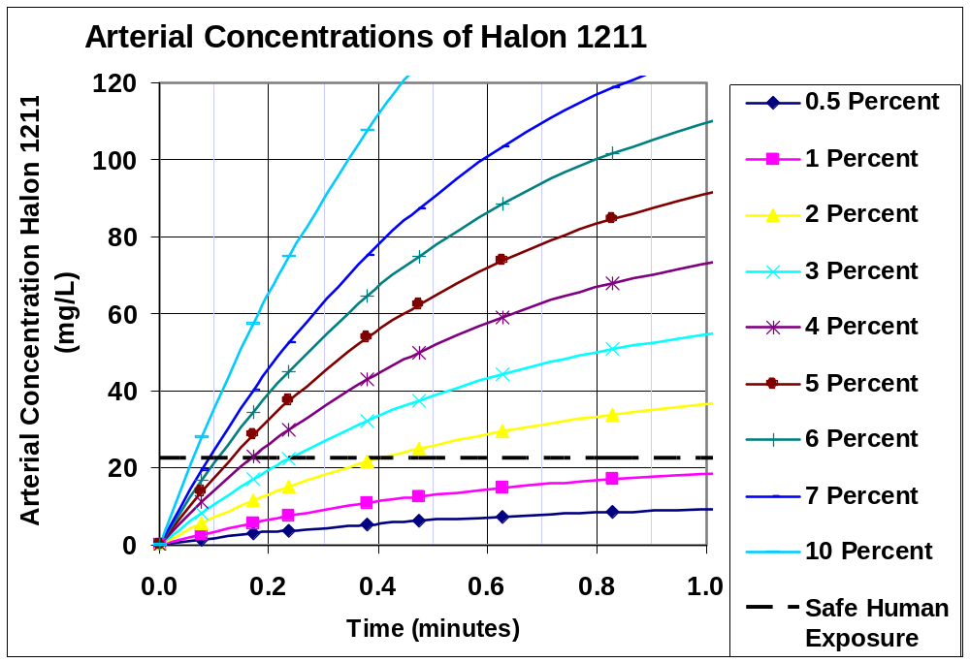
KINETIC MODELING OF ARTERIAL HALON 1211
BLOOD CONCENTRATION (No Ventilation)
Halon 1211 Gas Concentrations
Allowed &
Unsafe
FAA cuurently allows up to 4% for 1 minute at sea level (7% at 14,000 ft)
FAA currently allows up to 8% for vent A/C at 8000 ft (10% at 14,000 ft)

Slide 26
VENTILATION
WARNING: Small increase in concentration above the Safe 5 Minute Human Exposure Concentration results in a much shorter time to effect:
Safe human exposure to constant concentration:
  HFC 236fa : 12.5% for 5 min, 15% for 30 sec.
  HFC 227ea: 10.5% for 5 min, 12.0% for 30 sec.,
Development of Ventilation Tables:
  Based on total weight of agent on aircraft for all extinguishers.
  Stratification of agents is a realistic expectation but is not included due to lack of acceptable methodology. Perfect mixing is assumed
  Agent manufacturers may apply pharmacokinetic modeling of blood concentration data to perfect mixing agent decay concentration curves.
  Tables for ventilated aircraft can be developed from that data.
  This work is to be preformed at the manufacturers expense.
  A limited number of laboratories have capability of performing this modeling.

Slide 27
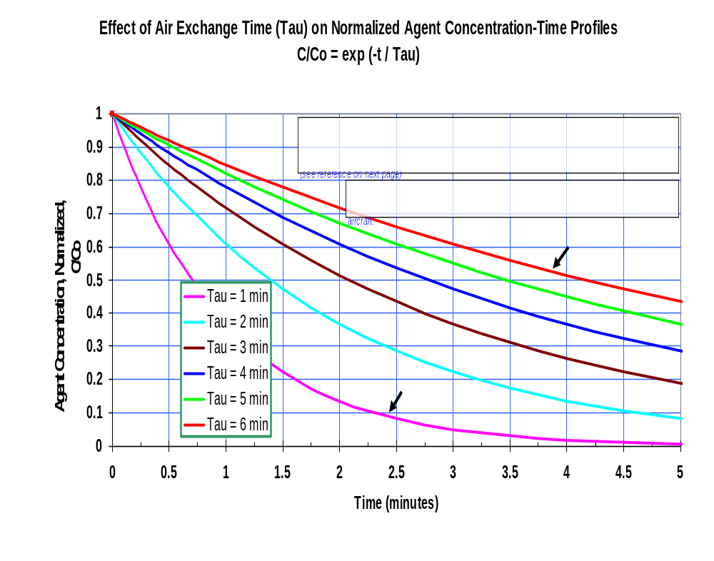
(assuming perfect mixing)
(assuming perfect mixing)
63% decrease in agent concentration over time for one air change

Slide 28
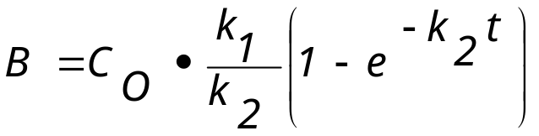
MODELING ARTERIAL BLOOD CONCENTRATIONS OF HALOCARBONS USING 1st ORDER KINETICS
Blood
B(t)
k₁
k₂
C(t)
Waste
dB/dt = k₁ C(t) - k₂B(t)
Case 1: C(t) = Constant
Solution:
Case 2: C(t) ≠ Constant
Changing Concentrations
Solution:
Lung
t
k
•
∫
C
(
t
)
•
e
+
k
t
dt
2
1
B
=
0
e
+
k
2
t

Slide 29
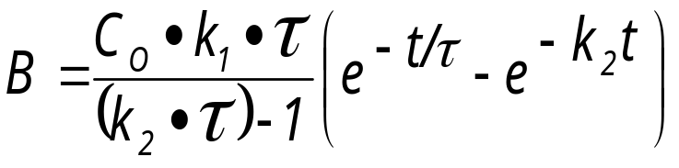
MODELING ARTERIAL BLOOD CONCENTRATIONS OF HALOCARBONS USING 1st ORDER KINETICS
Blood
B(t)
k₁
k₂
C(t)
Waste
dB/dt = k₁ C(t) - k₂B(t)
Case 2a: Ventilated Cabin
τ = Air Change Time
where: C(t) = C₀ . Exp(-t/τ)
Solution:
Lung

Slide 30
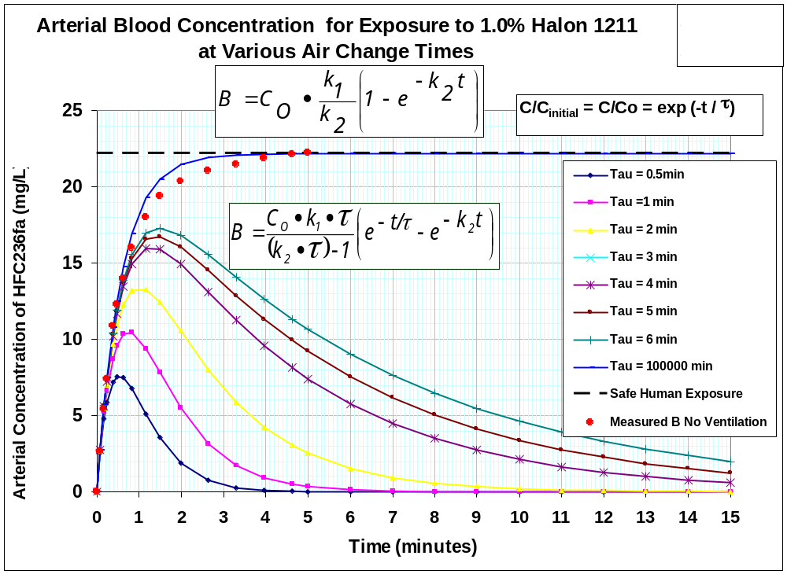
KINETIC MODELING OF ARTERIAL HALON 1211 BLOOD CONCENTRATION IN VENTILATED AIRCRAFT
22.2
Critical Arterial Concentration
τ = Air Change Time
τ =6 minutes
τ = 6 minutes
τ =1 minute
τ =1 minute
As τ increases, arterial concentration (at t = τ) approaches 0.37x arterial conc with no air change)

Slide 31
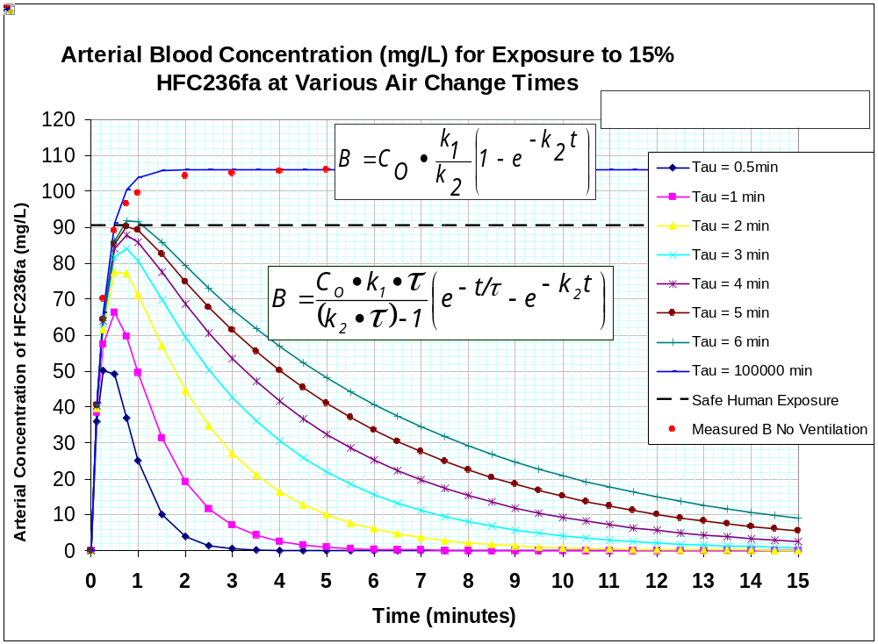
KINETIC MODELING OF ARTERIAL HFC236fa BLOOD CONCENTRATION IN VENTILATED AIRCRAFT
k₁= 27.73
k₂= 3.924
τ = Air Change Time
Critical Arterial Concentration
τ =1 minute
τ =6 minutes
As τ increases, arterial concentration (at t = τ) approaches 0.37x arterial conc with no air change)

Slide 32
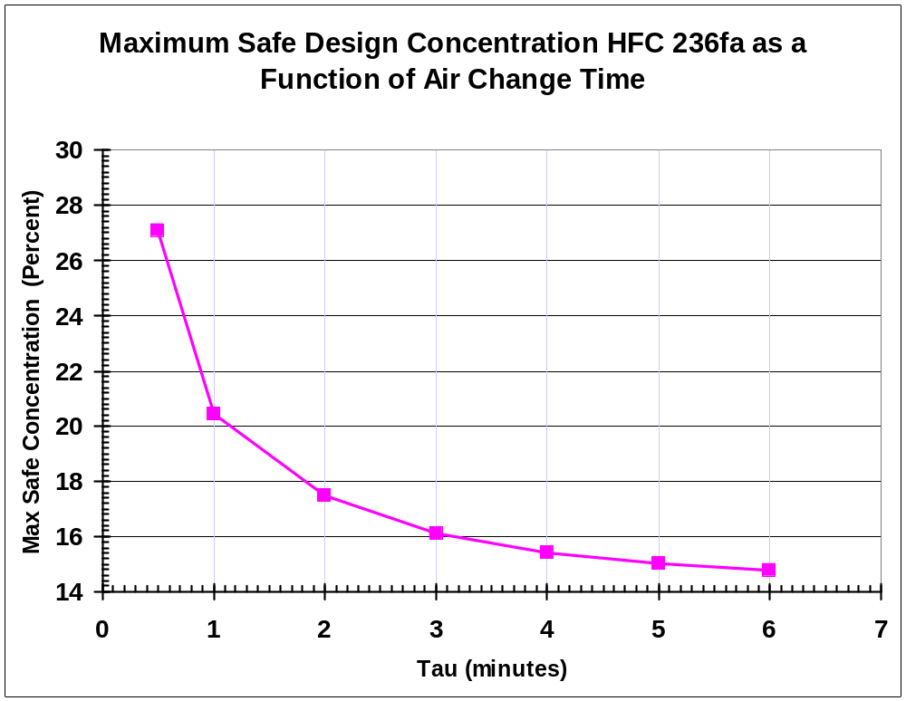
KINETIC MODELING OF ARTERIAL BLOOD HFC236fa CONCENTRATION IN VENTILATED AIRCRAFT
Perfect mixing assumed
(=12.75 with no ventilation)
For any τ , get the maximum safe concentration,C from the curve :

Slide 33
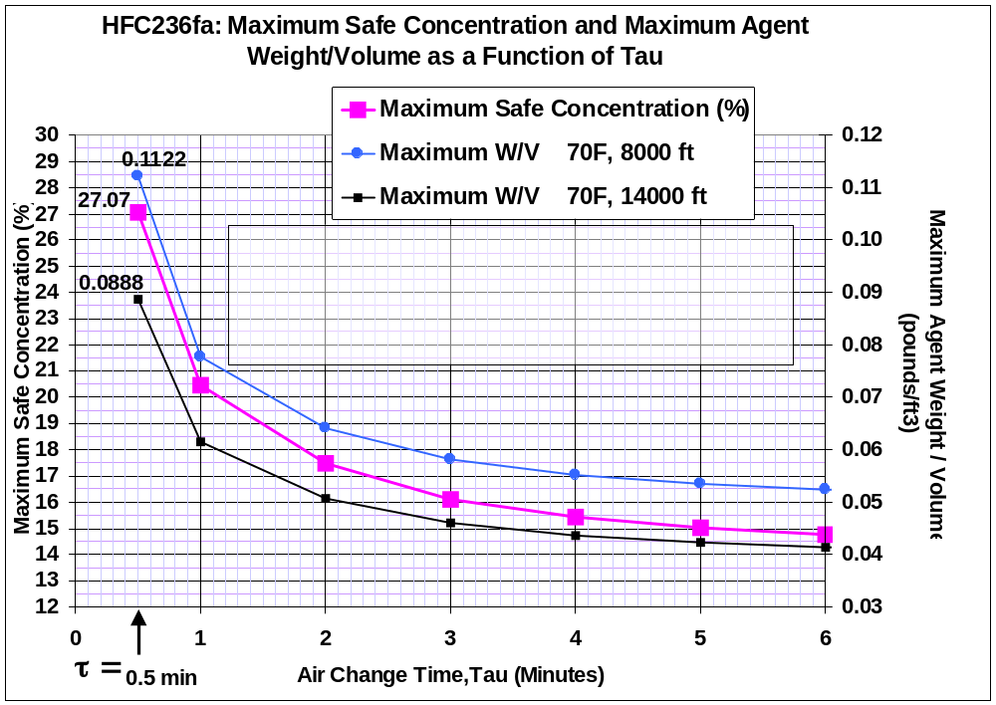
KINETIC MODELING OF ARTERIAL BLOOD HFC236fa CONCENTRATION IN VENTILATED AIRCRAFT
For any τ , get the maximum safe W/V and concentration from curve :

Slide 34
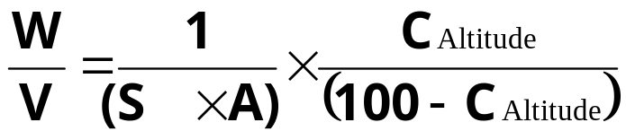
KINETIC MODELING OF ARTERIAL BLOOD CONCENTRATIONS IN VENTILATED AIRCRAFT
Perfect mixing assumed
Maximum Safe Weight HFC236fa
Altitude (ft) | Temp (ºF) | Specific Volume = S x A (ft³/lb) | Maximum Safe Weight for Hazard Volume, W/V (lb/ft³) Maximum Safe Concentration at Altitude (% by Volume)
 |  |  | 14 | 15 | 16 | 17 | 18 | 19 | 20 | 21 | 22 | 23 | 24 | 25 | 26 | 27
8, 000 | 70 | S=2.4574 A=1.346 3.3077 | .0492
14,000 | 70 | S= 2.4574 A=1.702 4.1825 |  |  |  |  |  |  |  |  |  |  |  |  |  | .0884
S = Specific volume of the agent at sea level:
At 70ºF (21.1ºC): S= 2.4574 ft3/lb
A = Altitude correction factor for S:
At 8000 ft: A= 1.346
At 14,000 ft: A= 1.702
Solve equation or use graph or table:

Slide 35
1st ORDER KINETIC MODELING OF ARTERIAL
BLOOD CONCENTRATION HISTORIES
Provides a simple mathematical solution to obtain data needed to develop perfect mixing ventilation tables which will provide maximum safe extinguishing agent weights for a range of compartment volumes and air change times.
Monte Carlo simulations of arterial blood concentration histories for 5 minute exposures to constant agent concentrations are used as input data for developing equations (95% confidence) for each extinguishing agent.
PBPK arterial blood data has been published for HFC 236fa and HFC 237fa which accounts for 95% (two standard deviations) of the simulated population having 5 minute arterial blood concentrations below the target concentration.
Equations can be developed for each agent, which transform agent concentration histories to arterial blood concentration histories in ventilated spaces.
Demonstrated to work for predicting blood concentration histories for exposures to a constant concentration of agent.
Must be validated for predicting blood concentration histories for exposures to changing concentrations of agent.

Slide 36
LOW OXYGEN HYPOXIA AT ALTITUDE: Very Small Aircraft (Min. Safe Vol. = 53.5 cubic feet for 1 5BC HFC236fa extinguisher at
14,000 ft. if τ = 0.5 min, C₀ = 27%) TENTATIVE HYPOXIA GUIDANCE 1:
Agent design concentration at FAA allowed maximum P altitudes can not exceed:
For all pressurized aircraft (at 8,000 ft P): 30 % (independent of cabin temperature)
For all unpressurized aircraft (at 14,000 ft P): 30% if aircraft descends to 8,000 ft.
within 1 minute. or 30% if cabin ventilates at least 1 air change/minute & descends to
12,000 ft. in 1 min.
Altitude (ft) | P (mm Hg) | P_{O2} (mm Hg) | P_{AO2} (mmHg) | P_{AO2 with 30%} _{Halocarbon} (mm Hg) | P_{AO2 with 30% Halocarbon} (mm Hg) after ventilating for τ minutes, when τ ≤ 1 minute
0 | 760 | 159.21 | 103.0 | 72.1 | =72.1+(103-72.1)*.63 = 91.6
8,000 | 564.64 | 118.29 | 68.9 | 48.2 | =48.2+(68.9-48.2)*.63= 61.2
9,000 | 543.31 | 113.82 | 65.0 | 45.5 | =45.5+(65.0-45.5)*.63= 58.1
10,000 | 522.73 | 109.51 | 61.2 | 42.8 | =42.8+(61.2-42.8)*.63= 54.4
11,000 | 502.92 | 105.36 | 57.8 | 40.5 | =40.5+(57.8-40.5)*.63= 51.4
12,000 | 483.36 | 101.26 | 54.3 | 38.0 | =38.0+(54.3-38.0)*.63= 48.3
13,000 | 464.82 | 97.38 | 51.0 | 35.7 | =35.7+(51.0-35.7)*.63= 45.3
14,000 | 446.53 | 93.55 | 47.9 | 33.5 | =33.5+(47.9-33.5)*.63= 42.6
Unpressurized aircraft currently allowed to fly at 14,000 ft. P for 30 minutes.

Slide 37
LOW OXYGEN HYPOXIA AT ALTITUDE Very Small Aircraft
(Min. Safe Vol. = 59 cubic feet for 1 5BC HFC236fa extinguisher at
14,000 ft. if τ = 0.5 min, C0 = 22%) TENTATIVE HYPOXIA GUIDANCE 2:
Agent design concentration at FAA alowed maximum P altitudes can not exceed:
For all pressurized aircraft (at 8,000 ft): 22 % (independent of cabin temperature)
For all unpressurized aircraft (at 14,000 ft): 22% if aircraft descends to 8,000 feet
within 1 minute. or 22% if cabin ventilates at least 1 air change/minute & descends to
12,500 ft. in 1 minute.
Altitude (ft) | P (mm Hg) | P_{O2} (mm Hg) | P_{AO2} (mmHg) | P_{AO2 with 22%} _{Halocarbon} (mm Hg) | P_{AO2 with 30% Halocarbon} (mm Hg) after ventilating A/C for τ minutes, when τ ≤ 1 minute
0 | 760 | 159.21 | 103.0 | 80.3 | =80.3+(103-80.3)*.63 = 94.6
8,000 | 564.64 | 118.29 | 68.9 | 53.7 | =53.7+(68.9-53.7)*.63= 63.3
9,000 | 543.31 | 113.82 | 65.0 | 50.7 | =50.7+(65.0-50.7)*.63= 59.7
10,000 | 522.73 | 109.51 | 61.2 | 47.7 | =47.7+(61.2-47.7)*.63= 56.2
11,000 | 502.92 | 105.36 | 57.8 | 45.1 | =45.1+(57.8-45.1)*.63= 53.1
12,000 | 483.36 | 101.26 | 54.3 | 42.4 | =42.4+(54.3-42.4)*.63= 49.9
13,000 | 464.82 | 97.38 | 51.0 | 39.8 | =39.8+(51.0-39.8)*.63= 46.9
14,000 | 446.53 | 93.55 | 47.9 | 37.4 | =37.4+(47.9-37.4)*.63= 44.0
Unpressurized aircraft currently allowed to fly at 14,000 ft. for 30 minutes.

Slide 38
A/C LANGUAGE FOR HALOCARBON FIRE EXTINGUISHERS
Provide safety guidance for halocarbon extinguishers.
Recommends a minimum UL rated 5 B:C sized extinguisher for occupied spaces
The proposed A/C requires adherence to the handheld Minimum Performance Standard for occupied spaces on transport category aircraft.
Recommends throw ranges for various sized aircraft
Recommends discharge hose or adjustable wand.
Provides guidance for minimizing risk of low oxygen hypoxia when released at altitude.

Slide 39
A/C LANGUAGE FOR HALOCARBON FIRE EXTINGUISHERS
States the maximum weight that all extinguishers should not exceed, based on agent toxicity, size of compartment, and maximum FAA-allowed altitude of the cabin.
May allow increased halocarbon clean agent concentrations in ventilated compartments:
  Consideration of allowing use of ventilation tables for small aircraft only.
  Tables can be developed if PBPK data is available.
  Tables would provide the maximum safe weight of agent based on safe concentration at altitude, compartment volume, time for an air change, and hypoxia considerations.
  Provides updated safe handling guidelines based on adverse toxicological or cardiac sensitization events and PBPK modeling.
Operators of non-transport category aircraft should become familiar with the information in this A/C.
The proposed AC is subject to change/ rewrite by the FAA Aircraft Certification Office.

Slide 40
CAVEATS
The contents of this presentation have not had a complete toxicological review.
The validity of applying existing kinetic models to high air change rates is uncertain at this moment.
The hypoxic guidelines need to be reviewed by aeromedical experts with experience with high altitude, low oxygen hypoxia issues.
The proposed AC is subject to change/ rewrite by the FAA Aircraft Certification Office.

Slide 41
WORKING GROUP PARTICIPANTS
Louise Speitel FAA
Rich Mazzone Boeing
Bradford Colton American Pacific Corp
Howard Hammell Dupont
Steve Happenny FAA
Gary Jepson Dupont
Bella Maranion EPA
Reva Rubenstein ICF Consulting

Slide 42
HANDHELD EXTINGUISHER WEB PAGE
http://www.fire.tc.faa.gov

Slide 43
HANDHELD TASK GROUP
Wednesday 12:30- 3:00
Open Meeting

