Slide 1
THE DEVELOPMENT OF GUIDANCE FOR THE USE OF NEW AGENTS IN HANDHELD EXTINGUISHERS FOR AIRCRAFT CABINS
Louise C. Speitel
Fire Safety Branch AAR-440
FAA W.J. Hughes Technical Center
Atlantic City International Airport, NJ 08405 USA
The Fourth Triennial Fire and Cabin Safety Research Conference
Lisbon, Portugal
November 15-18, 2004

Slide 2
OUTLINE OF TALK
FAR requirements for hand-held extinguishers
Minimum performance standard (MPS) for transport category aircraft
Purpose of handheld advisory circular (AC)
Approach
Combined or separate AC?
Extinguisher ratings
Throw range
Fixed nozzle/ hose/ adjustable wand
Toxicity
Ventilation nomograms
A/C language for halocarbon fire extinguishers

Slide 3
FEDERAL AVIATION REGULATION (FAR) REQUIREMENTS FOR HAND FIRE EXTINGUISHERS
Specifies the minimum number of Halon 1211 or equivalent extinguishers for various size aircraft.
Specifies the location and distribution of extinguishers on an aircraft.
Each extinguisher must be approved.
Each extinguisher intended for use in a personnel compartment must be designed to minimize the hazard of toxic gas concentration.
The type and quantity of extinguishing agent, if other than Halon 1211, must be appropriate for the kinds of fires likely to occur.
The FAR does not give extinguisher ratings. This is done in the AC.

Slide 4
THE MINIMUM PERFORMANCE STANDARD (MPS)
Provides requirements for equivalency to Halon 1211 5 B:C extinguishers to satisfy Federal Aviation Regulations citing “Halon 1211 or equivalent”:
UL rated 5 B:C Halocarbon extinguishers that will be used in transport category aircraft must pass 2 tests identified in DOT/FAA/AR-01/37 Development of a Minimum Performance Standard (MPS) for Hand-Held Fire Extinguishers as a replacement for Halon 1211 on Civilian Transport Category Aircraft.
  Hidden Fire Test
  Seat Fire/Toxicity Test
The MPS guarantees extinguishers to replace halon 1211 will have equal fire performance and an acceptable level of toxicity (for decomposition products of the agent). Guidance for agent toxicity can be found in the advisory circular.
The MPS requires that a permanent label be affixed to the extinguisher identifying FAA approval for use on board commercial aircraft.

Slide 5
PURPOSE OF ADVISORY CIRCULAR
“Provide methods for showing compliance with the hand fire extinguisher provisions in parts 21. 25, 29, 91,121, 125, 127 and 135 of the Federal Aviation Regulations (FAR 14)”.
21 Certification procedures for products and parts
25 Airworthiness standards - Transport category airplanes
29 Airworthiness standards - Transport category rotorcraft
91 General operating and flight rules
121 Operating requirements - Domestic, flag and supplemental operations
125 Certification & operations- Airplanes having a seating capacity of 20 or more passengers or a maximum payload capacity of 6000 pounds or more
127 Certification and Operations of Scheduled Air Carriers with Helicopters ?
135 Air Taxi Operators and commercial operators

Slide 6
PURPOSE OF ADVISORY CIRCULAR (cont.)
Provides guidance for approval of each hand fire extinguisher.
  Provide safety guidance for halon replacement agents.
    Effectiveness in fighting onboard fires.
    Toxicity to passengers and crew
  Provides updated general information.
Applies to aircraft and rotorcraft.
Requires adherence to outside documents:
  ASTM specifications
  MPS for hand fire extinguisher for transport category aircraft
  CFR Title 40: Protection of the Environment, Part 82- Protection of Stratospheric Ozone, Subpart G, Significant New Alternatives Program and Subpart H- Halon Emissions Program.

Slide 7
RELATED SECTIONS
FEDERAL AVIATION REGULATIONS (FARS)
21.305 Certification procedures for products and parts
23.561 Normal, utility, acrobatic, and commuter category airplanes
25.561; 25.851 Transport category airplanes
27.561 Normal category rotorcraft
29.561; 29.851; 29.853 (e) and (f)
91.193 (c) ?
121.309 (c)
125.119 (b) and (c)
127.107 (c) ?
135.155

Slide 8
RELATED TITLES: CODE OF FEDERAL REGULATIONS (CFRs)
Title 40: Protection of the Environment
Title 46 Shipping
Title 49 Transportation
OTHER RELATED INFORMATION (ACs and ADs)
AC-120-80 In-Flight Fires
AC 20-42C Hand Fire Extinguishers for Use in Aircraft
AD 93-07-15 (2)(i) Airworthiness Directives:
    Boeing Models 707, 727, 737, 747, and 757
    McDonnell Douglas Models DC-8, DC-9, and DC-10

Slide 9
APPROACH
The FAA Fire Safety Section is providing guidance material to the FAA Aircraft Certification Office. The guidance material includes a draft AC for halocarbon hand-held extinguishers.
The Aircraft Certification Office will be tasked to write the advisory circular.
Recommend a separate AC for Halon Replacement Extinguishers.
This AC will be revised as new agents are introduced.
Use science-based approach published in peer-reviewed literature and adapted in NFPA 2001 Standard for Clean Agent Extinguishing Systems.
  Conservative
  More accurate than approach used for halons
The safe-use guidance is based on an assessment of the relationship between halocarbons in the blood and any adverse toxicological or cardiac sensitization event.

Slide 10
APPROACH (cont.)
Safe human exposure limits, up to 5 minutes are derived using a Physiologically-based Pharmakokinetic (PBPK) modeling of measured agent levels in blood .
Non-ventilated aircraft: The allowed concentration would be based on the No Observable Adverse Effect Level (NOAEL) or 5-minute PBPK concentration.
Ventilated aircraft: Nomograms can be obtained if PBPK data is available for an agent.
Agent manufacturers may provide PBPK data and nomograms for ventilated aircraft at their expense.
Operators of non-transport category aircraft should become familiar with the information in this AC and the precautions for the different types of fire extinguishers.
The proposed AC is subject to change/ rewrite by the FAA Aircraft Certification Office.

Slide 11
COMBINED OR SEPARATE A/C?
ONE A/C FOR ALL HANDHELD EXTINGUISHERS:
  The safe-use guidance for Halons would be changed to match the safe-use guidance for halon replacements.
    New guidance for the halons would restrict Halon 1211 from being used in small aircraft.
    Adoption would take years, or may never happen due to resistance from industry to lower the allowed weights of halon.
SEPARATE A/C FOR HALON REPLACEMENTS:
  A separate A/C for halon replacements may be adapted relatively quickly. Halon replacements are available meeting UL and MPS requirements: Halotron I, HFC236fa, and HFC227ea.
  The Montreal Protocol and U.S. Clean Air Act require phase out of ozone depleting halons and transition to available alternatives.
  Current A/C 20-42C for halons may be revised at any time.

Slide 12
EXTINGUISHER RATINGS FOR HALONS
AC 20-42C:
  A minimum UL rated 5 B:C sized extinguisher was recommended for Halon 1211 for all sized aircraft.
  A minimum UL rated 2 B:C extinguisher was recommended for Halon 1301 for aircraft with a maximum certificated occupant capacity (MCOC) of 4 including the pilot.
  Recommends a minimum 2A, 40B:C rating for accessible cargo compartments of combination passenger/cargo and cargo aircraft.
NFPA 408 allows 2 B:C UL rated bottle of Halon 1211 in aircraft with a MCOC of 4.

Slide 13
EXTINGUISHER RATINGS FOR HALOCARBONS
Proposed Halocarbon Extinguisher Advisory Circular:
  Recommends a minimum UL rated 2 B:C sized extinguisher for occupied spaces with a volume less than 100 cubic feet, on small aircraft only. Occupied spaces with a volume greater or equal to 100 cubic feet require a minimum 5B:C UL rating.
  For transport category aircraft, extinguishers with a minimum UL 5 B:C rating must meet the Minimum Performance Standard. A permanent label is required, indicating FAA approval for use on-board commercial aircraft.
  Recommends a listed classification and rating proportional to the threat for accessible cargo compartments of combination passenger/cargo and cargo aircraft.

Slide 14
THROW RANGE
The MPS requires a throw range of 6-8 feet
Additional range needed for terrorist gasoline seat fire threat.
A throw range of 10 feet or greater is recommended for 5 B:C halocarbon extinguishers with a maximum certificated occupant capacity (MCOC) of 19 or more persons including the pilot.
A throw range of 3 feet or greater is recommended for 2 B:C halocarbon extinguishers.

Slide 15
FIXED NOZZLE/HOSE/ ADJUSTABLE WAND
For access to underseat, overhead and difficult to reach locations, it is recommended that extinguishers be equipped with a discharge hose or adjustable wand.
An extinguisher with a discharge hose or adjustable wand is more likely to result in the extinguisher being properly held during use.
Provides a means of directing a stream of agent to more inaccessible areas.
An extinguisher with an adjustable wand allows one-handed use.

Slide 16
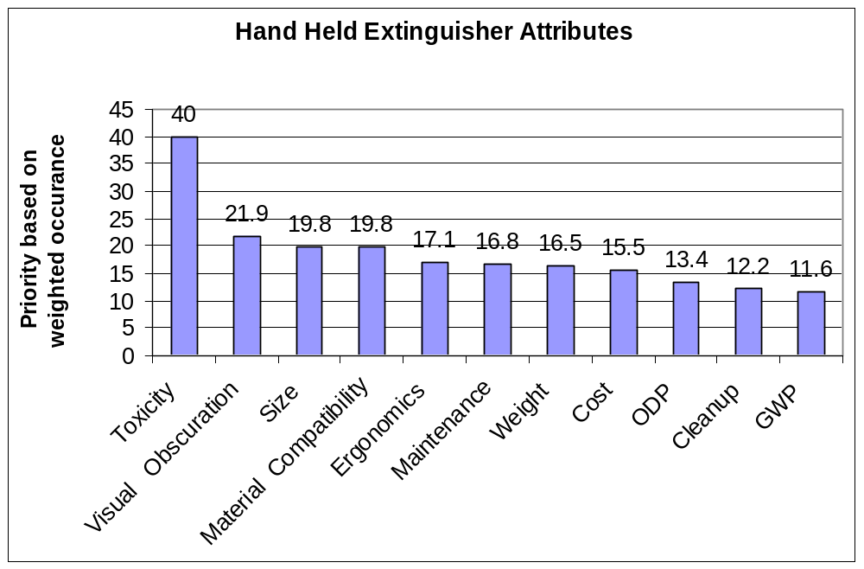
USER PREFERENCE SURVEY
The toxicity issues for extinguishing agents in portable fire extinguishers is the most important concern of the airline industry as indicated in over 111 responses to the User Preference Survey conducted by the FAA sponsored IASFPWG.

Slide 17
AGENT TOXICITY CONSIDERATIONS
Toxicity of halocarbon decomposition products
  Evaluated in tests described in the minimum performance standard.
Toxicity of the halocarbon itself
  Guidelines in the proposed AC are stricter than UL 2129 “Halocarbon Clean Agent Fire Extinguishers”. Immediate egress assumed for UL 2129 standard.

Slide 18
AGENT TOXICITY:
FAA ALLOWED CLEAN AGENT CONCENTRATION
Nonventilated passenger or crew compartment where passengers can’t leave after extinguishers are discharged:
  Total agent available from all extinguishers should not be capable of producing concentrations in the compartment by volume at 120ºF (49ºC) that exceeds the agent’s safe exposure guidelines, namely:
    PBPK derived 5 minute safe human exposure concentration, if known.
    If PBPK data is not available, the agent NO Observable Adverse Effect Level (NOAEL) is to be used. (Note: UL 2129 allows use of LOAEL Concentration)
Ventilated Compartments: Use nomograms, if available. If nomograms are not available, follow concentration guidelines for nonventilated compartments.

Slide 19
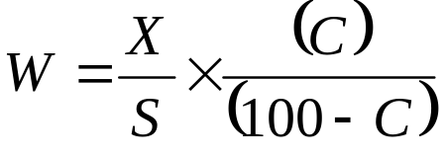
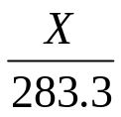
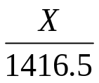
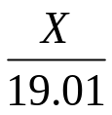
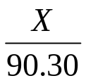
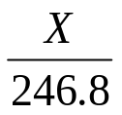

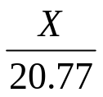
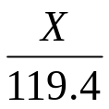
AGENT TOXICITY: FAA ALLOWED CLEAN AGENT (NO VENTILATION)
C is the maximum FAA allowed clean agent concentration (%):
W is the maximum FAA allowed weight of clean agent (lb) for volume X
X is the volume of a compartment (ft³)
S is the specific volume of the agent at 120ºF (48º C) (ft³/lb)
Agent | C (%) | S (ft³/lb) | W (lb) | One 5BC Ext. (lb) | Max No. Ext. | Max. No. 5BC Ext. /1000 ft³
Halotron 1 | 1.0 | 2.858 |  | 5.0 |  | 0.7
HFC 236fa | 12.5 | 2.717 |  | 4.75 |  | 11.1
Halon 1211 | 1.0 | 2.493 |  | 2.5 |  | 1.6
HFC 227ea | 10.5 | 2.437 |  | 5.75 |  | 8.4
0.44x
7x
5 x

Slide 20
AGENT TOXICITY: MINIMUM COMPARTMENT VOLUME (NO VENTILATION)
The toxicity guidelines in the proposed halocarbon advisory circular allow the following minimum compartment volumes for the following 5 B:C extinguishers:
Agent | Minimum Volume of Compartment (ft3)
HFC236fa | 90
Halotron I | 1417
HFC227ea | 119
Halon 1211 | 617 (If the proposed Halocarbon extinguisher AC was applied to Halon 1211)

Slide 21
AGENT TOXICITY: NO. OF 5BC BOTTLES ALLOWED
(NO VENTILATION)
Aircraft/ Helicopter | Vol (ft³) | Max No. Seats | Halon 1211 |  |  | HFC-236fa | Halotron 1 | HFC-227ea
 |  |  | AC20-42C & UL 1093 | AC20-42C 1 air-change /min | NFPA 2001 | New AC and NFPA 2001 | New AC and NFPA 2001 | New AC and NFPA 2001
Cessna 152- | 77 | 2 | 0.3 | 0.4 | 0.1 | 0.9 | 0.05 | 0.6
Cessna 210C | 140 | 6 | 0.5 | 0.7 | 0.2 | 1.6 | 0.1 | 1.2
Cessna C421B | 217 | 10 | 0.7 | 1.1 | 0.4 | 2.4 | 0.2 | 1.8
Sikorsky S76 | 204 | 14 | 0.7 | ___ | 0.3 | 2.3 | 0.1 | 1.7
B727-100 | 5,333 | 131 | 17 | ___ | 8.6 | 59 | 3.8 | 45
B767-200 | 11,265 | 255 | 36 | ___ | 18 | 125 | 8.0 | 94
B 747 | 27,899 | 500 | 90 | ___ | 45 | 309 | 20 | 234
 | Less than one 5 B:C extinguisher allowed

Slide 22
TOXICITY GUIDELINES FOR HANDHELDS
(NO VENTILATION)
Agent | AC 20-42C If Egress is possible within 1 minute | A/C20-42C Otherwise, Max Design Concentration | Max Safe Concentration (Constant Concentration) | Guidance for New A/Cs
Halon 1211 | 4% (basis for nomograms- used for ventilated compartments) | 2% | 2.8% for 15 sec 1.8% for 30 sec 1.3% for 1 min 1 % for 5 min | 1% for 5 min
Halon 1301 | 10% (basis for nomograms- used for ventilated compartments) | 5% | 10% for ~15 sec 6% for 5 min | 6% for 5 min
HCFC Blend B | N/A | N/A | Between 1% and 2% for 5 min | 1% for 5 min
HFC 236fa | N/A | N/A | 15% for 30 sec 12.5% for 5 min | 12.5% for 5 min
HFC 227ea | N/A | N/A | 12.0% for 30 sec 10.5% for 5 min | 10.5% for 5 min

Slide 23
VENTILATION
Very small ventilation benefit with halocarbon toxicity
guidelines : safe human exposure to constant concentration
  HFC 236fa : 15% for 30 sec., 12.5% for 5 min
  HFC 227ea: 12.0% for 30 sec., 10.5% for 5 min
Development of nomograms:
  Stratification of agents is a realistic expectation but is not included due to lack of acceptable methodology. Perfect mixing is assumed
  Agent manufacturers may apply pharmacokenetic modeling of blood concentration data to perfect mixing agent decay concentration curves.
  Nomograms for ventilated aircraft can be developed from that data.
  This work is to be preformed at the manufacturers expense.
  A limited number of laboratories have capability of performing this modeling.
  Allows very small increase in agent concentration.

Slide 24
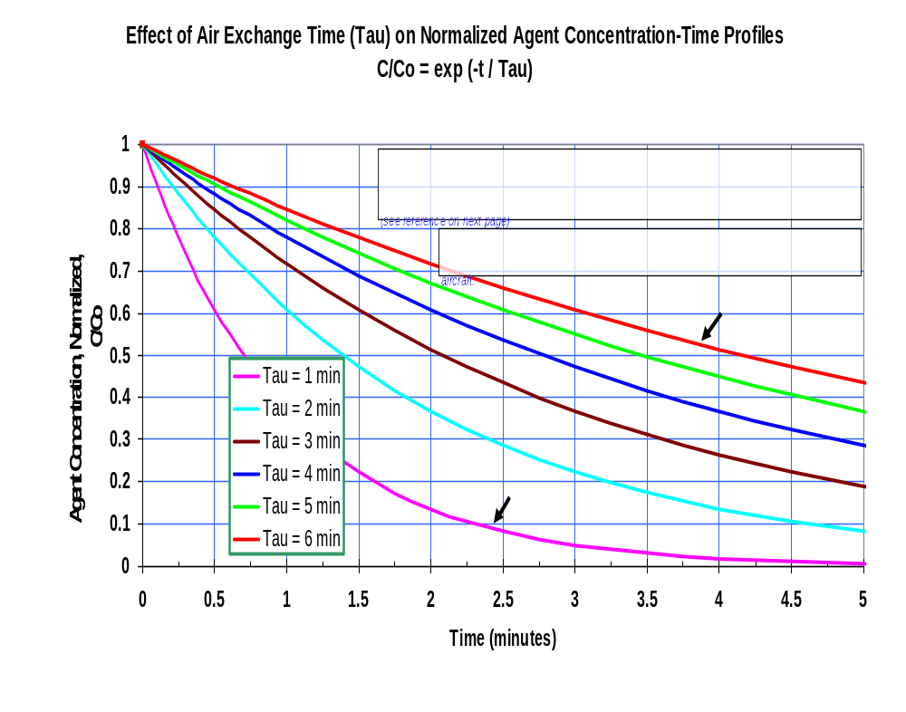

Slide 25
A/C LANGUAGE FOR HALOCARBON FIRE EXTINGUISHERS
Provide safety guidance for halocarbon extinguishers.
Recommends a minimum UL rated 2 B:C sized extinguisher for occupied spaces with a volume less than 100 cubic feet, on small aircraft only. Occupied spaces with a volume greater or equal to 100 cubic feet require a minimum 5B:C UL rating.
The proposed A/C requires adherence to the handheld Minimum Performance Standard for occupied spaces on transport category aircraft with a volume of 100 cubic feet and greater.
Recommends throw range minimums for 2 B:C and 5 B:C extinguishers.
Recommends discharge hose or adjustable wand.

Slide 26
A/C LANGUAGE FOR HALOCARBON FIRE EXTINGUISHERS
States the maximum weight that all extinguishers should not exceed, based on agent toxicity and size of compartment.
May allow slightly increased halocarbon clean agent concentrations in ventilated compartments: Nomograms can be developed if PBPK data is available.
Provides updated safe handling guidelines based on adverse toxicological or cardiac sensitization events and PBPK modeling.
Operators of non-transport category aircraft should become familiar with the information in this A/C.
The proposed AC is subject to change/ rewrite by the FAA Aircraft Certification Office.

Slide 27
WORKING GROUP PARTICIPANTS
Louise Speitel FAA
Rich Mazzone Boeing
Bradford Colton American Pacific Corp
Howard Hammell Dupont
Gary Jepson Dupont
Bella Maranion EPA
Reva Rubenstein ICF Consulting

Slide 28
PROPOSED ADVISORY CIRCULAR ON THE WEB
http://www.fire.tc.faa.gov

