Slide 1

Biotechnology/Chemical/Pharmaceutical
Customer Partnership Road Show, Aug. 20-24, 2001
Jasemine C. Chambers, Ph.D., J.D.
Director, Technology Center 1600
(703) 308-1123
jasemine.chambers@uspto.gov

Slide 2
Topics
Technology Center 1600 Overview
Utility Examination Guidelines
Written Description Examination Guidelines

Slide 3
Biotechnology/Chemical/Pharmaceutical
Customer Partnership Road Show, Aug. 20-24, 2001
Technology Center 1600

Slide 4
Technology Center 1600
Directors
Jasemine C. Chambers
(703) 308-1123
jasemine.chambers@uspto.gov
John J. Doll
(703) 308-1123
john.doll@uspto.gov

Slide 5
Technology Center 1600
Workgroups
  1610 - Organic Compositions and Treatments
  1620 - Organic Compounds and Uses
  1630 - Molecular Biology/Plants/Multicellular Animals
  1640 - Immunobiology
  1650 - Non-immunological Proteins & Peptides
  1660 - Plant Patents

Slide 6
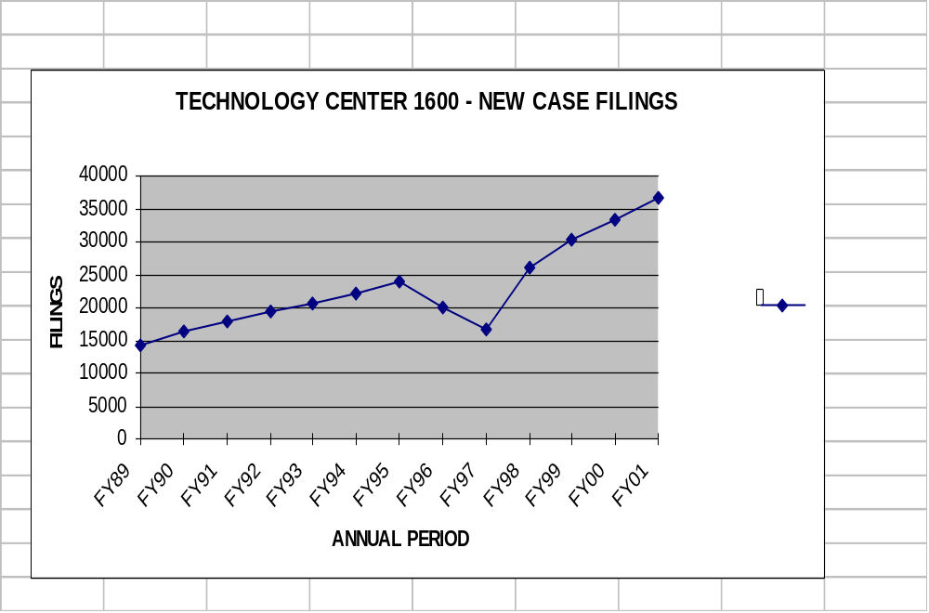
TC 1600 New Case Filings

Slide 7
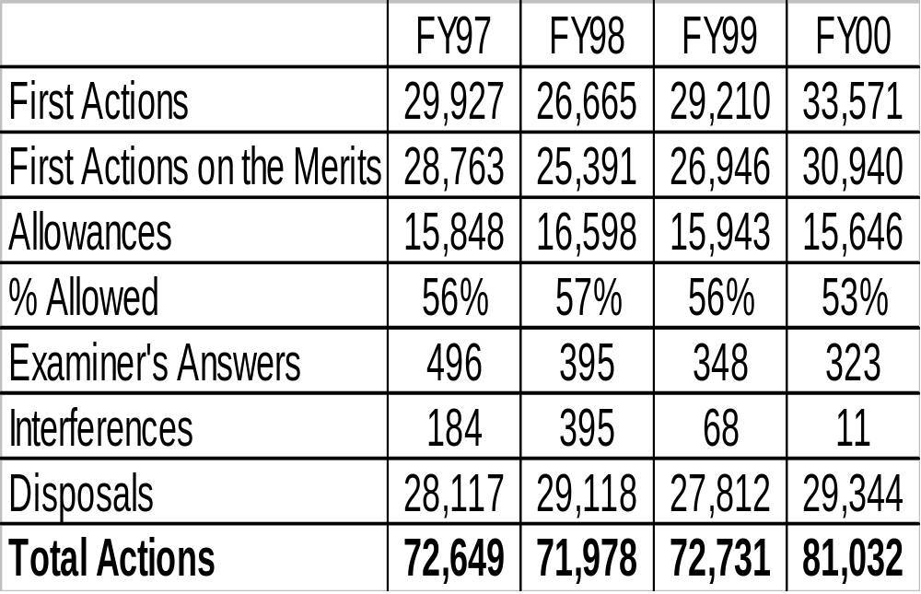
TC 1600 Workload Statistics

Slide 8
TC 1600 Information On-Line
Organization Chart
Phone Book
  All Examiners, Clerks and Management Types
Vital Stats
  Everything from Workload Stats to Animal Stats
Art Unit Rosters
  Listing Art Units, Examiners and SPEs
External Customer Service Guide
  Everything You Ever Wanted to Know
http://www.uspto.gov/web/patents/tc1600info.htm

Slide 9
TC 1600 Customer Service Center
  Paula Hutzell
  Technology Center Practice Specialist
  Helen Childs
  Head Supervisory Legal Instrument Examiner
  Renee Pettus
  Customer Service Representative
  Yvonne Brown
  Customer Service Representative
  Tel. No. (703) 308-0197; (703) 308-0198
  Fax No. (703) 308-4407

Slide 10
Biotechnology/Chemical/Pharmaceutical
Customer Partnership Road Show, Aug. 20-24, 2001
Utility Examination Guidelines

Slide 11
Utility Guidelines
Federal Register:
  (http://www.access.gpo.gov/su_docs/aces/aces140.html)
  Utility Guidelines:
    66 FR 1092 (January 5, 2001)
Apply to All Pending Applications.

Slide 12
Raising the Bar
Old Test: Two-pronged
        Specific
        Credible
New Test: Three-pronged
        Specific
        Substantial
        Credible

Slide 13
Specific and Substantial Utility
Brenner v. Manson, 383 U.S. 519 (1966)
  The basic quid pro quo contemplated by the Constitution and the Congress for granting a patent monopoly is the benefit derived by the public from an invention with substantial utility. Unless and until a process is refined and developed to this point -- where specific benefit exists in currently available form -- there is insufficient justification for permitting an applicant to engross what may prove to be a broad field.

Slide 14
Specific Utility - Definition
A utility that is specific to the subject matter claimed. This contrasts with a general utility that would be applicable to the broad class of the invention.

Slide 15
Substantial Utility - Definition
A utility that defines a "real world" use.
  Utilities that require or constitute carrying out further research to identify or reasonably confirm a "real world" context of use are not substantial utilities.

Slide 16

Substantial Utility “Wheel”
Nucleic Acid
Protein
Probe for
disease state
e.g. cancer gene
mutation
Assay for specific,
substantial,
credible use
Antibody

Slide 17
“Throw Away” Utility
Note that “throw away” utilities do not meet the tests for a specific or substantial utility.
  For example, using transgenic mice as snake food is a utility that is neither specific (all mice could function as snake food) nor substantial (using a mouse costing tens of thousands of dollars to produce as snake food is not a “real world” context of use). Similarly, use of any protein as an animal food supplement or a shampoo ingredient are “throw away” utilities that would not pass muster as specific or substantial utilities under 35 U.S.C. §101.

Slide 18
“Throw Away” Utility
This analysis is tempered by consideration of the context and nature of the invention.
  If a transgenic mouse was generated with the specific provision of an enhanced nutrient profile, and disclosed for use as an animal food, then the test for specific and substantial asserted utility would be considered to be met.

Slide 19
Credible Utility - Definition
An Assertion Is Credible Unless
  (A) the logic underlying the assertion is seriously flawed, or
  (B) the facts upon which the assertion is based are inconsistent with the logic underlying the assertion.
Credibility as used in this context refers to the reliability of the statement based on the logic and facts that are offered by the applicant to support the assertion of utility.

Slide 20
Credible Utility - Definition
A credible utility is assessed from the standpoint of whether a person of ordinary skill in the art would accept that the recited or disclosed invention is currently available for such use.
Recited or disclosed invention is currently available for such use.
  For example, no perpetual motion machines would be considered to be currently available. However, nucleic acids could be used as probes, chromosome markers, or forensic or diagnostic markers.

Slide 21
Well Established Utilities - Definition
A specific, substantial, and credible utility which is well known, immediately apparent, or implied by the specification’s disclosure of the properties of a material, alone or taken with the knowledge of one skilled in the art.

Slide 22
Biotechnology/Chemical/Pharmaceutical
Customer Partnership Road Show, Aug. 20-24, 2001
Written Description Examination Guidelines

Slide 23
35 USC §112, 1st Paragraph
Written Description
The specification shall contain a written description of the invention and of the manner and process of making and using it, in such full, clear, concise, and exact terms . . . any person skilled in the art to which it pertains . . . to make and use the same . . .

Slide 24
Written Description Guidelines
Federal Register:
  (http://www.access.gpo.gov/su_docs/aces/aces140.html)
  Written Description Guidelines:
    66 FR 1099 (January 5, 2001)
Will Promote Uniformity & Consistency in the Examination Process.
Apply to All Pending Applications.

Slide 25
Technology and Claim Coverage
Written in technology neutral manner since recent decisions of the Federal Circuit have written description implications in a broad range of technologies.
Products, Processes, and Products by Process.

Slide 26
General Principles
Basic inquiry: Can one skilled in the art reasonably conclude that the inventor was in possession of the claimed invention at the time the application was filed?
Written description requirement is separate and distinct from the enablement requirement.

Slide 27
Analysis
If a skilled artisan would have understood the inventor to be in possession of the claimed invention at the time of filing, even if every nuance of the claim is not explicitly described in the specification, then the requirement for an adequate written description is met.

Slide 28
Evidence of Possession
Reduction to Practice
  Actual reduction to practice not always required.
  Deposit of biological materials not a substitute for written description.
Clear depiction of the claimed invention in detailed drawings.
What is conventional or well known to one skilled in the art need not be disclosed in detail.

Slide 29
Evidence of Possession
Written description describing sufficient relevant identifying characteristics.
  Weigh factual considerations in view of level of skill and knowledge in the art.
  The less mature the technology, the more evidence is required to show possession.
  Level of skill and knowledge in the art increases over time.

Slide 30
Evidence of Possession
Relevant Identifying Characteristics
      Complete or partial structure.
      Physical and/or chemical properties.
      Functional characteristics.
      Correlation between structure and function.
      Method of making.
      Combinations of the above.

Slide 31
Quality Matrix
Technology Center Practice Specialists
  Paula Hutzell
    paula.hutzell@uspto.gov (703) 308-4310
  Brian Stanton
    brian.stanton@uspto.gov (703) 308-2801
Quality Assurance Specialist
  Robert Hill
    robert.hill@uspto.gov; (703) 308-4314
Senior Level Examiner
  Jim Martinell
    james.martinell@uspto.gov; (703) 308-0296

Slide 32
Problem Resolution
Working Your Way Up the Food Chain
  Examiner
  Primary (if other than the Examiner)
  SPE
  Practice Specialist/QAS
  Director

Slide 33
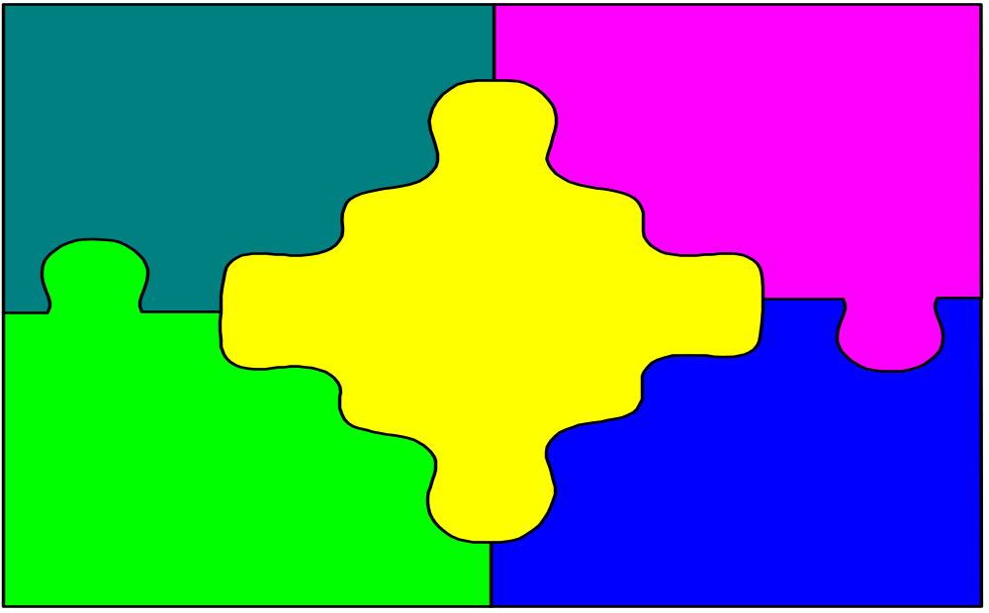
Questions
DNA
Proteins
ESTs
SNPs
Chimera
? ? ?

Slide 34
Biotechnology/Chemical/Pharmaceutical
Customer Partnership Road Show, Aug. 20-24, 2001
Jasemine C. Chambers, Ph.D., J.D.
Director, Technology Center 1600
(703) 308-1123
jasemine.chambers@uspto.gov

