Slide 1


Teuchos::RefCountPtr
An Introduction to the Trilinos Smart Reference-Counted Pointer Class for (Almost) Automatic Dynamic Memory Management in C++
Roscoe A. Bartlett
Department (1411) 9211: Optimization and Uncertainty Estimation
Sandia National Laboratories
Sandia is a multiprogram laboratory operated by Sandia Corporation, a Lockheed Martin Company,
for the United States Department of Energy under contract DE-AC04-94AL85000.

Slide 2
Outline
Background on memory management in C++
Simple motivating example using raw pointers
Persisting and non-persisting associations
Refactoring of simple example to use RefCountPtr
RefCountPtr: Nuts & bolts and avoiding trouble
Summary and RefCountPtr philosophy

Slide 3
Outline
Background on memory management in C++
Simple motivating example using raw pointers
Persisting and non-persisting associations
Refactoring of simple example to use RefCountPtr
RefCountPtr: Nuts & bolts and avoiding trouble
Summary and RefCountPtr philosophy

Slide 4
Dynamic Memory Management in C++
C++ requires programmers to manage dynamically allocated memory themselves using operator new and operator delete
Problems with using raw new and delete at application programming level
  Very error prone (multiple deletes or memory leaks)
  Difficult to know who’s responsibility it is to delete an object
  Creates memory leaks when exceptions are thrown
Reference counting to the rescue?
Examples (C++ and other):
  CORBA
  COM
Client A
Client B
Client C
Reference Count Node
count=3
Shared Object
UML object diagram
  How is the reference count updated and managed?
  When is the object deleted?
  How is the object deleted?

Slide 5
Smart Pointers : A C++ Reference Counting Solution
C++ supports development of “smart” pointer classes that behave a lot like raw pointers
Reference counting + smart pointers = smart reference counted pointers
Advantages of Smart Pointer approach:
  Access to shared object uses pointer-like syntax
    (*ptr).f() [operator*()]
    ptr->f() [operator->()]
  Reference counts automatically updated and maintained
  Object automatically deleted when last smart pointer is destroyed
Client A
Client B
Client C
Smart Ptr A
Smart Ptr B
Smart Ptr C
Reference Count Node
count=3
Shared Object
Examples of C++ smart reference counted pointer classes
  boost::shared_ptr: Part of the Boost C++ class library (created in 1999?)
    Being considered to go into the next C++ standard
    Does not throw exceptions
  Teuchos::RefCountPtr:
    Originally developed as part of rSQP++ (Bartlett et. al.) in 1998
    Does throw exceptions in some cases in debug mode and has addition features
    Being used more and more extensively in Thyra, NOX/LOCA, Rythmos, Belos, Anasazi, TSFExtended, Charon, …

Slide 6
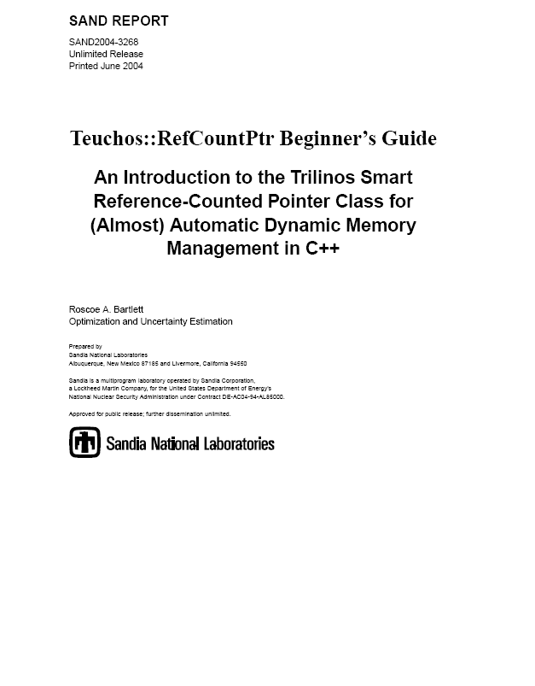
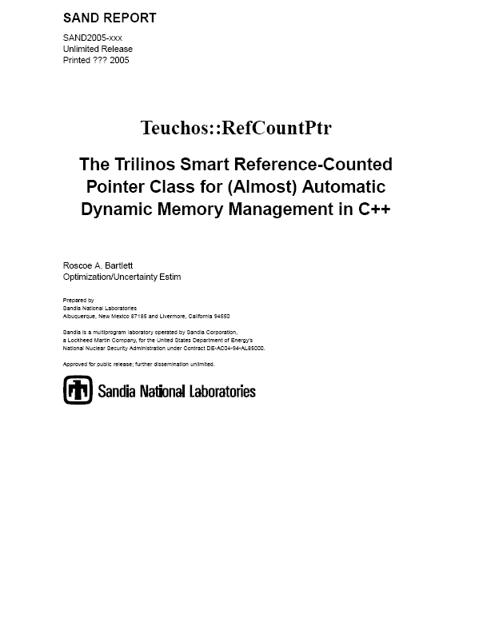
RefCountPtr SAND Reports
http://software.sandia.gov/Trilinos/RefCountPtrBeginnersGuideSAND.pdf
Trilinos/doc/RefCountPtr/RefCountPtrSAND.tex (to be completed)

Slide 7
Outline
Background on memory management in C++
Simple motivating example using raw pointers
Persisting and non-persisting associations
Refactoring of simple example to use RefCountPtr
RefCountPtr: Nuts & bolts and avoiding trouble
Summary and RefCountPtr philosophy

Slide 8
Introduction of Simple Example Program
Example program that is described in the Beginner’s Guide
  Complete program listings in Appendix E and F
Uses basic object-oriented programming
Demonstrates the basic problems of using raw C++ pointers and delete for high-level memory management
Provides context for differentiating “persisting” and “non-persisting” object associations
Show step-by-step process of refactoring C++ code to use RefCountPtr

Slide 9
Abstract Interfaces and Subclasses in Example Program
Utility interface and subclasses
class UtilityBase {
public:
virtual void f() const = 0;
};
class UtilityA : public UtilityBase {
public:
void f() const {…}
};
class UtilityB : public UtilityBase {
public:
void f() const {…}
};
Utility “abstract factory” interface and subclasses (see “Design Patterns” book)
class UtilityBaseFactory {
public:
virtual UtilityBase* createUtility() const = 0;
};
class UtilityAFactory : public UtilityBaseFactory {
public:
UtilityBase* createUtility() const { return new UtilityA(); }
};
class UtilityBFactory : public UtilityBaseFactory {
public:
UtilityBase* createUtility() const { return new UtilityB(); }
};

Slide 10
Client Classes in Example Program
class ClientA {
public:
void f( const UtilityBase &utility ) const { utility.f(); }
};
class ClientB {
UtilityBase *utility_;
public:
ClientB() : utility_(0) {}
~ClientB() { delete utility_; }
void initialize( UtilityBase *utility ) { utility_ = utility; }
void g( const ClientA &a ) { a.f(*utility_); }
};
class ClientC {
const UtilityBaseFactory *utilityFactory_;
UtilityBase *utility_;
bool shareUtility_;
public:
ClientC( const UtilityBaseFactory *utilityFactory, bool shareUtility )
:utilityFactory_(utilityFactory)
,utility_(utilityFactory->createUtility())
,shareUtility_(shareUtility) {}
~ClientC() { delete utilityFactory_; delete utility_; }
void h( ClientB *b ) {
if( shareUtility_ ) b->initialize(utility_);
else b->initialize(utilityFactory_->createUtility());
}
};

Slide 11
Example Main Program
int main( int argc, char* argv[] )
{
// Read options from the commandline
bool useA, shareUtility;
example_get_args(argc,argv,&useA,&shareUtility);
// Create factory
UtilityBaseFactory *utilityFactory = 0;
if(useA) utilityFactory = new UtilityAFactory();
else utilityFactory = new UtilityBFactory();
// Create clients
ClientA a;
ClientB b1, b2;
ClientC c(utilityFactory,shareUtility);
// Do some stuff
c.h(&b1);
c.h(&b2);
b1.g(a);
b2.g(a);
// Cleanup memory
delete utilityFactory;
}
This program has memory usage problems!

Slide 12
Example Program Memory Usage Problem #1
class ClientC {
…
public:
ClientC( const UtilityBaseFactory *utilityFactory, bool shareUtility )
:utilityFactory_(utilityFactory)
,utility_(utilityFactory->createUtility())
,shareUtility_(shareUtility) {}
~ClientC() { delete utilityFactory_; delete utility_; }
…
};
int main( int argc, char* argv[] )
{
…
// Create factory
UtilityBaseFactory *utilityFactory = 0;
if(useA) utilityFactory = new UtilityAFactory();
else utilityFactory = new UtilityBFactory();
// Create clients
…
ClientC c(utilityFactory,shareUtility);
// Do some stuff
…
// Cleanup memory
delete utilityFactory;
}
The UtilityBaseFactory object is deleted twice!

Slide 13
Example Program Memory Usage Problem #2
class ClientB {
UtilityBase *utility_;
public:
~ClientB() { delete utility_; }
void initialize( UtilityBase *utility ) { utility_ = utility; }
};
class ClientC {
const UtilityBaseFactory *utilityFactory_;
UtilityBase *utility_;
bool shareUtility_;
public:
…
~ClientC() { delete utilityFactory_; delete utility_; }
void h( ClientB *b ) {
if( shareUtility_ ) b->initialize(utility_);
else b->initialize(utilityFactory_->createUtility());
}
};
int main( int argc, char* argv[] )
{
…
ClientB b1, b2;
ClientC c(utilityFactory,shareUtility);
c.h(&b1);
c.h(&b2);
…
}
The UtilityBase object is deleted three times if shareUtility_==true!

Slide 14
Problems with using raw pointers for memory management
Important points
Fixing the memory management problems in this example program is not too hard
However, writing complex OO software with independently developed modules without memory leaks nor multiple calls to delete is very hard!
  Example: Epetra required major refactoring to address these problems!
The designers of C++ never expected complex high level code to rely on raw C++ memory management and raw calls to delete
Almost every major C++ middleware software collection provides some higher-level support for dynamic memory management and wraps raw calls to delete
Raw calls to delete are fragile and create memory leaks in the presents of exceptions
void someFunction() {
A *a = new A;
a->f(); // memory leak on throw!
delete a;
}
void someFunction() {
std::auto_ptr<A> a(new A);
a->f(); // no leak on throw!
}
What is an alternative to using raw pointers for memory management?
Smart Reference Counted Pointers! => Teuchos::RefCountPtr

Slide 15
Outline
Background on memory management in C++
Simple motivating example using raw pointers
Persisting and non-persisting associations
Refactoring of simple example to use RefCountPtr
RefCountPtr: Nuts & bolts and avoiding trouble
Summary and RefCountPtr philosophy

Slide 16
RefCountPtr: Persisting and Non-Persisting Associations
Non-persisting association: An object association that only exists within a single function call and no “memory” of the object persists after the function exits
Persisting association: An object association that exists beyond a single function call and where some “memory” of the object persists
Examples:
class ClientA {
public:
void f( const UtilityBase &utility ) const { utility.f(); }
};
class ClientB {
UtilityBase *utility_;
public:
ClientB() : utility_(0) {}
~ClientB() { delete utility_; }
void initialize( UtilityBase *utility ) { utility_ = utility; }
void g( const ClientA &a ) { a.f(*utility_); }
};
Non-persisting associations:
  Use raw C++ references and pointers
Persisting associations:
  Use RefCountPtr
ClientA
ClientB
Non-persisting association
UtilityBase
Persisting association
UML class diagram

Slide 17
Outline
Background on memory management in C++
Simple motivating example using raw pointers
Persisting and non-persisting associations
Refactoring of simple example to use RefCountPtr
RefCountPtr: Nuts & bolts and avoiding trouble
Summary and RefCountPtr philosophy

Slide 18
Refactoring Example Program to use RefCountPtr : Part #1
Before Refactoring
class UtilityBaseFactory {
public:
virtual UtilityBase* createUtility() const = 0;
};
class UtilityAFactory : public UtilityBaseFactory {
public:
UtilityBase* createUtility() const { return new UtilityA(); }
};
class UtilityBFactory : public UtilityBaseFactory {
public:
UtilityBase* createUtility() const { return new UtilityB(); }
};
After Refactoring
class UtilityBaseFactory {
public:
virtual RefCountPtr<UtilityBase> createUtility() const = 0;
};
class UtilityAFactory : public UtilityBaseFactory {
public:
RefCountPtr<UtilityBase> createUtility() const { return rcp(new UtilityA()); }
};
class UtilityBFactory : public UtilityBaseFactory {
public:
RefCountPtr<UtilityBase> createUtility() const { return rcp(new UtilityB()); }
};

Slide 19
Refactoring Example Program to use RefCountPtr : Part #2
Before Refactoring
class ClientA {
public:
void f( const UtilityBase &utility ) const { utility.f(); }
};
After Refactoring (no change)
class ClientA {
public:
void f( const UtilityBase &utility ) const { utility.f(); }
};
Before Refactoring
class ClientB {
UtilityBase *utility_;
public:
ClientB() : utility_(0) {}
~ClientB() { delete utility_; }
void initialize( UtilityBase *utility ) { utility_ = utility; }
void g( const ClientA &a ) { a.f(*utility_); }
};
After Refactoring
Constructor and Destructor are Gone!
class ClientB {
RefCountPtr<UtilityBase> utility_;
public:
void initialize(const RefCountPtr<UtilityBase> &utility) { utility_=utility; }
void g( const ClientA &a ) { a.f(*utility_); }
};

Slide 20
Refactoring Example Program to use RefCountPtr : Part #3
Before Refactoring
class ClientC {
const UtilityBaseFactory *utilityFactory_;
UtilityBase *utility_;
bool shareUtility_;
public:
ClientC( const UtilityBaseFactory *utilityFactory, bool shareUtility )
:utilityFactory_(utilityFactory)
,utility_(utilityFactory->createUtility())
,shareUtility_(shareUtility) {}
~ClientC() { delete utilityFactory_; delete utility_; }
void h( ClientB *b ) {
if( shareUtility_ ) b->initialize(utility_);
else b->initialize(utilityFactory_->createUtility());
}
};
Destructor is Gone!
After Refactoring
class ClientC {
RefCountPtr<const UtilityBaseFactory> utilityFactory_;
RefCountPtr<UtilityBase> utility_;
bool shareUtility_;
public:
ClientC(const RefCountPtr<const UtilityBaseFactory> &utilityFactory, … )
:utilityFactory_(utilityFactory)
,utility_(utilityFactory->createUtility())
,shareUtility_(shareUtility) {}
void h( ClientB *b ) {…}
};

Slide 21
Refactoring Example Program to use RefCountPtr : Part #4
Before Refactoring
After Refactoring
int main( int argc, char* argv[] )
{
// Read options from the commandline
bool useA, shareUtility;
example_get_args(argc,argv,&useA
,&shareUtility);
// Create factory
UtilityBaseFactory *utilityFactory = 0;
if(useA)
utilityFactory=new UtilityAFactory();
else
utilityFactory=new UtilityBFactory();
// Create clients
ClientA a;
ClientB b1, b2;
ClientC c(utilityFactory,shareUtility);
// Do some stuff
c.h(&b1);
c.h(&b2);
b1.g(a);
b2.g(a);
// Cleanup memory
delete utilityFactory;
}
int main( int argc, char* argv[] )
{
// Read options from the commandline
bool useA, shareUtility;
example_get_args(argc,argv,&useA
,&shareUtility);
// Create factory
RefCountPtr<UtilityBaseFactory> utilityFactory;
if(useA)
utilityFactory = rcp(new UtilityAFactory());
else
utilityFactory = rcp(new UtilityBFactory());
// Create clients
ClientA a;
ClientB b1, b2;
ClientC c(utilityFactory,shareUtility);
// Do some stuff
c.h(&b1);
c.h(&b2);
b1.g(a);
b2.g(a);
}
New program runs without any memory problems
New program will be easier to maintain

Slide 22
Outline
Background on memory management in C++
Simple motivating example using raw pointers
Persisting and non-persisting associations
Refactoring of simple example to use RefCountPtr
RefCountPtr: Nuts & bolts and avoiding trouble
  More background
  Construction, reinitialization, and object access
  Explicit casting
  Recommendations for passing objects to and from functions
  Implicit casting
  Common casting problems
Summary and RefCountPtr philosophy

Slide 23
Outline
Background on memory management in C++
Simple motivating example using raw pointers
Persisting and non-persisting associations
Refactoring of simple example to use RefCountPtr
RefCountPtr: Nuts & bolts and avoiding trouble
  More background
  Construction, reinitialization, and object access
  Explicit casting
  Recommendations for passing objects to and from functions
  Implicit casting
  Common casting problems
Summary and RefCountPtr philosophy

Slide 24
Value Semantics vs. Reference Semantics
A. Value Semantics
class S {
public:
S(); // Default constructor
S(const S&); // Copy constructor
S& operator=(const S&); // Assignment operator
…
};
  Used for small, concrete datatypes
  Identity determined by the value in the object, not by its object address (e.g. obj==1.0)
  Storable in standard containers (e.g. std::vector<S>)
  Examples: int, bool, float, double, char, std::complex, extended precision …
B. Reference Semantics
Important points!
RefCountPtr class has
value semantics
RefCountPtr usually wraps classes with reference semantics
class A {
public:
// Pure virtual functions
virtual void f() = 0;
…
};
  Abstract C++ classes (i.e. has pure virtual functions) or for large objects
  Identity determined by the object’s address (e.g. &obj1 == &obj2)
  Can not be default constructed, copied or assigned (not storable in standard containers)
  Examples: std::ostream, any abstract base class, …

Slide 25
Raw Pointers and RefCountPtr : const and non-const
Example:
A a;
A* a_ptr = &a;
Important Point: A pointer object a_ptr of type A* is an object just like any other object with value semantics and can be const or non-const
an address
A’s data
a_ptr
a
Raw C++ Pointers
RefCountPtr
Remember this equivalence
typedef A* ptr_A;
equivalent to
RefCountPtr<A>
typedef const A* ptr_const_A;
equivalent to
RefCountPtr<const A>
an address
A’s data
non-const pointer to non-const object
ptr_A a_ptr;
equivalent to
RefCountPtr<A> a_ptr;
A * a_ptr;
an address
A’s data
const pointer to non-const object
const ptr_A a_ptr;
equivalent to
const RefCountPtr<A> a_ptr;
A * const a_ptr;
an address
A’s data
non-const pointer to const object
ptr_const_A a_ptr;
equivalent to
RefCountPtr<const A> a_ptr;
const A * a_ptr;
an address
A’s data
const pointer to const object
const ptr_const_A a_ptr;
equivalent to
const RefCountPtr<const A> a_ptr;
const A * const a_ptr;

Slide 26
Example C++ Class Hierarchies
// Abstract hierarchy
class A {
public:
virtual ~A(){}
virtual void f(){…}
};
class B1 : virtual public A {…};
class B2 : virtual public A {…};
class C : virtual public B1, virtual public B2 {…};
A
B1
B2
C
UML class diagram
D
// Non-abstract hierarchy (no virtual functions)
class D {…};
class E : public D {…};
E
Assume all these classes have reference semantics

Slide 27
Outline
Background on memory management in C++
Simple motivating example using raw pointers
Persisting and non-persisting associations
Refactoring of simple example to use RefCountPtr
RefCountPtr: Nuts & bolts and avoiding trouble
  More background
  Construction, reinitialization, and object access
  Explicit casting
  Recommendations for passing objects to and from functions
  Implicit casting
  Common casting problems
Summary and RefCountPtr philosophy

Slide 28
Constructing RefCountPtr Objects
C++ Declarations for constructing a RefCountPtr object
template<class T>
class RefCountPtr {
public:
RefCountPtr( ENull null_arg = null );
…
};
template<class T> RefCountPtr<T> rcp( T* p );
template<class T> RefCountPtr<T> rcp( T* p, bool owns_mem);
Initializing a RefCountPtr<> object to NULL
RefCountPtr<C> c_ptr; // Good for class data members!
RefCountPtr<C> c_ptr = null; // May help clarity
Creating a RefCountPtr object using new
RefCountPtr<C> c_ptr = rcp(new C);
Initializing a RefCountPtr object to an object not allocated with new
C c;
RefCountPtr<C> c_ptr = rcp(&c,false);
Example
void foo( const UtilityBase &utility ) // Non-persisting with utility
{
ClientB b;
b.initialize(rcp(&utility,false)); // b lives entirely in foo()
…
}

Slide 29
Commandment 1 : Give a ‘new’ object to just one RCP
Commandment 1: Thou shall put a pointer for an object allocated with operator new into a RefCountPtr object only once. E.g.
RefCountPtr<C> c_ptr = rcp(new C);
Anti-Commandment 1: Thou shall never give a raw C++ pointer returned from operator new to more than one RefCountPtr object.
Example:
A *ra_ptr = new C;
RefCountPtr<A> a_ptr1 = rcp(ra_ptr); // Okay
RefCountPtr<A> a_ptr2 = rcp(ra_ptr); // no, No, NO !!!!
  a_ptr2 knows nothing of a_ptr1 and both will call delete!
Anti-Commandment 2: Thou shall never give a raw C++ pointer to an array of objects returned from operator new[] to a RefCountPtr object using rcp(new C[n]).
Example:
RefCountPtr<std::vector<C> >
c_array_ptr1 = rcp(new std::vector<C>(N)); // Okay
RefCountPtr<C>
c_array_ptr2 = rcp(new C[n]); // no, No, NO!
  c_array_ptr2 will call delete instead of delete []!

Slide 30
Reinitialization of RefCountPtr Objects
The proper way to reinitialize an object with value semantics is to use the assignment operator! (boost::shared_ptr violates this principle!)
C++ Declarations for reinitializing a RefCountPtr Object
template<class T>
class RefCountPtr {
public:
RefCountPtr<T>& operator=(const RefCountPtr<T>& r_ptr);
…
};
Resetting from a raw pointer
RefCountPtr<A> a_ptr;
a_ptr = rcp(new A());
Resetting to null
RefCountPtr<A> a_ptr = rcp(new A());
a_ptr = null; // The A object will be deleted here
Assigning from a RefCountPtr object
RefCountPtr<A> a_ptr1;
RefCountPtr<A> a_ptr2 = rcp(new A());
a_ptr1 = a_ptr2; // Now a_ptr1 and a_ptr2 point to the same A object

Slide 31
Access Underlying Reference-Counted Object
C++ Declarations for accessing referenced-counted object
template<class T>
class RefCountPtr {
public:
T* operator->() const; // Allows ptr->f(); [throws exception if NULL]
T& operator*() const; // Allows (*ptr).f() [throws exception if NULL]
T* get() const;
…
};
template<class T> bool is_null(const RefCountPtr<T>& p);
template<class T> bool operator==(const RefCountPtr<T>& p, ENull);
template<class T> bool operator!=(const RefCountPtr<T>& p, ENull);
Access to object reference (debug runtime checked)
C &c_ref = *c_ptr; // Throws exception if c_ptr.get()==NULL
Access to object pointer (unchecked, may return NULL)
C *c_rptr = c_ptr.get(); // Never throws an exception
Access to object pointer (debug runtime checked, will not return NULL)
C *c_rptr = &*c_ptr; // Throws exception if c_ptr.get()==NULL
Access of object’s member (debug runtime checked)
c_ptr->f(); // Throws exception if c_ptr.get()==NULL
Testing for null
if( a_ptr.get()==NULL ) std::cout << “a_ptr is null\n”;
if( is_null(a_ptr) ) std::cout << “a_ptr is null\n”;
if( a_ptr==null ) std::cout << “a_ptr is null\n”;

Slide 32
Outline
Background on memory management in C++
Simple motivating example using raw pointers
Persisting and non-persisting associations
Refactoring of simple example to use RefCountPtr
RefCountPtr: Nuts & bolts and avoiding trouble
  More background
  Construction, reinitialization, and object access
  Explicit casting
  Recommendations for passing objects to and from functions
  Implicit casting
  Common casting problems
Summary and RefCountPtr philosophy

Slide 33
Explicit Casting of RefCountPtr Objects : Template Functions
C++ Declarations for explicit casting of RefCountPtr Objects
// implicit cast
template<class T2, class T1>
RefCountPtr<T2> rcp_implicit_cast(const RefCountPtr<T1>& p1);
// static cast
template<class T2, class T1>
RefCountPtr<T2> rcp_static_cast(const RefCountPtr<T1>& p1);
// const cast
template<class T2, class T1>
RefCountPtr<T2> rcp_const_cast(const RefCountPtr<T1>& p1);
// dynamic cast
template<class T2, class T1>
RefCountPtr<T2> rcp_dynamic_cast(const RefCountPtr<T1>& p1
,bool throw_on_fail = false );

Slide 34
Explicit Casting of RefCountPtr Objects : Examples
Raw C++ Pointers
RefCountPtr
D
A
Static cast (non-checked)
D*
d = new E;
E*
e = static_cast<E*>(d);
B1
B2
RefCountPtr<D>
d = rcp(new E);
RefCountPtr<E>
e = rcp_static_cast<E>(d);
E
C
Constant cast
const A*
ca = new C
A*
a = const_cast<A*>(ca);
RefCountPtr<const A>
ca = rcp(new C);
RefCountPtr<A>
a = rcp_const_cast<A>(ca);
Dynamic cast (runtime check, can return NULL on fail)
A*
a = new C;
B1*
b1 = dynamic_cast<B1*>(a);
RefCountPtr<A>
a = rcp(new C);
RefCountPtr<B1>
b1 = rcp_dynamic_cast<B1>(a);
Dynamic cast (runtime check, can not return NULL on fail)
A*
a = new B1;
B2*
b2 = ( a ? &dynamic_cast<B2&>(*a)
: (B2*)NULL );
RefCountPtr<A>
a = rcp(new B1);
RefCountPtr<B2>
b2 = rcp_dynamic_cast<B2>(a,true);
Note: In last dynamic cast, rcp_dynamic_cast<B2>(a,true) throws exception with much better error message than dynamic_cast<B2&>(*a). See Teuchos::dyn_cast<>()!

Slide 35
Commandment 4 : Casting RefCountPtr Objects
Commandment 4: Thou shall only cast between RefCountPtr objects using the default copy constructor (for implicit conversions) and the nonmember template functions rcp_implicit_cast<>(...), rcp_static_cast<>(...), rcp_const_cast<>(...) and rcp_dynamic_cast<>(...).
Anti-Commandment 5: Thou shall never convert between RefCountPtr objects using raw pointer access.
A
B1
B2
Example:
RefCountPtr<A> a_ptr = rcp(new C);
RefCountPtr<B1> b1_ptr1 = rcp_dynamic_cast<B1>(a_ptr); // Yes :-)
RefCountPtr<B1> b1_ptr2 = rcp(dynamic_cast<B1*>(a_ptr.get())); // no, No, NO !!!
C
  b1_ptr2 knows nothing of a_ptr and both will call delete!

Slide 36
Outline
Background on memory management in C++
Simple motivating example using raw pointers
Persisting and non-persisting associations
Refactoring of simple example to use RefCountPtr
RefCountPtr: Nuts & bolts and avoiding trouble
  More background
  Construction, reinitialization, and object access
  Explicit casting
  Recommendations for passing objects to and from functions
  Implicit casting
  Common casting problems
Summary and RefCountPtr philosophy

Slide 37
Recommendations for passing objects to and from C++ functions
Recommendations for writing function prototypes for passing objects that:
  Lead to code that is as self documenting as possible (write less extra documentation)
  Maximizes compile-time checking
  Maximizes runtime performance and simplifies debugging
Consider passing objects of type A which use reference semantics
out = func( args )
(
)
non-persisting
non-changeable
[input]
persisting
non-changeable
non-persisting
changeable
[input-output]
persisting
changeable
out = func
A*
A&
const A*
const A&
RCP<A>
RCP<const A>
const RCP<A>&
const RCP<const A>&
Recommended
A*
A&
RCP<A>
const RCP<A>&
optional
required
Passing RefCountPtr objects by constant reference :
  Avoids needless copy constructor and destructor calls
  Makes it easier to step into function in a debugger
  Avoids accidentally resetting RefCountPtr
A*
A&
const A*
const A&
RCP<A>
RCP<const A>
Return RefCountPtr objects by value
See Appendix D in Beginner’s Guide for more recommendations
  objects with value semantics, arrays, arrays of RefCountPtr objects etc.

Slide 38
Outline
Background on memory management in C++
Simple motivating example using raw pointers
Persisting and non-persisting associations
Refactoring of simple example to use RefCountPtr
RefCountPtr: Nuts & bolts and avoiding trouble
  More background
  Construction, reinitialization, and object access
  Explicit casting
  Recommendations for passing objects to and from functions
  Implicit casting
  Common casting problems
Summary and RefCountPtr philosophy

Slide 39
Implicit Casting in Function Calls : Raw C++ Pointers
A
// Typedefs
typedef A* ptr_A;
typedef const A* ptr_const_A;
// Takes pointer to A (by value)
void foo1( ptr_A a_ptr );
// Takes pointer to const A (by value)
void foo2( ptr_const_A a_ptr );
// Takes pointer to A (by const reference)
void foo3( const ptr_A &a_ptr );
// Takes pointer to A (by non-const reference)
void foo4( ptr_A &a_ptr );
void boo1()
{
C* c = new C;
A* a = c;
foo1(c); // Okay, implicit cast to base class
foo2(a); // Okay, implicit cast to const
foo2(c); // Okay, implicit cast to base class and const
foo3(c); // Okay, implicit cast to base class
foo4(a); // Okay, no cast
foo4(c); // Error, can not cast from (C&*) to (A&*)!
}
B1
B2
C
Compiler can perform implicit conversions on arguments passed by value or const reference!
Compiler can not perform implicit conversions on arguments passed by non-const reference!

Slide 40
Implicit Casting of RefCountPtr Objects
C++ Declarations for implicit casting
template<class T>
class RefCountPtr {
public:
template<class T2>
RefCountPtr(const RefCountPtr<T2>& r_ptr); // Templated copy constructor!
…
};
template<class T2, class T1>
RefCountPtr<T2> rcp_implicit_cast(const RefCountPtr<T1>& p1);
A
B1
B2
Raw C++ Pointers
RefCountPtr
C
Implicit cast to base class
C* c_rptr = new C;
A* a_rptr = c_rptr;
RefCountPtr<C> c_ptr = rcp(new C);
RefCountPtr<A> a_ptr = c_ptr;
Implicit cast to const
A* a_rptr = new A;
const A* ca_rptr = a_rptr;
RefCountPtr<A> a_ptr = rcp(new A);
RefCountPtr<const A> ca_ptr = a_ptr;
Implicit cast to base class and const
C* c_rptr = new C;
const A* ca_rptr = c_rptr;
RefCountPtr<C> c_ptr = rcp(new C);
RefCountPtr<const A> ca_ptr = c_ptr;
Note: Templated copy constructor allows implicit conversion of RefCountPtr objects in almost every situation where an implicit conversion with raw C++ pointers would be allowed

Slide 41
Implicit Casting : Raw C++ Pointers verses RefCountPtr
Raw C++ Pointers
RefCountPtr
typedef A* ptr_A;
typedef const A* ptr_const_A;
void foo5(ptr_A a_ptr);
void foo6(ptr_const_A a_ptr);
void boo2()
{
C* c = new C;
A* a = c;
foo5(c); // Okay, cast to base
foo6(a); // Okay, cast to const
foo6(c); // Okay, to base+const
}
void foo5(const RefCountPtr<A> &a_ptr);
void foo6(const RefCountPtr<const A> &a_ptr);
void boo3()
{
RefCountPtr<C> c = rcp(new C);
RefCountPtr<A> a = c;
foo5(c); // Okay, cast to base
foo6(a); // Okay, cast to const
foo6(c); // Okay, to base+const
}
Implicit conversions for RefCountPtr objects to satisfy function calls work almost identically to implicit conversions for raw C++ pointers and raw C++ references except for a few unusual cases:
  Implicit conversions to call overloading functions (see example on next page)
  ???

Slide 42
Outline
Background on memory management in C++
Simple motivating example using raw pointers
Persisting and non-persisting associations
Refactoring of simple example to use RefCountPtr
RefCountPtr: Nuts & bolts and avoiding trouble
  More background
  Construction, reinitialization, and object access
  Explicit casting
  Recommendations for passing objects to and from functions
  Implicit casting
  Common casting problems
Summary and RefCountPtr philosophy

Slide 43
Implicit Casting with RefCountPtr : Common Problems/Mistakes
Passing RefCountPtr by non-const reference instead of by const reference
Programming mistake!
void foo7(RefCountPtr<A> &a);
void foo7(const RefCountPtr<A> &a);
void boo4() {
RefCountPtr<C> c = rcp(new C);
RefCountPtr<A> a = c;
foo7(a); // Okay, no cast
foo7(c); // Error, can not cast involving non-const reference
foo7(c); // Okay, implicit case involving const reference okay
}
A
B1
B2
C
Failure to perform implicit conversion with overloaded functions
A deficiency of smart pointers over raw pointers
RefCountPtr<A> foo9(const RefCountPtr<A> &a);
RefCountPtr<const A> foo9(const RefCountPtr<const A> &a);
RefCountPtr<A> boo5() {
RefCountPtr<C> c = rcp(new C);
return foo9(c); // Error, call is ambiguous!
RefCountPtr<A> a = c;
return foo9(a); // Okay, calls first foo9(…)
return foo9(rcp_implicit_cast<A>(a)); // Okay, calls first foo9(…)
}
Calls foo9(A* a) when using raw C++ pointers!

Slide 44
Outline
Background on memory management in C++
Simple motivating example using raw pointers
Persisting and non-persisting associations
Refactoring of simple example to use RefCountPtr
RefCountPtr: Nuts & bolts and avoiding trouble
Summary and RefCountPtr philosophy

Slide 45
Summary of RefCountPtr and Advanced Features Overview
RefCountPtr combines concepts of “smart pointers” and “reference counting” to build an imperfect but effective “garbage collection” mechanism in C++
Smart pointers mimic raw C++ pointer usage and syntax
  Value semantics: i.e. default construct, copy construct, assignment etc.
  Object dereference: i.e. (*ptr).f()
  Pointer member access: i.e. ptr->f()
  Conversions :
    Implicit conversions using templated copy constructor: i.e. C* to A*, and A* to const A*
    Explicit conversions: i.e. rcp_const_cast<T>(p), rcp_static_cast<T>(p), rcp_dynamic_cast<T>(p)
Reference counting
  Automatically deletes wrapped object when last reference (i.e. smart pointer) is deleted
  Watch out for circular references! These create memory leaks!
RefCountPtr<T> is not a raw C++ pointer!
  Implicit conversions from T* to RefCountPtr<T> and visa versa are not supported!
  Failure of implicit casting and overload function resolution!
  Other problems …
Advanced Features (not covered here)
  Template deallocation policy object
    Allows other an delete to be called to clean up
    Allows one smart pointer (i.e. boost::shared_ptr) to be embedded in a RefCountPtr
  Extra data
    Allows RefCountPtr to wrap classes that do not have good memory management (e.g. old Epetra)
    Allows arbitrary events to be registered to occur before or after the wrapped object is deleted
A
B1
B2
C

Slide 46
The Philosophy of RefCountPtr
Using RefCountPtr for only persisting associations increases the vocabulary of the C++ language and makes in more self documenting.
void foo( const A &a, const RefCountPtr<C> &c );
Responsibilities of code that generates shared objects (e.g. factories)
  Create and initialize the concrete object to be given away
  Define the deallocation policy that will be used to deallocate the object
RefCountPtr<BaseClass>
SomeFactory::create() const {
ConcreteSubclass *instance; InitializeObject(&instance); // Initialize!
new rcp(instance,DeallocConcreteSubclass(),true); // Define destruc. policy!
}
Responsibilities of client code maintains persisting associations with shared objects
  Accept RefCountPtr objects that wrap shared objects
  Maintain RefCountPtr objects to shared objects while in use
  Destroy or assign to null RefCountPtr objects when it is finished using shared object
  class SomeClient {
  RefCountPtr<A> a_; // Maintain A
  public:
  void accept(const RefCountPtr<A> &a) { a_ = a; } // Accept A
  void clear_out() { a_ = null; } // Forget A
  };
RefCountPtr allows radically different types of software to be glued together to build a correct and robust memory management system
  Use RefCountPtr to wrap objects not currently wrapped with RefCountPtr and use customized deallocation policies
  Combine different smart pointer objects together

Slide 47
A Truism
Ben Parker once said to Peter Parker:
“With great power comes great responsibility”
and the same can be said of the use of RefCountPtr and of C++ in general

Slide 48
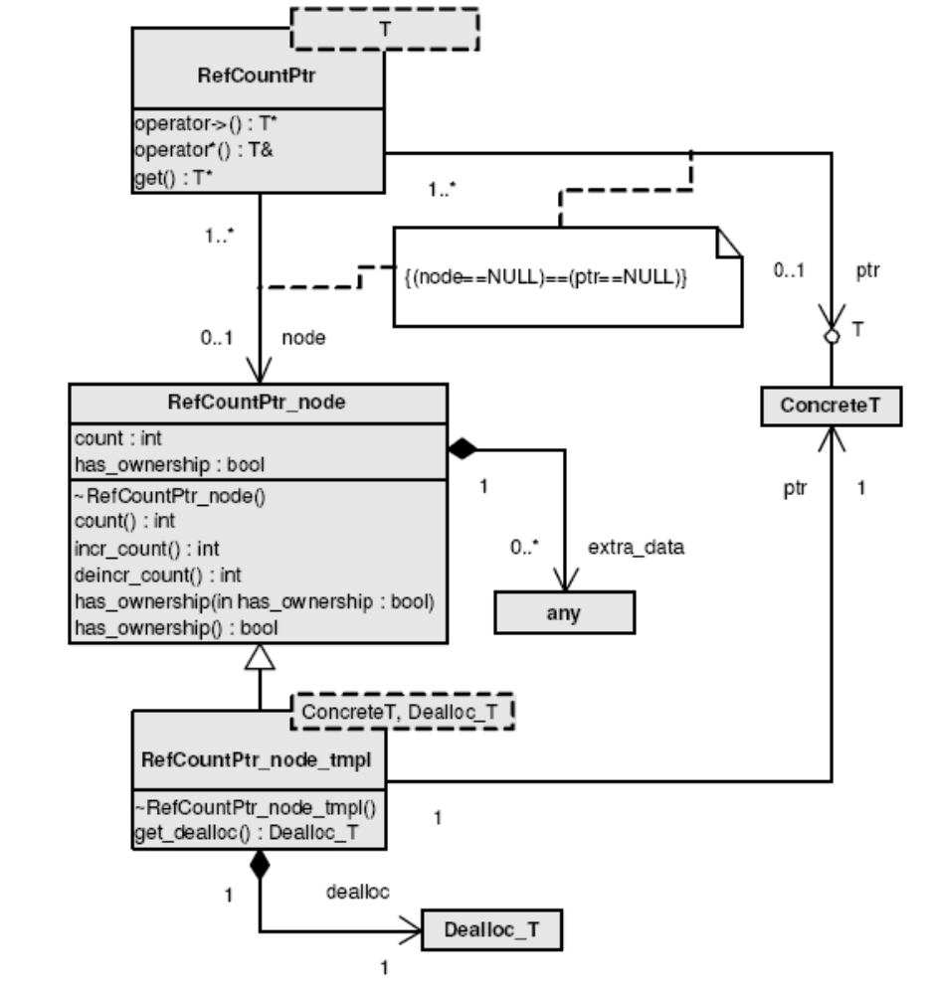
Design of RefCountPtr

