Slide 1
Quantum Cryptography
Today and Tomorrow
Or,
How to Make and
Break Quantum Cryptosystems
(Without Being an Expert in Quantum Mechanics)
Summer Undergraduate Research Fellowship Seminar
Rick Kuhn
kuhn@nist.gov

Slide 2
Goals of Talk
Very brief summary of cryptography
  Impact of technology
Introduce basics of quantum cryptography
  Learn a little bit about quantum mechanics along the way
Explain two types of quantum crypto protocols
Show how to break quantum crypto
  To understand the engineering difficulties of going from theory to practice

Slide 3
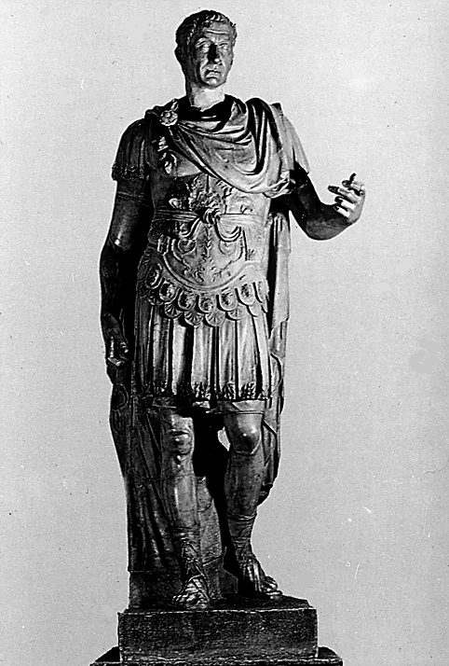
Old Style Cryptography
Shift of alphabet
  e.g. Caesar cipher A=D, B=E, C=F
  Probably never fooled anybody
  (except Caesar)
Many more sophisticated systems developed from 1500s to mid-20th century
  Substitution and transposition of letters
  Some essentially unbreakable by manual means
Made obsolete by computers circa 1940

Slide 4
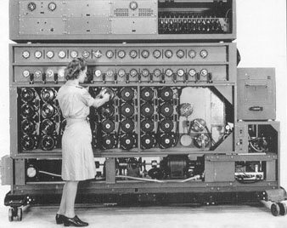
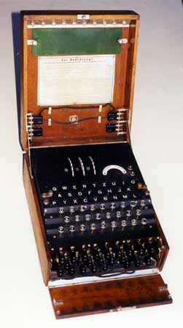
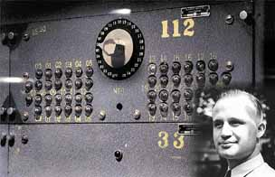

Technology Determines What is Breakable
Enigma vs. Human – Enigma wins!
Turing's machine
Enigma vs. Computer
– computer wins!
Desch's machines – even faster
Weakest part of cryptosystem

Slide 5
Modern Cryptography
One: hard problems in mathematics
  Breaking the system requires an efficient algorithm for solving a hard problem – e.g. Factoring large numbers, discrete logarithms
  Examples: RSA, El Gamal
  Used in public key systems
  Slow
Two: information theory
  Texts scrambled by repeated application of bit shifts and permutations
  Examples: DES, AES
  Used in private key systems
  Fast

Slide 6
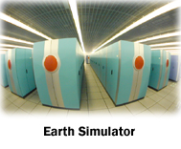
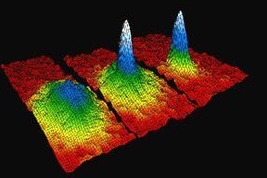
Technology Determines What is Breakable
RSA Cryptosystem
C = Me mod n
d = e⁻¹ mod ((p-1) (q-1))
RSA vs. supercomputer: 40 Tflop/s (4 x 10¹² flop/sec)
– RSA wins!
RSA vs. Quantum Computer
– computer wins!

Slide 7
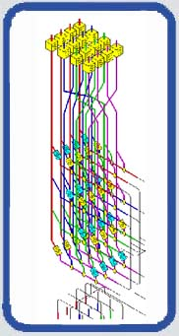
Modern Ciphers vs. Quantum Computer
“Hard problem” variety
  Exponential speedup – easily breaks algorithms such as RSA
  If information requires long term protection (e.g. 20+ years), these algorithms are already dead
“Information theory” variety
  Quadratic speedup (so far)
  Longer keys can keep them useful

Slide 8
Quantum Crypto – Why?
Protect against attack by quantum computer
  or any future machine
Eavesdropping detection
  Hard to do now
High volume key distribution
  If it can be made fast enough

Slide 9

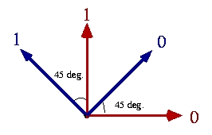
Quantum Mechanics for Cryptography – Measurement Basis
Basis – frame of reference for quantum measurement
Example – polarization
vertical/horizontal vs. diagonal
  Horizontal filter, light gets through = 0
  Vertical filter, light gets through = 1
  45 deg. filter, light = 0
  135 deg. filter, light = 1

Slide 10

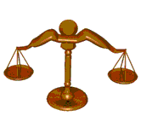

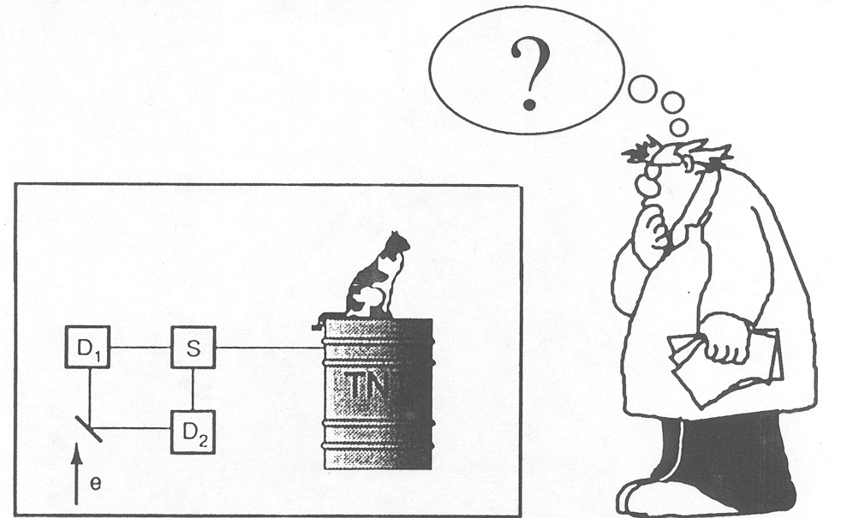
Quantum Mechanics for Cryptography- Superposition
Superposition – in “2 states at once” (at least think of it that way), until measured
Probability of either
result can be varied
Schrodinger's cat – dead and alive

Slide 11

Quantum Mechanics for Cryptography - Entanglement
Entanglement – like superposition, but more so
  Measuring one determines result for all
  No matter where they are in the universe!
  Result is unpredictable, but same result for all
A
B
A
B
A
B

Slide 12

Classical interlude – unbreakable cipher
1 0 1 1 0 0 1 0 1 0 0 1 1 1
XOR
0 0 1 0 01 1 0 1 0 1 1 0 1
All keys equally likely
Can't determine unique key
So can't determine original message
Key can never be reused
Key must be same length as message
=> impractical for most use
1 0 0 1 0 1 0 0 0 0 1 0 1 0
One time pad or Vernam cipher

Slide 13
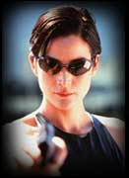
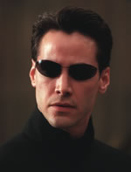
Quantum Key Distribution
Alice
Bob
Polarized photons sent from Alice to Bob
Bob measures
in basis
Result
Send
50%
X
50%
+
100%

Slide 14
Quantum Key Distribution
BB84 protocol – Bennett and Brassard, 1984
Bob measures
in random basis
Alice
Result
X
+
+
X
X
+

Slide 15
BB84 Quantum Key Distribution
Alice tells basis used
Bob compares w/ his basis
+
Throw away
+
0
X
Throw away
X
1
X
0
+
0

Slide 16
Quantum Key Distribution – detecting eavesdropping
Eve's
basis
Bob measures
in basis
Alice
Result
+
X
Throw away
X
+
ERROR!
Eve detected!
+
+
Throw away
X
X
1
X
X
0
+
+
0

Slide 17
BB84 Result
Alice and Bob share a random bit string that can be used as a one time pad for encryption/decryption
Eavesdropping is detected as a 25% error rate in transmission
1 0 1 1 0 0 1 0 1 0 0 1 1 1 . . .

Slide 18

Ping Pong Protocols
Beige, Kurtseifer, Englert, Weinfurter – 2002
Several variations by different developers
Outline:
  Alice creates entangled pair
  Alice sends one qubit to Bob
  Bob rotates according to secret operation
  Bob returns qubit to Alice
  Alice measures with her qubit to determine operation
  Security: need both qubits to measure;
  Eve does not know basis

Slide 19
Ping Pong Protocol
Create entangled pair
No change = 0
Transform = 1
Send one qubit
Both qubits needed to measure
Return
No change = 0
Transform = 1

Slide 20
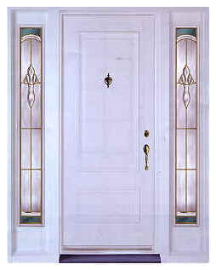
Breaking Quantum Crypto Protocols
Similar to breaking conventional crypto protocols
Choose one:
  Break crypto algorithm
  Look for weaknesses and
  flaws in implementation
  (find an invalid assumption
  and exploit it)

Slide 21
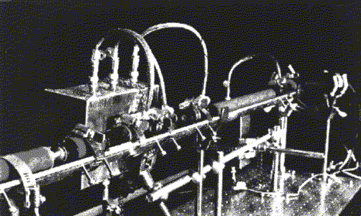
Breaking Quantum Crypto
Break underlying cryptography
  No go – laws of physics make it unbreakable
Attack the implementation
  Hardware
  Protocols
  Software

Slide 22
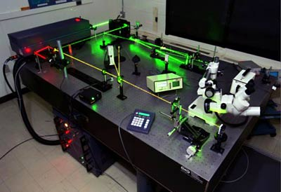
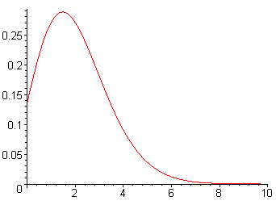
Attack Hardware Implementation
BB84
Attenuated lasers used to generate average of one photon per time slice
Poisson process ensures that sometimes there will be more than one
Pick out extras - “photon number splitting”

Slide 23


Attack the Protocol
Eve captures qubit from Alice, creates entangled pairs, forwards one qubit to Bob
Eve measures return qubit from Bob, duplicates his measurement on captured qubit, returns to Alice - Eve can determine basis from stray qubits, since Bob's distribution of bases is 50/50
Capture
Eve creates pair
Transform

Slide 24
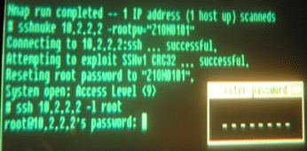
Attack Software Implementation
Quantum crypto running in a TCP/IP network
on top of ordinary servers and operating systems
'nuff said!

Slide 25
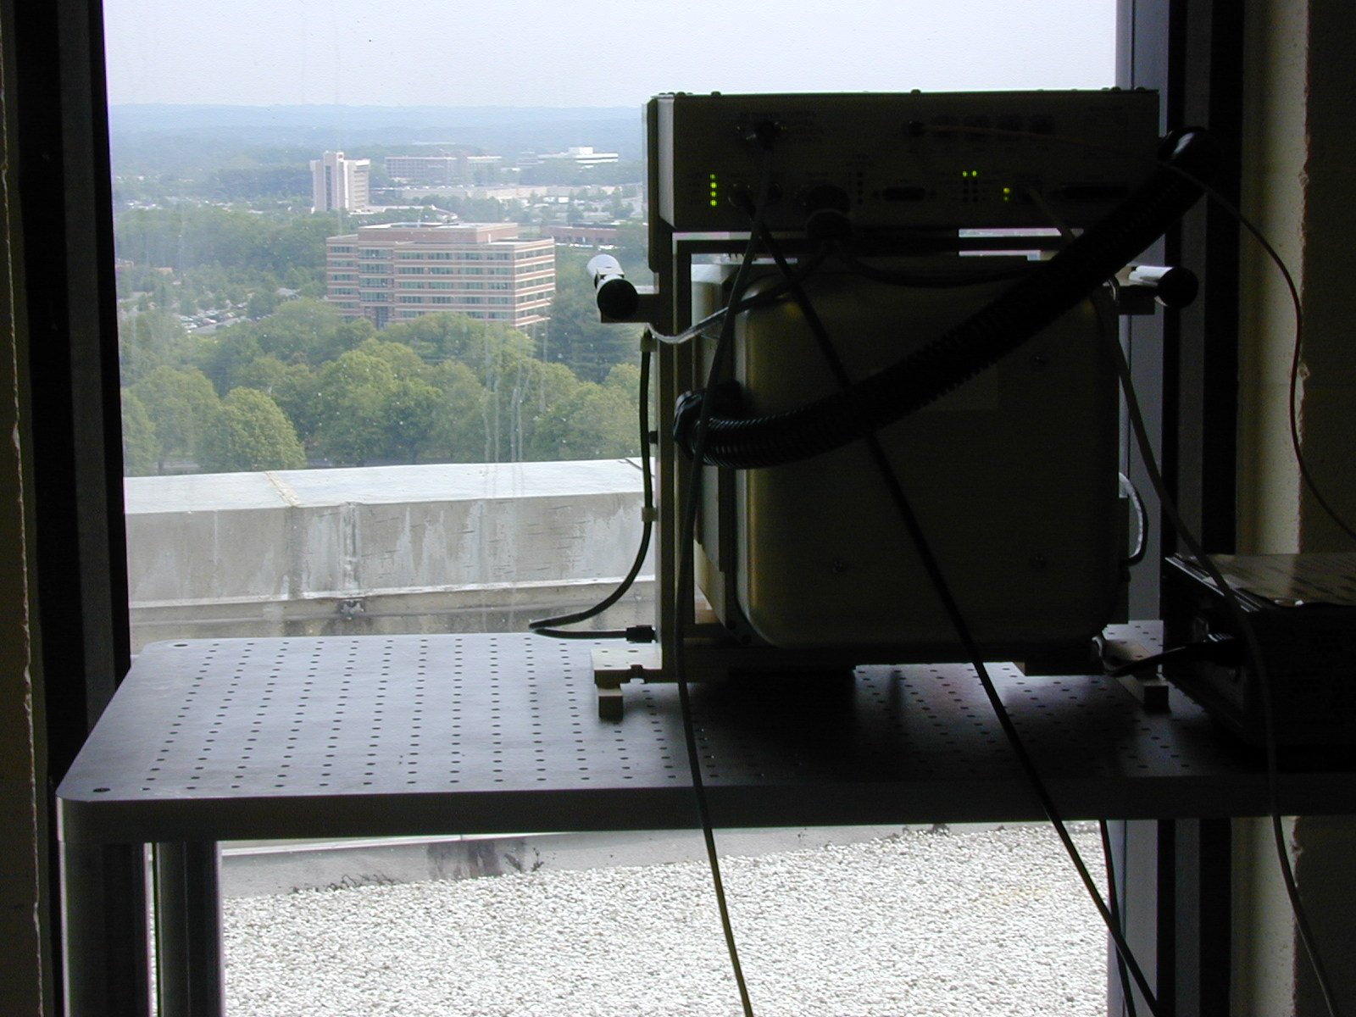
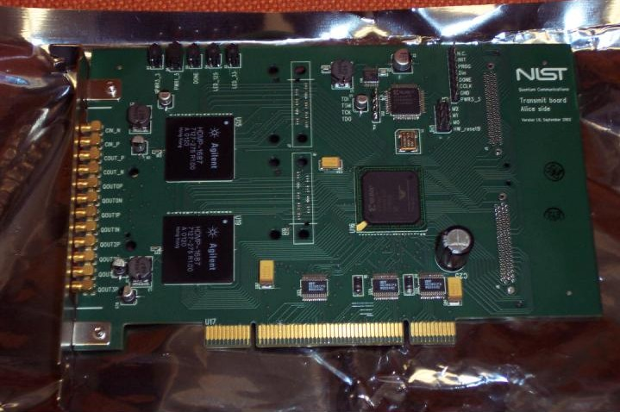
NIST Quantum Communication Testbed
Scalable, high speed quantum network
Provides a measurement infrastructure for quantum protocols, and testbed for experiments

Slide 26


Industrial Prospects and Tech Transfer
Selling points
  Protect secrets long-term/forever $
  Distribute large volumes of key efficiently $$
Currently two (count 'em!) commercial implementations of quantum crypto
Potential markets?
  Financial services (large key volume)
  Government/military (long term secrecy, key dist.)
  Ultra-high bandwidth networks, media/content distribution??

Slide 27
To Probe Further
Introduction to quantum computing and crypto:
  qubit.org
  “Quantum Computing and Communications”,- introductory technical article on NIST site below:
NIST quantum information testbed: math.nist.gov/quantum

Slide 28
Questions?

