Slide 1
L3DAQ
An Introduction
Michael Clements 5/5/03

Slide 2
A Quick Glance
The DZero DAQ
L3DAQ components
L3DAQ communication
An in depth look at monitoring
Michael Clements 5/5/03

Slide 3
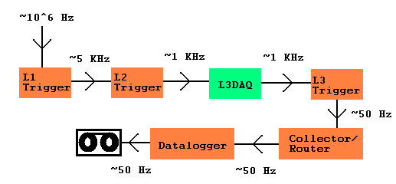
Dzero DAQ
63 readout crates in DAQ
0-20 kb/crate/event
Maximum events size ~250kb

Slide 4
The Players…. L3DAQ Components
L3 is comprised of both hardware and software components
Hardware
Software
SBC
2948G Ethernet Switches
6509 Ethernet Switch
Farm Nodes
Routing Master
Supervisor
Node Processes
SBC Processes
Monitoring
Michael Clements 5/5/03

Slide 5
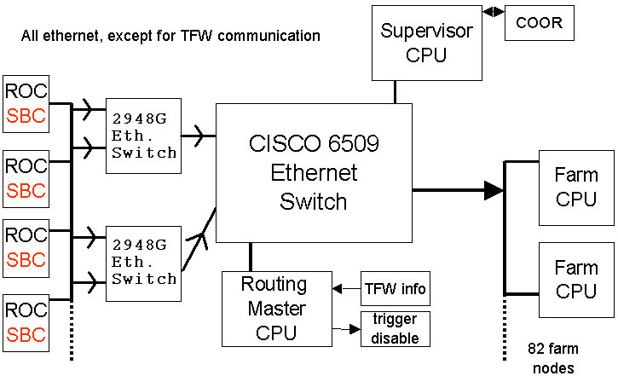
L3DAQ - Overview

Slide 6
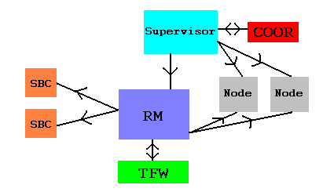
L3DAQ – Communication Flow

Slide 7
SBC – Single Board Computer
2 main functions
  Readout controller for event data (many instances)
  Routing master (1 instance)
PIII 933Mhz, 128Mb RAM, 128Mb flash, 2 100 Mb/s Ethernet ports
Tundra Universe II chip as VME-PCI interface
  Programmable DMA controller
PMC expansion slot
  Holds BVM DIO module responsible for VME readout over J3 backplane
Michael Clements 5/5/03

Slide 8
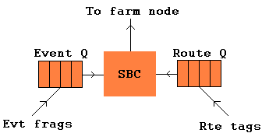
SBC – Logic & Operation
Event fragment thrown out after 1s if still waiting for route tag
Route tags thrown out after several seconds if no event fragment
If evt# in event fragment > evt# in route tag, throw out route tag
If evt# in event fragment < evt# in route tag, throw out fragment
Michael Clements 5/5/03

Slide 9
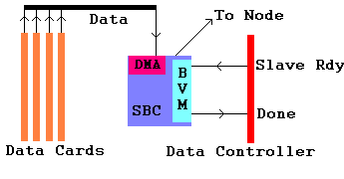
SBC – How a Crate Reads Out
Michael Clements 5/5/03

Slide 10
SBC – Routing Master Basics
Receives crate list per bit and list of farm nodes from Supervisor
Receives bits fired, event number from TFW
Chooses which nodes to send event for filtering
Sends routing info to SBCs based on event #
Sends crate info to nodes based on event#
Receives number of available buffers from nodes
If number of available buffers in the farm becomes to low, RM
can disable triggers allowing farm can catch up
Michael Clements 5/5/03

Slide 11
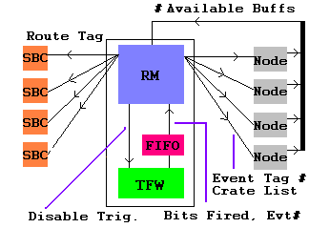
SBC – Routing Master Comm. Flow
Michael Clements 5/5/03

Slide 12
Ethernet Switches
2984G switch
  Concentrates signal from up to 10 100Mb/s connections to 1Gb/s optical line
  Limits number of 100Mb/s connections to prevent network congestion
6509 switch
  Receives the Gigabit links and connects to the L3 nodes
Michael Clements 5/5/03

Slide 13
L3 Farm Nodes
48 Dual PIII 1GHz, 1GB RAM
34 Dual AMD Athlon 2GHz, 1GB RAM
Dual Ethernet ports
  One dedicated to online system
  One dedicated to L3DAQ
Runs several processes
  Event builder (EVB)
  Filtershell process (actually 2 running instances)
Michael Clements 5/5/03

Slide 14
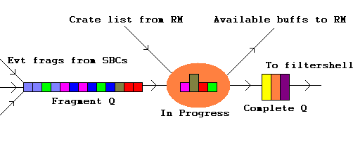
Node – Event Builder
Always connected to all SBCs (including RM)
In-progress has a 1s timeout, resulting in incomplete event
Max of 3 buffers advertised to RM to limit data flow into 6509
Michael Clements 5/5/03

Slide 15
Supervisor
Primary function is L3 interface to COOR
Communicates with ScriptRunner and RM
  No communication with SBCs or EVB
Sends RM crate list per bit and node info
  RM complains if nodes/SBCs not connected
Sends trigger programming to ScriptRunner when a trigger download is performed
Michael Clements 5/5/03

Slide 16
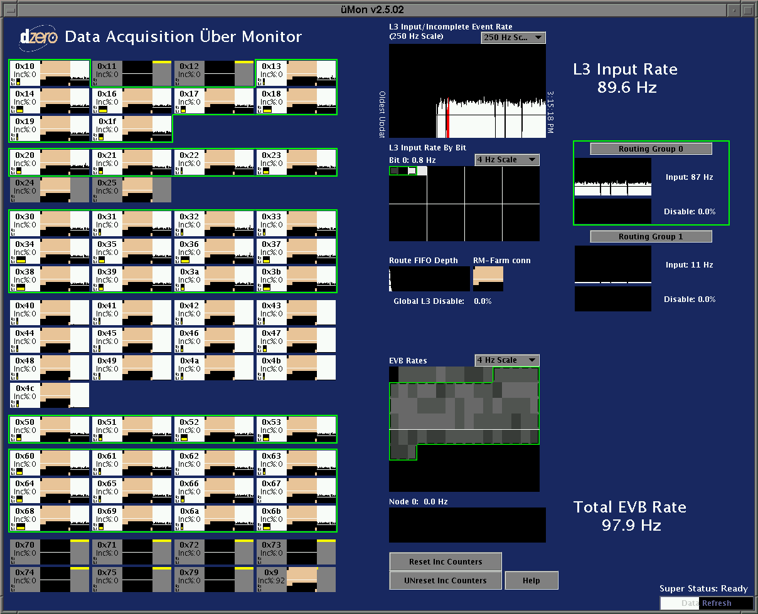
uMon

Slide 17
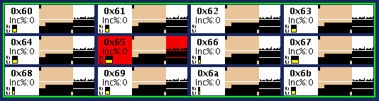
uMon – Front End Crates
uMon monitors from the Routing Masters perspective!
When crate color is….
  Red: At least one event fragment from the crate did not reach the farm. Included in a run.
  Yellow: Monitoring information is not available for the crate. Included in a run.
  White: Included in a run and experiencing no problems .
  Grey: Crate not included in a run.

Slide 18


uMon – Front End Crates, Part 2
“Inc%: XX” monitors the percentage of events from a crate that have been missing.
  This is a running total. Hitting the “Reset Inc Counters” button will reset this total to zero. To go back to the running total simply hit the “Unreset Inc Counters”
Live SBC connections to the farm nodes are shown as beige boxes, otherwise black. The uppermost left box is node 0 (which does not exist and is therefore always black), next is node 1 and so forth. The lowermost right box is the SBCs connection to the Routing Master (beige connected, black not).
The strip chart is the rate which the SBC is reading from crate electronics.

Slide 19
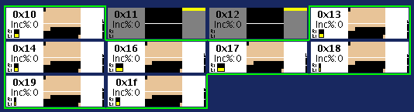
uMon – Front End Crates, Part 3
Yellow block on the strip chart indicates no monitoring info from SBC
Route Q bar chart:
  Fractional use of route Q
Event Q bar chart:
  Fractional use of event Q
Both charts utilize yellow on black background
Route Q should be nearly empty and event Q should be < 2/3

Slide 20
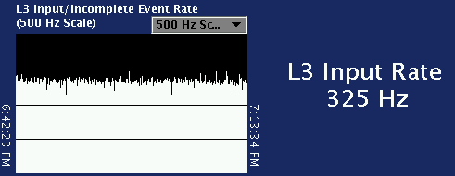
uMon – L3 Input/Inc. Event Rate
Strip chart shows the rate at which the RM is receiving/sending event tags
The “L3 Input Rate” is just the instantaneous rate
Pull down list allows the vertical scale of the chart to be changed
A yellow bar at the top of the strip chart indicates that there is not monitoring
information available.

Slide 21
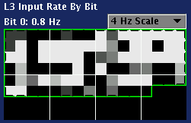
uMon – L3 Input Rate By Bit
Blocks, going from left to right, correspond to L1/L2 trigger bits 0 to 127
The grayscale of each block represents the rate of the particular trigger
with black being 0 Hz and white maximum rate.
Clicking on a block will display the corresponding bit and its current rate
Scale may be selected from drop down menu

Slide 22

uMon – Route Fifo Depth
“Global L3 Disable” gives the fraction of time since the last update
that the Routing Master has disabled triggers.
“Route FIFO Depth” histogram shows the number of events in the TFW FIFO as determined by polls from RM conducted every 10ms.
“RM-Farm conn” shows the RM connections to the farm nodes.

Slide 23
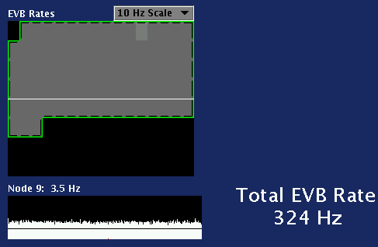
uMon – EVB Rates
“EVB Rates” shows the
EVB input rate into
each individual node.
Missing event rate as
fraction of the total for a
node will show as a red
bar chart on top of the
bin.
“Node” strip chart
shows the EVB rate of
the chosen node over a
period of ~20 minutes
“Total EVB Rate” shows the input rate into all EVB processes on L3 farm.

Slide 24
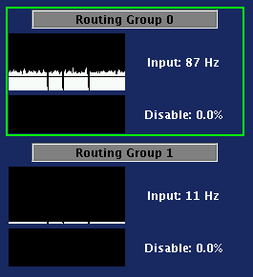
uMon – Routing Groups
Selecting a routing group will highlight all
crates associated with that group.
Input is given for each group
Disable fraction is given for each group

Slide 25
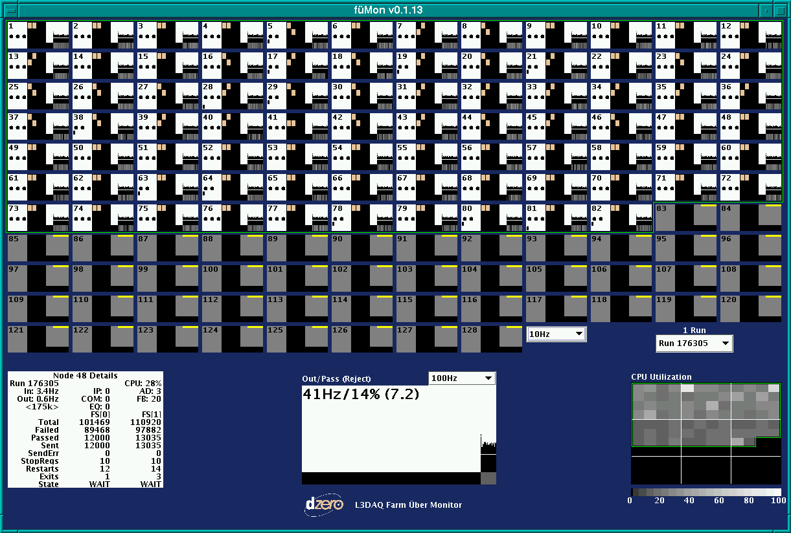
fuMon

Slide 26
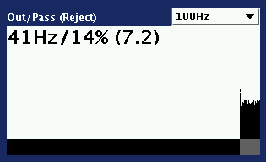
fuMon – Output/Pass Rate
fuMon monitors from the nodes perspective!
Main strip chart shows total output rate of the farm
Smaller chart shows pass fraction as grayscale bars
Scale may be changed by drop down menu
Reject is the ratio of input_events/sent_events over entire farm

Slide 27




fuMon - Nodes
When the color is…
  Orange: 10 or more complete EVB buffers waiting for processing by FS
  Red: One or more events were incomplete and dropped by EVB
  White: In a run and experiencing no problems
  Grey: Not in a run.
Three black dots represent # of advertised free buffers to RM
First bar chart represents in process EVB buffers
Second bar chart represents complete EVB buffers

Slide 28

fuMon – Nodes, Part 2
2 beige boxes in the middle represent the state of the two filtershell processes
running on the node.
  1st (highest) position: WAIT
  2nd position: FILTER
  3rd position: FLATTEN
  4th position: SEND
Top strip chart shows the event rate into the filtershell processes
Bottom strip chart shows the pass fraction for the filtershell processes
A yellow bar on the top of the strip chart indicates there is no monitoring info

Slide 29
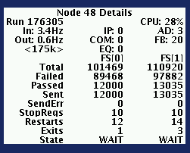
fuMon – Node Details
Clicking on a particular node will give you detailed instantaneous
information about that node.

Slide 30
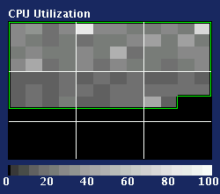
fuMon – Node CPU Usage
“CPU Utilization” shows what fraction of the nodes total processing power is
being consumed.

Slide 31
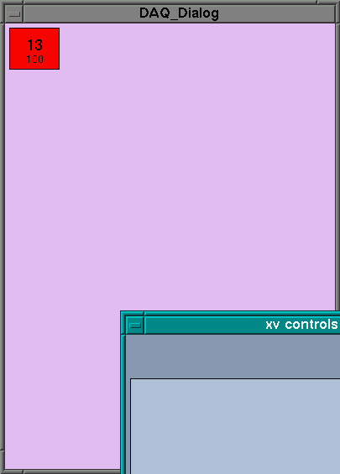

DAQ Dialog

Slide 32
Typical Problems
Not enough nodes in run
  Symptom: L3 disables, nodes in FILTERING
  SMT/CFT/CAL in full-readout mode?
Collector Router backed up
  Farmnodes orange (SENDING) in fuMon
  L3 output rate too high or event size too large
  Farmnodes wont respond to Super when SENDING
    Supervisor appears hung
    Must PAUSE and wait OR restart farmnodes and Super
Crate 100% missing
  Almost always a component problem
  Check Route and Event queue state in uMon

Slide 33
Some Useful Scripts
Supervisor
  start_daq l3supervisor
Nodes
  l3xreset <node>, or l3xreset to reset entire farm
Monitor server
  l3xdaq_monitor_server
SBC
  l3xdaq_reset <sbc>
SBC scripts
  is_crate_requesting_readout.sh (SlaveReady asserted?)
  getInfo.sh (sbc driver stats and status)
  sbc_config_rdwr (VME targets and modes)
  reset_all.sh (restarts processes)

Slide 34
Website
http://www-d0online.fnal.gov/www/groups/l3daq/default.html
  Documentation for all monitoring packages
  This and previous Level 3 talks and papers
  “What to do when” page for troubleshooting L3 problems
  Log files for the SBCs, Supervisor, Monitor Server, & daqAI
  On call expert list

Slide 35
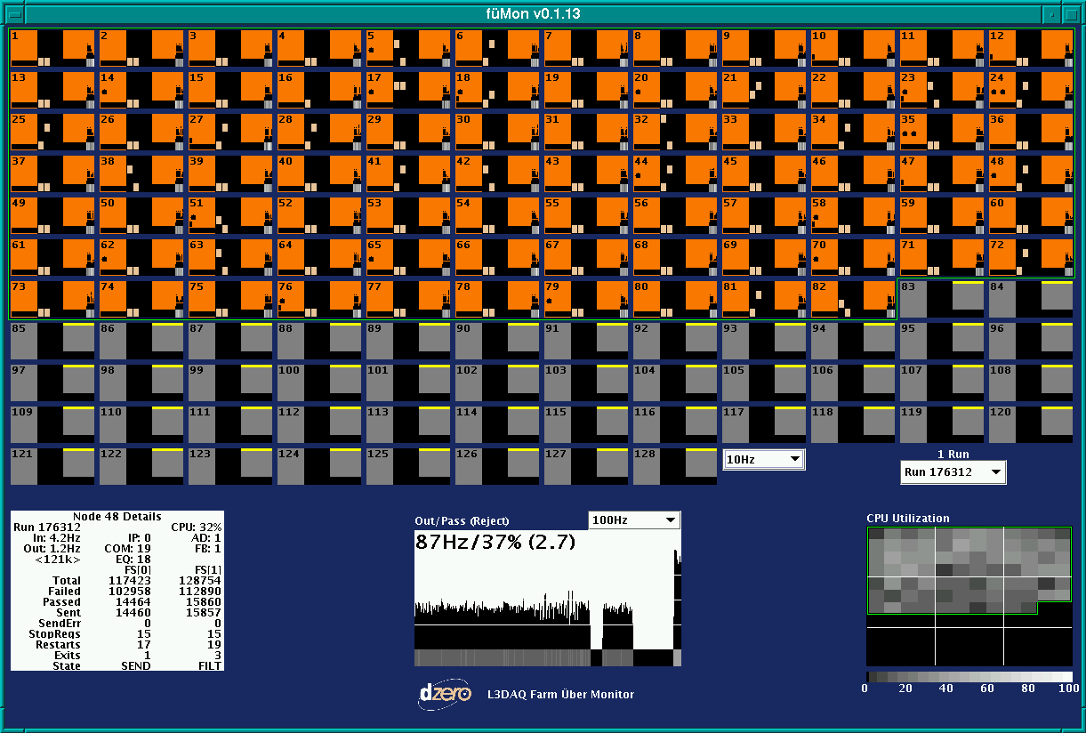

Slide 36
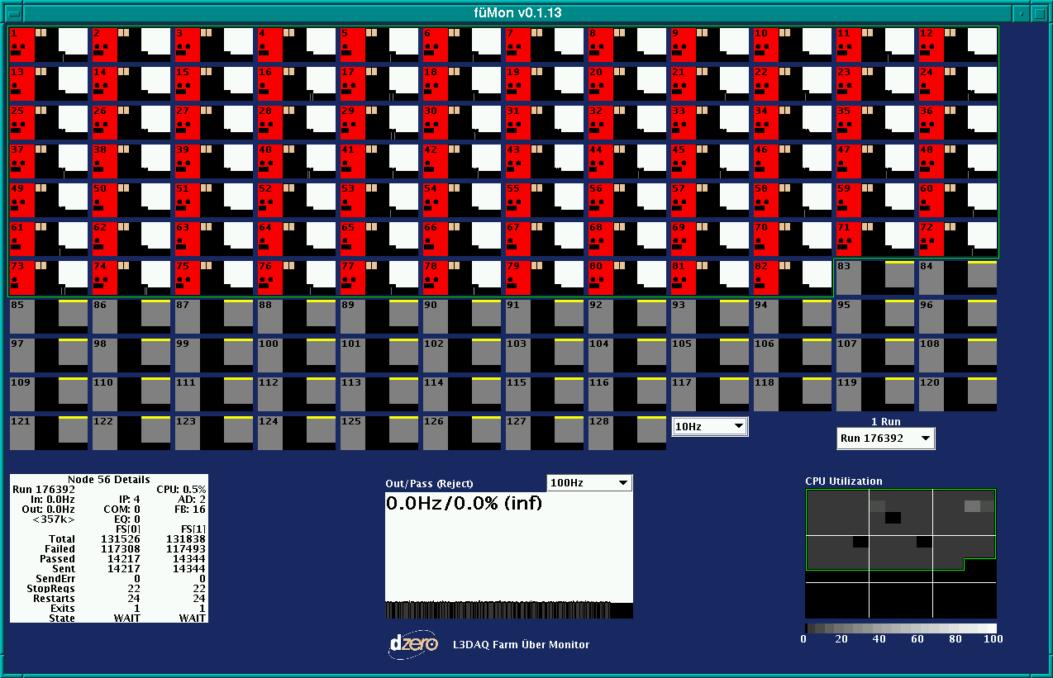

Slide 37
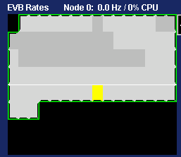
Missing Node Info

