Slide 1

A Crash Course in Supercomputing: MPI Programming Project
Rebecca Hartman-Baker
Oak Ridge National Laboratory
hartmanbakrj@ornl.gov
© 2004-2006 Rebecca Hartman-Baker. Reproduction permitted for non-commercial, educational use only.

Slide 2
Outline
Project description
Programming concepts
Parallelization strategies

Slide 3
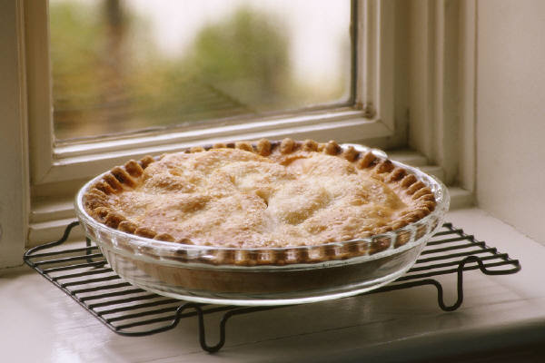
I. Project Description
We want to compute π
One method: method of darts
Ratio of area of square to area of inscribed circle proportional to π

Slide 4
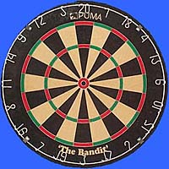
Method of Darts
Imagine dartboard with circle of radius R inscribed in square
Area of circle
Area of square
Area of circle
Area of square

Slide 5
Method of Darts
So, ratio of areas proportional to π
How to find areas?
  Suppose we threw darts (completely randomly) at dartboard
  Could count number of darts landing in circle and total number of darts landing in square
  Ratio of these numbers gives approximation to ratio of areas
  Quality of approximation increases with number of darts
π = 4 × # darts inside circle
# darts thrown

Slide 6
Method of Darts
Okay, Rebecca, but how in the world do we simulate this experiment on computer?
  Decide on length R
  Generate pairs of random numbers (x, y) s.t. -R ≤ x, y ≤ R
  If (x, y) within circle (i.e. if (x²+y²) ≤ R²), add one to tally for inside circle
  Lastly, find ratio

Slide 7
II. Programming Concepts
Random numbers: in C language, function int rand(void) generates “pseudo-random integer in range 0 to RAND_MAX”
RAND_MAX: C-language constant denoting maximum random number generated; actual value varies with implementation
Divide “random” number by maximum random number to get a number between 0 and 1

Slide 8
Programming Concepts
Type cast and coercion:
  int a = rand(); double b = a/RAND_MAX;
    b equals 0
  int a = rand(); double b = ((double) a)/((double) RAND_MAX);
    b equals correct value
  Type conversion rules:
    int/int → int
    int/double → double
    double/int → double
    double/double → double

Slide 9
Programming Concepts
Numbers generated by rand() not really random; same sequence every time
Change seed for random number generator with void srand(unsigned int seed)
Datatypes:
  For a lot of darts, need larger datatype than int or risk overflow
  On some computers (varies by platform):
Data Type | Range
int | -32,768 — +32,767
long int | -2,147,483,648 — +2,147,483,648
unsigned long int | 0 — +4,294,967,295

Slide 10
III. Parallelization Strategies
What tasks independent of each other?
What tasks must be performed sequentially?
Using PCAM parallel algorithm design strategy

Slide 11
Partition
“Decompose problem into fine-grained tasks to maximize potential parallelism”
Finest grained task: throw of one dart
Each throw independent of all others
If we had huge computer, could assign one throw to each processor

Slide 12
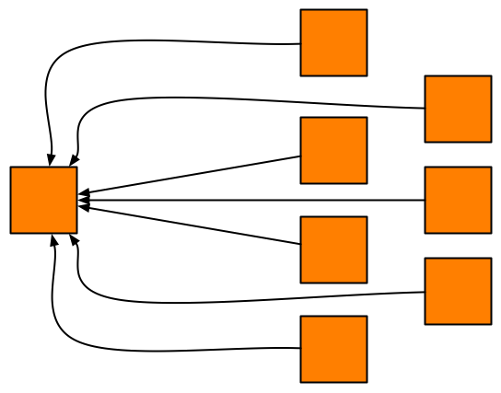
Communication
“Determine communication pattern among tasks”
Each processor throws dart(s) then sends results back to manager process

Slide 13
Agglomeration
“Combine into coarser-grained tasks, if necessary, to reduce communication requirements or other costs”
To get good value of π, must use millions of darts
We don’t have millions of processors available
Furthermore, communication between manager and millions of worker processors would be very expensive
Solution: divide up number of dart throws evenly between processors, so each processor does a share of work

Slide 14
Mapping
“Assign tasks to processors, subject to tradeoff between communication cost and concurrency”
Assign role of “manager” to processor 0
Processor 0 will receive tallies from all the other processors, and will compute final value of π
Every processor, including manager, will perform equal share of dart throws

Slide 15
Bibliography/Resources
Heath, Michael T. (2006) Notes for CS554: Parallel Numerical Algorithms, http://www.cse.uiuc.edu/cs554/notes/index.html
Kernighan, Brian W. and Dennis M. Ritchie. The C Programming Language, 2nd ed. Upper Saddle River, NJ: Prentice-Hall, 1988.
C: The float and double Data Types and the sizeof Operator http://www.iota-six.co.uk/c/b3_float_double_and_sizeof.asp
C Data types http://www.phim.unibe.ch/comp_doc/c_manual/C/CONCEPT/data_types.html

