Slide 1



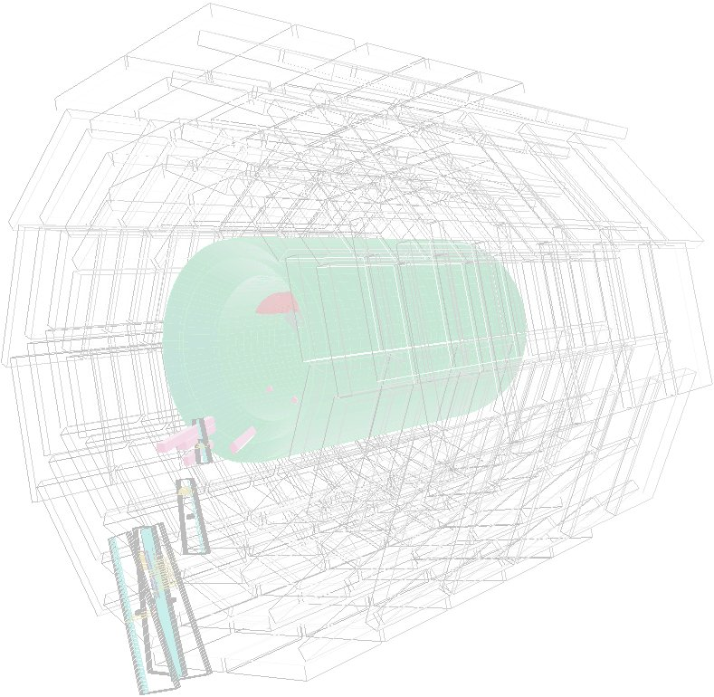
CSC DPG meeting Feb. 1st 07
CSC Segment finding - part III
S. Stoynev¹, M. Schmitt¹,
E. James², I. Bloch²
1 - Northwestern University
2 - Fermilab
Finding pre-clusters
Optional segment pruning
Compare ST with TC
Conclusions

Slide 2
Pre-clustering in the chamber plane (xy)
Aim:
  Avoid considering clearly separated hits when building segments
      Build (rough & fast) local xy-groups of separated
  hits and calculate xy-mean and xy-size of groups.
  Do segment finding on these smaller groups
  or optionally special treatment when group is too large
  (use e.g. only use group mean x and y then)
Requirements:
fast:
avoid CPU intensive calculations e.g. sqrt
stop loops as early as possible
robust:
independent of sorting of hits
rather group up too many hits than split hits off a segment
xy coordinates should be fine, as one is clustering roughly only.

Slide 3
Pre-clustering - Method
Accumulate hits that are close in x and y
Define a larger box based on the merged hits
Again merge new box with close hits or boxes.
Implemented as loop over hits:
if 2 hits/boxes closer than Δx < 4cm & Δy < 8cm (current cuts - can be optimized)
=> add&replace, calc. running mean and
open new box defined by hits min/max X and min/max Y:
3
6
2
5
y
1
4
x

Slide 4
Pre-clustering - Method
Accumulate hits into boxes - measure distance between boxes in x and y, add close
boxes:
3
6
2
5
y
1
4
x

Slide 5
Pre-clustering - Method
Accumulate hits into boxes - measure distance between boxes in x and y, add close
boxes:
3
6
2
5
y
1
4
x

Slide 6
Pre-clustering - Method
Accumulate hits into boxes - measure distance between boxes in x and y, add close
boxes:
3
6
2
5
y
1
4
x

Slide 7
Pre-clustering - Method
Accumulate hits into boxes - measure distance between boxes in x and y, add close
boxes:
3
6
2
5
y
1
4
x

Slide 8
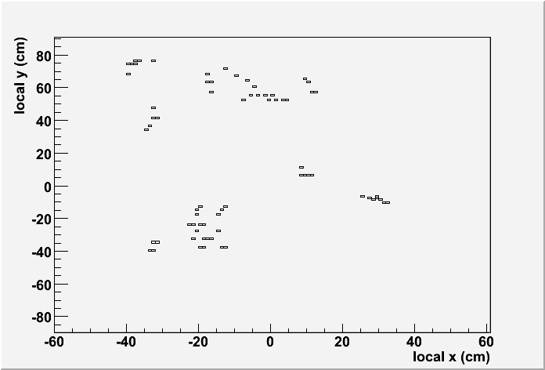
Pre-clustering - Constructed event:
As “training groundƒ overlaid 10 difficult MTCC events:
y
x

Slide 9
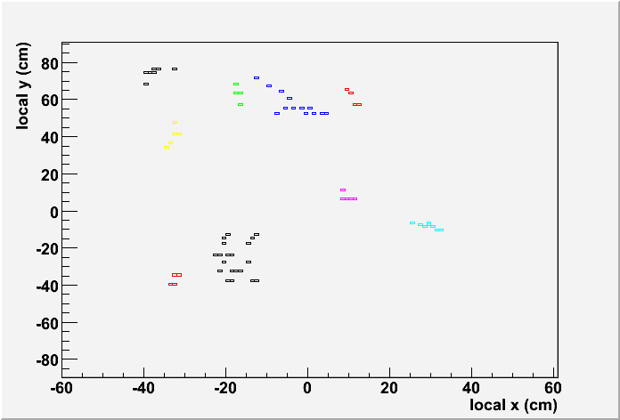
Should we add also
a demonstration, how
the segment finder
finds the original
segments back??
Fun thing...
if we have the time...
Pre-clustering - Constructed event:
This is what is clustered up.
Two overlapping segments stubs get merged:
y
x
The cluster step merges up close hits as desired.

Slide 10
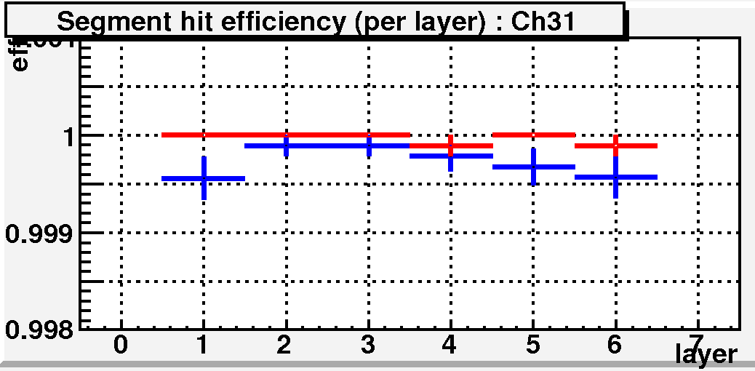
Timing? w / w/o clustering? For ST from Stoyan - I could provide TC
comparison
Pre-clustering - Performance
Benefits of pre-clustering step:
    fast, as explicit distance calculation between all hits are avoided
    could be used to throw exceptions on messy events (more than N
hits in small box)
    may be useful for trigger as rough estimate of x and y of a segment?
    improves speed of standard segment finders by ~10%
    reduces time for large multiplicity events in ST
Clustering does not lead to fake
splitting:
Efficiency to place a hit present on the given layer onto the segment:
ST with clustering
ST without clustering
as proof that no splitting occurs, show Stoyan's efficency! - mention here, show later?

Slide 11
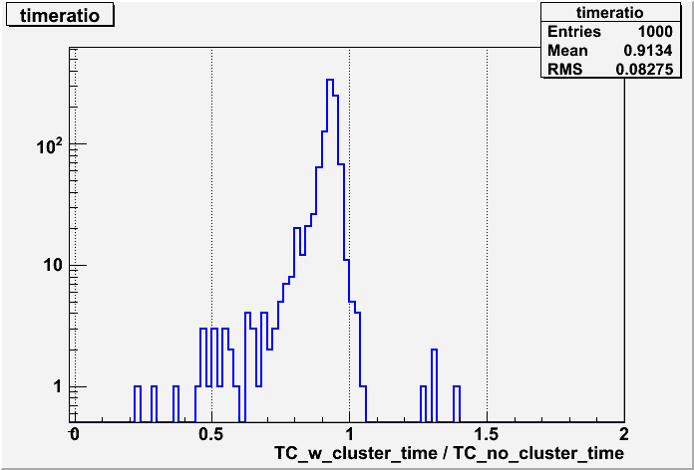
Timing? w / w/o clustering? For ST from Stoyan - I could provide TC
comparison
Pre-clustering - Performance
Benefits of pre-clustering step:
    fast, as explicit distance calculation between all hits are avoided
    could be used to throw exceptions on messy events (more than X
hits in small box)
    may be useful for trigger as rough estimate of x and y of a segment?
    improves speed of standard segment finders by ~10%
    reduces time for large multiplicity events in ST:
with clus.
faster
with clus.
slower
Clustering speeds up other
finders too:
TC (MC) with clustering:
~10% faster
up to 3x faster in tails
as proof that no splitting occurs, show Stoyan's efficency! - mention here, show later?

Slide 12
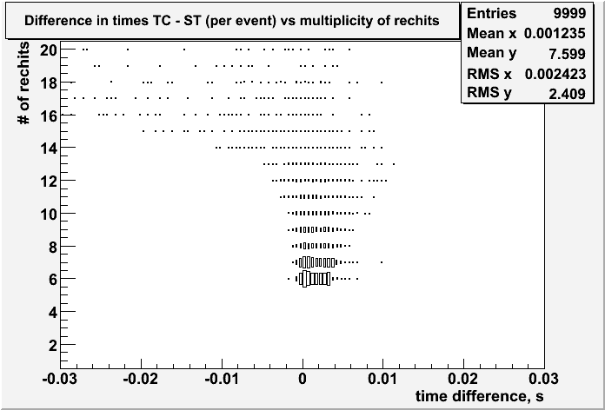
Timing? w / w/o clustering? For ST from Stoyan - I could provide TC
comparison
Pre-clustering - Performance
Benefits of pre-clustering step:
    fast, as explicit distance calculation between all hits are avoided
    could be used to throw exceptions on messy events (more than X
hits in small box)
    may be useful for trigger as rough estimate of x and y of a segment?
    improves speed of standard segment finders by ~10%
    reduces time for large multiplicity events in ST:
Time difference: TC - ST
before clustering:
→ ST slows down at larger
multiplicities
TC faster
ST faster
as proof that no splitting occurs, show Stoyan's efficency! - mention here, show later?

Slide 13
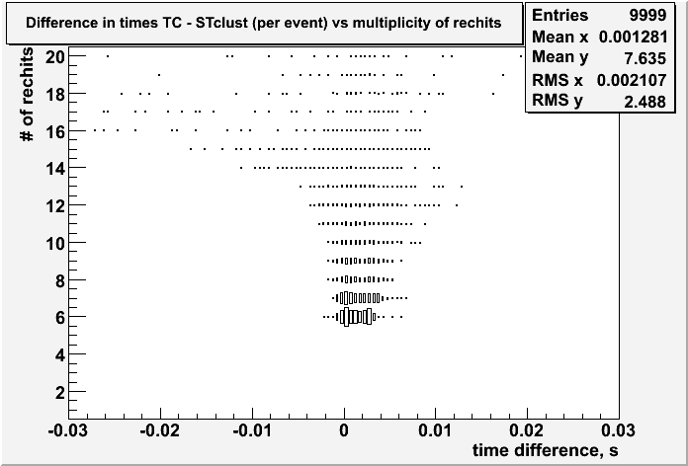
Timing? w / w/o clustering? For ST from Stoyan - I could provide TC
comparison
Pre-clustering - Performance
Benefits of pre-clustering step:
    fast, as explicit distance calculation between all hits are avoided
    could be used to throw exceptions on messy events (more than X
hits in small box)
    may be useful for trigger as rough estimate of x and y of a segment?
    improves speed of standard segment finders by ~10%
    reduces time for large multiplicity events in ST:
Time difference TC - ST
after clustering:
→ ST slow-down is reduced
(further improvements
foreseen inside ST)
TC faster
ST faster
as proof that no splitting occurs, show Stoyan's efficency! - mention here, show later?

Slide 14
show effi before and after (overlaid)
show chi2 before and after
Prefer large number of hits over perfect line - not trying to remove “worst hitƒ
Just pattern, not trying to remove outlier hits!
Segment pruning
In pattern recognition step: find largest number of hits “on a lineƒ.
Find the pattern, don't try to eliminate outlier hits.
Separate step - Pruning: try to remove spurious hit:
Current strategy (needs to be fast!, want to avoid biasing):
    Only for “bad segmentsƒ currently P(χ2,ndf) < 10⁻⁴
    Determine one (just one) “worst hitƒ (modular):
      hit with largest normalized “Δx - residualƒ
      if 1.5 times larger than the 2nd worst (minimum implicit significance >7 sigma)
    Redo fit and replace orig. n-hit segment with (n-1)-hit segment if resulting
    P(n-1) > 1000*P(n) and P(n-1) > 10⁻¹⁰
    Should be expanded to also include e.g. charge, Δy(?), ...
    OUT!!! Alternative cross check method: refit all n-1 combinations and select subsegment with highest P(chi2, ndf) (just as a cross check!)

Slide 15
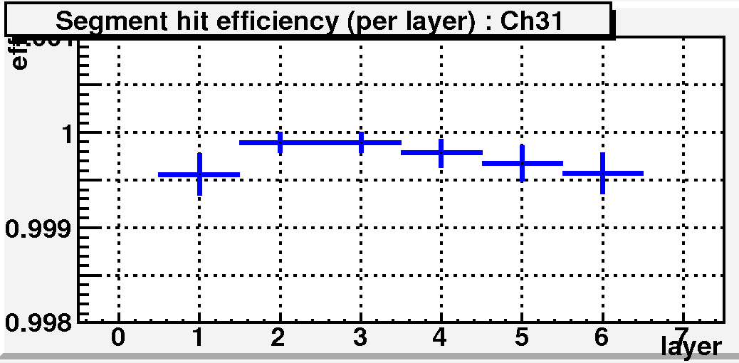
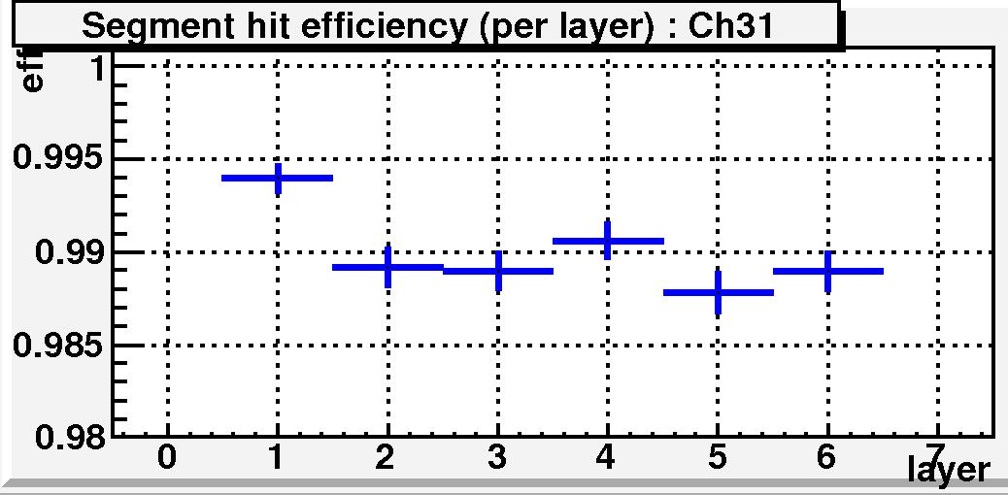
show effi before and after (overlaid)
show chi2 before and after
Segment pruning - ST segment efficiency (data)
Efficiency to place a hit
present on the given layer
onto the segment.
ST before pruning
ST after pruning:
Removal of spurious hits
keeps segment efficiency
at ~ 99%
    OUT!!! Alternative cross check method: refit all n-1 combinations and select subsegment with highest P(chi2, ndf) (just as a cross check!)

Slide 16
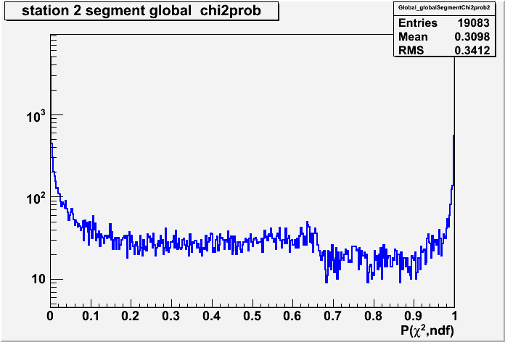
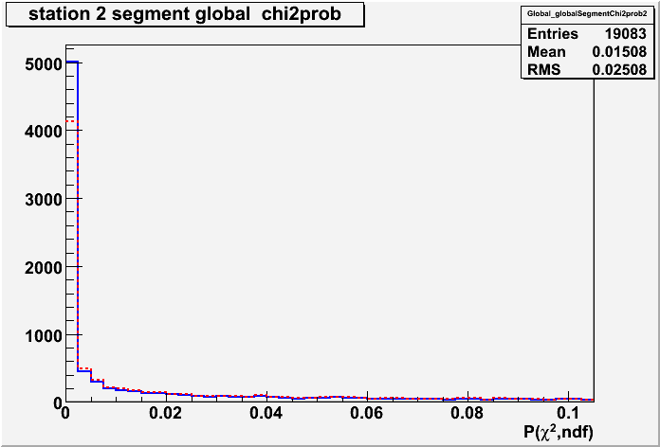
P(Chi2, ndf ) here
show effi before and after (overlaid)
show chi2 before and after
P(Chi2, ndf ) here
Segment pruning - chi2 probability (data)
ST before pruning
Removal of spurious hits reduces
segments with very low probability.
Still too many entries at low probability
- same picture for other finders
→ need to investigate
blue solid: ST before pruning
red dashed: ST after pruning
    OUT!!! Alternative cross check method: refit all n-1 combinations and select subsegment with highest P(chi2, ndf) (just as a cross check!)

Slide 17
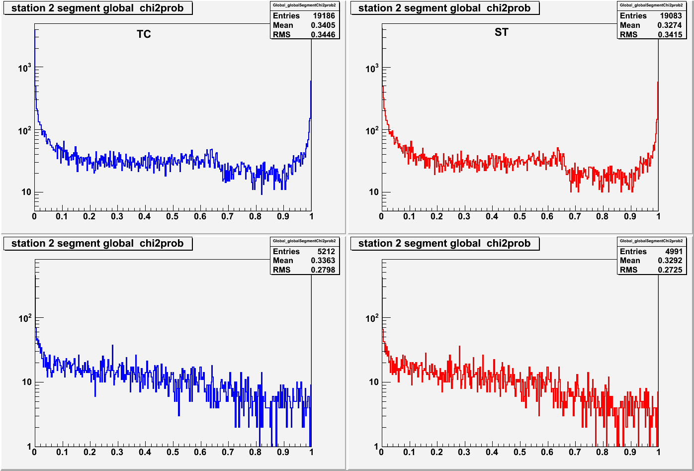
show effi before and after (overlaid)
show chi2 before and after
Segment chi2 probability: TC and ST on data/MC
TC on MTCC data
ST on MTCC data
ST and TC:
Similar P(χ2, ndf)
distributions.
TC on MC
ST on MC
Both data and MC show enhancement at low P(χ2,ndf). Peak at 1 missing in MC.
    OUT!!! Alternative cross check method: refit all n-1 combinations and select subsegment with highest P(chi2, ndf) (just as a cross check!)

Slide 18
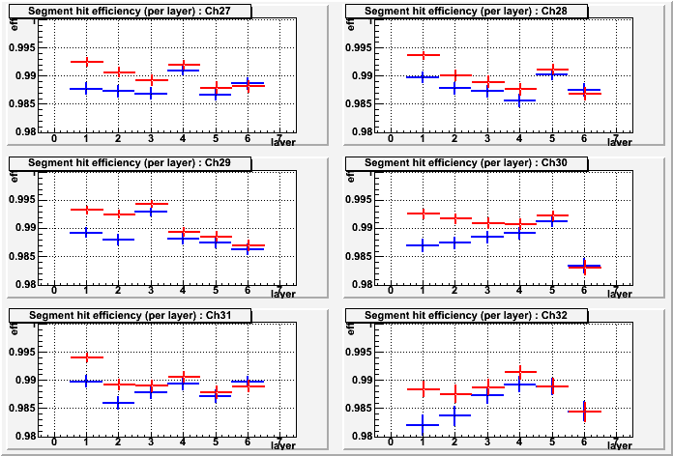
Segment finding - Efficiency TC / ST (data)
Efficiency to place
a hit present on the
given layer onto the
segment.
Both with clustering
and pruning.
ST algorithm
TC algorithm
The behaviour for both ST and TC is similarly flat.
ST yields globally higher efficiency than TC.

Slide 19
Segment finding - Conclusion
New package:
- faster - less biased - more efficient - more modular
than existing finders.
Segment finding is done as pattern recognition
- avoiding biases by swimming
Clustering and pruning step can also be used for other finders
- just plug in your favourite finder.
Actual code not yet releasable
- want some people to help testing it
- we still foresee some improvements in the code
Plan to have it finished in about 1-2 months
We look forward to discussing this further, at UCLA

