Slide 1
A high grade secure VoIP using the TEA Encryption Algorithm
By
Ashraf D. Elbayoumy
2005 International Symposium on Advanced
Radio Technologies
Boulder, Colorado
March 1, 2005

Slide 2
Voice over IP (VoIP)
In recent years, we have witnessed a growing interest in the transmission of voice using the packet-based protocols. Voice over Internet protocol (VoIP) is a rapidly growing technology that enables the transport of voice over data networks such as the public Internet.

Slide 3
About Network Programming
networks are organized as a series of layers (or levels)
the rules to communicate are called protocol
Examples of protocol: TCP, UDP, IP, Ethernet, HTTP
the OSI reference model defines seven layers:
e.g. HTTP, FTP, SMTP
Application
Application
Presentation
Presentation
Session
Session
e.g. TCP, UDP
Transport
Transport
e.g. IP
usually not the concern of
network programmers
Network
Network
Data Link
Data Link
Physical
Physical

Slide 4
Socket
Socket is the endpoints of a communication channel
In Unix, the standard is BSD socket; in Windows, we use WinSock.
WinSock basically follows the BSD socket standard, but there are some modifications.
The latest version, Winsock 2, provides more support for various protocols.
Two types of sockets
  SOCK_STREAM (TCP)
  SOCK_DGRAM (UDP)
TCP is connection-oriented, reliable, … A stream socket works much like an input/output stream.
UDP is connectionless, unreliable, send and receive in packets (may arrive out-of-order)

Slide 5
Typical Work Flow
create socket
create socket
create socket
bind
create socket
bind
bind
wait for
connection
connect to peer
accept
connection
throw/receive
datagram
thru socket
throw/receive
datagram
thru socket
r/w from
socket
r/w from
socket
close socket
close socket
close socket
close socket
connectionless
(SOCK_DGRAM, UDP)
connection-oriented
(SOCK_STREAM, TCP)

Slide 6

Programming Basics
port 1
port 2
port N
Things to fill in:
  protocol
  local IP address, local port
  remote IP address, remote port
IP address is in the form 123.23.23.22
Choose a port:
    some well known ports
    for network programming, choose port number > 1024
111.222.33.4
Transport layer (de-multiplexing)
111.222.33.4
packets arrive

Slide 7
The basic idea behind VoIP
The user’s voice is converted from analogue form into a digital form, compressed and broken down into a series of packets (Packetisation). These packets are then routed through private or public IP networks from one user to another and reassembled and decompressed at the receiving side.

Slide 8
Quality of Service is fundamental to the operation of a VoIP network. Despite all the money VoIP can save users and the network elegance it provides, if it cannot deliver at least the same quality of call setup and voice relay functionality and voice quality as a traditional telephone network, then it will provide little added value.

Slide 9
Among the factors that degrade voice quality are end-to-end delay, packet loss, delay variation, or jitter, voice compression schemes (CODECs), echo cancellation algorithms.

Slide 10
In the case of voice transmission, the maximum acceptable delay in packet delivery for optimal voice quality is 150ms, which can be extended up to 200ms in case of encrypted communications.

Slide 11
The time spent by the CODEC, the device that performs the digitization process, may vary between 0.75-30ms, depending on the coding schemes adopted and the quality of the reproduced signal. The queuing delay (i.e., the time spent by a packet in the router buffers waiting for being routed) may add up to 30 ms. A further delay in the range of 40-70ms, called jitter delay, is introduced by buffering arriving packets so that they can be delivered at a uniform rate.

Slide 12
VoIP Security
Security is a serious bottleneck for the future of VoIP (anyone with physical access to the office LAN can potentially connect network-monitoring tools and tap into telephone conversations) . Because of the time-critical nature of VoIP most of the same security measures currently implemented in today’s data networks could not be used in VoIP networks.

Slide 13
VoIP Security Vulnerabilities
Voice transport protocols
RTP
RTCP
SCTP
Signaling protocols and architecture
SIP
H.323
MEGACO
MGCP

Slide 14
What’s at Risk?
IP phones
Core routers
Media gateways
SIP proxies
Gatekeepers
Location servers
Switches
VoIP-based firewalls
Any equipment in VoIP infrastructure

Slide 15
Voice Data Convergence Multiplies Threats
VoIP inherits IP data network threat models
Reconnaissance, DoS, host vulnerability exploit, surveillance,
hijacking, identity theft, misuse, etc.
VoIP QoS requirements increase exposure to DoS
attacks that affect:
Delay, jitter, packet loss, bandwidth
PCs = authentication; phones = any user
User identity theft
VoIP inherits PBX phone vulnerability
Unauthorized access and privileges, service theft
Device identity theft
Malicious devices on IP network act like IP phones
Reduced service availability, eavesdropping
Inserting/Deleting/Modifying audio streams

Slide 16
Threats from Phreakers and Hackers
Phreakers use phone system to:
Gain free calls
Disrupt system
Fun
Hackers use computer system to:
Gain free services/products
Denial of Service (DoS)
Business
Fun

Slide 17
Denial of Service Threat
DoS venues
Flood
Abuse protocols
Target devices
IP phones (easy)
Routers, switches (depends on equipment)
Signaling gateways, media gateways, SIP proxies
Any device in the path a call takes from a caller to a
called party

Slide 18
Encryption Algorithms:
DES
3DES
IDEA
BLOWFISH
TEA

Slide 19
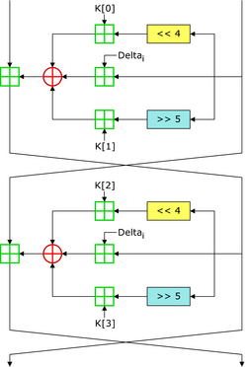
Two rounds of the TEA block cipher

Slide 20
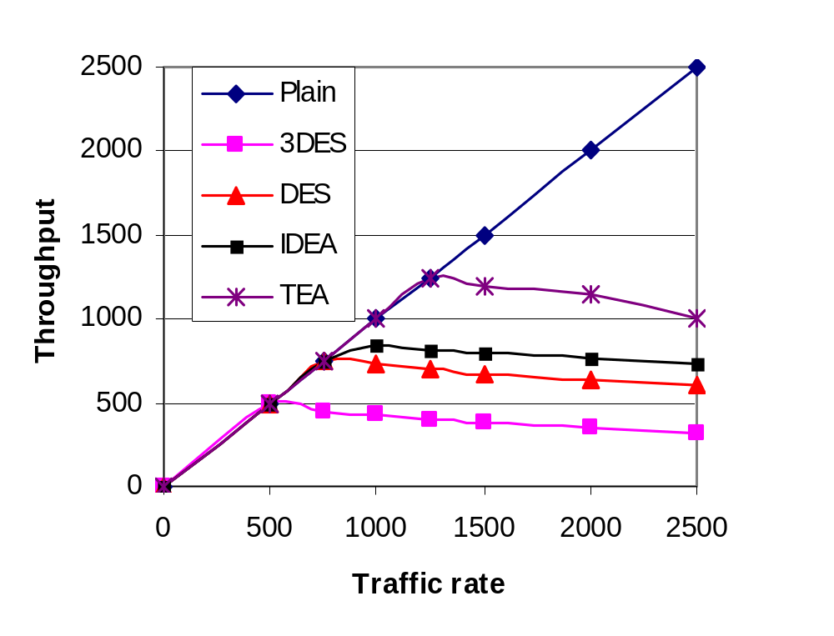

Slide 21
Thank You

