Slide 1
Pharmaceutical Promotion: Perhaps Don’t Throw The Baby Out With The Bathwater
September 22 2003
Robert W. Dubois, M.D., Ph.D.

Slide 2
Potential Impact of Pharmaceutical Promotion
DTC increases the unnecessary use of medications
Promotion leads to greater disease awareness, broader understanding of treatment options, and reduced variation in care

Slide 3
Research Questions
Is there significant inappropriate use of statins, and has the rate of inappropriateness increased over time as DTC promotion has occurred?
Is there greater geographic variation in the use of medications than in the use of surgical or medical procedures?

Slide 4
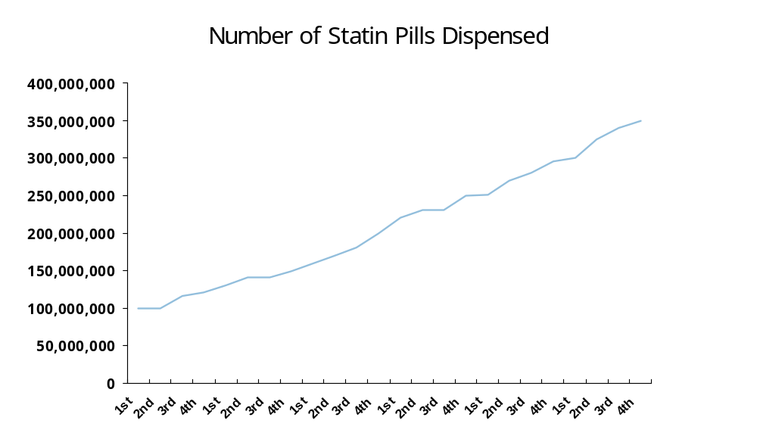
Quarter1995
Quarter1996
Quarter1997
Quarter1998
Quarter1999
Quarter2000
Source: Estimated from Calfee JE, Winston C, Stempski R. Direct-to-Consumer Advertising and the Demand for Cholesterol-Reducing Drugs. Journal of Law and Economics. 2002; XLV;673-690.

Slide 5
Statin Appropriateness Study
Research Design
Cardiovascular risk criteria developed based upon NCEP guidelines
Administrative database of medical and pharmaceutical claims from managed care enrollees in 22 States
Patients receiving statins in 1997 and 1999 were assigned to 1 of 7 categories representing cardiovascular risk
Odds calculated to determine if use changed during this time interval (adjusted for age, gender changes)

Slide 6
Appropriateness of Lipid Therapy
Hierarchy
  1 Prior “event” (MI, CABS/PTCA)
  2 Vascular Disease (Angina, PVD, CVD)
  3 Diabetes
  4 Multiple Risk Factors
  5 Single Risk Factor
  6 Hypercholesterolemia
  7 No Reason
2° Prevention
1° Prevention

Slide 7
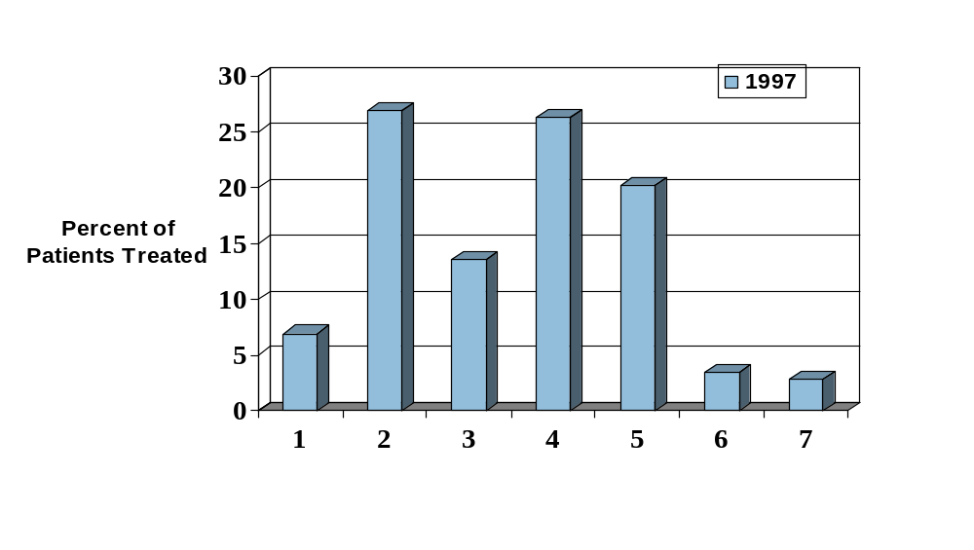
Distribution of Patients by Appropriateness Level for Cholesterol-Lowering Therapy
No
Reason
Secondary
Primary
Prevention
Source: Dubois, Alexander, Wade et al. Growth in Use of Lipid-lowering Therapies: Are We Targeting the Right Patients? American Journal of Managed Care. 2002;8(10):862-867.

Slide 8
Changes In Use From 1997 To 1999
60% growth in the number of patients using statins
  5% of the population in 1997
  8% of the population in 1999

Slide 9
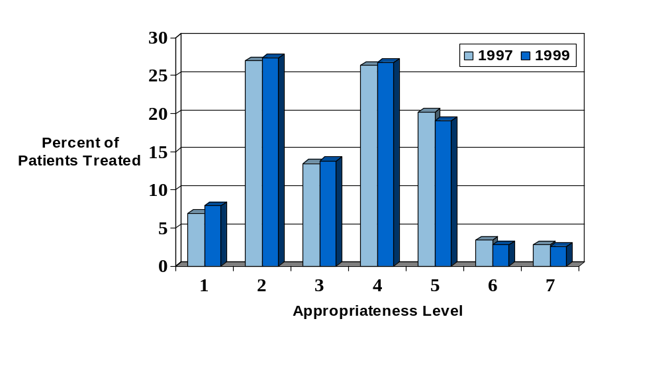
Distribution of Patients by Appropriateness Level for Cholesterol-Lowering Therapy*
No
Reason
Secondary
Primary
Prevention
Source: Dubois, Alexander, Wade et al. Growth in Use of Lipid-lowering Therapies: Are We Targeting the Right Patients? American Journal of Managed Care. 2002;8(10):862-867.
*no statistical difference

Slide 10
Implications
Significant growth in use of statins during a time of substantial pharmaceutical promotion
95% of statin users had existing heart disease or risk factors for its development
No change from ’97 to ‘99 in the cardiovascular risk profile of patients on statins
Despite DTC promotion, no apparent increase in the unnecessary use of this medication class
Perhaps other temporal factors accounted for the increase in use
Similar assessment of appropriateness is needed for other common drug classes

Slide 11
Geographic Variation In Use Study
Background
Likelihood of receiving a surgical procedure varies based upon where you live (4-10 fold geographic variation in use of tonsillectomy, prostatectomy, GI endoscopy, and coronary angiography
Reducing unexplained variation in care has been a key tenet of quality improvement efforts
Little known about the geographic variation in use of medications

Slide 12
Geographic Variation In Use Study
Research Design
  Administrative database of medical and pharmaceutical claims data from 3 Health Plans in California (Blue Cross, Blue Shield, PacifiCare)
  638,188 patients in database (’98-’99)
  Variety of Plan Types (HMO, PPO, POS)
  Variety of pharmacy benefit structures (flat co-payment, 2-tier, 3-tier, open vs. closed formulary)
  Analyzed medication use in 11 California regions within condition and across population
  Analyzed use of surgical and medical procedures as comparison
Notes:
The Bulleted List Slide
This is the most common auto-layout you will use when creating Powerpoint presentations.
This is a commonly used slide, and can be inserted by selecting "New Slide" from the "Insert" menu. A screen will appear with choices of slide layouts. This slide is the second auto-layout listed at the top left of the screen. It is called the "Bulleted List" layout. Just click to select it.
To adopt it for your use, just type over the text on the slide.
If you need to indent text, or reduce its indentation, use the green arrows at the top of the screen. These arrows have been programmed with automated text standards, wrapping and text styles. When you use these arrows to move your text, text will automatically change size, and margins, according to its position on the page.
Do not tab, or manually space blocks of text, as it will not automatically format according to these specifications. In addition, you will find lining up text difficult.
Also, do not use the icon on the screen bar that formats texts with bullets. These bullets are not formatted consistently with our standards. Your text will not wrap properly. Instead, use the programmed green arrows to move "promote" or "demote" text. Bullets will appear automatically.
If you do not have a subtitle for your slide, and you only need bullet points, click your cursor at the start of this line, then click the green "demote" arrow at the top of the screen. The line will be "demoted" to a bullet line.

Slide 13
Results
Rather than 400%-1000% variation previously seen for procedures, medications varied by just 30-40%
49% of all asthmatics used an inhaled corticosteroid, ranging from 40% in the lowest use area to 59% in the highest use area
Dubois RW, Batchlor E, Wade S. Geographic Variation in the use of medications: is uniformity good news or bad? Health Affairs 2002;21:240-250.

Slide 14
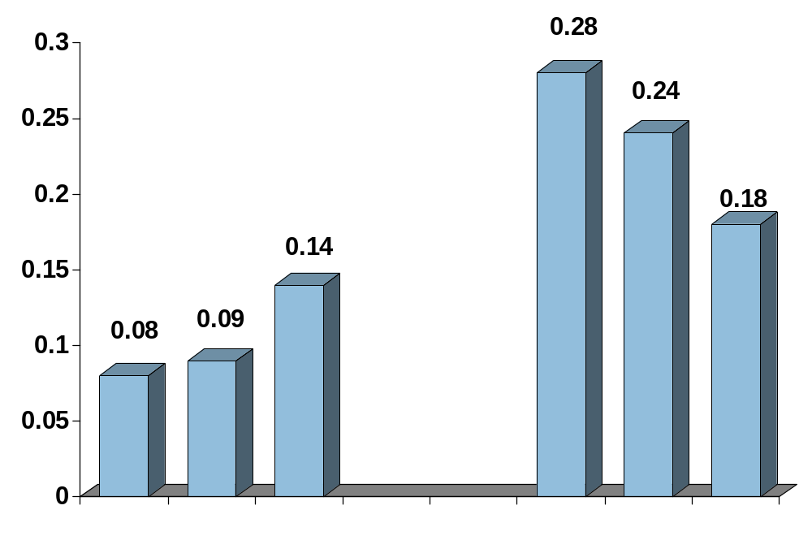
Variation in Use of Medications and Procedures
Coefficient of Variation
ACE (CHF)
Brand Antibiotics (URI)
ICS (Asthma)
Lamin-
ectomy
CT/MRI Head
CABS
Medications
Procedures

Slide 15
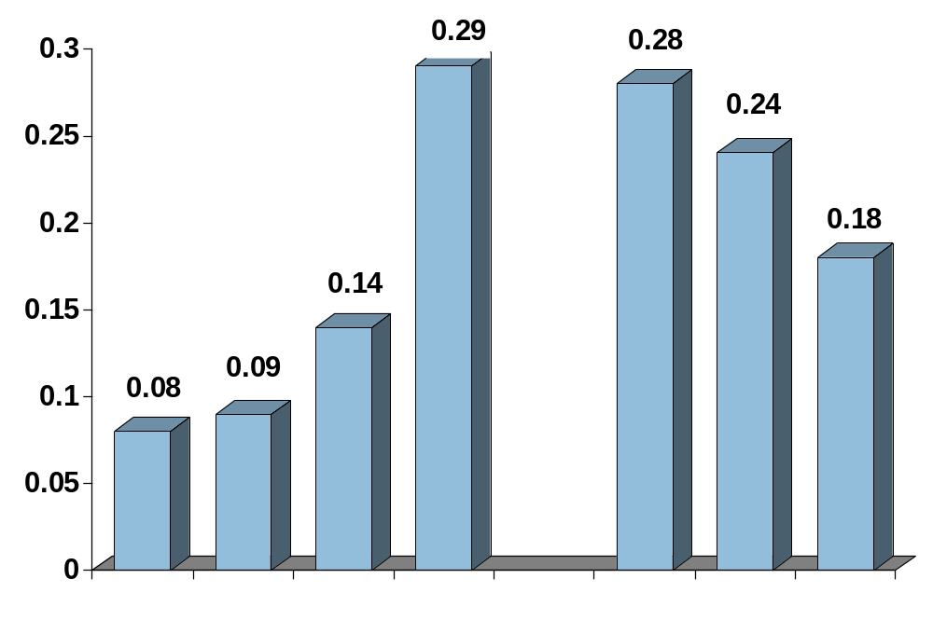
Variation in Use of Medications and Procedures
Coefficient of Variation
ACE (CHF)
Brand Antibiotics (URI)
ICS (Asthma)
COX 2 (RA/OA)
Lamin-
ectomy
CT/MRI Head
CABS
Medications
Procedures

Slide 16
Potential Explanations For Low Variation
Unique California Managed Care phenomenon?
Clinical areas studied had low amount of “uncertainty”?
Required clinical trials for drugs provide more data for decision-making than is typically available for procedures?
Less financial incentives for the use of medications than for the use of procedures?
Pharmaceutical promotion more uniformly educates patients and providers?

Slide 17
Summary
Despite significant pharmaceutical promotion in the latter ’90s, no change in the appropriateness of statin use
Significantly less geographic variation in use of medications than procedures
This research had limitations in the number of drug classes and areas of the country studied but found more evidence to support greater awareness than growing overuse

