Slide 1



FEMA HIGHER EDUCATION CONFERENCE
JUNE 7 – 9, 2005
Incorporating Resources into
Emergency Management Programs—Periodicals, Web Sources, List-Serves . . . .
Henry W. Fischer III
PhD, Sociology
Director, Center for Disaster Research & Education

Slide 2




WE REALLY DON’T HAVE TO REINVENT
THE WHEEL , THROW DARTS, OR FIND YOUR WAY OUT OF A BOX
IN ORDER TO FIND
CURRICULUM MATERIALS & TEACHING AIDS
RESOURCES EXIST
GOOD ONES
AND READABLE—NOT FOR RESEARCHERS ONLY

Slide 3
A FEW EXAMPLES
ONLINE PERIODICALS: Journals, Newsletters
WEB SITES: Site Info, Online Library, Forums
LIST SERVES: Reporting, Info Q&A

Slide 4
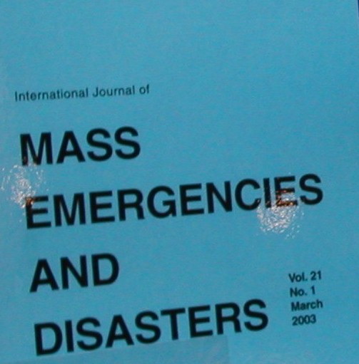
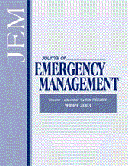
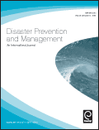
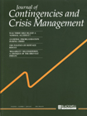

JOURNALS
International Journal of Mass Emergencies & Disasters http://www.ijmed.org/
Journal of Emergency Management
http://www.pnpco.com/pn06001.html
Int’l Journal of Disaster Prevention & Management
http://www.managementfirst.com/strategy/journals/disaster_prevention.php
Journal of Contingencies & Crisis Management
http://www.blackwellpublishing.com/journal.asp?ref=0966-0879
Risk Management: An International Journal
http://www.extenza-eps.com/extenza/contentviewing/viewJournal.do?journalId=382
The Australian Journal of Emergency Management
http://www.ema.gov.au/agd/EMA/emaInternet.nsf/Page/AJEM

Slide 5
International Journal of
Mass Emergencies & Disasters (IJMED) ijmed.org
Excellent Research Journal. Most articles written to be understandable by most interested readers.
Published by the International Research Committee on Disasters, of the International Sociological Association (ISA).
The publication focuses on the social and behavioral aspects of relatively sudden collective stress situations typically referred to as disasters or mass emergencies.
For the first time, this journal is being offered for free, worldwide to facilitate a greater educational and professional understanding of disasters.
http://www.ijmed.org/

Slide 6
Newsletters
UnScheduled Events
  Published by the International Research Committee on Disasters, of the International Sociological Association (ISA).
  Focus is on events occurring within the discipline. It serves as an excellent medium to begin to network with leading researchers and educators within disaster research, emergency management.
  It is free (e-version), worldwide and easily accessible. Written to communicate and educate, not pontificate.
The Natural Hazards Observer http://www.colorado.edu/hazards/o/
  Published by the Natural Hazards Center, University of Colorado
  Focus is on recent work, findings, grants. Goal is to merge practitioner and researcher for the common good.
  It is free, snail mail and e-version.
http://muweb.millersville.edu/%7Eisarcdue/

Slide 7

WEB Source Examples
Natural Hazards Center http://www.colorado.edu/hazards/
CDRE http://www.millersville.edu/~CDRE
Forums
  IJMED http://www.ijmed.org
  Environmental Issues Forum, Oberlin College, Ben Wisner http://132.162.64.84/forum/
FEMA
  The short courses
  The fact sheets
National Weather Service
CBS News Disaster Links
  http://www.cbsnews.com/digitaldan/disaster/disasters.shtml

Slide 8

List Serve Examples
FEMA Higher Education Project Weekly Report
IAEM Email Discussion Group http://www.iaem.com/listserve/listagreement.htm

Slide 9

BROUGHT TO YOU
BY THE
CENTER FOR DISASTER
RESEARCH & EDUCATION
Thank You !

