Slide 1

-Policy Development-
A Key Component in Achieving HIV Testing Technical Solutions to Program Questions
Thomas L. Hearn, PhD
Deputy Director
Division of Laboratory Systems
Centers for Disease Control and Prevention
May 14, 2003

Slide 2

When a fire is raging, throw water on it!

Slide 3
HIV Program Activities
Voluntary counseling & testing
Prevention of mother-to-child transmission
Blood safety
Surveillance
Care & treatment

Slide 4
In order to prevent fires, that is build a sustainable system, more than throwing water is required.

Slide 5
When you are preparing to fight fires, build a system to assure that:
the community authorities support fire prevention
agreements are in place assigning responsibilities
sufficient fire “stations” are strategically placed
there are firefighters who know what to do
the necessary equipment is ready
the supply of water is available
alarms are in place and work
fire drills are run to assure preparedness

Slide 6
Frames of Reference for Successful (Laboratory) Systems
Laboratory Path of Workflow (Reference NCCLS and ISO)
  Pre-analytic
  Analytic
  Post Analytic
  Quality System Essentials
  Organization Documents/Records
      Personnel Internal assessment
      Equipment Process improvement
      Purchasing & Inventory Process control
      Occurrence Management Service & Satisfaction
    Policies, Processes, and Procedures

Slide 7
Quality System
“what to do”
Policies
“how it happens”
Processes
“how to do it” - (SOPs)
Procedures

Slide 8
HIV Program Activities
Voluntary counseling & testing
Prevention of mother-to-child transmission
Blood safety
Surveillance
Care & treatment

Slide 9
Critical Steps in Policy Development
Don’t assume the U.S. model
Determine who makes policy
Determine how policy is made
Determine what drives policy development?
  law,
  financial leverage,
  culture,
  data supporting best practices…
  politics
If policies exist, are they followed?

Slide 10
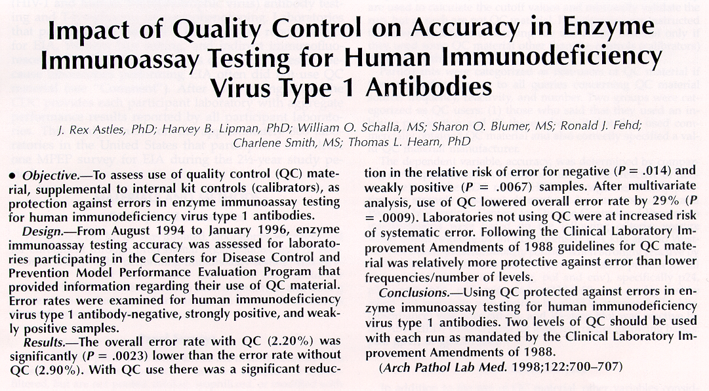

Slide 11
Using Quality Control
Reduces Error Rate
Sample HIV Number ------------Errors-------------
Ab Reactivity Correct With QC Without QC p-value
Negative 6168 3 19 0.014
Strong 4896 4 3 0.830
Positive
Weak 7021 152 307 0.0067
Positive
--------------------------------------------------------------------------------------------------------------------
Total 18085 159 329 0.0023
(97.37%) (2.20%) ( 2.90%)

Slide 12
Critical Partners in HIV Policy Development
High Level Appointees in the Ministries of Health and Boards created by MOHs
International Health and Standards Organizations (e.g., WHO, PAHO, CAREC, EU)
National AIDS Control Boards
Bilateral donors (e.g., DIFID, AMREF, USAID, CDC, GDZ, JICA, World Bank)
Medical and laboratory scientists/leaders
HIV counselors
Nurses and midwives
Hospital authorities
Clients

Slide 13
HIV Testing Policy Questions
In each of the programs, who will be tested?
What is the primary purpose for testing and are there ethical issues?
What will be done as an outcome of testing?
How will testing be funded?
What happens if financial and other program resources wane?

Slide 14
HIV Testing Policy Questions
continued--
Who can do the testing?
Will training be provided?
Which tests can be used?
Who is responsibility for purchase and inventory control?
How will testing be audited?

Slide 15
HIV Testing Policy Questions
continued--
At the national level, who has authority & responsibility for QA?
What is the role of laboratory directors (national, provincial, and district) in QA?
Who makes, and will review, testing policies?

Slide 16
Policy Is Needed for Every Step in the Testing Process
Analytic
Specimen processing
Specimen storage
Reagent preparation
Preventive Maintenance
Quality Control
Method Validation / Evaluation
Test performance
Proficiency Testing / EQA
Safety
Pre-Analytic
Competency of Personnel
Test selection
Patient /client preparation
Test requisition
Collect, label, transport specimen
Safety
Post-Analytic
Results review
Quality control review
Report test results
Results interpretation
Records

Slide 17
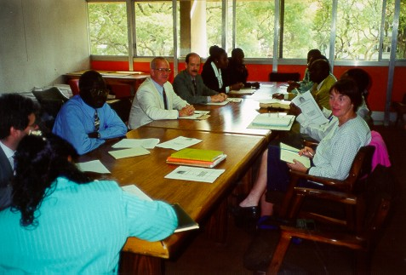
Zimbabwe HIV Rapid Testing Committee

Slide 18
Views from Leaders
International AIDS Conference, Barcelona Spain: 10 July 2002
Dr. Patrick Osewe - USAID, Zimbabwe
  Importance of Coalition Building for Implementing Rapid HIV Testing in VCT
Dr. Roland Swai - NACP, Tanzania
  Importance of Broad Input into Evaluation of HIV Rapd Tests and Policy for Use
Dr. James Hospedales - Caribbean Region Epidemiology Center
  Role that can be played by major health organizations

Slide 19
Consequences of Jumping Past Policy Development
Lack of buy-in with critical partners / players (e.g., gov’t officials, medical staff, laboratory scientists, procurement officers
Without Clear Policy, processes and procedures can follow a hazardous path
Loss of invested resources, time, and credibility

Slide 20
In Conclusion
Policy development is a critical step in implementation of lab testing strategies
Policy development requires technical expertise, negotiation skills, listening skills, thick skin, and patience
Reaching agreement on critical policy issues paves a path for sustainable laboratory systems to support programs
March 5, 2003

