Slide 1
L3 DAQ
Doug Chapin
for the L3DAQ group
Overview of L3 DAQ
uMon
l3xqt
l3xmon
DAQShifters Meeting 10 Sep 2002

Slide 2
The L3DAQ System
Supervisor
CPU
COOR
All ethernet, except for TFW communication
ROC
SBC
CISCO 6509
Ethernet
Switch
ROC
SBC
Farm
CPU
ROC
SBC
Farm
CPU
Routing
Master
CPU
TFW info
ROC
SBC
63
readout
crates
trigger
disable
48 farm
nodes

Slide 3
Communication Flow
Supervisor
COOR
Run information:
crate and node list
by trigger bit
ScriptRunner
trigger
programming
ROC
SBC
Routing info:
destination
farmnode
by event
Crate list
by event
Routing
Master
EVB
Filter-
shell
ROC
SBC
“node ready”
Farm node
Bits fired
by event
TFW
trigger
disable
SCL: accept

Slide 4
ReadOutCrate Example
SCL
Ethernet
Data
Card
Data
Card
VME block
transfer(s)
SBC
ctrl reg
programming
CPU
Card
SBC
intiated
Controller
Card
Slave Ready
J3
Done

Slide 5
SBCs
Intel ~1GHz, 128MB RAM, dual 100Mb ethernet, 128MB flash, VME Universe2
VME slave interface
  VBD control register emulation
  Data buffer access
    Component front-end debugging
J3 Control (SlaveReady,Done)
  DIO PMC add-on card
    Also drives status LEDs
Software connections
  Actively connect to RM
  Recieve up to 2 connections from each farmnode

Slide 6
SBC Operation
To node
Event Fragment
Queue (23)
Route Queue
(100)
Event fragments
from VME
SBC
Process
Event Tags
From RM
Match head event tag to head fragment via event number
Fragments have one sec timeout
  If no tags, throw away head event after 1s
Route queue circular, non-blocking
  Tags can be overwritten if no fragments are available
Event number mismatch
  If frag ev# > tag ev#, throw away tag
  If frag ev# < tag ev#, drop fragment

Slide 7
Supervisor Process
Connections to
  RM
    Receives crate and node list per bit
    RM complains if needed nodes/sbcs not connected
  Scriptrunner processes
    Receive complete trigger programming
      Passed on from COOR
      When trigger downloaded
    Node processes may get stuck
    Big trigger lists take several minutes to download
  *N0* connection to SBC or EVB processes

Slide 8
Farm Nodes
Dual 1GHz Intel, 1GB RAM
  48 nodes so far
Runs Event Builder (EVB) and Filtershell processes
Filtershell Processes (usually 2)
  This is ScriptRunner (L3 filters)
  Recieves trigger programming info from supervisor
  Recieves full event from EVB process
EVB Process Operation
  Connects to all SBCs (incl RM), all the time
  Receive crate list by event# from RM
  Sends no. of free buffers to RM (“node ready”)
  Builds event from received fragments
    1 - 5 second timeout

Slide 9
Routing Master (RM)
Recieves “run” information from supervisor
  Farm node list and crate list per bit
Gets bits fired per event# from TFW
Recieves no. of free buffers from each farm node
Decides which nodes receive which events
Sends routing info by event# to SBCs
Sends crate list by event# to farm nodes
Disables triggers when necessary

Slide 10
RM Operation
Event Tag
Queue
TFW bit mask
and event#
sender
thread
To
d0sbc001b
Main RM
Process
sender
thread
To
d0sbcXXXb
Crate list to target node
Process generates event tags and crate list
  based on bits fired and run info
One sender thread and event tag queue per SBC
  Wait for 10 tags or 250ms, then send
    Minimize ethernet overhead
Crate list sent to target node on every event

Slide 11
L3 Disable
RM process running on TFW crate’s SBC (d0sbc001b)
Spy on the TFW data block
  Extract L1 fired bits and L3 transfer number
When L3-disable is needed
  Update RM monitoring information
  RM tells SBC to stop reading out the TFW crate
    TFW crate goes 100% front-end-busy and stops triggers
    Acts as global disable
Cons
  Actual L3 Disable line is not used
    Cannot easily separate out l3daq backup (accounting issue)
  Shifter must check L3DAQ monitoring every time TFW crate is 100% front-end-busy

Slide 12
Monitoring
All processes (SBC, RM, super, EVB) produce monitoring info
Monitor clients
  l3xmon
    ScriptRunner status (processing,flattening, sending,…)
  üMon is your friend
    SBC, RM, and some Supervisor info
    EVB info (missing crates, input rate)
    Send comments to sean@fnal.gov
  l3xqt
    Mostly expert info
    Daqmon info (L1/L2 busy fractions) useful to shifters

Slide 13
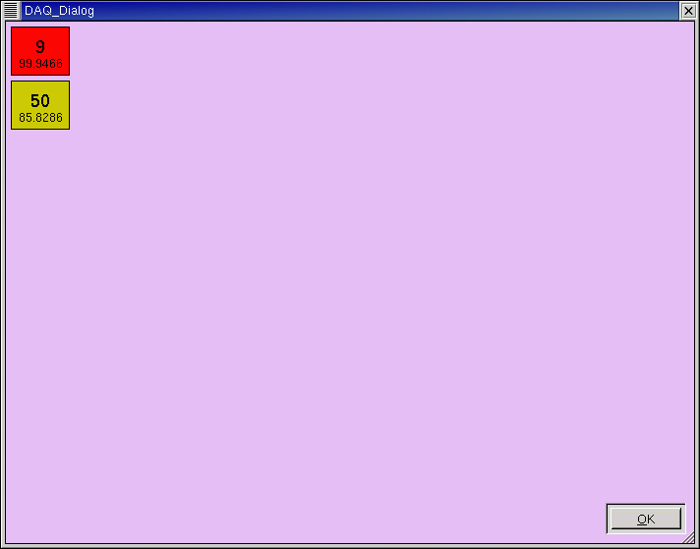

Slide 14
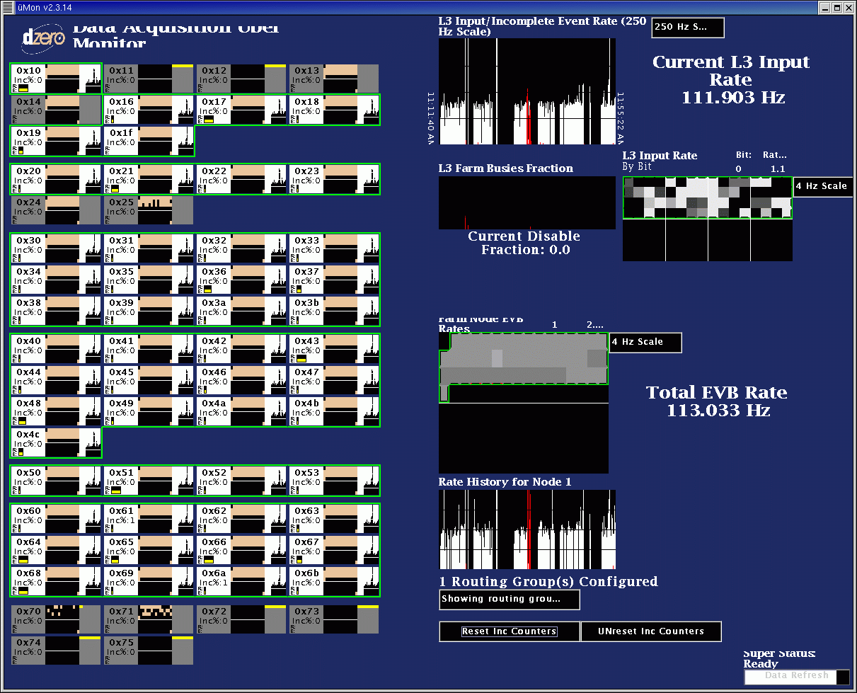

Slide 15
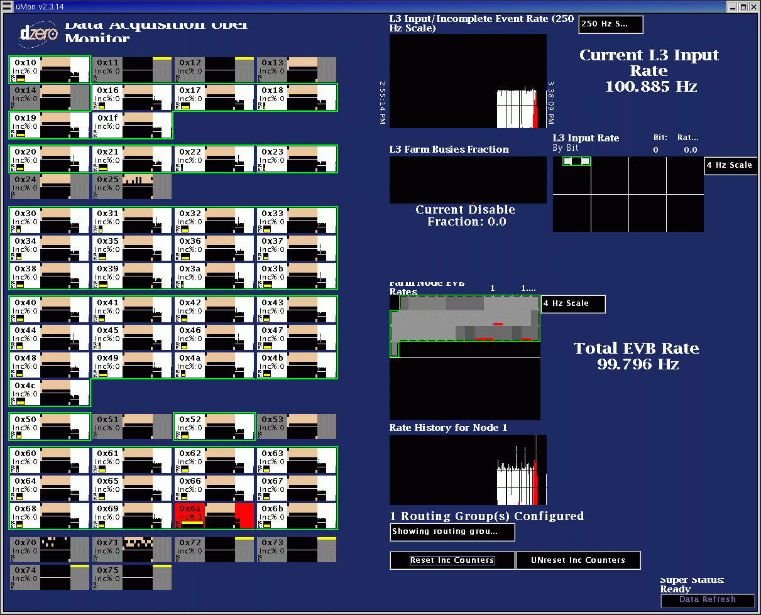

Slide 16
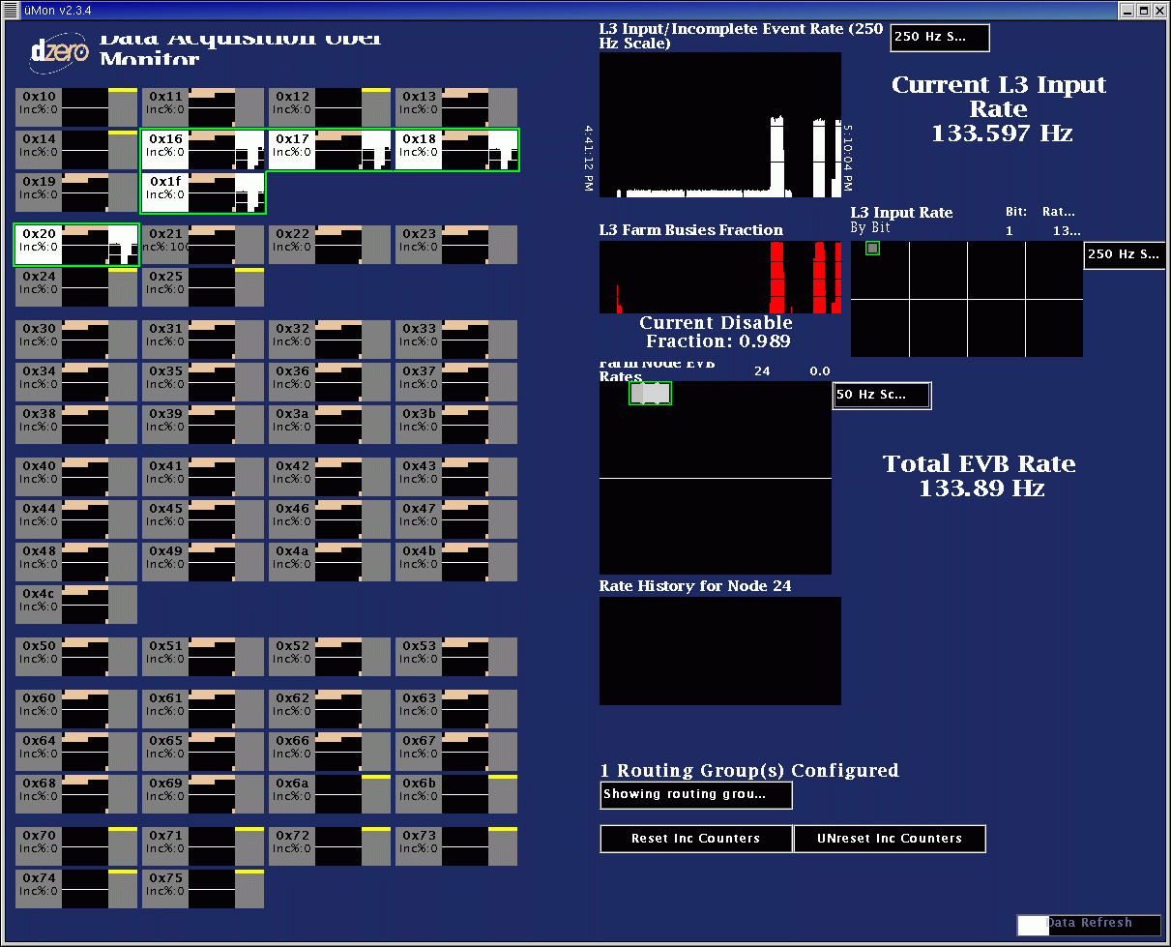

Slide 17
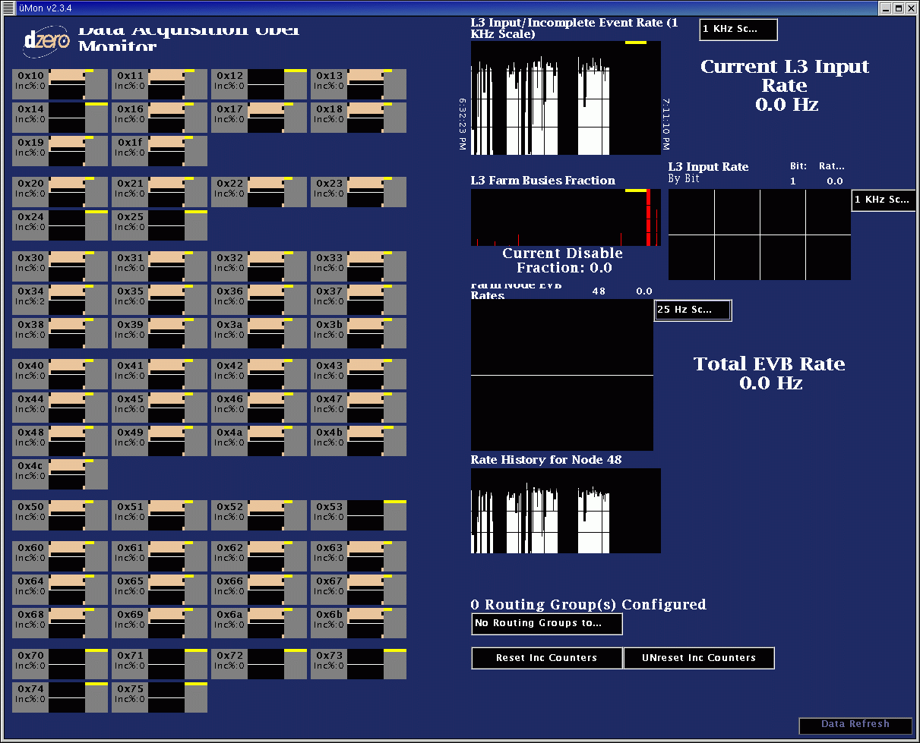

Slide 18
Scripts
Online scripts
  l3xreset
    can restart farmnode processes\
      EVB and ScriptRunner simultaneously
    can restart Supervisor process (node d0lxmast)
  l3xdaq_reset
    Restarts sbc processes (incl RM)
SBC scripts
  is_crate_requesting_readout.sh (SlaveReady asserted?)
  getInfo.sh (sbc driver stats and status)
  reset_all.sh (restarts processes)

Slide 19
L3DAQ Shifter Webpage
http://www-d0ol/www/groups/l3daq/shifter
“What To Do When”
  Extremely useful
  Frequently updated???
On-call schedule
uMon documentation!!!
Logfile access

Slide 20
Typical Problems
Prescales set for < 10Hz
  Unpredictable results (all crates missing)
Not enough nodes in run
  L3 disables (TFW 100% FEB)
  SMT/CFT/CAL in full-readout mode?
Farmnode loses connection to SBC
  Crate is missing (reset farmnode to fix)
Crate 100% missing
  Almost always a component problem
  Check Route and Event queue state in uMon

Slide 21
Improvements to Come…
Phase out l3xmon
  Currently uses a separate monitor server
  Move features into uMon
Trigger Crate
  Set L3 disables correctly

