Slide 1
The Coriolis force- a qualitative introduction
Science Olympiad Resource Page

Slide 2
Suppose you (represented by the dark blue circle) and a friend (represented by light blue circle) are on a merry go round.
Suppose you gently toss a ball towards your friend, but somewhat ahead of them.
The ball doesn’t actually get there!
Click, to look at this effect again, but this time watch the path of the ball relative to the dark blue dot.

Slide 3
Relative to you, the ball seems to go to the center, and then return.
If you click again, you will see the apparent path of the ball.

Slide 4
This is a consequence of Newton’s second law.
An object in motion will continue in motion if no force is applied to it.
When you throw the ball, it starts off you’ve cancelled some, but not all of its initial motion towards the right. Moreover, while it is going in a straight line- you are moving underneath it.
As a result while the ball is actually going in a straight line, it seems to move in a curved line relative to you.

Slide 5
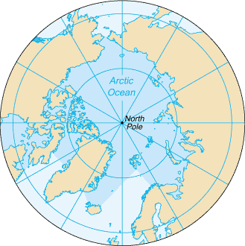
Looking down on the north pole, the earth is rotating like the merry-go-round on the previous slides.
So an object that is thrown towards the north will appear to curve to the right as shown, both because it has more eastward velocity than the earth moving underneath it and because the earth itself is rotating underneath it, causing it to appear to return to the same location.

Slide 6
Thus from the point of view of someone on the earth, the object which we saw moving in a straight line is actually moving in a curve.
The vectors in the plot above show the apparent force associated with causing this curving motion.
The Coriolis force is always at right angles to the motion of a parcel.

Slide 7
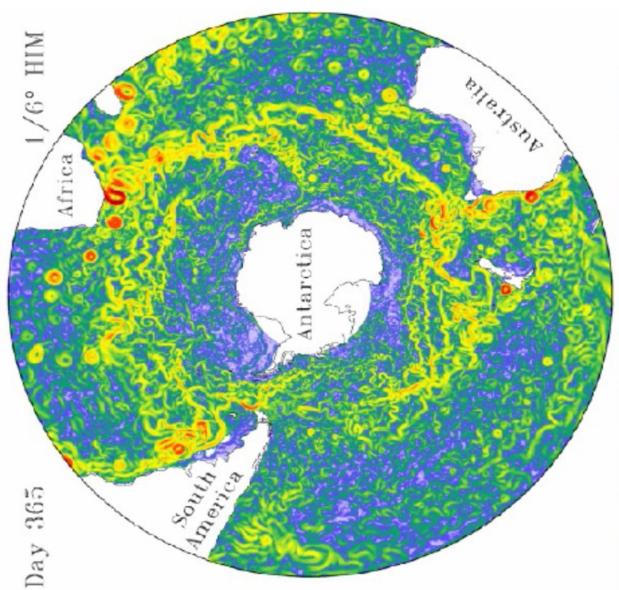
Southern Hemisphere?
The plot at left is a polar projection of the Southern Ocean. It shows surface currents (red being fast, blue being slow) from a computer model of Southern Ocean circulation.
Now think about the Southern Hemisphere. If you look down on a rotating globe from above the North Pole, it appears to be rotating counterclockwise. What direction is the rotation if you look at the rotating earth from below the South Pole? What does this imply about the direction of deflection associated with the Coriolis force?

Slide 8
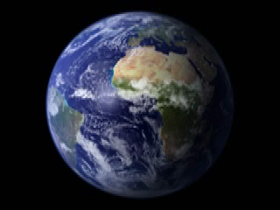
Another way of thinking about this
A parcel near the North pole will move eastward slowly
A parcel near the equator will move eastward more quickly
And a column of water near the south pole will also move eastward slowly
Animation courtesy of NASA
http://visibleearth.nasa.gov
So parcel of water (or air) moving polewards will have an excess of eastward velocity and will tend to turn eastward – or right in the northern hemisphere and left in the southern.

Slide 9

A fictional force?
The Coriolis force is sometimes referred to as a “fictional force”. What does this mean?
Imagine you are in a car that comes to a screeching halt.
As the car stops, your seat belt tightens, making you feel as if someone is pressing you from behind.
But in fact, what’s happening is that as the car slows down, you are moving faster than the car, and so the car pushes on you! So we physicists would say that the force you feel pushing you forward is “fictional” (it results from inertia- the tendency to keep moving in the same direction)- despite the fact that it results directly from the car slowing down.

Slide 10
Similarly in order for particles to move in a circle, there needs to be a constant acceleration changing their direction. For particles along the surface of the earth, this force is provided by gravity. If a particle is to move eastward, in the direction of the earth’s rotation, it will change direction more quickly, and so a large force towards the center of rotation will be required. In the absence of such a force, the parcel will tend to drift outwards, again, not because something is pushing it but because it can’t “keep up” with the earth underneath it.

Slide 11
Force balance with the Coriolis force
L
Suppose we have a low pressure over the north pole. This will result in a force towards the north. Such a force will enable a parcel of air, shown here by the blue ball, to change direction more rapidly, and so move eastward. So one way to think about this is that the pressure force gets “used up” in forcing the air parcel to continue to move in a circle. An alternative way of thinking about it is that the pressure force gets counteracted, or balanced, by the Coriolis force.

Slide 12
A quick quiz
Jupiter has a much shorter day than the earth. Is the Coriolis force near the north pole stronger or weaker on Jupiter?
Answer: Stronger
A parcel of water is moving to the northeast near the north pole. In what direction is the Coriolis force?
Answer: Towards the southeast (or exactly 90 degrees to the right of the direction of motion)
A parcel of water is moving to the south near the south pole. In what direction is the Coriolis force?
Answer: To the east (exactly 90 degrees to the left of the direction of motion).

Slide 13
Some further challenges
In what sense can the Coriolis force be considered “fictional”?
At the equator, is there a Coriolis force on an air parcel moving eastward? In what direction (think 3D)?
See if you can explain the Coriolis force to a friend or teammate.

