Slide 1
This presentation is for illustrative and general educational purposes only and is not intended to substitute for the official MSHA Investigation Report analysis nor is it intended to provide the sole foundation, if any, for any related enforcement actions.

Slide 2
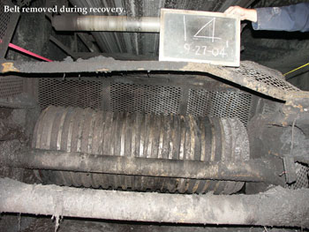
Coal Mine Fatal Accident 2004-19
GENERAL INFORMATION
Operator: Consolidation Coal Company
Mine: Buchanan Mine #1
Accident Date: September 26, 2004
Classification: Powered Haulage
Location: District 5, Buchanan County, VA
Mine Type: Underground
Employment: 418
Production 18,000 Tons/Day

Slide 3
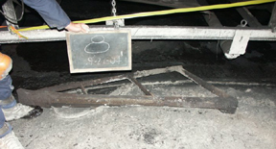
ACCIDENT DESCRIPTION
OLD SCRAPER REMOVED BEFORE ACCIDENT
At approximately 7:00 p.m., on Sunday, September 26, 2004, a 46-year old utility worker with 12 years mining experience was fatally injured when he came in contact with an underground belt conveyor and tailpiece roller while they were in motion.
The victim was attempting to install a belt scraper at the tailpiece. He attached a chain to the scraper and attempted to throw the other end of the chain between the belts. The chain became caught between the top of the bottom belt and the tail roller, which caused the chain, scraper, and victim to be pulled through the tail roller.

Slide 4
ROOT CAUSE ANALYSIS
Causal Factor: The root cause of the accident was management's failure to ensure that all workers followed the specified safety precautions for the job. The primary cause was performing repair and/or maintenance work with the belt conveyor running.
Corrective Actions: An Action Plan was submitted to MSHA by the coal company. The plan states that all employees will be given additional training. Mine management will also conduct weekly job observations on employees that normally have duties that require lock-out and tag procedures. These observations will be recorded on appropriate forms.

Slide 5
CONCLUSION
The victim sustained fatal injuries when he was caught between the conveyor belt and tail roller of an underground belt conveyor. The primary cause was performing maintenance work with the belt conveyor running.

Slide 6
ENFORCEMENT ACTIONS
104(a) Citation was issued for a violation of 30 CFR 75.1725(c) because repairs and/or maintenance was being conducted on the 3 East Mains No. 1 Belt Tailpiece without removing power and blocking the machinery against motion. 2nd Shift Utility Workers removed the belt scraper from the 3 East Mains No. 1 belt conveyor and attempted to install a new scraper while it was operating. As a result, one of the workers contacted the moving belt conveyor and was fatally injured.

Slide 7
BEST PRACTICES
Never perform work on a moving conveyor belt!
Always de-energize equipment and use lockout and tag-out procedures! Ensure that power is off with a visual disconnect before any work is performed on such equipment.
"Think before you act" - Always identify safety hazards before beginning any work task.
Ensure that machinery is blocked against motion before performing maintenance or repairs.
Follow company safety procedures.
Stay out of areas along a moving conveyor belt where clearance is restricted.

