Slide 1
Spatial Management in Fisheries
Lessons from Empirical Bioeconomics
Martin D. Smith
Nicholas School of the Environment and Earth Sciences
Duke University
Prepared for
NMFS/NOAA Spatial Modeling Fisheries Economics Workshop
October 22, 2002

Slide 2
Four Key Phrases
Spatial Closure
Marine Reserve
Marine Protected Area (MPA)
No-take (harvest) Zones

Slide 3
Key Questions
Are marine reserves a good idea for fisheries management?
If so, under what conditions?
What are the implications of ignoring fisher behavior?

Slide 4
Biological Justifications
Rebuild overexploited areas
Take advantage of dispersal mechanisms (e.g. sink/source patterns)
Returns to scale in organism size and population density
Preserve natural life cycle
Hedge against stock collapse

Slide 5
Economic Skepticism
Reserves do not necessarily address the fundamental driving force of overexploitation - open access
Could be more costly than other forms of management
Whatever happened to equimarginality?

Slide 6
A Realistic Synthesis
Biological arguments throw a wrench into our typical economic modeling efforts (e.g. convex production sets). Predicting the ultimate consequences of reserves requires empirical bioeconomic modeling.

Slide 7
Catch Improvement Conjecture
Marine reserves may generate aggregate harvest increases

Slide 8
Preview of Findings
Marine reserves are unlikely to increase harvest in the fishery described below
Most biological modeling of reserves has resulted in overly optimistic predictions about their performance
The magnitude and spatial distribution of fishing effort before and after reserve formation are key

Slide 9
Empirical Setting
Northern California Red Sea Urchin Fishery
Uni
Daily diving trips
Uniform harvest technology
About 135 owner-operators
Data combine logbooks and landings tickets (and weather buoy data) from 1988-97
Marine reserves under consideration

Slide 10
California Sea Urchins:
Ideal for Spatial Management?
The resource is “patchy” – has potential for sinks and sources
Subpopulations connected via larval dispersal, sedentary adults
Density-dependent reproduction
Fecundity returns to scale (in organism size)
CPUE has shown dramatic declines

Slide 11
Structure of the Economic Model:
3 Decision Layers
Daily discrete participation choice
  Fish or not

Slide 12
Daily Participation
Do Not Go
Diver i
at time t
Go

Slide 13
Structure of the Economic Model:
3 Decision Layers
Daily discrete participation choice
  Fish or not
Location choice
  If fish, choose a patch or fishing ground

Slide 14
Daily Participation and Location Choice
Do Not Go
Patch 0
Patch 1
Patch 2
Diver i
at time t
Patch 3
Patch 4
Patch 5
Patch 6
Go
Patch 7
Patch 8
Patch 9
Patch 10

Slide 15
Empirical Strategy
Repeated Nested Logit for Participation and Location Choice Branches

Slide 16
Participation and Location Results
Spatial pattern of exploitation is not uniform and is responsive to economic conditions
Higher revenues and shorter travel distances increase fishing in a patch
Higher revenues increase participation
Participation also driven by institutional characteristics and weather conditions

Slide 17
Structure of the Economic Model:
3 Decision Layers
Daily discrete participation choice
  Fish or not
Location choice
  If fish, choose a patch or fishing ground
Port switching
  Within Northern California
  Between Northern and Southern California

Slide 18
Northern California Ports
3
8
°
3
7
°
3
6
°

Slide 19
Empirical Strategy
SUR share models

Slide 20
Port Switching Results
Port shares respond to revenue differences across space
Shares respond sluggishly; there are time lags involved
The speed of adjustment differs across share models
  more immediate across ports within northern California
  slower for switches between northern and southern California

Slide 21
The Sea Urchin Life Cycle
Adults
Broadcast
Spawn
Larvae Transported
in Ocean Currents
Juveniles Settle
in Patches
Fishing
Mortality
Natural
Mortality
Growth

Slide 22
Structure of the Biological Model
Age- and size-structured metapopulation.
Fecundity as a function of urchin size is increasing at an increasing rate
Discrete subpopulations linked through larval dispersal
The size limit combined with growth and allometric parameters convert number of organisms in each age/size class into patch-specific harvestable biomass

Slide 23
The Bioeconomic Link
Catch in each patch as a function of fishing effort and harvestable biomass
Biomass dynamics evolve according to the metapopulation model and catch
Resource abundance feeds back into expected revenues
Spatially explicit fishing effort predictions feed back into catch in the next period

Slide 24
Steady-State Size Distribution and Egg Production
Patch 8 when Fished
450
6,000
400
5,000
350
300
4,000
250
Millions of Organisms
Billions of Eggs
3,000
200
150
2,000
100
1,000
50
0
0
2
10
18
26
34
42
50
58
66
74
82
90
98
106
114
122
130
138
146
Size Class (mm)
Organisms Below the Size Limit
Organisms Above the Size Limit
Egg Production from Size Class

Slide 25
Steady-State Size Distribution and Egg Production
Patch 8 when Closed
450
6,000
400
5,000
350
300
4,000
250
Millions of Organisms
Billions of Eggs
3,000
200
150
2,000
100
1,000
50
0
0
2
10
18
26
34
42
50
58
66
74
82
90
98
106
114
122
130
138
146
Size Class (mm)
Organisms Below the Size Limit
Organisms Above the Size Limit
Egg Production from Size Class

Slide 26
Two Issues to Explore
Best prediction for performance of a marine reserve
Implications for ignoring behavioral responses
  ECON versus NOECON

Slide 27
Marine Reserves and Economic Behavior
Steady-State
Steady-State
Discounted*
Harvest
Egg Production
Revenues
(1,000 pounds)
(Billions)
($1000)
With Discrete Choice ECON
No Closure
830
1,316
17,440
Close Patch 8
752
1,441
15,074
With No Economic Model - NOECON Steady-state Calibration
No Closure
829
**
434
17,400
Close Patch 8
868
553
16,423
With No Economic Model - NOECON Approach Path Calibration
No Closure
386
***
267
8,096
Close Patch 8
545
397
8,204
* Uses a 5% constant discount rate and assumes $1 per pound of sea urchin.
** Calibrated steady-state harvest to behavioral model.
*** Calibrated approach path catch to actual catch.

Slide 28
Economics of Marine Reserves with Macroeconomic Shocks
Steady-State
Trips
Steady-State
Steady-State
Discounted*
N. California
Per Diver
Partic
Harvest
Egg Production
Revenues
Divers
Per Year
Rate
(1,000 pounds)
(Billions)
($1000)
Discrete Choice Only
No Closure
131
29.9
13%
830
1,316
17,440
Close Patch 8
131
25.3
11%
752
1,441
15,074
Port Choice and Discrete Choice
No Closure
33
57.8
25%
638
1,627
13,400
Close Patch 8
36
47.2
20%
576
1,692
11,660
Port Choice and Discrete Choice - 50% Decrease in S. Cal. Revenues
No Closure
83
37.9
16%
802
1,399
16,846
Close Patch 8
89
31.2
13%
728
1,495
14,683
Discrete Choice Only
Double prices and exogenous increase in participation rate
No Closure
131
107.1
46%
883
720
18,548
Close Patch 8
131
96.5
41%
921
879
17,362
Port Choice and Discrete Choice
75% Decrease in S. Cal. Revenues, double prices, and exogenous increase in participation rate
No Closure
56
174.5
75%
972
796
20,402
Close Patch 8
68
143.1
61%
952
910
18,865
* Uses a 5% constant discount rate and assumes $1 per pound of sea urchin.

Slide 29
Conclusions
Both magnitude and the spatial pattern of fishing effort influence the performance of reserves
Fixed effort assumption at high levels of exploitation on the approach path drives marine reserve optimism
Assumption of uniformly distributed effort at high levels of exploitation also drives marine reserve optimism
A realistic depiction of reserves that includes behavioral responses along the approach path to the steady-state leads to far more pessimism
It is essential to distinguish between two types of externalities - excess fishing effort and an inefficient spatial allocation

Slide 30
Discussion
As a policy instrument for controlling fishing effort, a marine reserve is an extreme policy.

Slide 31
Appendix A
Statistical Models and Results

Slide 32
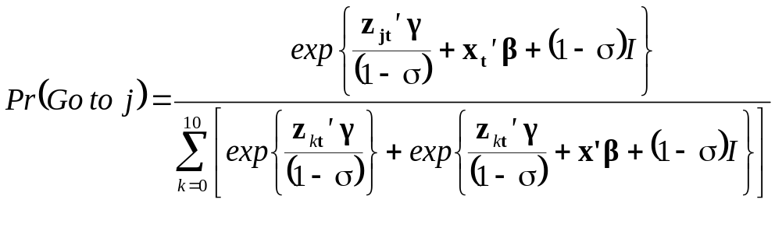
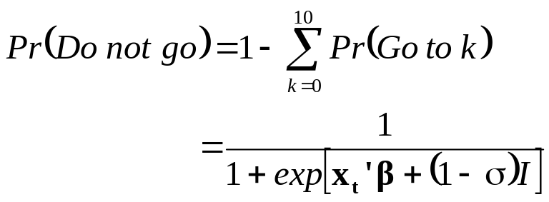
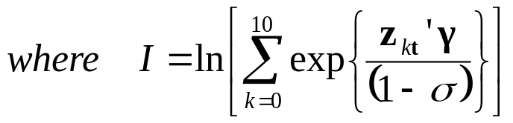
Statistical Model of Partic. And Loc.

Slide 33
Nested Logit Estimates
Not Location-Specific
Standard
Variable
Coefficient
Error
Z - statistic
Constant
1.06
0.048
22.21
WP
-0.18
0.005
-34.69
WS
-0.11
0.003
-36.69
WH
-0.74
0.011
-70.36
DWEEK
-0.74
0.012
-60.02
Location-Specific
Variable
Coefficient
Standard Error
Z - statistic
DISTANCE
-7.27
0.036
-203.72
ER
0.08
0.001
65.17
σ
0.22
0.027
8.34
Log-likelihood
-189,878
Observations
401151
Pseudo R
2
(1)
0.21
Pseudo R
2
(2)
0.81
Pseudo R
2
(1) is based on the log-likelihood in a Conditional Logit Model with choice-specific constants.
Pseudo R
2
(2) is based on the log-likelihood of n*ln(1/J), where J = 12 possible choices.

Slide 34
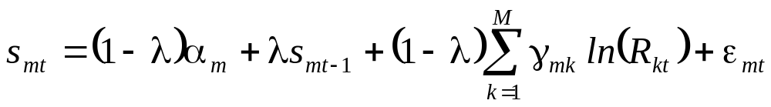
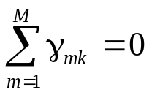
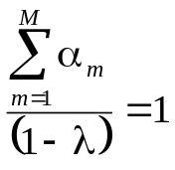
Statistical Model of Port Switching
An SUR Partial Adjustment Approach
Estimating Equation
Restrictions:

Slide 35
South/North Switching OLS Model of Port Shares
Variable
Parameter
Coefficient
t-statistic
Constant
α
0.028061
0.151
Lagged SOC Share
λ
0.861212
17.242
**
ln(R
SOC
)
γ
0.056192
1.6678
*
SOC
ln(R
NOC
)
γ
-0.050767
-1.908
*
NOC
R
2
0.8231
n
111
** indicates significant at the 5% level and * indicates the 10% level.

Slide 36
The Metapopulation Model
(
)
Size
=
L
j
1
−
e
−
k
j
a
j,a
∞
⎧
A
e
-m
j
if
Size
<
L
=
⎪
j,
a
j
,
a
lim
it
A
⎨
j,
a
⎪
A
e
-
m
j
−
f
j
if
Size
>
L
⎩
j,
a
j
,
a
lim
it
10
360
f
C
=
∑
∑
j
(
1
−
e
−
f
+
m
)
w
Size
b
A
∀
>
j
j
j,a
j
, a ,
Size
L
m
+
f
j
,
a
lim
it
j
=
0
a
=
0
j
j
=
⎧
Size
if
Size
>
L
a
360
⎪
e
=
∑
α
x
β
A
where
x
=
⎨
j
,
a
j
,
a
maturity
j
j,a
⎪
0
if
Size
<
L
a
=
0
⎩
j
,
a
maturity
s
in
=
p
De
s
in
s
out
=
j
j
a
−
1
+
c
−
1
s
in
j

Slide 37
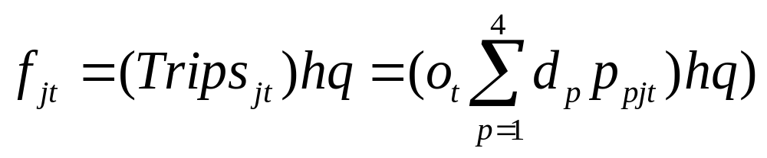
The Bioeconomic Link

Slide 38
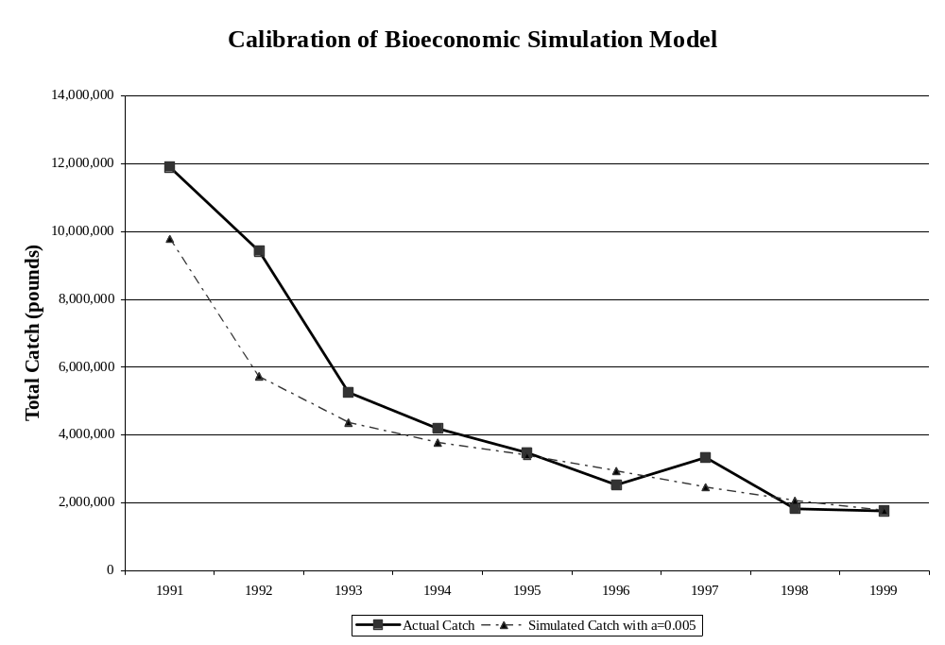

Slide 39
Appendix B
Biological Parameter Values

Slide 40
Parameter Values for Biological Model
From Botsford et al. (1993, 1994, 1999); Morgan (1997) and Morgan et al. (2000)
Parameter
Description
Value
k
growth
0.24
m
natural mortality
0.09
Linf
terminal size (mm)
118
Llimit
min. size limit (mm)
89
Lmature
min. size of sexually mature organism
60
f
fishing mortality
0.29
w
1st allometric weighting parm.
0.001413
b
2nd allometric weighting parm.
2.68
α
1st egg production parm.
5.47E-06
β
2nd eggs production parm.
3.45
p
survival probability
1.0
a
resiliency settlement parm.
0.005 - 0.05
c
carrying capacity settlement parm.
1.2E+07 - 2.4E+07

Slide 41
Appendix C
Details on the economic and biological literature

Slide 42
Summary of Key Biological Articles
Citation
Modeling or
Pre- and Post-Reserve
Article
Year
Count
Empirical
Effort Assumptions
Dugan and Davis
1993
74
Discussion
none
Polacheck
1990
49
Modeling
fixed total effort and uniform
redistribution
Carr and Reed
1993
48
Modeling
constant harvest - no behavior
DeMartini
1993
45
Modeling
fixed total effort and uniform
redistribution
Lauck et al.
1998
41
Modeling
random harvest fraction.
Russ and Alcala
1996
39
Empirical
N/A
Quinn et al.
1993
38
Modeling
fixed total effort and uniform
redistribution, fishers give up at
very low densities
Man et al.
1995
34
Modeling
fixed total effort and uniform
redistribution
Bohnsack
1993
30
Discussion
N/A
Hastings and Botsford
1999
14
Modeling
fixed harvest fraction

Slide 43
Economics Articles on Reserves
Holland and Brazee (1996)
Brown and Roughgarden (1997)
Hanesson (1998)
Sanchirico and Wilen (1999, 2001)
Wilen, Smith, Lockwood and Botsford (2002)
Smith (2002a, 2002b)
Smith and Wilen (2002a, 2002b)

