Slide 1
Introduction

Slide 2
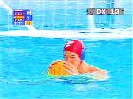
Water Sports
Swimmers need to go fast.
  What slows swimmers down? How could they go faster? What animals swim fast? What could science learn from them?
Water polo players need to stay above the water for a long time.
  How could science help them stay up? What would happen if you played water polo in street clothes?
  They also wear helmets. What kind of helmets? Why?
  What happens to water polo players’ suits during a game?
Design two swimsuits (and accessories): one for “speed” swimming, and one for water polo. Explain the differences.

Slide 3
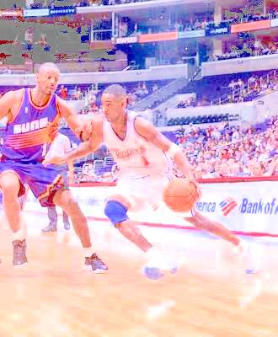
Ball Sports
Basketball
  What kind of shoes do basketball players wear? Why?
  How would you design a shoe for basketball?
Soccer
  What kind of shoes do soccer players wear? How are they different?
  What are the differences between a basketball and a soccer ball? Why are they so different?
American Football
  A football is something else entirely. What happens to a football when you throw it? And when you kick it?
Bowling
  Don’t even think about heading a bowling ball! How do bowling balls differ from each other? Why?
What would happen if you played a sport with a ball from another sport?
How does the playing surface affect the game?
Design a shoe and a ball for your favourite sport, and explain why you designed it that way.

Slide 4
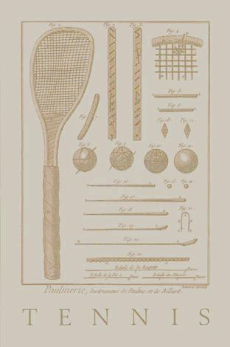
Raqcuet sports
Tennis can be played on grass, on hardcourt, or on gravel.
  How does the playing surface affect the game?
Racquetball, ping-pong and badminton are different sports all together.
  What are the differences between the racquets or paddles?
  What are the differences between the balls?
  How do these differences affect the game?
  What are the advantages of a heavier (or lighter) racquet?
  And what difference does the size make?
What would happen if you changed the ball?
How would you design your favourite racquet or paddle? How would you test it?

Slide 5
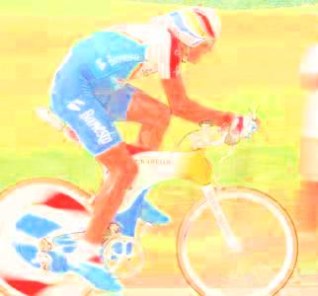
Cycling
In road racing, sometimes riders ride in a group, and sometimes alone. Sometimes they ride uphill, sometimes they ride into the wind. What different requirements would you put on a bike for all these different conditions?
In mountain biking, cyclists ride over very rough terrain: from grassy meadows to mud and rocks and roots. How is a mountain bike different from a road bike? Think about the frame, the handlebars, the tires, suspension...
Track riding is also very different. Track cyclists race on a wooden or concrete oval. Track bikes have no gears or breaks. Why not?
How would you design a bike for a race in your neighbourhood? Explain your design; how would you test it?

Slide 6
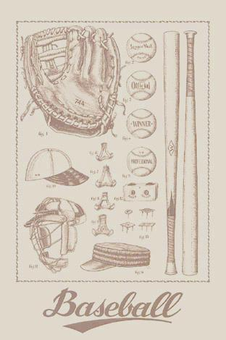
Baseball
Baseball players use a lot of equipment.
  What difference does the weight of the bat make? And the length? What about the material? (Why does Major League baseball not allow the use of aluminum bats?) Should bats be different for power hitting and contact hitting?
  Think about the ball: what effect do the seams have? What about the size and weight of the ball? And the material?
  Some parks have artificial turf. Some still have grass and gravel infields. What difference does the ground surface make? And the dimensions of the field?
  What kind of shoes do baseball players wear? Why?
Pick your favourite position in the field and design your ideal field, shoes and glove for that position. Then, decide whether you want to hit a high percentage or want to go for the long ball, and design your ideal bat. How would you test it?

Slide 7
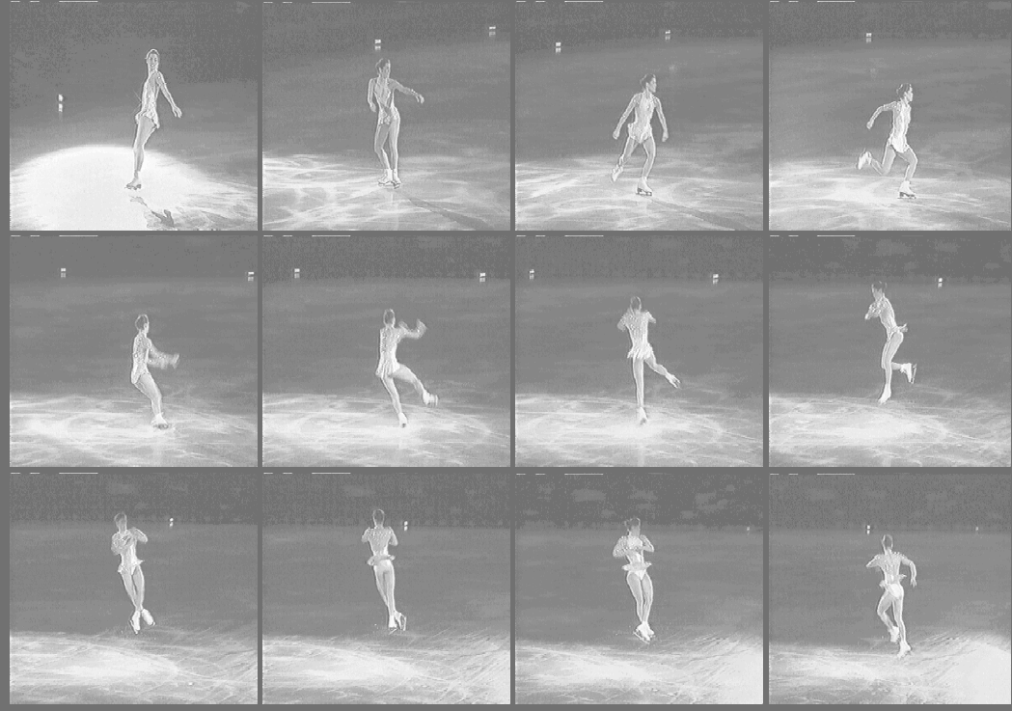
Winter Sports
Speed skaters ride laps around a 400m oval, on their own
Short track skaters ride in groups of up to 8. Laps are only 111m long.
Figure skaters have a whole ice rink to themselves. They do all kinds of tricks: jumps, pirouettes, balancing.
Hockey players are well packed up in gear. They share the ice with their teammates and the referees, not to mention a bunch of angry opposing players.
How are the skates for the different ice sports different? What about the clothing? Why are the designs different?
Pick out one discipline and design their equipment. Why did you make the choices you made? How would you test your design?

Slide 8
Track & Field
Long jump
High jump
Pole vault
100 meters
Marathon

Slide 9
Projectile Sports
Archery
Clay pigeon shooting
Shot put
Spear throwing
Discus throwing
Ultimate frisbee

Slide 10
Gymnastics
Vault
Balance beam
Uneven bars
Floor
Rings
Parallel bars
Horse

Slide 11
Overall questions
How does your design affect the performance of the athletes? Does it affect only a single athlete, a specific group of athletes or the entire field?
How does it affect the safety of the sport?
How would you test it? How would you get athletes to use it?

