Slide 1
Virtual Data Technologies in ATLAS
Alexandre Vaniachine
Pavel Nevski
US-ATLAS Core/GRID software workshop
Brookhaven National Laboratory
May 6-7, 2002

Slide 2
Pre-VDC Experience
Recipes for producing the data (DC0 jobOptions, kumacs) has to be fully tested, the produced data has to be validated through a QA step
Preparation production recipes takes time and efforts, encapsulating considerable knowledge inside. In DC0 more time has been spent to assemble the proper recipes than to run the production jobs.
When you got the proper recipes, producing the data is straightforward
After the data have been produced, what do we have to do with the developed recipes? Do we really need to save them?
Data are primary, recipes are secondary

Slide 3
Virtual Data Perspective
GriPhyN provides a different perspective:
recipes are as valuable as the data
production recipes are the Virtual Data
If you have the recipes you do not need the data (you can reproduce them)
recipes are primary, data are secondary
Do not throw away the recipes,
save them (in VDC)
Methods (recipes) should be encapsulated with the data in VD Objects

Slide 4
VDC Evaluation Strategy
Gradual implementatation plan has been proposed:
Suppose the tools are there (imitate them when necessary)
Collect as much components as possible and try to classify there by their functionality
Start with event generation and GEANT simulation
…

Slide 5
DC0 Production System
Used in DC0 Geant3 simulations
  High-throughput features:
    scatter-gather data processing architecture
  Fault tolerance features:
    agent-based implementation
    local caching of output and input data (except Objy input)
Processing time per job: ~24 hours
Typical output file size is 200–300 MB
(170–320 events with hits and digits)
Typical fault: lost LSF jobs (2-3%)
  Sometimes LSF batch machines are suddenly switched off
  Occasionally LSF counts time several (2-3) times faster then Linux getrusage
2 jobs lost due to malloc error in C++ new operator (Objy interface)
1 job stopped in GCALOR

Slide 6
Data Challenge Features
ATLAS DC1 phase 1 (starts beginning of May)
10⁸ Generator particles events
(all data produced at CERN)
10⁷ Geant3 detector response events (atlsim framework)
10⁷ reconstructed objects events (Athena framework)
Data production is for physics purposes (Trigger TDR)
2/3 of data produced outside of CERN
production on a global scale:
Asia, Australia, Europe and North America
19 countries

Slide 7
VDC Status in DC1
Approved as an R&D activity (parallel to the production scripts not using VDC)
Templated jobOptions approach was used for Generator events production
USA site (BNL) will use VDC in simulation production transformation
Participants from Canada and UK expressed interest in using VDC-based scripts

Slide 8
Production Policies in VDC
  Allocation of unique event ID
    implementing the event ID allocation policy
  Allocating random number seeds
    providing unified random number seed allocation policy
  Support for automatic generation of jobs
    Unique partition numbering
    Encapsulation of environment variables
VDC database backend guaranties uniqueness of
  event ID
  output PFN
  random number seeds
which is difficult with a non-VDC “perl script” approach in a massive parallel production environment

Slide 9
VDC Integration in Production
  Production System is extended in DC1 with features provided by few “ortogonal” VDC component:
Data reproducibility
SIGNATURE (application software version)
Grid dimension:
LOCATION (site)
Application complexity
CONFIGURATION (application configuration)
VDC-based automatic “garbage collection”:
  Agents (jobs) get the next derivation from VDC
  After the data has been materialized agents register “success” in VDC
if some previous invocation has not been completed within the specified timeout period, it is invoked again

Slide 10
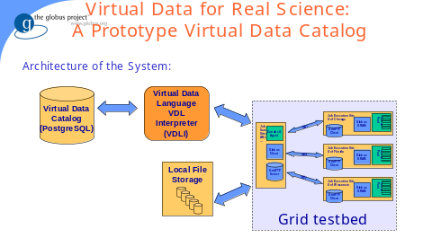
Virtual Data Catalog
Proven two-tier architecture:
  Database backend, Interface front-end
That should work! Works indeed: in CMS, LIG0, SDSS

