Slide 1
Land Survival
Developed as part of the National Emergency Services Curriculum Project

Slide 2
Survival Needs
Food
Water
Shelter
Positive Mental Attitude

Slide 3
Food
Most healthy people can go without for a week to 10 days, depending on the conditions
Ground Team Members should be carrying at least a few meals when they go out, and normally don’t use them

Slide 4
Water
Can go without for only a few days at most, depending again on the conditions
Personnel require greater amounts of water in warmer climates
Personnel actually working will require more water than those sitting idle

Slide 5
Water Purification
If stuck in the field for a longer period, team members may need to gather and purify water if they don’t have enough
Several methods are available to purify water in the field
  Boiling
  Improvised or Commercial Filters
  Chemicals (iodine based tablets normally)

Slide 6
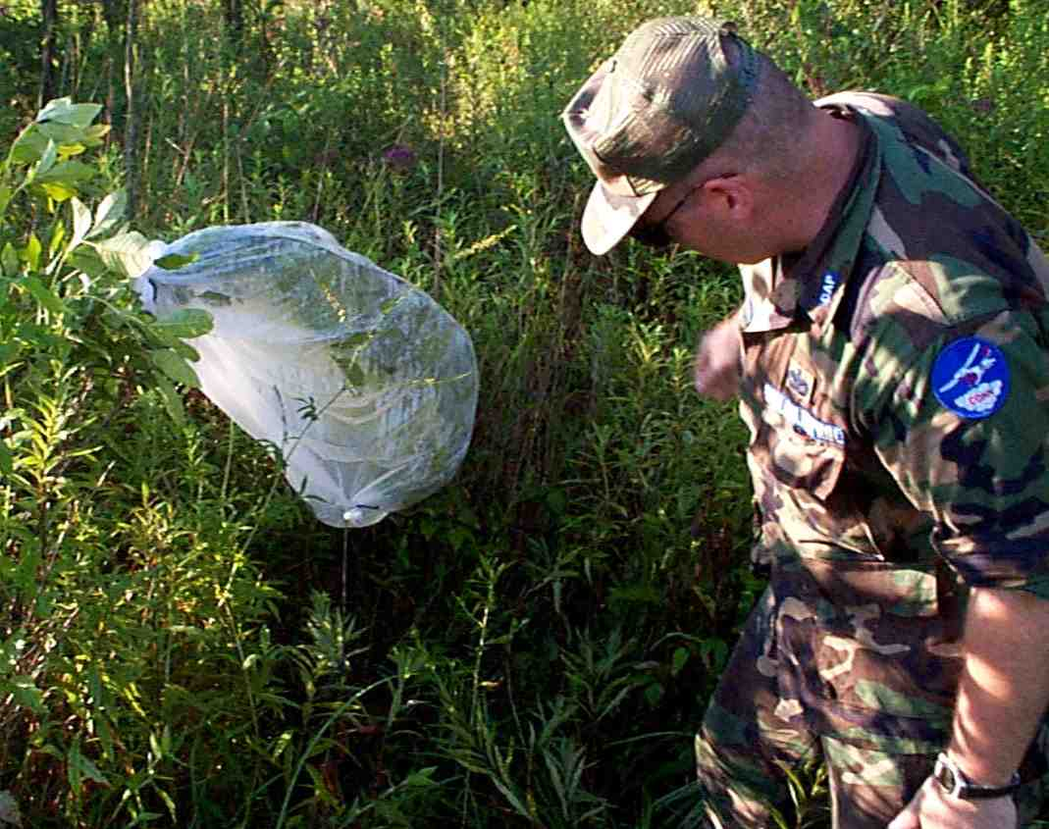
Water Transpiration Bag

Slide 7
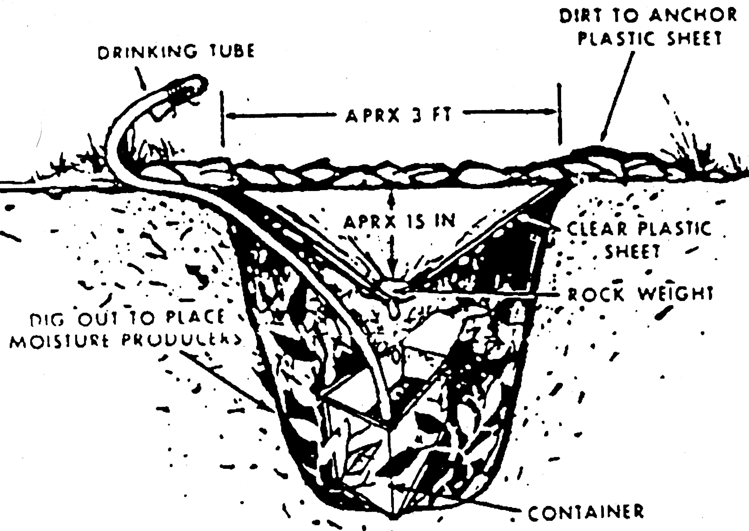
Solar Still

Slide 8
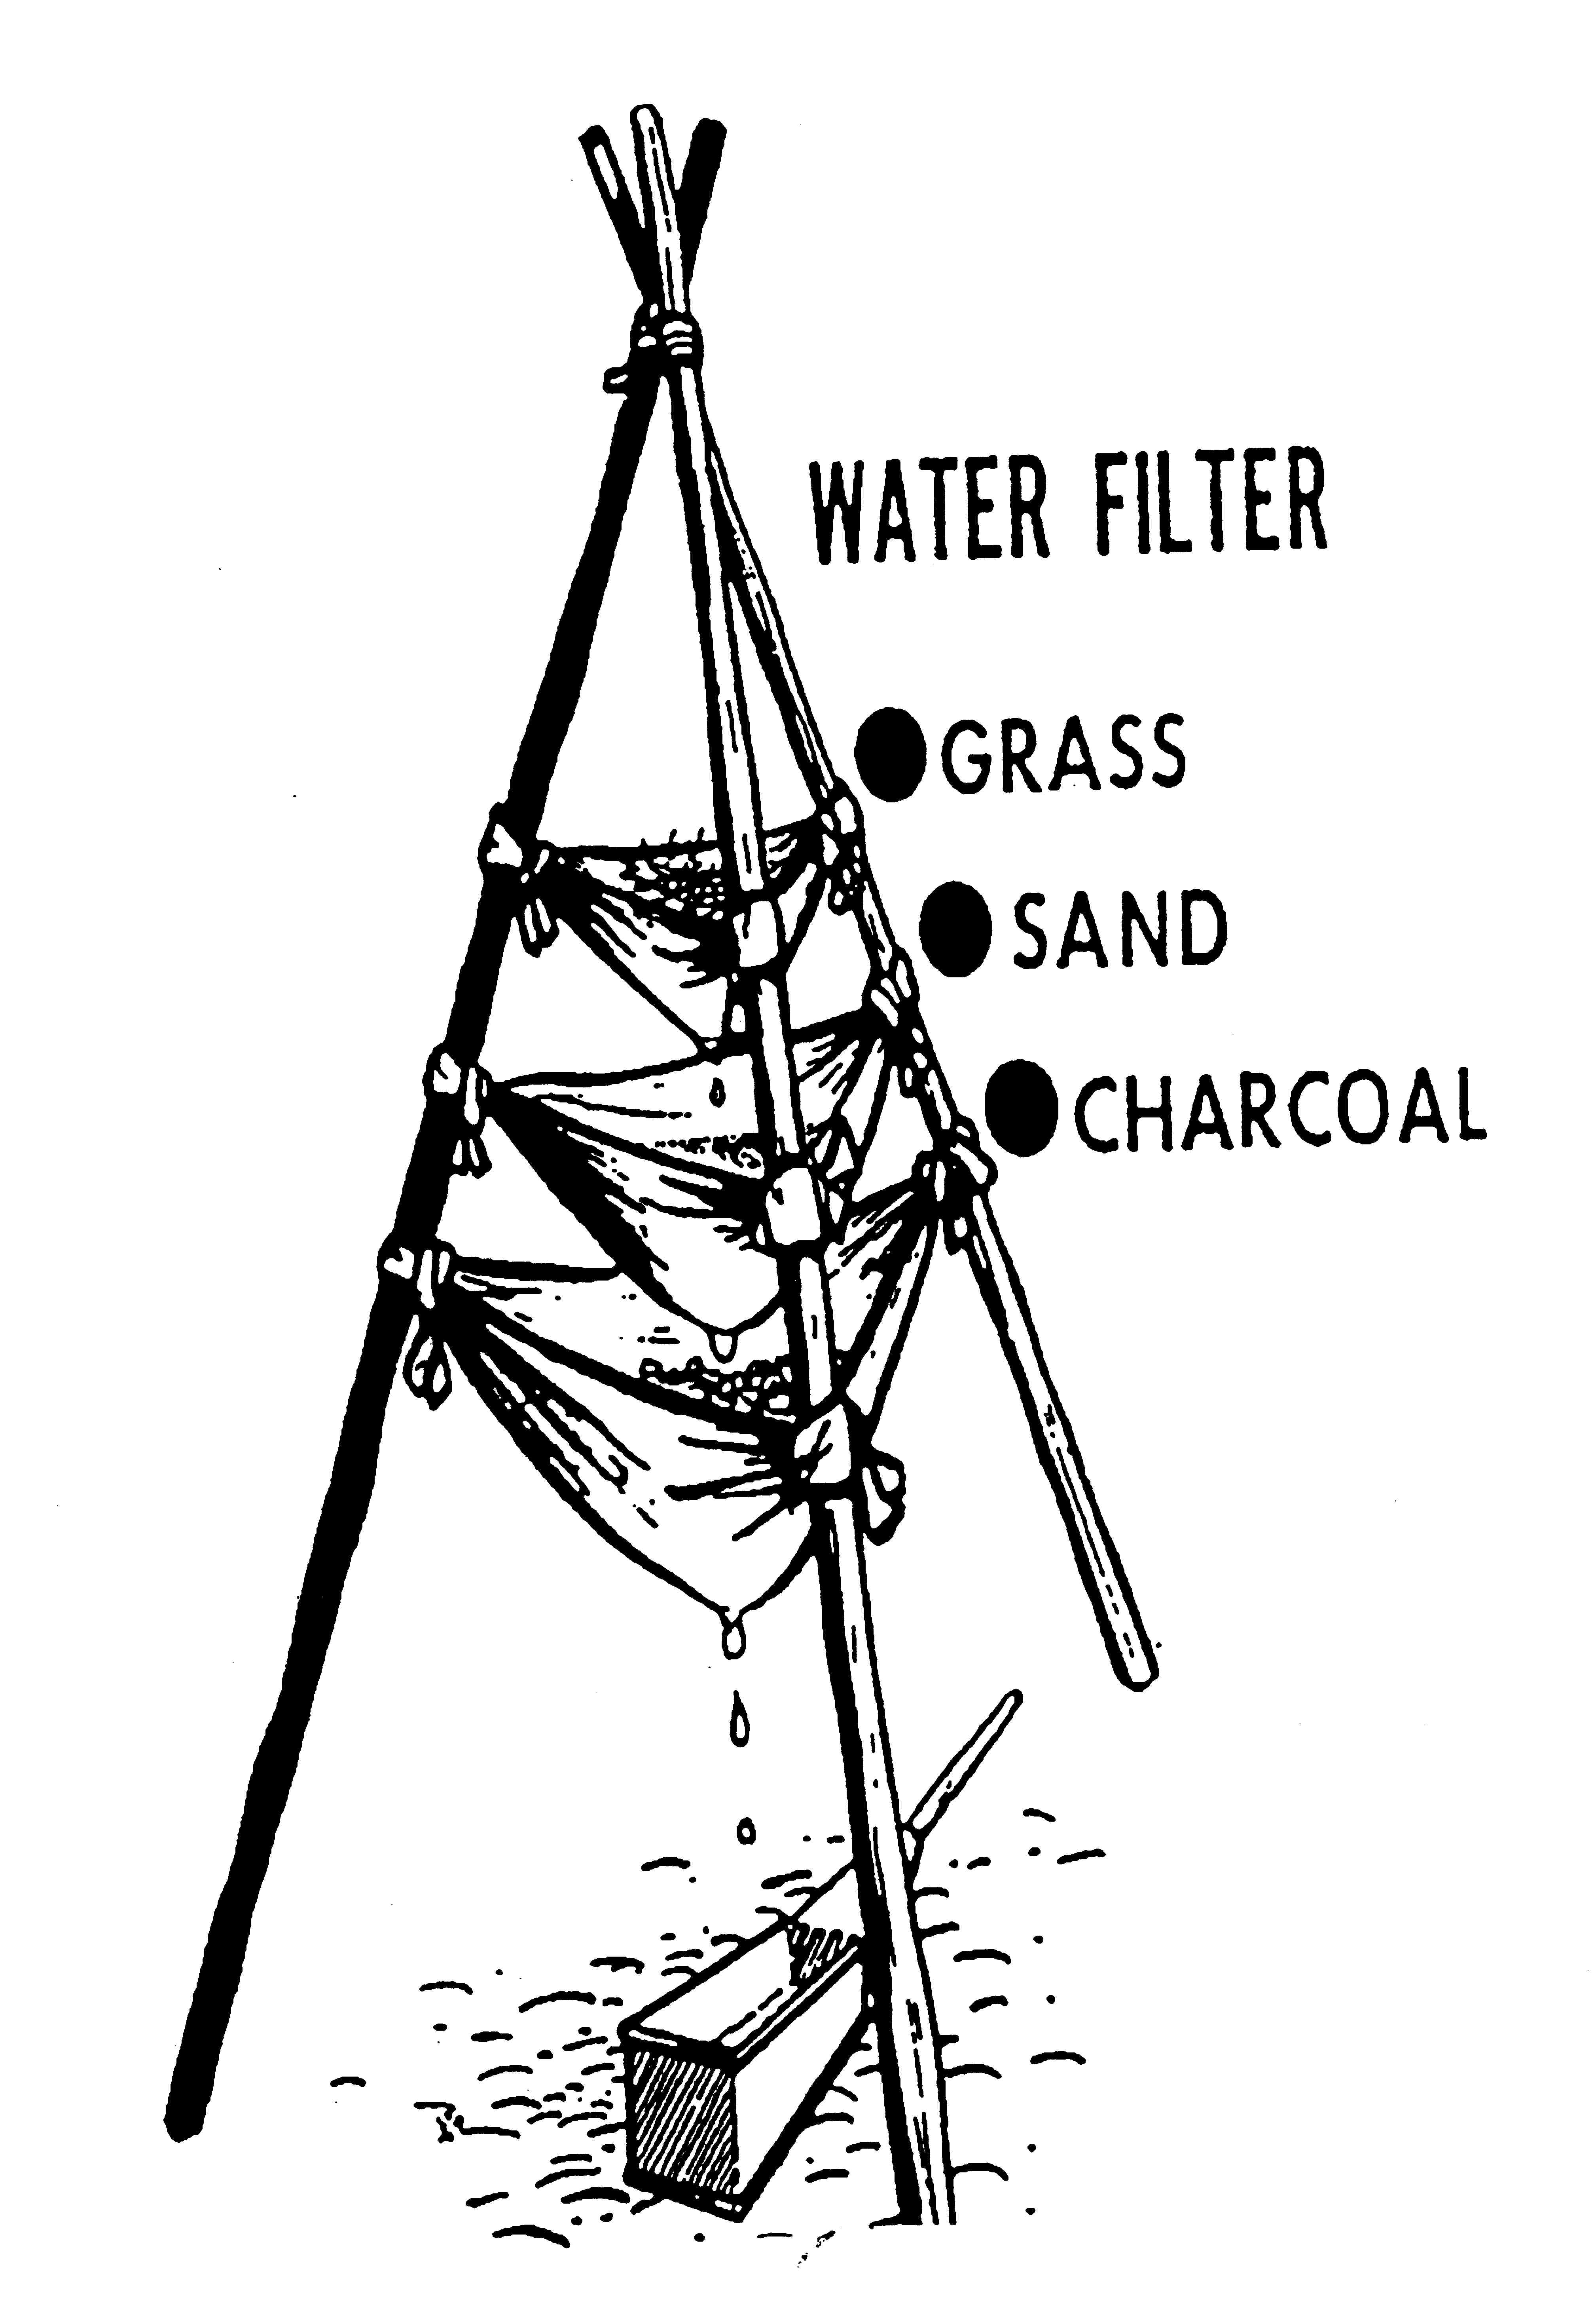
Filtration Tri-pod

Slide 9
Shelter
The type of shelter required depends on current conditions and clothing being worn by survivor
  Needs to meet the user’s needs for the duration expected
  Can use materials readily available in the wilderness or equipment packed into the field
    Refer to discussions in Campsite Selection lecture for additional information

Slide 10
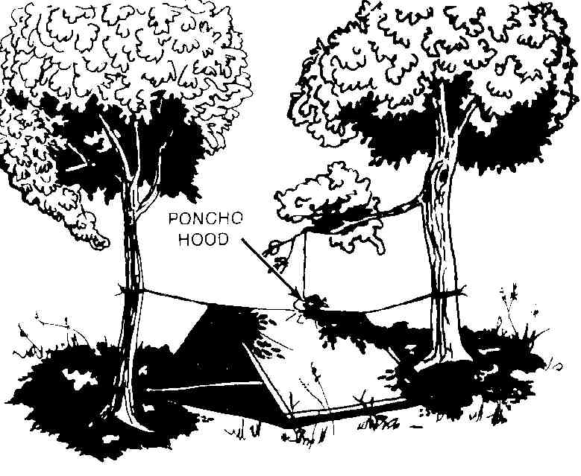
Poncho Tent

Slide 11
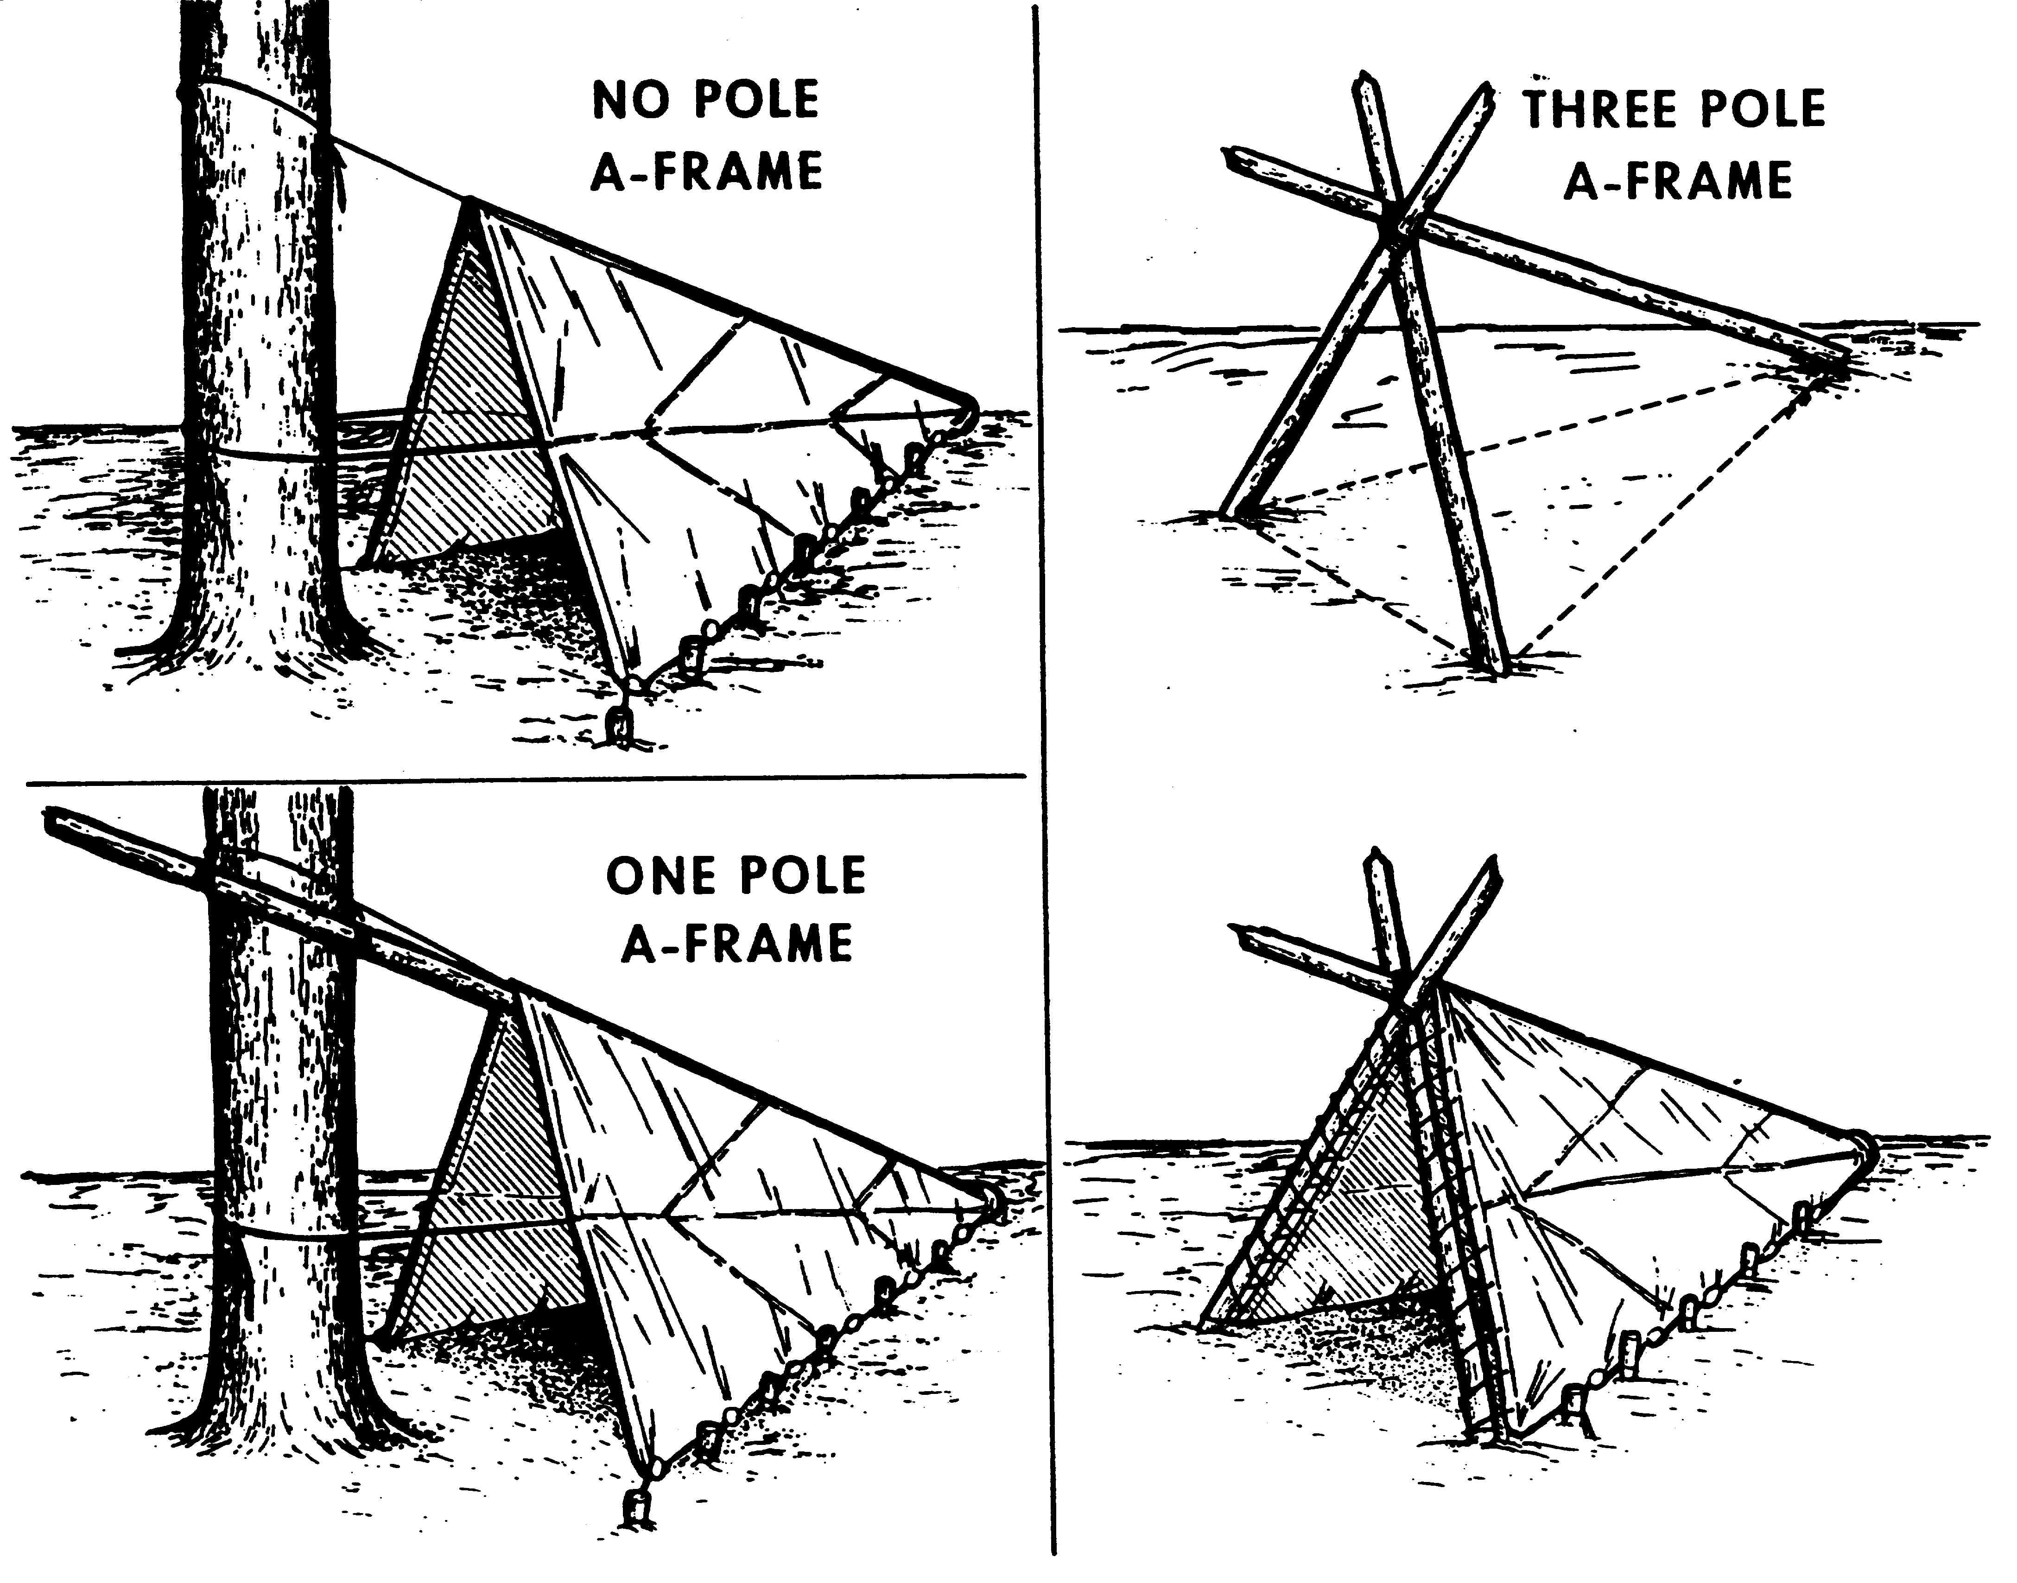
A-Frame Shelters

Slide 12
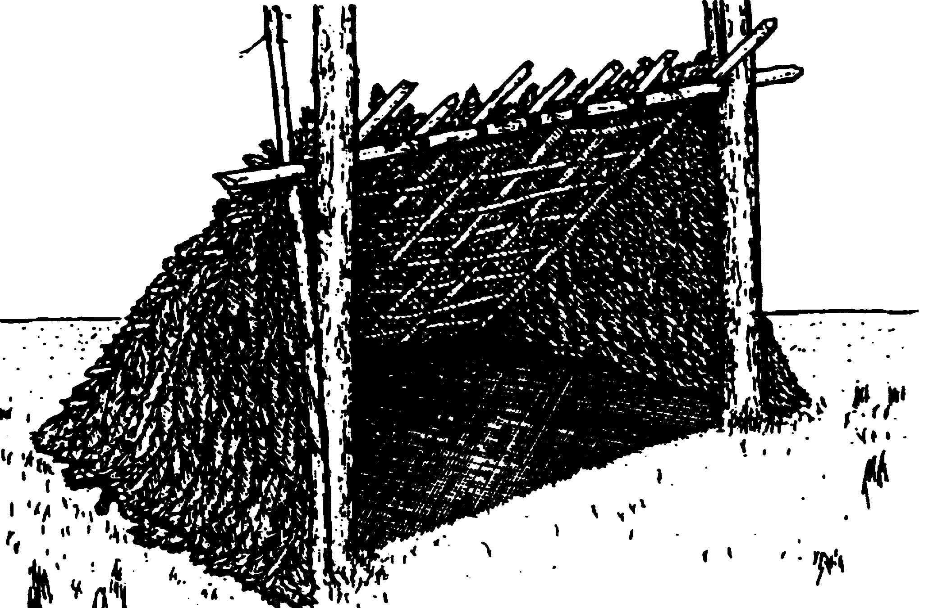
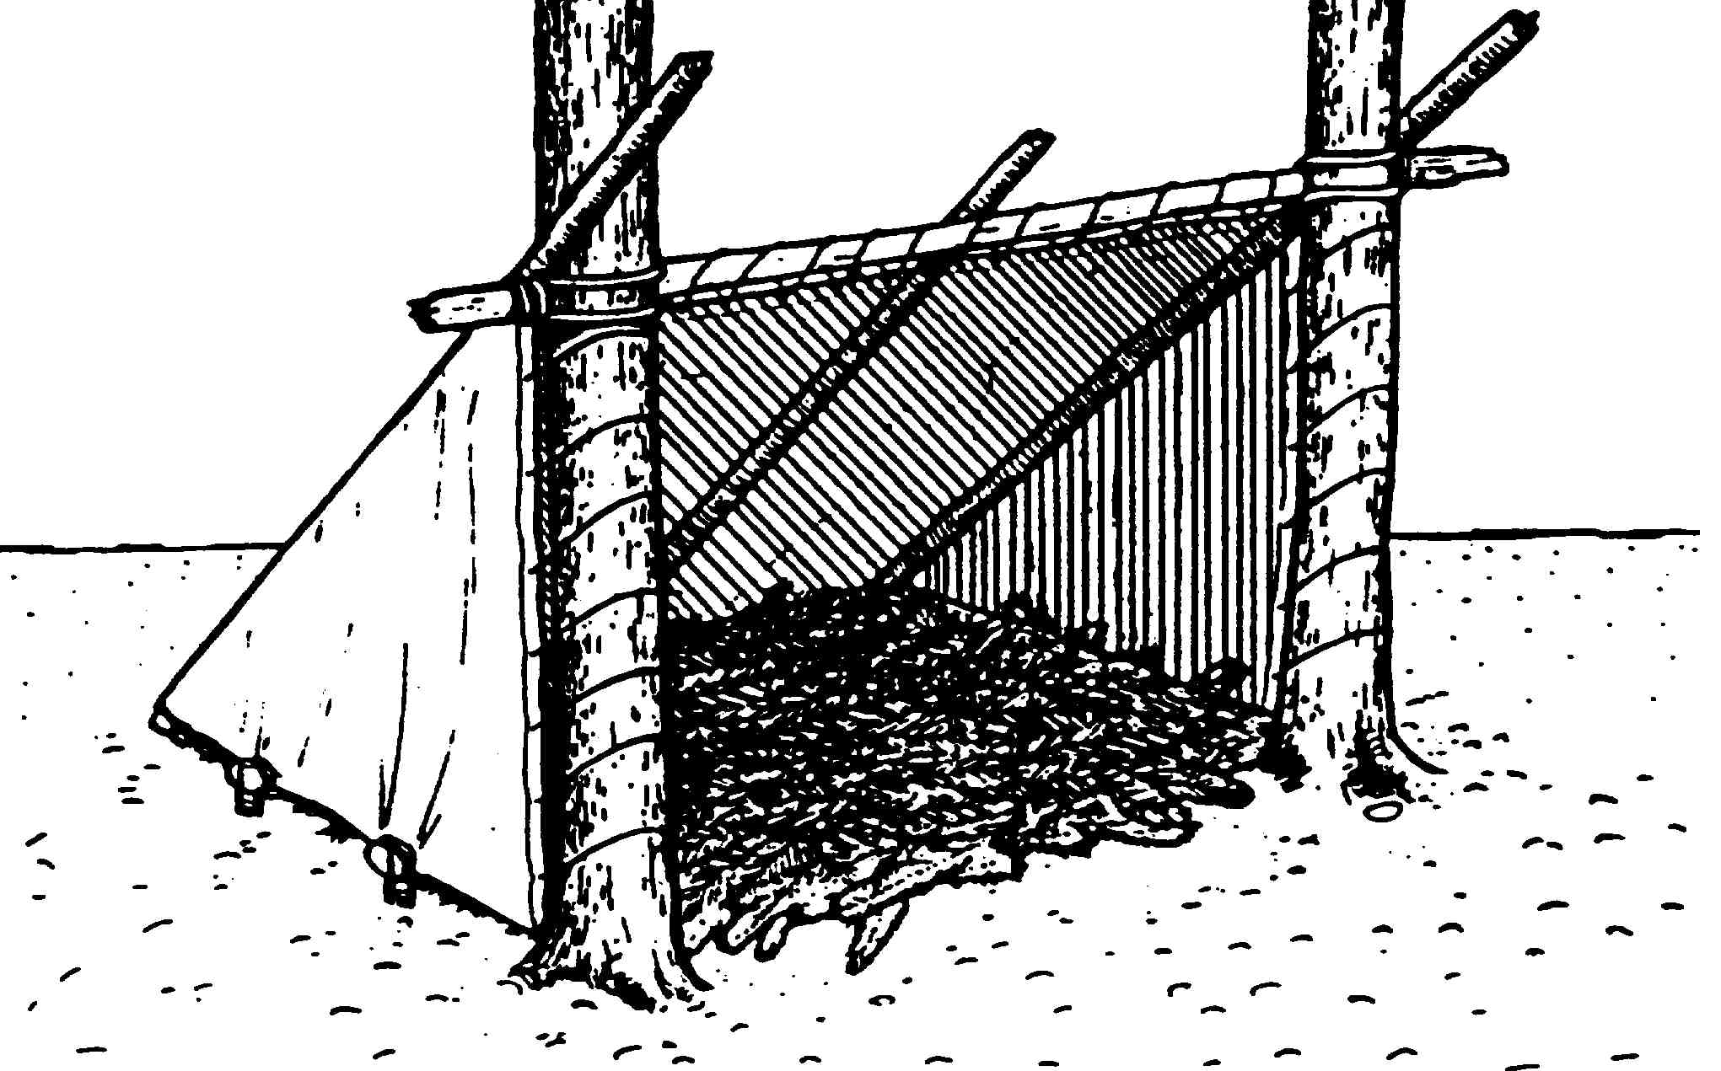
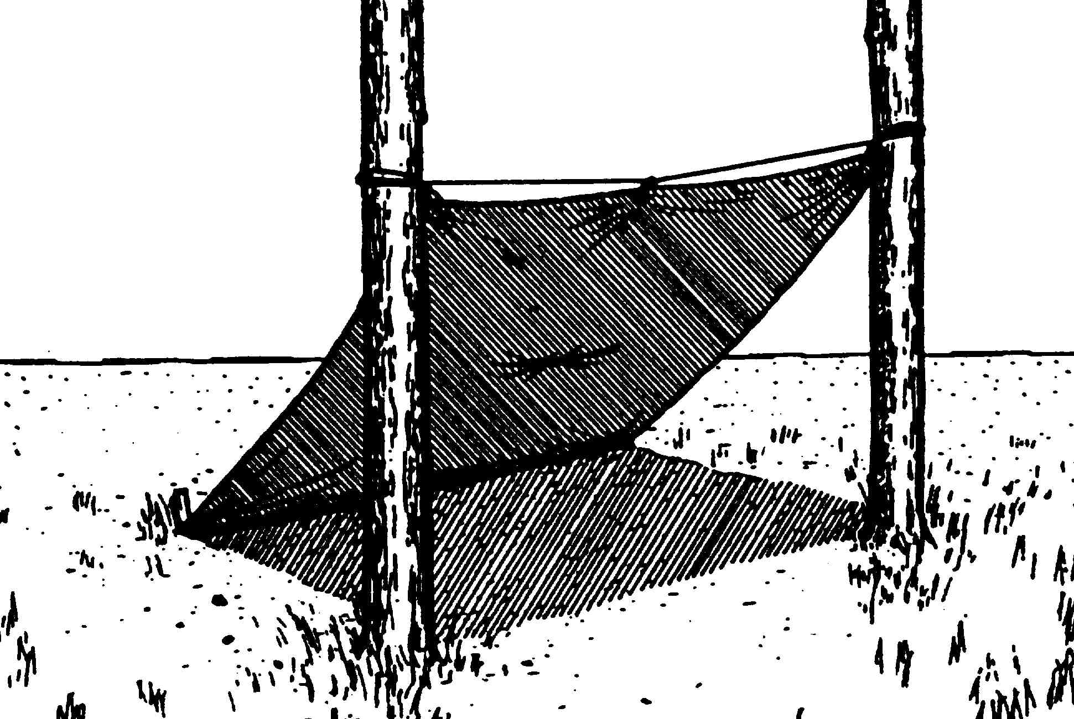
Lean-to Shelters

Slide 13
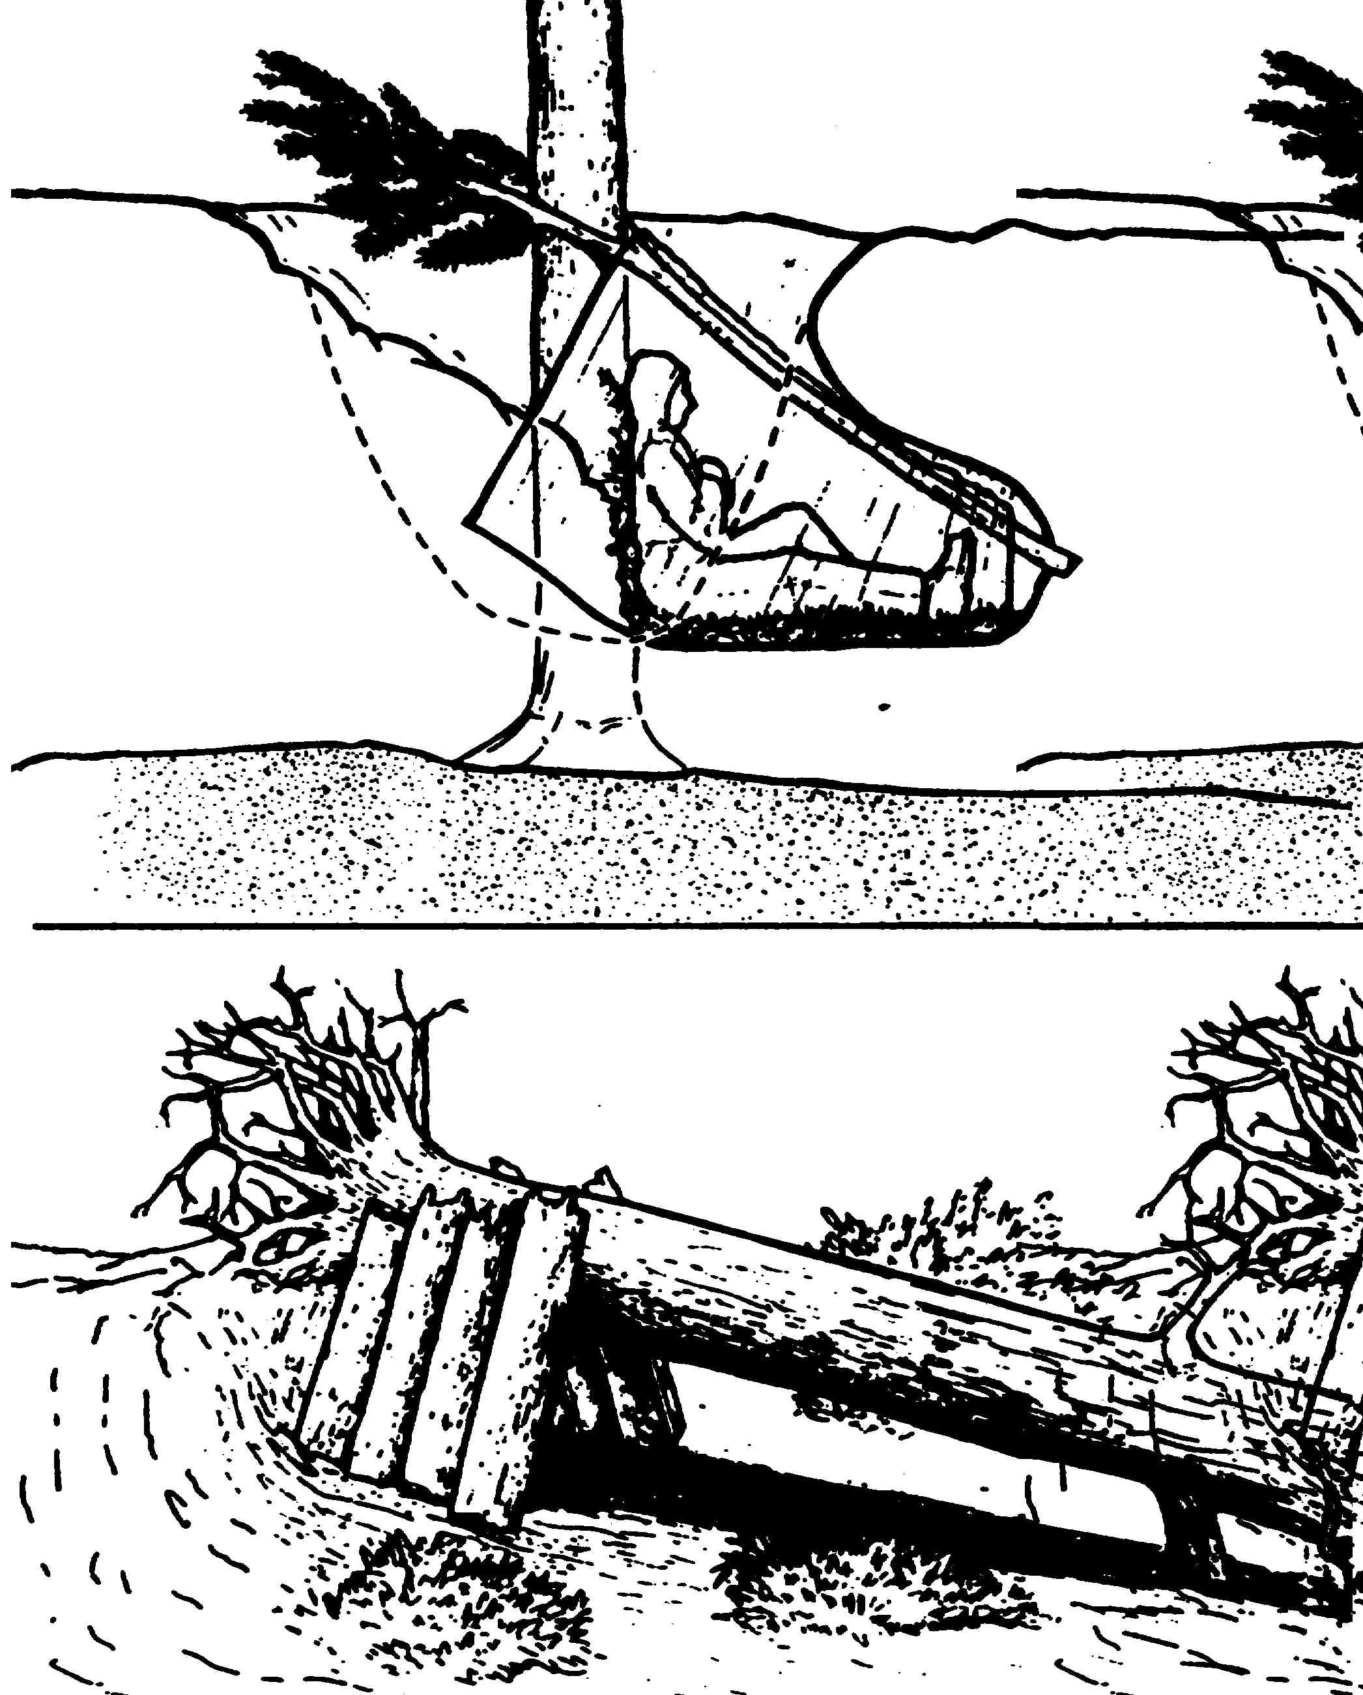
Field Expedient Shelters

Slide 14
Positive Mental Attitude
In any survival situation you have to want to live to do so. There are many cases of people that “shouldn’t have survived” living, and the field expert expiring in the field attributed to their individual “will to live”
Never Give Up!

Slide 15
Fire Building
Fire is not a necessity to live but can calm or sooth survivors, and makes things much more livable
  Boil Water
  Cook Food
  Keeps the mind occupied
If you build it, you put it out

Slide 16
Fire Building Continued
7 Steps
  Decide that fire is necessary
  Choose a good fire location and prepare it
  Collect wood for the fire
  Arrange the firewood for burning
  Ignite the tinder
  Add fuel as necessary
  Extinguish the fire

Slide 17
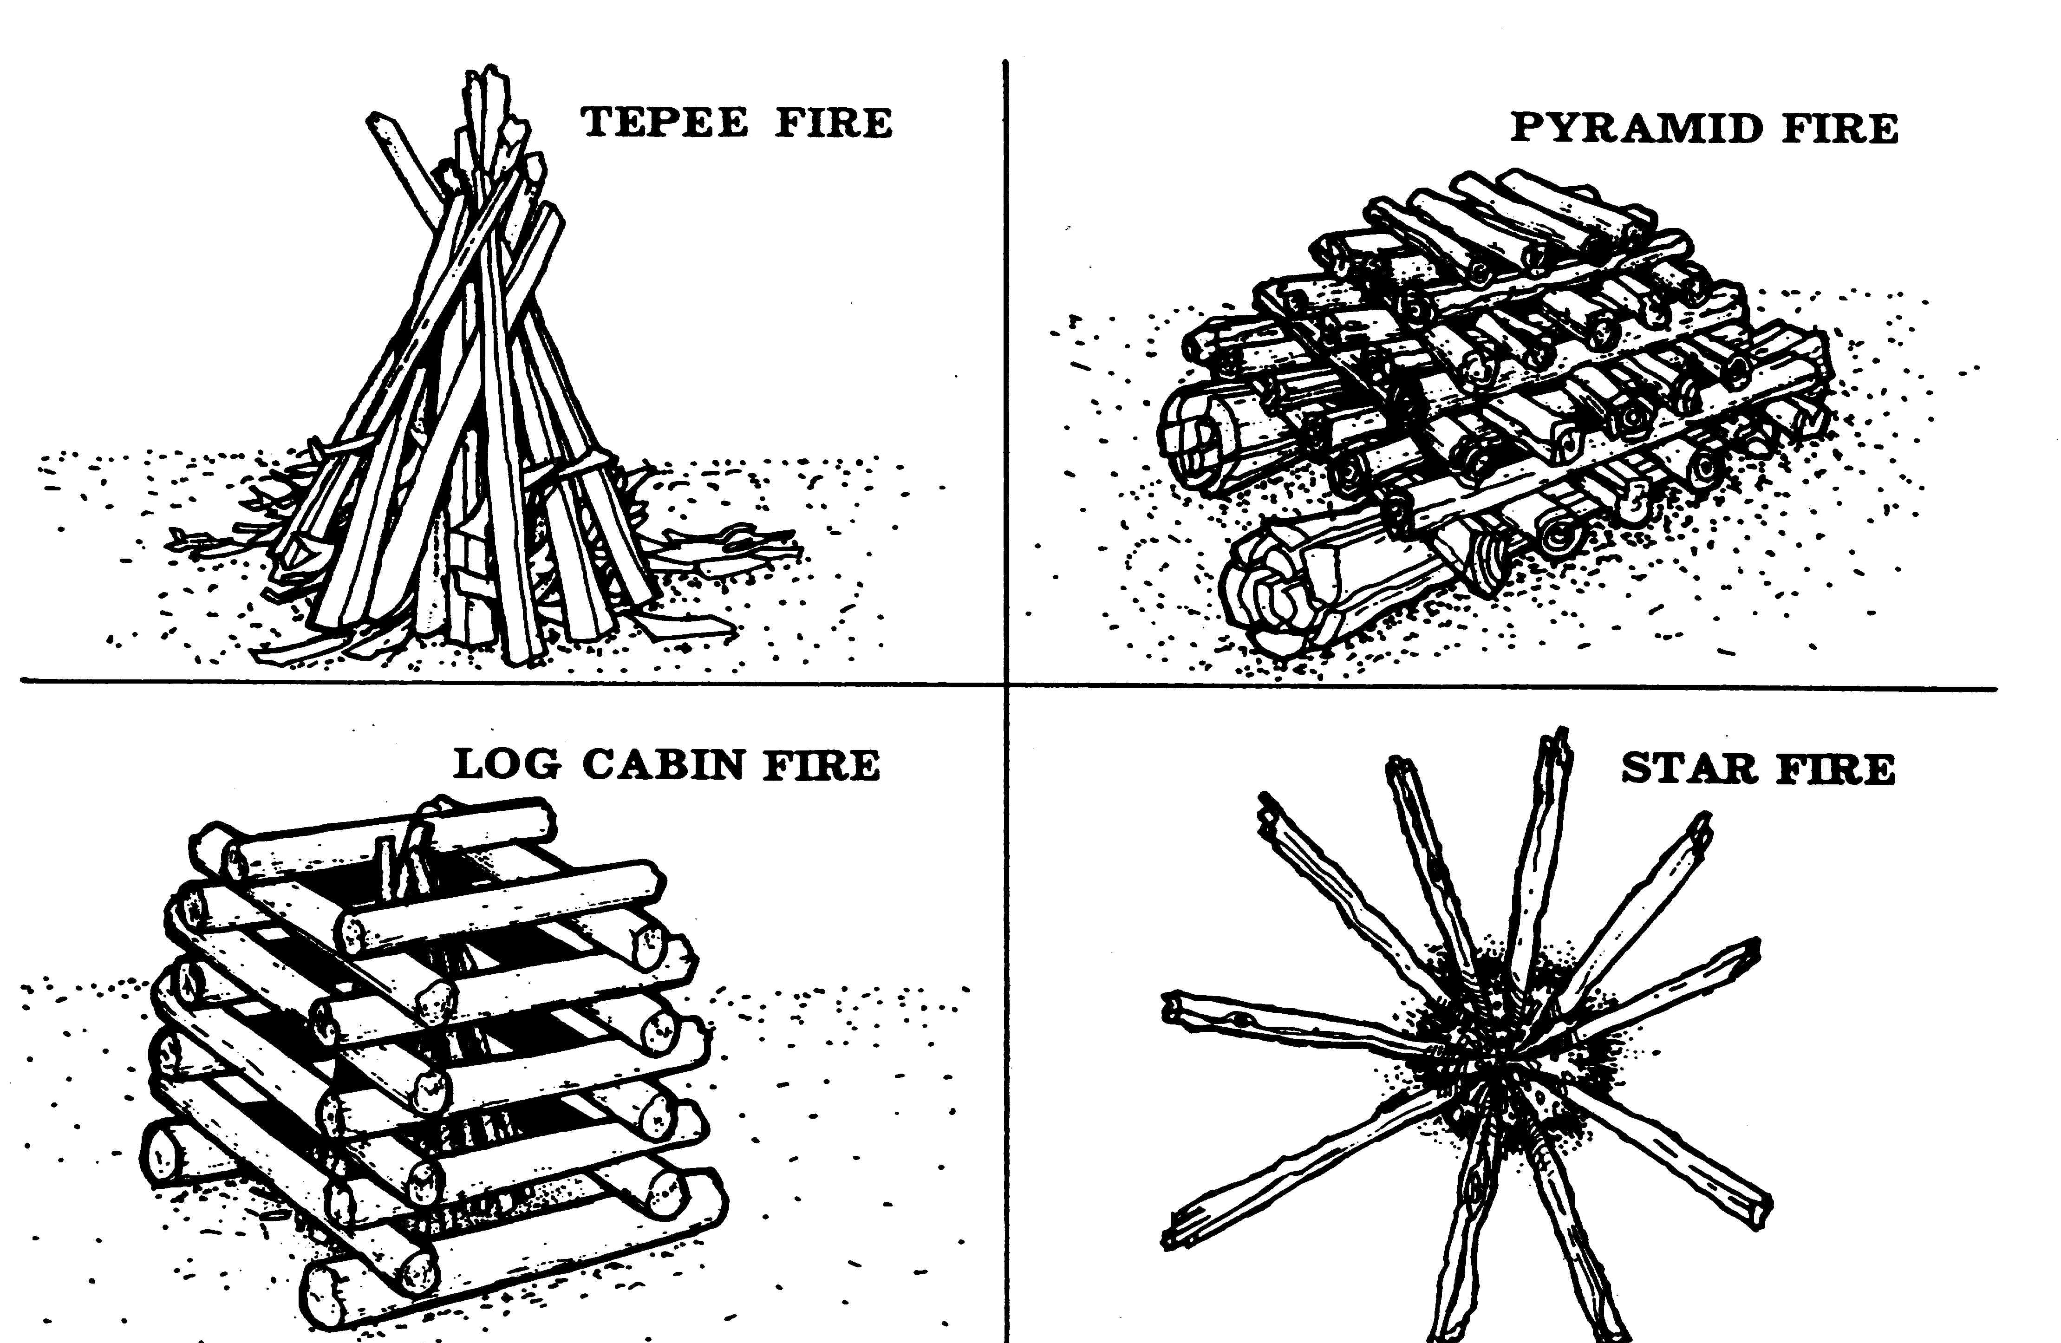
Common Fire Arrangements

Slide 18
Extinguishing a Fire
Fire burns in two basic modes
  Flaming and surface combustion (represented by the fire triangle)
  Flaming combustion (represented by the fire tetrahedron/pyramid)
Break the triangle or pyramid to put it out
- Remove the fuel - Reduce the heat
- Remove the oxygen - Interfere with the chemical reaction

Slide 19
Fire Triangle vs.
Fire Pyramid
Fuel
Chemical
Reaction
Heat
Oxygen
Heat
Oxygen
Fuel
Fire Triangle
Fire Pyramid

Slide 20
Using a Fire Extinguisher
Use the right type
  Class A: Common combustibles
  Class B: Flammable liquids and gases
  Class C: Electrical fires
  Class D: Flammable metals

Slide 21
Using a Fire Extinguisher Continued
Follow the acronym PASS
  Pull
  Aim
  Squeeze
  Sweep

Slide 22
Extinguishing Outdoor Fires (Campfires)
Keep personnel and equipment upwind and ready to move
Use water if available
  Don’t throw away drinking water if not easily replenished
Splash, spray, or sprinkle water on the fire
  Don’t pour all at once

Slide 23
Extinguishing Outdoor Fires (Campfires) Continued
Break up material and continue adding water until all signs of flames and glowing embers are gone
If water is not available, or in combination with water, throw soil, sand, etc. While breaking up burned materials

Slide 24
Extinguishing Outdoor Fires (Campfires) Continued
Using care, place your hand close to the burned area to check to see if cool
  Campfires, signal fires, etc., must always be completely extinguished and cool to the touch before leaving them
Efforts to extinguish a brushfire should only be attempted if the fire is very small, there is little or no wind, and an escape route is available. If in doubt, retreat and call the authorities

Slide 25
Land Survival Tasks
Ground Team Members
  O-0601: Conduct Actions if Lost
  O-0602: Locate Natural Water Sources
  O-0603: Prepare a Natural Shelter
  O-0604: Build a Fire
  O-0605: Extinguish a Fire

