Slide 1

Inter Brigade Communications System

Slide 2
IBCS
The IBCS program was Funded by Program Executive Office Command
Control and Communications Tactical.(PEO-C3T)
Mr. John Sklinar Deputy Director.
Guidance provided by CECOM RDEC, Space and Terrestrial
Communications Directorate, S&TCD, Space and Technology Branch.
Mr. Michael Harrigan, Branch Chief

Slide 3
IBCS
The Prototype IBCS System provides Echelons, Brigade and below high speed digital communications.
The IBCS is Designated as a leave behind system for 2nd
Brigade, 82nd Airborne Division, Ft Bragg, NC

Slide 4
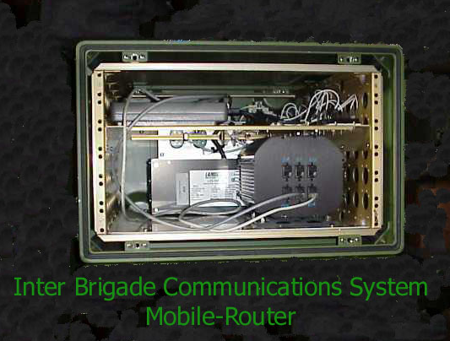
Prototype IBCS System

Slide 5






Players:
IBCS
LSI

Slide 6
IBCS
The IBCS prototype systems were designed with the solider in mind. Designed for harsh, rugged environments, the IBCS provides communications within a soldiers TOC, and to other TOC’s
As was demonstrated in Spiral Three, and the FTX, at
Ft Bragg, and MC02 at Ft Irwin the IBCS is a push to
talk system.
Customer requirements drive the final size of the IBCS system. The customer delivers his requirements, and a systems is designed around those requirements. The system can be as large or small as the customer requires.

Slide 7
IBCS
The concept revolved around a Universal Transit Case design for Ground – Airborne – Battlefield application.
Concept System designed as a throw on the ground,
erect mast, power on, and push to talk.
No further human intervention, the focus of the entire
engineering team, from code writers down to labelers
was remember the soldier, it must be set and forget.
The systems can operate on a wide range of power sources; AC inputs from 60 to 400 Hz and DC inputs of 28 VDC, make the IBCS system capable of world wide operations.
Additionally, the IBCS is fully FCC compliant 802.11b.

Slide 8
IBCS
Concept System contains CISCO Systems 3200 router,
running the Mobile - Router feature set, allowing
for an always on connection.
.

Slide 9
IBCS
Concept System tested Spiral Three, Ft Bragg
May/June 02.
Concept System used in Field Training Exercise,
FTX, Ft Bragg, July 02.
Concept System deployed by 2nd Brigade, 82nd Airborne
Division at National Training Center, Ft Irwin, CA,
July/August 02.

