Slide 1
INCREASING PROFESSIONAL CAPACITY FOR DISASTER RESILIENCE
WALTER HAYS
GLOBAL ALLIANCE FOR DISASTER REDUCTION

Slide 2
OPPORTUNITY: 2005-2014
Building a Global Culture of Community Disaster Resilience for the Greater Good in Global Perspective

Slide 3

GOAL: COMMUNITY RESILIENCE TO DISASTERS
FLOODS
REDUCED COMMUNITY VULNERABILITIES
SEVERE WIND STORMS
INCREASED TECHNICAL AND POLITICL CAPACITY OF COMMUNITY TO COPE
EARTHQUAKES
DROUGHTS
INCREASED OWNERSHIP AND USE OF KNOWLEDGE AND EXPERIENCE
LANDSLIDES
WILDFIRES
VOLCANIC ERUPTIONS
TSUNAMIS
GLOBAL CLIMATE CHANGE
TERRORISM

Slide 4

DECADE ON EDUCATION FOR SUSTAINABLE DEVELOPMENT (2005-2014)
BLUEPRINTS ON EDUCATION: An Infrastructure For Increasing Professional Capacity in Communities
THE KNOWLEDGE BASE
CAPACITY BUILDING
CONTINUING EDUCATION
Hazard Characterization
Public/Private Sector Partnership
Update Knowledge Bases After Each Disaster
Vulnerability Classifications
Disaster Scenarios
Assisting the Community CEO
Alternative Practices
Up Close and Personal and Distance Learning
Transfer Ownership of Technology
Collect, Store and Process Data
Public Awareness
Cause & Effect Relationships
Public/Private Sector Cooperation
Event-Action Capability
Warning Systems
Toolboxes for Disaster Reduction
Interface with Other Information Sources
Increased Knowledge, and Understanding

Slide 5
ROAD MAP FOR THE DECADE ON EDUCATION (2005-2014)
Don’t throw away tomorrow by forgetting the past.

Slide 6
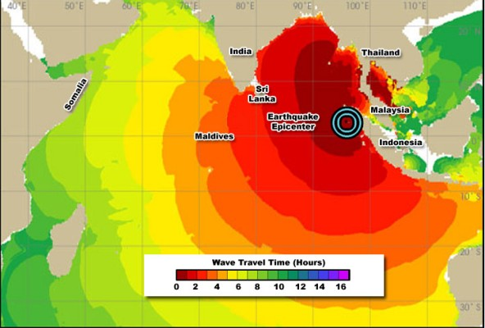

Slide 7
AN AGENDA FOR HIGHER EDUCATION PROFESSIONALS (2005-2014)
EXPAND RESOURCES
IMPROVE DELIVERY MECHANISMS
INCREASING PROFESSIONAL CAPACITY FOR DISASTER REDUCTION
IDENTIFY TARGETS OF OPPORTUNITY
CREATE TURNING POINTS OF CHANGE
MAINTAIN ONGOING DIALOGUE ON THE CHALLENGES

Slide 8
TURNING POINTS FOR CHANGE
EDUCATION: PENETRATE SOCIETY
IGNORANCE: TOWARD ENLIGHTENMENT
INCREASING COMMUNITY DISASTER RESILIENCE
APATHY: TOWARD EMPOWERMENT
BOUNDARIES: TOWARD SEAMLESS
ENABLEMENT: Toward POLITICAL WILL

Slide 9
The Challenge for Educators
Creating “Books of Knowledge” (Blueprints on Education) for Sustainable Development in over 1 Million Communities by end of 2014.

Slide 10


BOOK OF
KNOWLEDGE - Perspectives
On Science, Policy,
And Change

Slide 11
KNOWLEDGE MANAGEMENT AND EDUCATION
EDUCATION
INFORMATION & PUBLIC AWARENESS
BASIC PRINCIPLES FOR INCREASING PROFESSIONAL CAPACITY
INCREASED KNOWLEDGE BASE
COMMUNITY EMPOWERMENT
INTERNATIONAL FORUMS

Slide 12
REGIONAL ALLIANCES FOR KNOWLEDGE DELIVERY
EUROPE
FOR COMMUNITY DISASTER RESILIENCE -
MEDITERRANEAN
SUB-SAHARAN AFRICA
REGIONAL KNOWLEDGE DIFFUSION NETWORKS
ASIA
AUSTRALIA & PACIFIC ISLANDS
SOUTH AMERICA & CARIBBEAN
NORTH AMERICA

