Slide 1
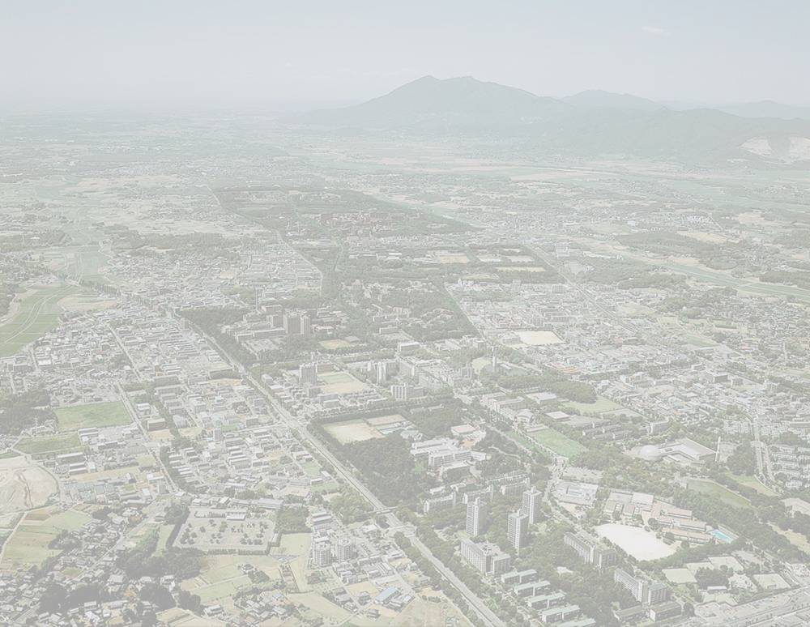
T. Nakatsukasa (Univ. of Tsukuba)
Collaborators:
S. Shinohara, K. Yabana (Univ. of Tsukuba)
H. Ohta (Sumitomo Chemical)
ORNL
2007/3/5-8
Complete spectroscopy with the Skyrme functional beyond mean field

Slide 2
Exploring the Skyrme DFT and more
Correlation beyond the mean field is often important for description of ground-state and excited states.
RPA, Projection, and GCM are typical methods, but with a limited applicability.
Toward the theoretical complete spectroscopy of low-lying states with a single Hamiltonian and with a very large model space:
“Stochastic” approach to configuration mixing with the Skyrme Hamiltonian

Slide 3
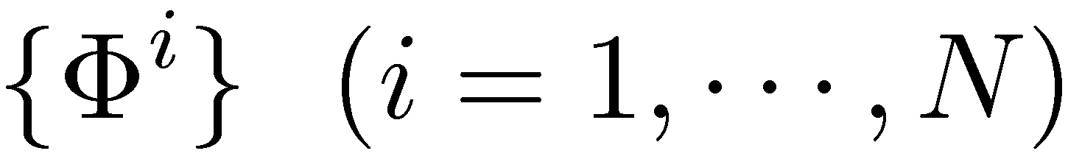
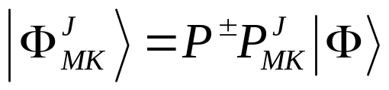
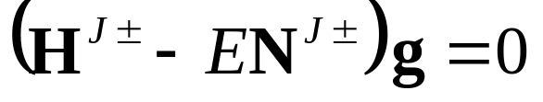
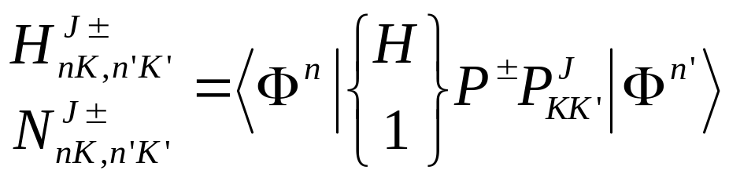
Stochastic configuration mixing with parity and angular momentum projection
Generation and selection of Slater det’s in the 3D Cartesian Coordinate space
Projection on good J^{π} (3D rotation)
Solution of generalized eigenvalue eq.

Slide 4
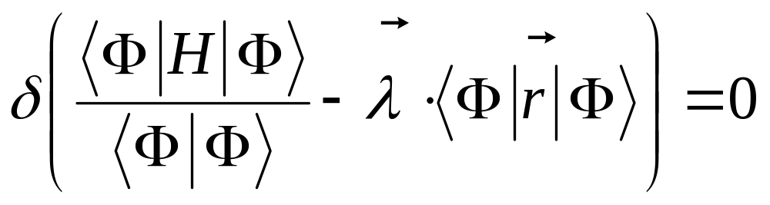
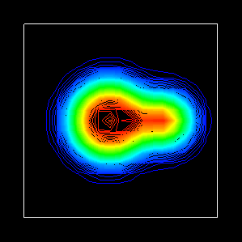
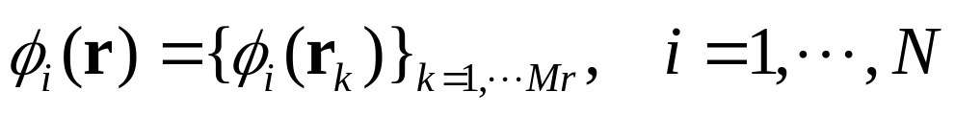
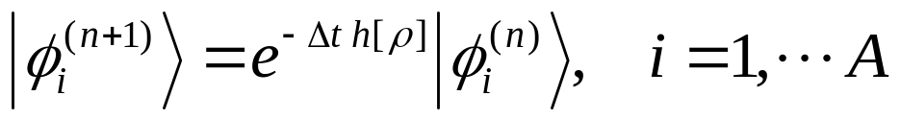
Skyrme Hartree-Fock in a mesh space
Variation for a Slater determinant
3D space is discretized in lattice
Single-particle orbital:
²⁰Ne
Imaginary-time Method

Slide 5
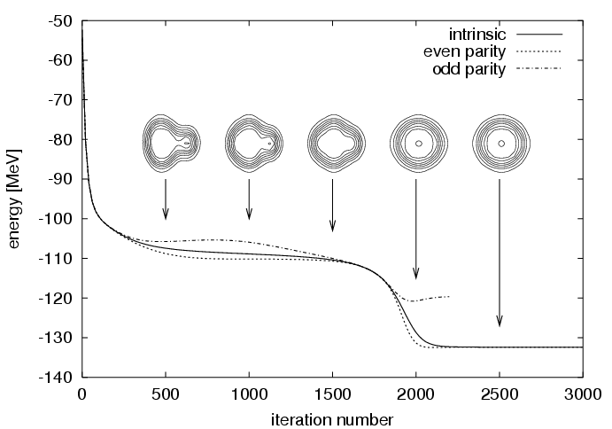
Generation of many S-det’s
Initial state
Imaginary-time evolution
¹⁶O (BKN)
3D real space
Gaussian wave packets (n & p) whose positions are determined by random numbers.
n

Slide 6
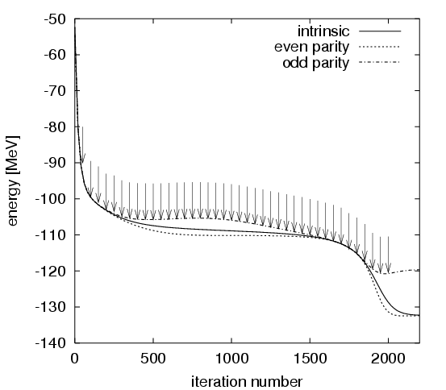
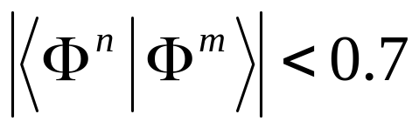

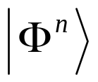

Selection of Slater det’s
Every 50 iterations, a Slater det is stored in a basket.
Check the linear dependence, then select some of them in a bag and throw away the rest.
If overlap
with all possible exchange of axes (24), we put them in a bag.

Slide 7
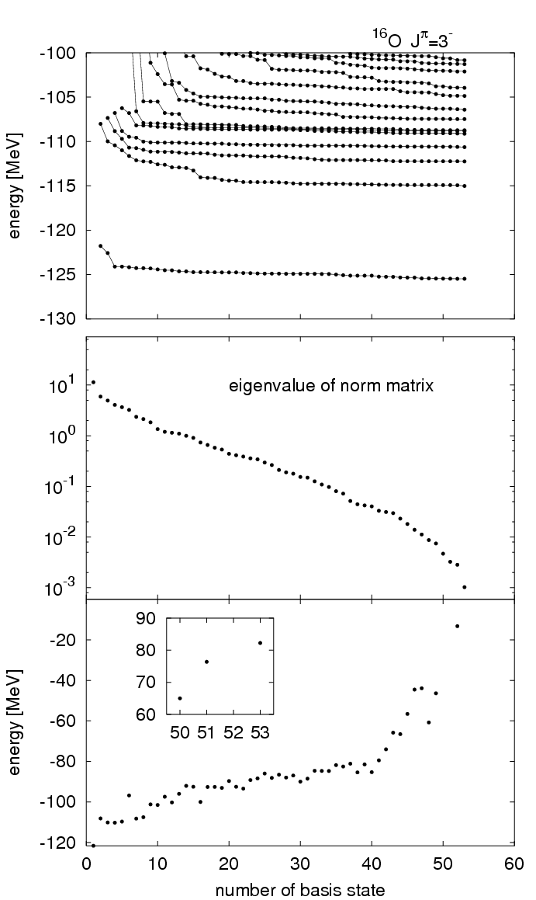
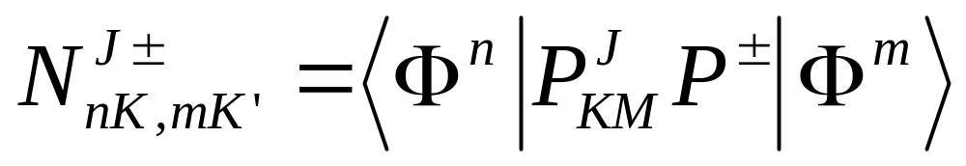


Further Selection …
BKN
Eigenvalues of the norm matrix
smaller than 10⁻³
Garbage box
Small norm only

Slide 8
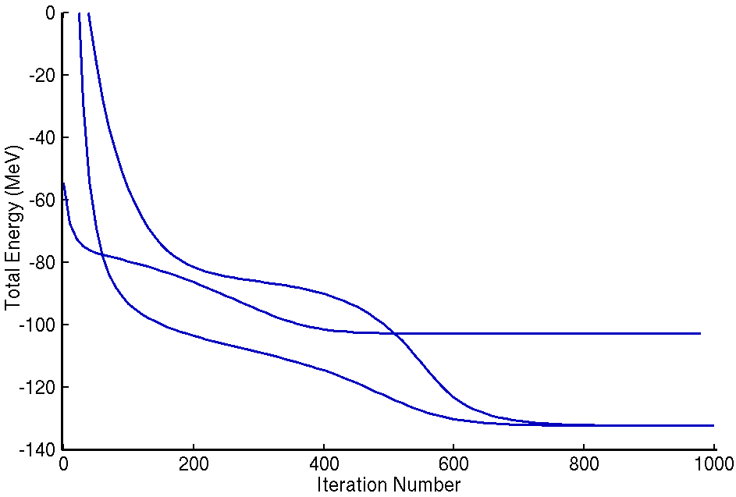
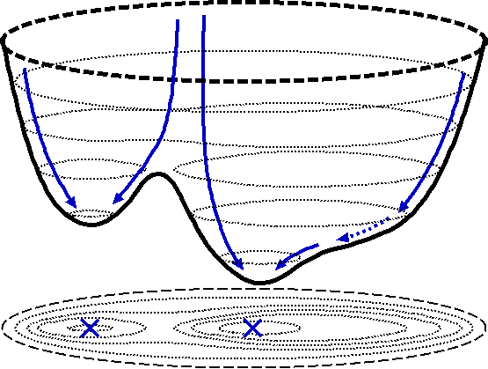
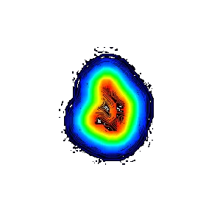
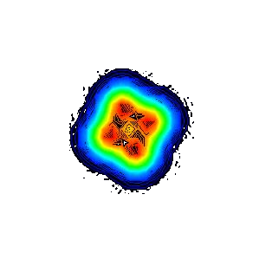
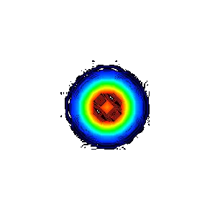
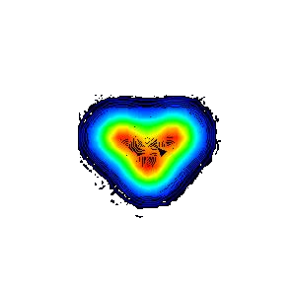
Many paths on a potential surface
Randomly-generated Slater determinants
¹⁶O
soft
HF state

Slide 9
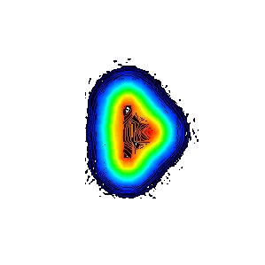
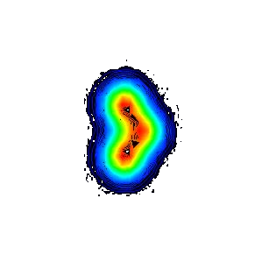
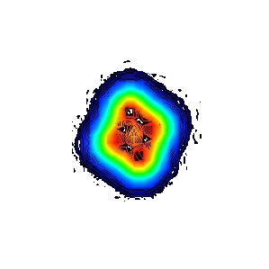
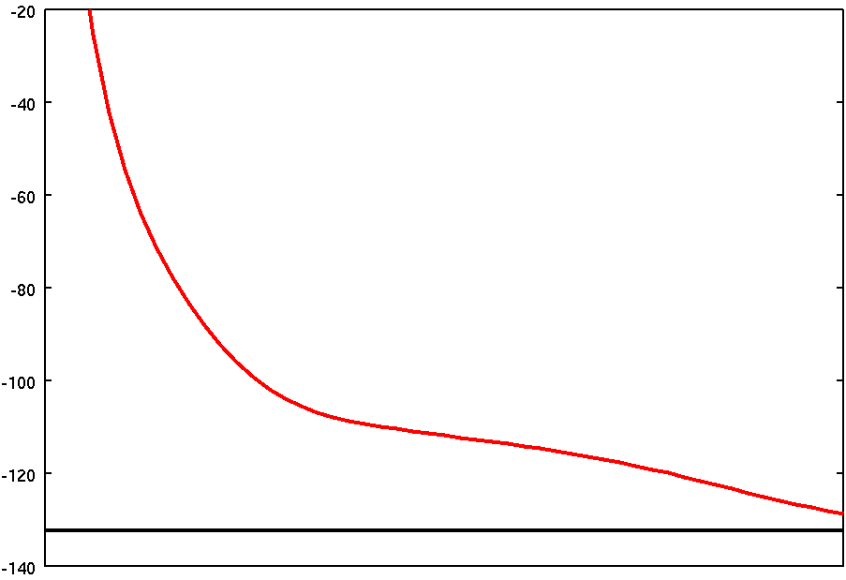
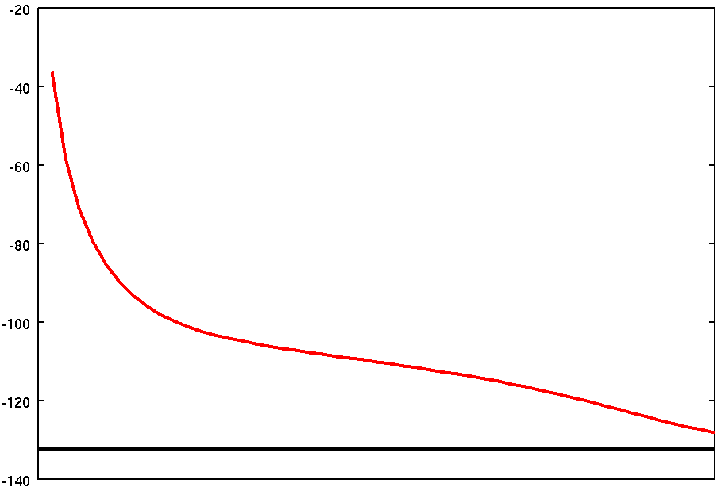
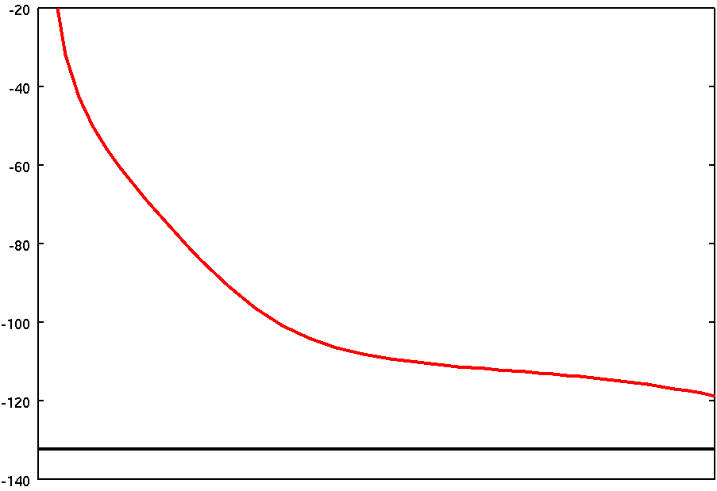
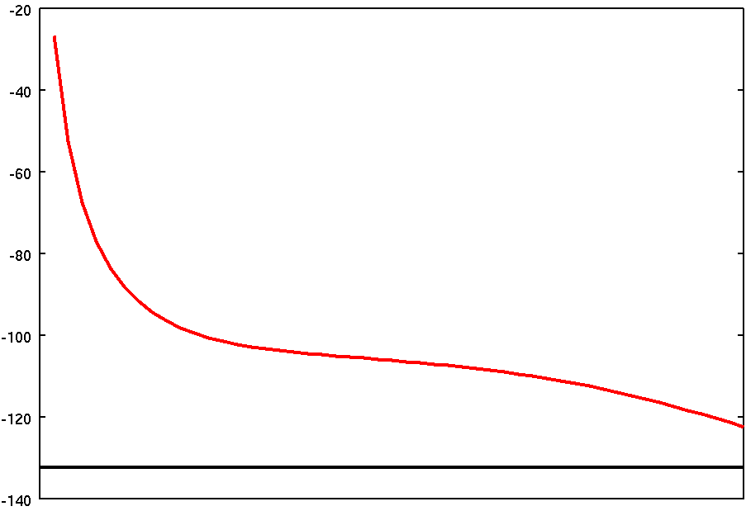
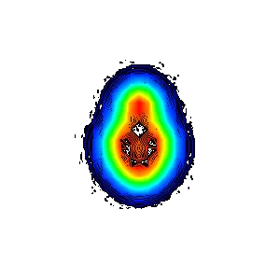
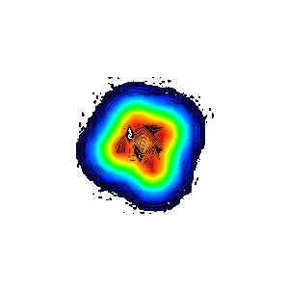
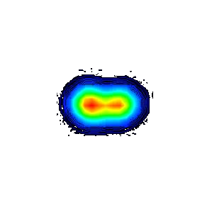
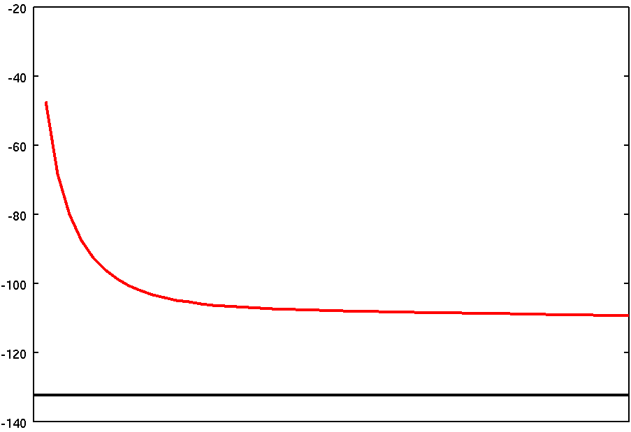
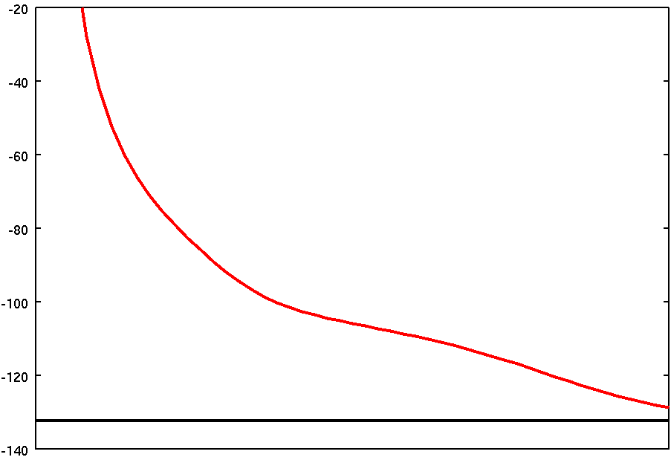
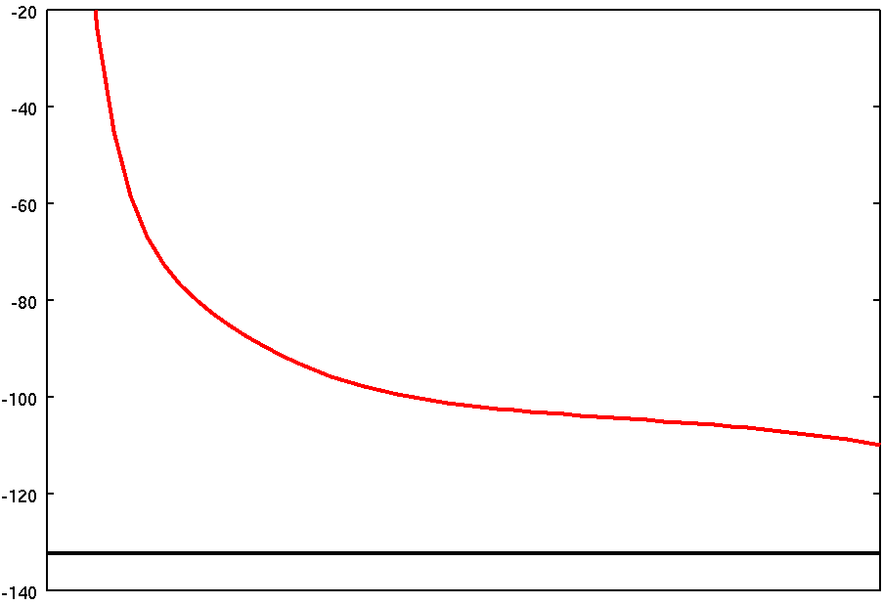
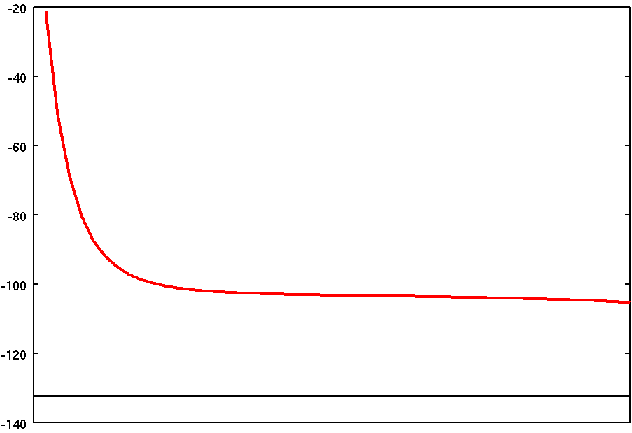
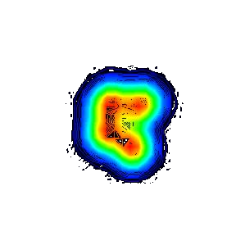
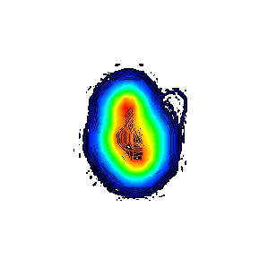
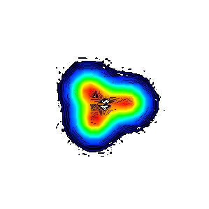
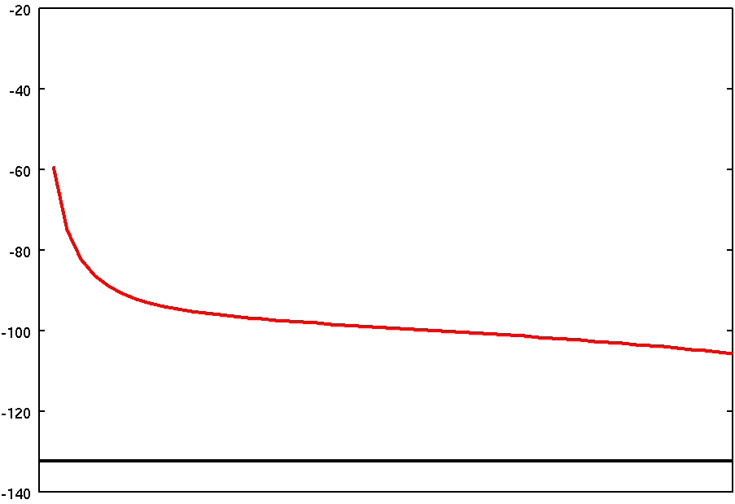
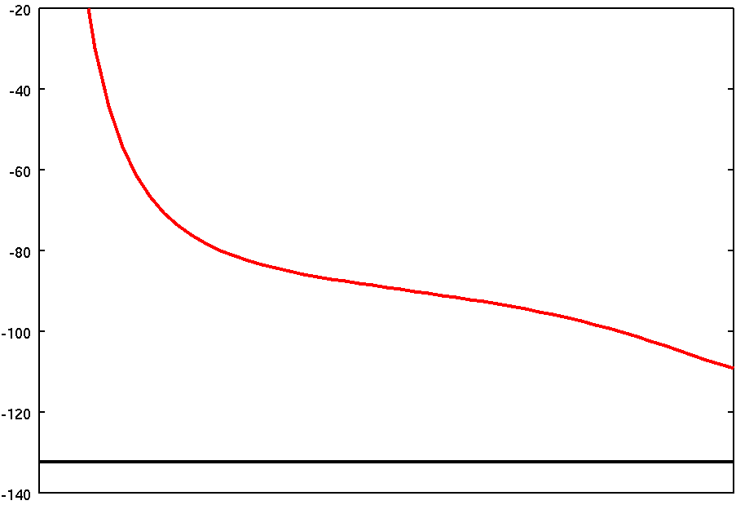
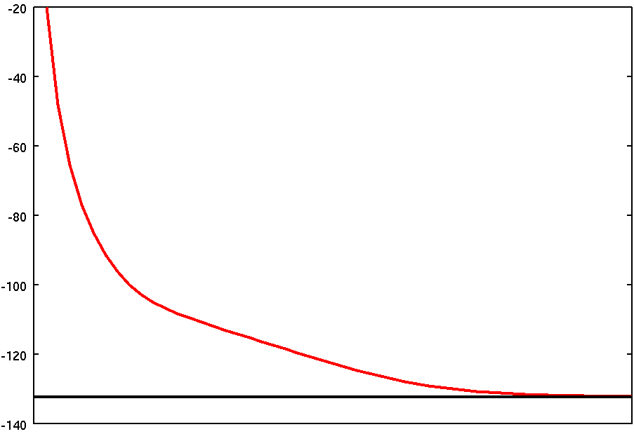
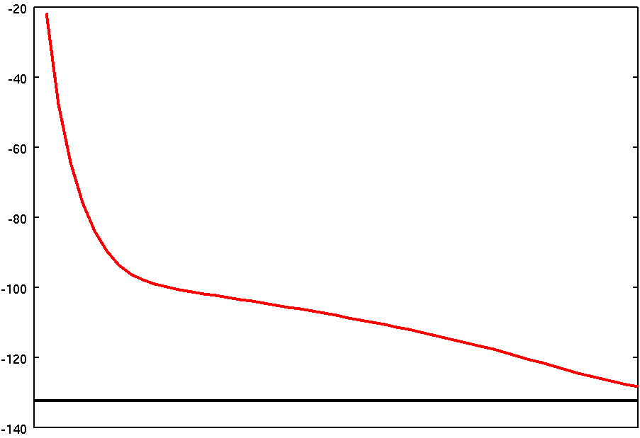
Many configurations included
in the calculation in ¹⁶O
Local minima and soft modes automatically appear.

Slide 10
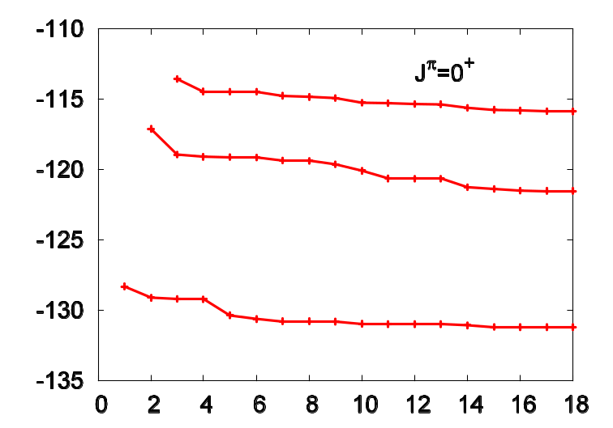
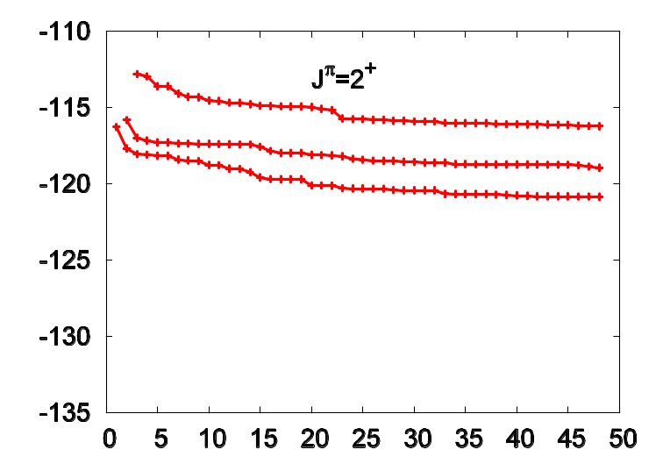
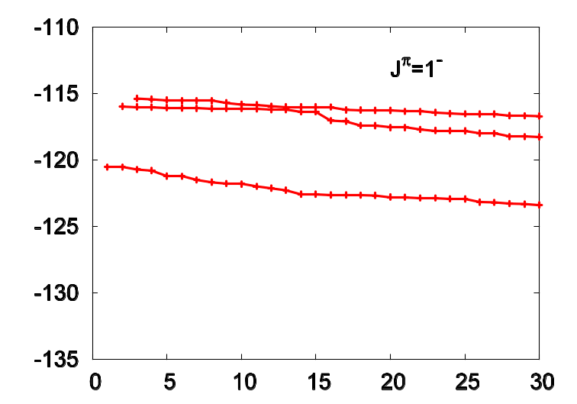
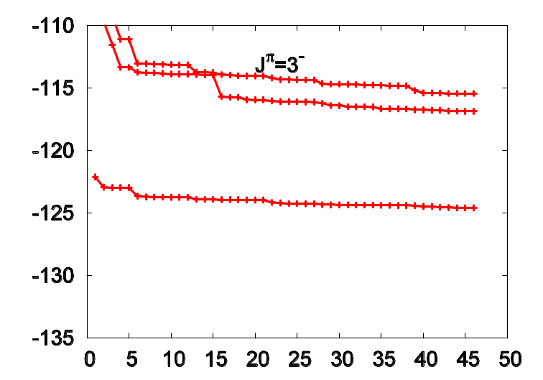
¹⁶O (SLy4)
J^{π}=0⁺
J^{π}=2⁺
Number of basis states
Number of basis states
J^{π}=1⁻
J^{π}=3⁻
Number of basis states
Number of basis states

Slide 11
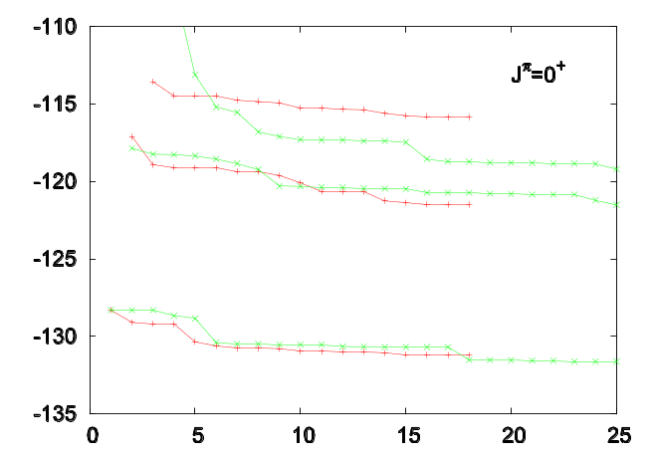
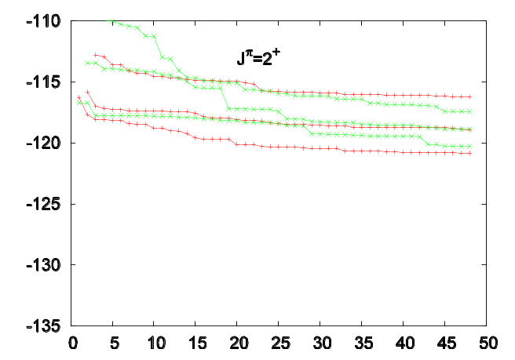
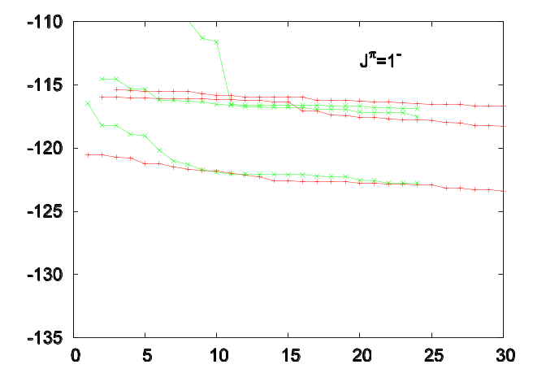
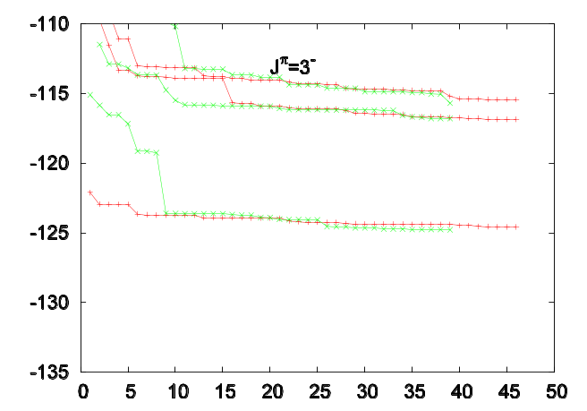
¹⁶O (SLy4)

Slide 12




¹⁶O
Calculation (SLy4)
Experiment
π=+
J^{π}
J^{π}
π=−
J^{π}
J^{π}

Slide 13


Energy spectrum in ¹⁶O
SGII
B(E2) (e²fm⁴)
56.40
49.70
150±18
76±13
(0p_{1/2})⁻¹(sd)¹
Main component
(parity doublet)
Deformed ¹²C (oblate）

Slide 14




Energy convergence in ¹²C
SGII
J^{π}=0⁺
J^{π}=2⁺
J^{π}=1⁻
J^{π}=3⁻

Slide 15

Energy spectrum in ¹²C
SGII
B(E2) (e²fm⁴)
14.09
12.10
13.4±1.8
8.42
7.81±0.44

Slide 16




Energy spectrum in ¹²C
SGII
second 0⁺: 42.4%
ground 0⁺: 94.8%
3⁻: 78.7%
third 0⁺: 62.1%

Slide 17


Variation after parity projection
¹²C
Ohta, Yabana, Nakatsukasa, PRC70 (2004) 014301
SGII
HF
VAPP(+)
Spin-orbit interaction is weakened by 20% to fit the g.s. band
VAPP(-)

Slide 18




Energy spectrum in ²⁰Ne
SGII
(0p_{1/2})⁻¹(sd)⁵

Slide 19
Energy spectrum in ²⁰Ne
B(E2) (e²fm⁴)
 | cal | exp
2⁺→0⁺ | 52.09 | 57±4
4⁺→2⁺ | 64.52 | 71±7
6⁺→4⁺ | 50.04 | 66±8
3⁻→1⁻ | 114.19 | 164±26
5⁻→3⁻ | 120.20

Slide 20
Energy spectrum in ²⁰Ne
B(E2) (e²fm⁴)
 | cal | exp
3⁻→2⁻ | 106.21 | 113±29
4⁻→3⁻ | 77.8 | 77±16
5⁻→4⁻ | 84.5 | <808
6⁻→5⁻ | 29.9 | 32±13

Slide 21


Variation after parity projection
²⁰Ne
Ohta, Yabana, Nakatsukasa, PRC70 (2004) 014301
SGII
HF
VAPP(+)
VAPP(-)
Negative-parity states are well reproduced.
The band termination of the g.s. band is not reproduced because the band is constructed from a single intrinsic state.
VAPP(-)

Slide 22
Summary
Shinohara et al, PRC 74, 054315 (2006)
Complete low-lying spectroscopy with the Skyrme Hamiltonian
Capable of describing a variety of excited states in a unified way, such as vibrational excitations, cluster excitations, single-particle excitations.
¹²C: ground-state band, 2nd 0^{+,} negative-parity bands (3^{-,} 1⁻ , 2⁻⁾
¹⁶O: 2nd K^{π}=0⁺ & 0⁻ bands, K^{π}=3⁻ ,1⁻ , 2⁻ bands
²⁰Ne: K^{π}=0⁺ & 0⁻ bands, K^{π}=2⁻ band
Non-empirical calculation without any restriction on shape of wave functions
Problems
Still overestimate the excitation energy of 2nd 0⁺ state in ¹⁶O by about 3 MeV, and underestimate its B(E2)
Center of mass? Weak-coupling phenomena?
Overestimate the moment of inertia of the ground-state band in ²⁰Ne
Pairing?

Slide 23




¹²C
Calculation (SIII)
Experiment
π=+
J^{π}
J^{π}
π=−
J^{π}
J^{π}

Slide 24


Initial Slater determinant
iteration
iteration
Gaussian wave packet
Gaussian single-particle wave functions are distributed.
Positions of the Gaussian-centers are determined by random numbers to remove any prejudice.

Slide 25
40 check points

Slide 26


¹²C
K^{π}=1⁻
K^{π}=3⁻
K^{π}=0⁺
cal
exp

Slide 27


²⁰Ne
K^{π}=0⁻
K^{π}=2⁻
K^{π}=0⁺
cal
exp

