Slide 1


Non-Photonic Electron-Hadron Correlations at STAR
Gang Wang
(University of California, Los Angeles)
for STAR Collaboration

Slide 2
Outline
Motivation
Analysis procedure
e-h correlations in p+p collisions
e-h correlations in Cu+Cu collisions
e-h correlations in Au+Au collisions
Summary

Slide 3
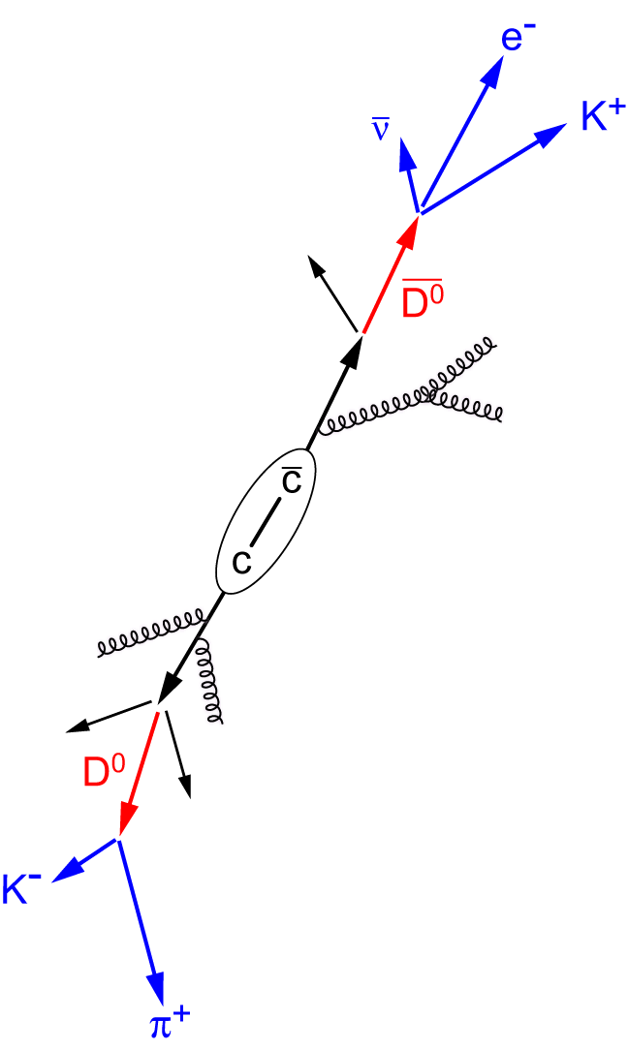
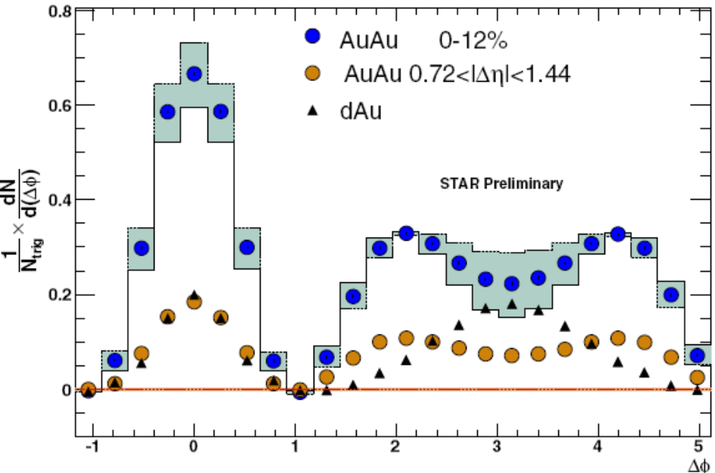
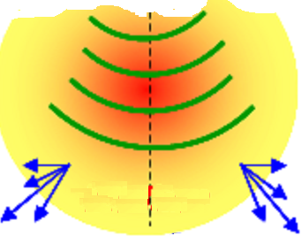
Near Side:
what’s the contribution of B/D decay to the non-photonic electrons?
trigger
Motivations
Conical Pattern in 2-Particle Correlations in Au+Au Collisions
p_{T}^{trig} = 2.5-4.0 GeV/c;
p_{T}^{asso} = 1.0-2.5 GeV/c
Mark Horner (for STAR Collaboration):
J. Phys. G: Nucl. Part. Phys. 34 (2007) S995
Away Side in medium:
How does B/D lose energy? Via conical emission?

Slide 4
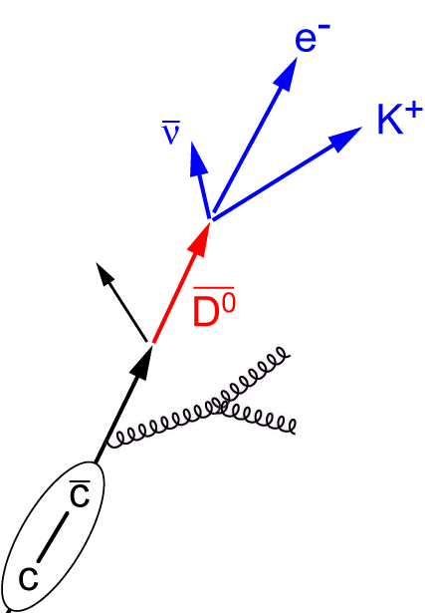
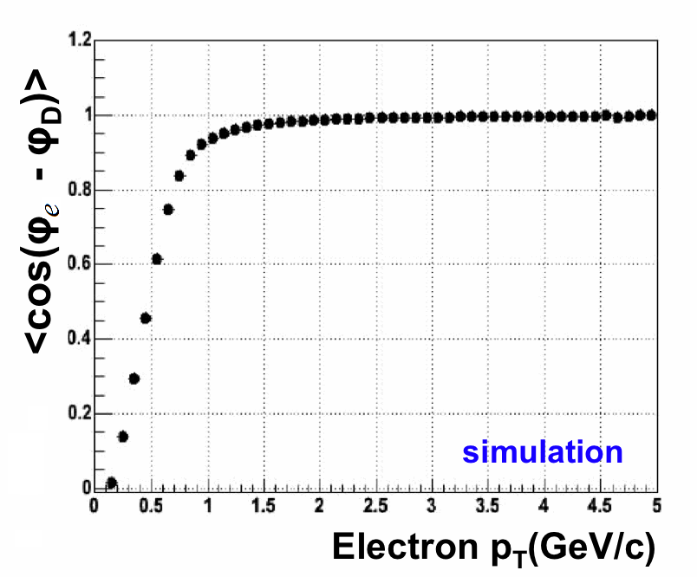
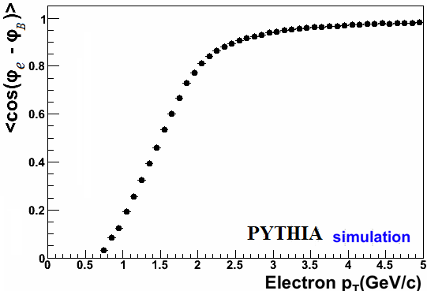
Non-photonic electrons
PYTHIA
D mesons have their directions well represented by the daughter electrons, above 1.5 GeV/c.
Electrons from B decays can represent the B meson momentum direction well if p_{T} > 3 GeV/c.

Slide 5
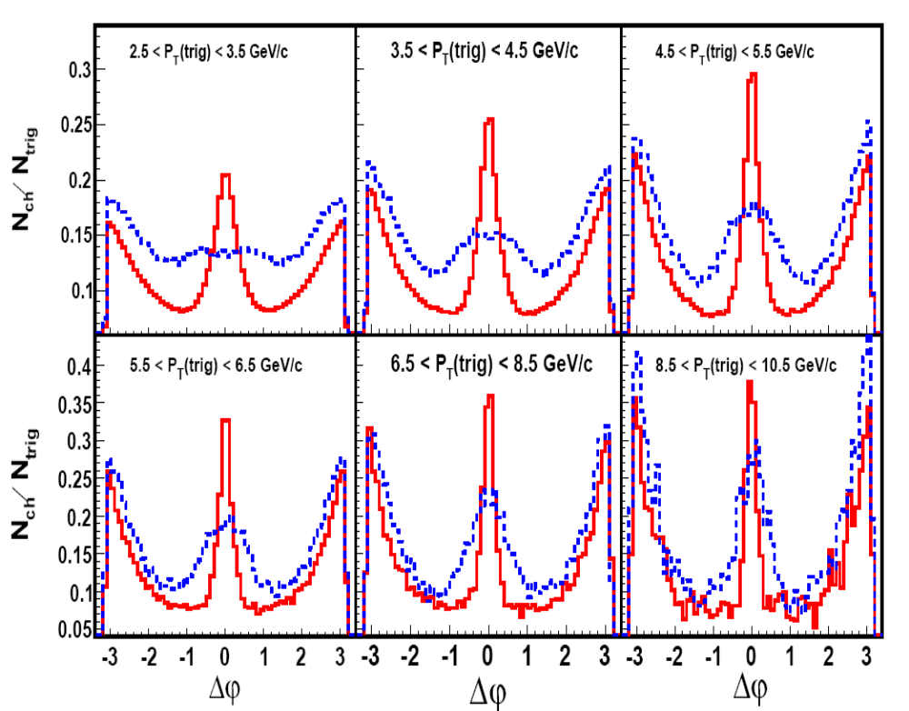
B vs D: contribution to non-photonic e
PYTHIA
X.Y. Lin, hep-ph/0602067
B
D
p_{T_asso} > 0.3 GeV/c
PYTHIA shows significant differences in B&D on the near-side correlations in p+p collisions, and we can fit the experimental data to obtain B/D contribution.

Slide 6
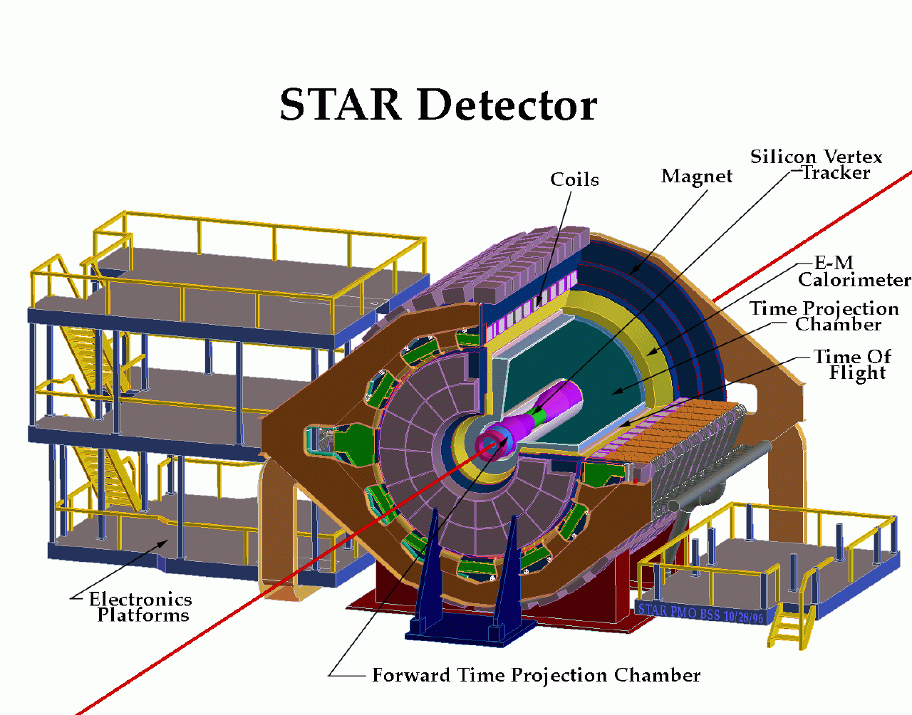
Major Detectors Used
Signal:
Non-photonic electron
Background:
Hadron Photonic electron
Charm decay
Bottom decay
Photon conversion
π⁰ Dalitz decay
η Dalitz decay
kaon decay
vector meson decays
Data Sample:
At √s_{NN} = 200 GeV,
p+p collisions in run6 (2006), Cu+Cu collisions in run5 (2005), Au+Au collisions in run7 (2007).
Time Projection Chamber (TPC)
Barrel Electro-Magnetic Calorimeter (BEMC)
Barrel Shower Maximum Detector (BSMD)

Slide 7
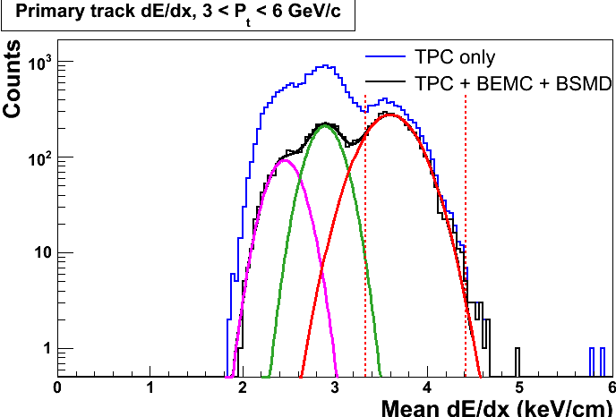
Electron ID Using TPC, BEMC and BSMD
Purity:
above 99% for
3 < p_{T} < 6 GeV/c in CuCu and AuAu;
above 98% for 3 < p_{T} < 6 GeV/c, and 80% for 9 GeV/c in p+p collisions.
With BEMC and BSMD, the electron peak is enhanced in the energy loss distribution, and we obtain a very pure electron sample.

Slide 8
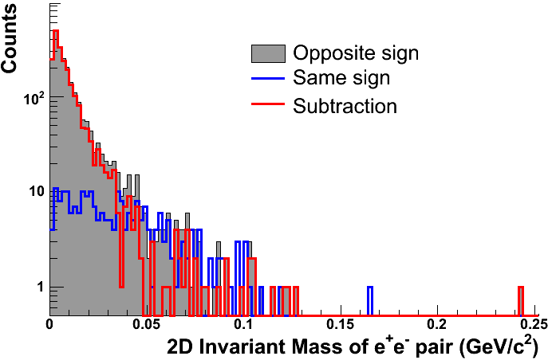
Photonic Background
e⁺
(global track)
e⁻
(assigned as primary track)
dca
e⁻
(primary track)
γ
The invariant masses of the OS and SS e-pairs have different distributions.
Reconstructed photonic electron is the subtraction.
Photonic electron is the reconstructed-photonic/ ε
ε is the background reconstruction efficiency calculated from simulations.

Slide 9
Procedure to Extract the Signal of e-h Correlations
All Tracks
Pass EID cuts
Inclusive electron
Non-photonic electron
Photonic electron
Reco-photonic electron
=OppSign - combinatorics
Not-reco-photonic electron
=(1/eff-1)*(reco-photonic)
Semi-inclusive electron
Δφ_{non-pho} = Δφ_{semi-incl} + Δφ_{SameSign-w/-partner}
– (1/eff -1)*(Δφ_{OppSign-w/o-partner} – Δφ_{SameSign-w/o-partner})
Each item has its own corresponding Δφ histogram.

Slide 10
Near Side in p+p

Slide 11
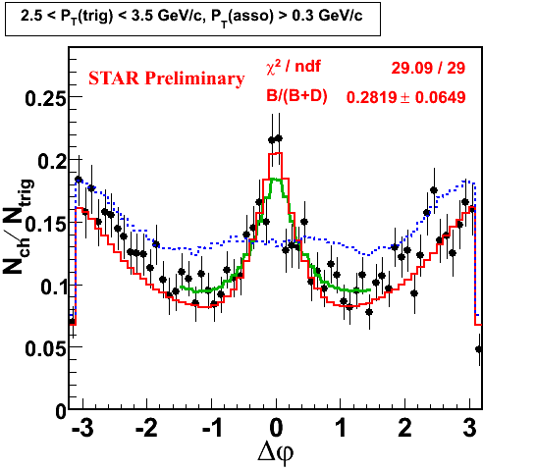
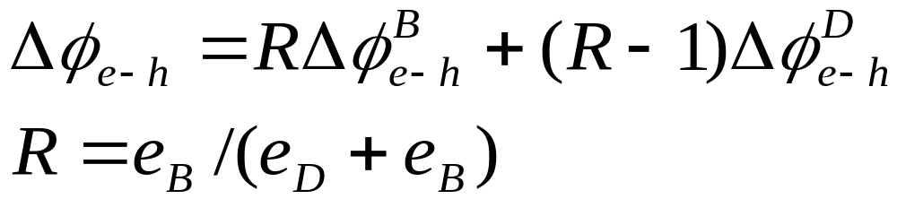
Non-photonic e-h correlations in p+p 200GeV
Clear azim. correlation is observed around near and away side.
Fitting measured dn/dφ distribution from B and D decays, we can estimate B decay contribution to non-photonic electron.

Slide 12
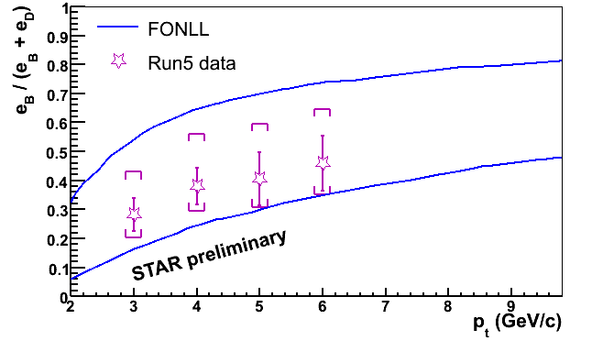
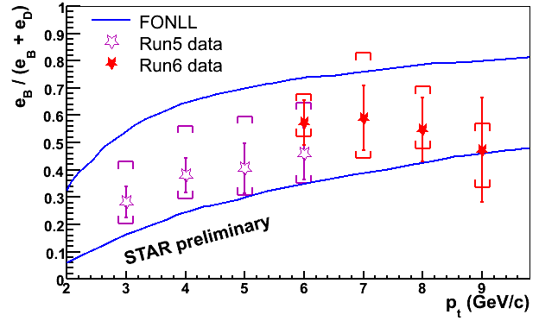
B contribution to non-photonic e in p+p 200GeV
See Shingo Sakai’s poster
Almost half-half B and D contributions to non-photonic e’s at 6 < p_{T} < 9 GeV/c, and FONLL prediction is consistent with our data within errors.
Substantial bottom contributions

Slide 13
Away Side in CuCu and AuAu

Slide 14
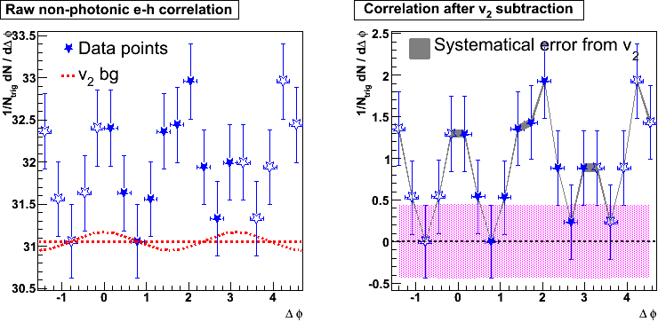
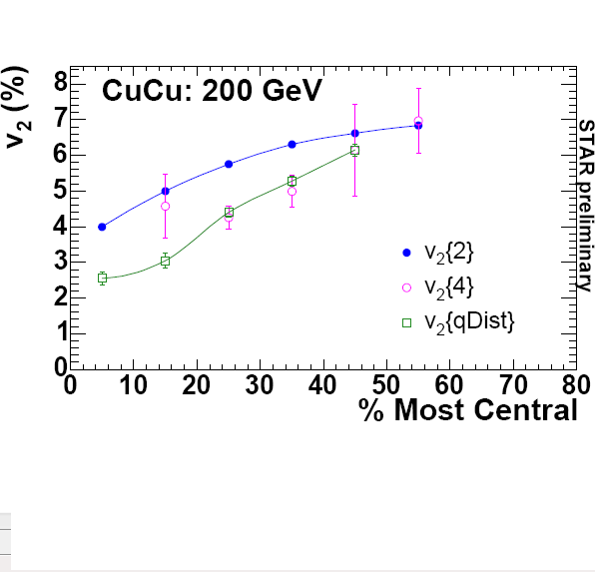

e-h correlations in Cu+Cu 200 GeV
0 – 20%: 3 < p_{T}^{trig} < 6 GeV/c & 0.15 < p_{T}^{asso} < 0.5 GeV/c
STAR Preliminary
Uncertainty from ZYAM
about 40% non-flow or fluctuation
(Gang Wang, Nucl. Phys. A 774 (2006) 515.)
Non-photonic e-h azimuthal correlation is measured in one π range,
and open markers are reflections. We see clear correlation structures.
On the away side, a broad structure or a possible double-hump feature has been observed, even before v₂ subtraction.
Upper limits of v₂ used are 60% of hadron v₂ values measured with the v₂{EP} method (equivalent to v₂{2}).

Slide 15
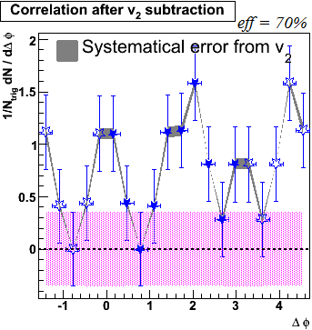
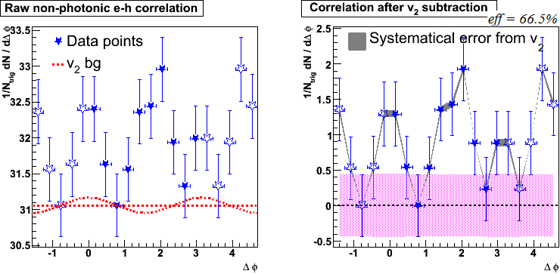
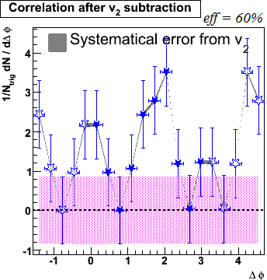
Robustness in CuCu 200 GeV
0 – 20%: 3 < p_{T}^{trig} < 6 GeV/c & 0.15 < p_{T}^{asso} < 0.5 GeV/c
STAR Preliminary
The broad structure on the away side is robust when we vary the efficiency of photonic electron reconstruction (66.5%, 60%, 70%).

Slide 16
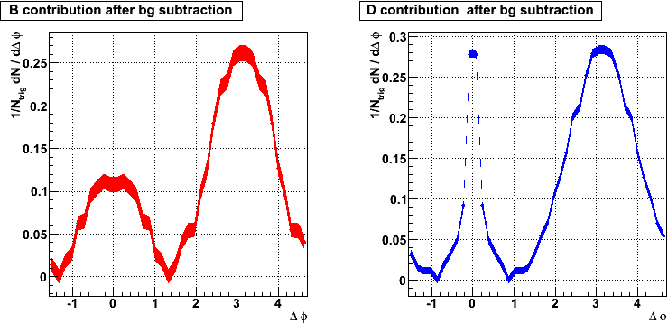
PYTHIA simulations weighted with CuCu yields
3 < p_{T}^{trig} < 6 GeV/c & 0.15 < p_{T}^{asso} < 0.5 GeV/c
B
D
Here we assume the B/D contribution in CuCu is similar to that in p+p. Even if they are not similar, we don’t expect the double-hump without a medium.

Slide 17
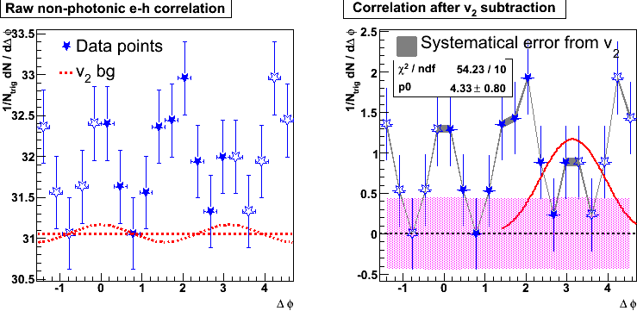
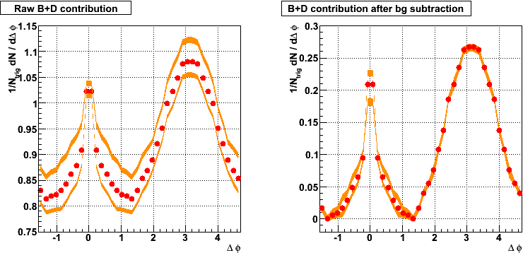

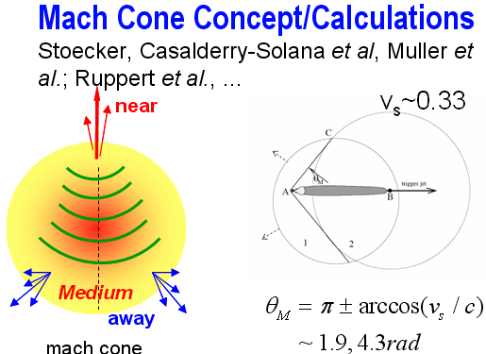
Interpretation
3 < p_{T}^{trig} < 6 GeV/c & 0.15 < p_{T}^{asso} < 0.5 GeV/c
In PYTHIA, B + D contribution has only one peak on the away side, unlike the experimental result in CuCu. PYTHIA fit has a big chi2.
The away side in e-h is similar to what has been observed in h-h correlations, and consistent with Mach Cone calculations etc.

Slide 18
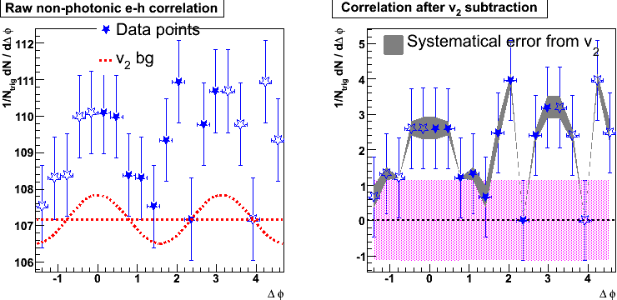
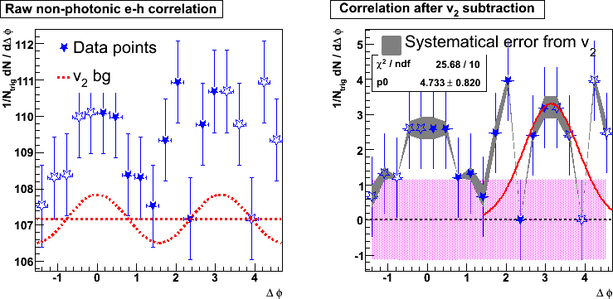
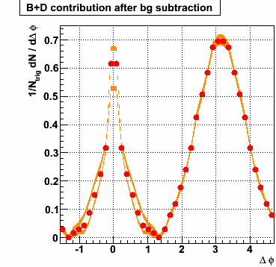
e-h correlations in Au+Au 200 GeV
0 – 20%: 3 < p_{T}^{trig} < 6 GeV/c & 0.15 < p_{T}^{asso} < 1 GeV/c
PYTHIA
STAR Preliminary
Upper limits of v₂ used are 80% of hadron v₂ values measured with the v₂{EP} method.
Non-photonic e-h correlation is broadened on the away side.

Slide 19
Summary
We have measured non-photonic e-h correlations in p+p collisions to retrieve B and D contributions to non-photonic electrons up to p_{T}~9 GeV/c. We found comparable B and D contributions for electron p_{T} 5.5~9 GeV/c.
FONLL prediction and our e_{B}/(e_{B}+e_{D}) results are consistent with each other within errors.
The shape of non-photonic e-h azimuthal correlation function is found to be modified in central Cu+Cu and Au+Au collisions due to the presence of the dense medium created in these collisions.
  Away-side: Hint of a broad structure, similar shape to that from h-h correlations.
  Induced by heavy quark interaction with the dense medium?
Quantitative measure and investigation of the nature of the possible conical emission pattern will require more statistics!

Slide 20
Back up slides

Slide 21
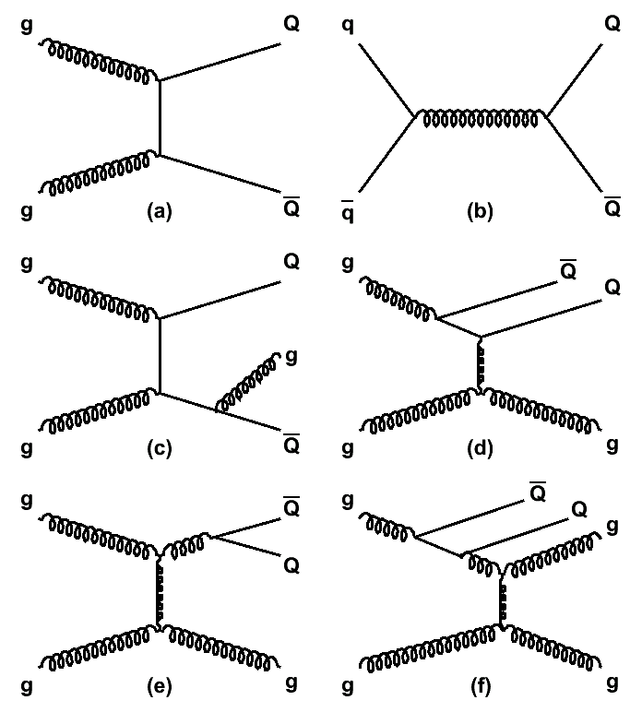
HQ Production Mechanism
Δφ ≈ π
  Due to large mass, HQ productions are considered as point-like pQCD processes
  HQ is produced at the initial via leading gluon fusion, and sensitive to the gluon PDF
  NLO pQCD diagrams show that Q-Qbar could be not back-to-back in transverse plane
  We need to study this smearing effect with models
Δφ ≈ π
flavor creation
Δφ ≈ 0
gluon splitting

Slide 22
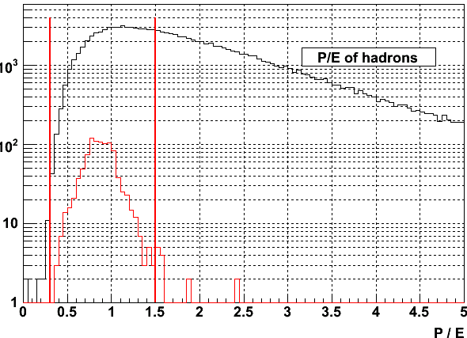
Electron Identification: P/E
P is measured by TPC. E is the sum of the associated BEMC point’s energy measured by BEMC.
Electrons will deposit almost all of their energy in the BEMC towers. 0.3 < P/E <1.5 was used to keep electrons and reject hadrons.

Slide 23
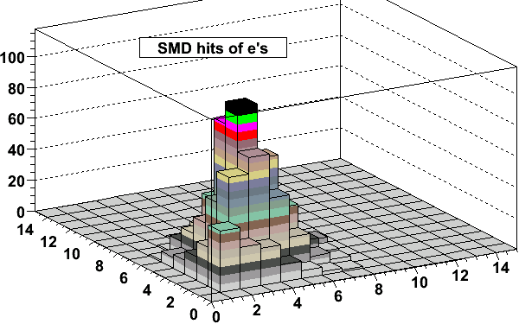
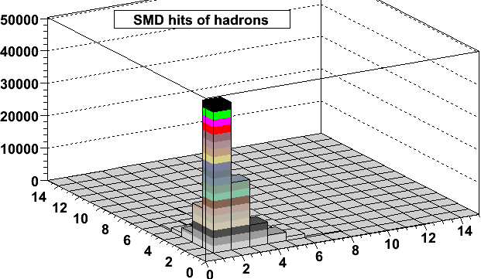
Electron Identification: Shower Size
Number of SMD hits per shower indicates shower size.
Electrons have larger number of BSMD hits than those for hadrons.
Electron candidates have to satisfy Number of BSMD hits > 1.

Slide 24
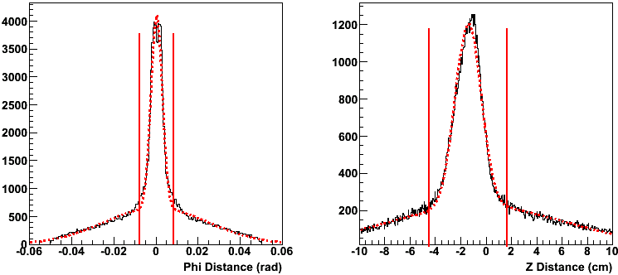
Electron Identification: Projection Distance
-3σ < Z-Dist < 3σ and -3σ < Phi-Dist < 3σ were set to remove lots of random associations between TPC tracks and BEMC points.

Slide 25
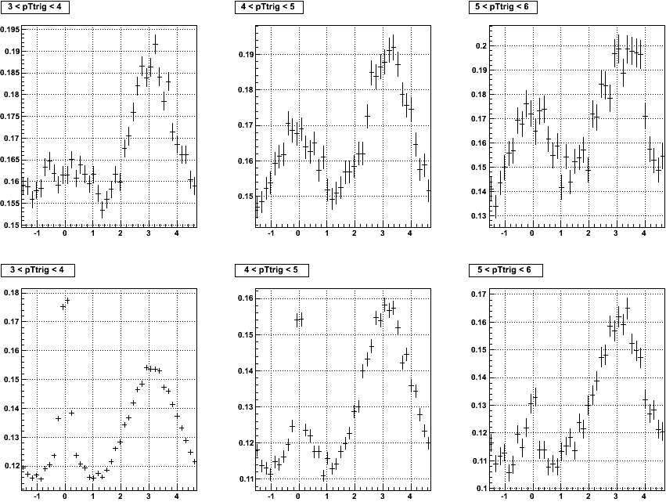
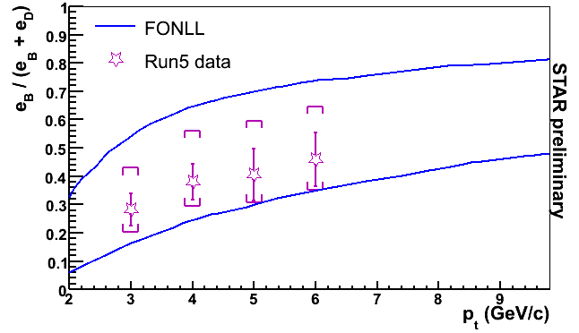
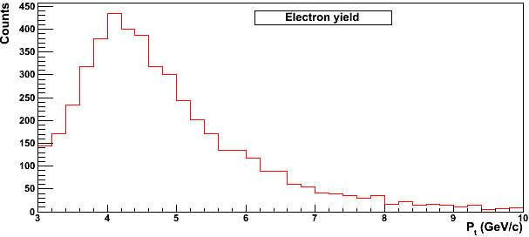
PYTHIA simulations
B
Each pt bin is weighted with their relative yields, and then they are summed up.
For each p_{t} bin, the non-photonic e-h correlations B_corr and D_corr are combined according to B’s and D’s relative contributions to the non-photonic electrons:
(e_{B}*B_corr + e_{D}*D_corr) / (e_{B}+e_{D})
D

Slide 26
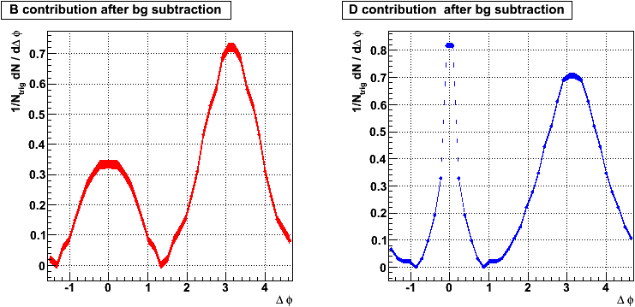
PYTHIA simulations with AuAu yields
3 < p_{T}^{trig} < 6 GeV/c & 0.15 < p_{T}^{asso} < 1 GeV/c
In PYTHIA, non-photonic e-h correlation functions show different B and D contributions on the near side, and similar on the away side.

Slide 27
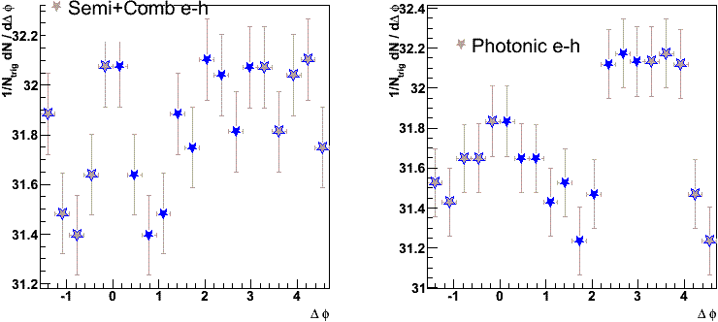
Middle steps in CuCu 200 GeV
0 – 20%: 3 < p_{T}^{trig} < 6 GeV/c & 0.15 < p_{T}^{asso} < 1 GeV/c
Semi+Comb and Photonic show different correlations.

