Slide 1
Top MCs from Tevatron to LHC
Un-ki Yang
University of Chicago
TEV4LHC workshop, Fermilab, Sep 16-18, 2004

Slide 2
Many exciting programs using top
q,l
q,ν
Top physics programs at the Tevatron is now in the phase of precision measurements.
Time to explore top quark physics potential from many different angles
At the LHC, even more precision measurements, however, major backgrounds in Higgs and new physics (ttH/h, VBF etc)
Production Xsection
SM(6.7pb)+resonance?
Production Kinematics
W helicity
W
t
b
q,l
W
t
Top Mass
b
q,ν
MC Modeling!!!
Decay modes
SM: BR(t→Wb)≈ 100 %
Rare decay (t->Zc )
Non-SM (t->H⁺b)
Single top: direct |Vtb|

Slide 3
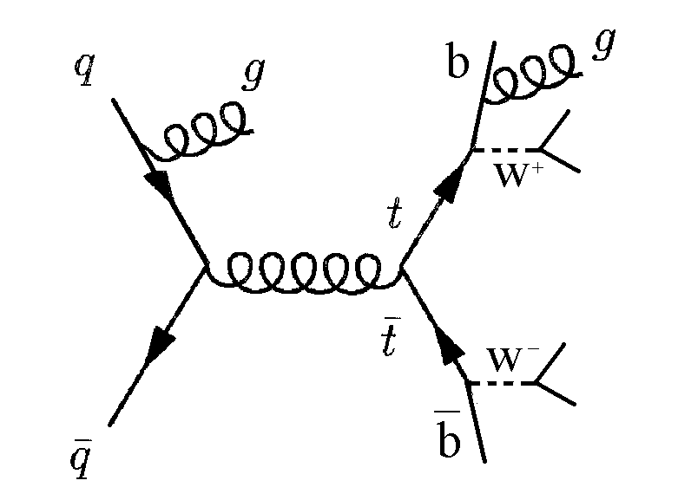
MC modeling for top pair production
Well predicted
Hard scattering: qq/gg->tt
  pQCD calculation with spin corr.
Top decay: t->bW(->lν,qq)
Start to wonder!
pp->tt+X -> lν +2 bjets + 2 W jets + extra jets (multi-jets and multi-scale process)
  pp->tt : (Q2 scale/PDFs)
  extra gluon: NLO hard emission, ISR, FSR
  Beam-beam remnants, multiple parton interactions
  Fragmentations (color singlet Wjet, non-singlet bjet, ISR/FSR jets)

Slide 4
Various MCs for top production
 | Pythia | Herwig | ME | MC@NLO
Hard scattering | LO tt | LO tt | LO tt+n | NLO tt (hard gluon)
PS shower (ISR/FSR) | coherent branching (LO DGLAP) | coherent branching (LO DGLAP) | Pythia or Herwig interface (double counting problem, can be fixed by the CKKW) | Herwig
Hadronization | LUND string | cluster model
beam-beam remants, MPI | all | No MPI (Yes, v605)
Spin corr | NO | Yes | Yes | No
Comments | Good for inclusive tt but poor in tt+njets |  | Good for multi-jets, but still LO | Good for tt multi jets
ME: ALPGEN/MadGraph/ComHep/TopRex etc
(Γ_{t}=0)

Slide 5
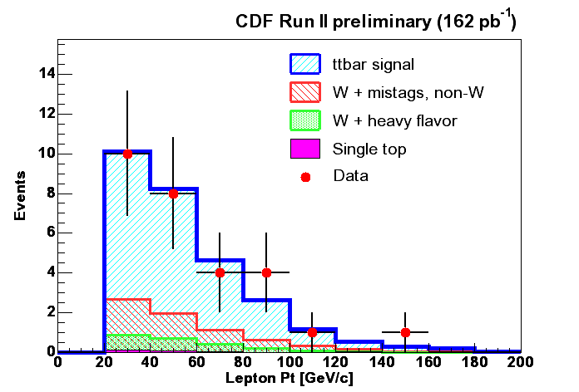
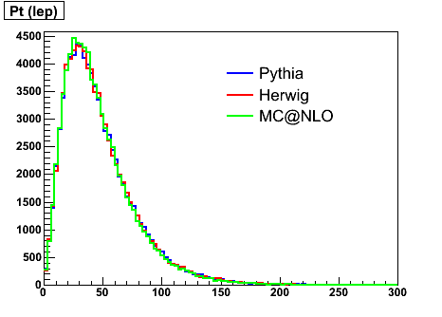
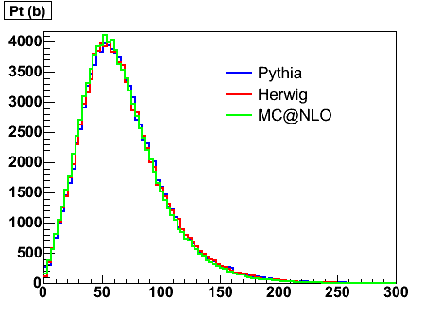
Kinematics in tt events
Rec: Pt(lep)
W,b,lepton from top decay are reasonably well described by various MCs.
But detailed modeling of multi-objects structure are now required for next phase of analysis
Gen: Pt(lep)
Gen: Pt(b parton)

Slide 6
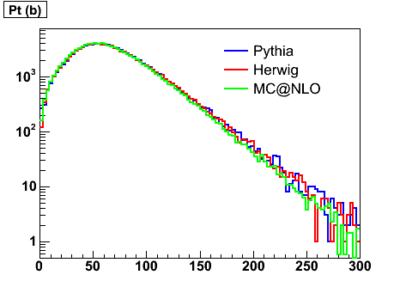
NLO effect on the leading jet Et
Leading jet Et
87.3
85.5
82.4
Tevatron
NLO effect reduce the leading Jet Et by 4% at the Tevatron

Slide 7
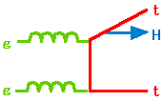
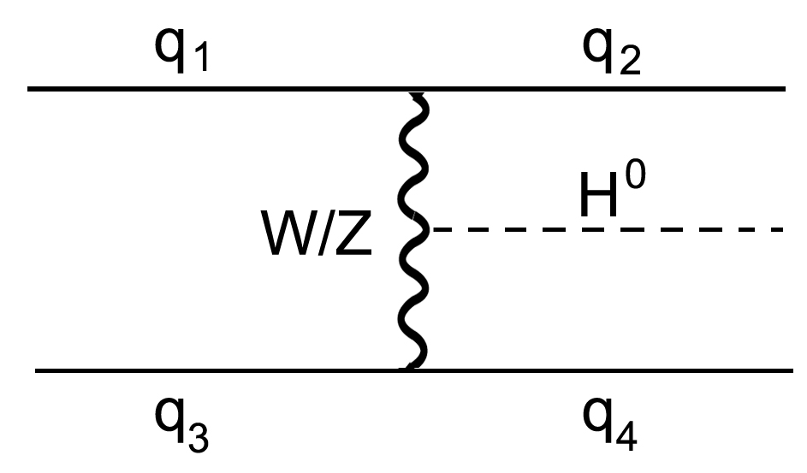
Modeling extra jets in tt
Extra jets from ISR/FSR/hard gluon emissions:
tt + Njets, Pt (tt), and δφ(tt)
Tevatron
Top mass
- ISR: wrong comb.=> δMtop=1.3 GeV RunI CDF (0.4 in RunII)
- Pt(tt) is used to select a correct combination.
LHC
tt+1/2j major bkgs to ttH/h and VBF
- top Yukawa coupling, Higgs and new physics searches
Jet
H→bb
WW
Jet

Slide 8
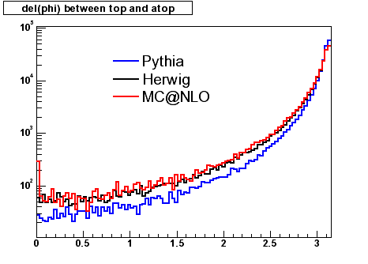
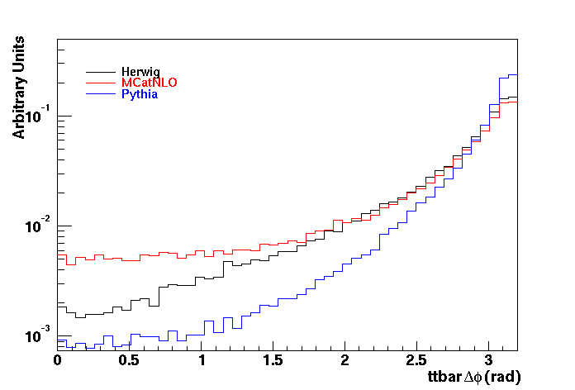
Angular correlations
between top and anti-top
tune-A
default
Tevatron
LHC
LHC plot from ATL-COM-PHYS-03-043
More back-to-back events in Pythia!!!

Slide 9
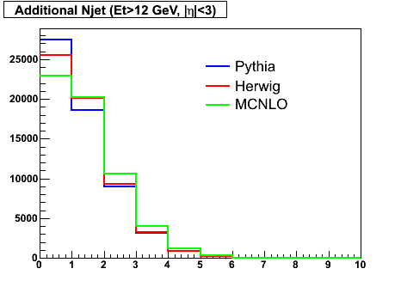
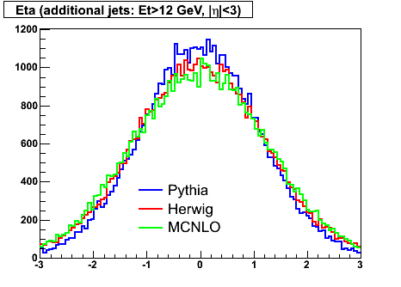
N jets and eta for extra jets
Gen: extra n jets (Et>12 GeV, |eta|<3)
Gen: eta for extra jets
0.8
0.9
1.0
MC@NLO has more extra jets than Pythia and Herwig
Herwig and MC@NLO: more extra jets in forward region than Pythia: same feature
in γ-jet between Herwig and Pythia

Slide 10
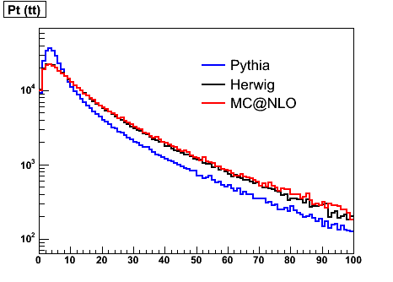
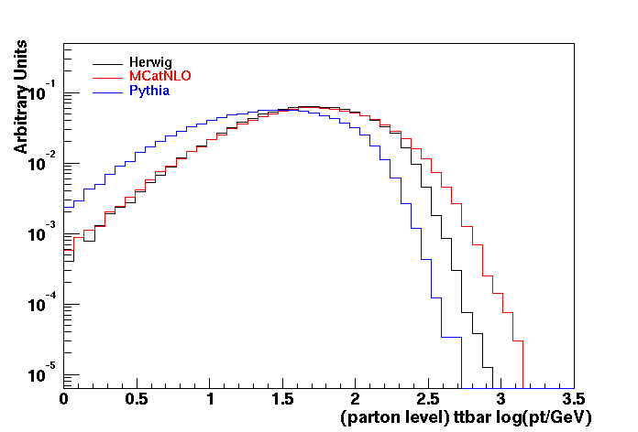
Pt(tt)
Pt(tt) from intrinsic Kt and ISR (extra jets)
Gen: Pt(tt)
LHC
Tevatron
Even at Tevatron: Pythia is very different from Herwig
MC@NLO effect is shown up at high-tail

Slide 11
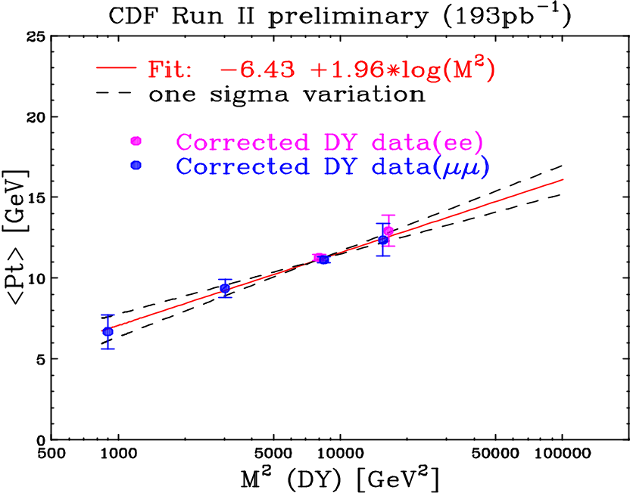
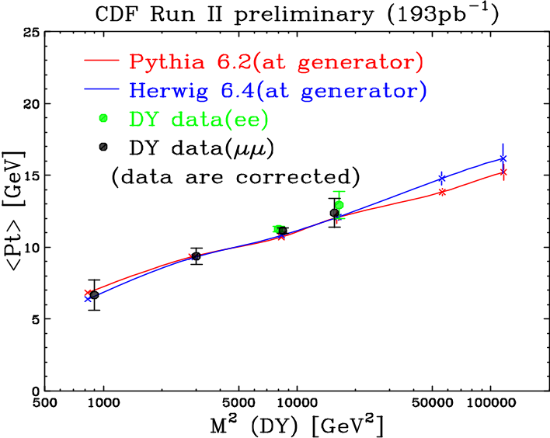
How to tune ISR and it’s uncertainty?
ISR effects are governed by DGALP eq.
( Q2, Λ_{QCD}, splitting functions, PDFs )
Average Pt of the DY [ Q2 ~M(DY)2 ]
- measure the slope :allows us to estimate
the size of ISR at top production region.
qq -> tt vs μ⁺μ⁻
μ+
μ-
Mt² +Pt²
The prediction at Q2=Mt²+Pt² is
slightly higher than Pythia

Slide 12
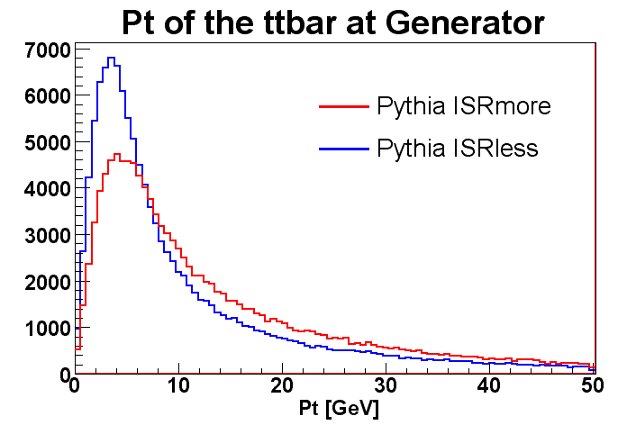
ISR uncertainty
Kt² = PARP(64)(1-z)Q²
Λ_{QCD} = PARP (61)
ISR uncertainty is only due to uncertainty in shower processing,
  PDF, factorization scale uncertainties are not treated as a part of the ISR uncertainty
Pythia | ISR more | ISR less
PARP(61) (D=0.192 GeV) | 0.384 | 0.100
PARP(64)(D=1.0) | 0.25 | 2.0
μ+
μ-
Q²max: K PARP(67):
Qmin : PARP(62)
Conservative
No effect
on s-ch resonance

Slide 13
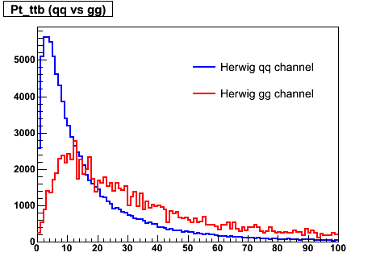
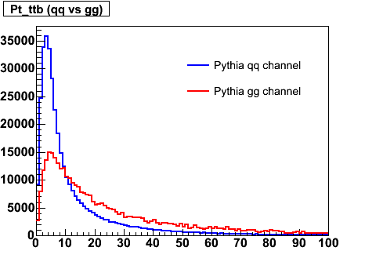
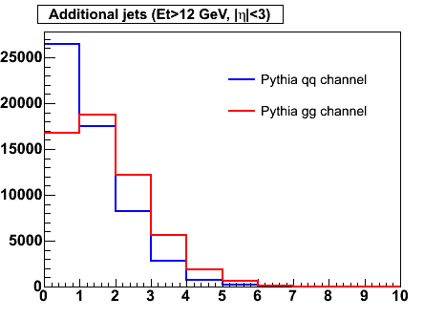
ISR effect on qq vs gg channels
gg channel has more extra jets than qq channel →higher Pt(tt), different peaks in Herwig
Extrapolation from Tevatron(qq) to LHC(gg): can be risky if you use wrong tuning parameter
Problem in LO Pythia/Herwig tt only 5% gg (compared to the 15% NLO), bias in kinematic analysis & top mass (DLM: δMt(qq-gg)=4 GeV)
Herwig Pt(tt): qq vs gg
Pythia Pt(tt): qq vs gg
Pythia: extra n jets (Et>12 GeV, |eta|<3)

Slide 14
Few thoughts on tuning
- Underlying events, ISR, FSR, Q2 scale, PDFs -
All correlated, so almost impossible to have an universal tune for underlying events, ISR etc. But perhaps we can select system such that other factors have very small correlations.
PDFs:
  DIS e/μ/ν-N, W/Z, jet data from pp ( Wu-ki Tung)
Beam-beam remnants, multiple interactions
  back-to-back dijet events (less ISR): (Rick Field),
  but even back-to-back DY events (less ISR, no Q2 scale dep)
ISR: now with tuned PDFs, underlying events
  DY events as a function of M(ll)², Pt(ll), Njet, δφ(ll): but diff. ISR for qq vs gg channel

Slide 15
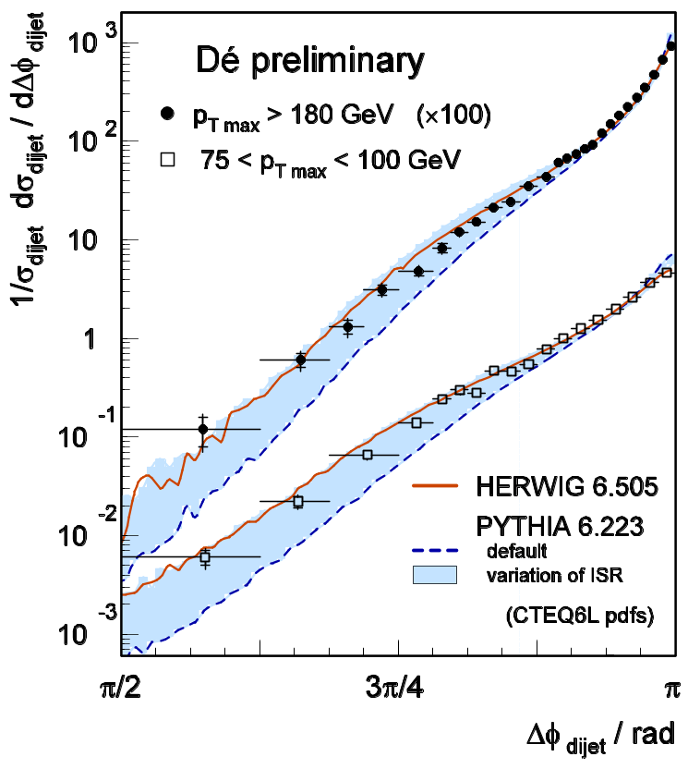
Tuning ISR using δφ [ dijet, DY(μμ) ]
Pythia with higher ISR using PARP(67)=4 describes the data like NLO, HERWIG.
Will be very interesting to look at same quantity δφ(μμ) using the DY data!!!, PARP(67) no longer plays here.

Slide 16
Wish lists
Need to resolve the difference in extra jets between Pythia and Herwig (any improvement in newer version?)
Develop a coherent scheme to tune underlying/ISR/FSR/Q2 scale for both Tevatron and LHC
Understanding of fragmentations (especially, color non-singlet b-jet) coherent work with LEP too.
MC@NLO and ME+PS CKKW/MLM give us a great opportunity for top physics, are these good enough?
  more MC@NLO processes (W/Z+jets, single top etc)
  NLO DGLAP shower evolution?
  ME+PS multi-jets with one K factor is not good enough, more NLO/NNLO calculations.
Coherent studies of the Tevatron, HEP, LEP, and LHC
theorists/experimentalists
are really crucial in order to explore new area of physics

Slide 17
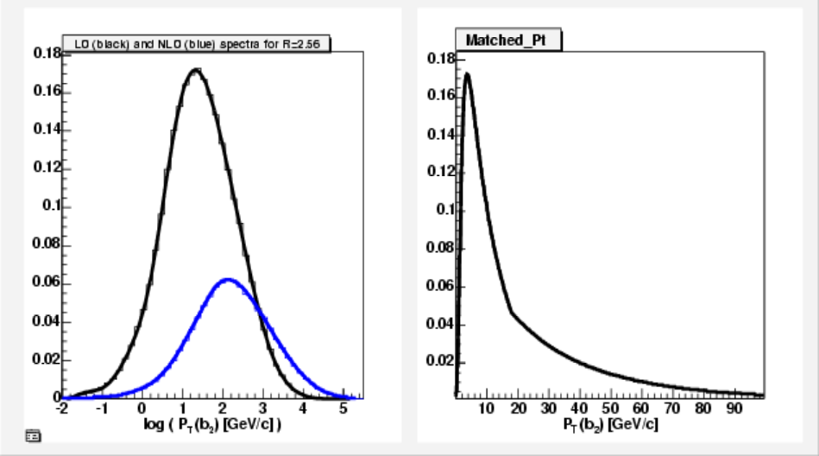
Problem in LO single top t-channel
“second-b” ( b not from top decay) is not properly described in LO.
Solution:
  Low-P_{T} from LO sample
  High-P_{T} from NLO sample
Low-High threshold 18 GeV/c.

Slide 18
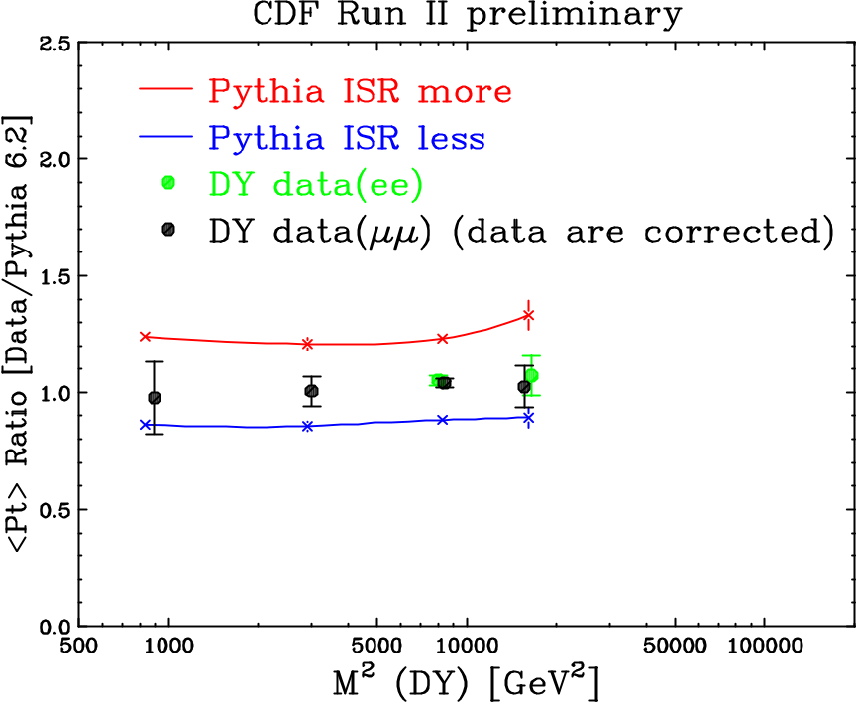
ISR variations due to Λ_{QCD}, K factor
ISR uncertainty samples
(conservative)
More ISR : Λ_{QCD} = 384, K = 0.5
Less ISR : Λ_{QCD} = 100, K = 2.0
Run I: no ISR: K = infinite

