Slide 1

Trilinos 101 (Part II)
Creating and managing linear algebra data in Trilinos:
Data management using Epetra and Teuchos
Michael A. Heroux
Sandia National Laboratories
Sandia is a multiprogram laboratory operated by Sandia Corporation, a Lockheed Martin Company,
for the United States Department of Energy under contract DE-AC04-94AL85000.
Notes:
Questions from audience
Can you use another matrix-vector multiply?
Are multivectors supported?
Are Petsc and Hypre available via TSF?
How does Trilinos differ from Petsc?

Slide 2
Outline
Creating Objects.
2D Objects.
Teuchos tidbits.
Performance Optimizations.

Slide 3
A Simple Epetra/AztecOO Program
// Header files omitted…
int main(int argc, char *argv[]) {
Epetra_SerialComm Comm();
// Header files omitted…
int main(int argc, char *argv[]) {
MPI_Init(&argc,&argv); // Initialize MPI, MpiComm
Epetra_MpiComm Comm( MPI_COMM_WORLD );
// ***** Create x and b vectors *****
Epetra_Vector x(Map);
Epetra_Vector b(Map);
b.Random(); // Fill RHS with random #s
// ***** Map puts same number of equations on each pe *****
int NumMyElements = 1000 ;
Epetra_Map Map(-1, NumMyElements, 0, Comm);
int NumGlobalElements = Map.NumGlobalElements();
// ***** Create Linear Problem *****
Epetra_LinearProblem problem(&A, &x, &b);
// ***** Create/define AztecOO instance, solve *****
AztecOO solver(problem);
solver.SetAztecOption(AZ_precond, AZ_Jacobi);
solver.Iterate(1000, 1.0E-8);
// ***** Create an Epetra_Matrix tridiag(-1,2,-1) *****
Epetra_CrsMatrix A(Copy, Map, 3);
double negOne = -1.0; double posTwo = 2.0;
for (int i=0; i<NumMyElements; i++) {
int GlobalRow = A.GRID(i);
int RowLess1 = GlobalRow - 1;
int RowPlus1 = GlobalRow + 1;
if (RowLess1!=-1)
A.InsertGlobalValues(GlobalRow, 1, &negOne, &RowLess1);
if (RowPlus1!=NumGlobalElements)
A.InsertGlobalValues(GlobalRow, 1, &negOne, &RowPlus1);
A.InsertGlobalValues(GlobalRow, 1, &posTwo, &GlobalRow);
}
A.FillComplete(); // Transform from GIDs to LIDs
// ***** Report results, finish ***********************
cout << "Solver performed " << solver.NumIters()
<< " iterations." << endl
<< "Norm of true residual = "
<< solver.TrueResidual()
<< endl;
MPI_Finalize() ;
return 0;
}

Slide 4
Typical Flow of Epetra Object Construction
Any number of Comm objects can exist.
Comms can be nested (e.g., serial within MPI).
Construct Comm
Maps describe parallel layout.
Maps typically associated with more than one comp object.
Two maps (source and target) define an export/import object.
Construct Map
Construct x
Construct b
Construct A
Computational objects.
Compatibility assured via common map.

Slide 5
Trilinos/packages/epetraext/test/inout/ (Part 1)
EpetraExt::BlockMapToMatrixMarketFile("Test_map.mm", *map, "Official EpetraExt test map",
"This is the official EpetraExt test map generated by the EpetraExt regression tests");
EpetraExt::RowMatrixToMatrixMarketFile("Test_A.mm", *A, "Official EpetraExt test matrix",
"This is the official EpetraExt test matrix generated by the EpetraExt regression tests");
EpetraExt::VectorToMatrixMarketFile("Test_x.mm", *x, "Official EpetraExt test initial guess",
"This is the official EpetraExt test initial guess generated by the EpetraExt regression tests");
EpetraExt::VectorToMatrixMarketFile("Test_xexact.mm", *xexact, "Official EpetraExt test exact solution",
"This is the official EpetraExt test exact solution generated by the EpetraExt regression tests");
EpetraExt::VectorToMatrixMarketFile("Test_b.mm", *b, "Official EpetraExt test right hand side",
"This is the official EpetraExt test right hand side generated by the EpetraExt regression tests");

Slide 6
Trilinos/packages/epetraext/test/inout/ (part 2)
Epetra_Map * map1;
Epetra_CrsMatrix * A1;
Epetra_Vector * x1;
Epetra_Vector * b1;
Epetra_Vector * xexact1;
EpetraExt::MatrixMarketFileToMap("Test_map.mm", comm, map1);
if (map->SameAs(*map1))
if (verbose) cout << "Maps are equal. In/Out works." << endl;
else
if (verbose) cout << "Maps are not equal. In/Out fails." << endl;
// Read Matrix:
EpetraExt::MatrixMarketFileToCrsMatrix("Test_A.mm", *map1, A1);
// Alternates:
EpetraExt::MatrixMarketFileToCrsMatrix("Test_A.mm", comm, A1); // Only need comm
EpetraExt::MatlabFileToCrsMatrix("Test_A.dat", comm, A1); // Read (row,col,val) (no MM header).
// Read Vector (Equivalent MultiVector versions.
EpetraExt::MatrixMarketFileToVector("Test_x.mm", *map1, x1);
EpetraExt::MatrixMarketFileToVector("Test_xexact.mm", *map1, xexact1);
EpetraExt::MatrixMarketFileToVector("Test_b.mm", *map1, b1);

Slide 7
Inout Summary
Reads from/writes to Matlab or Matrix Market compatible files.
Works for any distributed map, matrix, vector or multivector.
If map is read in on the same number of processor it was written to, the map layout will be preserved.

Slide 8
Details about Epetra Maps
Note: Focus on Maps (not BlockMaps).
Getting beyond standard use case…

Slide 9
1-to-1 Maps
1-to-1 map (defn): A map is 1-to-1 if each GID appears only once in the map (and is therefore associated with only a single processor).
Certain operations in parallel data repartitioning require 1-to-1 maps. Specifically:
  The source map of an import must be 1-to-1.
  The target map of an export must be 1-to-1.
  The domain map of a 2D object must be 1-to-1.
  The range map of a 2D object must be 1-to-1.

Slide 10
2D Objects: Four Maps
Epetra 2D objects:
  CrsMatrix
  CrsGraph
  VbrMatrix
Have four maps:
  RowMap: On each processor, the GIDs of the rows that processor will “manage”.
  ColMap: On each processor, the GIDs of the columns that processor will “manage”.
  DomainMap: The layout of domain objects
  (the x vector/multivector in y=Ax).
  RangeMap: The layout of range objects
  (the y vector/multivector in y=Ax).
Typically a 1-to-1 map
Typically NOT a 1-to-1 map
Must be 1-to-1 maps!!!

Slide 11
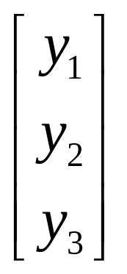
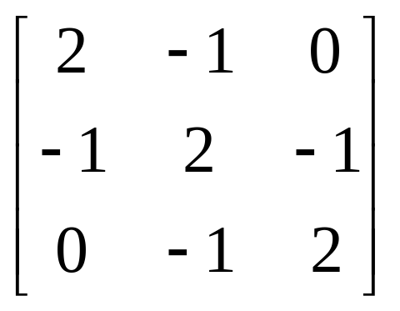
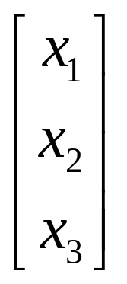
Sample Problem
y
A
x
=

Slide 12
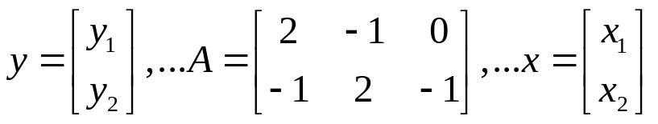

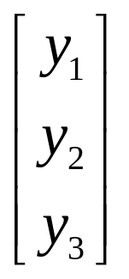
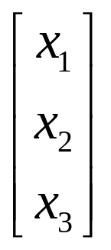
Case 1: Standard Approach
  First 2 rows of A, elements of y and elements of x, kept on PE 0.
  Last row of A, element of y and element of x, kept on PE 1.
PE 0 Contents
PE 1 Contents
RowMap = {0, 1}
ColMap = {0, 1, 2}
DomainMap = {0, 1}
RangeMap = {0, 1}
RowMap = {2}
ColMap = {1, 2}
DomainMap = {2}
RangeMap = {2}
Original Problem
Notes:
Rows are wholly owned.
RowMap=DomainMap=RangeMap (all 1-to-1).
ColMap is NOT 1-to-1.
Call to FillComplete: A.FillComplete(); // Assumes
y
A
x
=

Slide 13
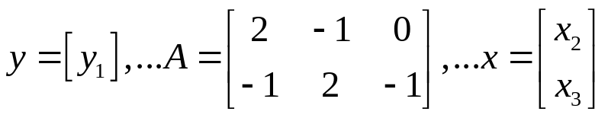
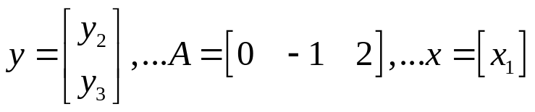
Case 2: Twist 1
  First 2 rows of A, first element of y and last 2 elements of x, kept on PE 0.
  Last row of A, last 2 element of y and first element of x, kept on PE 1.
PE 0 Contents
PE 1 Contents
RowMap = {0, 1}
ColMap = {0, 1, 2}
DomainMap = {1, 2}
RangeMap = {0}
RowMap = {2}
ColMap = {1, 2}
DomainMap = {0}
RangeMap = {1, 2}
Notes:
Rows are wholly owned.
RowMap is NOT = DomainMap
is NOT = RangeMap (all 1-to-1).
ColMap is NOT 1-to-1.
Call to FillComplete:
A.FillComplete(DomainMap, RangeMap);
Original Problem
y
A
x
=

Slide 14
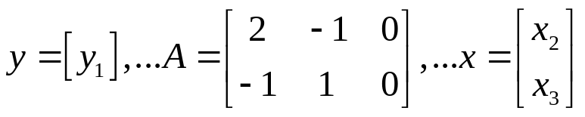
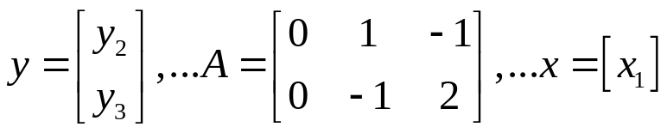
Case 2: Twist 2
  First row of A, part of second row of A, first element of y and last 2 elements of x, kept on PE 0.
  Last row, part of second row of A, last 2 element of y and first element of x, kept on PE 1.
PE 0 Contents
PE 1 Contents
RowMap = {0, 1}
ColMap = {0, 1}
DomainMap = {1, 2}
RangeMap = {0}
RowMap = {1, 2}
ColMap = {1, 2}
DomainMap = {0}
RangeMap = {1, 2}
Notes:
Rows are NOT wholly owned.
RowMap is NOT = DomainMap
is NOT = RangeMap (all 1-to-1).
RowMap and ColMap are NOT 1-to-1.
Call to FillComplete:
A.FillComplete(DomainMap, RangeMap);
Original Problem
y
A
x
=

Slide 15
What does FillComplete Do?
A bunch of stuff.
One task is to create (if needed) import/export objects to support distributed matrix-vector multiplication:
  If ColMap  DomainMap, create Import object.
  If RowMap  RangeMap, create Export object.
A few rules:
  Rectangular matrices will always require:
    A.FillComplete(DomainMap,RangeMap);
  DomainMap and RangeMap must be 1-to-1.

Slide 16
Teuchos::RefCountPtr
Goal: Empty Destructors
Goal of memory allocation: Empty destructors.
RefCountPtr important for this goal.
Sample attribute list:
private:
Epetra_Map cmsMap_;
Epetra_Map densityMap_;
Epetra_Map block2Map_;
Teuchos::RefCountPtr<Epetra_CrsMatrix> cmsOnDensityMatrix_;
Teuchos::RefCountPtr<Epetra_Vector> cmsOnCmsMatrix_;
Teuchos::RefCountPtr<Epetra_Vector> densityOnDensityMatrix_;
Teuchos::RefCountPtr<Epetra_Vector> densityOnCmsMatrix_;
Epetra_IntSerialDenseVector indices_;
Epetra_SerialDenseVector values_;
Ifpack factory_;
};
#endif /* DFT_POLYA22_EPETRA_OPERATOR_H */

Slide 17
Exception Testing
Teuchos exception macros:
Standard approach to handling errors.
int dft_PolyA22_Epetra_Operator::ApplyInverse(const Epetra_MultiVector& X,
Epetra_MultiVector& Y) const {
TEST_FOR_EXCEPT(!X.Map().SameAs(OperatorDomainMap()));
TEST_FOR_EXCEPT(!Y.Map().SameAs(OperatorRangeMap()));
TEST_FOR_EXCEPT(Y.NumVectors()!=X.NumVectors());

Slide 18
Epetra Performance Optimization Guide
SAND2005-1668
Topics:
  3rd Party Libraries: BLAS and LAPACK
  Epetra_MultiVector Data Layout
  Epetra_CrsGraph Construction
  Epetra_CrsMatrix Construction
  Selecting the Right Sparse Matrix Class
  Parallel Data Redistribution
  General Practices
Tiered Approach to practices.

Slide 19
Practice Categories
Each practice falls into one of three categories:
VSR
Very Strongly Recommended - Practices necessary for Epetra to perform well.
SR
Strongly Recommended - Practices that are definitely a good thing or that have proved to be valuable.
R
Recommended - Practices that are probably a good idea.

Slide 20
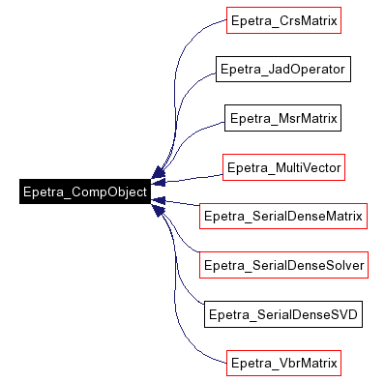
Epetra Computational Classes
Epetra contains base class Epetra_CompObject.
Small class, but classes that derive from it are exactly those which are the focus of guide.

Slide 21
Fast BLAS
VSR
Link to high-performance BLAS for Epetra_MultiVector, Epetra_VbrMatrix and Epetra_SerialDense performance
Options:
  Atlas (All platforms).
  GOTO BLAS (PC).
  vecLib (Mac).
  Native BLAS on legacy platforms.

Slide 22
Epetra_MultiVector Layout
VSR
Create Epetra_MultiVector objects with strided storage.
  Improved block vector updates, block dot products.
  Improve sparse matrix multiplication/solves.

Slide 23
Epetra_CrsGraph/Matrix Construction
VSR
Construct Epetra_CrsGraph objects first:
  When constructing multiple Epetra_CrsMatrix or Epetra_VbrMatrix objects, much of the overhead in sparse matrix construction is related solely to the graph structure of the matrix.
  By pre-constructing the Epetra_CrsGraph object, this expense is incurred only once and then amortized over multiple matrix constructions.
  Note: Even when constructing a single matrix, it is often the case that matrix construction is done within a nonlinear iteration or a time-stepping iteration. In both of these cases, it is best to construct the Epetra_CrsGraph object one time and then reuse it.
When constructing Epetra_CrsGraph/matrix objects, carefully manage the nonzero profile and set StaticProfile to ‘true’ :
  Although it is very convenient to use the flexible insertion capabilities of Epetra_CrsGraph/Matrix, the performance and memory cost can be substantial.
  StaticProfile is an optional argument to the Epetra_CrsGraph/Matrix constructors that forces the constructor to pre-allocate all storage for the graph, using the argument NumIndicesPerRow as a strict upper limit on the number of indices that will be inserted.
After calling FillComplete(), call OptimizeStorage() :
  The OptimizeStorage() method frees memory that is used only when submitting data to the object.
  Also, the storage that remains is packed for better cache memory performance due to better spatial locality.
  If StaticProfile is true, the packing of data is fast and cheap, if needed at all .
  If StaticProfile is false, then the graph data is not contiguously stored, so we must allocate contiguous space for all entries, copy data from the existing arrays, and then delete the old arrays. This can be a substantial overhead in memory costs and could even double the high-water memory mark. However, the performance improvement for matrix operations can be 20% to a full doubling of performance.
VSR
VSR

Slide 24
Epetra_CrsGraph/Matrix (cont)
VSR
Use Epetra_FECrsMatrix if you have many repeated indices. Then extract the associated Epetra_CrsGraph for subsequent use:
  Although there is no Epetra_FECrsGraph class (something that we may introduce in the future), it is typically best to use the Epetra_FECrsMatrix class to construct matrices when you have many repeated indices.
  This is typically the case when forming global stiffness matrices from local element stiffness matrices in a finite element assembly loop.
  Note: Even though there is no Epetra_FECrsGraph class, once an Epetra_FECrsMatrix has been constructed, call it myFEMatrix, there is an Epetra_CrsGraph that can be accessed via myFEMatrix.Graph() and used to construct further matrices that have the same pattern as myFEMatrix.
When inserting indices into Epetra_CrsGraph/Matrix objects, avoid large numbers of repeated indices:
  To reduce time costs, indices that are inserted into a row are not checked for redundancy at the time they are inserted. Instead, when FillComplete() is called, indices are sorted and then redundant indices are removed.
  Because of this approach, repeated indices increase the memory used by a given row, at least until FillComplete() is called.
Submit large numbers of graph/matrix indices at once:
  When inserting indices, submit many entries at once if possible.
  Ideally, it is best to submit all indices for a given row at once.
SR
SR

Slide 25
Picking a Sparse Matrix Class
Epetra_CrsMatrix: Compressed Row Storage scalar entry matrix.
Epetra_FECrsMatrix: Finite Element Compressed Row Storage matrix.
Epetra_VbrMatrix: Variable Block Row block entry matrix.
Epetra_FEVbrMatrix: Finite Element Variable Block Row matrix.
Note: Epetra_JadOperator does not implement Epetra_RowMatrix, but is worth mentioning for users of vector processors. This class is a first version to support vectorization of sparse matrix-vector multiplication.

Slide 26
Picking a Sparse Matrix Class (cont)
VSR
Use Epetra_FEVbrMatrix to construct a matrix with dense block entries and repeated summations into block entries
Use Epetra_VbrMatrix to construct a matrix with dense block entries and few repeated submissions:
  Block entries should be of size 4 or larger before Vbr formats are preferable to Crs formats.
Use Epetra_FECrsMatrix to construct a matrix with scalar entries and repeated summations into entries:
  Epetra_FECrsMatrix is designed to handle problems such as finite element, finite volume or finite difference problems where a single degree of freedom is being tracked at a single mesh point, and the matrix entries are being summed into the global stiffness matrix one finite element or control volume cell at a time.
Use Epetra_CrsMatrix in all other cases:
  Epetra_CrsMatrix is the simplest and most natural matrix data structure for people who are used to thinking about sparse matrices. Unless you have one of the above three situations, you should use Epetra_CrsMatrix.
Use Epetra_RowMatrix to access matrix entries:
  If you are writing code to use an existing Epetra sparse matrix object, use the Epetra_RowMatrix interface to access the matrix.
  This will provide you compatibility with all of Epetra’s sparse matrix classes, and allow users of your code to provide their own custom implementation of Epetra_RowMatrix if needed.
R
VSR
VSR
VSR

Slide 27
Other RowMatrix adapters
In addition, there are numerous other implementation of Epetra_RowMatrix provided in other packages. For example:
  Epetra_MsrMatrix:
    This class is provided within AztecOO.
    The constructor for Epetra_MsrMatrix takes a single argument, namely an existing AZ_DMSR matrix.
    Epetra_MsrMatrix does not make a copy of the Aztec matrix. Instead it make the Aztec matrix act like an Epetra_RowMatrix object.
  Ifpack Filters:
    Ifpack uses the Epetra_RowMatrix interface to provide modified views of existing Epetra_RowMatrix objects.
    For example, Ifpack_DropFilter creates a new Epetra_RowMatrix from an existing one by dropping all matrix values below a certain tolerance.

Slide 28
Parallel Data Redistribution
Use EpetraExt to balance load:
  Although an advanced feature, any serious use of Epetra for scalable performance must ensure that work and data are balanced across the parallel machine.
  EpetraExt provides an interface to the Zoltan library that can greatly improve the load balance for typical sparse matrix computations.
Use Epetra_OffsetIndex to improve performance of multiple redistributions:
  Often the data distribution that is optimal for constructing sparse matrices is not optimal for solving the related system of equations.
  As a result, the matrix will be constructed in one distribution, and then redistributed for the solve.
  Epetra_OffsetIndex precomputes the offsets for the redistribution pattern, making repeated redistributions cheaper.

Slide 29
General Practices
Check method return codes:
  Almost all methods of Epetra classes provide an integer return argument.
  This argument is set to zero if no errors or warning occurred.
  However, a number of performance-sensitive methods will communicate potential performance problems by returning a positive error code.
  For example, if the matrix insertion routine must re-allocate memory because the allocated row storage is too small, a return code of 1 is set. Since memory reallocation can be expensive, this information can be an indication that the user should increase the nonzero profile values (NumEntriesPerRow).
Compile Epetra with aggressive optimization:
  Epetra performance can benefit greatly from aggressive compiler optimization settings.
  In particular, aggressive optimization for FORTRAN can be especially important. Configuring Epetra (or Epetra as part of Trilinos) with the following compiler flags works well on 32-bit PC platforms with the GCC compilers:
      ../configure CXXFLAGS="-O3" CFLAGS="-O3" \
      FFLAGS="-O5 -funroll-all-loops -malign-double"

Slide 30
Summary
2D objects:
  Epetra provides very flexible support for:
    Placing any matrix entry on any processor, and
    Even sharing a matrix entry across processors.
Performance Optimizations Matter.

