Slide 1
Proposal for Fast-Tracking
NIST Role-Based Access Control Standard
David Ferraiolo
Rick Kuhn
National Institute of Standards and Technology
Gathersburg, Maryland
Ravi Sandhu
George Mason University
Fairfax, Virginia

Slide 2
Agenda
Why an RBAC Standard?
Is the Standard Ready to Go?

Slide 3















Some of the Vendors Offering RBAC Products

Slide 4


Accurate Configuration Control Over User Privileges
Lots of users and privileges scattered over many platforms and applications.
Who are the valid users?
What are they entitled to access?
How do you keep access rights up-to-date?
How do you specify and enforce policy?
Notes:
Wherever I go, I ask two questions:
What is the most important asset of your company? They kind of hem and haw. If I’m talking to a bank they might initially say my holdings; if I’m talking to a manufacturer company, they might say my incredible manufacturing plant. But when you really push them, it will get down to the answer being my people.
Whether it’s their employees, their customers, their contractors, or their partners, ultimately it’s the people. Why? Gartner has done studies that state that over 85% of any information about a corporation is inside somebody’s head. Only 15% of the corporation’s information is actually in repositories, in databases, on the web, in some kind of a manual infrastructure. So if 85% of the intelligence around how companies work is in people’s head, it’s pretty easy to see why people are the most important asset of a company.
Then the next question I ask is “what’s your biggest challenge?” You get everything from Greenspan’s killing me, we just had an earthquake 2 days ago and that’s killing me, to XYZ Corporation, my competitor, did this and that’s really killing me. But when you really circle around it, it’s change. If you really think about it, what company have you ever worked for that has not required you to rethink or change how you do something, who you do it with, what tools you get to use? Every time there is a government regulation change, natural or manmade disaster, economic or currency fluctuation, competitive pressure, the CEO woke up with a headache, there’s some other reason, but ultimately, it how fast a company can react or proact to change while still maintaining policy, still ensuring security, and still dealing with privacy issues. It’s the timing and the accuracy of access that really predicates the success that dictates how effective or ineffective that you are going to be.

Slide 5
Maintaining Access Configurations is Labor-Intensive
Privileges almost double yearly growing from less than 200k to over 1M in 2004
Adding IT Staff Scales Linearly
Administering Privileges Scales Non-Linearly
Symptoms of the problem
  Unused accounts proliferate
  Turn-on time rises for user privilege creation
  Privilege review is impractical
  Security audits fail
  User down-time increases
  Security admin requests staff increases
  Help desk requests staff increases
1,200
1,000
800
Privileges
(1,000's of)
600
400
Users (100's of)
200
-
Resources
2000
2001
Year
2002
Source: IDC, 2001
2003
Estimated Privilege distribution Activity
in Typical Companies

Slide 6
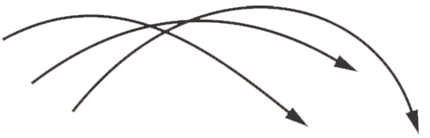



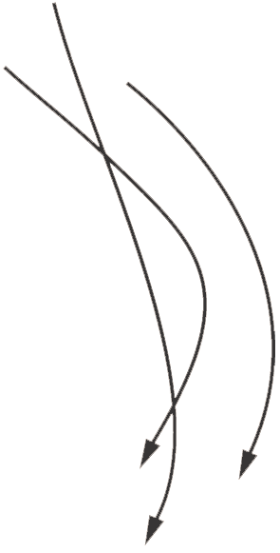
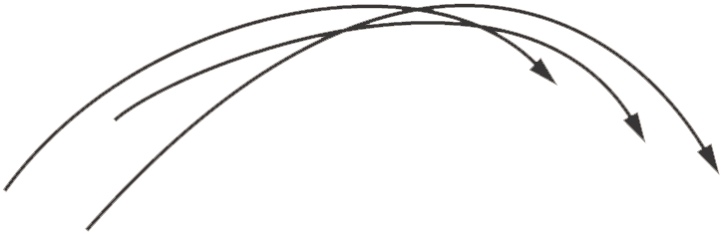

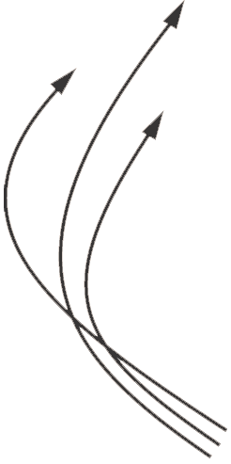

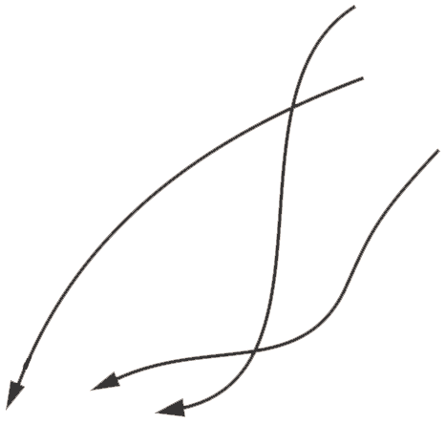

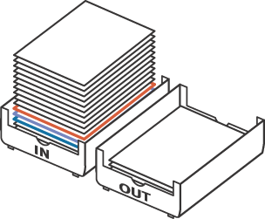
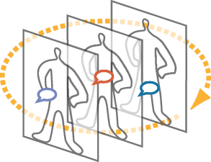
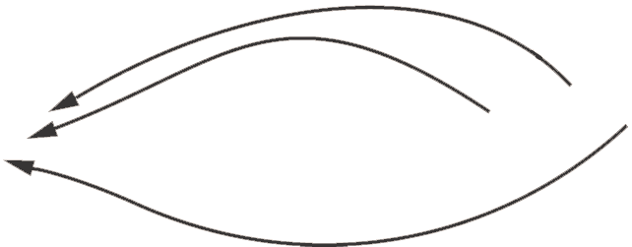
Manually Configuring Privileges
Request for
Access
Generated
Organizations use slow and inconsistent processes to create user access rights
User Change
Users with Accounts
Administrators
Create Accounts &
Access Rights
Elapsed turn-on time: up to 12 days per user
Policy &
Role Examined
Account turn-off performance: 30-60% of accounts are invalid
IT InBox
Approval Routing
Notes:
The manual process for provisioning poses a huge challenge for today’s businesses. Believe it or not, most companies still use manual processes to provision access rights to users.
Build 1 First, when an employee is hired, a new user profile is created and stored in an HR database.
Build 2 A request for access is created.
Build 3 The user profile is compared to a company’s role-authorization policies.
Build 4 The request is then routed for the necessary approval, and
Build 5 Sent to the IT department if approval is granted.
Build 6 Finally, the IT department submits the approved request to various system administrators to provision user access rights.
Build 7 The user is provisioned and the approval is recorded in a history file.
Key Point: Manual provisioning can take up to 12 days for each user.

Slide 7
RBAC Supports Front-End Processes
Request for
Access
Generated
User Change
Maintain who gets what based on your organization’s operational policies
Users with Accounts
Administrators
Create Accounts
Policy &
Role Examined
IT InBox
Approval Routing
Notes:
The manual process for provisioning poses a huge challenge for today’s businesses. Believe it or not, most companies still use manual processes to provision access rights to users.
Build 1 First, when an employee is hired, a new user profile is created and stored in an HR database.
Build 2 A request for access is created.
Build 3 The user profile is compared to a company’s role-authorization policies.
Build 4 The request is then routed for the necessary approval, and
Build 5 Sent to the IT department if approval is granted.
Build 6 Finally, the IT department submits the approved request to various system administrators to provision user access rights.
Build 7 The user is provisioned and the approval is recorded in a history file.
Key Point: Manual provisioning can take up to 12 days for each user.

Slide 8
Installed Technology Base
Access Control List (ACL) are the most common access control mechanism in use today
  Fine when end-users are viewed as “owners” of enterprise resources
  Resource Oriented: poorly organized to address many commercial and Government security policies
  Costly and difficult to centrally administrate
  At the wrong level of abstraction
  Platform Dependent with proprietary administrative tools

Slide 9
Role-Based Access Control – A Strategy for Security Policy Management
Centrally administered and locally enforced role based access control policies
Policy Rich: highly configurable (richer set of parameters)
Enforces access control across the virtual enterprise
  Employees
  Suppliers
  Consultants
Role membership is based on Competency, Duty, Authority, giving the user’s the potential to execute privileges
Role centric (roles are global and persistent)

Slide 10
Motivations
Simple and Intuitive Administrative Interface
Administrative Efficiency
  Automatic user privilege assignment
  Automatic revocation of user privilege
  Simple user functional re-assignment
Administrative Flexibility
  Static Separation of duty (SSD)
  Fine granularity of resource/administration partitioning
Scalability, Extensibility, Accuracy
Agreement of core RBAC Features
For Each RBAC feature in the standard there are one or more known implementations
Broad industry involvement in ACM RBAC Workshops

Slide 11
Background
NIST study reviewed the access control practices of 30 large organizations
First RBAC model published in 1992
  Combined several existing and emerging concepts (OS user groups, DBMS privilege groups [Baldwin90], separation of duty [Clark-Wilson87, Sandhu88, Brewer-Nash89] into a single relational model [Ferraiolo-Kuhn92]
  Reference implementation led to a revision [Ferraiolo-Cugini-Kuhn95]
Annual ACM RBAC Workshop series started in 1995 with international vendor and researcher participation
Sandhu et al, developed a well accepted comprehensive RBAC framework in 96
Sybase implemented most of NIST RBAC model in 1996, DBMS survey showed other vendors have RBAC features
Based on these efforts numerous other models have been proposed that have often included reference implementations

Slide 12
Background
Since 1995 vendors, users, and researchers have gathered on an annual basis to present papers and discuss issues related to RBAC, in a formal ACM workshop setting
RBAC has matured to the point where it is being consistently prescribed as a generalized approach to access control
  “the most attractive solution for providing security in e-government” IEEE COMPUTER, Feb. 2001
  “most relevant in meeting complex policy needs of Web-based applications” ACM COMMUNICATIONS, Feb. 2001
First effort to define a consensus standard for RBAC was proposed in a special session at the 5th ACM Workshop on RBAC
Published comments resulted in the existing proposed standard

Slide 13
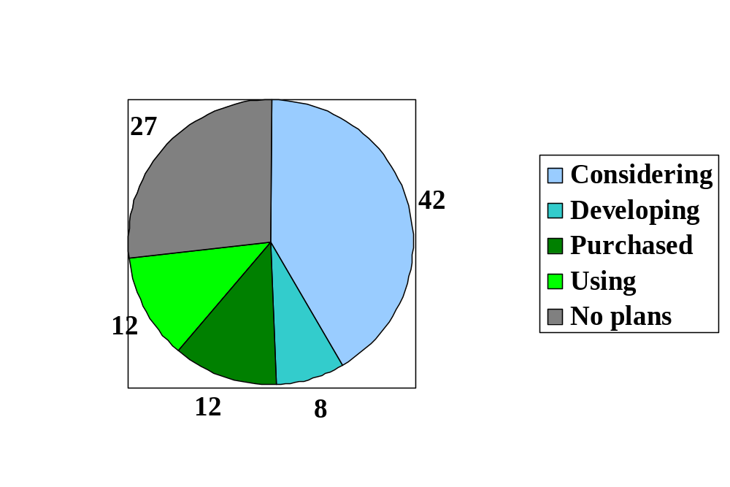
Diffusion of RBAC - 2001

Slide 14
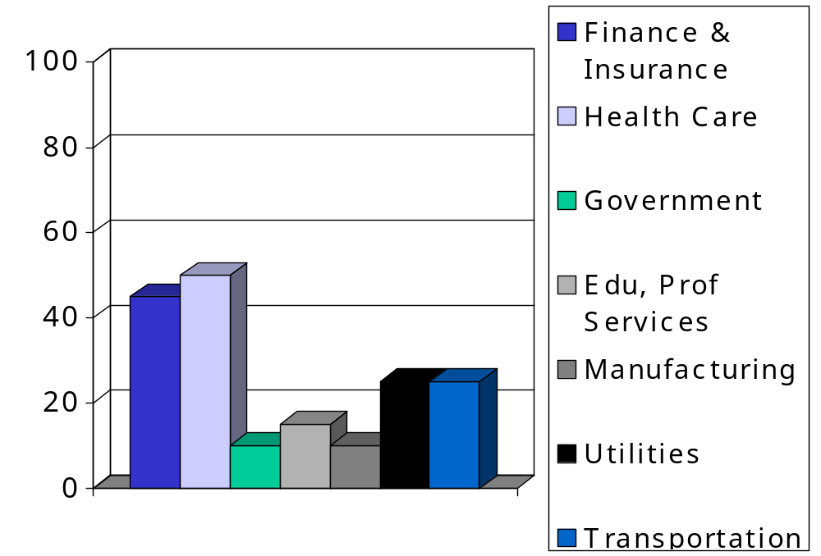
Estimated Use of RBAC in 2005 - by industry (mid-range est)

Slide 15
Timeliness & Appropriateness of RBAC Standard
Need for consistent, universally understood semantics for RBAC
Vendors value “establishing a taxonomy and a shared vocabulary for us, our customers, and the industry as a whole”

Slide 16
Is RBAC ready for a standard?
Network Applications Consortium - $500,000,000,000 customer base says:
“If RBAC is going to ‘move to the mainstream’, then there will have to be some sort of standard.”

Slide 17
Current Situation - Problem
Although existing models and implementations use similar RBAC concepts, they differ in significant areas and use different terminology
RBAC is a rich and open-ended technology, ranging from the very simple to the complex
  Not all features are appropriate for all environments
  No vendors implement all RBAC features
  Research continues to promote its use in other applications and extended features

Slide 18
Solution - RBAC Standard
Standardization over a collection of basic and well accepted RBAC features
Features are divided into logical components and sub-components
Sub-components can be combined into relevant packages giving:
  IT consumers a basis for uniform acquisition specification and a basis for making purchasing decisions
  Vendors a set of benchmarks use in the characterization and marketing of their products
Each feature is known to be viable in that there exists at least one example commercial and/or reference implementation

Slide 19
Standard Organization
Two Main Parts
-- RBAC Reference Models
-- Requirement Specification
Four Components
-- Core RBAC
-- Hierarchical RBAC
--- Limited Hierarchies
--- General Hierarchies
-- Static Separation of Duty Relations
--- Without Hierarchies
--- With Hierarchies
-- Dynamic Separation of Duty Relations

Slide 20
Conformance
Standard provides for conformance by vendor self-declaration
Standard provides foundation for third-party conformance testing sought by vendors and customers

Slide 21
Requirement Specification
Requirements are specified using the relations defined by the reference model
Administrative Operations
(e.g., create/delete role, create/delete user assignment, create/delete hierarchical relation)
Administrative Queries and Review Functions
(e.g., assigned users, assigned roles, authorized users, authorized permissions, separation of duty relations)
System Functions
(e.g., session management, access calculation)

Slide 22
Select Core RBAC
Option: Advanced Review
Core RBAC
Choose a. or b
Option: Advanced Review
Hier. RBAC
a. Limited
b. General
Adhere to dependency
SSD Relations
a. w/hierarchies
b. wo/hierarchies
DSD Relations
Methodology for Creating
Requirement Packages
Requirements
Package

Slide 23
Conclusion
RBAC is ready for a standard
User need - $500,000,000,000 customer base says:
“If RBAC is going to ‘move to the mainstream’, then there will have to be some sort of standard.” – NAC
Vendors - At least 28 vendors offer some type of RBAC product
Future solutions - “the most attractive solution for providing security in e-government” IEEE COMPUTER, Feb. 2001

Slide 24
Additional Information on Standard Components
Core RBAC
Hierarchical RBAC
Role Inheritance
Static Separation of Duty
Dynamic Separation of Duty

Slide 25
Core RBAC
(PA)
Permission Assignment
(UA) User Assignment
USERS
ROLES
OPERA
TIONS
OBJECTS
privileges
user_sessions
session_roles
Sess-
ions
Many-to-many relationship among individual users and privileges
Session is a mapping between a user and an activated subset of assigned roles
User/role relations can be defined independent of role/privilege relations
Privileges are system/application dependent
Accommodates traditional but robust group-based access control

Slide 26
Hierarchical RBAC
Role Hierarchy
(PA)
Permission Assignment
(UA) User Assignment
USERS
ROLES
OPERA
TIONS
OBJECTS
privileges
user_sessions
session_roles
Sess-
ions
Role/role relation defining user membership and privilege inheritance
Reflects organizational structures and functional delineations
Two types of hierarchies:
  - Limited hierarchies
  - General hierarchies

Slide 27
Role Inheritance
Jill
Dermatologist
Cardiologist
CSD Secretary
“contains”
“contains”
m
e
m
b
e
r
s
h
i
p
p
r
i
v
i
l
e
g
e
Comp Security Division
Specialist
MEL Secretary
ITL Secretary
“contains”
NIST Secretary
Doctor
Added Advantages:
User’s can be included on edges of graph
Role’s can be defined from the privileges
of two or more subordinate roles
“contains”
Employee
a-Limited Hierarchies
b-General Hierarchies

Slide 28
Static Separation of Duty
SSD
Role Hierarchy
(UA) User
Assignment
(PA) Permission
Assignment
USERS
ROLES
OPERA
TIONS
OBJECTS
privileges
session_roles
user_sessions
SES-
SIONS
SoD policies deter fraud by placing constrains on administrative actions and there by restricting combinations of privileges that are available to users
E.g., no user can be a member of both Cashier and AR Clerk roles in Accounts Receivable Department

Slide 29
Dynamic Separation of Duty
Role Hierarchy
User Assign-
ment
Permission
Assignment
USERS
ROLES
OPERA
TIONS
OBJECTS
privileges
session_roles
user_sessions
SES-
SIONS
Dynamic
Separation of Duty
DSoD policies deter fraud by placing constrains on the roles that can be activated in any given session there by restricting combinations of privileges that are available to users
E.g., No user can active both cashier and cashier supervisor role although the user maybe assigned to both
Valuable in the Enforcement of least privilege

