Slide 1
Information Security: The Attacker’s Perspective
  Gary Geisbert
  Crucial Security, Inc.

Slide 2
Welcome
Open Forum
Audience Participation
Feel free to interact with questions and comments

Slide 3
Who am I?
Security Specialist with Crucial Security
Over 10 years experience with information security
Worked with various 3-letter-agencies
“Information Operations” are part of my daily responsibilities

Slide 4
What I Will Cover
How an attacker will attack your web application
Various techniques one can use
Ways to defend against these attacks
Useful information for system/network administrators and programmers

Slide 5
What I Will Not Cover
How an attacker will attack your
  Network
  Computers
  Routers, Switches
  Firewalls
  ...
Social engineering
Any attack vector that isn't using the web application as the conduit

Slide 6
Vocabulary
Vulnerability: Flaw that can allow unauthorized access if manipulated
Exploit: Tool that manipulates a vulnerability to gain access
0-day (vulnerability): A vulnerability that the vendor is unaware of

Slide 7
Best things first...
  The most important slide is next...

Slide 8
Defense in Depth!
Can't say it enough
Security from the ground up
Multiple layers of security
The harder you make the attacker's job, the more likely they will fail (or give up)‏
The more layers of security, the more likely you are to catch an attack

Slide 9
Defense in Depth: Analogy
Highly secure buildings
  Multiple security perimeters before getting in
  Getting out is as hard as getting in
Use the same concepts when securing your web applications
  Don't rely on one firewall or packet filter
  Filter traffic on the way out
  Allow traffic to update sites, and nothing else
  Tune IDS sensors to watch for this

Slide 10
Defense in Depth: Scenario
Attacker has exploit for 0-day vulnerability in Oracle
Finds SQL injection vulnerability in your software
Although DB compromised, attacker is unable to communicate with compromised server
  Outbound filtering could save you...

Slide 11
Think like an attacker
  How we do what we do

Slide 12
Multiple Phases
Identify mission
Passive intelligence gathering
Active intelligence gathering
  Scanning
  Fingerprinting
Analyze gathered intelligence
Attack and exploit

Slide 13
Identify mission
As an attacker, your job is to determine the most effective method to accomplish the mission
Not always a “remote root” in a database server
Consider security posture of target
Do we care if we get caught?

Slide 14
Passive Intelligence Gathering
Search engines
  See “Google Hacking”
  Any information about target
Newsgroups
Support forums
  Vendors
  Identify hardware/software used

Slide 15
Passive Intelligence Gathering
Identify key employees and their roles
  IT personnel
  Management
Gather intelligence on employees
  Myspace
  Blogs
All of this was done without touching target networks/systems

Slide 16
Active Intelligence Gathering
Download documents, spreadsheets, diagrams, presentations, etc.
  Analyze the meta-data
  Analyze the actual data
Ping/Port-scanning
Operating System and application fingerprinting
Probe for attack vectors
Overall goal is to determine attack surface

Slide 17
Active Intelligence Gathering
Attackers love a web presence
  Huge attack surface
  Vast amounts of intelligence
  Can usually communicate with databases and other important systems
  Might be able to take advantage of encryption
A vulnerable web application is almost like an API to your database/back-end servers

Slide 18
Intelligence Analysis
Should have very clear picture of target
  People, addresses, phone numbers
  Network diagrams, configuration
  Hardware in use
  Software in use
  Potential targets once inside network perimeter
Determine most effective attack vector
Obligatory Robert Morris quote

Slide 19
Intelligence Analysis
Exactly 5 minutes of intel gathering
  Names and UNC path to network file-servers
  Mapped network drives
  Around 20 usernames
  Full names of over 30 people
  Versions of MS-word used
  Templates used to create documents
Everything was in a published document, intended for public distribution
This is very bad

Slide 20
Attack and Exploit
Types of attacks
  Parameter manipulation
  SQL injection
  Cross-site scripting (XSS)‏
Sometimes the standard buffer overflow stuff works too
  Is the application a compiled CGI or ISAPI dll?
  Stack/heap overflows
  Format string attacks

Slide 21
Parameter Manipulation
Changing/modifying data from the user
  GET values
  POST values
  Cookies
  HTTP Headers
  URL path manipulation
Treat all data from the user as malicious

Slide 22
Parameter Manipulation
Consider a page that displays information on a user
URL is http://somehost/ex1.php?id=1

Slide 23
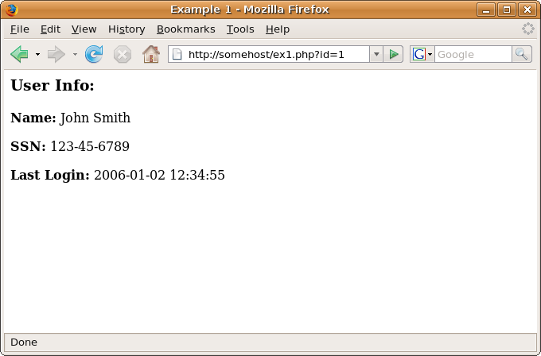
Parameter Manipulation

Slide 24
Parameter Manipulation
Notice that “id” is a GET variable we can easily manipulate
Might display data for another user or whatever “id” is referring to
Was the mission to simply gather personal information?

Slide 25
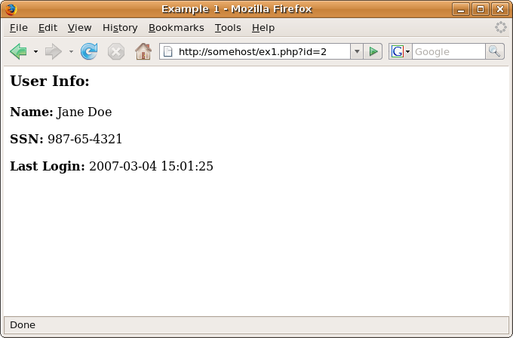
Parameter Manipulation

Slide 26
Parameter Manipulation: What to do?
Filter all input from the user
  Anything sent by the web-browser
Be careful to filter everything
  HTTP Server Variables
  “Host:” header
  “User-Agent:” header
  Cookies
  GET/POST of course

Slide 27
SQL Injection
Structured Query Language is the language that your web (or application) servers use to communicate with your database servers
SQL injection is a class of vulnerabilities that exist when the web application is appending unfiltered user data into a SQL statement
Allows an attacker to “inject” malicious SQL code in a query

Slide 28
SQL Injection
SQL is a powerful language, not limited to manipulating the data in your database
Can potentially
  Open/append/overwrite files
  Execute commands
  Upload/download files
Allowing an attacker to execute arbitrary SQL commands is very bad

Slide 29
SQL Injection
Some vulnerable PHP code
  $sql = “SELECT name,author FROM books WHERE type=“ . $_GET[“type”];
Queries table “books” for the type specified in the querystring variable “type”
I chose the arbitrary value “5” to be the type we are looking for

Slide 30
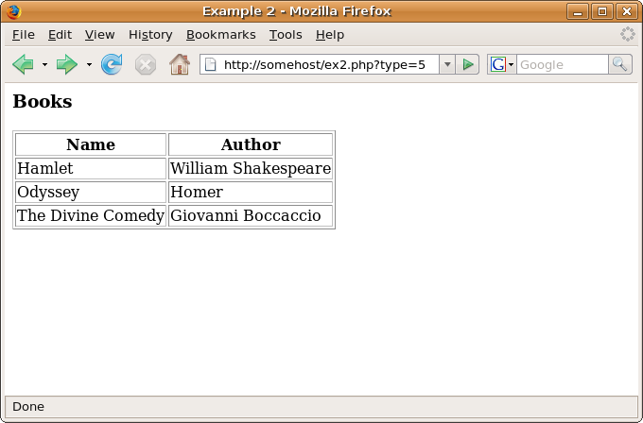
SQL Injection

Slide 31
SQL Injection
By manipulating the “type” variable, we can execute arbitrary SQL statements
  type=5; INSERT INTO ...
  type=5; DROP TABLE ...
  type=5; EXEC ...
  type=5 UNION SELECT ...
Let’s use UNION to view the contents of another table
  http://somehost/ex2.php?type=5 UNION SELECT name,password FROM users
This takes the same data from before, and concatenates the list of users and password hashes to the list

Slide 32
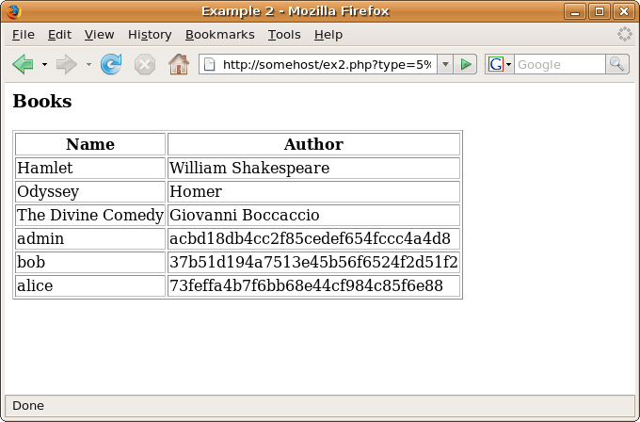
SQL Injection

Slide 33
SQL Injection
Previous example only worked with data in the database
Using the same vulnerability, we could have
  Modified data in the database
  Viewed/modified files on the file system
  Downloaded and installed a backdoor
This is why outbound filtering is effective

Slide 34
SQL Injection: What to do?
Similar to parameter manipulation, filter data from the user
Filter it correctly
  Strings and integers handled differently
  Escape all characters, not just single quotes
  Watch for encoding issues, different character sets
Consider using a layer of abstraction
  Single piece of code to handle ingress/egress of data

Slide 35
SQL Injection: MySQL and PHP
Multiple ways to escape strings
  Your own method…
  addslashes() ← no
  addcslashes() ← no
  mysql_escape_string() ← close, but still no
  mysql_real_escape_string() ← yes!
Make sure to escape strings, and type-cast numbers
  sprintf() is very helpful for this
Never use gpc_magic_quotes

Slide 36
SQL Injection: MySQL and PHP
Consider the following
$sql = “SELECT something FROM table WHERE name=‘$foo’ AND age > $bar”;
  $foo can be secured with mysql_real_escape_string()
  $bar can still be manipulated with mysql_real_escape_string()
To secure numbers, you must type-cast them
The right way:
$sql = sprintf(“SELECT something FROM table WHERE name=‘%s’ AND age>%d”, mysql_real_escape_string($foo), $bar)

Slide 37
Cross-Site Scripting (XSS)‏
“... is a type of computer security exploit where information from one context, where it is not trusted, can be inserted into another context, where it is. From the trusted context, an attack can be launched.” --Wikipedia
“Forcing Javascript to run where it doesn't belong.” --Gary G.

Slide 38
Cross-Site Scripting (XSS)‏
Understand what Javascript is
  What about VBScript?
Javascript is code that runs on the client side (the web browser)‏
Has access to things like cookies
Can make arbitrary HTTP requests
Very powerful feature-set

Slide 39
Cross-Site Scripting (XSS)‏
A typical attack scenario
  Page is displayed with information from the database
  Data in database came from unfiltered user input and contains malicious Javascript
  When page is displayed to user, malicious Javascript executes
Could transmit session cookies to attacker
  Attacker then re-uses session cookie

Slide 40
Cross-Site Scripting (XSS)
Guestbook example
Mallory has posted an entry containing:
  <script>alert(“owned”);</script>

Slide 41
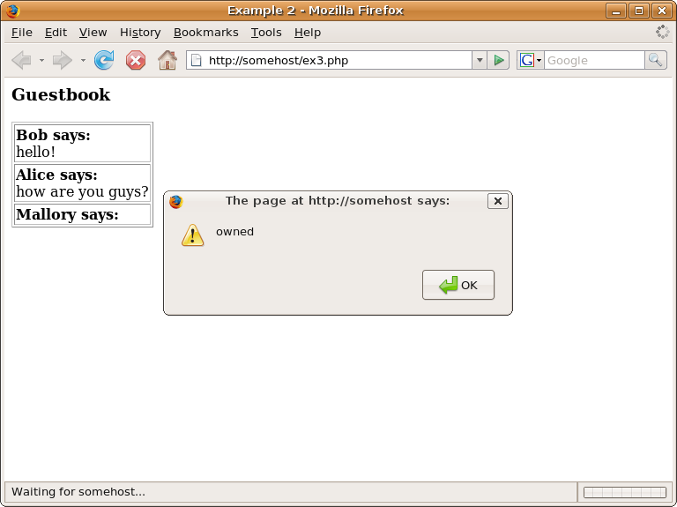
Cross-Site Scripting (XSS)

Slide 42
Cross-Site Scripting (XSS): What to do?
XSS can be prevented by escaping special HTML characters when displayed
  Always do this, no exceptions
In PHP there is:
  htmlentities()
  Make sure to use ENT_QUOTES to fix both single and double quotes
  For example:
    <?=htmlentities($foo, ENT_QUOTES);?>

Slide 43
What to do?
Reduce your footprint
  Remove as much information as possible from your sites (Names, places, etc)‏
  Strip metadata from public documents
  Have a formal public disclosure policy to address this
  Educate users about risks of posting information to forums, support groups, newsgroups, etc

Slide 44
What to do?
Audit your systems and applications
  A “new set of eyes” can shed a lot of light
  Because you never know, until you know...
Training
  Both developers and engineers will benefit from security training
  Thinking like an attacker will change the way they design systems

Slide 45
What to do?
“Security is a requirement not a feature”
  Woven throughout your systems from the ground up
  Defense in depth!
Upkeep
  Make sure everyone stays on top of the latest technology
  Security industry moves very fast

Slide 46
The End.
  Questions, comments?

Slide 47
Links
Crucial Security - http://www.crucialsecurity.com
Google Hacking - http://johnny.ihackstuff.com
OWASP - http://www.owasp.org

Slide 48
  ggeisbert@crucialsecurity.com
  703-961-9456 x139

