Slide 1
Atlas Heavy Ions
Mark D. Baker for
R. Debbe, J.H. Lee, J. Jia, P. Nevski, R. Nouicer,
P. Steinberg, H. Takai, F. Videbaek, S. White
(BNL)

Slide 2
Some Lessons from RHIC
Strongly interacting matter interacts strongly!
  20 GeV and higher jets can be stopped.
Hard probes are essential for quantifying strong interaction physics
  Reconstruct and study jets in γ+jet and jet+jet events.
  Quantify partonic energy loss, fragmentation effects and excited-medium modes using direct-γ-tagged jets

Slide 3
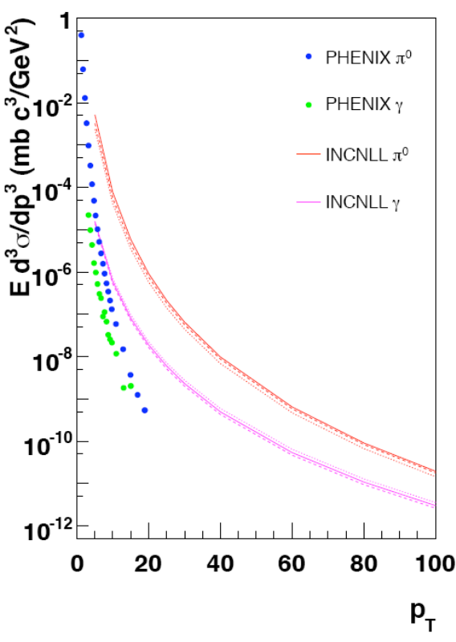
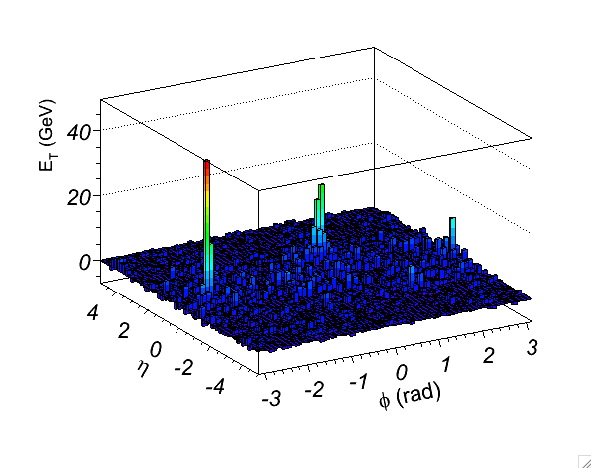
How?
P. Steinberg
Build a world-class calorimeter for the LHC
  Large acceptance
  Good resolution
  Longitudinal segmentation for γ/π⁰ separation
Spend $100M’s & person-millenia of effort
Local experts at BNL (HW&SW)
Start ~15 years ago so that it’s ready on time!
Direct γ’s (pp@200GeV)
Direct γ’s (pp@5.5TeV)
99+104 GeV dijet in a b=2fm PbPb sim.

Slide 4
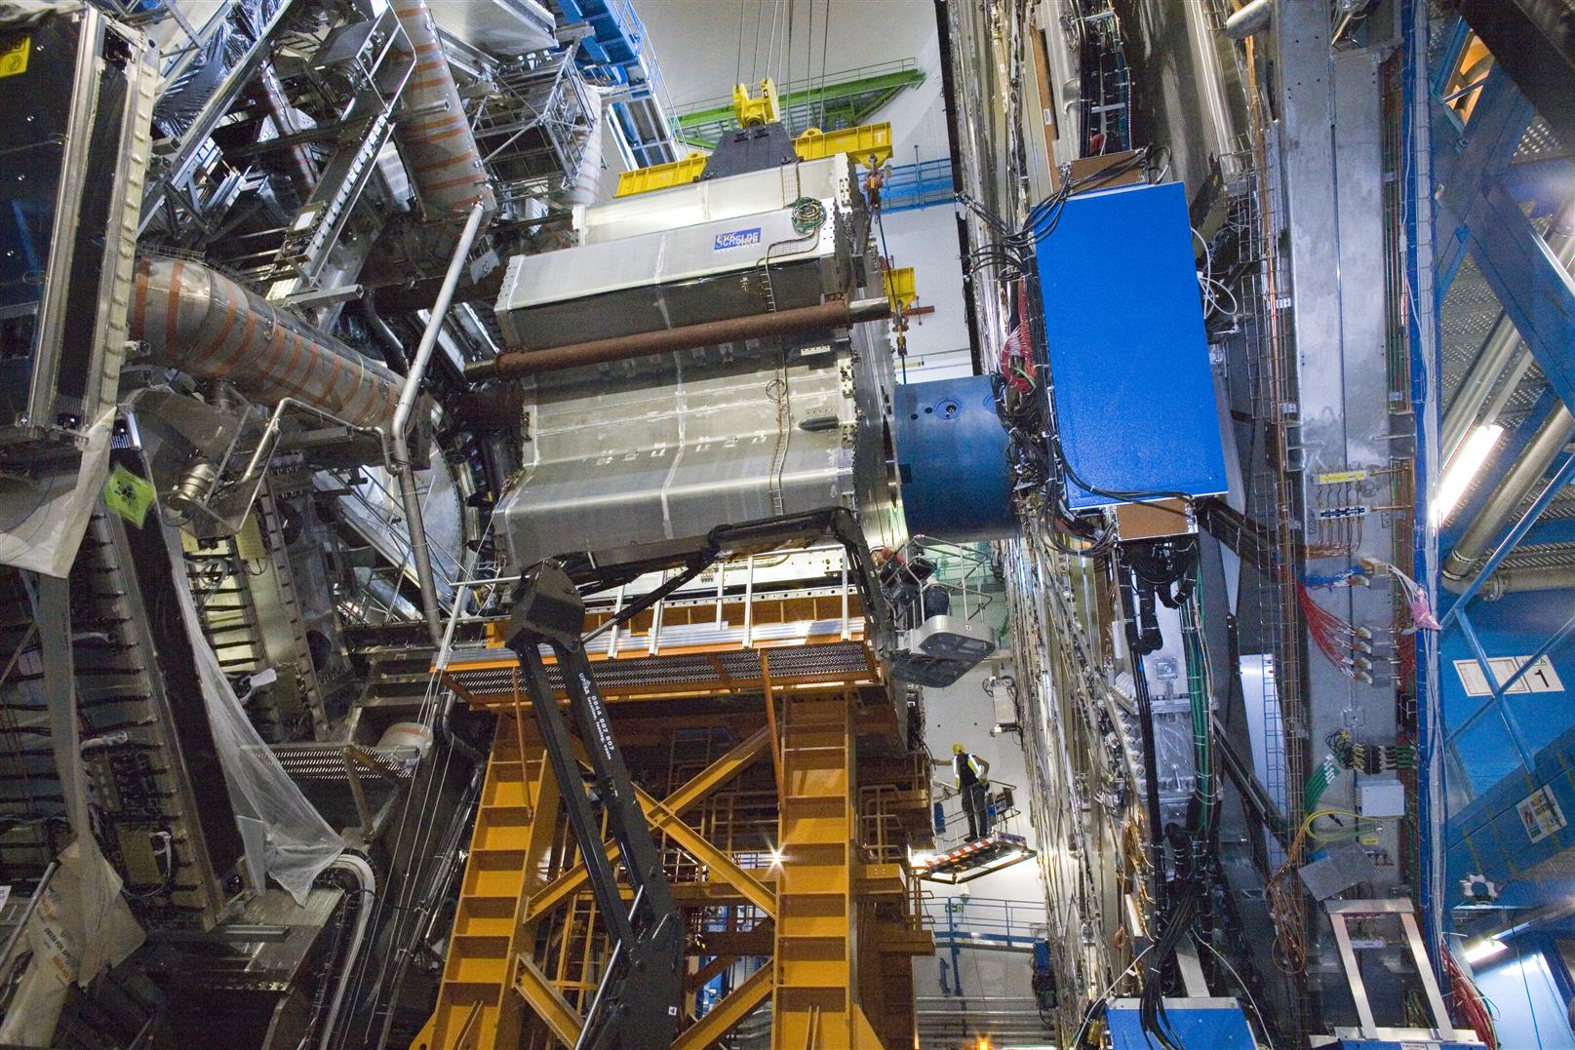
Nearly Done!
Thanks to BNL
ATLAS (HEP) effort!

Slide 5
Large Acceptance (CMS similar)
π
ATLAS
Forward
EM+HCAL
ATLAS LAr+Tile
EM+HCAL
ATLAS
Forward
EM+HCAL
US-ALICE
EMCAL
ϕ
0
ALICE PHOS
−π
-5
-4
-3
-2
-1
0
η
1
2
3
4
5

Slide 6
Large Acceptance
π
ATLAS
Forward
EM+HCAL
ATLAS
LAr+Tile
EM+HCAL
STAR
BEMC
STAR
EEMC
ATLAS
Forward
EM+HCAL
ϕ
0
PHENIX
EMCAL
−π
-5
-4
-3
-2
-1
0
η
1
2
3
4
5

Slide 7
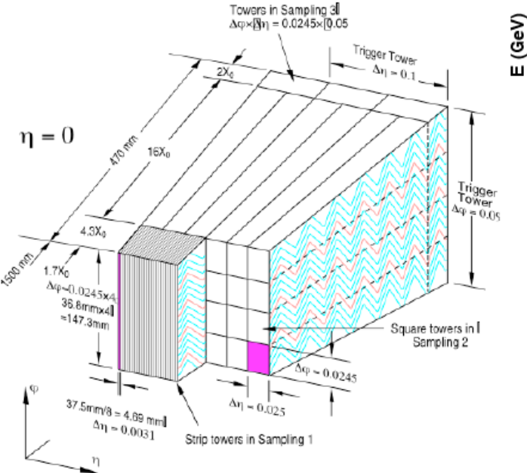
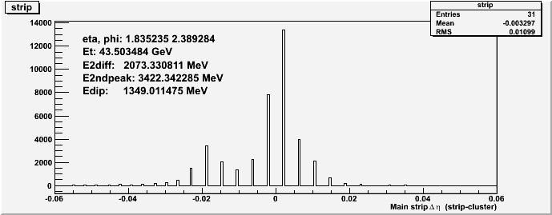
Unique (@LHC) ATLAS feature: γ ID
Longitudinally segmented large-acceptance EMCAL w/ precision strips (in η direction).
Factor of ~5 S/N improvement for direct photons for ε_{γ}~45% in 20-70 GeV E_{T} range.
  Over and above usual isolation and overall shower shape cuts
E_{T}=44 GeV η particle rejected due to
double-peaked structure in strips

Slide 8
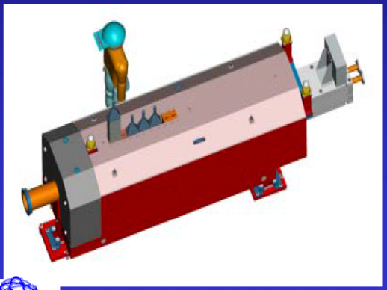
What do we need?
Modest support for people
Modest NP-specific computing (<<RCF)
&
Measure
  Centrality & luminosity
  Low-x parton densities
    10x lower than HERA
    after 1 nominal month
ATLAS Zero Degree Calorimeter
Stationed @ +/-140m from I.P.
Insert PHENIX
Caterpillar plot…
Hard Ultraperipheral:
Jets into ATLAS!
S. White et al.
20 GeV γ
5.5 A TeV Pb
Strikman, Vogt, White, PRL 96 (2006) 082001

Slide 9
Conclusions
ATLAS@LHC presents an amazing opportunity to study strongly interacting matter with a world class detector.
Complementary to RHIC.
Tremendous synergy with other activities of the department:
  Physics center
  USATLAS center
  Computing center
  Leaders in ATLAS calorimeter hardware/software
  Experience in zero-degree calorimetry
  Proximity to Columbia & Stony Brook collaborators

Slide 10
US ATLAS HI activities
BNL
  Debbe – High multiplicity tracking
  Debbe – forward physics
  Videbaek, Steinberg – computing
  Baker, Steinberg, Jia – γ+jet
  Steinberg – global observables & pp
Columbia – jets & γ+jet
Iowa State – heavy flavor
StonyBrook – jets & global observables.

Slide 11
Backups

Slide 12
Why Should BNL Participate?
Programmatic argument
  BNL has declared its intent to lead the field of strong interaction physics for the foreseeable future: QCD Lab.
  BNL can’t afford to not participate in the next major program in QCD physics.
  But, with a modest manpower investment in ATLAS, BNL can play a significant role in the LHC physics program
    That complements RHIC and e-RHIC
    That leverages BNL investment in ATLAS

Slide 13
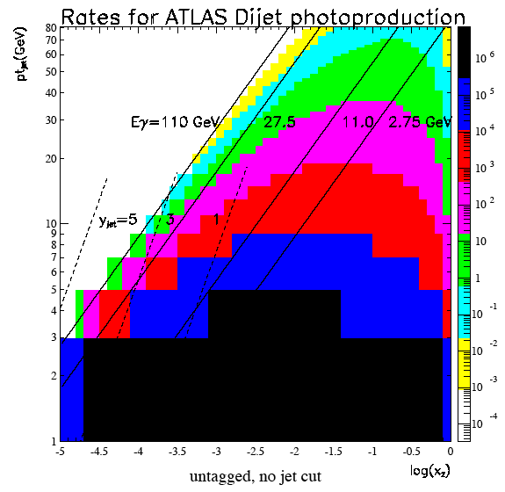

Probing small x parton densities
Ultraperipheral AA collisions
Jets into the large acceptance calorimeter!
20 GeV γ
5.5 A TeV Pb
Strikman, Vogt, White, PRL 96(2006) 082001
After 1 nominal month of PbPb:
“~10 times the x reach of
HERA for fixed virtuality”
Preview of eRHIC

