Slide 1

Reliability and Quality Assurance Issues & Methods for Commercial MEMS
Gisela Lin, Stephen A. Raccio, Walter Li
Nevenka C. Liakopoulos, Raji Mali
Standard MEMS, Incorporated
JPL MRQW, Pasadena, California, December 12, 2001

Slide 2
Outline
Introduction
SMI Commercial Device Examples
  MEMS with integrated CMOS
  Bulk Micromachining
  Surface Micromachining
Reliability and QA issues & testing
  Process level
  Device level
Further reliability and QA challenges
Conclusions

Slide 3
Introduction to SMI
Standard MEMS, Incorporated
  Founded in 1995
  Independent, contract manufacturer of MEMS and CMOS ICs.
  Shipped 50 Millionth MEMS device in October 2001
  Cover many application areas
Two MEMS/IC fabrication facilities
  4” and 6” wafer production

Slide 4
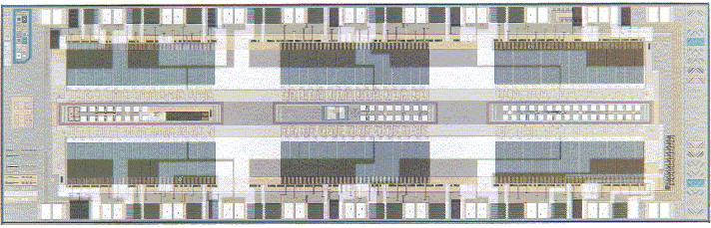
Tri-color Ink-Jet Printhead
Bulk micromachined nozzle with integrated CMOS
Ink is resistively flash heated and propelled out nozzle.
Fabricated at Standard MEMS Inc.

Slide 5
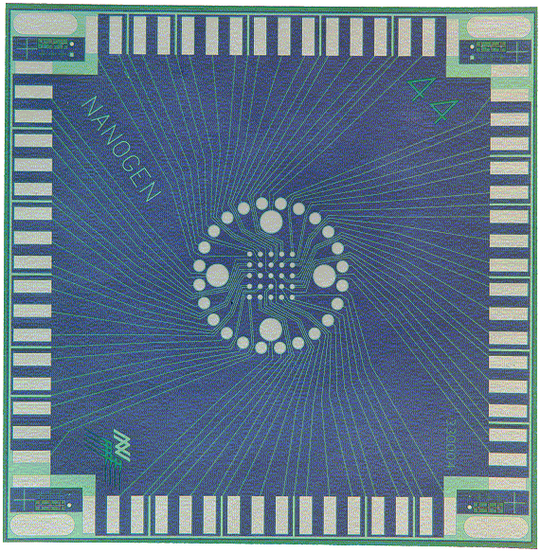
DNA Analysis Chip
Fabricated at Standard MEMS Inc. for Nanogen

Slide 6
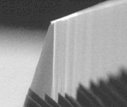

Bulk Micromachining - Blades
Silicon microblades formed via chemical etching
Used for delicate microsurgery
Microneedles fabricated in a similar fashion
Fabricated at Standard MEMS, Inc.

Slide 7
Standard MEMS, Inc.
Triple-Poly Process
Metal (0.5μm)
Polysilicon #2 (1.5μm)
Oxide #2 (0.75μm)
Polysilicon #1 (2μm)
Oxide #1 (2μm)
Polysilicon #0 (0.5μm)
Nitride (0.6μm)
Silicon Substrate

Slide 8
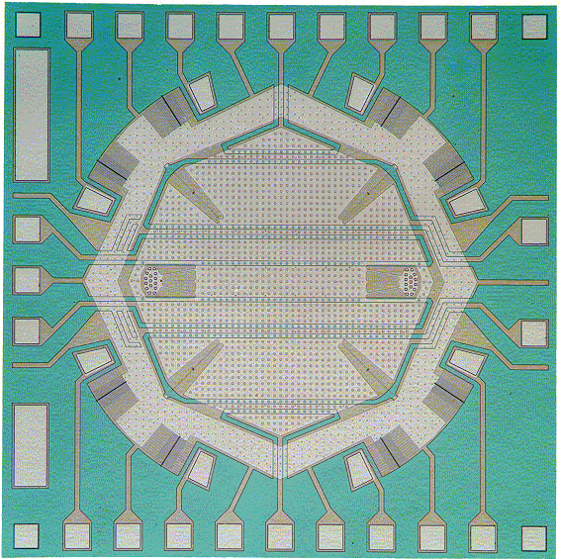
MEMS Gyroscope
Fabricated at Standard MEMS Inc.

Slide 9
Reliability & QA Issues at SMI
Fabrication process validation
  Film quality (thickness, stress, grain size, etc.)
  Feature uniformity (run to run, wafer to wafer)
  In-situ diagnostics and sets of test structures
Product performance
  Performance validation (both MEMS and ICs)
  Environmental test (elevated temperature, pressure, humidity, under bias, etc.)
  Accelerated lifetime test
Next: examples of each…

Slide 10
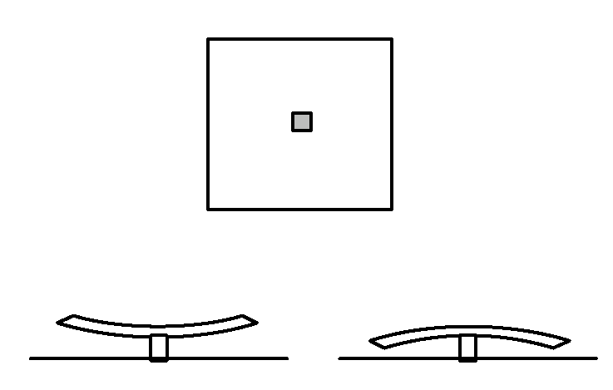
Process Validation Example
Residual stress characterization in polysilicon thin films via plate curvature test structures:
Square plates fabricated in Poly1, Poly2, and Poly1 + Poly2
Curvature measured using non-contact, surface mapping interferometric microscope (Wyko), in both x and y direction.
Plate size varies from 100μm square to 700μm square.
Plates annealed at 1000°C for 1 hour.

Slide 11
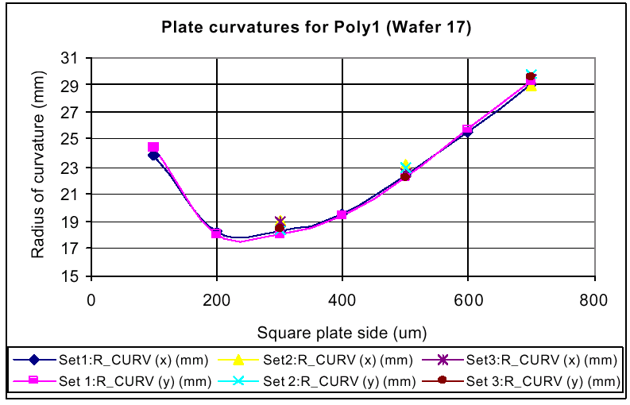
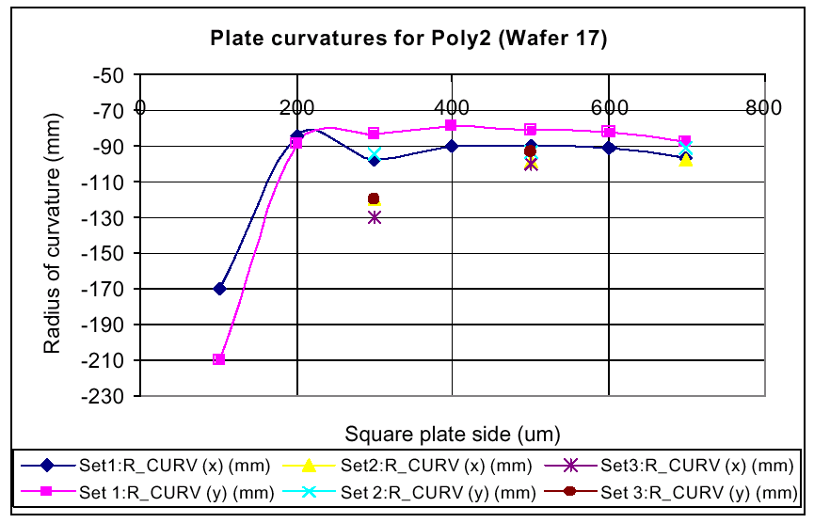
Example Data for Polysilicon
Poly1
3 die from random locations on a single wafer
Poly2
3 die from random locations on a single wafer

Slide 12
Thin Film Residual Stress
By controlling annealing conditions, we can control stress in polysilicon films
  0 – 50MPa (typical)
  Low compressive to low tensile
Similar stress control methods in silicon nitride, silicon carbide films

Slide 13
Pull-in Voltage Test Structure
Poly1, poly2, or poly1 + poly2 stack
Poly0
Silicon substrate
Silicon nitride
Length of beam varies from 100μm – 1mm
Beams test structures of 2 types:
  (1) fixed-free and (2) fixed on both sides
Test structures have 2 kinds of pull down electrode:
  (1) Poly0 ground plane (2) bare silicon substrate

Slide 14
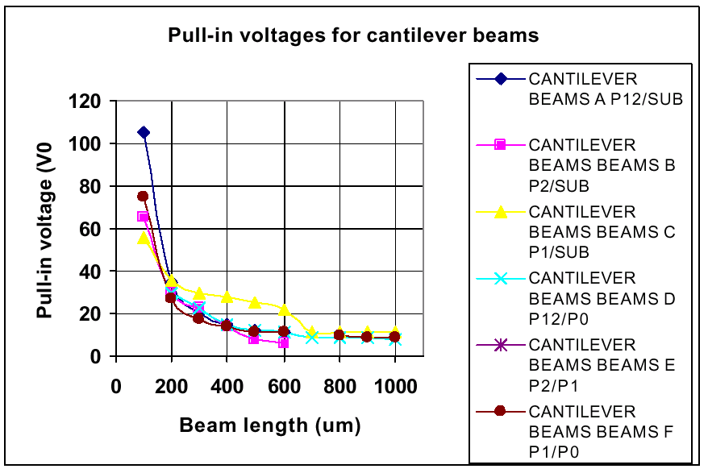
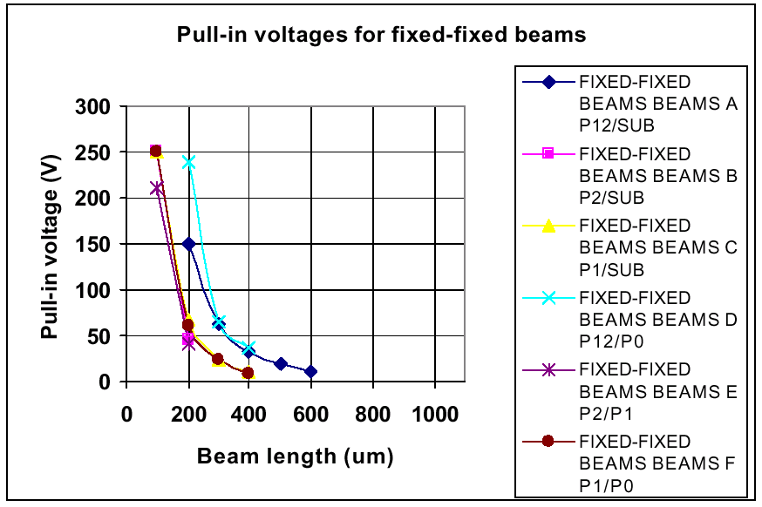
Data for Beam Arrays
Cantilever beams
Double clamped beams

Slide 15
Additional Process Validation Tests
Buckled beam strain measurements
Film thickness, critical dimension measurement and validation
Sheet resistance, contact resistance
Tensile testing of thin films
Bi-axial stress characterization
  Guckel rings
  Clamped-free and doubly clamped beams

Slide 16
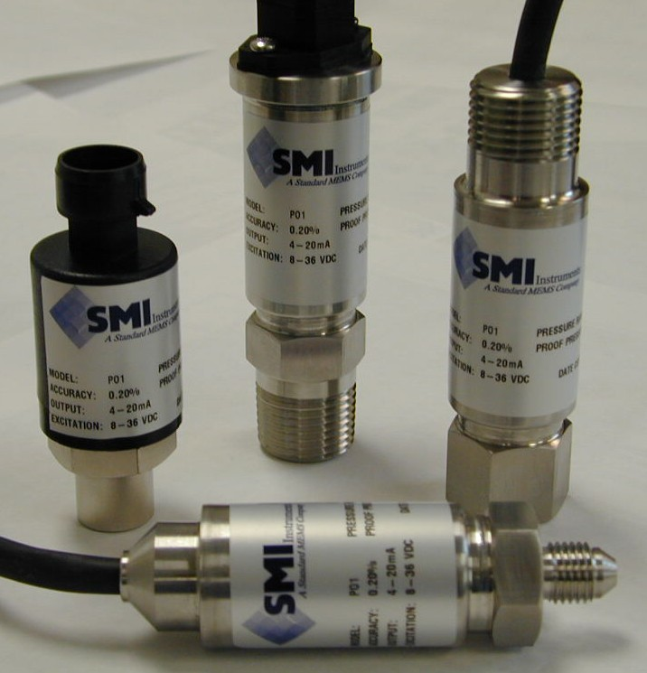
Device Performance Example
Bulk micromachined, piezoresistive pressure transducer, rated to 100psi:
3
1
Pressure sensor output #1
Input bias
Membrane
Pressure sensor output #2
Ground
2
4
Silicon

Slide 17
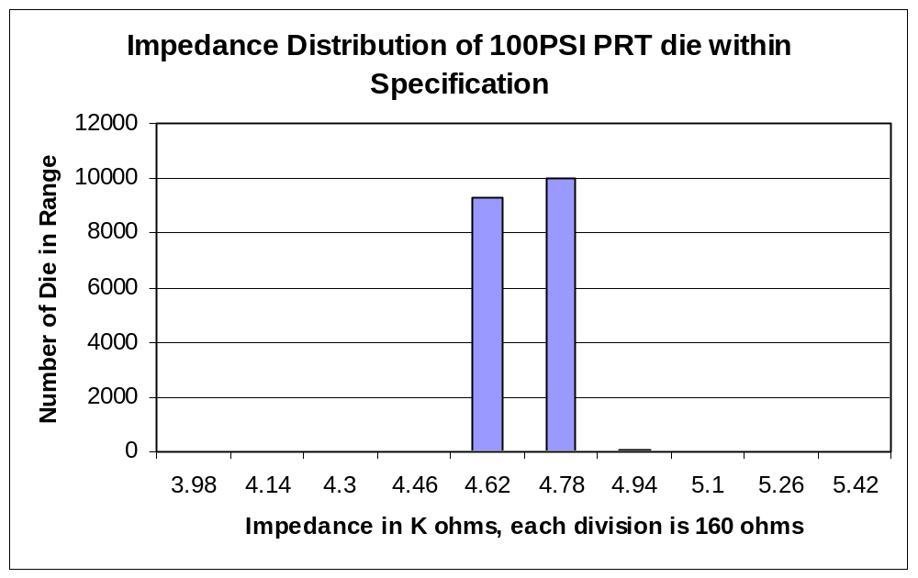
Nominal Resistance Data
Bridge resistance specification is 4700Ω ± 800Ω
180 out of 19,544 die tested were out of spec
Yield = 99%

Slide 18
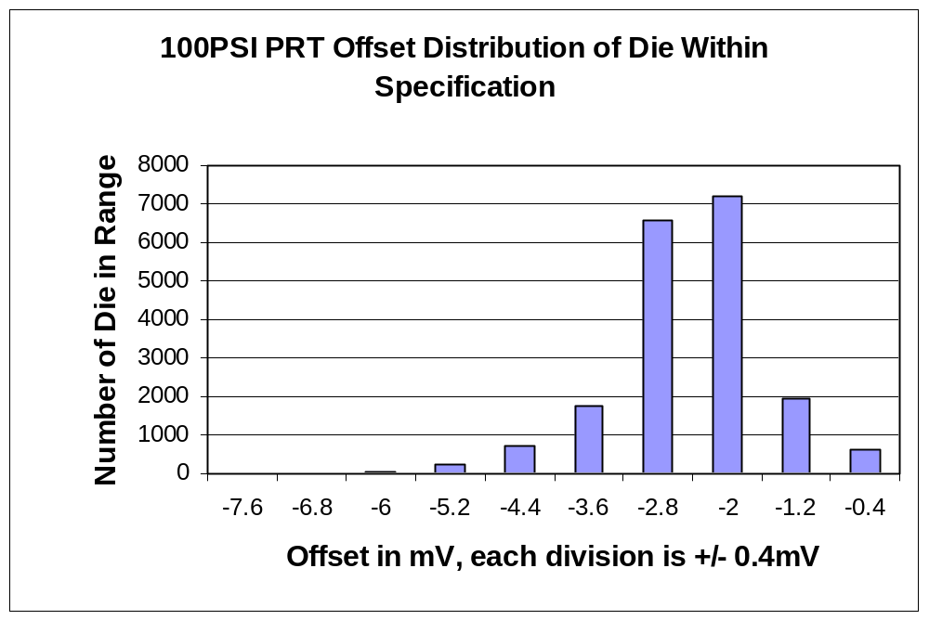
Wheatstone Bridge Offset Data
Offset specification is –4mV ± 4mV
337 out of 19,427 die tested were out of spec
Yield = 98%

Slide 19
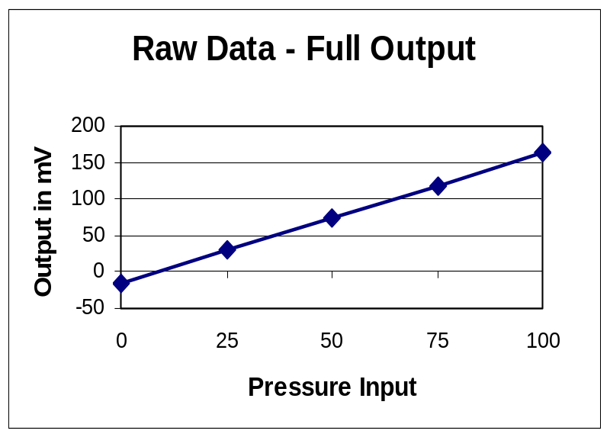
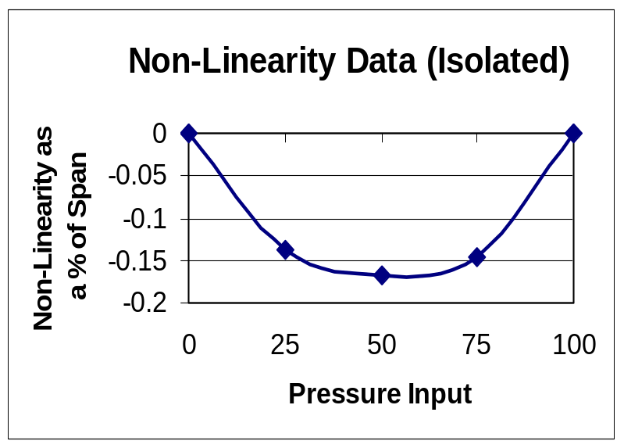
Device Linearity Testing
Span = Full-scale output range (in mV)
Data replotted as % of span (i.e. deviation from non-linearity if endpoints used as fitting points)

Slide 20
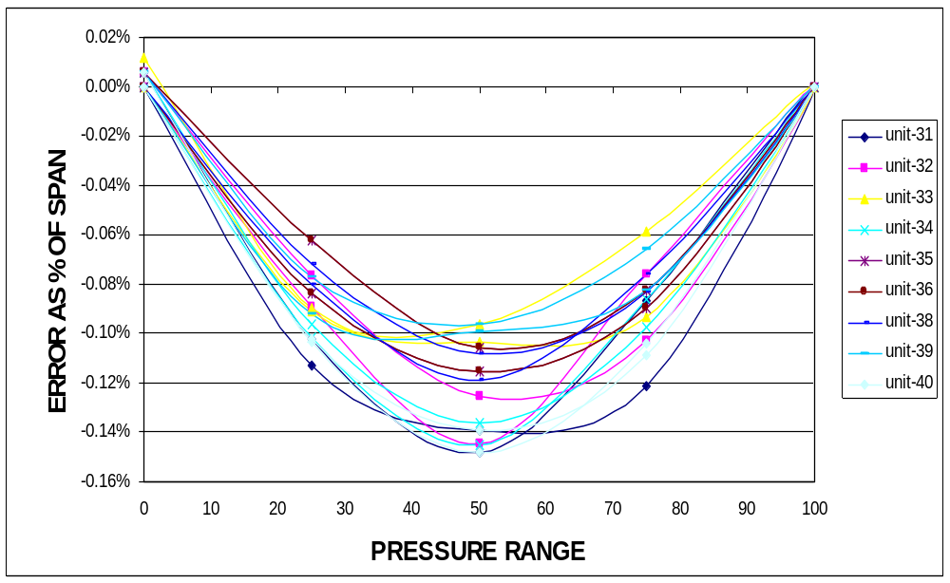
Device Linearity Data
10 devices tested per wafer in a 25 wafer lot

Slide 21
Additional Performance Tests
For pressure sensors:
  Initial zero, full scale error, span error, sensitivity…
  Packaged, unpackaged
In general for MEMS and CMOS ICs:
  Environmental test (elevated temperature, pressure, humidity, under bias, etc.)
  Electrical testing (impedance, breakdown voltage, resistance, etc.)
  Accelerated lifetime test

Slide 22
Further Issues & Challenges
Application specific reliability and QA
  Performance and process “windows” of acceptance
  Standard tests (first order influences)
  Specific tests (second order influences)
Multi-level reliability and QA
  Process (microscopic)
  Device, package, system (macroscopic) …
Design of appropriate test structures and diagnostic tools
  Complex, integrated systems

Slide 23
Conclusions
SMI has several standard processes:
  MEMS with integrated CMOS
  Bulk Micromachining
  Surface Micromachining
Each requires reliability and QA testing
  Process level (test structures, microscopy, etc.)
  Device level (environmental, electrical, etc.)
Further reliability and QA challenges:
  Specific testing for certain applications
  Levels: process, device, package, system
www.stdmems.com

