Slide 1
Users Group
May 9, 2006

Slide 2
Overview
Partial Funding
  New functionality – Greater flexibility
Short Subjects
  FFOs, FRNs, Omnibus Announcements
    Current Functionality – Future Plans
  Electronic Recipients
    All new Recipients are Electronic
  Expanded Authorities No-Cost Extensions
    Recipient on time, FPO not, getting them done
  Legal Signatures
    What constitutes a legal signature

Slide 3
Overview
Short Subjects - Continued
  Project Description/Abstract
    Who looks at them and what are they looking for
  Project Progress Reports and the PO Checklist
    Getting the frequency right
  Federal Financial Reports
    Still submitted in paper
  RFAs and Fiscal Years
    Must use RFA for current FY to fund in current FY
  Workflow and Communications with Recipients
    Recipients can’t see workflow comments

Slide 4
Partial Funding
What is it?
  Obligating remaining funds on approved Application
  Can be single year award or multi-year award
Rules
  One Application per Partial Funding
  Each application can be funded to 105% of approved amount (with appropriate explanation and budget)
  Can fund past, current, or future Fiscal Years
  Multiple Partial Funding actions per Application per Fiscal Year allowed

Slide 5
Partial Funding
Remaining Funds on Approved Application
  Single-year application
    Application amount = negotiated amount
    Obligation is for less than application amount
  Multi-year application
    Application is for certain amount with plan for multiple budget periods = negotiated plan
    Obligation can be for any amount less than the total application multi-year amount
GMD signature on Award document is approval of negotiated amounts
  Included in Special Award Condition
The Federal Government is not obligated to provide any remaining approved funding on any application
  Always dependent on availability of funds and satisfactory progress

Slide 6
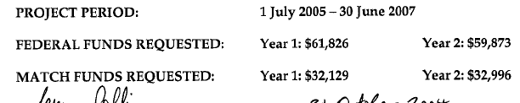

Partial Funding
Approved Funding Example
Paper Application
Negotiation
Grants Online can only use the negotiated amount
  Correlation between application and negotiation is a flag for the Grants Specialist
  For multi-year Applications from Grants.gov, the PO must revise/enter the Application Funding Details
Procurement Request and obligation for this Application can be any amount up to $121,699

Slide 7
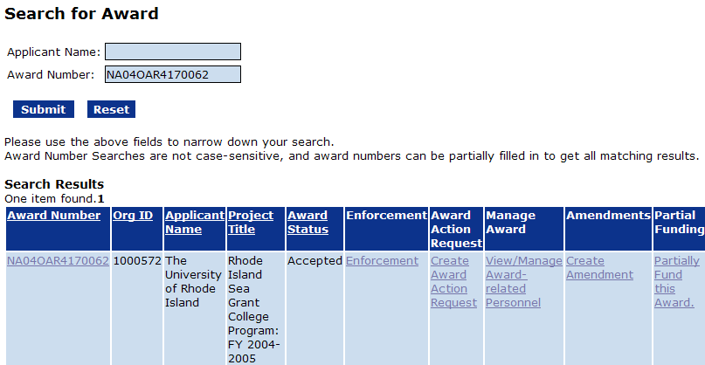
Partial Funding
1
2
3
Find the Award to be Partially Funded
  Enter Award Number (1)
  Click Submit (2)
Start the Partial Funding (3)

Slide 8
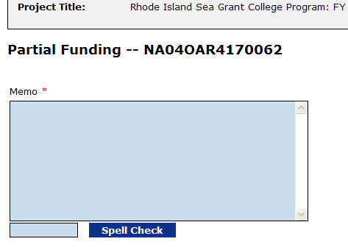
Partial Funding
Top of Partial Funding Screen
Memo not required until application and amount is selected and user is ready to save.
Memo is Required Field
  Short explanation of what this release of funds is about.
  Certification of currency of Project Progress Reports
  Program Officer recommendation for continued funding is implied by sending the Partial Funding action forward
    But it doesn’t hurt to state your recommendation

Slide 9
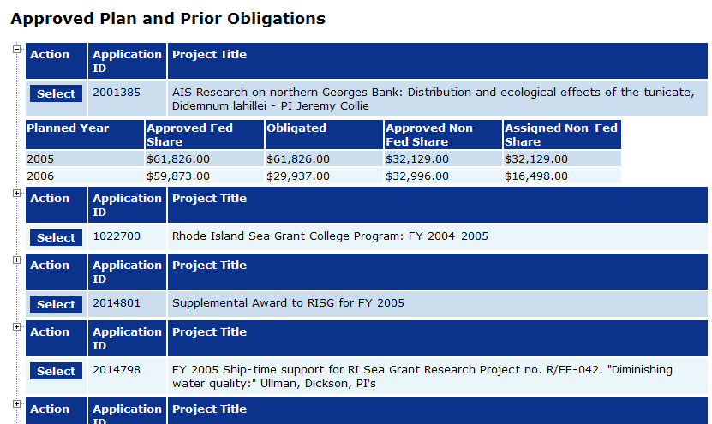
Partial Funding
Application List in Partial Funding Screen

Slide 10
Partial Funding
Application List in Partial Funding Screen
  All approved Applications for Award are shown
  Application list only appears when starting a new Partial Funding
  The “+” box shows the approved plan and corresponding obligations for each Fiscal Year
  Pending actions do not appear in the plan
  Clicking the “Select” button adds a Selected Application section to the page

Slide 11
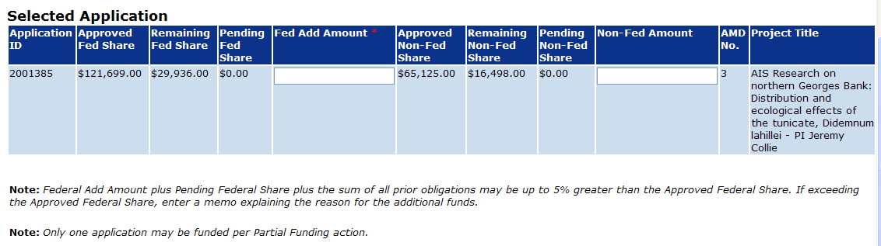
Partial Funding
Plan is informational only
  The important part of Partial Funding is what is approved and what is remaining.
Actions in pipeline show up here.
Original amendment for application
Before clicking Save
  Change selected application by using “Select” buttons
  Enter the memo.
    Memo can be changed after the Procurement Request is approved.

Slide 12
Partial Funding
Clicking Save
  The application list and plans disappear
  The memo can still be edited
  Award File is created
    Partial Funding document, Procurement Request, FAIS, Amendment
Clicking Save and Continue
  Workflow starts
    Tasks are in initiator’s inbox
      Review Release of Funds (Award File)
      Procurement Request

Slide 13
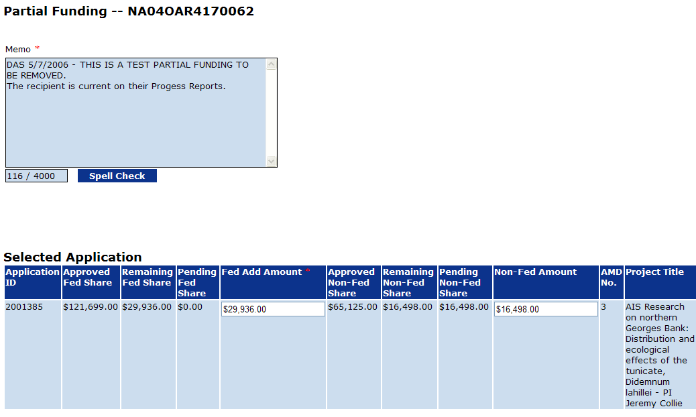
Partial Funding
Partial Funding Screen After Workflow Starts
Depending on state of Procurement Request (PRCF), the Pending Federal Share will show different values.
  Shows 0 until the PRCF is filled out.
  Shows pending amount until PRCF is approved by Auth Official
  Shows 0 after approval by Auth Official

Slide 14
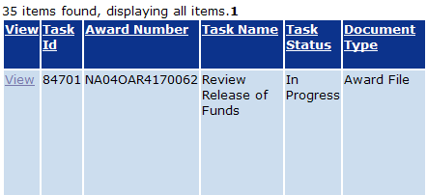
Partial Funding
Partial Funding Workflow for Program Officer, Grants Specialist and Grants Officer
Questions?

Slide 15
FFOs, FRNs, Omnibus Announcements
FFO Repaired for mid-May Release
  Can be published directly from Grants Online Report
  Document history comparison feature added
June Omnibus is set for publication
  Using FFO feature still not required
Building full featured Omnibus, FRN, Omnibus Synopsis, FRN Synopsis
  Expected for October 1 release – will be required for December Omnibus

Slide 16
FFOs, FRNs, Omnibus Announcements
Advantages of using Grants Online FRN/FFO Features
  Fooling the workflow not necessary
  Direct comparison of versions by FALD
  Forced compliance with OMB standards
  Directly publishable
    Special formatting does not have to be removed
    Non-ASCII characters do not have to be converted
Advanced FPO Training
  May 24, 25
  Features training on the FFO

Slide 17
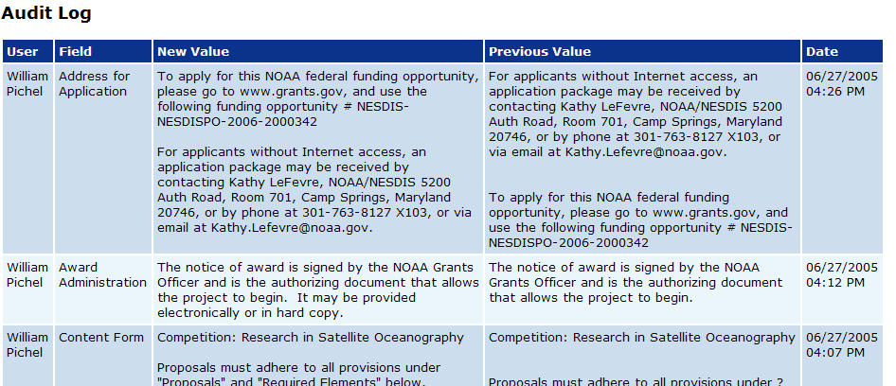
FFOs, FRNs, Omnibus Announcements
Audit Trail provides FALD with tool for rapid determination of changes between versions

Slide 18
Electronic Recipients
All New Recipients are Electronic
  Upon award, Recipient Authorized Representative gets email notification
  Help Desk provides initial access
  For paper applications, Program Officer needs to make sure that email address of Recipient Authorized Representative is correct
By October 1, ALL Recipients will be Electronic

Slide 19
Electronic Recipients
Be Aware of Electronic Status
  Some PIs are bypassing their Authorized Reps by submitting paper documents
  Grants Online is developing a “Submitting PI” role to add greater flexibility to Recipient Administration
    For an Electronic Recipient with a paper document submission, Program Officers need to question why it was submitted in paper
    If the submitter is a PI, is the submission authorized by their organization?

Slide 20
Expanded Authorities No-Cost Extensions
Electronic Recipients
  Must initiate Expanded Authorities No-Cost Extension 10 or more days before the award expires.
  Must do it in Grants Online
    There is no human intervention. Expanded Authorities is automatic if the Expanded Authorities link is available.
    After execution of extension, task is sent to CBS/ASAP personnel to extend drawdown period.

Slide 21
Expanded Authorities No-Cost Extensions
Non-Electronic Recipients
  If the Program Officer does not initiate Award Action Request (AAR) before window closes:
    Start the EA NCE AAR
      Attach Recipient notification
      Attach evidence that EA NCE was requested on time (The Help Desk will not assist in execution of an EA NCE that was not submitted on time – Get waiver from Grants Officer)
    Contact Help Desk for assistance
      A temporary short-term award extension will be applied to provide a window for completion of the EA NCE.
    Complete EA NCE
      Search for award – navigate to EA NCE details – click Save & Continue

Slide 22
Expanded Authorities No-Cost Extensions
PO Checklist
  Will be modified to only ask if the Award supports research.
  Values currently reset for all active awards based on recipient type
EA NCE Link Activation Change
  Check the answer to “Supports Research”
  Check Recipient Type
    Be careful of “Other” recipient types that may qualify as non-profits
  Check “High-Risk” status of Recipient
Until changes made, Help Desk performing workaround

Slide 23
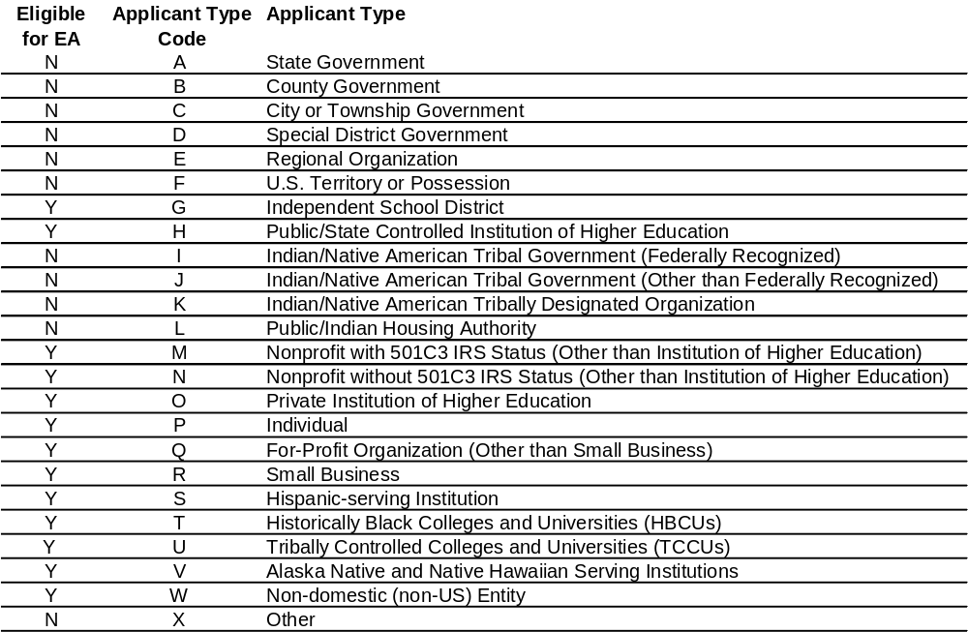
Expanded Authorities No-Cost Extensions

Slide 24
Legal Signatures
Applications
  YES: Signed paper application with an original wet signature
  YES: Grants.gov submitted application
  NO: Faxed application
  NO: Emailed application (even with scanned signature)
  NO: PureEdge Application File
Program Officers cannot accept applications that do not have legal signatures

Slide 25
Legal Signatures
Negotiations
  Program Officers must set the Authorized Representative to the Person who actually signed the application.
  There are legal and security requirements that Grants Online must follow in order to allow electronic access by the recipients.

Slide 26
Project Description/Abstract
Entered through the PO Checklist
  Has 4000 character limit – too much for what is required
Who Looks at the Project Description/Abstract?
  Non-scientists are target
    Congressional Liaisons, Members of Congress, Public Affairs, DOC Senior Management, NOAA Senior Management, General Public
Purpose
  Provide the target audience with an understandable description of how our tax dollars are being spent

Slide 27
Project Description/Abstract
What should it look like?
  SHORT 1-paragraph description of the project or planned activities
    Upon compilation for reports, multi-paragraph descriptions will be stuck together as one long (and probably boring) paragraph
  Not a repeat of the Project Title
  NO ACRONYMS.
    Not even NOAA!
  No special formatting
    No special characters
      When copying from Word, check the results to see if your left double-quote turns into a block character
  Spell checked and grammar checked

Slide 28
Project Progress Reports and the PO Checklist
Standard Terms and Conditions
  Semi-Annual Interim Project Progress Reports (PPRs).
  Comprehensive Final PPR
    A last semi-annual PPR covering the final six months (or less) of the award is required
    Example: A 1-year Award requires 2 semi-annual interim reports plus a comprehensive final report
For anything else there are 2 requirements:
  Indicate the change in frequency and/or Final Report type in the PO Checklist
  Create a Special Award Condition (SAC)
    The existence or lack of a SAC overrides the checklist values
Program Officer responsibility to ensure the SAC is in place and the PO Checklist values are correct

Slide 29
Federal Financial Reports
Submission
  All Federal Financial Reports (FFR) must be submitted in paper to the Grants Management Division.
  We will switch to using Grants Online for submission of the FFRs after OMB approval of the new combined FFR to replace the SF-269 and SF-272.
    Additional testing and modification will be required.
Post-Submission
  Report information is manually entered into a spreadsheet.
  Grants Online uploads tracking information for reports into system.

Slide 30
RFAs and Fiscal Years
Applications that are to be funded in a Fiscal Year must be associated with an RFA for that Fiscal Year
  Award Tracking Report puts Award Actions associated with Applications into Fiscal Years based on the FY of the Application’s RFA.
    The Help Desk regularly searches for dead workflow. Only Applications that show up in the current FY are of the Award Tracking Report are searched.
  There are multiple Senior Management Reports. Some track the Application process and use the FY of the RFA. Others track the Award process and use the FY of the signed award. Incorrectly associated applications cause discrepancies in reported numbers.
Applications missing deadline need to be switched to RFA for following Fiscal Year

Slide 31
Workflow and Communications with Recipients
Program Officers can send documents back to Electronic Recipients for revision
Recipients do not have access to workflow comments
Use the provided Notes sections to discuss problems with submitted documents
  Or send an email
  Or call

Slide 32
Additional Resources
Go to the Grants Online PMO Website at www.ofa.noaa.gov/~grantsonline to Access:
  Grants Online Training/Support Resources
  Frequently Asked Questions
  GrantsOnline.HelpDesk@NOAA.gov
  GrantsOnline.QandA@NOAA.gov

